Slide 1
ISYE 671
Linear Programming and Network Flows
Lecture 2 – Basic Linear Programming Models
Instructor: Dr. Ziteng Wang

Slide 2
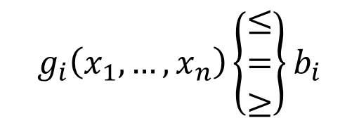

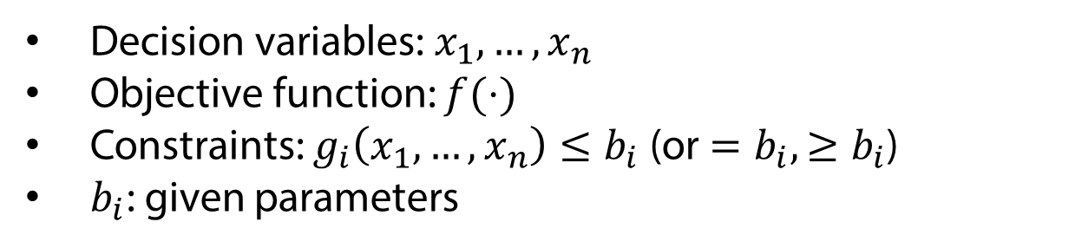

Mathematical programming/Optimization
min or max
$$f(x_{1},…,x_{n})$$
$$g_{i}\left(x_{1},…,x_{n}\right)\left\{\begin{aligned}≤ \\ = \\ ≥\end{aligned}\right\}b_{i}$$
s.t.
$$i=1,…,m$$
Decision variables: $x_{1},…,x_{n}$
Objective function: $f(⋅)$
Constraints: $g_{i}\left(x_{1},…,x_{n}\right)≤b_{i}$ (or $=b_{i}, ≥b_{i}$)
$b_{i}$: given parameters

Slide 3
Linear Programming Model
Objective function is linear
Constraints are linear
Decision variables are continuous
Also called “linear program”, “linear programming problem”

Slide 4











Examples
max
$$3x_{1}+5x_{2}$$
max
$$3x_{1}+5x_{2}$$
s.t.
$$x_{1}+2x_{2}≤4$$
s.t.
$$x_{1}+2x_{2}≤4$$
$$4x_{1}−x_{2}≥1$$
$$4x_{1}−x_{2}≥1$$
$$x_{1},x_{2}≥0$$
min
$$3x_{1}+5x_{2}$$
min
$$3x_{1}+5x_{2}$$
s.t.
$$x_{1}+2x_{2}=4$$
$$4x_{1}−x_{2}≥1$$

Slide 5
Other mathematical programming models
Nonlinear programming
  objective and/or constraint(s) are nonlinear
Integer programming
  (some) decision variables must be integer
Multi-objective programming
  more than one objectives

Slide 6







Are these linear programs?
max
$$3x_{1}+5x_{2}$$
s.t.
$$x_{1}+2x_{2}≤4$$
$$4x_{1}−x_{2}≥1$$
$x_{1},x_{2}$ are integers
min
$$3.50\left[\left(r−55\right)+\frac{q}{2}\right]+\frac{2000}{q/55}$$
s.t.
$$q≥100$$
$$r≥55$$

Slide 7
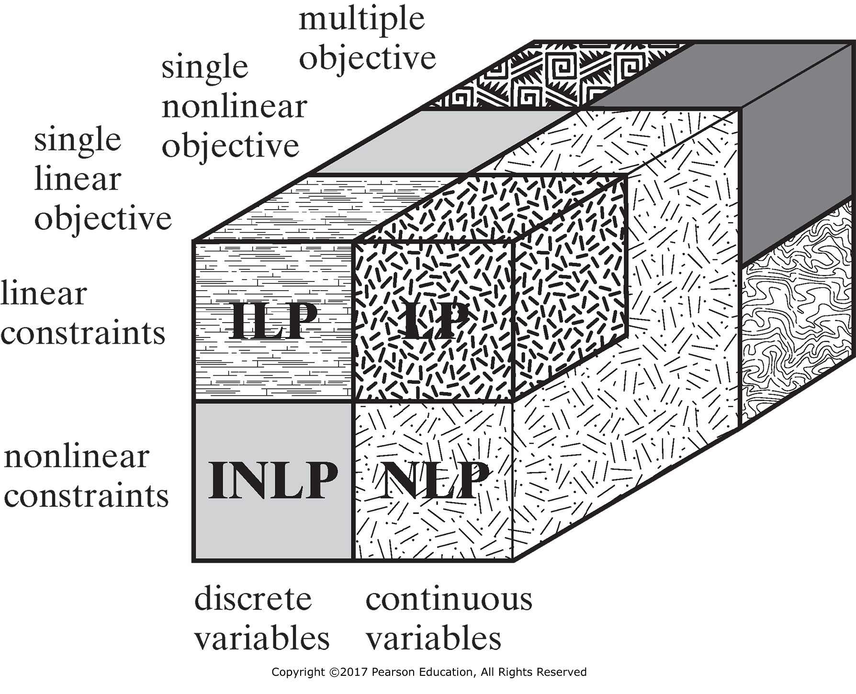
Classification of optimization models

Slide 8
Why LP?
Fundamental of optimization and OR
  Linear relationship is the simplest
Modeling power
  Linear relationship is a good approximation
Wide application and efficient computation
  1st choice of OR/optimization model in industry
  Commercial software and solvers are available

Slide 9
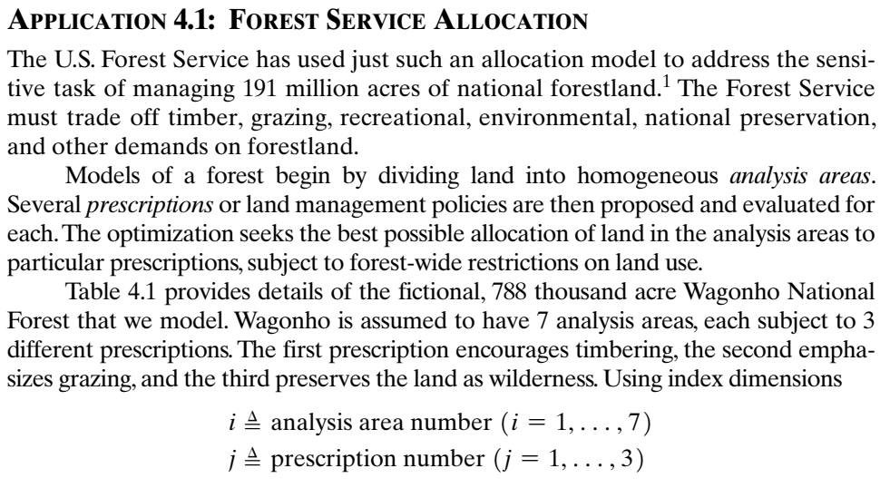
Example: Forest Service Allocation
Textbook Application 4.1

Slide 10
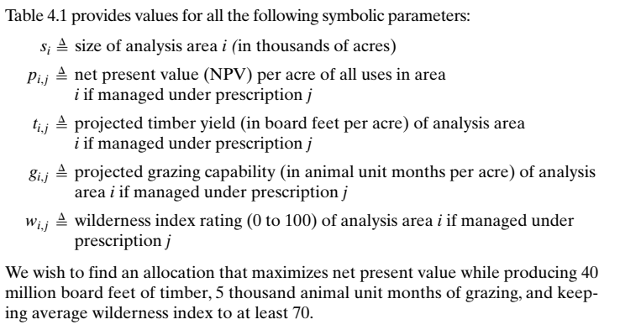
Example (cont.)

Slide 11
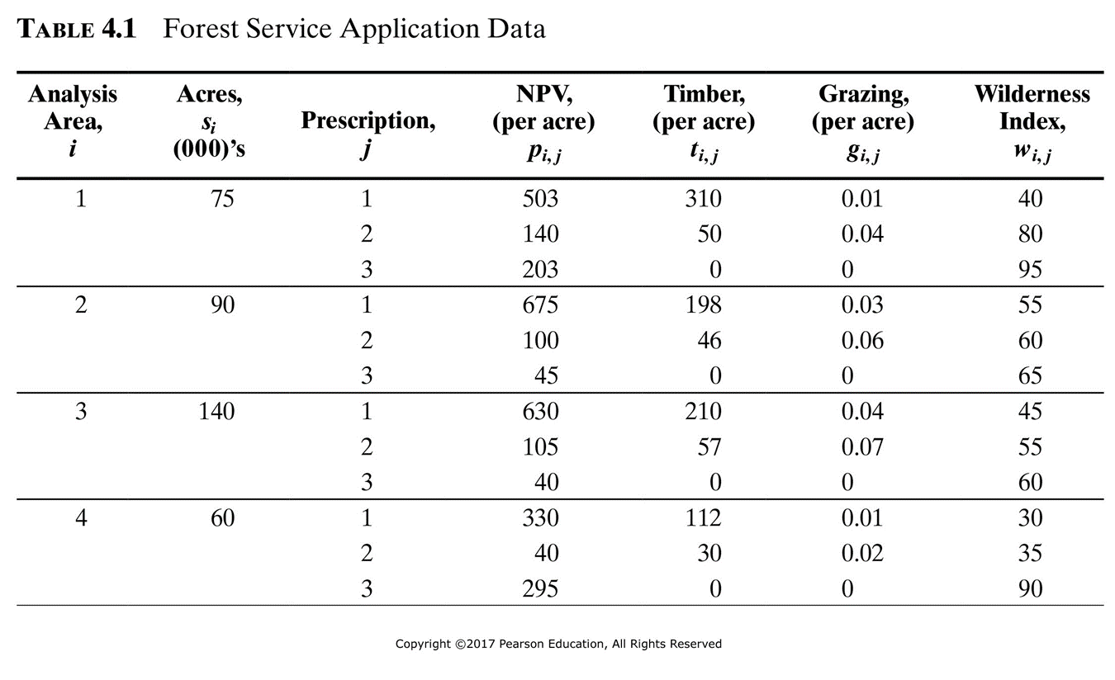
Data

Slide 12
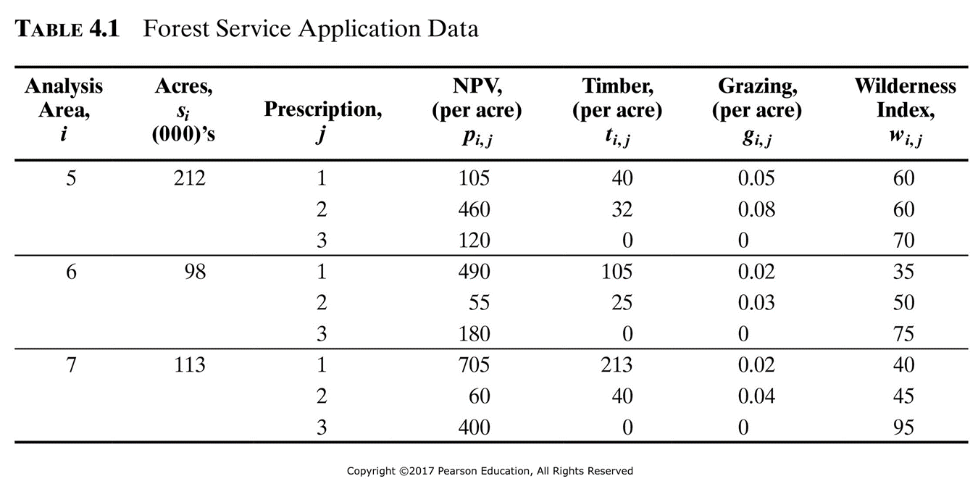
Data (cont.)

Slide 13
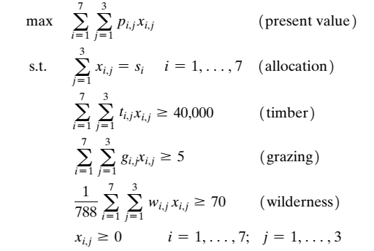

LP model

Slide 14
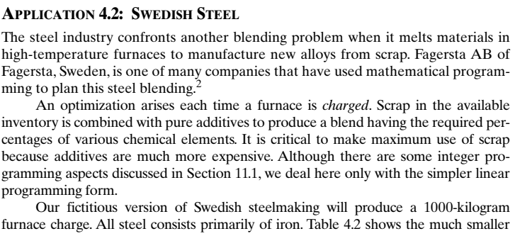
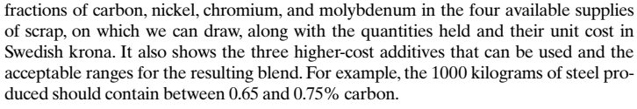
Example: Blending model
Combining resources to meet output requirements

Slide 15
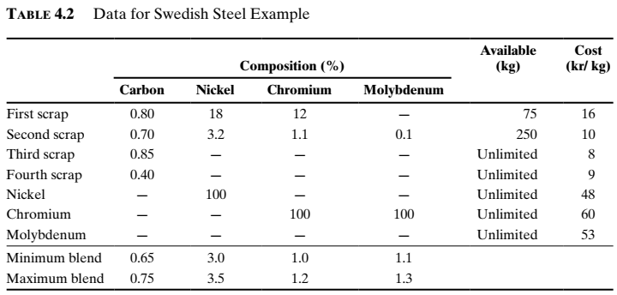
Data

Slide 16
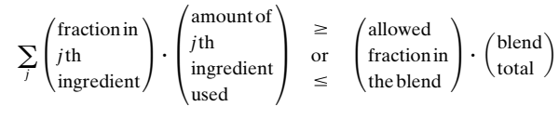
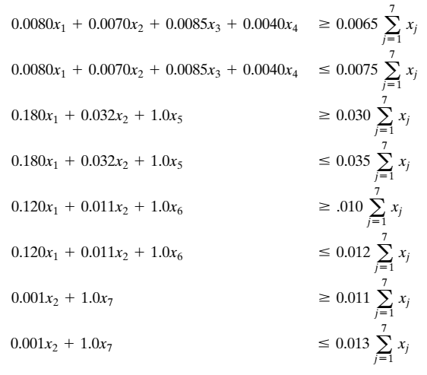
Composition constraints in blending models

Slide 17
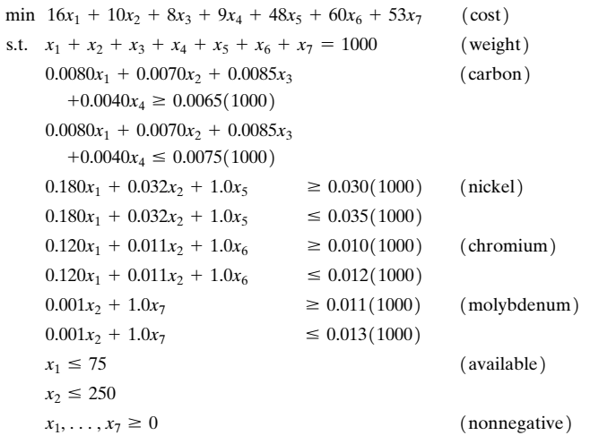
LP model

Slide 18
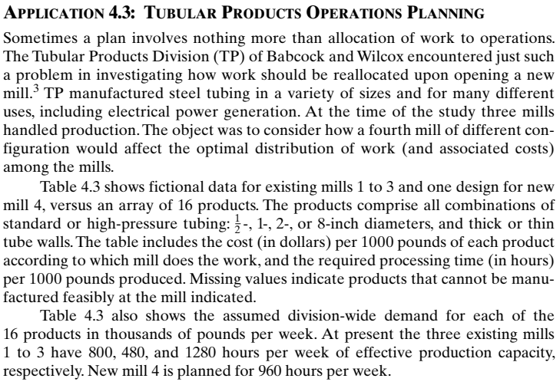
Example: Operations Planning
What to do? Who, When and Where to do it?

Slide 19
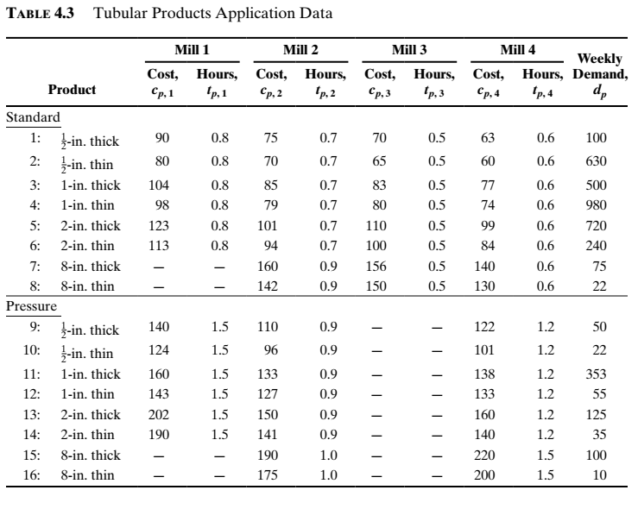
Data

Slide 20
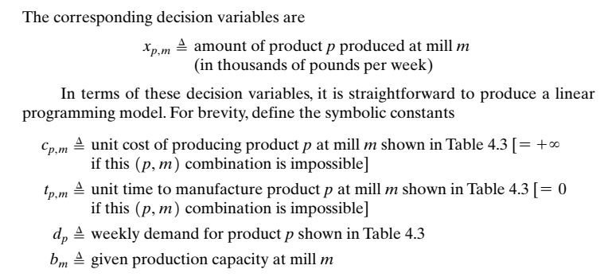
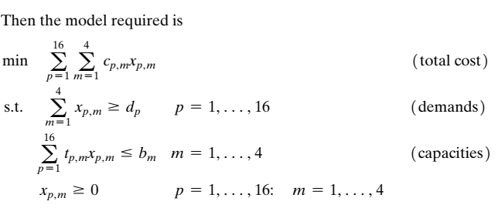
LP model

Slide 21
Example: Staff Planning Model
Plan the human resources to accomplish work.
Type of workers: full-time, part-time, overtime…
Labor regulations
Work covering
Textbook Application 4.5

Slide 22
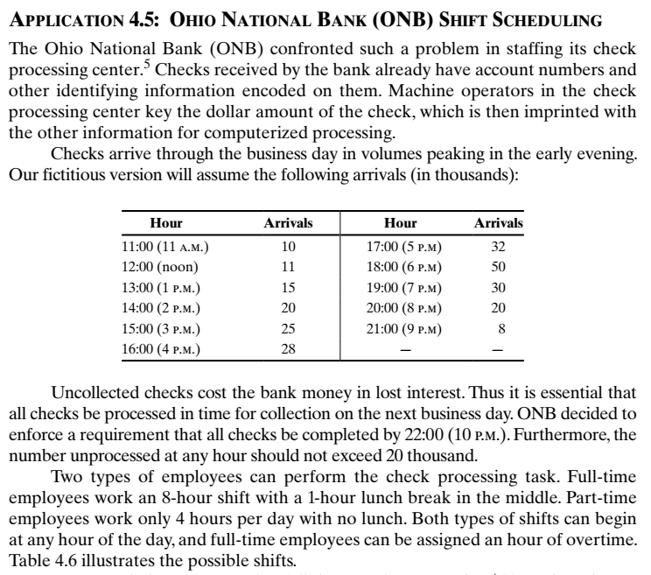
Example

Slide 23
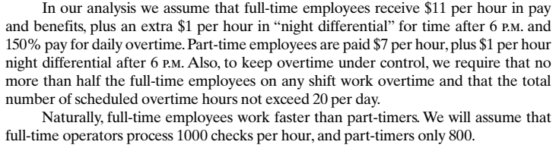
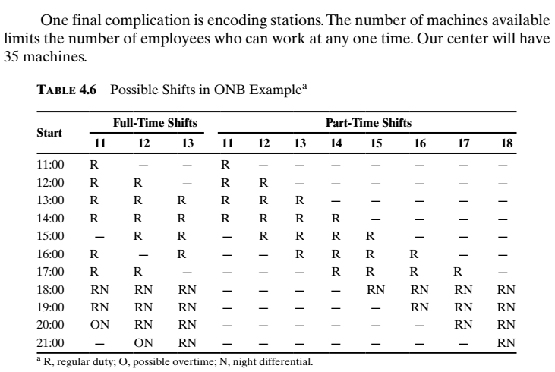
Example (cont.)

Slide 24
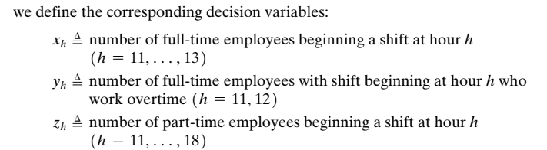
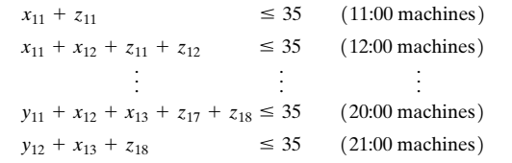
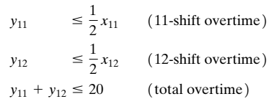
Variables and constraints

Slide 25
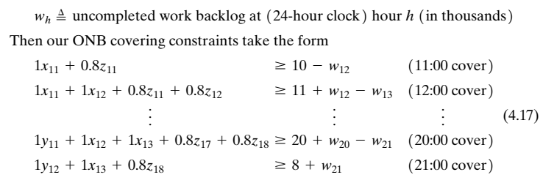
Covering constraints

Slide 26
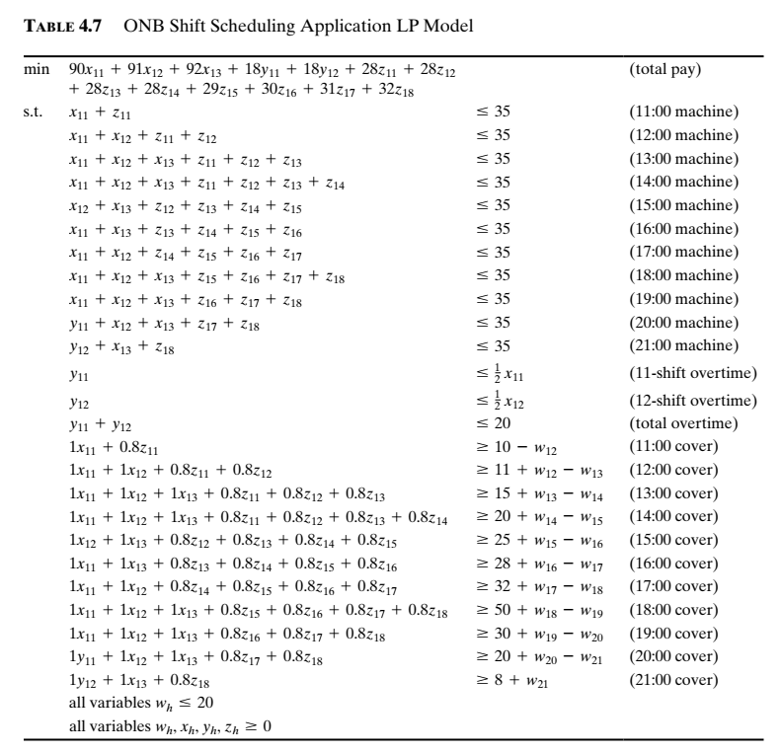
LP model

Slide 27
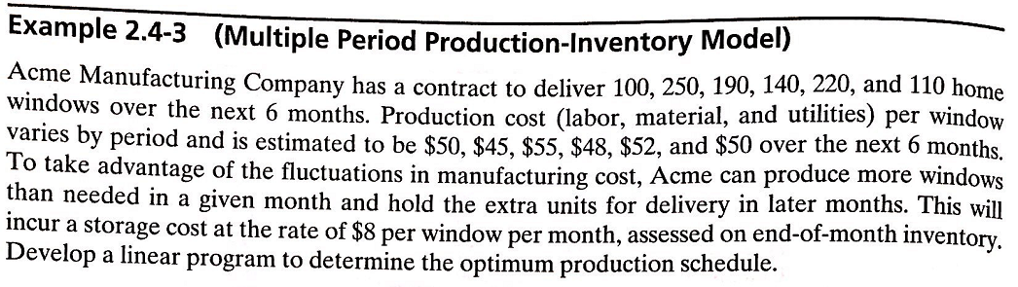
Application – Multiple-period production planning

Slide 28
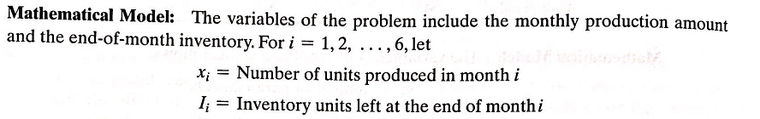
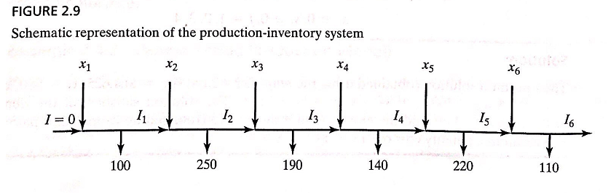
Production planning (cont.)

Slide 29
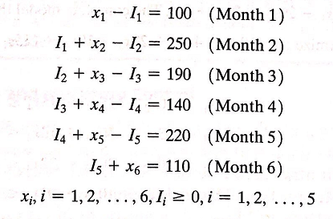
LP formulation
s.t.

Slide 30
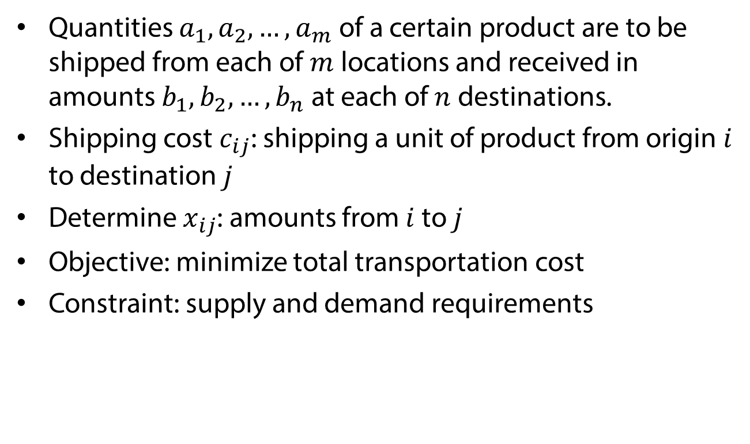
Example: Transportation Problem
Quantities $a_{1},a_{2},…,a_{m}$ of a certain product are to be shipped from each of $m$ locations and received in amounts $b_{1},b_{2},…,b_{n}$ at each of $n$ destinations.
Shipping cost $c_{ij}$: shipping a unit of product from origin $i$ to destination $j$
Determine $x_{ij}$: amounts from $i$ to $j$
Objective: minimize total transportation cost
Constraint: supply and demand requirements

Slide 31

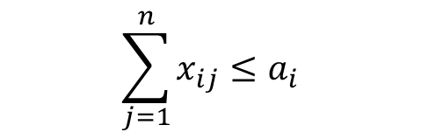

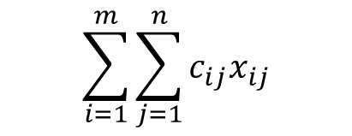



LP model
$$\sum_{i=1}^{m}{\sum_{j=1}^{n}{c_{ij}x_{ij}}}$$
min
$$\sum_{j=1}^{n}{x_{ij}}≤a_{i}$$
s.t.
$$i=1,2,…,m$$
$$\sum_{i=1}^{m}{x_{ij}}≥b_{j}$$
$$j=1,2,…,n$$
$$x_{ij} ≥0$$
$$i=1,2,…,m;j=1,2,…,n$$

Slide 32
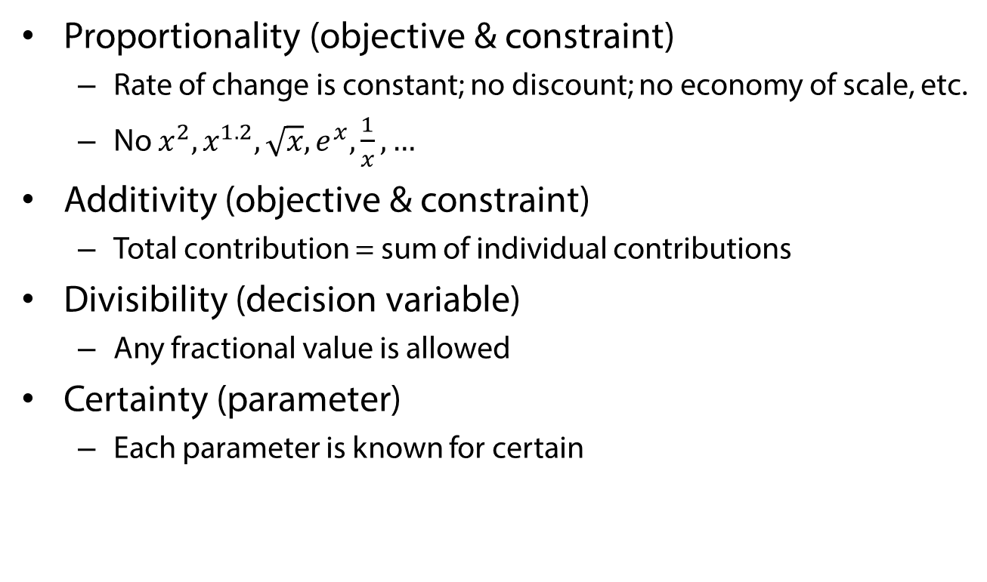
Assumptions of LP
Proportionality (objective & constraint)
  Rate of change is constant; no discount; no economy of scale, etc.
  No $x^{2},x^{1.2},\sqrt{x},e^{x},\frac{1}{x},…$
Additivity (objective & constraint)
  Total contribution = sum of individual contributions
Divisibility (decision variable)
  Any fractional value is allowed
Certainty (parameter)
  Each parameter is known for certain

