Slide 1
William Stallings
Data and Computer Communications
7th Edition
Chapter 9
Spread Spectrum

Slide 2
Spread Spectrum
Analog or digital data
Analog signal
Spread data over wide bandwidth
Makes jamming and interception harder
Frequency hoping
  Signal broadcast over seemingly random series of frequencies
Direct Sequence
  Each bit is represented by multiple bits in transmitted signal
  Chipping code

Slide 3
Spread Spectrum Concept
Input fed into channel encoder
  Produces narrow bandwidth analog signal around central frequency
Signal modulated using sequence of digits
  Spreading code/sequence
  Typically generated by pseudonoise/pseudorandom number generator
Increases bandwidth significantly
  Spreads spectrum
Receiver uses same sequence to demodulate signal
Demodulated signal fed into channel decoder

Slide 4
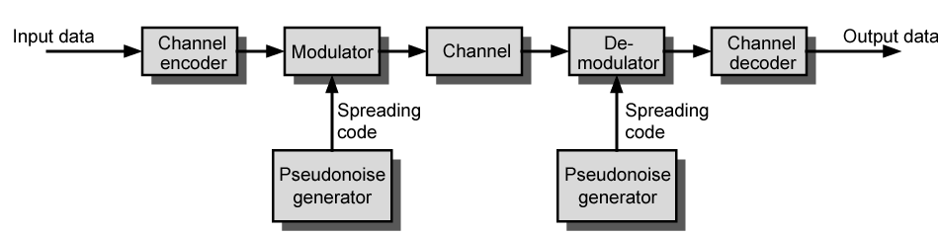
General Model of Spread Spectrum System

Slide 5
Gains
Immunity from various noise and multipath distortion
  Including jamming
Can hide/encrypt signals
  Only receiver who knows spreading code can retrieve signal
Several users can share same higher bandwidth with little interference
  Cellular telephones
  Code division multiplexing (CDM)
  Code division multiple access (CDMA)

Slide 6
Pseudorandom Numbers
Generated by algorithm using initial seed
Deterministic algorithm
  Not actually random
  If algorithm good, results pass reasonable tests of randomness
Need to know algorithm and seed to predict sequence

Slide 7
Frequency Hopping Spread Spectrum (FHSS)
Signal broadcast over seemingly random series of frequencies
Receiver hops between frequencies in sync with transmitter
Eavesdroppers hear unintelligible blips
Jamming on one frequency affects only a few bits

Slide 8
Basic Operation
Typically 2^{k} carriers frequencies forming 2^{k} channels
Channel spacing corresponds with bandwidth of input
Each channel used for fixed interval
  300 ms in IEEE 802.11
  Some number of bits transmitted using some encoding scheme
    May be fractions of bit (see later)
  Sequence dictated by spreading code

Slide 9
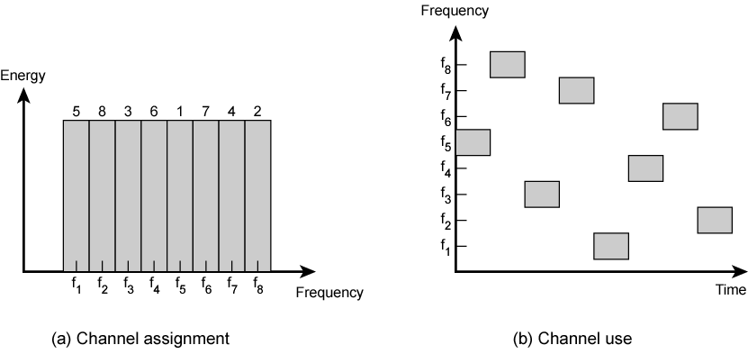
Frequency Hopping Example

Slide 10
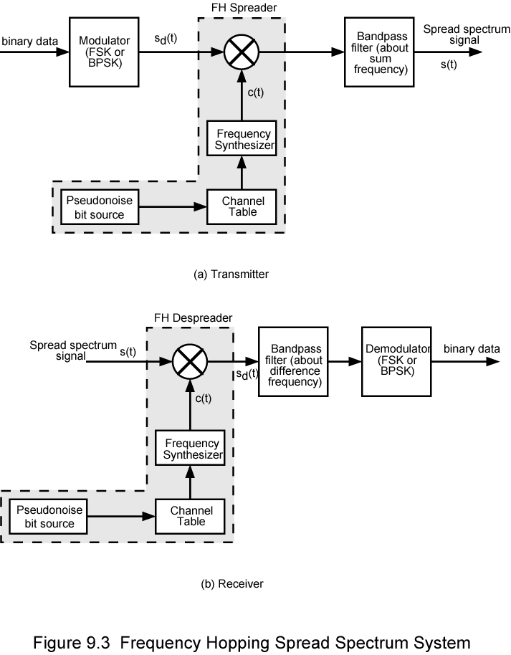
Frequency Hopping Spread Spectrum System (Transmitter)

Slide 11
Frequency Hopping Spread Spectrum System (Receiver)

Slide 12
Slow and Fast FHSS
Frequency shifted every T_{c} seconds
Duration of signal element is T_{s} seconds
Slow FHSS has T_{c} ≥ T_{s}
Fast FHSS has T_{c} < T_{s}
Generally fast FHSS gives improved performance in noise (or jamming)

Slide 13
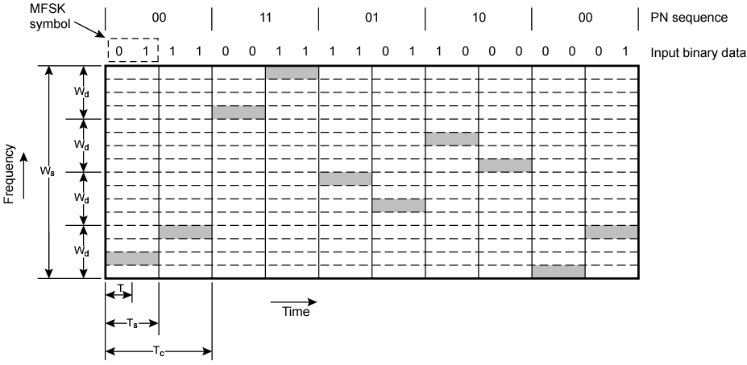
Slow Frequency Hop Spread Spectrum Using MFSK (M=4, k=2)

Slide 14
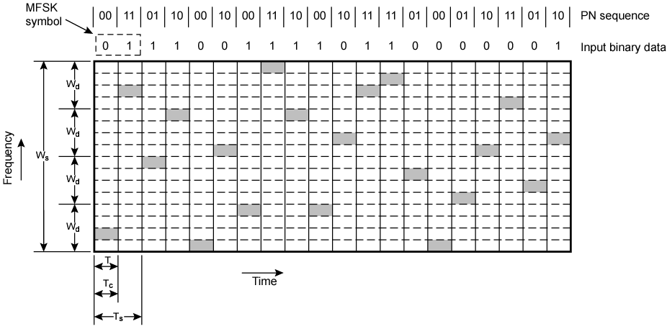
Fast Frequency Hop Spread Spectrum Using MFSK (M=4, k=2)

Slide 15
FHSS Performance Considerations
Typically large number of frequencies used
  Improved resistance to jamming

Slide 16
Direct Sequence Spread Spectrum (DSSS)
Each bit represented by multiple bits using spreading code
Spreading code spreads signal across wider frequency band
  In proportion to number of bits used
  10 bit spreading code spreads signal across 10 times bandwidth of 1 bit code
One method:
  Combine input with spreading code using XOR
  Input bit 1 inverts spreading code bit
  Input zero bit doesn’t alter spreading code bit
  Data rate equal to original spreading code
Performance similar to FHSS

Slide 17
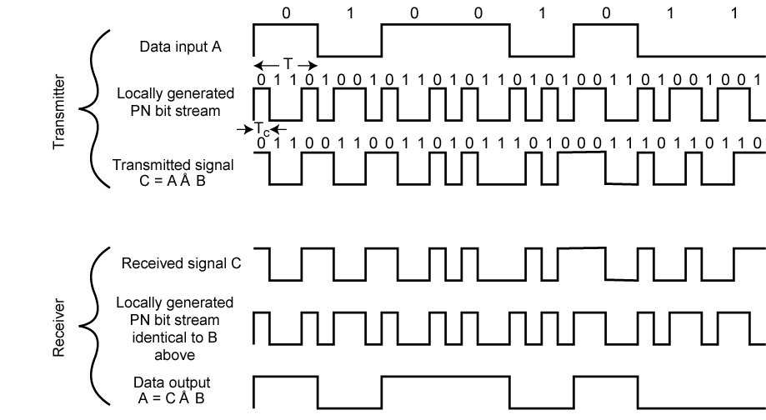
Direct Sequence Spread Spectrum Example

Slide 18
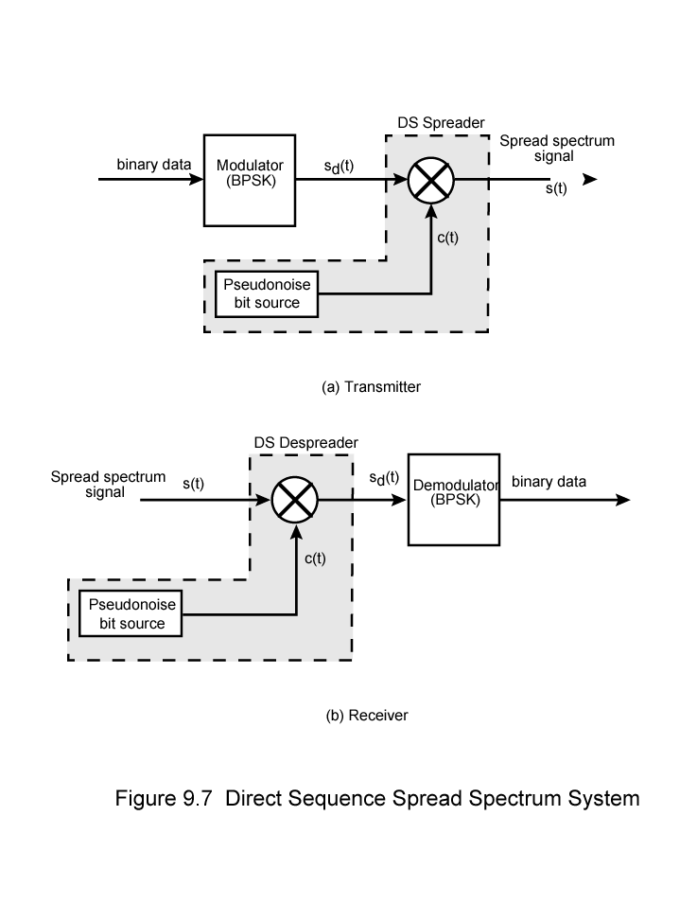
Direct Sequence Spread Spectrum Transmitter

Slide 19
Direct Sequence Spread Spectrum Transmitter

Slide 20
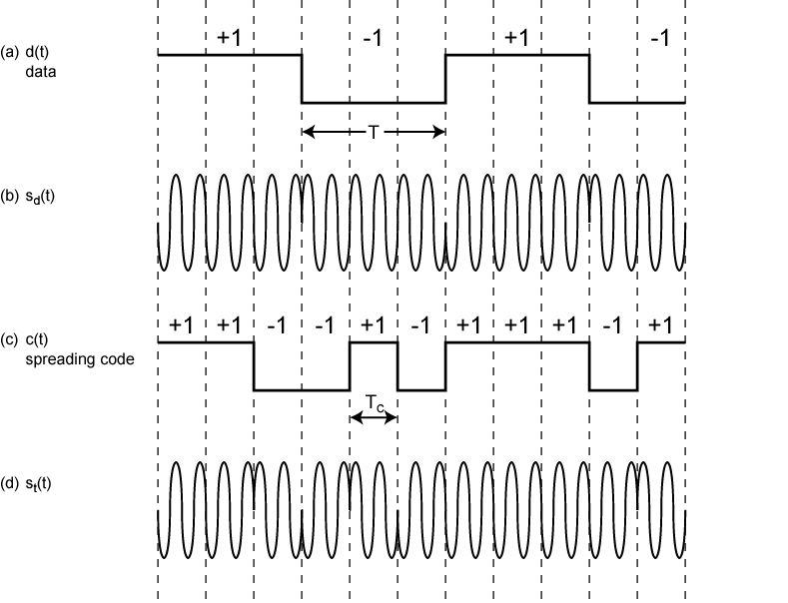
Direct Sequence Spread Spectrum Using BPSK Example

Slide 21
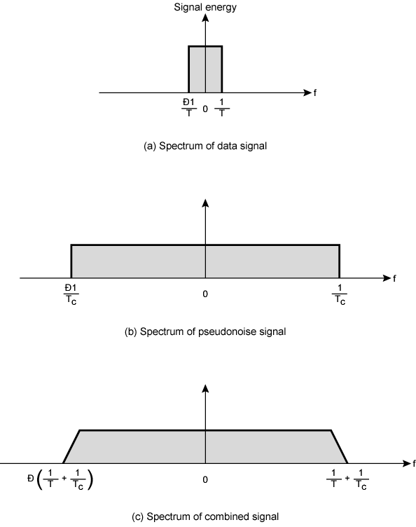
Approximate
Spectrum of
DSSS Signal

Slide 22
Code Division Multiple Access (CDMA)
Multiplexing Technique used with spread spectrum
Start with data signal rate D
  Called bit data rate
Break each bit into k chips according to fixed pattern specific to each user
  User’s code
New channel has chip data rate kD chips per second
E.g. k=6, three users (A,B,C) communicating with base receiver R
Code for A = <1,-1,-1,1,-1,1>
Code for B = <1,1,-1,-1,1,1>
Code for C = <1,1,-1,1,1,-1>

Slide 23
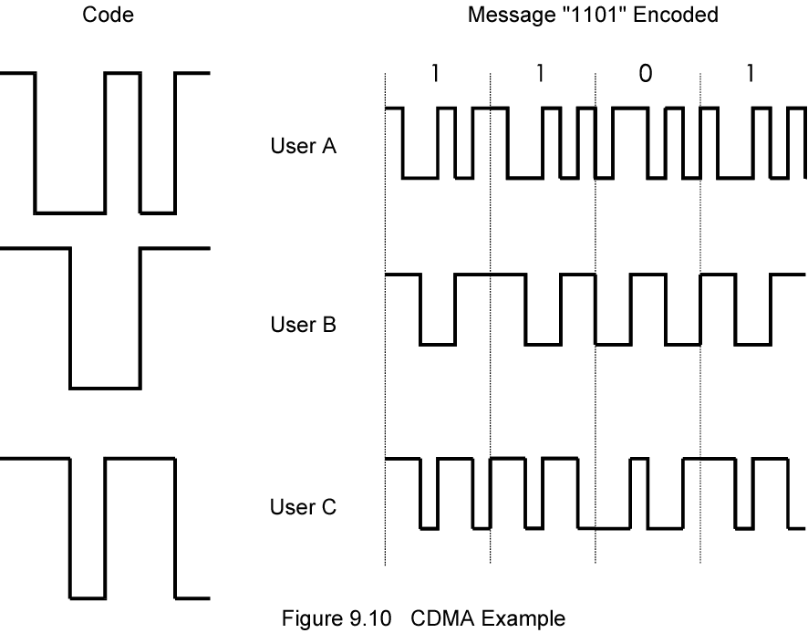
CDMA Example

Slide 24
CDMA Explanation
Consider A communicating with base
Base knows A’s code
Assume communication already synchronized
A wants to send a 1
  Send chip pattern <1,-1,-1,1,-1,1>
    A’s code
A wants to send 0
  Send chip[ pattern <-1,1,1,-1,1,-1>
    Complement of A’s code
Decoder ignores other sources when using A’s code to decode
  Orthogonal codes

Slide 25
CDMA for DSSS
n users each using different orthogonal PN sequence
Modulate each users data stream
  Using BPSK
Multiply by spreading code of user

Slide 26
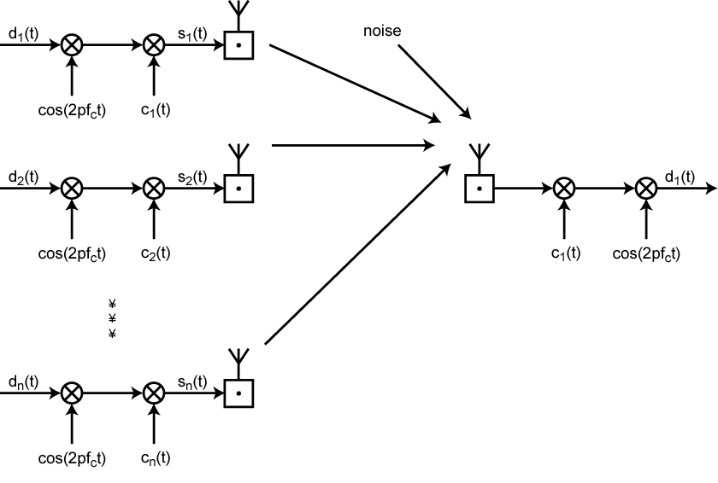
CDMA in a DSSS Environment

Slide 27
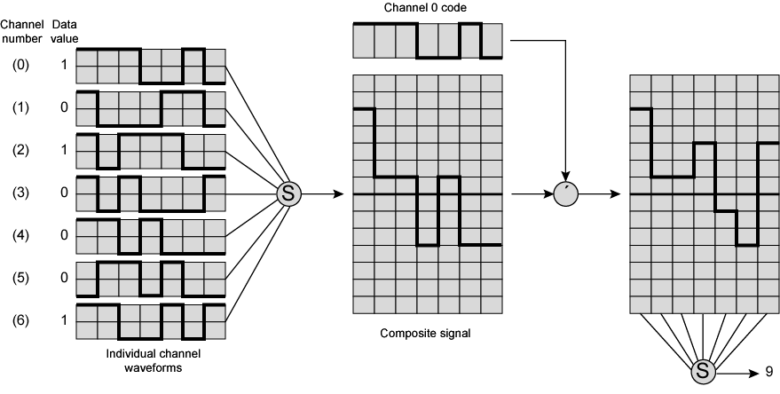
Seven Channel CDMA Encoding and Decoding

Slide 28
Required Reading
Stallings chapter 9

