Slide 1
On the systematic improvement in electronic structure theories
Dissertation Defense
Zachary W. Windom
Advisor: Rodney Bartlett
Department of Chemistry
Quantum Theory Project
University of Florida
3/09/2020

Slide 2
What does “improvement” mean?
More accurate result ➔Part 1
Significantly reduce calculation cost ➔Part 2

Slide 3
Mean-field approximation
More accurate result ➔Part 1
Significantly reduce calculation cost ➔Part 2

Slide 4
Electron correlation definition and “types”
Measuring electron correlation: The impact of symmetry and orbital transformations. JCTC 2023 10.1021. Robert Izsak, et al.

Slide 5
What we want:
“Ideal” electronic structure method
Systematically improvable toward “exact” answer
Algorithmically tractable, and applicable to systems of varying size/dimension
A computational “black-box”, largely independent of user-defined parameters
Amenable to emerging compute paradigms, such as quantum or exascale computing
Variational, to accommodate near-degeneracies

Slide 6
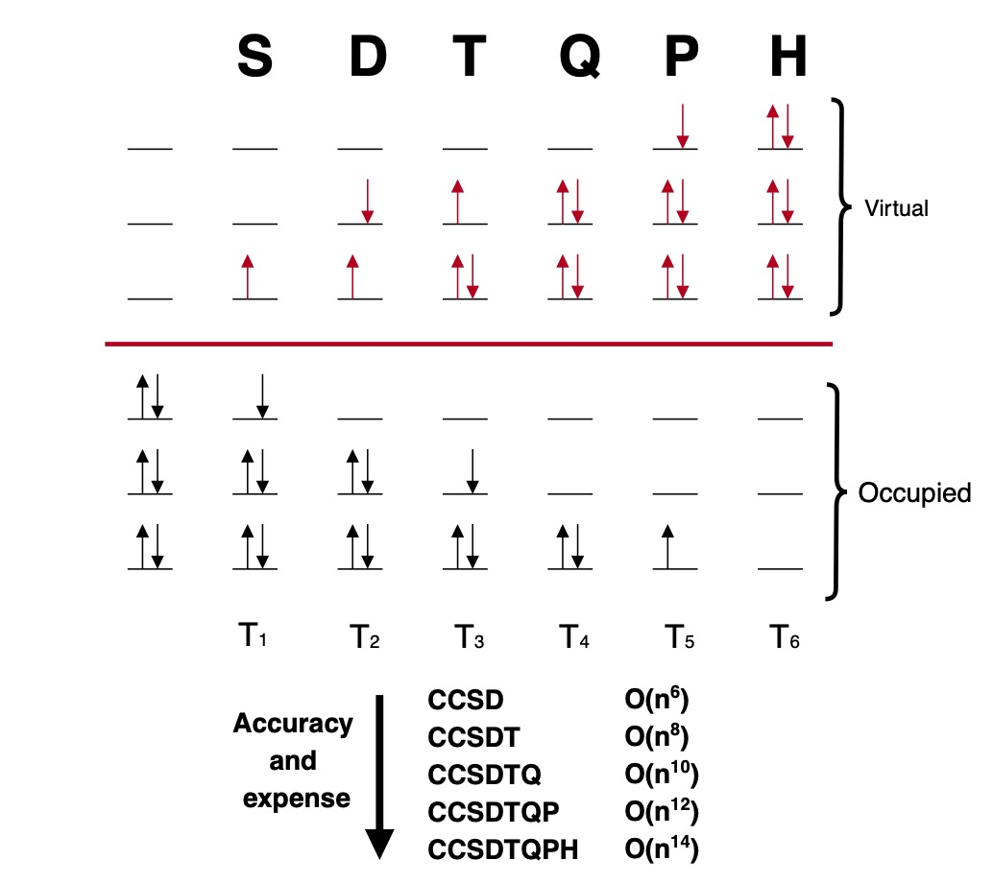
Brief overview of coupled cluster theory

Slide 7
A problem? Dissociation of N₂

Slide 8
Standard coupled cluster theory is:
“Ideal” electronic structure method
Systematically improvable toward “exact” answer
Algorithmically tractable, and applicable to systems of varying size/dimension
A computational “black-box”, largely independent of user-defined parameters
Amenable to emerging compute paradigms, such as quantum or exascale computing
Variational, to accommodate near-degeneracies
??

