Slide 1
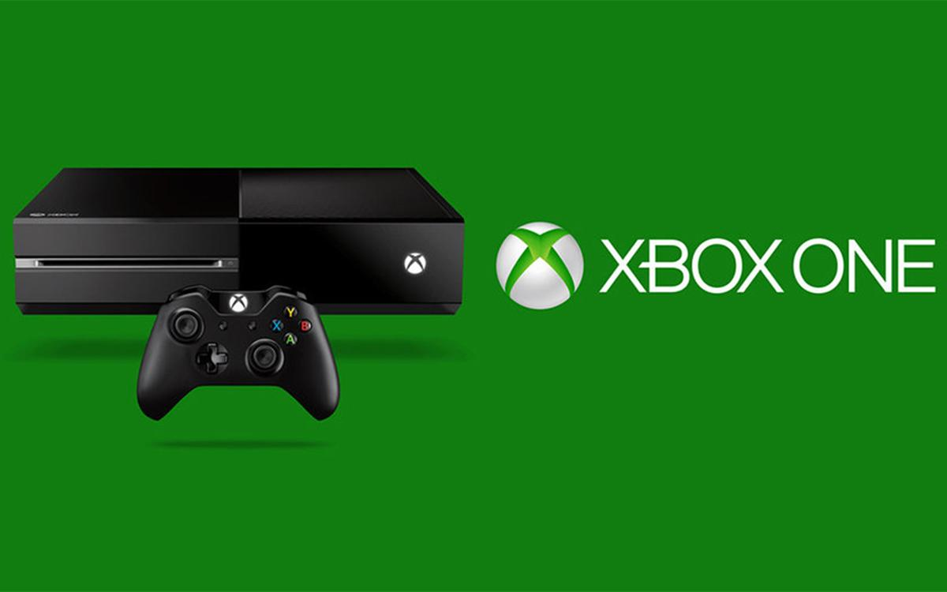
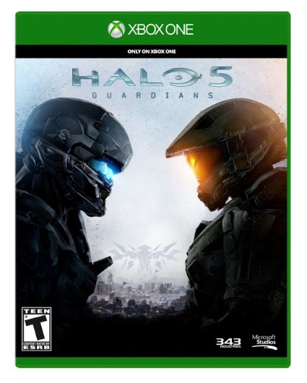
Xbox One and Halo 5 Mutual Friend Finder
Blake Myers and Zhiwei Yang
Project Description and Goal:
Using in-game statistics from Halo 5, an Xbox One game, and profile information for Xbox One players, create a database that will allow a user to find mutual friends to play with who have similar skills and also recommend games based on Halo 5 play style.

Slide 2
Data - Source and Description
Using a python script, the Xbox One player data was scraped from xboxapi.com.
The following tables were populated from that api:
PLAYERS - includes Xbox Gamertag with unique id number for each player
FRIENDS_OF - includes list of all friend ids associated with all unique player ids
GAMES - includes list of all games found during scraping on players, Game Title, and Game ID
GAMES_PLAYED -includes list of all games a player has played and include time played as well as overall game progress
Using the same script, the Halo 5 data was scraped from developer.haloapi.com.
The following tables were populated from that api:
PLAYLISTS - includes list of Halo 5 playlists
SEASONS - includes list of Halo 5 seasons, usually month to month
RANKS - includes list of Rank ID and associated description: Bronze, Silver, Gold, etc
PLAYER_STATS - includes list of players stats in a certain playlist during a certain season, which includes wins, losses, total games, and ranking

Slide 3
Interesting Finding and Results
After pulling the games played data for the players we scraped, the top five games played among all the players were all first person shooters, including Halo 5. The list included:
Destiny
Halo: The Master Chief Collection
Titanfall
Halo 5: Guardians
Call of Duty: Black Ops III
With the Halo 5 statistics, only two of the players scraped were able to obtain the highest ranking in a Halo 5 playlist: Champion. The average ranking was just above a Platinum rank, which is rank 4 on a scale of 0 to 7.

Slide 4
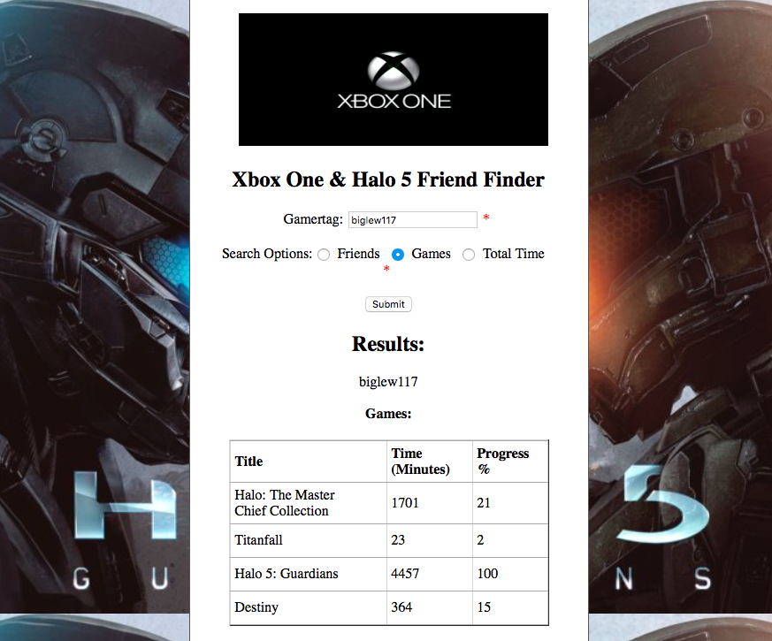
Conclusion, UI, ....
UI consists of basic webpage that allows the user to type in a Gamertag and then choose whether they would like Friend or Game recommendations.
Our database can also pull the total game time spent for a player on Xbox One.

