Slide 1
NP-Complete Problems
CIT 596, Spring 2012

Slide 2
Problems that Cross the Line
What if a problem has:
  An exponential upper bound
  A polynomial lower bound
We have only found exponential algorithms, so it appears to be intractable.
But... we can’t prove that an exponential solution is needed, we can’t prove that a polynomial algorithm cannot be developed, so we can’t say the problem is intractable...

Slide 3
NP-Complete Problems
The upper bound suggests the problem is intractable
The lower bound suggests the problem is tractable
The lower bound is linear: O(N)
They are all reducible to each other
  If we find a reasonable algorithm (or prove intractability) for one, then we can do it for all of them!

Slide 4
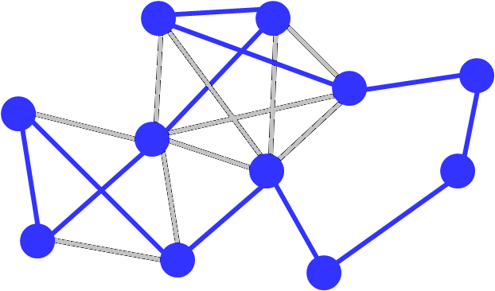
Traveling Salesman

Slide 5
5-Clique

Slide 6
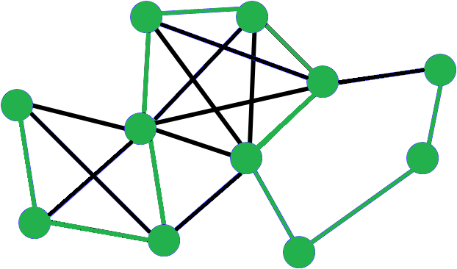
Hamiltonian Path

Slide 7
Map Coloring

Slide 8
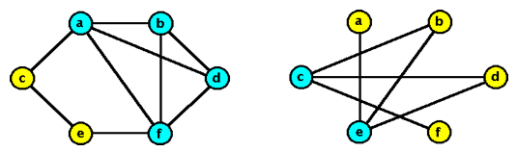
Vertex Cover (VC)
Given a graph and an integer k, is there a collection of k vertices such that each edge is connected to one of the vertices in the collection?

Slide 9
Class Scheduling Problem
With N teachers with certain hour restrictions M classes to be scheduled, can we:
  Schedule all the classes
  Make sure that no two teachers teach the same class at the same time
  No teacher is scheduled to teach two classes at once

Slide 10
Pair Programming Problem
With N students and K projects, where N is even, can we:
  Assign pairs of students to each project
  Every student works on every project
  No student has the same partner more than once
Is this an NP-complete problem?

Slide 11
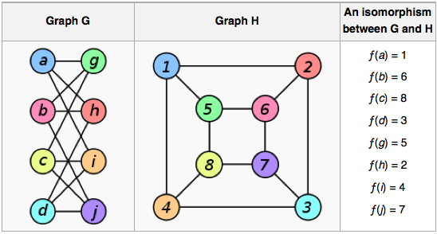
Graph isomorphism
Graph isomorphism is NP-hard; is it NP-complete?

Slide 12
NP and P
What is NP?
NP is the set of all decision problems (question with yes-or-no answer) for which the 'yes'-answers can be verified in polynomial time (O(n^k) where n is the problem size, and k is a constant) by a deterministic Turing machine. Polynomial time is sometimes used as the definition of fast or quickly.
What is P?
P is the set of all decision problems which can be solved in polynomial time by a deterministic Turing machine. Since it can solve in polynomial time, it can also be verified in polynomial time. Therefore P is a subset of NP.

Slide 13
NP-Complete
What is NP-Complete?
A problem x that is in NP is also in NP-Complete if and only if every other problem in NP can be quickly (ie. in polynomial time) transformed into x. In other words:
x is in NP, and
Every problem in NP is reducible to x
So what makes NP-Complete so interesting is that if any one of the NP-Complete problems was to be solved quickly then all NP problems can be solved quickly

Slide 14
NP-Hard
What is NP-Hard?
NP-Hard are problems that are at least as hard as the hardest problems in NP. Note that NP-Complete problems are also NP-hard. However not all NP-hard problems are NP (or even a decision problem), despite having 'NP' as a prefix. That is the NP in NP-hard does not mean 'non-deterministic polynomial time'. Yes this is confusing but its usage is entrenched and unlikely to change.

Slide 15
Certificates
Returning true: in order to show that the schedule can be made, we only have to show one schedule that works
  This is called a certificate.
Returning false: in order to show that the schedule cannot be made, we must test all schedules.

Slide 16
Oracles
If we could make the ‘right decision’ at all decision points, then we can determine whether a solution is possible very quickly!
  If the found solution is valid, then True
  If the found solution is invalid, then False
If we could find the certificates quickly, NP-complete problems would become tractable – O(N)
This (magic) process that can always make the right guess is called an Oracle.

Slide 17
Determinism vs. Nondeterminism
Nondeterministic algorithms produce an answer by a series of “correct guesses”
Deterministic algorithms (like those that a computer executes) make decisions based on information.

Slide 18
NP-Complete
“NP-Complete” comes from:
  Nondeterministic Polynomial
  Complete - “Solve one, Solve them all”
There are more NP-Complete problems than provably intractable problems.

Slide 19
Proving NP-Completeness
Show that the problem is in NP. (i.e. Show that a certificate can be verified in polynomial time.)
Assume it is not NP complete
Show how to convert an existing NPC problem into the problem that we are trying to show is NP Complete (in polynomial time).
If we can do it we’ve done the proof!
Why?
If we can turn an exisiting NP-complete problem into our problem in polynomial time... →⏐←

Slide 20
Become Famous!
To get famous in a hurry, for any NP-Complete problem:
  Raise the lower bound
  (via a stronger proof)
  Lower the upper bound
  (via a better algorithm)
They’ll be naming buildings after you before you are dead!

Slide 21
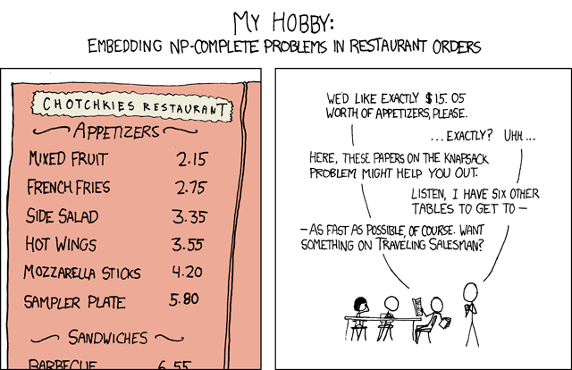
http://xkcd.com/287/

Slide 22
End
http://www.coursehero.com/file/3292647/cs1311lecture29wdl/
http://www.cs.uky.edu/~lewis/cs-heuristic/text/class/more-np.html
http://stackoverflow.com/questions/210829/what-is-an-np-complete-problem
Wikipedia

