Slide 1

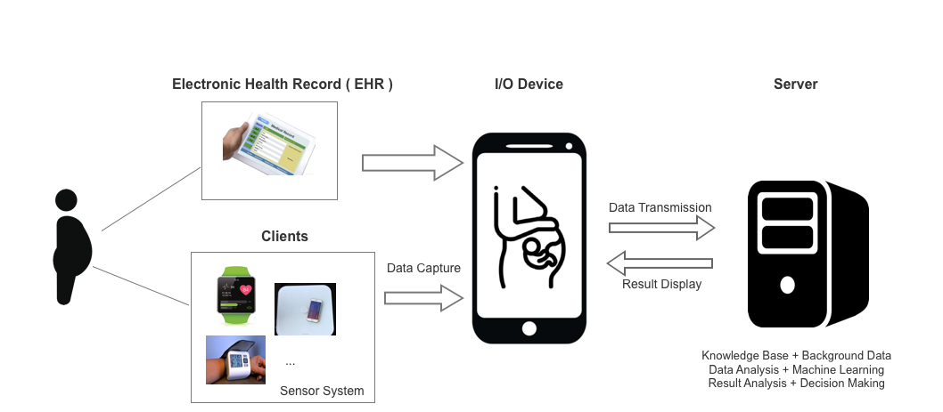
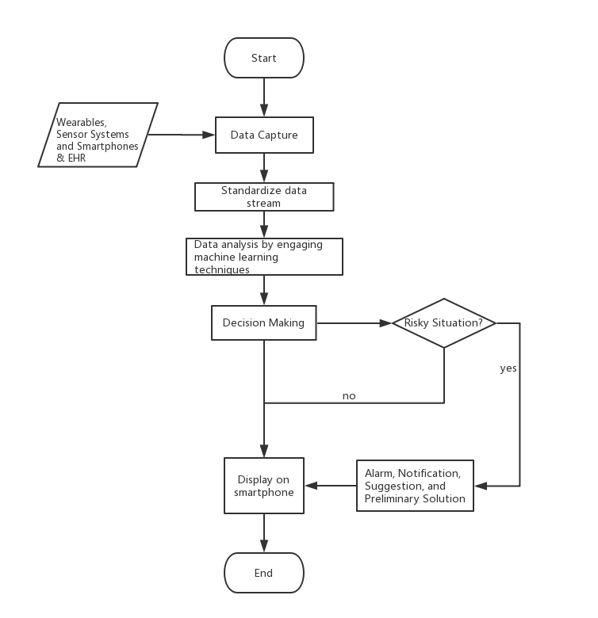
Final Year Project
School of Computer Science
University of Nottingham Ningbo China
Monitoring Pregnancy using Mobile Applications
Xiang Zhang, Vladimir BRUSIC
BACKGROUND & MOTIVATION
Traditional health care system is supply-based and organized around providers (hospitals, medical practices, clinics, and others). In most parts of the world, population is aging and becoming less healthy due to consumerism, unhealthy diet, and sedentary life style. Health care costs are rapidly rising and there is a trend of moving health care services to patient homes as much as possible. New technologies make this possible; technology-enabled infrastructure that connects providers, caregivers and patients and links multiple sources of data. Simple collecting and connecting data are not sufficient, these data need to be coupled with medical knowledge and algorithms that help make timely and correct decisions about patient’s health needs. New technologies include sensor systems [1,2], wearables [1,3], personal health records [4], and the connectivity of devices through the Internet of Things [5,6]. Although these technologies offer a great promise, to date no system has been shown to accurately collect data [7]. We propose to develop and implement a system for monitoring pregnancy through integration of wearable devices, medical knowledge and relevant algorithms, and with the use of personal pregnancy record (Figure 1). This system takes input from continuous activity monitoring device (smart watch, heart beat, breathing rate), smart devices that are used several times a day (smart scale, blood pressure monitor, blood sugar meter, and temperature). Similar systems have been proposed [8-12] but a truly functional system is not available. The system will focus on comprehensive data collection from wearable devices, linked smart devices, early detection of risks and possible complications that will trigger alarms and recommendations to see health care specialists. The system will use commercially available devices and sensors and we will focus on the development of a software system. The proposed software will be used in health monitoring (data collection, management and processing) and will provide automated support for medical decision making through application of machine learning approaches [12]. The main aim of this project is to develop and implement a system for online analytics of pregnancy monitoring data that can be used to maintain healthy pregnancy and enable early prediction of various complications and rapidly advise patient about the emerging risks. Our application will monitor several basic signs (weight, blood pressure, temperature, physical activity, heart rate, and sleep) and integrate these data into a decision-making system. We will focus on prediction of gestational diabetes [13] and pre-eclampsia [14].
Figure 1 : Block diagram of software design
Figure 1: Hardware components of the proposed system. Data capture is on the client side combined with the EHR and individuals health history. Data capture is facilitated by mobile devices. Data analytics and decision making is done at the server side.
Figure 2: Workflow diagram that represents high-level decision-making based on based on the results of prediction algorithm applied to the streamed data.
CHALLENGES
It is difficult to guarantee the quality of data collected from wearable devices or other sensor systems
Prediction accuracy by machine learning needs to be satisfactory
Ensuring data security and reliability is a complex problem
Acceptance by the users is not guaranteed and the use of the system requires training and automated quality assurance
REFERENCES
1. Tricoli A et al. Wearable and miniaturized sensor technologies for personalized and preventive medicine. Advanced Functional Materials. 2017;27(15):1605271.
2. Andreu-Perez et al.. Big data for health. IEEE J Biomed Health Inform. 2015;19(4):1193-208.
3. Piwek L et al. The rise of consumer health wearables: promises and barriers. PLoS Medicine. 2016;13(2):e1001953.
4. Smith MI et al. Lessons Learned After Redesigning a Personal Health Record. InMEDINFO 2017: Precision Healthcare Through Informatics: Proceedings of the 16th World Congress on Medical and Health Informatics 2018 Jan 31 (Vol. 245, p. 216). IOS Press.
5. Al-Fuqaha A et al. Internet of things: A survey on enabling technologies, protocols, and applications. IEEE Communications Surveys & Tutorials. 2015;17(4):2347-76.
6. Dimitrov DV. Medical internet of things and big data in healthcare. Healthcare informatics research. 2016;22(3):156-63.
7. Rosenberger ME et al. 24 hours of sleep, sedentary behavior, and physical activity with nine wearable devices. Medicine and science in sports and exercise. 2016;48(3):457.
8. Groenen CJ et al. Improving maternity care using a personal health record: study protocol for a stepped-wedge, randomised, controlled trial. Trials. 2016;17(1):202.
9. Bachiri M et al. Mobile personal health records for pregnancy monitoring functionalities: Analysis and potential. Computer methods and programs in biomedicine. 2016;134:121-35.
10. Signorini M et al. Antepartum Fetal Monitoring through a Wearable System and a Mobile Application. Technologies. 2018;6(2):44.
11. Moreira MW et al. Postpartum depression prediction through pregnancy data analysis for emotion-aware smart systems. Information Fusion. 2019;47:23-31.
12. Chen JH, Asch SM. Machine learning and prediction in medicine—beyond the peak of inflated expectations. The New England journal of medicine. 2017;376(26):2507.
13. Spaight C et al. Gestational diabetes mellitus. InNovelties in Diabetes 2016 (Vol. 31, pp. 163-178). Karger Publishers..
14. Wright D et al. Competing risks model in screening for preeclampsia by maternal characteristics and medical history. American journal of obstetrics and gynecology. 2015;213(1):62-e1.
Contacts: Xiang ZHANG zy18743@Nottingham.edu.cn
Vladimir BRUSIC vladimir.brusic@Nottingham.edu.cn

