Slide 1




Detecting Webhook-Based
Keylogger Exfiltration
Using Network Traffic Analysis

Slide 2


KEY TERMS
Two concepts this project builds on
Keylogger
Webhook
A program that secretly records what a user types — keystrokes, and in more advanced cases screenshots or camera captures — without their knowledge.
A way for one app to automatically send data to another app's URL the moment something happens — normally used for legitimate notifications (e.g. a message posting to Discord).
e.g. watcher.exe (this project's test sample)
e.g. discord.com/api/webhooks/...
Put together: a keylogger that uses a webhook as its exfiltration channel — captured data rides an ordinary-looking HTTPS request straight into an attacker's Discord/Telegram/Slack.
2

Slide 3


HOW IT WORKS
The exfiltration chain, end to end
STEP 1
STEP 2
STEP 3
STEP 4
Local Capture
Local Storage
HTTPS POST
Webhook Server
Keystrokes, screenshots, camera frames captured on the host
Captured data briefly written/buffered before transmission
Data sent out over standard TLS to a webhook endpoint
Discord/Telegram/Slack receives it as ordinary API traffic
Because step 3 rides standard HTTPS to a trusted domain, it looks identical to normal application traffic — this is the blind spot the project targets.
3

Slide 4




SAMPLE ARCHITECTURE
Inside watcher.exe
Keystroke Logger
Hooks keyboard input, batches text
Webhook POST
HTTPS to Discord API
Screenshot Module
Captures the screen on an interval / trigger
watcher.exe
No local persistence. Runs only while manually executed — every capture batches into one outbound POST.
single unsigned process
Camera Capture
Grabs webcam frames when triggered
Three capture modules feed one process, which funnels everything through a single exfiltration path — the same path Layer 1 and Layer 2 of the demo target.
4

Slide 5
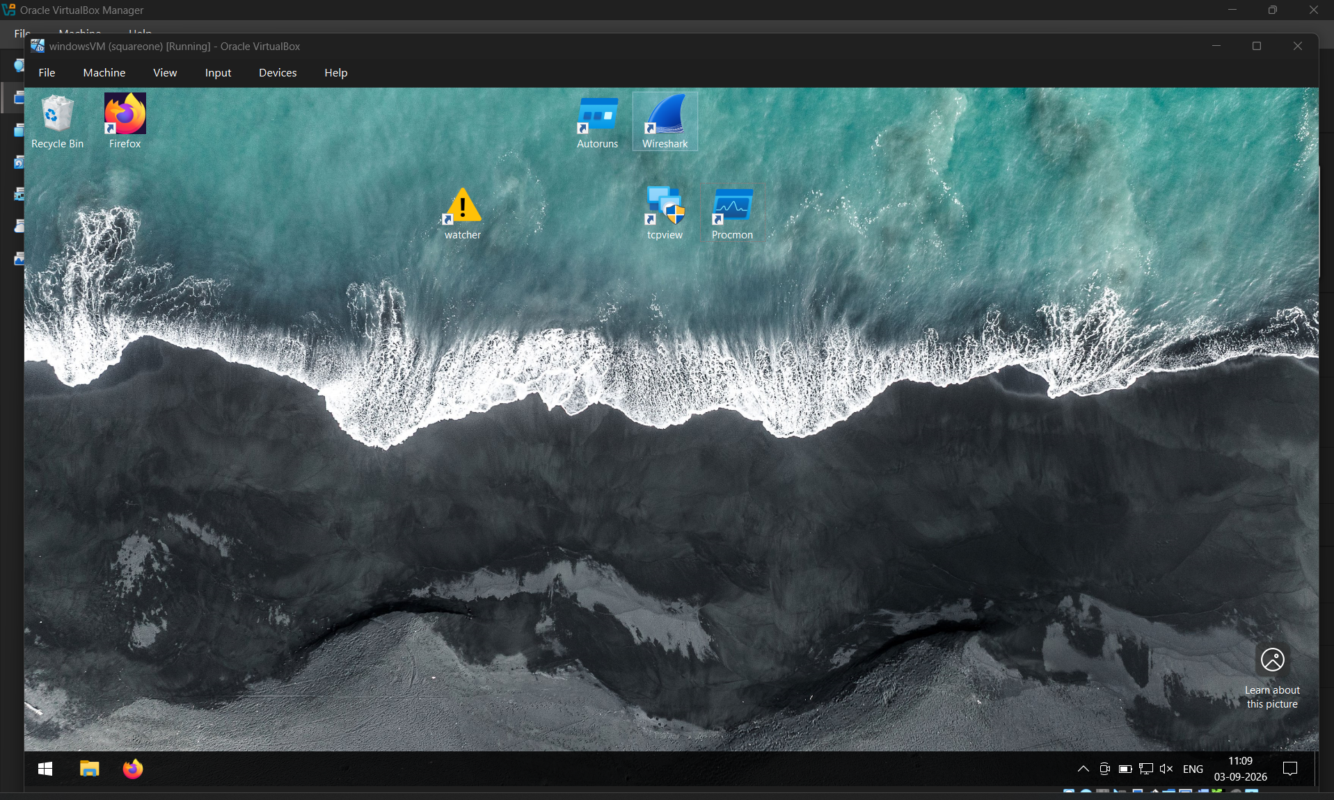
TEST ENVIRONMENT
The Virtual Machine this was actually run on
windowsVM
VirtualBox — isolated guest
OS
Windows 10 (64-bit)
MEMORY
~10 GB base
NETWORK
Bridged adapter
TOOLS INSTALLED
watcher, Wireshark,
TCPView, Autoruns
Kept isolated from the host — the sample never touches the physical machine.
10

Slide 6
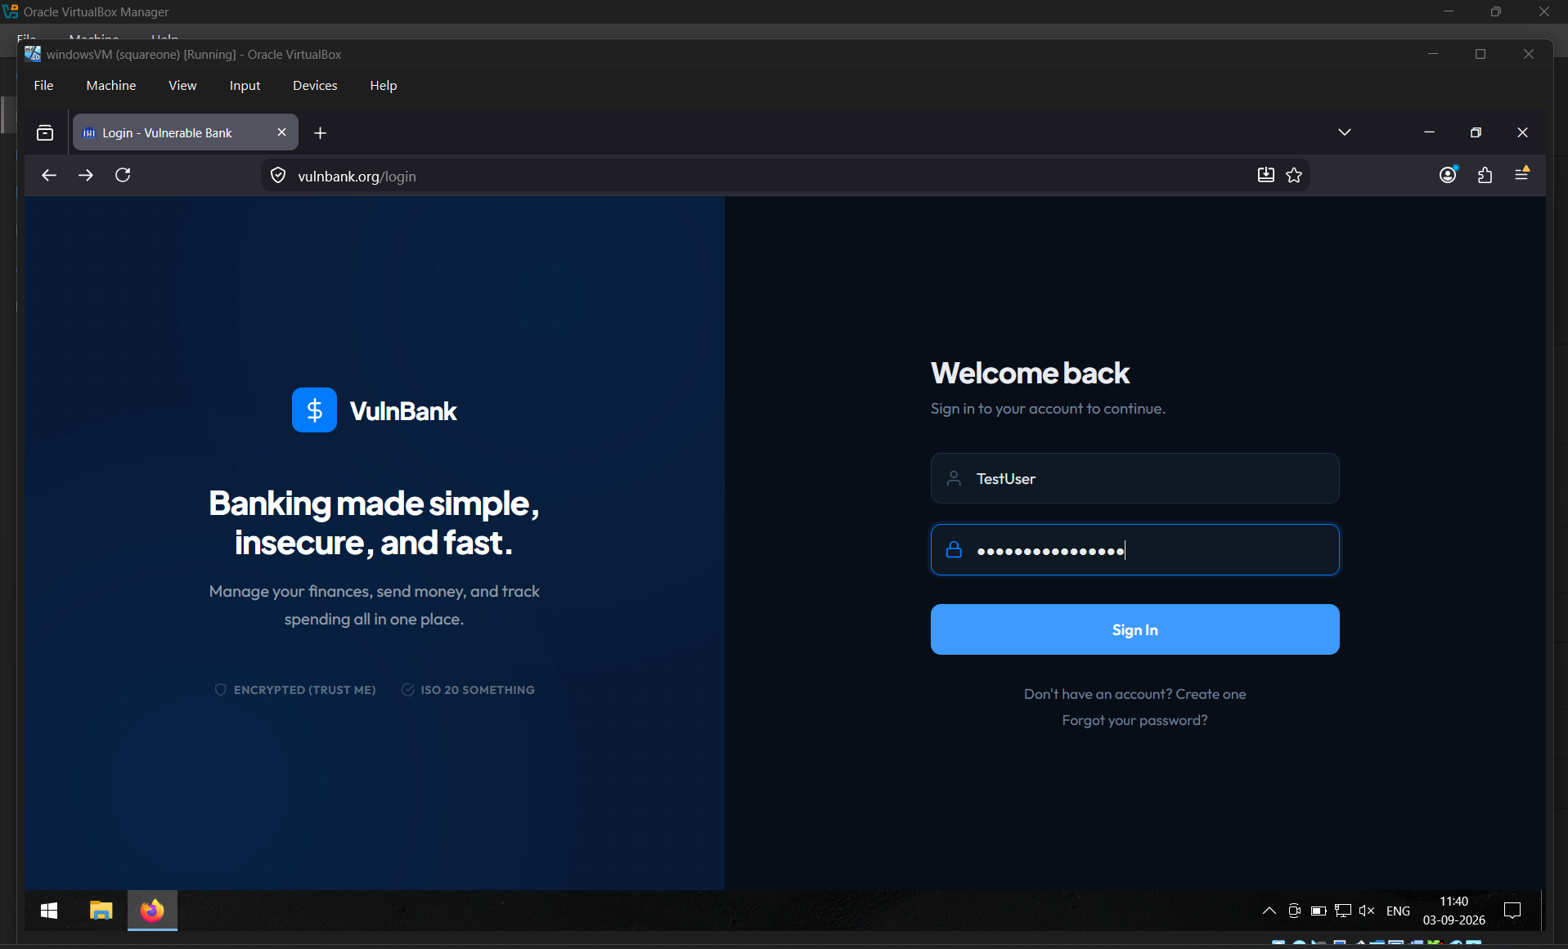
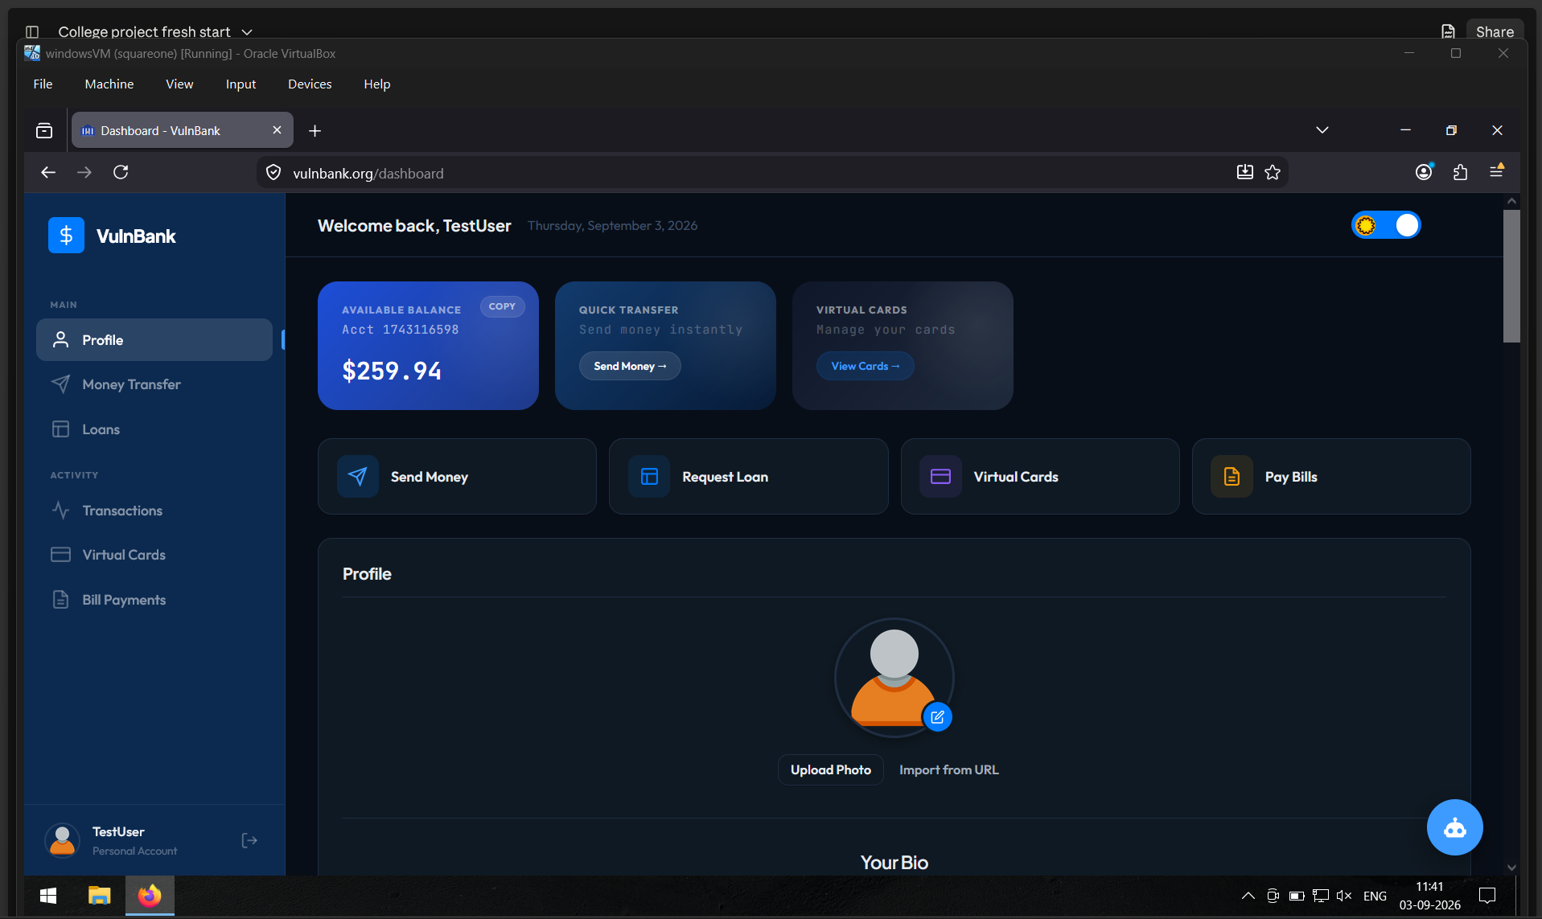
LIVE SAMPLE OUTPUT — STEP 1 & 2
The bait: a fake bank the victim logs into
STEP 1
Victim signs in to VulnBank (test target)
STEP 2
Session begins — dashboard loads normally
5

Slide 7
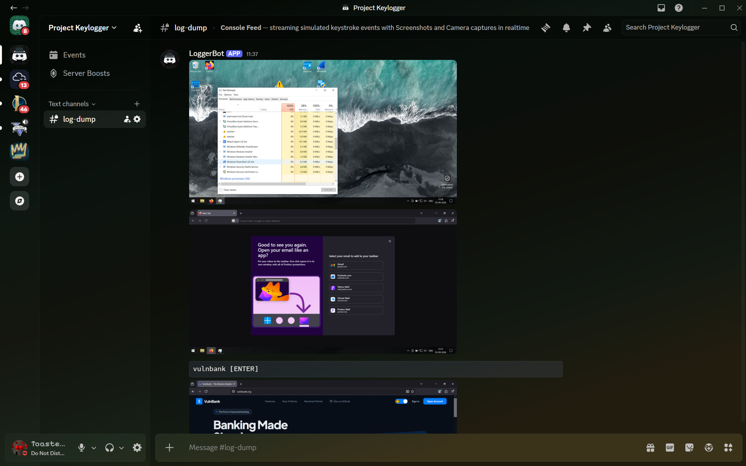
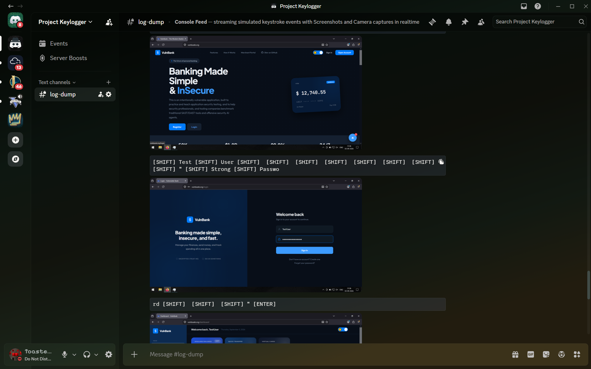
LIVE SAMPLE OUTPUT — STEP 3 & 4
The capture: what watcher.exe sends back
STEP 3
Screenshot of the session posted to Discord
STEP 4
Every keystroke logged and matched to the login
Both captures post automatically to a private Discord channel — no visible window, no user-facing indication the sample is running.
6

Slide 8


THE PROBLEM
Malware hides in traffic you already trust
Legitimate cover
Signature AV misses it
Growing technique
Malware exfiltrates data through trusted services — Discord, Telegram, Slack — riding ordinary HTTPS traffic.
No malicious binary signature is transmitted; the traffic pattern looks identical to normal app usage.
Webhook-based exfiltration is increasingly common in commodity malware and info-stealers.
7

Slide 9
OBJECTIVE
Catch it without knowing its signature
01
Identify covert exfiltration channels at the network layer
Detect webhook-based data exfiltration using multi-layer network and host analysis, with no prior knowledge of the malware sample required.
02
Correlate suspicious traffic with the local process responsible
Grounded in the same detection principle used by real SOC tooling.
03
Confirm persistence to establish malicious intent
8

Slide 10
METHODOLOGY
Three layers, one evidence chain
01 — NETWORK
02 — HOST
03 — PERSISTENCE
Network Layer
Host Layer
Persistence Layer
Wireshark
TCPView / Process Explorer
Autoruns
Inspect TLS SNI and traffic timing/size pattern to spot covert channels.
Map each connection to the exact local process generating it.
Check startup, registry, and scheduled tasks for how it survives reboot.
9

Slide 11
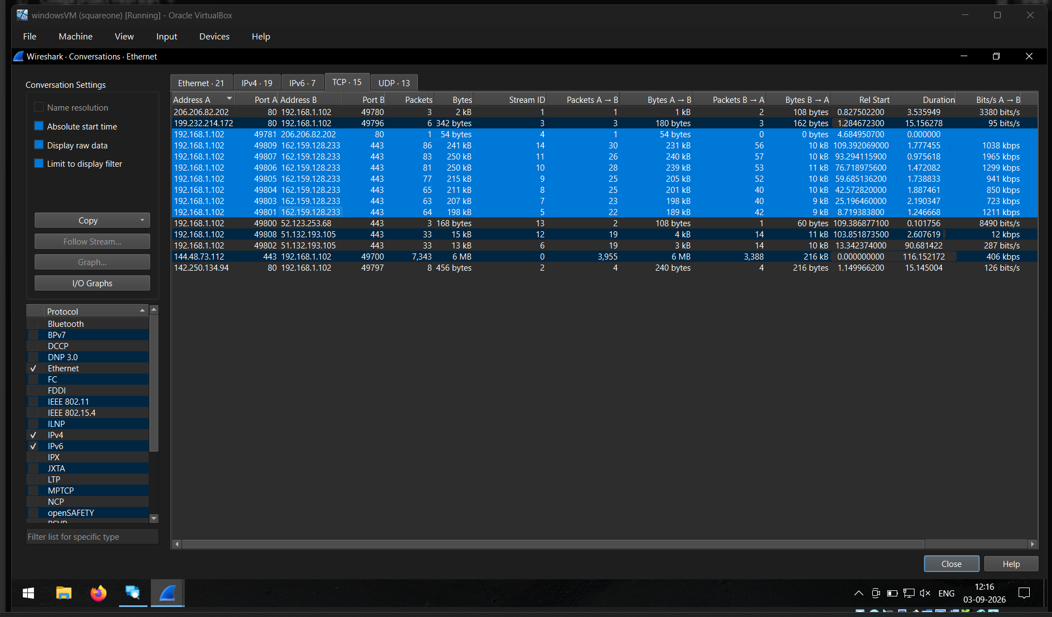
LIVE DEMO — LAYER 1 OF 3
Network Layer — Wireshark
PCAP
What to point out
Wireshark is used to monitor and analyze network traffic. It helps identify unusual HTTPS connections and communication patterns related to data exfiltration.
[ paste annotated screenshot here ]
11

Slide 12
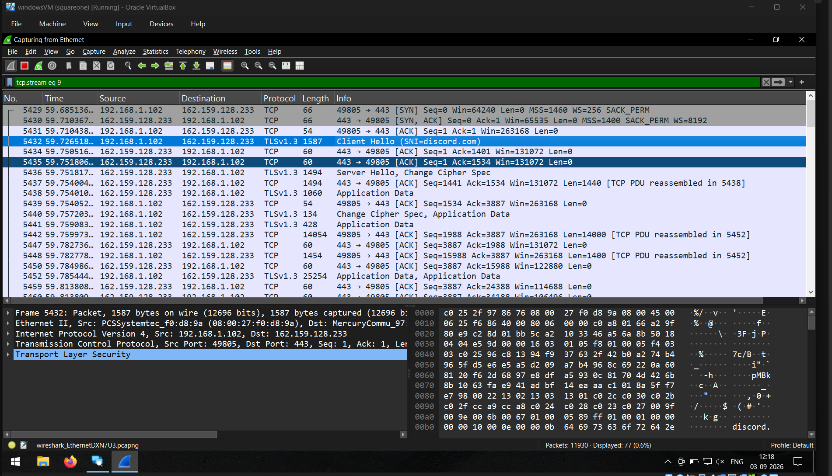
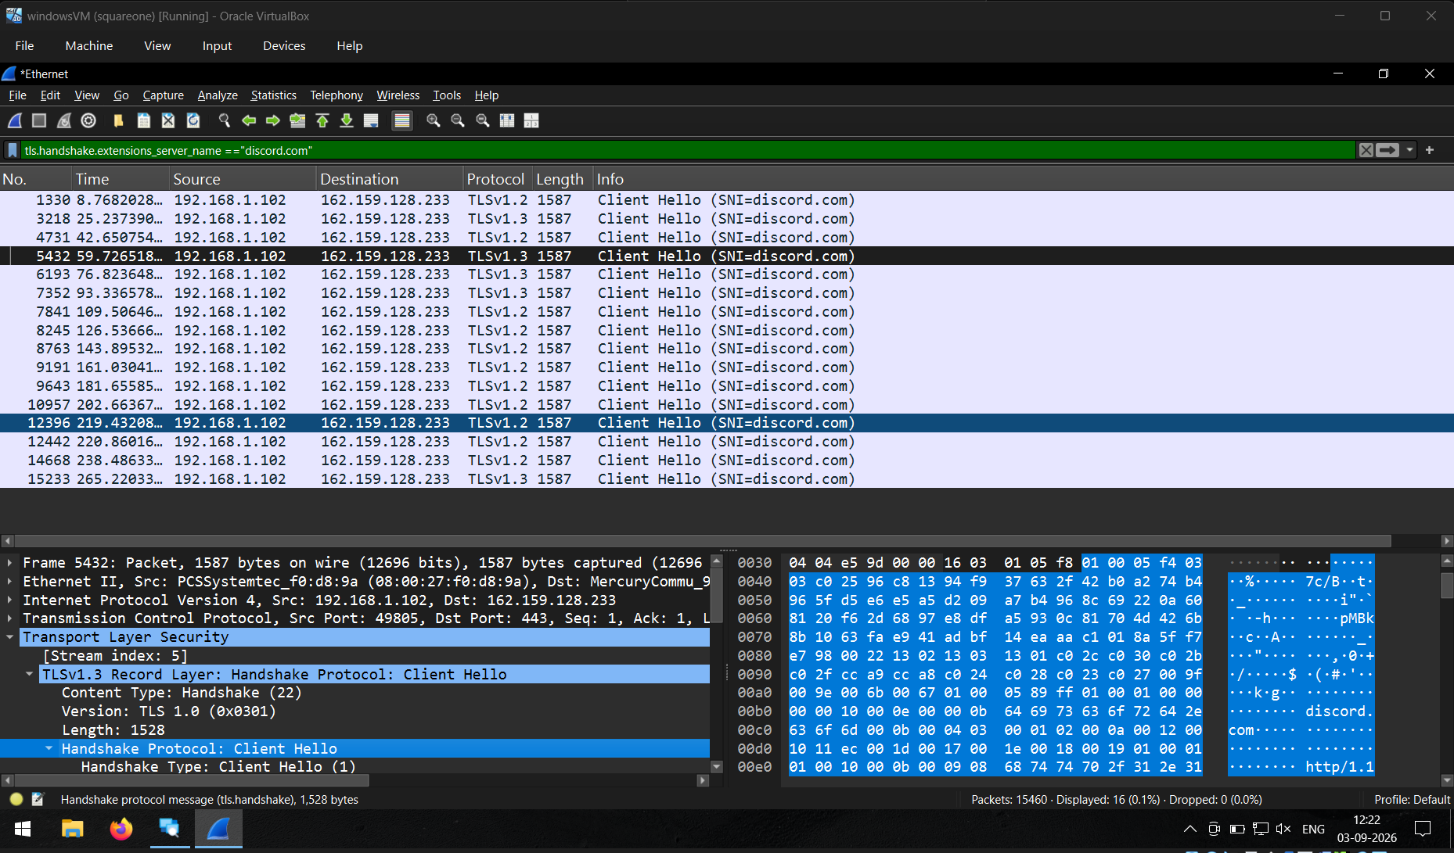
LIVE DEMO — LAYER 1.1 OF 3
Network Layer — Wireshark
PCAP
[ paste annotated screenshot here ]
What to point out
The captured network traffic is examined to find suspicious communication. Packet size, timing, and destination are checked to identify possible webhook-based data transfer. traffic is examined to find suspicious communication. Packet size, timing, and destination are checked to identify possible webhook-based data transfer.
11

Slide 13
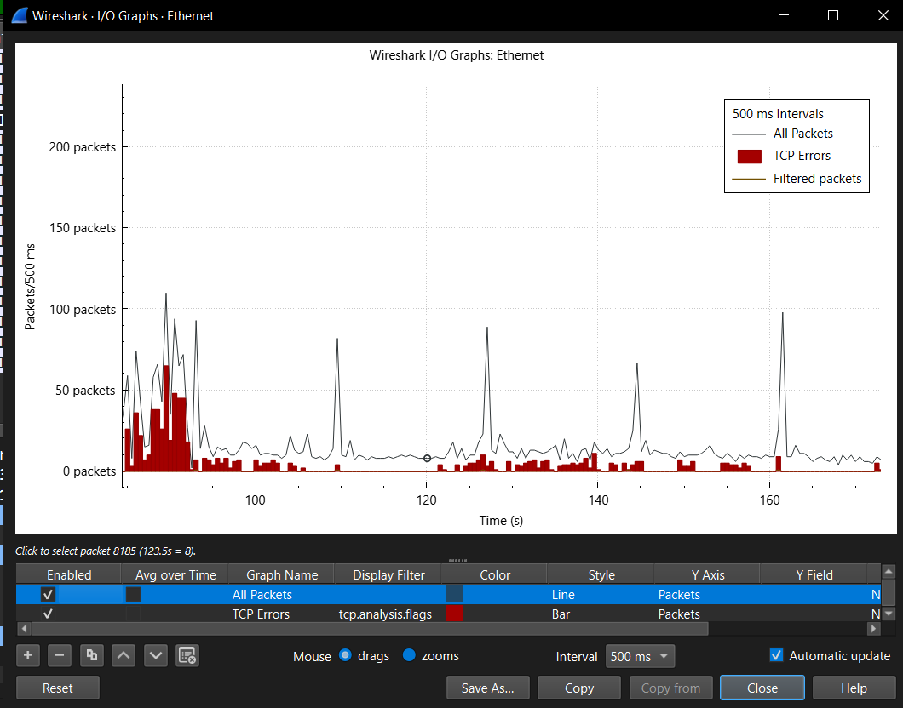
LIVE DEMO — LAYER 1.2 OF 3
Network Layer — Wireshark
PCAP
What to point out
TCPView is used to identify which process created the suspicious network connection. It helps connect the network activity to the watcher.exe process.
[ paste annotated screenshot here ]
11

Slide 14
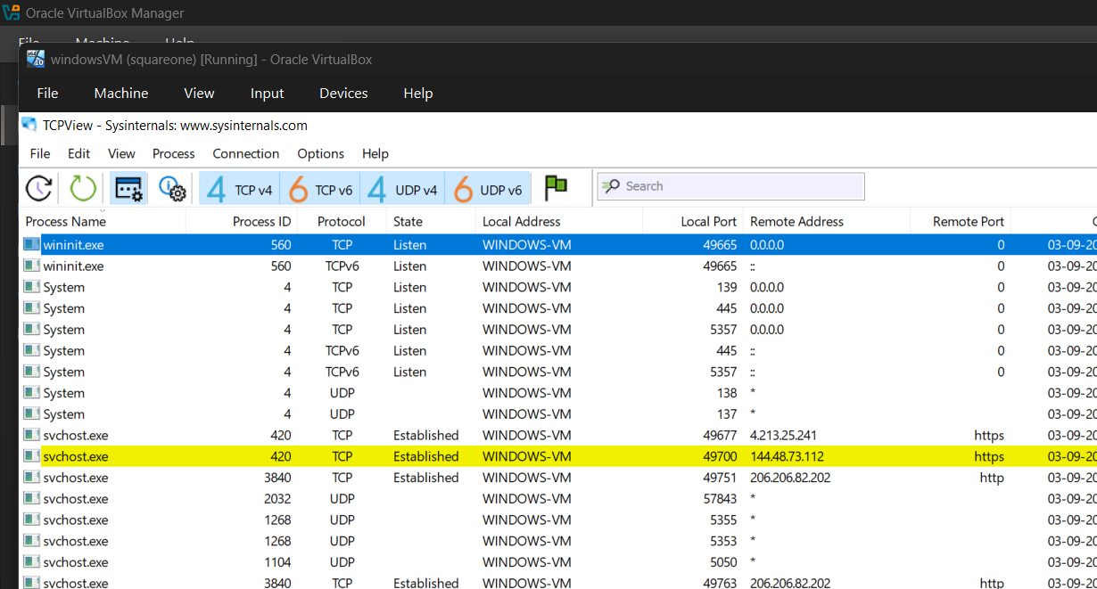
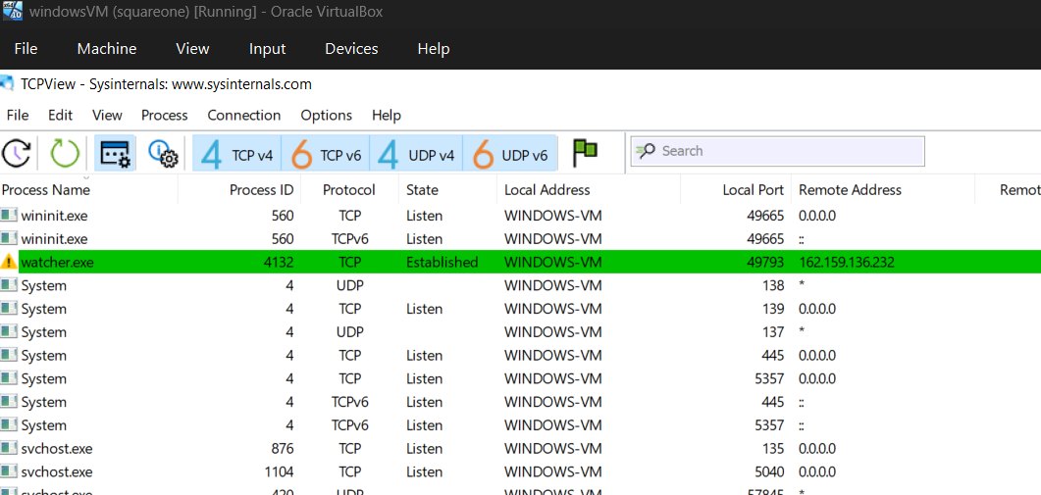
LIVE DEMO — LAYER 2 OF 3
Host Layer — TCPView
SOCKET
$
> correlating socket to process owner...
What to point out
Directly maps the flagged connection to the exact local process — no guesswork
Works even when the destination alone isn't conclusive
Cross-checked against expected apps for that destination
12

Slide 15
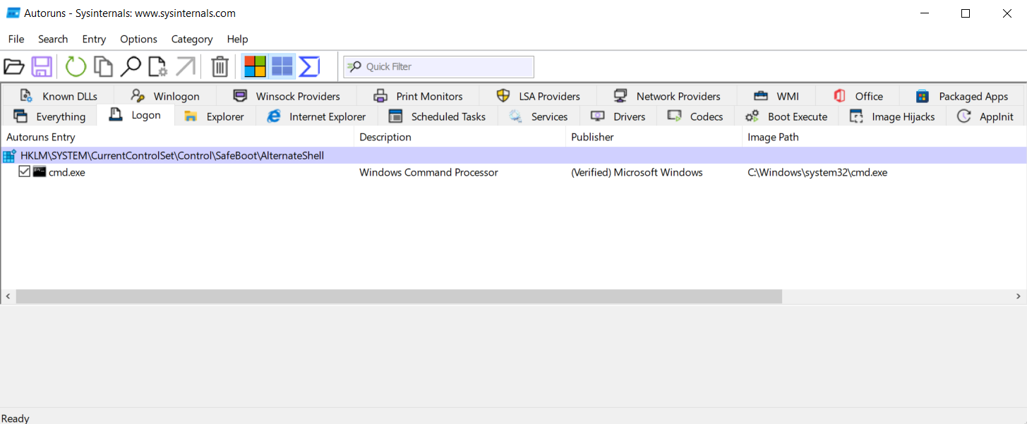
LIVE DEMO — LAYER 3 OF 3
Persistence Layer — Autoruns
AUTORUN
$
Logon tab: baseline vs. post-run diff
> no new entries detected — sample is non-persistent
[ paste annotated screenshot here ]
What to point out
Baseline snapshot taken before running the sample, compared after
No persistence found — a legitimate, reportable finding about the sample's sophistication
Completes the evidence chain alongside layers 1 and 2
13

Slide 16

GENERALIZATION
A methodology, not a one-off trick
Discord Webhooks
Telegram Bot API
Slack Incoming Webhooks
Generic REST Exfil
Same three-layer approach — SNI/pattern, then process mapping, then persistence check — applies across all of these, since they share one structure: a legitimate API endpoint receiving periodic small payloads.
14

Slide 17


LIMITATIONS
Where this approach needs help
VPN / DNS-over-HTTPS
Hides the destination SNI and IP at the network layer — Wireshark loses the domain signal if the VPN runs inside the same host.
Host-layer detection still holds
TCPView / Process Explorer map connections by local socket ownership — this doesn't depend on knowing the traffic's destination.
Encrypted payload
Content of captured keystrokes/images is never visible in transit — detection relies on metadata and behavior, not payload inspection.
15

Slide 18
CONCLUSION
A layered chain beats a single signal
Network traffic, host process mapping, and persistence checks together reliably identify webhook-based exfiltration without prior signature knowledge — reflecting the same correlation techniques real-world SOC analysts use daily.
Thank you
16

