Slide 1

Double Regression Network To Improve Video Super-Resolution
Feng He A20479032
Xingli Li A20482592

Slide 2
Problems currently dealing with super-resolution
Learning the mapping from LR to HR images is typically an ill-posed problem since there exist infinitely many HR images that can be downscaled to obtain the same LR image. Thus, the space of the possible functions that map LR to HR images becomes extremely large.
It is hard to obtain a promising SR model when the paired data are unavailable.

Slide 3
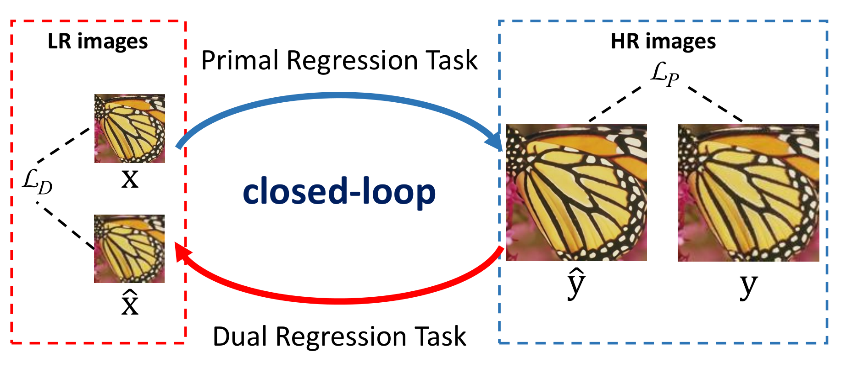
Dual regression training scheme, which contains a primal regression task for super-resolution and a dual regression task to project super-resolved images back to LR images. The primal and dual regression tasks form a closed-loop.

Slide 4
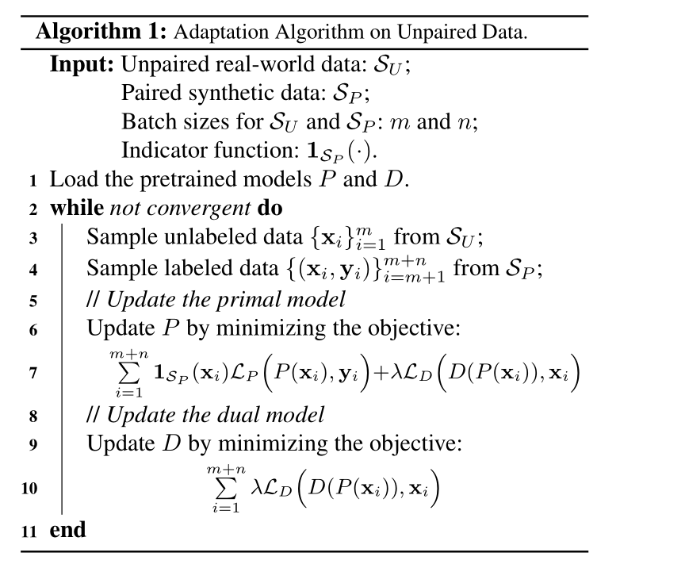

Slide 5
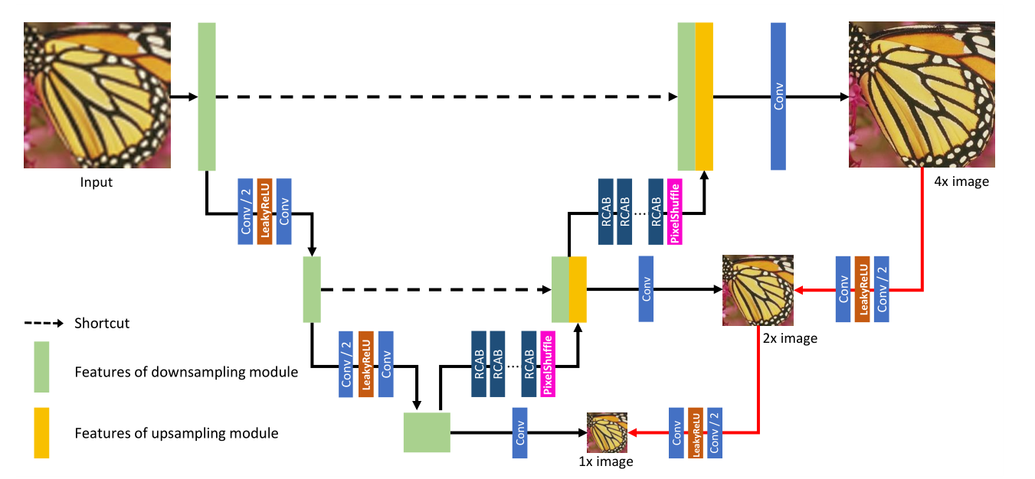
The architecture of DRN for 4×SR. DRN contains a primal network and a dual network (marked as red lines). The green box denotes the feature maps of the downsampling module (left half) while the yellow box refers to the feature maps of the upsampling module (right half). Following U-Net, we concatenate the corresponding shallow and deep feature maps via shortcut connections.

Slide 6
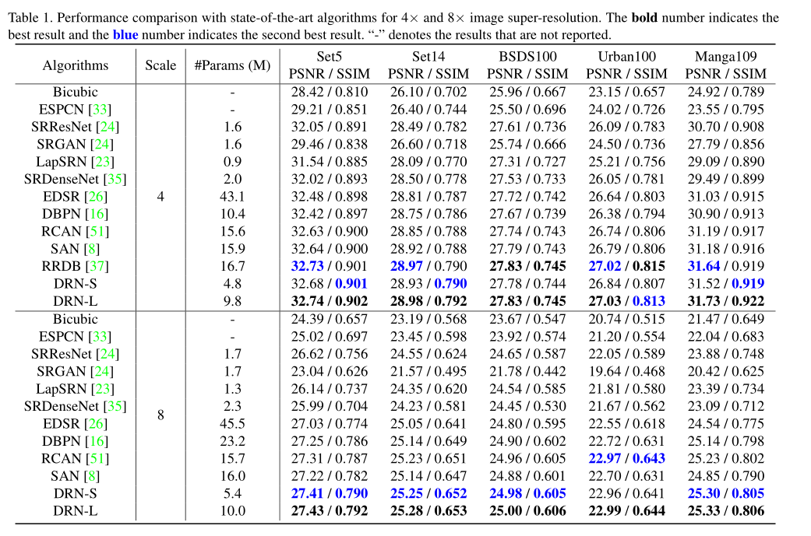

Slide 7
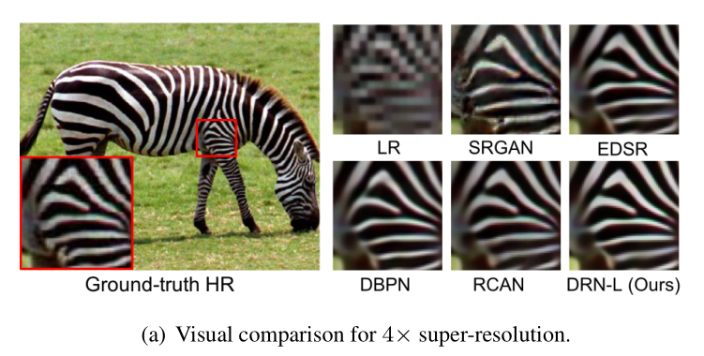
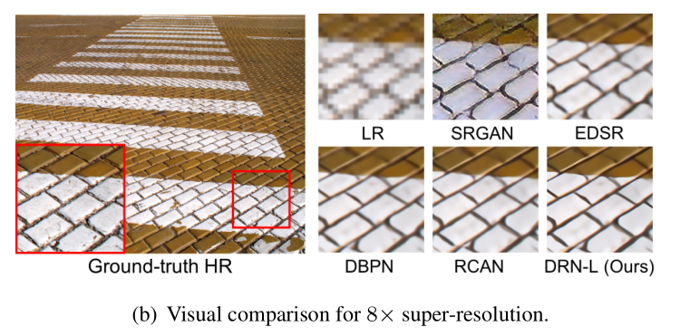
Visual comparison of different methods for (a)4×and (b)8×image super-resolution

Slide 8
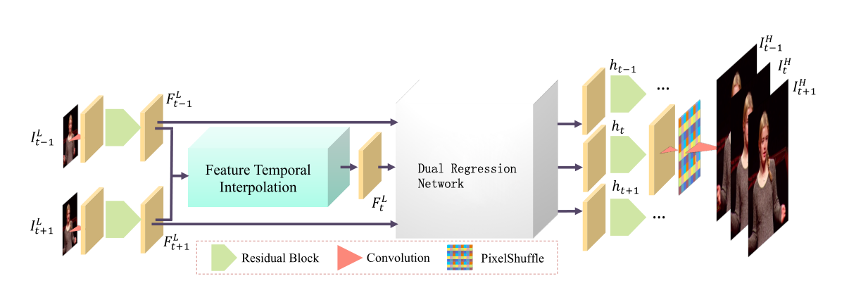
This is our solution for space-time video super-resolution.

Slide 9
Thank YOU

