Slide 1
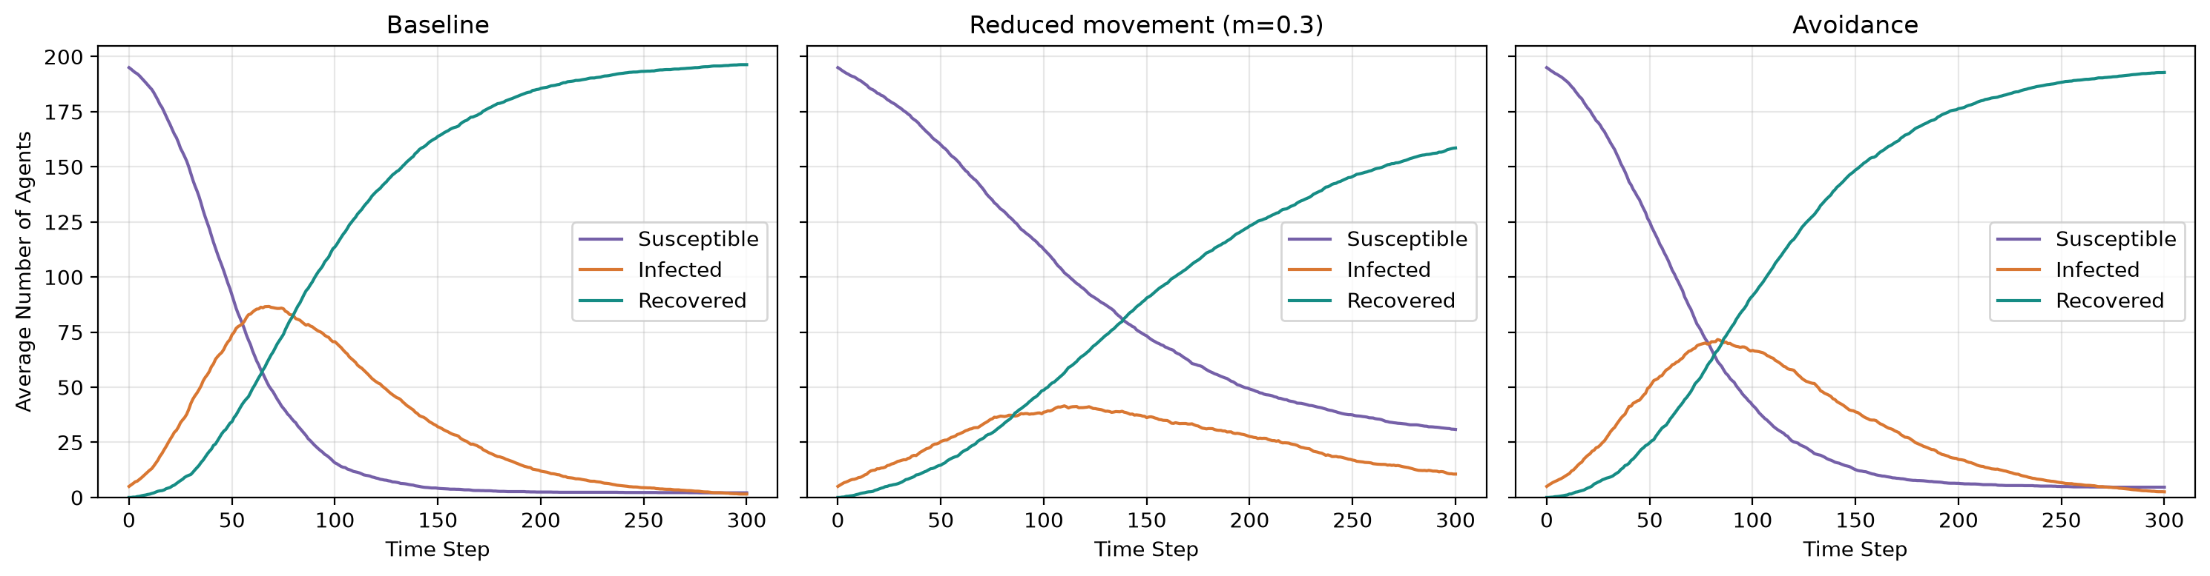
HW 2: Agent-Based Modeling of Pandemic Spread
Hypothesis: Reducing movement will lower the infection peak and delay it. Agents will meet fewer new infected individuals, but transmission is still possible in a shared cell.
Reducing movement: partly supported.
Reducing movement lowered the average number of infected agents at the peak, but did not always delay it. The latest average peak occurred at m=0.3. With stronger restrictions at m=0.1, outbreaks were smaller and peaked earlier.
Table 1: Mean peak infected and time to peak
 | Mean peak infected | Mean time to peak
Baseline | 94.7 | 71.9
Reduced movement (m=0.3) | 49.7 | 133.4
Avoidance | 79.2 | 82.2
Figure 1: Average SIR curves across 20 runs
The three plots compare the baseline, reduced movement (m=0.3), and avoidance models with p=0.3 and q=0.02. Reduced movement lowered the average peak by 47.5%, compared with 16.4% for avoidance. All 20 reduced-movement runs still had infected agents at step 300.
Peaks (agents) and peak times (steps) are calculated for each run, then averaged across 20 runs. Reduced movement delayed the mean peak from step 71.9 to 133.4. Avoidance delayed it to step 82.2.
Lesson learned from modeling
Stopping at step 300 does not mean an outbreak has ended. Some runs still had infected agents, so their final infection totals could be higher.

