Slide 1
2023 影像處理 Image Processing
Homework 1

Slide 2
Notice
The report should be written in Chinese or English and 2 pages in length at least.
The report should include the Problem 1(c), 2(c), 3, 4.
Please print it out and hand it in at the demonstration.
You could come to Office 4208 to demo at 2023/12/04 - 2023/12/08 . The schedule will be announced in advance on NCKU moodle.
Please inform the teaching assistant if you cannot attend the demonstration one week earlier.

Slide 3
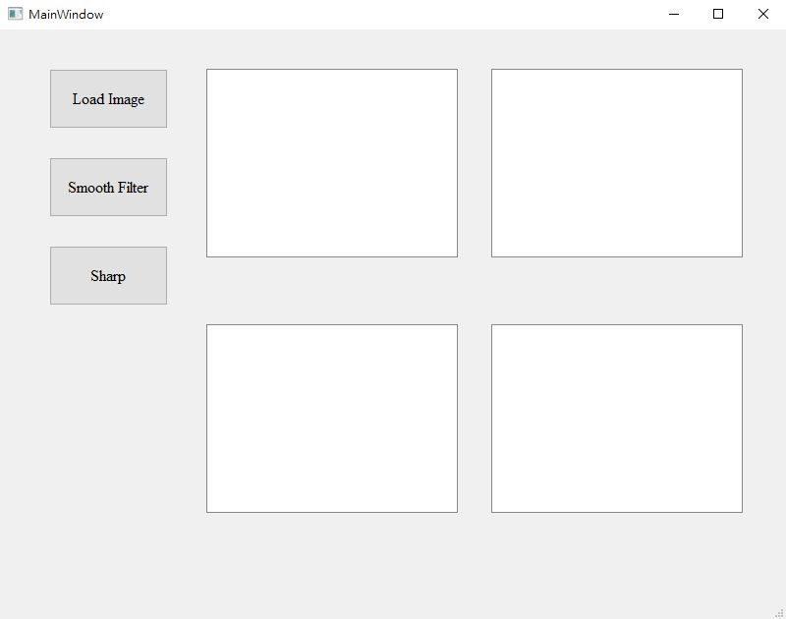
Notice
Create standalone executables from Python applications. Ensure to develop a graphical user interface (GUI) and use the provided example as a reference.
Python (recommended)
Pyinstaller
Opencv-contrib-python
Matplotlib
UI framework: pyqt5
Pillow
example
Original Image
Image
Gaussian
Lower-pass
Image
Image

Slide 4
1. Remove noise-(a)(b)
Load and show Figure1.jpg (click “Load Image”)
Display the outcome using the specified method. (click “Smooth Filter”)
Original Image
1(a) Average filter
Gaussian
Lower-pass
1(a) Median filter
1(b) Fourier transform

Slide 5
2. Sharp-(a)(b)
Load and show Figure2.jpg (click “Load Image”)
Display the outcome using the specified method. (click “Sharp”)
Original Image
No use
Gaussian
Lower-pass
2(a) Sobel mask
2(b) Fourier transform

Slide 6
3. Design a Gaussian filter of 5*5 mask
Load and show Figure1.jpg (click “Load Image”)
Display the outcome using the specified method. (click “Gaussian”)
Original Image
Result
Gaussian
Lower-pass
No use
No use

Slide 7
4. Design a lower-pass filter
Load and show Figure1.jpg (click “Load Image”)
Display the outcome using the specified method. (click “Lower-pass”)
Original Image
Result
Gaussian
Lower-pass
No use
No use

Slide 8
File Upload
 Please compress the program source code, execution file as a zip file and
upload it to FTP before 11:59 p.m. of 12/02(Sat.).
 ftp://140.116.247.97, port:102
 id: imagehw
 password: imagehw
 The format of the zip file name :
 [VS version]_[student id].zip
 e.g VS2023_P78901234.zip.
 Please add your version number if you have any new update
 e.g. VS2023_P78901234_v02.zip

Slide 9
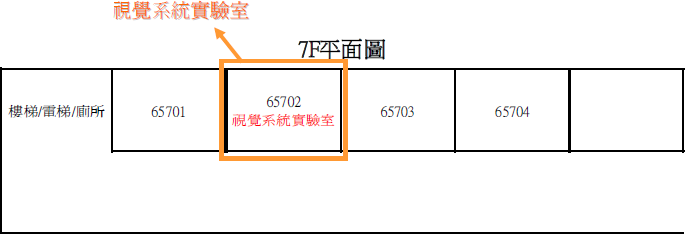
Vision System Lab (Room 65702)

Slide 10
Information
 NCKU moodle
TA :
P76111377@gs.ncku.edu.tw
P76111173@gs.ncku.edu.tw
P76111775@gs.ncku.edu.tw
P76111432@gs.ncku.edu.tw

