Slide 1
Chapter 4 IMAGE ENHANCEMENT IN THE FREQUENCY DOMAIN
Enhance: To make greater <as in value, desirability, or attractiveness>.

Slide 2
Background
Any periodic function can be expressed as the sum of sines and/or cosines of different frequencies, each multiplied by a different coefficient (Fourier series).
As an illustrated example shown in Fig. 4.1, the function at the bottom is the sum of the four functions above it.
Even functions that are not periodic can be expressed as the integral of sines and/or cosines multiplied by a weight function (Fourier transform).
We deal only with functions (images) of finite duration, so the Fourier transform is the tool in which we are interested.

Slide 3
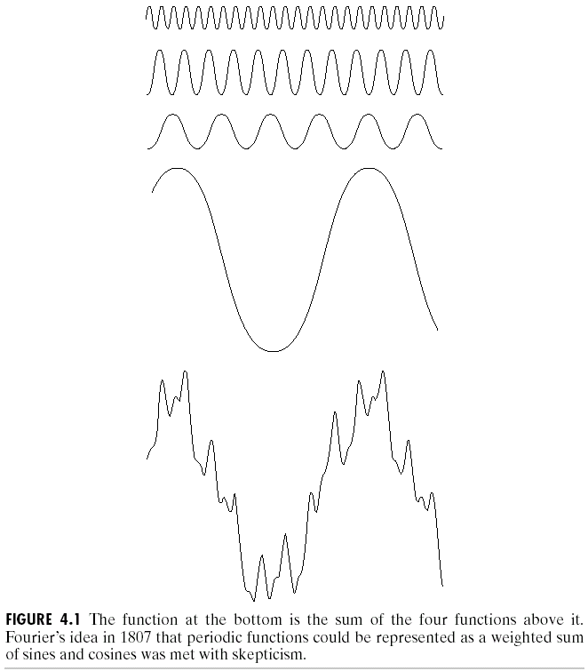

Slide 4
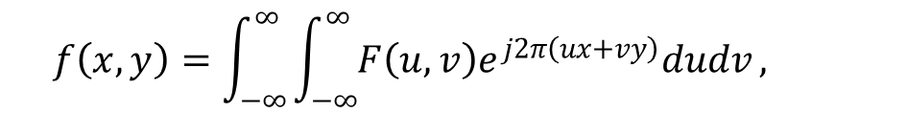

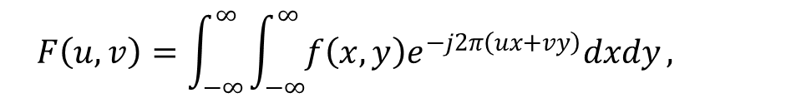
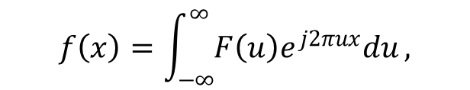
1-D Fourier Transform and Its Inverse
The Fourier transform, F(u), of a single variable, continuous function, f(x), is defined by:
(4.2-1)
where . Conversely, given F(u), we can obtain f(x) by means of the inverse Fourier transform:
(4.2-2)
The Fourier transform pair can be easily extended to two variables, u and v:
(4.2-3)
(4.2-4)
$$F\left(u\right)=\int_{−∞}^{∞}{f\left(x\right)e^{−j2πux}dx},$$
$$f\left(x\right)=\int_{−∞}^{∞}{F\left(u\right)e^{j2πux}du},$$
$$F\left(u,v\right)=\int_{−∞}^{∞}{\int_{−∞}^{∞}{f\left(x,y\right)e^{−j2π\left(ux+vy\right)}dxdy}},$$
$$f\left(x,y\right)=\int_{−∞}^{∞}{\int_{−∞}^{∞}{F\left(u,v\right)e^{j2π\left(ux+vy\right)}dudv}},$$

Slide 5
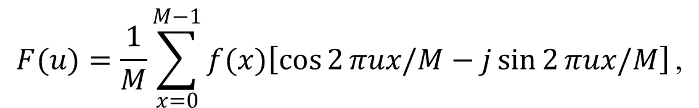
The Fourier transform of a discrete function of one variable (1-D DFT), f(x), x = 0, 1, 2, ..., M – 1, is given by:
for u = 0, 1, 2, …, M – 1. (4.2-5)
Similarly, given F(u), we can obtain the original function using the inverse DFT:
for x = 0, 1, 2, …, M – 1. (4.2-6)
It takes approximately M² summations and multiplications to compute the discrete Fourier transform (DFT).
From Euler’s formula: (4.2-7)
using the fact that , we have:
for u = 0, 1, 2, …, M – 1.
,
$$F(u)=\frac{1}{M}\sum_{x=0}^{M−1}{f(x)\left[\cos{2}πux/M−j\sin{2}πux/M\right]}\text{,}$$
(4.2-8)

Slide 6

The domain (values of u) over which the values of F(u) range is called the frequency domain. Each of the M terms of F(u) is called a frequency component of the transform.
To express F(u) in polar coordinates:
(4.2-9)
where
(4.2-10)
is called the magnitude or spectrum of the Fourier transform, and
(4.2-11)
is called the phase angle or phase spectrum of the transform.
In Eqs. (4.2-10) and (4.2-11), R(u) and I(u) are the real and imaginary(虛數) parts of F(u), respectively.
,
,
$$φ(u)=\tan^{−1}\left[\frac{I(u)}{R(u)}\right]$$
,

Slide 7
The power spectrum (or the power density) is defined as the square of the Fourier spectrum:
(4.2-12)
Fig. 4.2(a) and (c) shows two discrete functions of M points and Fig. 4.2(b) and (d) shows the corresponding Fourier spectra, respectively.
If the sampled interval is
represent M sampled values. Thus,
(4.2-13)
Similarly, the sequence for the values of u is
. Thus,
(4.2-14)
for u = 0, 1, 2, …, M – 1.
.
.
,

Slide 8
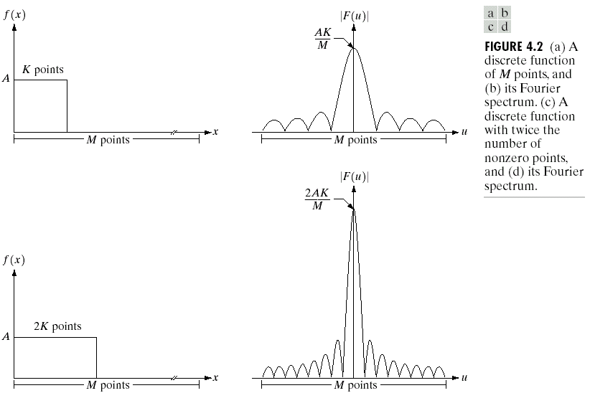
and are inversely related by:
(4.2-15)
.

Slide 9
2-D DFT and Its Inverse
The discrete Fourier transform of a function (image) f(x, y) of size M×N is given by:
(4.2-16)
where u = 0, 1, 2, …, M – 1, and also for v = 0, 1, 2, …, N – 1.
Similarly, given F(u, v), we obtain f(x, y) via the inverse Fourier transform, given by:
(4.2-17)
for x = 0, 1, 2, …, M – 1 and y = 0, 1, 2, …, N – 1.
u and v are the transform or frequency variables, whereas x and y are the spatial or image variables.

Slide 10
The Fourier spectrum, phase angle, and power spectrum are defined, respectively, as:
(4.2-18)
(4.2-19)
(4.2-20)
where R(u, v) and I(u, v) are the real and imaginary parts of F(u, v), respectively.
Due to the properties of exponentials, it is not difficult to show that:
(4.2-21)
where denotes the Fourier transform of the argument.
Multiplying f(x, y) by (-1)^{x+y} shifts the origin of F(u, v) from (0, 0) to frequency coordinates (M/2, N/2), which is the center of the M×N area occupied by the 2-D DFT.
,
,
,
,

Slide 11
The value of the transform at (u, v) = (0, 0) is, from Eq. (4.2-16),
(4.2-22)
which is the average of f(x, y) or the dc (direct current) component of the spectrum.
If f(x, y) is real, its Fourier transform is conjugate symmetric, i.e.,
(4.2-23)
where “*” indicates the standard conjugate operation on a complex number. And
(4.2-24)
i.e., the spectrum of the Fourier transform is symmetric.
,

Slide 12


In the 1-D case, we have the following relationships between samples in the spatial and frequency domains:
$$Δu=\frac{1}{MΔx},$$
(4.2-25)
$$Δv=\frac{1}{NΔy}.$$
(4.2-26)

Slide 13
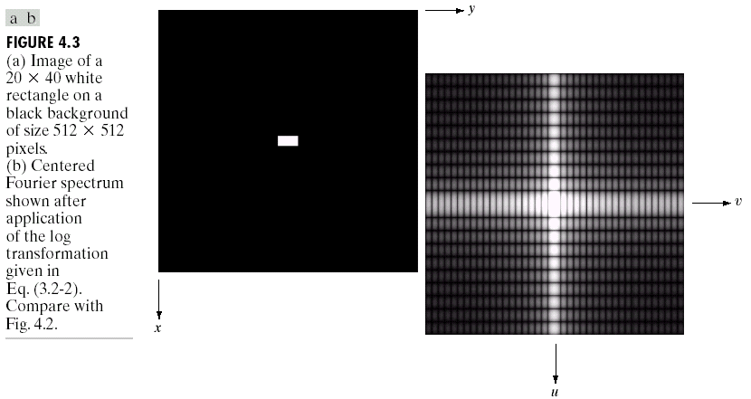
Fig. 4.3(a) shows a white rectangle of size 20 × 40 superimposed on a background of size 512 × 512. Centered Fourier spectrum (multiplied by (-1)^{x+y}) after application of the log transformation (Eq. (3.2-2)) is shown in Fig. 4.3(b).

Slide 14
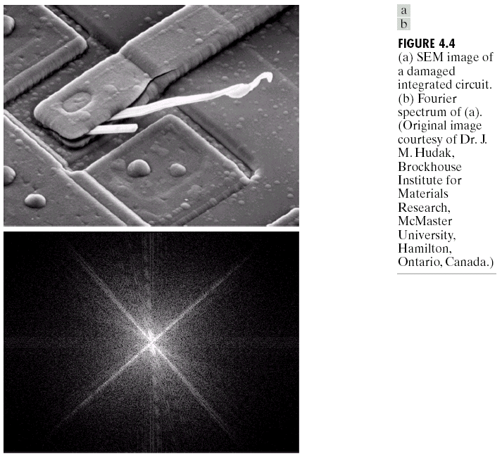
Filtering in the Frequency Domain
Fig. 4.4(a) shows an SEM image of a damaged IC and Fig. 4.4(b) shows the corresponding Fourier spectrum.

Slide 15
Basics of filtering in the frequency domain
1. Multiply the input image by (-1)^{x+y} to center the transform, as indicated in Eq. (4.2-21).
2. Compute F(u, v), the DFT of the image from (1).
3. Multiply F(u, v) by a filter function H(u, v).
4. Compute the inverse DFT of the result in (3).
5. Obtain the real part of the result in (4).
6. Multiply the result in (5) by (-1)^{x+y}.
H(u, v) is called a filter (or filter transfer function) because it suppresses certain frequencies in the transform while leaving others unchanged.

Slide 16


If f(x, y) represent the input image in Step 1 and F(u, v) its Fourier transform, the Fourier transform of the output image is given by:
(4.2-27)
The filtered image is obtained simply by taking the inverse Fourier transform of G(u, v):
Filtered Image = (4.2-28)
The filtering procedure is summarized in Fig. 4.5.
$$G(u,v)=H(u,v)F(u,v).$$
$$ℑ^{−1}\left[G\left(u,v\right)\right].$$

Slide 17
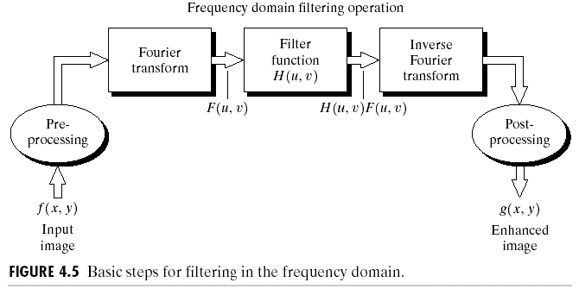

Slide 18
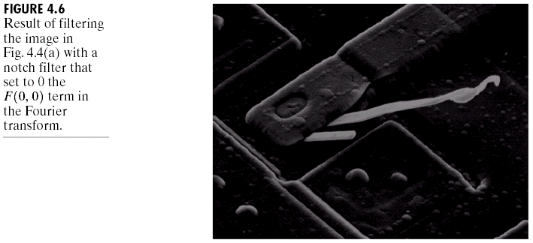
Some Basic Filters and Their Properties
To force the average value of an image to zero, we can multiply all values of F(u, v) by the filter function:
(4.2-29)
This type of filter is called a notch filter because it is a constant function with a hole (notch) at the origin.
The result of processing the image in Fig. 4.4(a) with this notch filter (set H(0,0) = 0) is shown in Fig. 4.6.
,
,
,

Slide 19
In the Fourier transform domain, low frequencies are responsible for the general gray-level appearance of an image over smooth areas, while high frequencies are responsible for detail, such as edges and noise.
A lowpass filter attenuates high frequencies while “passing” low frequencies.
A highpass filter, a bandpass filter, and a band reject filter can be similarly defined.
Fig. 4.7(a) and (c) shows the 2-D lowpass and highpass filters, while Fig. 4.7(b) and (c) shows the results of processing the image in Fig. 4.4(a) with the 2-D filters, respectively.

Slide 20
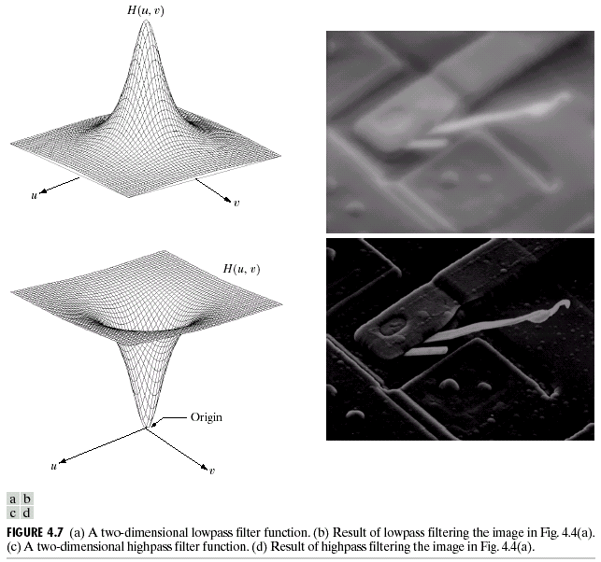

Slide 21
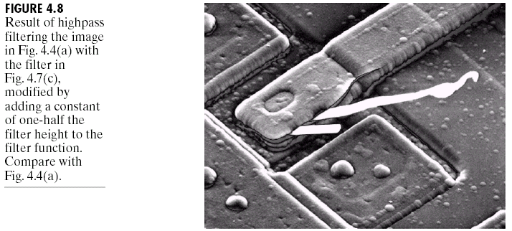
Fig. 4.8 shows the result by using the filter in Fig. 4.7(c) with some modifications (offsets).

Slide 22
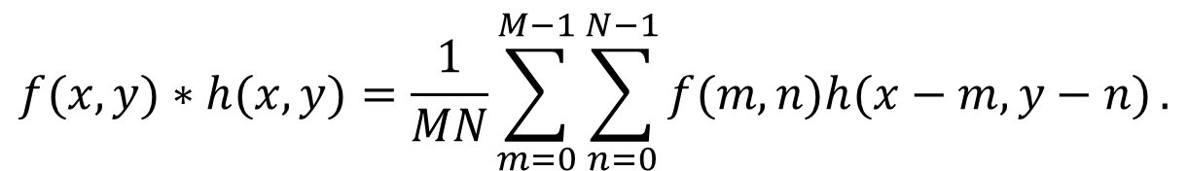
Correspondence Between Filtering in the Spatial and Frequency Domains
The convolution theorem:
The discrete convolution of two functions f(x, y) and h(x, y) of size M×N is denoted by f(x, y)*h(x, y) and is defined by:
(4.2-30)
Three steps to implement
(1) flipping one function about the origin;
(2) shifting that function with respect to the other by changing the values of (x, y);
(3) computing a sum of products over all values of m and n, for each displacement (x, y).
$$f(x,y)∗h(x,y)=\frac{1}{MN}\sum_{m=0}^{M−1}{\sum_{n=0}^{N−1}{f(m,n)h(x−m,y−n)}}.$$

Slide 23
Let F(u, v) and H(u, v) denote the Fourier transforms of f(x, y) and h(x, y), respectively. Then f(x, y)*h(x, y) and F(u, v)H(u, v) constitute a Fourier transform pair, i.e.,
(4.2-31)
Similarly, f(x, y)h(x, y) and F(u, v)*H(u, v) also constitute a Fourier transform pair, i.e.,
(4.2-32)
An impulse function of strength A, located at coordinates (x₀, y₀), is deonted by and is defined by:
(4.2-33)
That is, the summation of a function s(x, y) multiplied by an impulse is simply the value of the function at the location of the impulse, multiplied by the strength of the impulse.
.

Slide 24
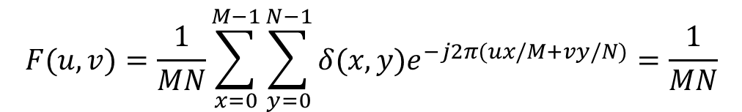
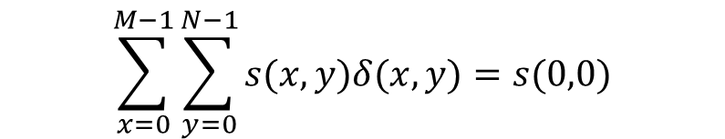
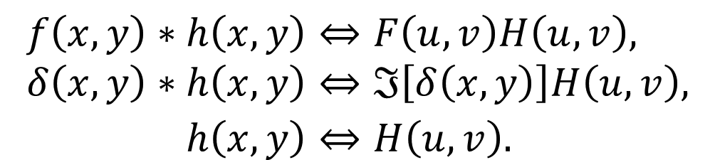
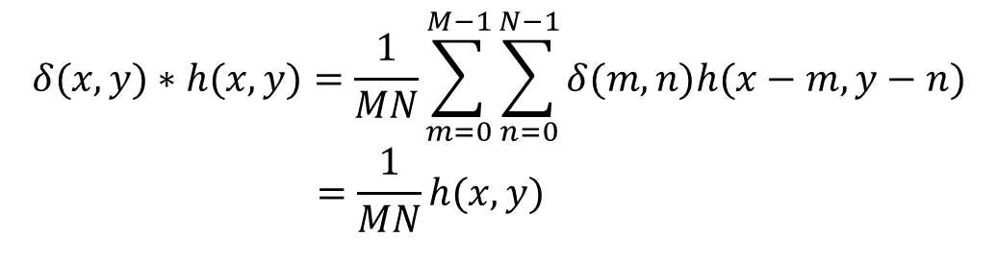
Convolution of a function with an impulse “copies” the value of that function at the location of the impulse.
(4.2-34)
(4.2-35)
(4.2-36)
Combining Eqs. (4.2-35) and (4.2-36) with Eq. (4.2-31), we have:
(4.2-37)
$$\sum_{x=0}^{M−1}{\sum_{y=0}^{N−1}{s(x,y)δ(x,y)=s(0,0)}}$$
$$F(u,v)=\frac{1}{MN}\sum_{x=0}^{M−1}{\sum_{y=0}^{N−1}{δ(x,y)e^{−j2π(ux/M+vy/N)}}}=\frac{1}{MN}$$
$$δ(x,y)∗h(x,y)=\frac{1}{MN}\sum_{m=0}^{M−1}{\sum_{n=0}^{N−1}{δ(m,n)h(x−m,y−n)}} \\ =\frac{1}{MN}h(x,y)$$
$$f\left(x,y\right)∗h\left(x,y\right)⇔F\left(u,v\right)H\left(u,v\right), \\ δ\left(x,y\right)∗h\left(x,y\right)⇔ℑ\left[δ\left(x,y\right)\right]H\left(u,v\right), \\ h\left(x,y\right)⇔H\left(u,v\right).$$

Slide 25
Gaussian Filters
Let H(u) and h(x) denote the Gaussian filter function in the frequency and spatial domains. Then
(4.2-38)
(4.2-39)
where σ is the standard deviation of the Gaussian curve.
Two important characteristics:
(1) They constitute a Fourier transform pair, both components of which are Gaussian and real.
(2) These functions behave reciprocally with respect to one another. When H(u) has a broad profile (large value of σ), h(x) has a narrow profile, and vice versa. When σ approaches infinity, H(u) tends toward a constant function and h(x) tends toward an impulse.
,

Slide 26
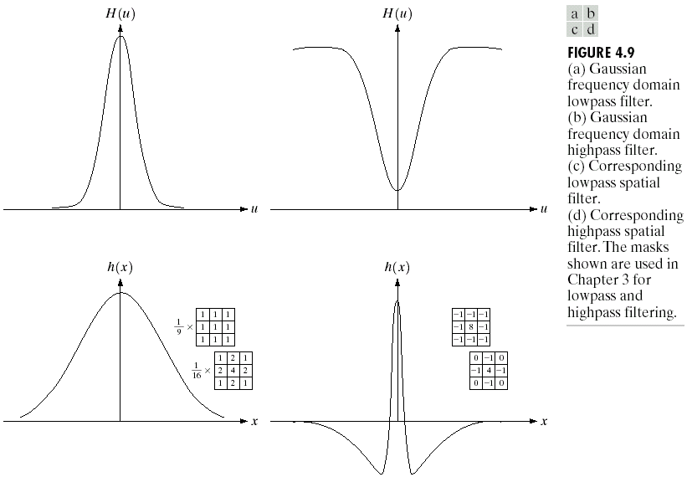
Fig. 4.9(a) and (b) shows two Gaussian filter functions in the frequency domain and Fig. 4.9(c) and (d) shows the corresponding Gaussian filter functions in the spatial domain.

Slide 27
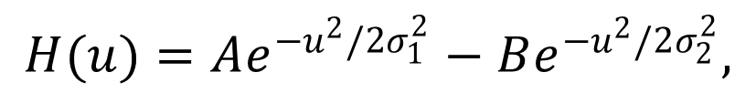
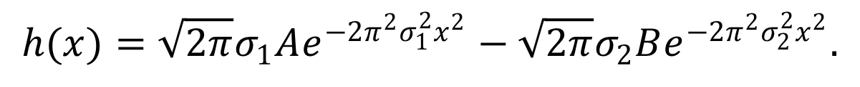
`1
We can construct a highpass filter as a difference of Gaussians (Fig. 4.9(b)):
(4.2-40)
with A ≥ B and . The corresponding filter in the spatial domain is (Fig. 4.9(d)):
(4.2-41)
$$H(u)=Ae^{−u^{2}/2σ_{1}^{2}}−Be^{−u^{2}/2σ_{2}^{2}},$$
$$h(x)=\sqrt{2π}σ_{1}Ae^{−2π^{2}σ_{1}^{2}x^{2}}−\sqrt{2π}σ_{2}Be^{−2π^{2}σ_{2}^{2}x^{2}}.$$

Slide 28

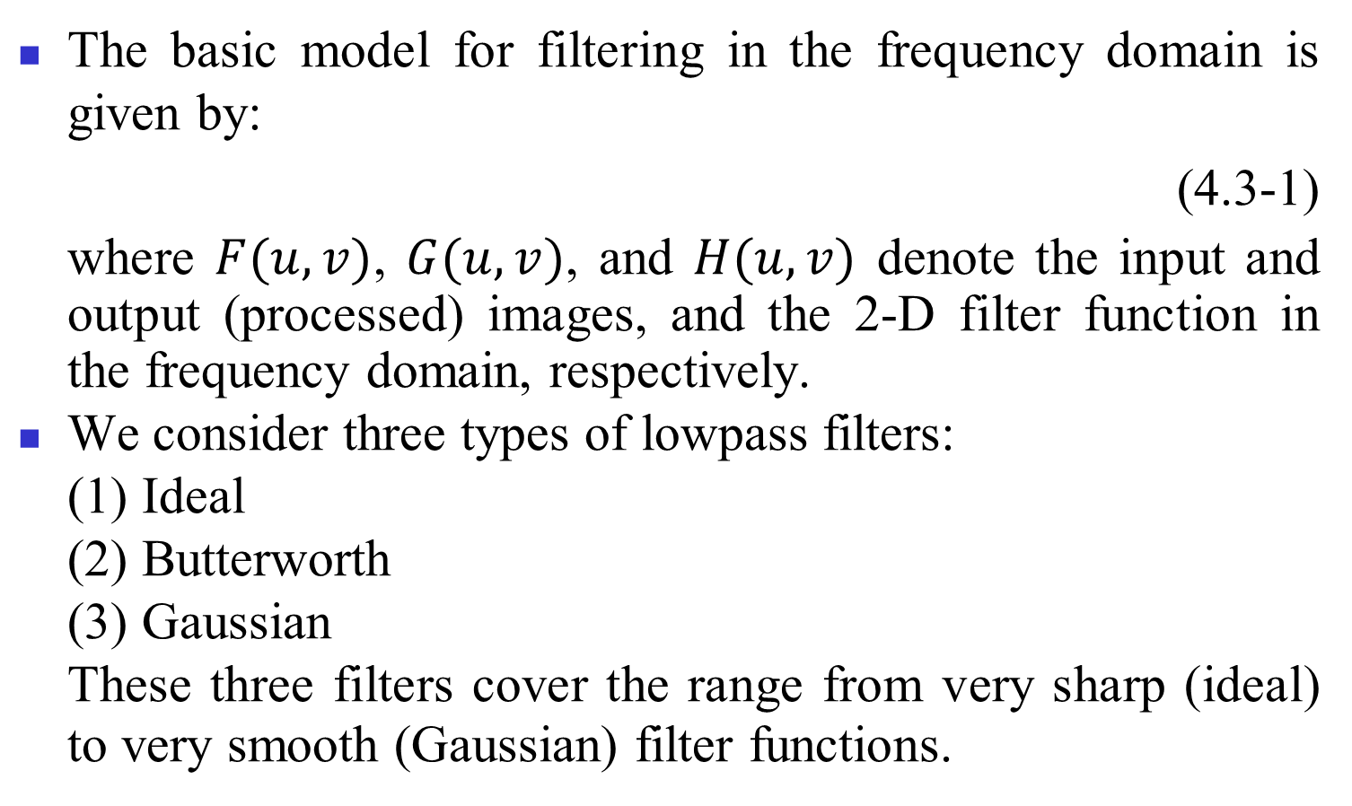
Smoothing Frequency-Domain Filters
The basic model for filtering in the frequency domain is given by:
(4.3-1)
where $F(u, v)$, $G(u, v)$, and $H(u, v)$ denote the input and output (processed) images, and the 2-D filter function in the frequency domain, respectively.
We consider three types of lowpass filters:
(1) Ideal
(2) Butterworth
(3) Gaussian
These three filters cover the range from very sharp (ideal) to very smooth (Gaussian) filter functions.
$$G(u,v)=H(u,v)F(u,v)$$

Slide 29
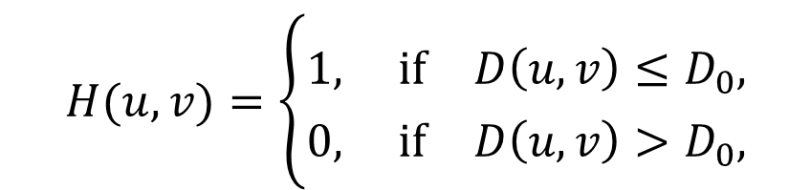
Ideal Lowpass Filters
A 2-D ideal lowpass filter (ILPF) has the transfer function:
(4.3-2)
where D₀ is a specified nonnegative quantity, and D(u, v) is the distance from point (u, v) to the center of the frequency rectangle.
If the image is of size M×N, the center of the frequency rectangle is at (u, v) = (M/2, N/2). The distance from any point (u, v) to the center (origin) of the Fourier transform is:
(4.3-3)
$$H(u,v)=\left\{\begin{aligned}1, \text{if} D\left(u,v\right)≤D_{0}, \\ 0, \text{if} D\left(u,v\right)>D_{0},\end{aligned}\right.$$
$$D(u,v)=[(u−M/2)^{2}+(v−N/2)^{2}]^{1/2}.$$

Slide 30
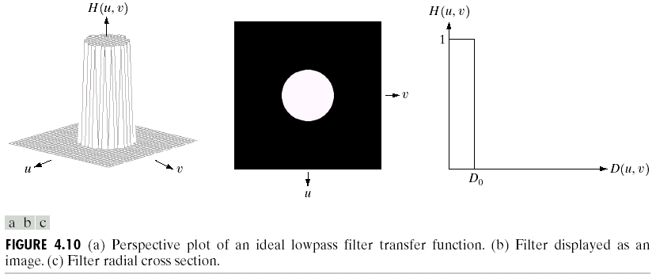
Fig. 4.10(a) shows a 3-D perspective plot of H(u, v), Fig. 4.10(b) shows H(u, v) displayed as an image, and Fig. 4.10(c) shows filter radial cross section.
For an ideal lowpass filter cross section, the point of transition between H(u, v) = 1 and H(u, v) = 0 is called the cutoff frequency.

Slide 31
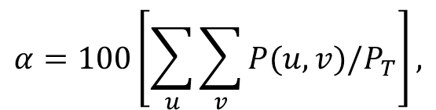

Ideal lowpass filters are not physically realizable with electronic componets.
One way to establish a set of standard cutoff frequency loci is to compute circles that enclose specified amounts of total image power P_{T}. This quantity is obtained by summing the components of the power spectrum at each point (u, v), for u = 0, 1, 2, …, M – 1 and v = 0, 1, 2, …, N – 1:
(4.3-4)
where P(u, v) is given in Eq. (4.2-20).
If the transform has been centered, a circle of radius r with origin at the center of the frequency rectangle encloses α percent of the power, where
(4.3-5)
and the summation is taken over the values of (u, v) that lie inside the circle or on its boundary.
$$P_{T}=\sum_{u=0}^{M−1}{\sum_{v=0}^{N−1}{P(u,v)},}$$
$$α=100\left[\sum_{u}{\sum_{v}{P(u,v)/P_{T}}}\right],$$

Slide 32
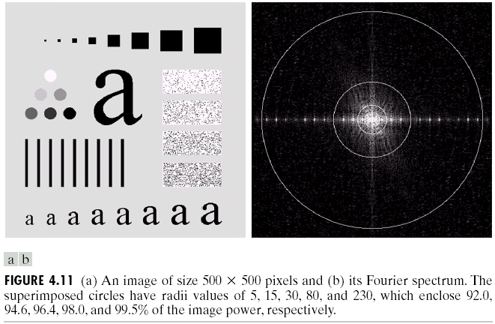
Fig. 4.11(a) shows the test pattern and Fig. 4.11(b) shows its Fourier spectrum.
Fig. 4.12 shows the results of applying ideal lowpass filters with cutoff frequencies at the radii shown in Fig. 4.11(b).

Slide 33
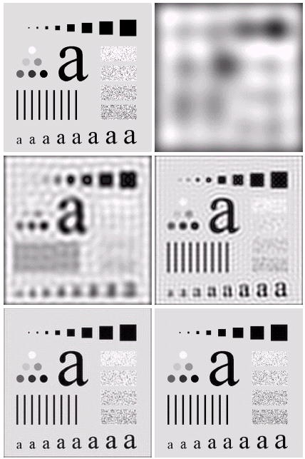


Slide 34
The original image, the blurred image, and the filter function are denoted by f(x, y) or F(u, v), g(x, y) or G(u, v), and h(x, y) or H(u, v), respectively. Then
The spatial filter function h(x, y) can be obtained by:
(1) H(u, v) was multiplied by (-1)^{u+v} for centering;
(2) this was followed by the inverse DFT;
(3) the real part of the inverse DFT was multiplied by (-1)^{x+y}.
Fig. 4.13(b) shows the result of this process.
If f(x, y) is a simple image composed of 5 bright pixels on a black background (Fig. 4.13(c)). The result of this operation is shown in Fig. 4.13(d).

Slide 35
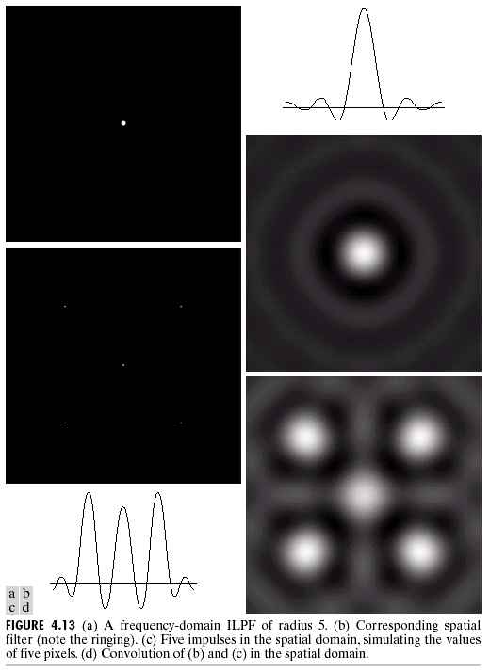

Slide 36
Butterworth Lowpass Filters
The transfer function of a Butterworth lowpass filter (BLPF) of order n, and with cutoff frequency at a distance D₀ from the origin, is defined as
(4.3-6)
where
(4.3-3)
A perspective plot, image display, and radial cross sections of the BLPF function are shown in Fig. 4.14.
Note that H(u, v) = 0.5 when D(u, v) = D₀.
,

Slide 37
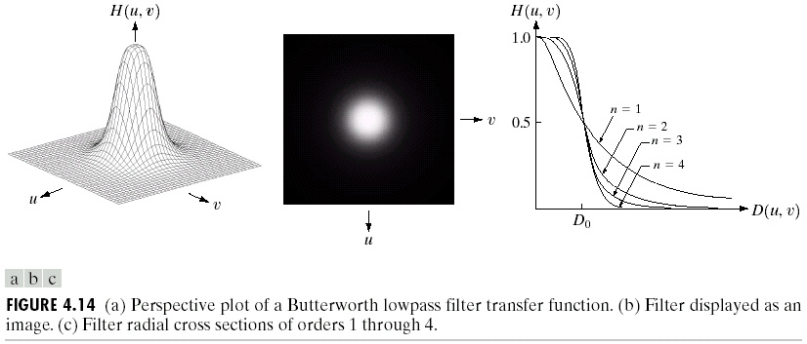

Slide 38
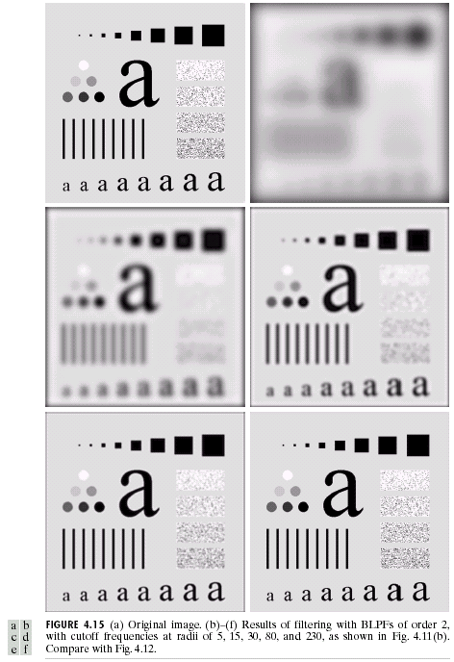
Fig. 4.15 shows the results of applying the BLPF of Eq. (4.3-6) to Fig. 4.15(a) with n = 2 and D₀ equal to the five radii shown in Fig. 4.11(b).

Slide 39
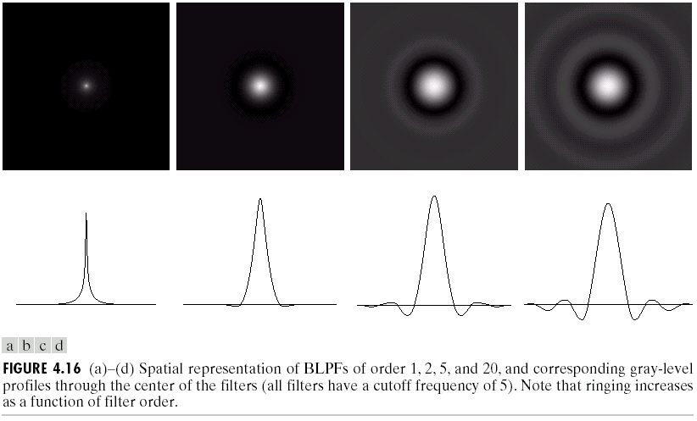
A Butterworth filter of order 1 has no ringing. Ringing generally is imperceptible in filters of order 2, but become a significant factor in filters of higher order.
Fig. 4.16 shows a comparison between the spatial representations of BLPFs of various orders.
BLPFs of order 2 are a good compromise between effective lowpass filtering and acceptable ringing characteristics.

Slide 40
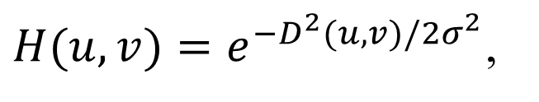
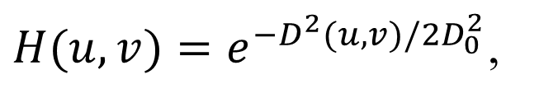
Gaussian Lowpass Filters
Gaussian lowpass filters in 2-D are:
(4.3-7)
where D(u, v) is the distance from the origin of the Fourier transform, i.e.,
(4.3-3)
σ is a measure of the spread of the Gaussian curve.
If σ is D₀, we have:
(4.3-8)
where D₀ is the cutoff frequency. When D(u, v) = D₀, the filter is down to 0.607 of its maximum value.
$H(u,v)=e^{−D^{2}(u,v)/2σ^{2}}$,
$H(u,v)=e^{−D^{2}(u,v)/2D_{0}^{2}}$,

Slide 41
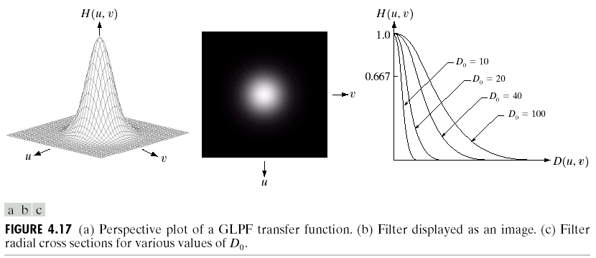
A perspective plot, image display, and radial cross sections of a GLPF function are shown in Fig. 4.17.

Slide 42
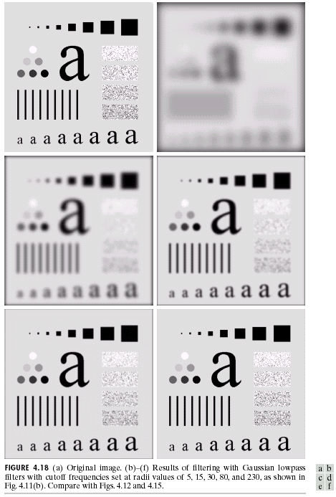
Fig. 4.18 shows the results of applying the GLPF of Eq. (4.3-8) to Fig. 4.18(a) with D₀ being equal to the five radii shown in Fig. 4.11(b).

Slide 43
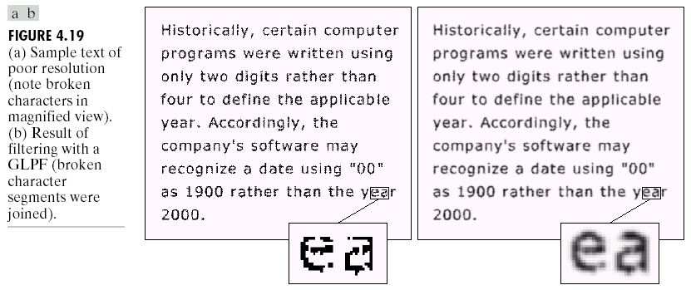
Additional Lowpass Filtering Examples
Fig. 4.19(a) shows a sample of text of poor resolution and Fig. 4.19(b) shows the corresponding processed image by using a Gaussian lowpass filter with D₀ = 80.

Slide 44
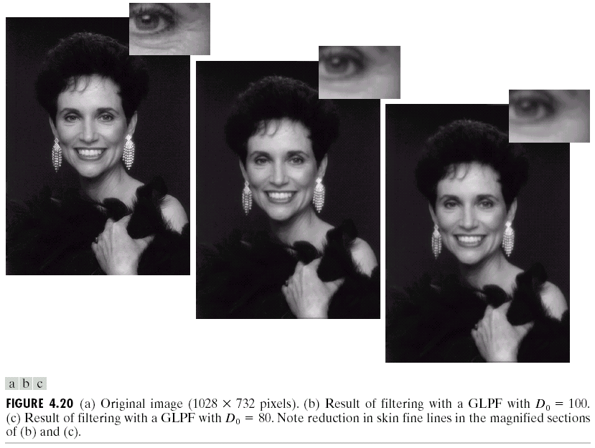
Fig. 4.20 shows an application of lowpass filtering to produce a smoother, soft-looking result from a sharp original.

Slide 45
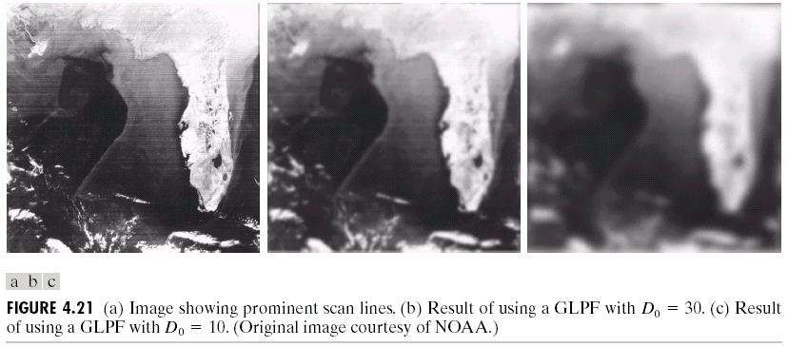
Fig. 4.21 shows two applications of lowpass filtering on the same image, but with totally different objectives.
Fig. 4.21(b) shows the result of reducing pronounced scan lines, whereas Fig. 4.21(c) shows the result of blurring out as much detail as possible, leaving large features recognizable.

Slide 46

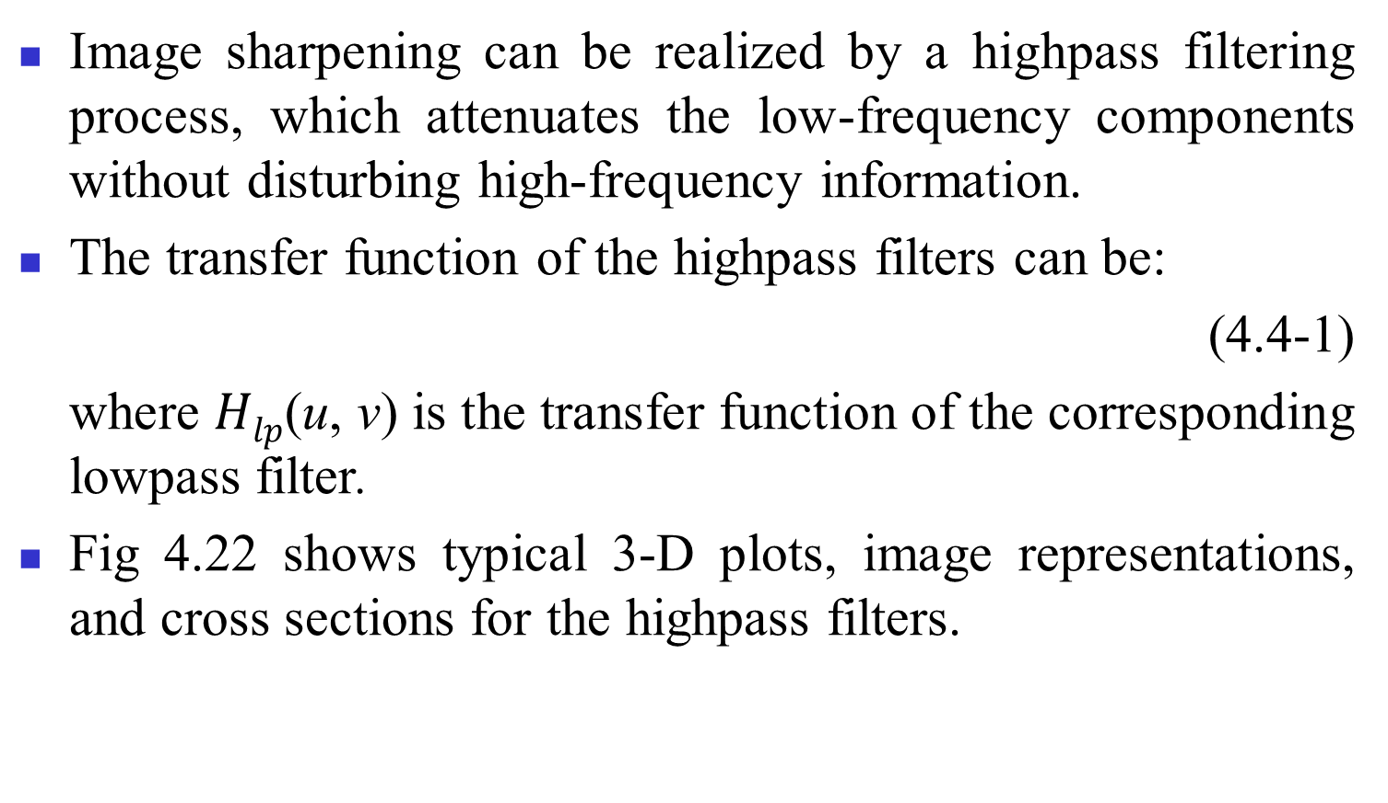
Frequency Domain Sharpening Filters
Image sharpening can be realized by a highpass filtering process, which attenuates the low-frequency components without disturbing high-frequency information.
The transfer function of the highpass filters can be:
(4.4-1)
where $Hlp$(u, v) is the transfer function of the corresponding lowpass filter.
Fig 4.22 shows typical 3-D plots, image representations, and cross sections for the highpass filters.
$$H_{hp}\left(u,v\right)=1−H_{lp}\left(u,v\right),$$

Slide 47
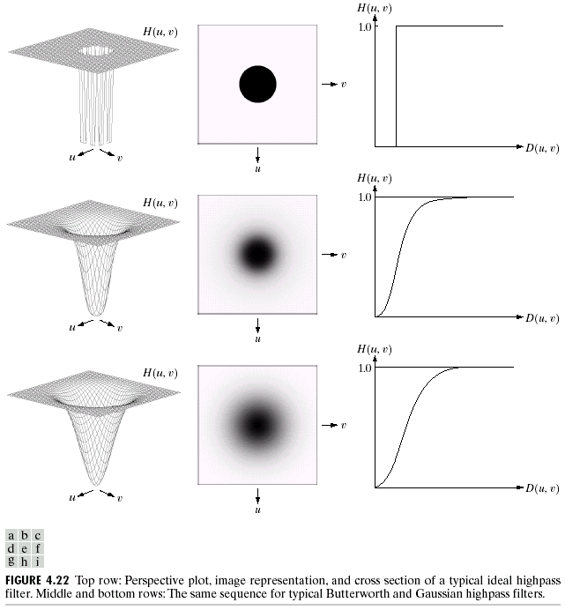

Slide 48
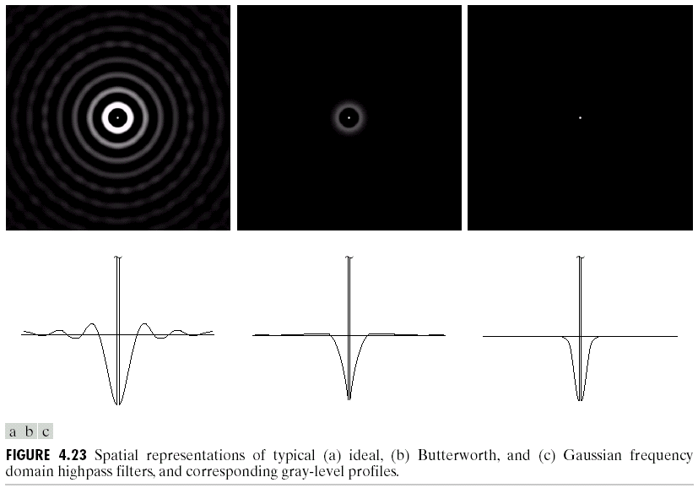
Fig. 4.23 illustrates what the highpass filters look like in the spatial domain.

Slide 49
Ideal Highpass Filters
A 2-D ideal highpass filter (IHPF) is defined as:
(4.4-2)
where D₀ is the cutoff distance measured from the origin of the frequency rectangle, and D(u, v) is given in Eq. (4.3-3).
Ideal highpass filters are not physically realizable with electronic components.
,
,
,
,

Slide 50
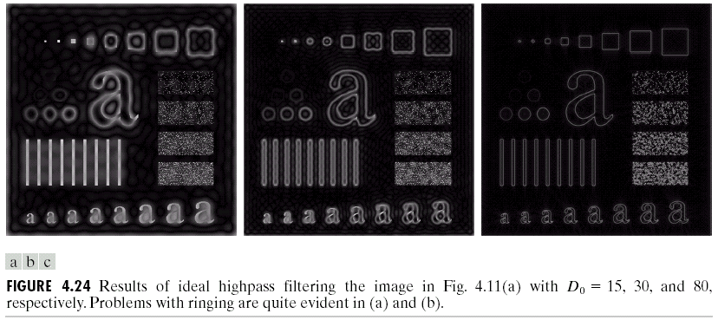
Fig. 4.24 shows the results of applying ideal highpass filters with D₀ = 15, 30, and 80, respectively. The ringing effect is evident in Fig. 4.24(a) and (b).

Slide 51
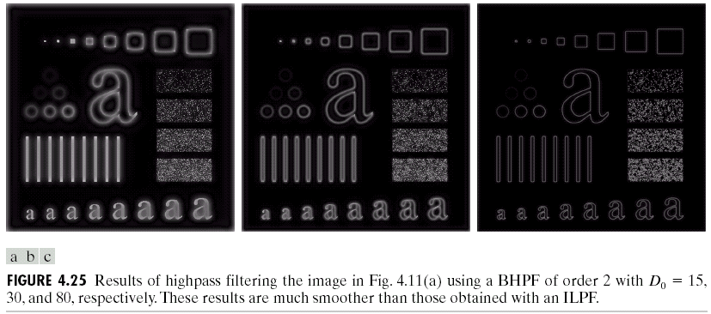
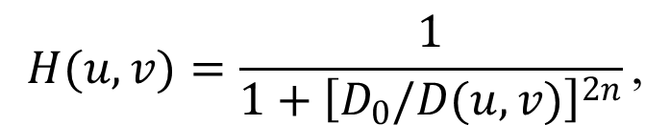
Butterworth Highpass Filters (BHPF)
The transfer function of the Butterworth highpass filter (BHPF) of order n and with cutoff frequency locus at a distance D₀ from the origin is given by:
(4.4-3)
where D(u, v) is given in Eq. (4.3-3).
The performance of a BHPF of order 2 and with D₀ set to the same values as in Fig. 4.24 is shown in Fig. 4.25.
$$H(u,v)=\frac{1}{1+{\left[D_{0}/D(u,v)\right]}^{2n}}\text{,}$$

Slide 52
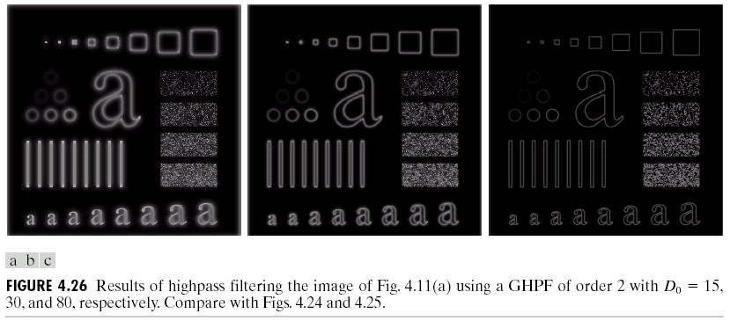
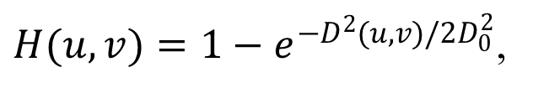
Gaussian Highpass Filters (GHPF)
The transfer function of the Gaussian highpass filter (GHPF) with cutoff frequency locus at a distance D₀ from the origin is given by:
(4.4-4)
where D(u, v) is given in Eq. (4.3-3).
Fig. 4.26 shows the comparable results using GHPFs of order 2 and with D₀ = 15, 30, and 80, respectively.
$H(u,v)=1−e^{−D^{2}(u,v)/2D_{0}^{2}}$,

Slide 53


The Laplacian in the Frequency Domain
Because
(4.4-5)
(4.4-6)
The Laplacian of f(x, y) has the result:
(4.4-7)
i.e., the Laplacian can be implemented in the frequency domain by using the filter:
(4.4-8)
$$ℑ\left[∇^{2}f(x,y)\right]=−4π^{2}(u^{2}+v^{2})F(u,v),$$
$$H(u,v)=−4π^{2}(u^{2}+v^{2}).$$

Slide 54
As before, the center of the filter function should be shifted:
(4.4-9)
The Laplacian-filtered image in the spatial domain is obtained by computing the inverse Fourier transform of H(u, v)F(u, v):
(4.4-10)
We express this dual relationship in the familiar Fourier-transform-pair notation:
(4.4-11)
Fig. 4.27(a) and (b) shows the 3-D plot of the Laplacian in the frequency domain and its image representation. Fig. 4.27(c)~(e) shows the Laplacian in the spatial domain, the zoomed section of the origin of (c), and the gray-level profile through the center of (d). Fig. 4.27(f) shows the Laplacian mask used.

Slide 55
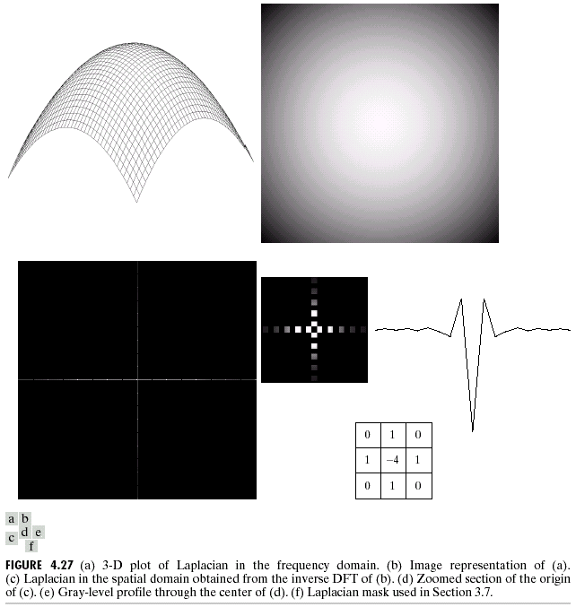

Slide 56
We can form an enhanced image g(x, y) by subtracting the Laplacian from the original image:
(4.4-12)
which can be performed by one filter:
➔ The enhanced image can be obtained with a single inverse transform operation:
(4.4-13)
Fig. 4.28(b) shows the result of filtering the image in Fig. 4.28(a) in the frequency domain using Eq. (4.4-10). Fig. 4.28(c) shows the level-shifted image (0~255). Fig. 4.28(d) shows the enhanced result obtained using Eq. (4.4-12).
$$H(u,v)=\left[1+{4π}^{2}\left[(u−M/2)^{2}+(v−N/2)^{2}\right]\right] .$$
$$g(x,y)=ℑ^{−1}\left\{\left[1+{4π}^{2}\left((u−M/2)^{2}+(v−N/2)^{2}\right)\right]F(u,v)\right\}$$

Slide 57


Slide 58






Unsharp Masking, High-Boost Filtering, and High-Frequency Emphasis Filtering
Unsharp masking consists of generating a sharp image by subtracting from an image a blurred version of itself, i.e.,
(4.4-14)
High-boost filtering generalizes this by multiplying f(x, y) by a constant A ≥ 1:
(4.4-15)
(4.4-16)
(4.4-17)
From Eq. (4.4-14), $F_{hp}$(u, v) = F(u, v) – $F_{lp}$(u, v). But, $F_{lp}$(u, v) =$H_{lp}$(u, v)F(u, v), where $H_{lp}$ is the transfer function of a lowpass filter. Therefore,
(4.4-18)
$$f_{hp}(x,y)=f(x,y)−f_{lp} (x,y).$$
$$f_{hb}(x,y)=Af(x,y)−f_{lp} (x,y)$$
$$=(A−1)f(x,y)+f(x,y)−f_{lp} (x,y)$$
$$=(A−1)f(x,y)+f_{hp} (x,y).$$
$$H_{hp}(u,v)=1−H_{lp}(u,v).$$

Slide 59


Similarly, high-boost filtering is:
(4.4-19)
with A ≥ 1.
Fig. 4.29(a), (b), (c), and (d) shows the input image, the highpass-filtered image, and the two high-boost-filtered images using Eq. (4.4-17) with A = 2 and A = 2.7, respectively.
High-frequency emphasis has a filter transfer function given by:
(4.4-20)
where a ≥ 1 and b > a.
$H_{hb}\left(u,v\right)=\left(A−1\right)+H_{hp}\left(u,v\right)$,
$H_{hfe}\left(u,v\right)=a+bH_{hp}\left(u,v\right)$,

Slide 60


Slide 61

Fig. 4.30(a) shows a chest X-ray image with a narrow range of gray levels. Fig. 4.30(b) shows the highpass filtering result using a Butterworth filter of order 2 and D₀ = 5% of the image vertical dimension. Fig. 4.30(c) and (d) shows the result of high-frequency emphasis filtering and its histogram-equalized image result.

Slide 62





Homomorphic Filtering
An image f(x, y) can be expressed as the product of illumination and reflectance components:
(4.5-1)
However,
Suppose we define:
(4.5-2)
then
(4.5-3)
or
(4.5-4)
where F_{i}(u, v) and F_{r}(u, v) are the Foruier transforms of
ln i(x, y) and ln r(x, y), respectively.
$$f(x,y)=i(x,y)r(x,y).$$
$$ℑ\left\{f(x,y)\right\}≠ℑ\left\{i(x,y)\right\}ℑ\left\{r(x,y)\right\}.$$
$$z(x,y)=\ln{f}(x,y) \\ =\ln{i}\left(x,y\right)+\ln{r}\left(x,y\right),$$
$$ℑ\left\{z(x,y)\right\}=ℑ\left\{\ln{f}(x,y)\right\} \\ =ℑ\left\{\ln{i}(x,y)\right\}+ℑ\left\{\ln{r}(x,y)\right\},$$
$$Ζ(u,v)=F_{i}(u,v)+F_{r}(u,v)$$
,

Slide 63





If we process $Z(u, v)$by means of a filter function $H(u, v)$, then
(4.5-5)
where $S(u,v)$ is the Fourier transform of the result. In the spatial domain,
(4.5-6)
By letting
(4.5-7)
(4.5-8)
Eq. (4.5-6) can be expressed in the form
(4.5-9)
$$S(u,v)=H(u,v)Z(u,v) \\ =H\left(u,v\right)F_{i}\left(u,v\right)+H\left(u,v\right)F_{r}\left(u,v\right),$$
$$s(x,y)=ℑ^{−1}\left\{S(u,v)\right\} =ℑ^{−1}\left\{H(u,v)F_{i}(u,v)\right\}+ℑ^{−1}\left\{H(u,v)F_{r}(u,v)\right\}.$$
$$i^{′}\left(x,y\right)=ℑ^{−1}\left\{H\left(u,v\right)F_{i}\left(u,v\right)\right\},$$
$$r^{′}\left(x,y\right)=ℑ^{−1}\left\{H\left(u,v\right)F_{r}\left(u,v\right)\right\}.$$
$$s(x,y)=i^{′}(x,y)+r^{′}(x,y).$$

Slide 64



As z(x, y) was formed by taking the logarithm of the original image f(x, y), the inverse (exponential) operation yields the desired enhanced image, denoted by g(x, y), i.e.,
(4.5-10)
where
(4.5-11)
(4.5-12)
are the illumination and reflectance components of the output image.
$$g(x,y)=e^{s(x,y)} \\ =e^{i^{′}(x,y)}⋅e^{r^{′}(x,y)} \\ =i_{0}\left(x,y\right)r_{0}\left(x,y\right),$$
$$i_{0}\left(x,y\right)=e^{i^{′}\left(x,y\right)},$$
$$r_{0}\left(x,y\right)=e^{r^{′}\left(x,y\right)},$$

Slide 65

The enhancement approach using the foregoing concepts is summarized in Fig. 4.31, which is known as homomorphic systems.
The illumination component of an image generally is characterized by slow spatial variations, while the reflectance component tends to vary abruptly, particularly at the junctions of dissimilar objects.
The homomorphic filter function H(u, v) can operate on the illumination and reflectance components seperately (as shown in Eq. (4.5-5)).

Slide 66

Fig. 4.32 shows a cross section of a homomorphic filter, where r_{L} < 1 and r_{H} > 1. The net result is simultaneous dynamic range compression and contrast enhancement.

Slide 67

The curve shape in Fig. 4.32 can be approximated by a modified form of the Gaussian highpass filter:
(4.5-13)
where D²(u, v) is given in Eq. (4.3-3) and the constant c is used to control the sharpness of the slope of the filter function as it transitions between and .
Fig. 4.33 shows the results of applying the homomorphic filtering function in Fig. 4.32 with = 0.5 and = 2.0.
,

Slide 68
Some Additional Properties of 2-D Fourier Transform
Translation
The Fourier transform pair has the following translation properties:
(4.6-1)
(4.6-2)
When u₀ = M/2 and v₀ = N/2, it follows that
➔ Eq. (4.6-1) becomes
(4.6-3)
Similarly,
(4.6-4)

Slide 69




Distributivity and Scaling
By definition:
(4.6-5)
In general:
(4.6-6)
For two scalars $a$ and $b$:
(4.6-7)
(4.6-8)
Rotation
If we introduce the polar coordinates:
$f(x, y)$and $F(u, v)$ become $f(r,θ)$ and $F(ω,φ)$, respectively, and
(4.6-9)
$$ℑ\left[f_{1}(x,y)+f_{2}(x,y)\right]=ℑ\left[f_{1}(x,y)\right]+ℑ\left[f_{2}(x,y)\right].$$
$$ℑ\left[f_{1}(x,y)⋅f_{2}(x,y)\right]≠ℑ\left[f_{1}\left(x,y\right)\right]⋅ℑ\left[f_{2}\left(x,y\right)\right].$$
$$af\left(x,y\right)⇔aF\left(u,v\right),$$
$$f(ax,by)⇔\frac{1}{\left|ab\right|}F(u/a,v/b).$$
$$x=r\cos{θ},y=r\sin{θ},u=ω\cos{φ},v=ω\sin{φ},$$
$$f\left(r,θ+θ_{0}\right)⇔F\left(ω,φ+θ_{0}\right).$$

Slide 70


Periodicity and conjugate symmetry
The discrete Foruier transform has the following periodicity properties:
(4.6-10)
The inverse transform also is periodic:
(4.6-11)
The conjugate symmetry:
(4.6-12)
The spectrum is symmetric about the origin:
(4.6-13)
$$F(u,v)=F(u+M,v)=F(u,v+N)=F(u+M,v+N).$$
$$f(x,y)=f(x+M,y)=f(x,y+N)=f(x+M,y+N).$$
$$F\left(u,v\right)=F^{∗}\left(−u,−v\right).$$
$$\left|F(u,v)\right|=\left|F(−u,−v)\right|.$$

Slide 71

The importance of the periodicity property is illustrated in Fig. 4.34.

Slide 72

Separability
The discrete Fourier transform in Eq. (4.2-16) can be expressed in the separable form:
(4.6-14)
where
(4.6-15)
The computation procedure of the 2-D Fourier transform is shown in Fig. 4.35.
,

Slide 73
Computing Inverse Fourier Transform Using Forward Transform Algorithm
For the 1-D Fourier transform pair:
(4.6-16)
for u = 0, 1, 2, …, M – 1, and
(4.6-17)
for x = 0, 1, 2, …, M – 1. Taking the complex conjugate of Eq. (4.6-17) and dividing both sides by M yields:
(4.6-18)
Similarly,
(4.6-19)
which is in the form of a 2-D forward Fourier transform.
,
,

Slide 74

Padding for Periodicity
Figure 4.36 illustrates the significance of periodicity. The left column of this figure shows convolution computed using the 1-D version of Eq. (4.2-30):
(4.6-20)
The right column of Fig. 4.36 shows the same function extending infinitely in both directions. It can be found that the segment from 100 through 400 is correct, while the segment from 0 through 100 is not correct.
$$f\left(x\right)∗h\left(x\right)=\frac{1}{M}\sum_{m=0}^{M−1}{f\left(m\right)h\left(x−m\right)}.$$

Slide 75


Slide 76


If f and h consist of A and B points, respectively, we append zeros to both functions so that they have identical periods P (where P ≥ A + B – 1), i.e.,
(4.6-21)
(4.6-22)
The results obtained after extending the functions in Fig. 4.36 are shown in Fig. 4.37.
$$f_{e}(x)=\left\{\begin{aligned}f\left(x\right), 0≤x≤A−1, \\ 0, A≤x≤P,\end{aligned}\right.$$
$$h_{e}(x)=\left\{\begin{aligned}h\left(x\right), 0≤x≤B−1, \\ 0, B≤x≤P.\end{aligned}\right.$$

Slide 77


Slide 78
If we have two images f(x, y) and h(x, y) of size A×B and C×D, respectively. Wraparound error in 2-D convolution is avoided if we choose
P ≥ A+C-1 (4.6-23)
Q ≥ B+D-1. (4.6-24)
The periodic sequences are formed by extending f(x, y) and h(x, y) as follows:
(4.6-25)
(4.6-26)
as illustrated in Fig. 4.38.
,
,
,
,
,

Slide 79


Slide 80


Fig. 4.39 shows the padded spatial representation (only the real part is shown) of the ideal lowpass filter used to generate Fig. 4.12(c), whereas Fig. 4.40 shows the result of filtering with padded functions.

Slide 81
Convolution and Correlation Theorems
The discrete convolution of two functions f(x, y) and h(x, y) of size M×N denoted by f(x, y)*h(x, y), is given by:
(4.6-27)
(4.6-28)
(4.6-29)
,
,
.

Slide 82




The correlation of two functions $f(x, y)$and $h(x, y)$is defined as:
(4.6-30)
where $f^{∗}$ denotes the complex conjugate of $f$.
(4.6-31)
(4.6-32)
The principal use of correlation is for template matching, where $f(x, y)$is a large image containing regions or objects of interest and $h(x, y)$is the region or object.
If there is a match, the correlation of $f(x, y)$and $h(x, y)$will be maximum at the location where h finds a corresponding region or object in $f$.
The autocorrelation theorem:
(4.6-33)
(4.6-34)
$$f\left(x,y\right)∘h\left(x,y\right)=\frac{1}{MN}\sum_{m=0}^{M−1}{\sum_{n=0}^{N−1}{f^{∗}\left(m,n\right)h\left(x+m,y+n\right)}},$$
$$f(x,y)∘h(x,y)⇔F^{∗}(u,v)H(u,v),$$
$$f^{∗}(x,y)h(x,y)⇔F(u,v)∘H(u,v).$$
$$f\left(x,y\right)∘f\left(x,y\right)⇔{\left|F\left(u,v\right)\right|}^{2},$$
$$\left|f(x,y)^{2}\right|⇔F(u,v)∘F(u,v).$$

Slide 83

Fig. 4.41 shows a simple illustration of image padding and correlation.

Slide 84

Properties of 2-D Fourier Transform
All the properties of the Fourier transform are summaried in Table 4.1

Slide 85



Slide 86






Slide 87







The Fast Fourier Transform (FFT)
The FFT algorithm here is based on the so-called successive doubling method.
(4.6-35)
where
(4.6-36)
(4.6-37)
with $n$ and $K$ being positive integers.
(4.6-39)
Based on the fact that we have:
(4.6-40)
$$F\left(u\right)=\frac{1}{M}\sum_{x=0}^{M−1}{f\left(x\right)W_{M}^{ux}},$$
$$W_{M}=e^{−j2π/M},$$
$$M=2^{n}=2K,$$
$$F(u)=\frac{1}{2K}\sum_{x=0}^{2K−1}{f(x)W_{2K}^{ux}} \\ =\frac{1}{2}\left[\frac{1}{K}\sum_{x=0}^{K−1}{f(2x)W_{2K}^{u(2x)}+\frac{1}{K}\sum_{x=0}^{K−1}{f(2x+1)W_{2K}^{u(2x+1)}}}\right].$$
$$W_{2K}^{2uk}=W_{K}^{ux},$$
$$F(u)=\frac{1}{2}\left[\frac{1}{K}\sum_{x=0}^{K−1}{f(2x)W_{2K}^{ux}+\frac{1}{K}\sum_{x=0}^{K−1}{f(2x+1)W_{K}^{ux}W_{2K}^{u}}}\right].$$

Slide 88






Defining
(4.6-41)
(4.6-42)
for u = 0, 1, 2, …, K - 1, we have:
(4.6-43)
Because and we have:
(4.6-44)
➔ An M-point transform can be computed by dividing the original expression into two parts (Eqs. (4.6-43) and (4.6-44)).
➔ The above procedure can be performed in a recursive fashion.
$$F_{even}\left(u\right)=\frac{1}{K}\sum_{x=0}^{K−1}{f\left(2x\right)W_{K}^{ux}},$$
$$F_{odd}\left(u\right)=\frac{1}{K}\sum_{x=0}^{K−1}{f\left(2x+1\right)W_{K}^{ux}},$$
$$F(u)=\frac{1}{2}\left[F_{even}(u)+F_{odd}(u)W_{2K}^{u}\right] .$$
$$W_{M}^{u+M}=W_{M}^{u}$$
$$W_{2M}^{u+M}=−W_{2M}^{u},$$
$$F(u+K)=\frac{1}{2}\left[F_{even}(u)−F_{odd}(u)W_{2K}^{u}\right] .$$

Slide 89






The number of multiplications and additions required to implement the FFT:
(4.6-45)
(4.6-46)
where $m(0)=0$ and $a(0)=0$.
➔ It can be shown that
(4.6-47)
(4.6-48)
The computational advantage of the FFT over a direct implementation of the 1-D DFT is defined as:
(4.6-49)
$$m\left(n\right)=2m\left(n−1\right)+2^{n−1}, n≥1,$$
$$a\left(n\right)=2a\left(n−1\right)+2^{n}, n≥1,$$
$$m\left(n\right)=\frac{1}{2}M\log_{2}{M},$$
$$a\left(n\right)=M\log_{2}{M}.$$
$$C(M)=\frac{M^{2}}{M\log_{2}{M}} \\ =\frac{M}{\log_{2}{M}}.$$

Slide 90

If M = 2^{n}, then
(4.6-50)
A plot of this function is shown in Fig. 4.42.

