Slide 1
Image Processing
Jin-Jang Leou
Office: EA411
Tel: 33105
E-mail: jjleou@cs.ccu.edu.tw
Department of Computer Science and Information Engineering, National Chung Cheng University

Slide 2
Outline
Introduction
Digital Image Fundamentals
Image Enhancement in the Spatial Domain
Image Enhancement in the Frequency Domain
Image Restoration
Color Image Processing
Wavelets and Multiresolution Processing
Morphological Image Processing
Image Segmentation
Representation and Description

Slide 3
Textbook and References
Textbook
  R. C. Gonzalez and R. E. Woods, Digital Image Processing, 4th Ed., Pearson, New York, NY, 2018.
References
  M. Sonka, V. Hlavac, and R. Boyle, Image Processing, Analysis, and Machine Vision, 4th Ed., Cengage Learning, 2015.
  A. K. Jain, Fundamentals of Digital Image Processing, Prentice Hall, NJ, 1989.
  W. K. Pratt, Introduction to Digital Image Processing, CRC Press, Boca Raton, FL, 2014.

Slide 4
Important Academic References – Journals
Pattern Recognition
Pattern Recognition Letters
IEEE Journal of Selected Topics in Signal Processing
IEEE Trans. on Pattern Analysis and Machine Intelligence
IEEE Trans. on Systems, Man, and Cybernetics (Part A and Part B)
IEEE Trans. on Medical Imaging
IEEE Trans. on Image Processing
IEEE Trans. on Signal Processing
Computer Vision and Image Understanding

Slide 5
Important Academic References – Journals
Graphical Modeling (Graphical Modeling and Image Processing)
Computer Vision, Graphics, and Image Processing
Journal of Machine Learning Research
Image and Vision Computing
International Journal of Computer Vision
Machine Vision and Applications
IEEE Trans. on Information Theory
IEEE Trans. on Multimedia
IEEE Trans. on Neural Networks

Slide 6
Neural Computing
Neural Networks
Signal Processing: Image Communication
‧
‧
‧

Slide 7
Important Academic References –
Conferences
ACM International Multimedia Conference
International Conference on Pattern Recognition (ICPR)
International Conference on Image Processing (ICIP)
IEEE International Conference on Computer Vision (ICCV)
IEEE Computer Society Conference on Computer Vision and Pattern Recognition (CVPR)
International Joint Conference on Neural Networks
IEEE Workshop on Multimedia Signal Processing (MMSP)
IEEE International Conference on Multimedia and Expo. (ICME)
IEEE International Symposium on Circuits and Systems (ISCAS)

Slide 8
Important Academic References –
Conferences
IEEE International Conference on Acoustics, Speech, and Signal Processing (ICASSP)
International Conference on Image Analysis and Recognition
‧
‧
‧

Slide 9
Grading Policy
Midterm examination 30%
Final examination 30%
Homeworks (Term Projects) 40%

Slide 10
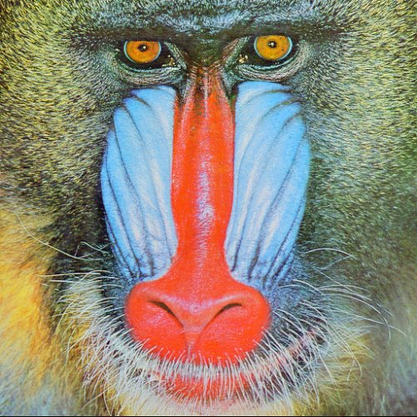
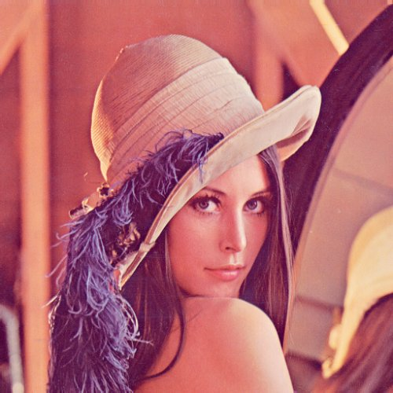
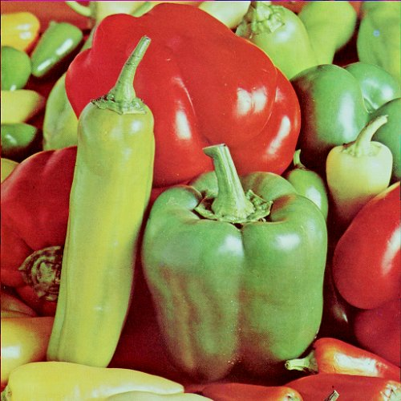
Some Test Images
Baboon
Lenna
Pepper

Slide 11
Homeworks
Cover page
  Homework title
  Student’s name (registration number)
  Data due
  Data handed in
Technical description
Experimental results
Discussions
References and Appendix

