Slide 1
Chapter 1 INTRODUCTION
One picture is worth more than ten thousand words.
Two principle application areas:
  Improvement of pictorial information for human interpretation
  Processing of image data for storage, transmission, and representation for autonomous machine perception

Slide 2
What is Digital Image Processing
An image may be defined as a two-dimensional (2-D) function, f(x,y), where x and y are spatial coordinates, and the amplitude of f(x,y) is called the intensity or gray level of the image at (x,y).
Three types of function f(t)
  Continuous function
  Discrete-time function
  Digital function
Digital image processing refers to processing digital images by means of a digital computer.

Slide 3
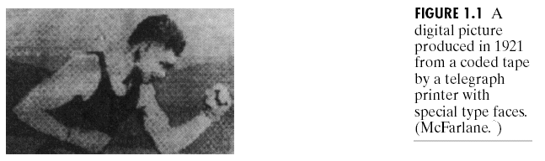
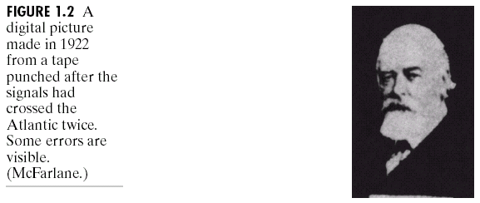
Origins of Digital Image Processing

Slide 4
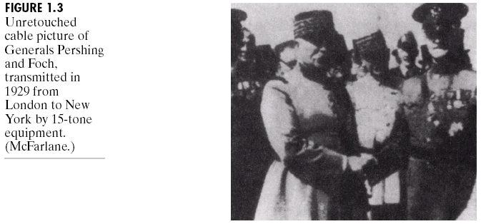
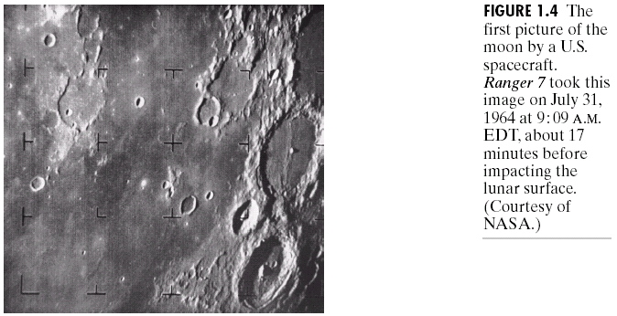

Slide 5
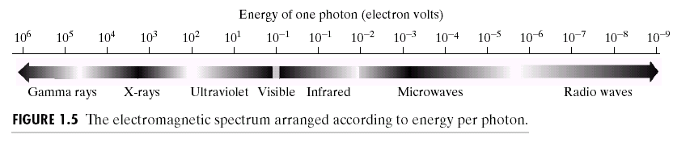
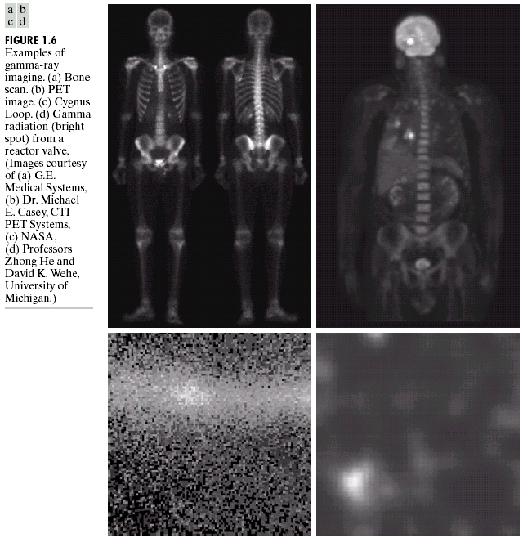
Application Fields (Sources) of Digital Image Processing
Gamma-Ray Imaging

Slide 6
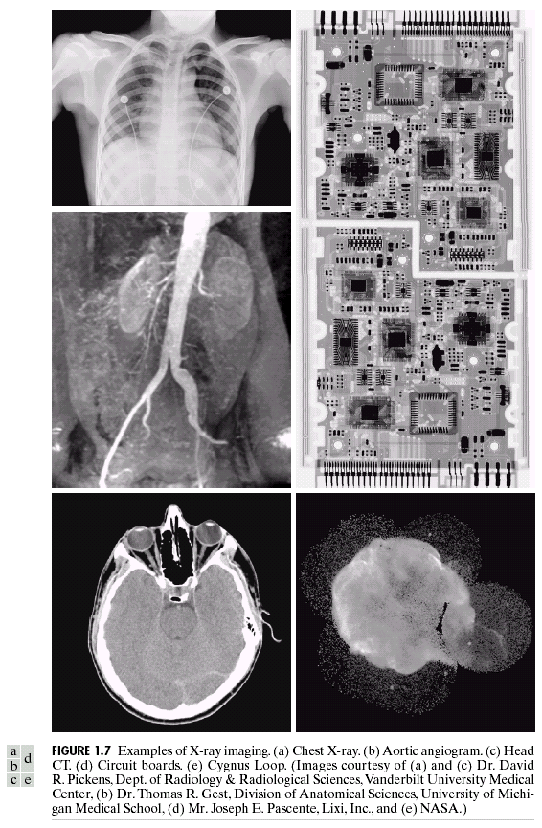
X-ray Imaging

Slide 7
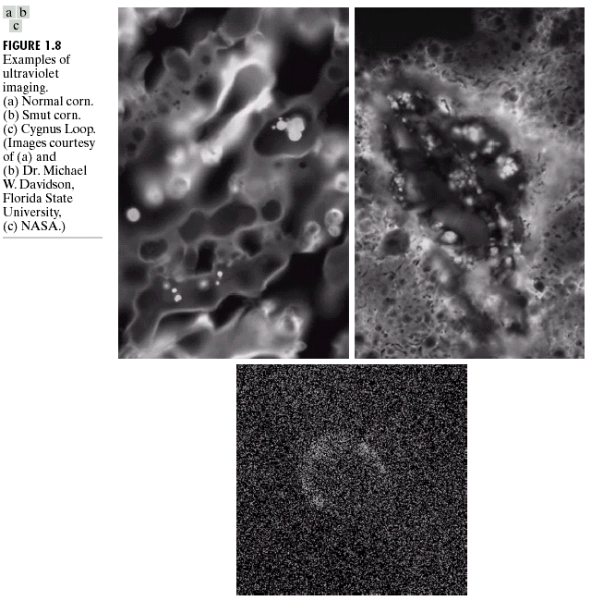
Imaging in Ultraviolet Band

Slide 8
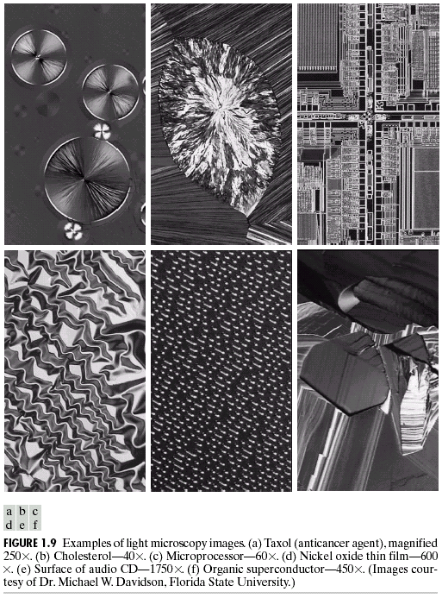
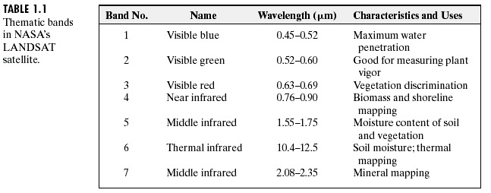
Image in Visible and Infrared Bands

Slide 9
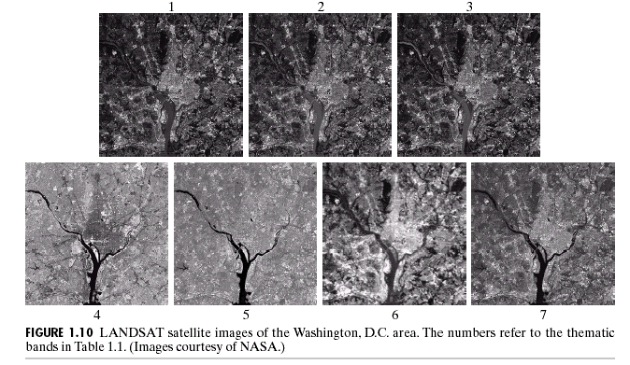
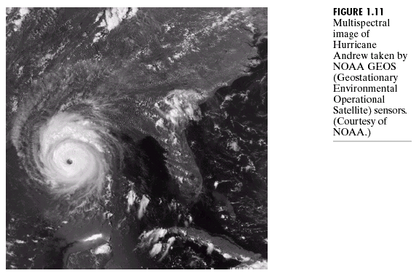
  Multi-spectral imaging

Slide 10
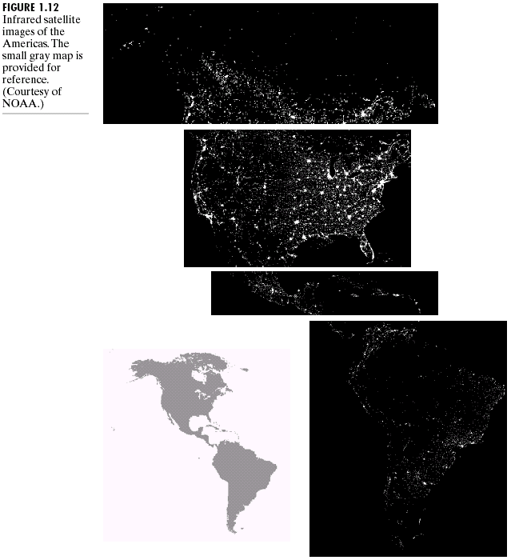

Slide 11
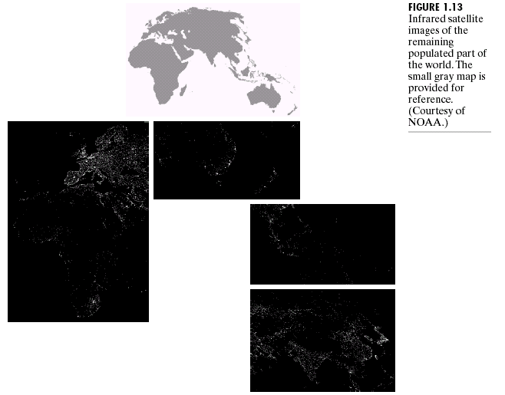

Slide 12
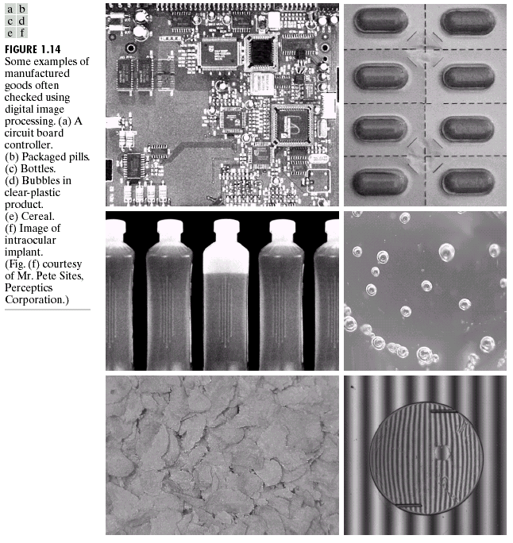
  Imaging in visual spectrum (Inspection)

Slide 13
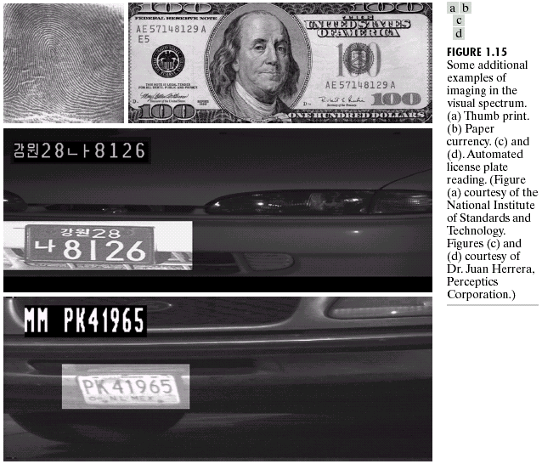

Slide 14
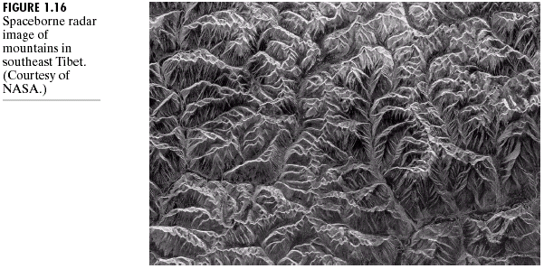
Imaging in Microware Band

Slide 15
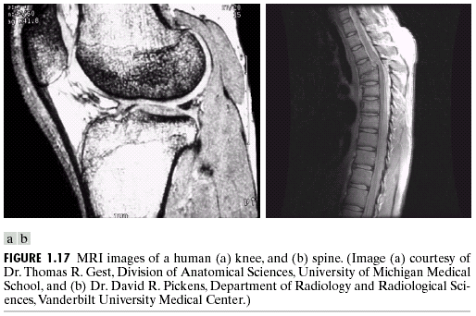
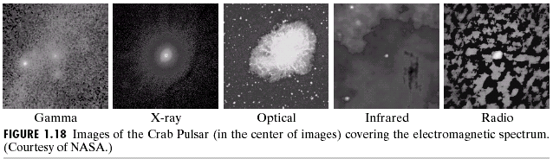

Slide 16
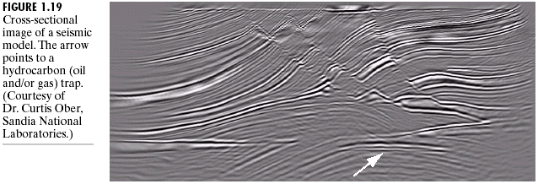
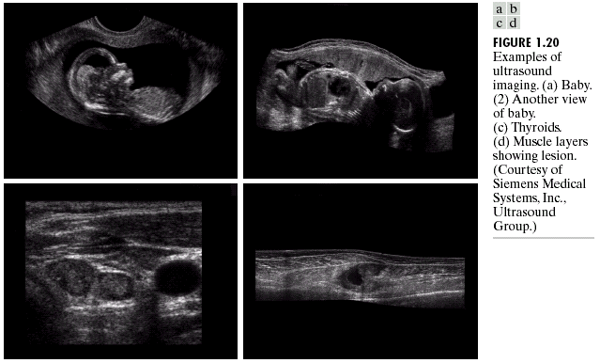
Other Imaging Modalities
  Seismic imaging
  Ultrasound imaging

Slide 17
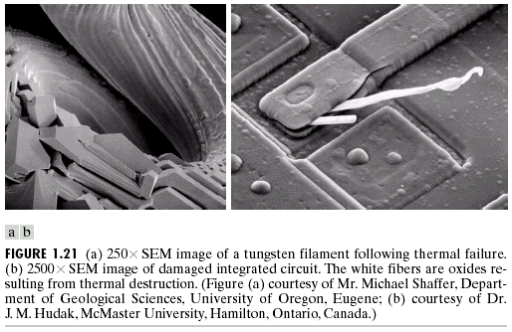
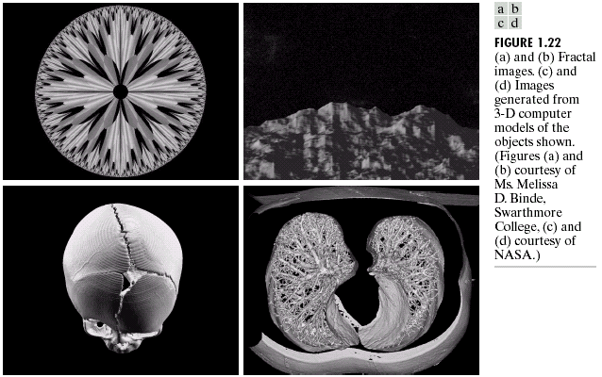
  Transmission (Scanning) electron microscope (TEM, SEM) imaging
  Fractal images

Slide 18
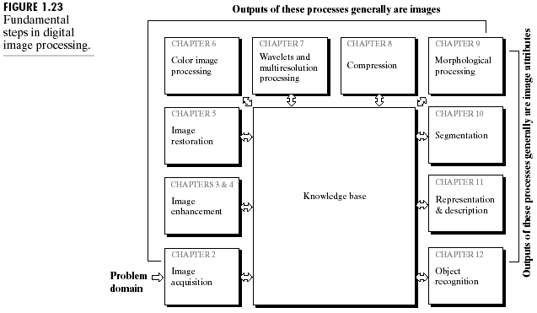
Fundamental Steps in Digital Image Processing

Slide 19
Image acquisition
Image enhancement
Image restoration
Color image processing
Wavelets and multiresolution processing
Compression
Morphological processing
Segmentation
Representation and description
Recognition

Slide 20
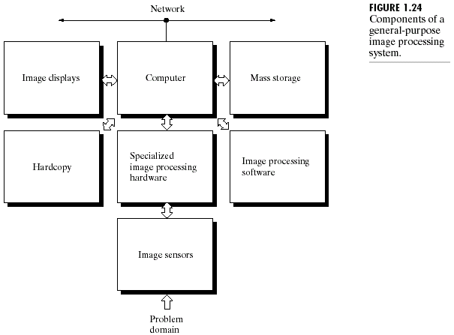
Image Processing System

Slide 21

Image Processing Applications
Medical images
Gray
Matter
White
Matter
Cerebral
Spinal Fluid
MR image classification

Slide 22
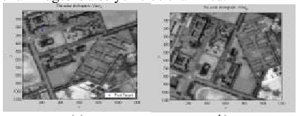

Aerial images
Photograph A
Photograph B
Positioning pixel target in Aerial images

Slide 23
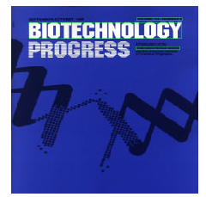
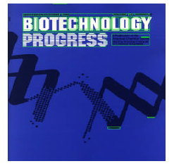
Text location in color images

Slide 24
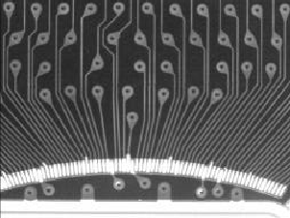
Non-defective PCB
Defect detection in PCB

Slide 25

Open Short MouseBite Spur
Defect detection in PCB (cont.)

Slide 26
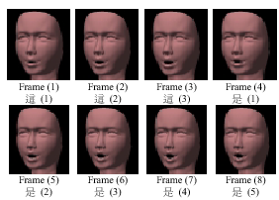
Lip animation

Slide 27


Face detection

Slide 28
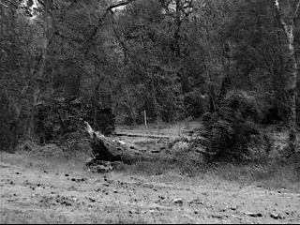
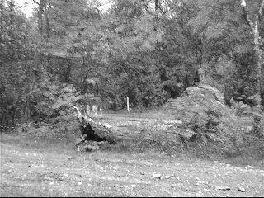
Background modeling

Slide 29
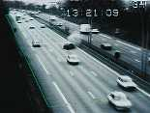

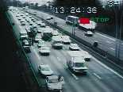
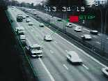
Event detection

Slide 30
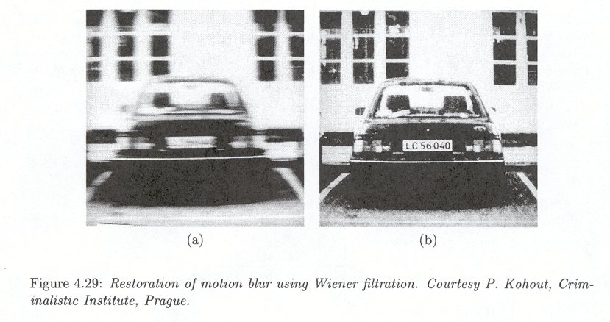
Image restoration

Slide 31
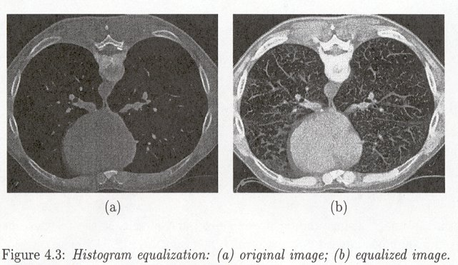
Image enhancement

Slide 32
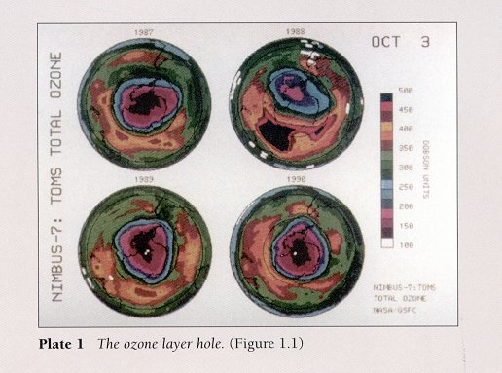
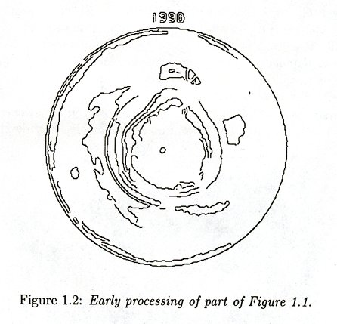
Image pre-processing

Slide 33
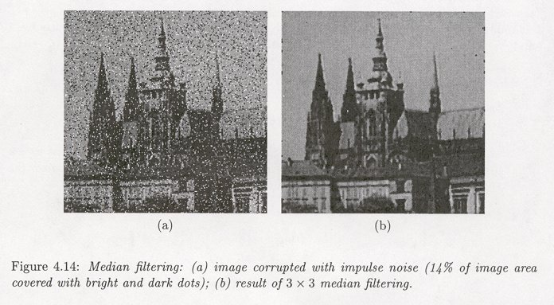
Noise removal

Slide 34
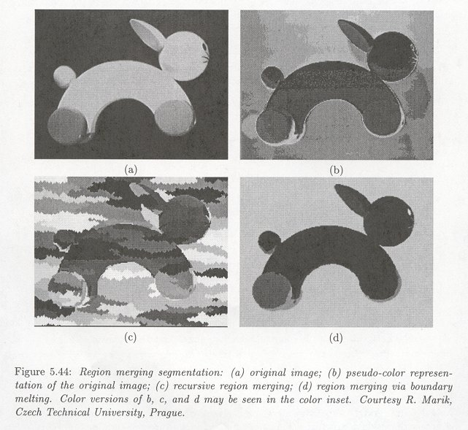
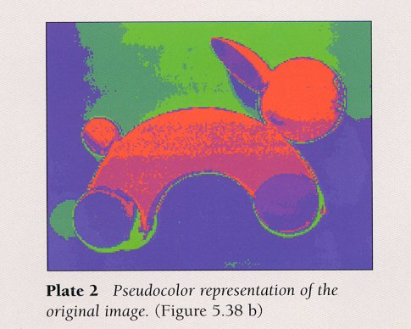
Image segmentation

Slide 35
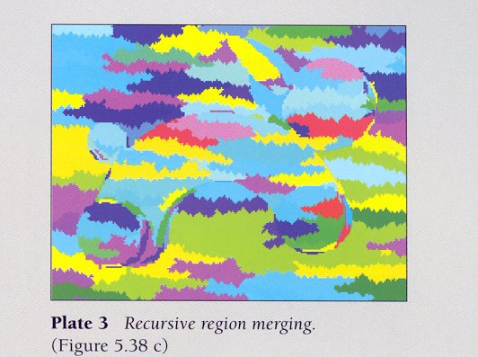
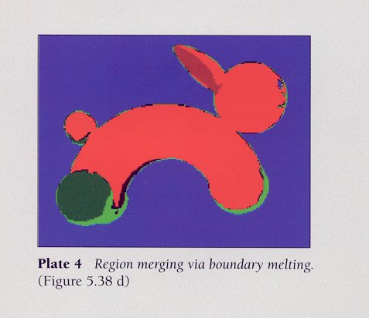

Slide 36
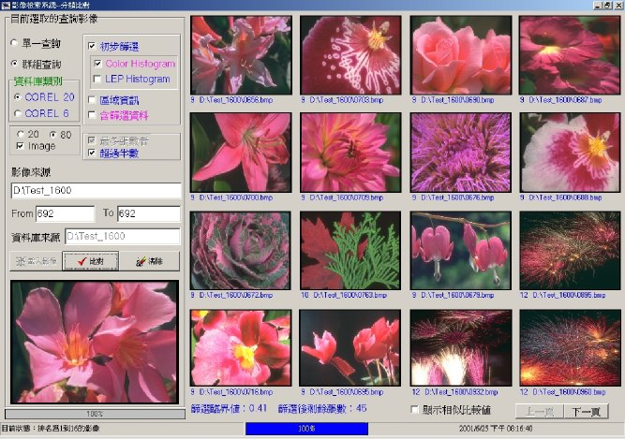
Image classification
Color

Slide 37
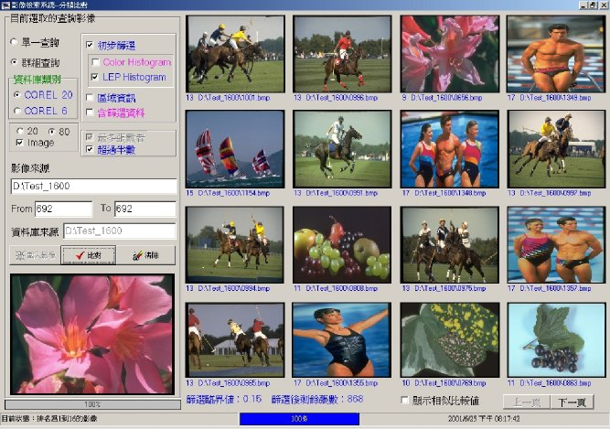
Edge

Slide 38
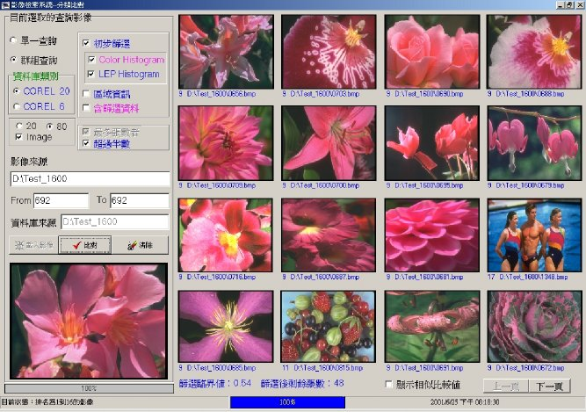
Color+Edge

Slide 39
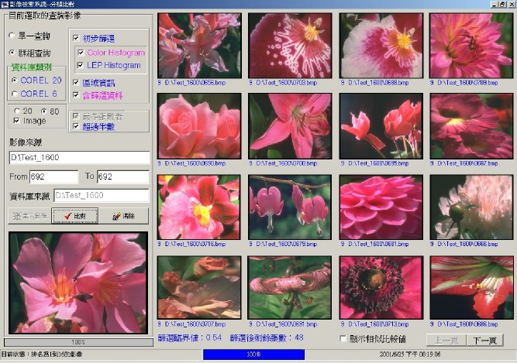
Color+Edge+Region

Slide 40
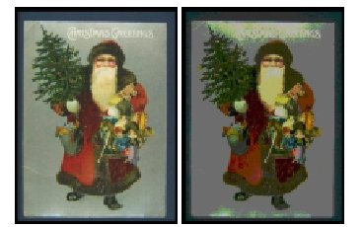
Original image
Quantization image
Region segmentation

Slide 41
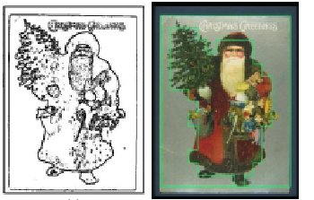
Edge image
Segmented image
Region segmentation (cont.)

Slide 42


Texture retrieval
Texture Images

Slide 43










Texture region
Rank 1
Rank 2
Rank 3
Query Image
Rank 4
Rank 5
Rank 6
Rank 8
Rank 9
Rank 7

Slide 44


Color texture segmentation

