Slide 1
Chapter 2 DIGITAL IMAGE FUNDAMENTALS
Those whose wish to succeed must ask the right preliminary questions.

Slide 2
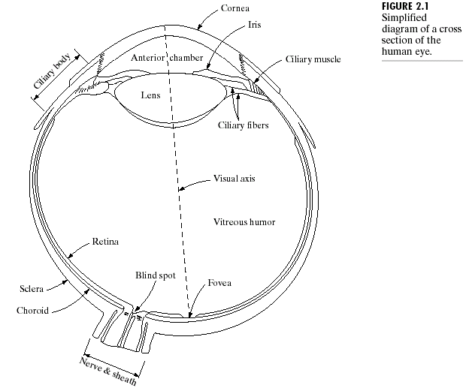
Elements of Visual Perception

Slide 3
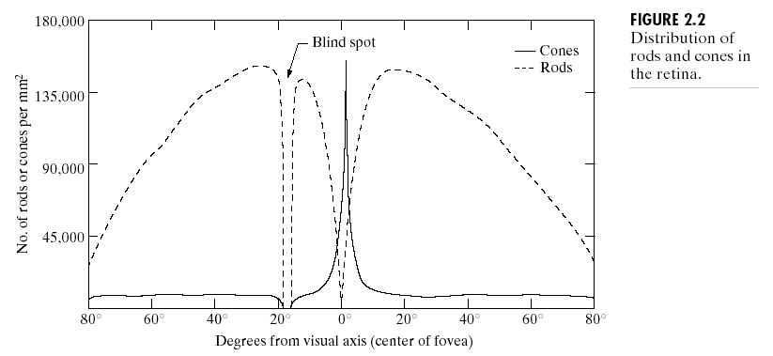
Three membranes enclose the eye:
  The cornea and sclera outer cover
  The choroid
  The retina

Slide 4
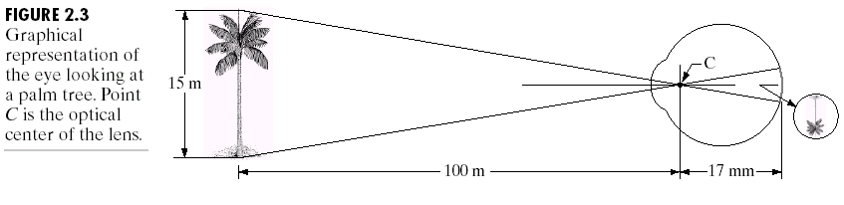
Image Formation in the Eye

Slide 5
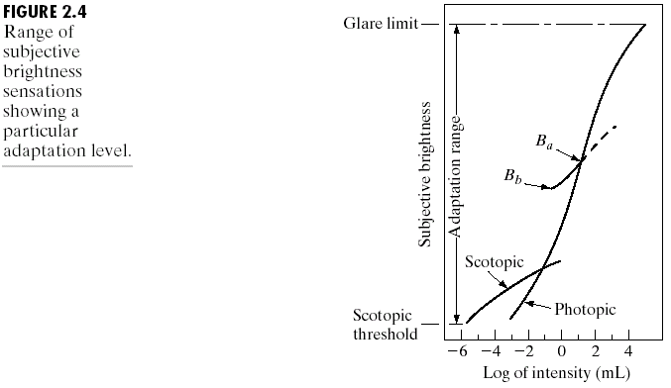
Brightness Adaptation and Discrimation
Subjective brightness (intensity as perceived by the human visual system)
is a logarithmic
function of the
light intensity
incident on the
eye (Fig. 2.4)
The human visual system perceives large intensity variation by changing in its overall sensitivity (brightness adaptation).

Slide 6
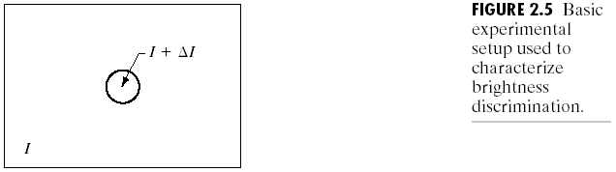
Intensity Change Discrimination
A light source whose intensity is I and an increment of illumination, ∆I (a short-duration flash) appears as a circle in the center (Fig. 2.5).
The Weber ratio = ∆I_{c}/I, where ∆I_{c} is the increment of illumination discriminable 50% of the time with background illumination I.
JND(Just-noticeable difference) -某一特定的感官刺激所能察覺的最小改變。

Slide 7
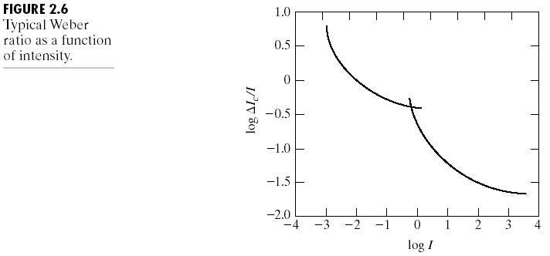
Typical Weber ratio as a function of intensity

Slide 8
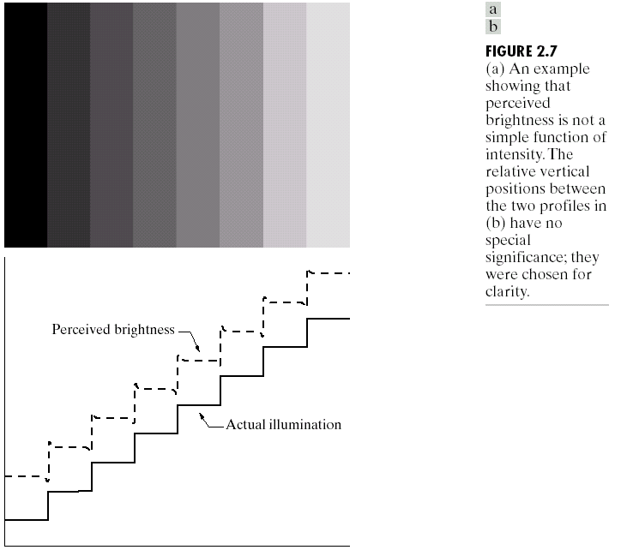
Perceived brightness is not a simple function of intensity
  Mach bands

Slide 9
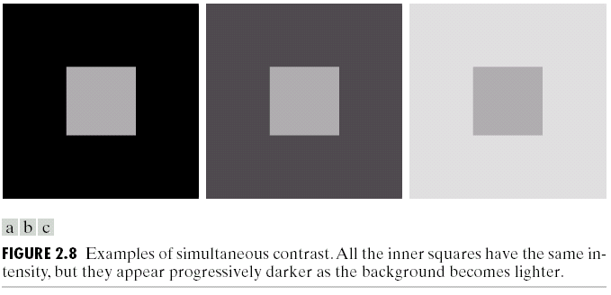
  Simultaneous contract

Slide 10
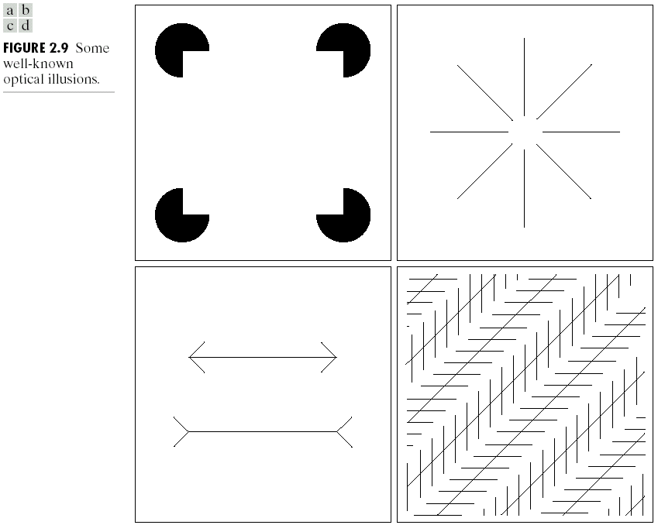
Some well-known optical illusions

Slide 11
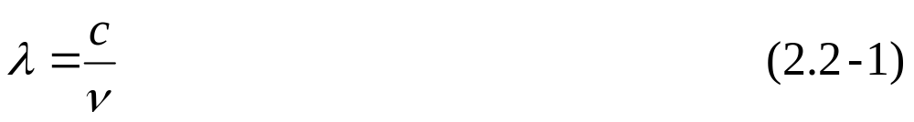
Light and Electromagnetic Spectrum
Wavelength (λ) and frequency (ν) are related by:
where c is the speed of light.
The energy of a component:
where h is Planck’s constant

Slide 12
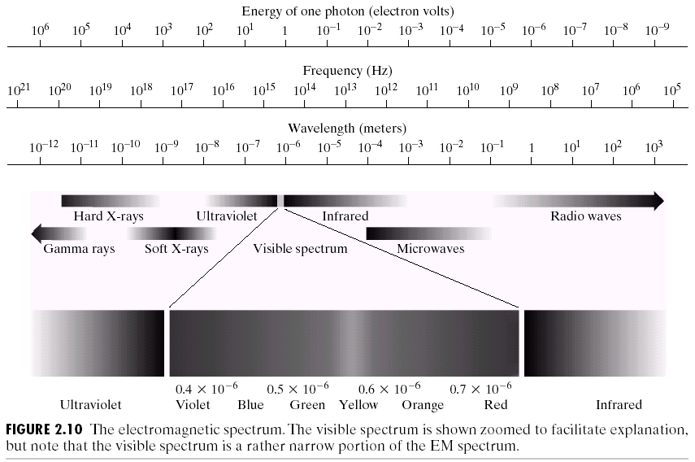
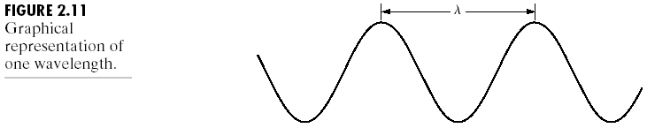

Slide 13
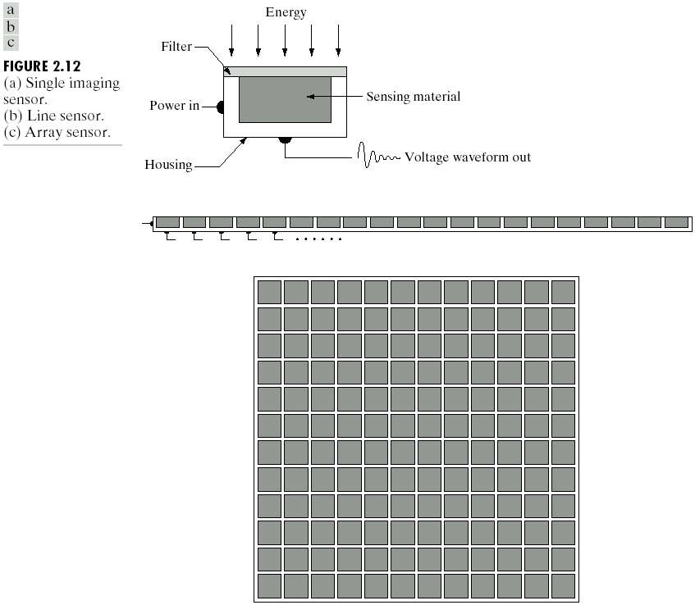
Image Sensing and Acquisition
Three types of sensor arrangements (Fig. 2.12)
  Single imaging sensor
  Line sensor
  Array sensor

Slide 14
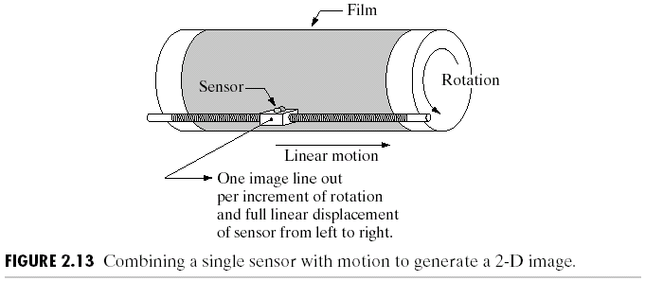
Image Acquisition Using a Single Sensor

Slide 15
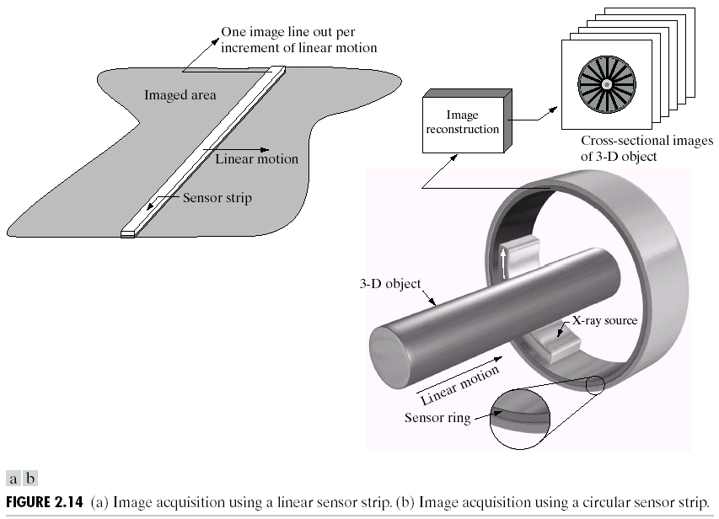
Image Acquisition Using Linear and Circular Sensor Strips

Slide 16

Image Acquisition Using Sensor Arrays

Slide 17
A Simple Image Formation Model
An image is denoted by a two-dimensional (2-D) function, f(x,y), satisfting
0 < f(x,y) < ∞ (2.3-1)
The function f(x,y) may be characterized by:
  Source illumination i(x,y) with 0 < i(x,y) < ∞, (2.3-3)
  Reflection r(x,y) with 0 < r(x,y) < 1, i.e., (2.3-4)
  f(x,y) = i(x,y) r(x,y) (2.3-2)

Slide 18
For a monochrome image, if
ℓ = f(x₀,y₀), (2.3-5)
ℓ lies in the image:
0 < L_{min} ≤ ℓ ≤ L_{max} < ∞, (2.3-6)
where L_{min} = i_{min} r_{min} and L_{max} = i_{max} r_{max}.
  Typical values: L_{min} ≈ 10 and L_{max} ≈ 1000.
The interval [L_{min}, L_{max}] is called the gray scale.
  We can shift the gray scale [L_{min}, L_{max}] to [0, L-1], where 0 denotes black and L-1 denotes white.

Slide 19

Sampling and Quantization
Digitizing the coodonate values is called sampling.
Digitizing the amplitude values is called quantization.

Slide 20


Slide 21
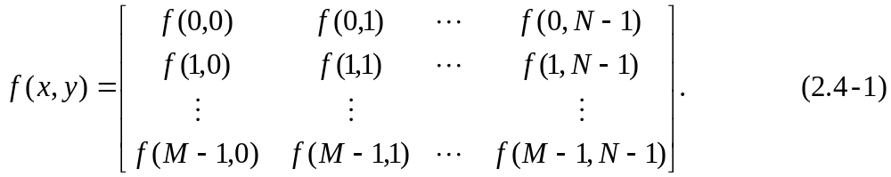
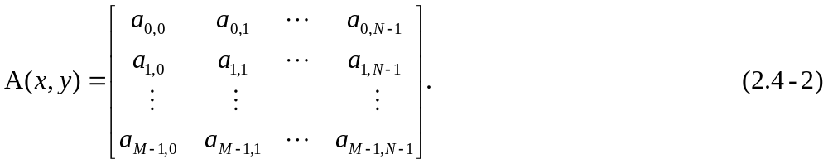
Digital Image Representation
The digital image f(x,y) of size M×N (M rows and N columns) can be written as:
  Each element of the matrix is called a picture element, pixel, or pel.
The traditional matrix notation to denote an image:
  a_{ij} = f(i,j).

Slide 22
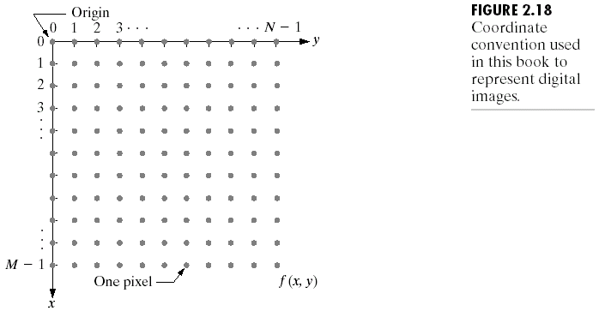
Let Z and R denote the set of real integers and the set of real numbers, respectively.

Slide 23
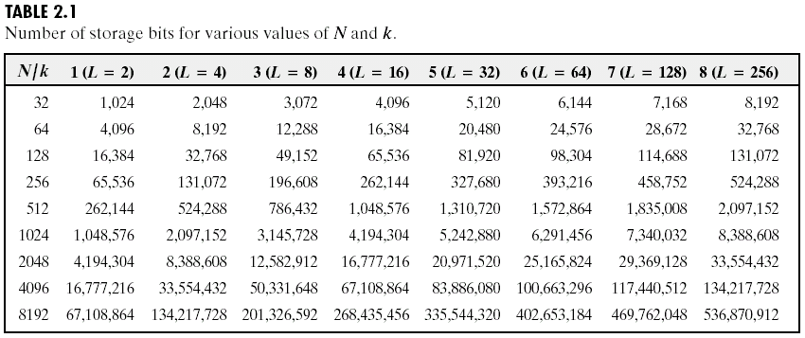
We consider an image of size N×M with L discrete gray levels,
L = 2^{k} (2.4-3)
  The number, b, of bits required to store a digitized image is
  b = N × M × k (2.4-4)
  If M = N, then
  b = N²k (2.4-5)
  The number of storage bits for various values of N and k is listed in Table 2.1.

Slide 24
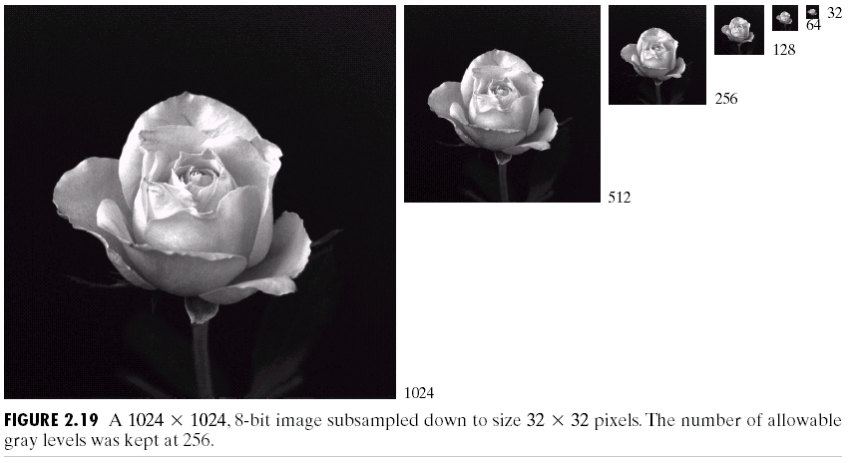
Spatial and Gray-Level Resolution
The different spatial resolutions of an image of size 1024 × 1024 are shown in Fig. 2.19, where L = 2⁸ = 256.

Slide 25
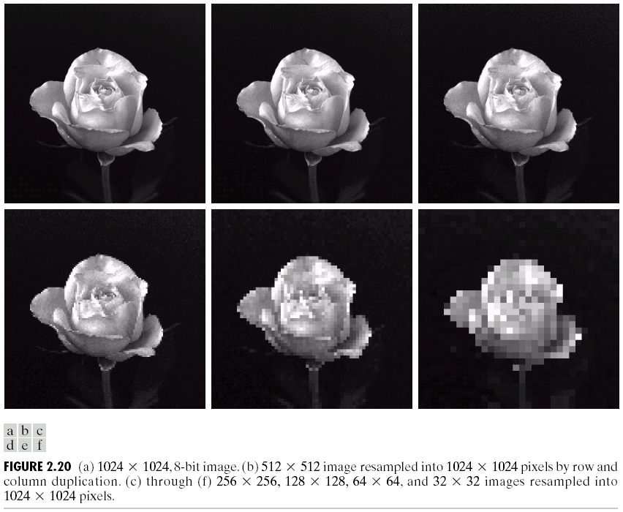
The different spatial resolutions (resampling) of an image of size 1024 × 1024 are shown in Fig. 2.20.

Slide 26

The different gray-level resolutions of an image of size 452 × 374 are shown in Fig. 2.21.

Slide 27


Slide 28
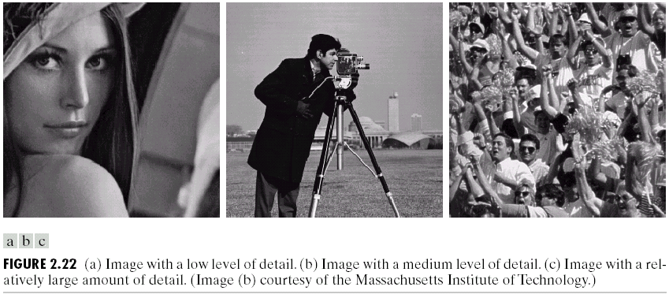
Three types of images (low-detailed, medium-detailed, large-detailed) are shown in Fig. 2.22.
Isopreference curves in the Nk-plane for the three images in Fig. 2.22 are shown in Fig. 2.23.

Slide 29
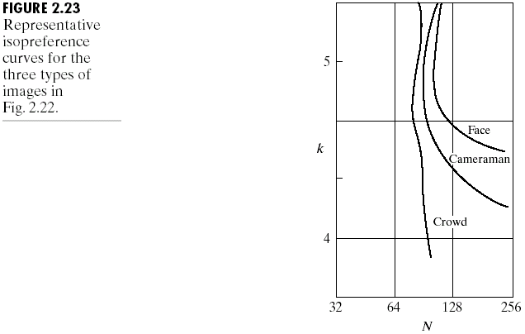

Slide 30
Aliasing and Moiré Patterns
A band-limited signal is one that its highest frequency, f_{w}, is finite and it is of unlimited duration.
The Shannon sampling theorem:
If a bandlimited signal is sampled at a rate, f_{s}, equal to or greater than twice its highest frequency, i.e., f_{s} ≥ 2 f_{w}, it is possible to recover completely the original signal from its samples.
If the signal is undersampled, i.e., f_{s} < 2 f_{w}, aliasing will corrupt the sampled signal.

Slide 31
Unlimited vs. limited duration
  We can only work with sampled data that are finite in duration.
  Equivalently, we multiply the unlimited function by a “gating function” that is valued 1 for some interval and 0 elsewhere.
  The gating function has frequency components extending to infinity. Therefore, aliasing is always presented in a sampled signal.

Slide 32
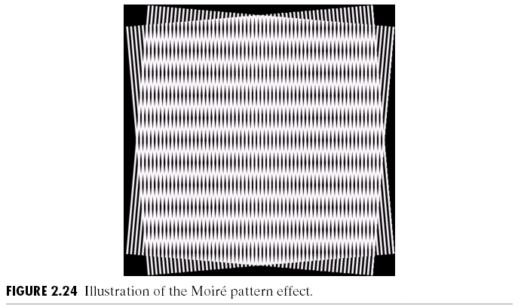
Moiré Pattern
When a function is periodic, it may be sampled at a rate equal to or exceeding twice its highest frequency (f_{s} ≥ 2f_{w}) and it is possible to recover the function from its samples provided the sampling captures exactly an integer number of periods of the function.

Slide 33
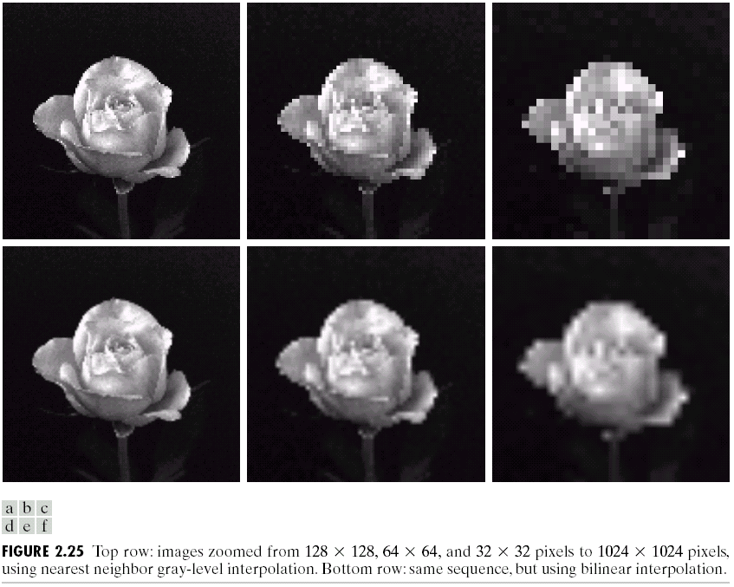
Zooming and Shrinking Digital Images
We can enlarge an image by pixel replication, which is a special case of nearest neighbor interpolation.

Slide 34
Bilinear Interpolation
To zoom an image by bilinear interpolation, the gray level v(x', y') is given by:
v(x', y') = ax' + by' + cx'y' +d, (2.4-6)
where a, b, c, d can be determined from the four equations in four unknowns (using the four nearest neighbors of point (x', y')).

Slide 35
Neighbors of a Pixel
A pixel p(x, y) has four neighbors, N₄(p), whose coordinates are:
(x + 1, y), (x - 1, y), (x, y + 1), (x, y - 1).
The four diagonal neighbors, N_{D}(p), of p have coordinates:
(x +1, y + 1), (x +1, y - 1), (x -1, y + 1), (x -1, y - 1).
The eight neighbors, N₈(p), of p are:
N₈(p) = N₄(p) + N_{D}(p).

Slide 36
Three Types of Adjacency
4-adjacency: Two pixels p and q with values from V are 4-adjacent if q is in the set N₄(p).
8-adjacency: Two pixels p and q with values from V are 8-adjacent if q is in the set N₈(p).
m-adjacency (mixed adjacency): Two pixels p and q with values from V are m-adjacent if:
  (i) q is in N₄(p) or
  (ii) q is in N_{D}(p) and the set N₄(p) and N₄(q) has no pixels whose values are from V,
where V is the set of gray levels used to define adjacency.

Slide 37
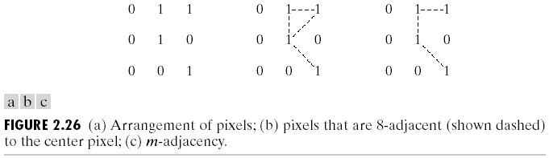
Connectivity
A path (curve) from p(x, y) to q(s, t) is a sequence of distinct pixels with coordinates:
(x₀, y₀), (x₁, y₁), …, (x_{n}, y_{n})
where (x₀, y₀) = (x, y), (x_{n}, y_{n}) = (s, t), pixels (x_{i}, y_{i}) and (x_{i-1}, y_{i-1}) are adjacent for 1 ≤ i ≤ n, and n is the length of the path.
  If (x₀, y₀) = (x_{n}, y_{n}), the path is a closed path.
  4-, 8-, or
  m-paths.

Slide 38
Regions and Boundaries
Let S be a subset of pixels in an image. Two pixels p and q are connected in S if there exists a path between them consisting entirely of pixels in S.
For any pixel p in S, the set of pixels connected to p in S is called a connected component of S.
If it only has one connected component, S is called a connected set.
R is a region of image if R is a connected set in the image.
The boundary of a region R is the set of pixels in the region that have one or more neighbors that are not in R.

Slide 39
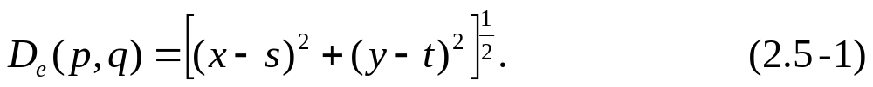
Distance Measures
For pixels p, q, and z, with coordinates (x, y), (s, t), and (v, w), respectively, D is a distance function or metric if
(a) D(p, q) ≥ 0 (D(p, q)=0 iff p=q),
(b) D(p, q) = D(q, p), and
(c) D(p, z) ≤ D(p, q) + D(q, z).
The Euclidean distance between p and q is defined as:
The D₄ distance (also called city-block distance) between p and q is defined as:
The D₈ distance (also called chessboard distance) between p and q is defined as:

Slide 40
Linear and Nonlinear Operations
Let H be an operator whose input and output are images. H is a linear operators if, for any two images, f and g, and any two scalars, a and b,
H(af + bg) = aH(f) + bH(g). (2.6-1)
An operation that fails the test of Eq. (2.6-1) is by definition nonlinear.

