Slide 1
Chapter 3 IMAGE ENHANCEMENT IN THE SPATIAL DOMAIN
It makes all the difference whether one sees darkness through the light or brightness through the shadows.

Slide 2
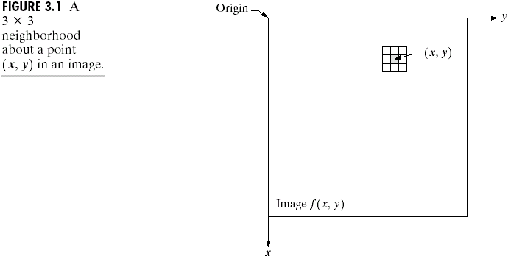
Background
Spatial domain processes will be denoted by the expression
where f(x,y) is the input image, g(x,y) is the processed image, and T is an operator on f, defined over some neighborhood of (x,y).
(3.1-1)

Slide 3
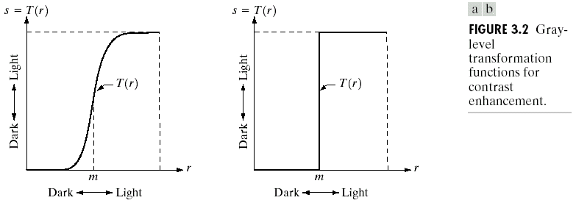
If g depends only on the value of f at (x,y), and T becomes a gray-level transformation function:
where r and s are variables denoting, respectively, the gray level of f(x,y) and g(x,y) at any point (x,y).
Fig. 3.2(a) is called contrast stretching and Fig. 3.2(b) is a binary thresholding function.
(3.1-2)

Slide 4
Point processing: the output g(x,y) at any point in an image depends only on the gray level at that point, f(x,y).
Masks (filters, windows): the output g(x,y) at the point (x,y) in an image depends on a function of the values of f in a predefined neighborhood of (x,y).

Slide 5
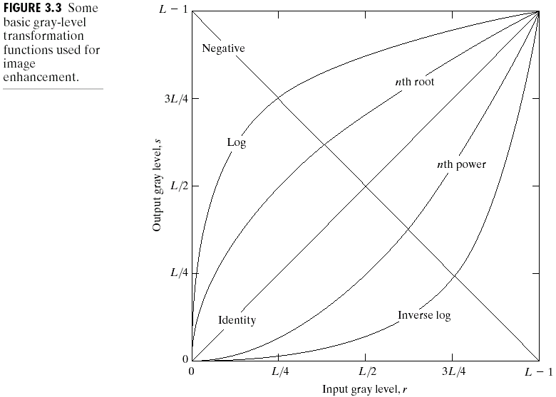
Some Basic Gray Level Transformations
Image Negatives
As shown in Fig. 3.3, the negative transformation is:
.
(3.2-1)

Slide 6
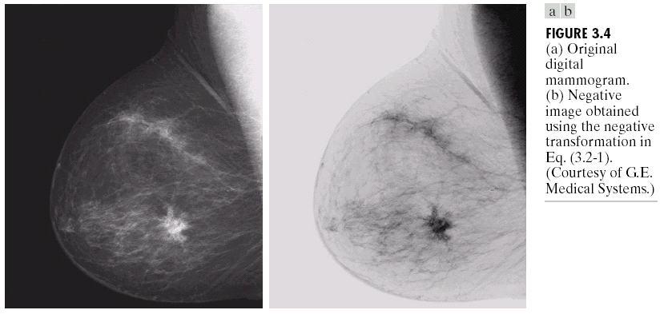
An example is shown in Fig. 3.4.

Slide 7
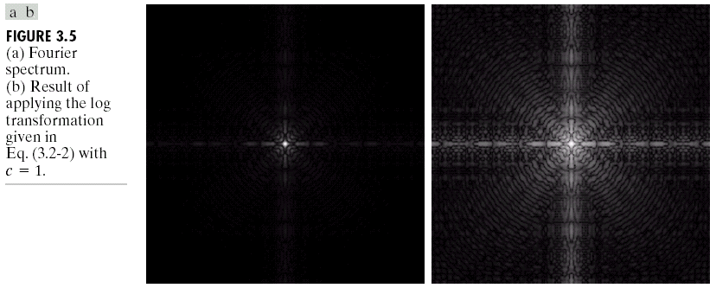

Log Transformations
The general form of the log transformation shown in Fig. 3.3 is:
where c is a constant and it is assumed that
Fig. 3.5(a) shows a Fourier spectrum and Fig. 3.5(b) shows the corresponding result of applying the log transformation (Eq. (3.2-2) with c=1).
$$s=c\log\left(1+r\right)$$
(3.2-2)

Slide 8
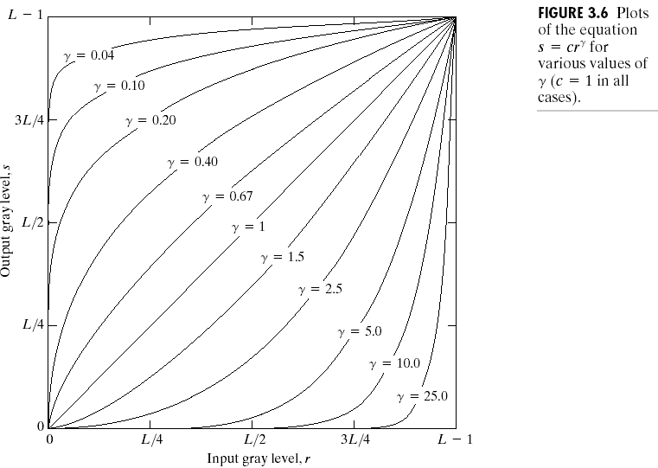
Power-Law Transformations
As shown in Fig. 3.6, power-law transformations have the basic form:
where c and are positive constants.
If an offset is considered, Eq. (3.2-3) can be written as:
.
(3.2-3)

Slide 9
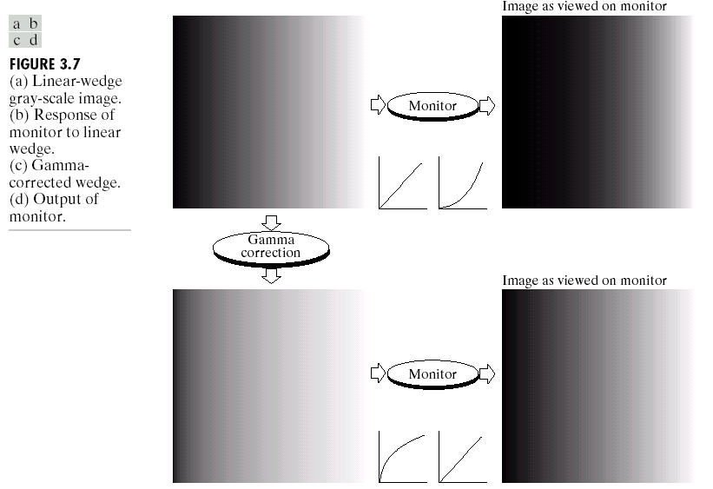
Gamma Correction
A variety of devices used for image capture, printing, and display respond according to a power law, where the exponent in the power-law equation is referred to as gamma.
As the illustrated example shown in Fig. 3.7, the process used to correct this power-law response phenomena is called gamma correction.

Slide 10
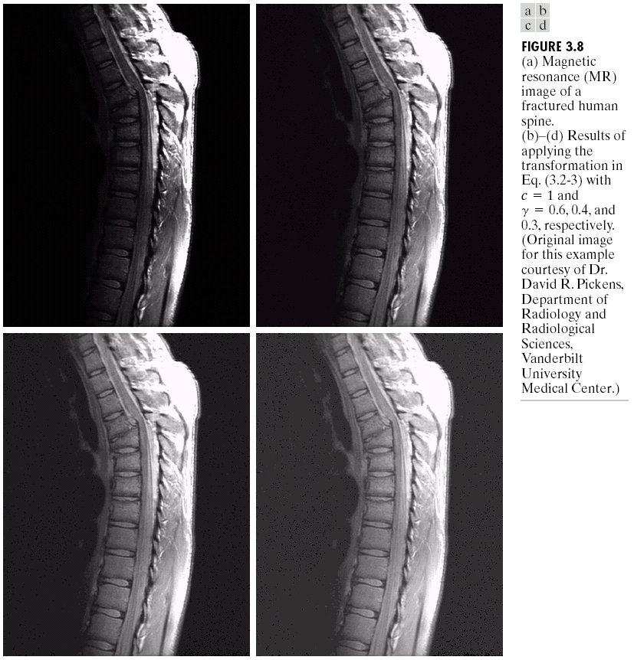
General-purpose Contrast Manipulation
Fig. 3.8(a) shows a magnetic resonance (MR) image and Fig. 3.8(b)~(d) shows the results of applying the power-law transformations with different gamma values ( =0.6, 0.4, and 0.3).

Slide 11
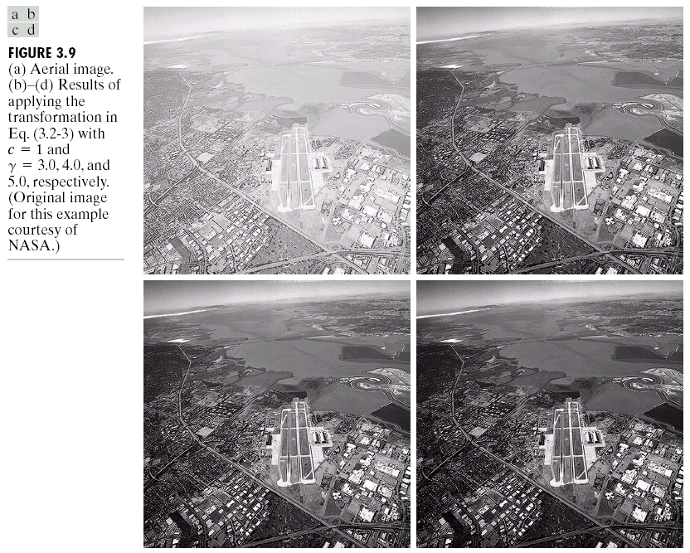
Fig. 3.9(a) shows the opposite problem of Fig. 3.8(a), i.e., Fig. 3.9(a) has a washed-out appearance.
Fig. 3.9(b)~(d) shows the corresponding result of applying the power-law transformation with different gamma values ( =3.0, 4.0, and 5.0).

Slide 12
Piecewise-Linear Transformations
Contrast Stretching
Fig. 3.10(a) shows a typical transformation for contrast stretching, where the control points (r₁,s₁) and (r₂,s₂) control the shape of the transformation.
If r₁=s₁ and r₂=s₂, the transformation is a linear function.
If r₁=r₂, s₁=0, and s₂=L-1, the transformation is a binary thresholding.
Intermediate values of (r₁,s₁) and (r₂,s₂) produce various degrees of spread in the gray levels of the output image.

Slide 13
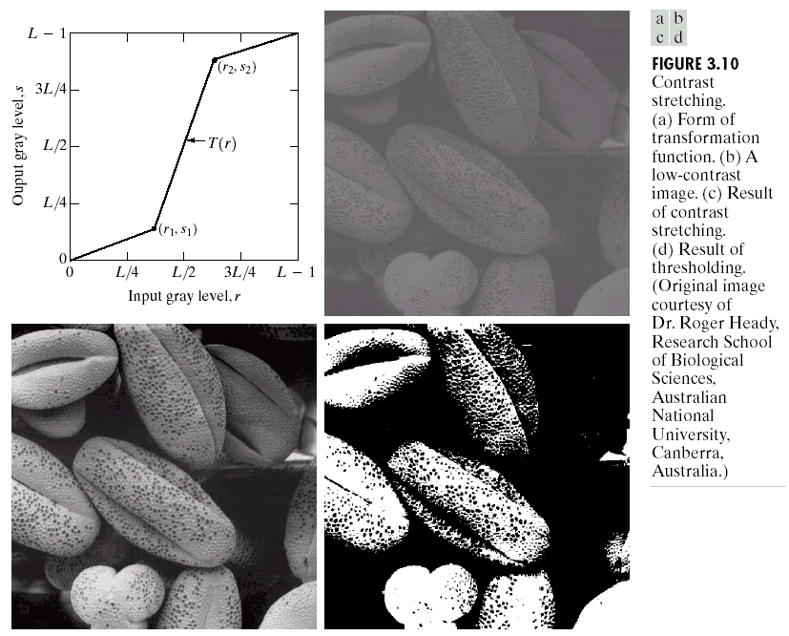
Fig. 3.10(b) shows a low-contrast image, and Fig. 3.10(b) and (c) shows the results of contrast stretching and binary thresholding, respectively.

Slide 14
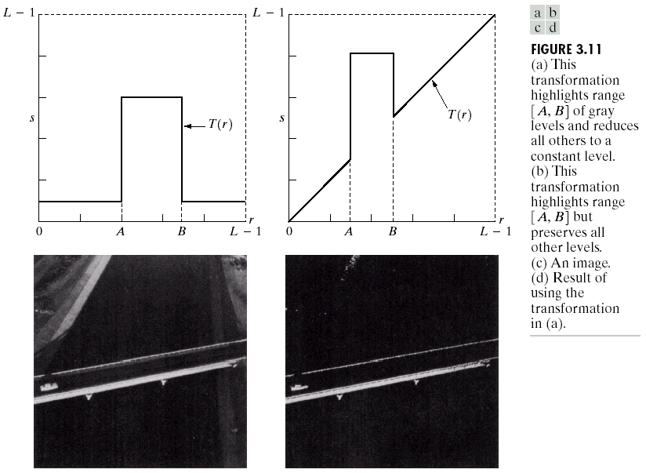
Gray-level Slicing
Fig. 3.11(a) and (b) shows two types of transformation highlighting range [A, B] of gray levels.
Fig. 3.11(c) and (d) shows the corresponding results using the transformations shown in Fig. 3.11(a) and (b), respectively.

Slide 15
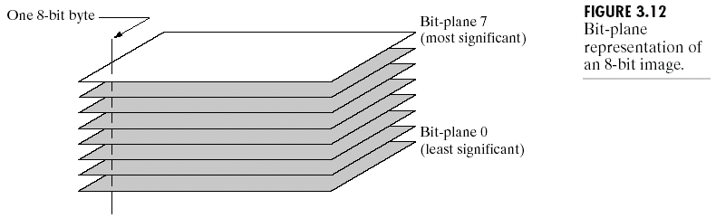
Bit-plane Slicing
Fig. 3.12 shows the bit-plane representation of an 8-bit image.

Slide 16
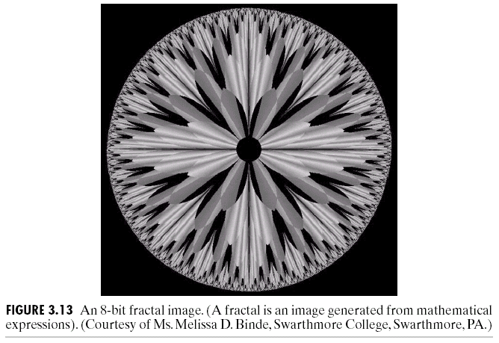
Fig. 3.13 shows an 8-bit fractal image and Fig. 3.14 shows the eight bit planes of the fractal image.

Slide 17
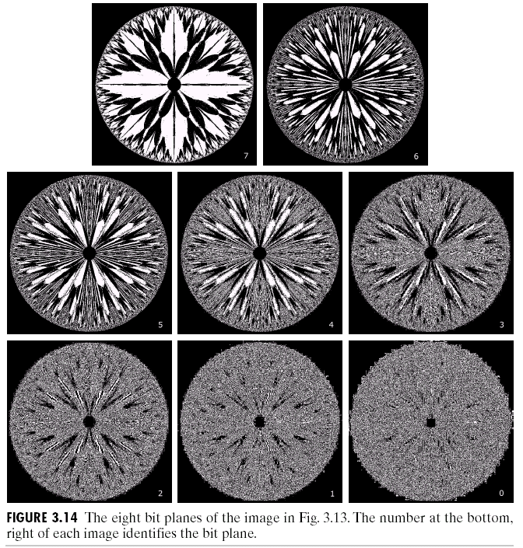

Slide 18
Histogram Processing
The histogram of a digital image with gray levels in the range [0, L-1] is a discrete function:
where r_{k} is the kth gray level and n_{k} is number of pixels in the image having gray level r_{k}.
If is the total number of pixels in the image, a normalized histogram is :
p(r_{k}) gives an estimate of the probability of occurrence of gray level r_{k}.
k = 0, 1, …, L - 1,

Slide 19
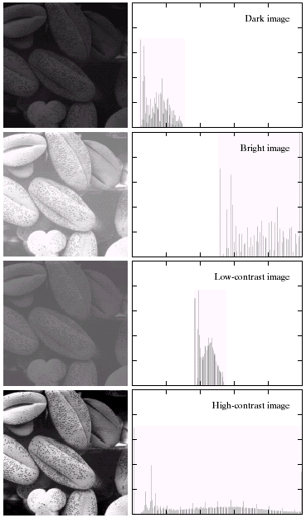

Fig. 3.15 shows four basic types of images, dark, light, low contrast, high contrast, and their corresponding histograms.

Slide 20


Histogram Equalization
If the gray level r is normalized to the interval [0, 1] with r=0 representing black and r=1 representing white, the transformation:
will produce a level s for every pixel value r in the original image (Fig. 3.16).
$$s=T\left(r\right)$$
$$0≤r≤1$$
(3.3-1)

Slide 21
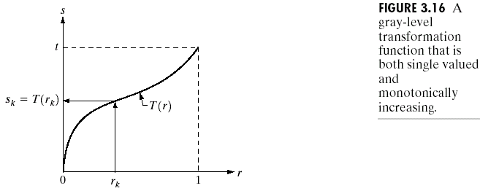
T(r) satisfies the following conditions:
(a) T(r) is single-valued and monotonically increasing in
the interval ; and
(b) for
The single-valued condition guarantees that the inverse transformation will exist and the monotonicity condition preserves the increasing order form black to white in the output image.
The condition (b) guarantees that the output gray levels will be in the same range as the input levels.

Slide 22
The inverse transformation from s back to r is denoted by:
The gray levels of an image may be viewed as random variables in the interval [0, 1].
Let p_{r}(r) and p_{s}(s) denote the probability density functions (pdf) of random variables r and s. Then
An important transformation function is:
i.e., s is the cumulative distribution function (cdf) of random variable r.
(3.3-2)
(3.3-3)
(3.3-4)

Slide 23
Based on Eqs. (3.3-3) and (3.3-4), we have:
,
Eq. (3.3-6) shows that s has a uniform pdf, independent of the form of p_{r}(r).
For discrete cases, the probability of occurrence of gray level r_{k} in an image is approximated by:
(3.3-5)
(3.3-6)
k = 0, 1, …, L – 1.
(3.3-7)

Slide 24
The discrete version of the transformation function given in Eq. (3.3-4) is:
The transformation (mapping) given in Eq. (3.3-8) is called histogram equalization or histogram linearization.
The inverse transformation from s back to r is denoted by:
(3.3-8)
k = 0, 1, …, L – 1.

Slide 25
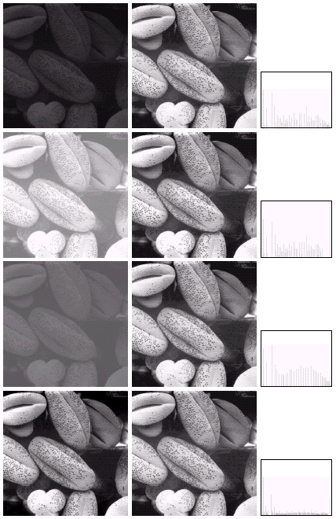

Fig. 3.17 shows the four images from Fig. 3.15 and the corresponding results of performing histogram equalization.

Slide 26
Histogram Matching (Specification)
Histogram matching (specification) is to generate a processed image having a specified histogram.
Let p_{r}(r) and p_{z}(z) denote the continuous pdf’s of r and z, respectively. p_{r}(r) can be estimated from the input image and p_{z}(z) is the specified pdf of the desired output image.
Let s be a random variable with the property:
We define a random variables z with the property:
Because G(z) = T(r) = s,
.
(3.3-10)
(3.3-11)
(3.3-12)

Slide 27
For the discrete case,
(3.3-13)
where n is the total number of pixels in the image, n_{j} is the number of pixels with gray level r_{j}, and L is the number of discrete gray levels. Similarly, using the given histogram p_{z}(z_{i}), i = 0, 1, 2, …, L - 1, we have:
Finally, the discrete version of Eq. (3.3-12) is given by:
or, form Eq. (3.3-13),
k = 0, 1, …, L – 1.
(3.3-14)
k = 0, 1, …, L – 1
(3.3-15)
k = 0, 1, …, L – 1.
(3.3-16)

Slide 28
Implementation
(1) Each set of gray levels {r_{j}}, {s_{j}}, and {z_{j}}, j=0, 1, 2, …, L – 1, is a one-dimensional array of dimension .
(2) All mappings from r to s and from s to z are simple table lookups between a given pixel value and these arrays.
(3) Each of the elements of these arrays, for example, s_{k}, contains two important pieces of information: The subscript k denotes the location of the element in the array, and s denotes the value at that location.
(4) We need to be concerned only with integer pixel values.

Slide 29
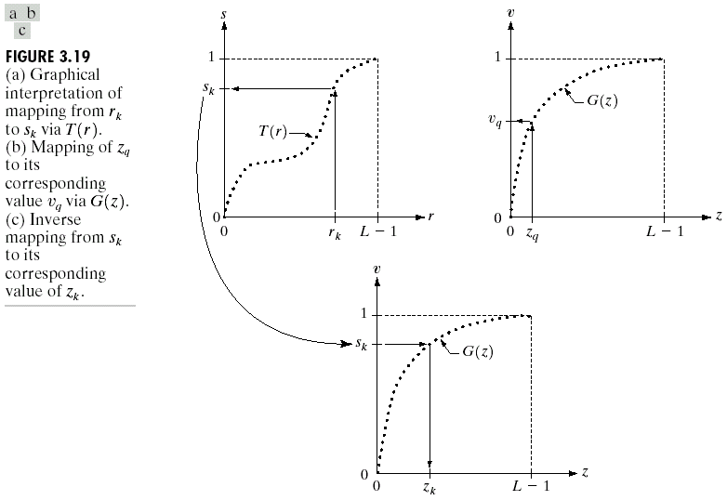
Fig. 3.19 shows the graphical interpretation of mappings (a) r_{k} to s_{k} via T(r); (b) z_{q} to v_{q} via G(z); and (c) inverse mapping from s_{k} to z_{k}.

Slide 30
Because we deal with integer, to satisfy the equation
is to let for each k, where is the smallest integer in the interval [0, L-1] such that
(3.3-17)
The histogram matching procedure:
1. Obtain the histogram of the given image.
2. Use Eq. (3.3-13) to precompute a mapped level s_{k} for each level r_{k}.
3. Obtain the transformation function G from the given p_{z}(z) using Eq. (3.3-14).
4. Precompute z_{k} for each value of s_{k} using the iterative scheme defined in connection with Eq. (3.3-17).
5. For each pixel in the original image, if the value of that pixel is r_{k}, map this value to its corresponding level s_{k}; then map level s_{k} into the final level z_{k}. Use the precomputed values from Steps (2) and (4) for these mappings.

Slide 31
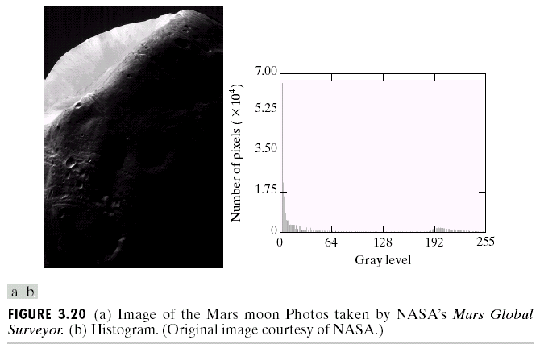
Fig. 3.20 shows an image of the Mars moon and its histogram.

Slide 32
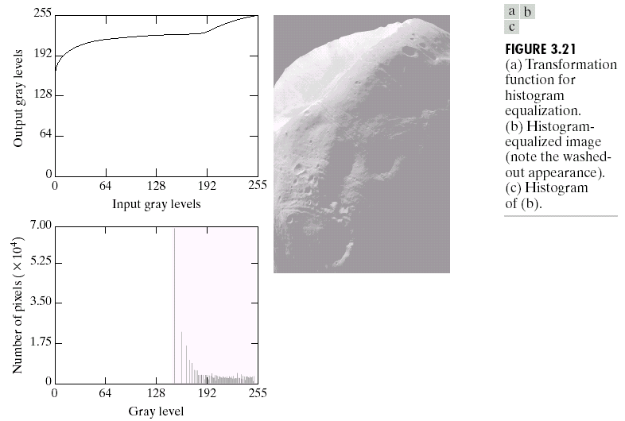
Fig. 3.21 shows the histogram-equalized function, image, and its histogram.

Slide 33
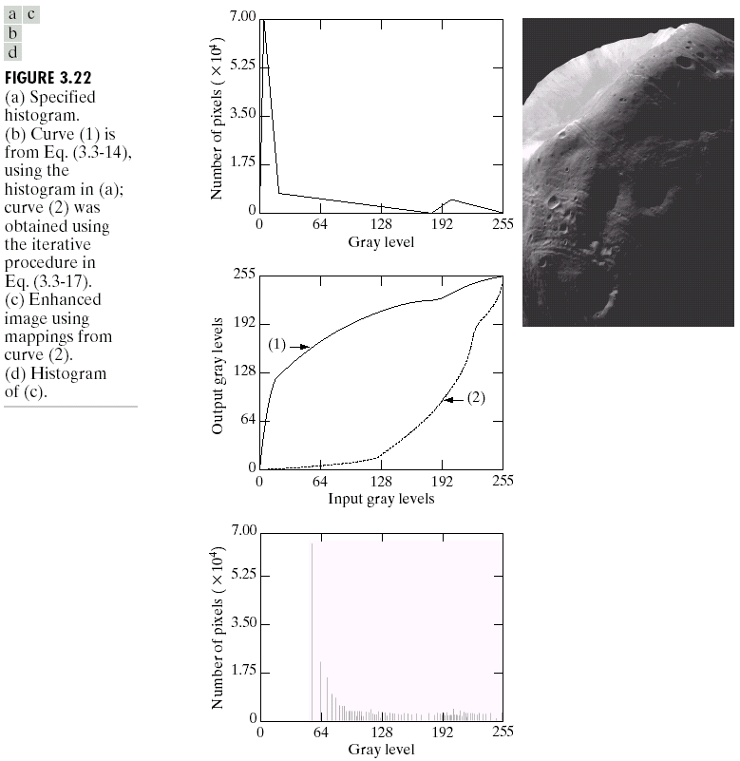
Fig. 3.22 shows the histogram-matching function, image, and its histogram.

Slide 34
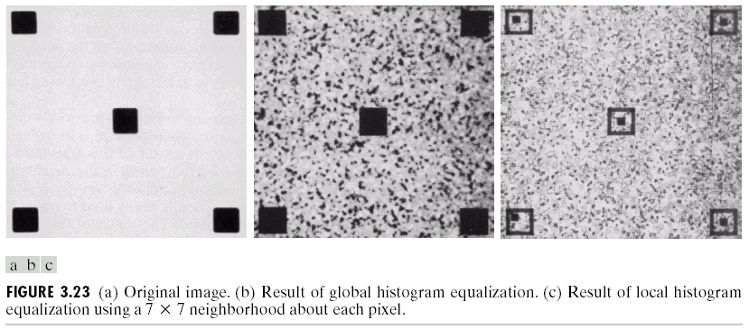
Local Enhancement
Fig. 3.23 shows the results of applying histogram equalization and local histogram equalization.

Slide 35
Using Histogram statistics for Image Enhancement
Let p(r_{i}) be the normalized histogram component corresponding to the ith value of r. The nth moment of r about its mean is defined as:
where m is the mean value of r:
It follows from Eqs. (3.3-18) and (3.3-19) that and
The second moment is given by:
,
(3.3-18)
(3.3-19)
(3.3-20)

Slide 36
The global mean and variance are useful for gross adjustments of overall intensity and contrast, whereas the local mean and variance are useful for local adjustments depending on local image characteristics.
Let S_{xy} be a subimage (window) centered at (x,y). The local mean and variance of the pixels in S_{xy} are defined, respectively, as:
,
where r_{s,t} is the gray level at coordinates (s,t) in the neighborhood, and p(r_{s,t}) is the neighborhood normalized histogram component corresponding to that value of gray level.
,
(3.3-21)
(3.3-22)

Slide 37
is a measure of average gray level in S_{xy} and is a measure of contrast in S_{xy}.
Fig. 3.24 shows an SEM image of a tungsten filament wrapped around a support.
The problem is to enhance dark areas while leaving the light area as unchanged as possible.
Let f(x,y) and g(x,y) be the input and output pixel values at (x,y). The enhancement method is:
where E, k₀, k₁, and k₂ are specified parameters, M_{G} is the global mean of the input image, and D_{G} is its global standard deviation.
if
AND
,
,
otherwise
,
,

Slide 38
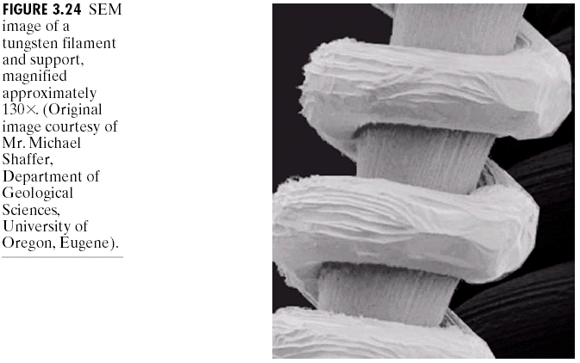
Figs. 3.25 and 3.26 show the immediate and final enhanced results of Fig. 3.24.

Slide 39
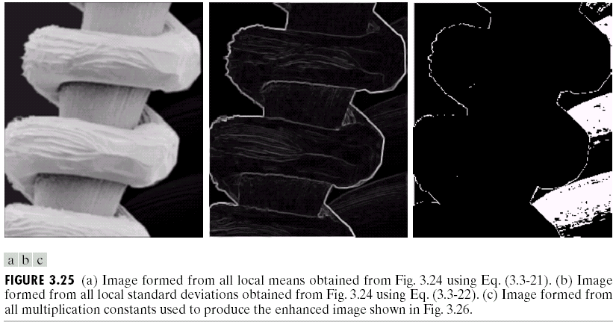
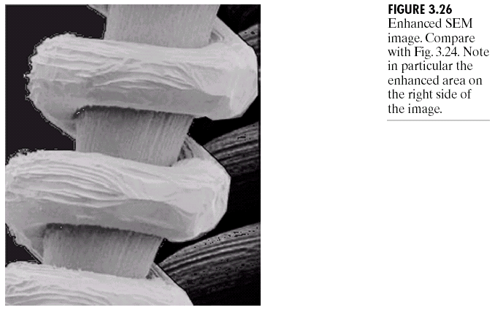

Slide 40
Enhancement Using Arithmetic/Logic Operations
Arithmetic/logic operators involving images are performed on a pixel-by-pixel basis between two or more images.
We need only to implement the AND, OR, and NOT logic operators, because these three operators are functionally complete.
The AND and OR operations are used for masking, where light represents a binary 1 and dark represents a binary 0.
Masking sometimes is referred to as region-of-interest (ROI) processing.

Slide 41
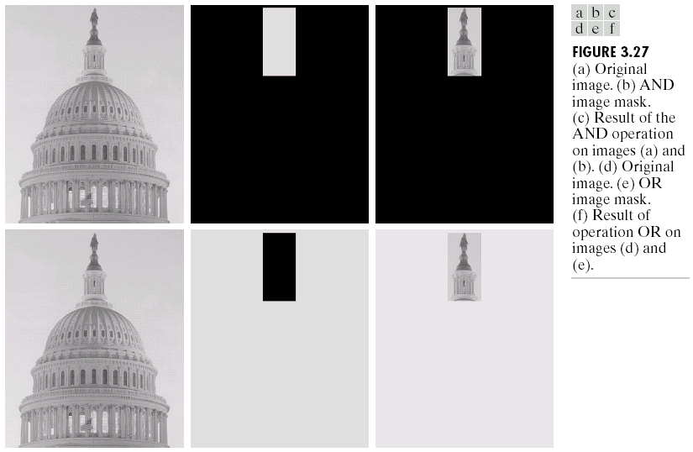
Fig. 3.27 shows an illustrated example.

Slide 42
Image Subtraction
The difference between two images f(x,y) and h(x,y) is defined as:
Fig. 3.28(c) shows the difference between the two fractal images in Fig. 3.28(a) and (b), and Fig. 3.28(d) shows the histogram-equalized difference image.
(3.4-1)

Slide 43
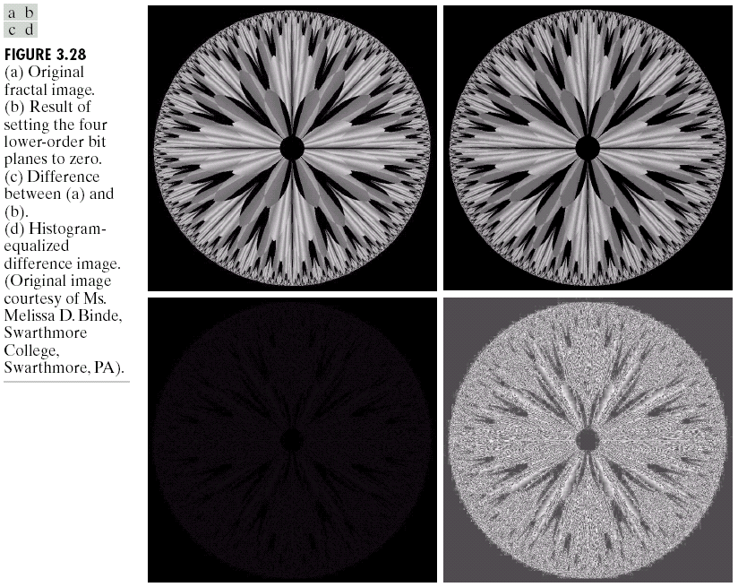

Slide 44
In mask mode radiography of medical imaging, the mask, h(x,y) is an X-ray image of a region of a patient’s body captured by an intensified TV camera located opposite an X-ray source.
The procedure:
<i> injecting a contrast medium into a patient’s bloodstream,
<ii> taking a series of images of the same anatomical region as h(x,y),
<iii>subtracting this mask from the series of incoming images after injection of the contrast medium.

Slide 45
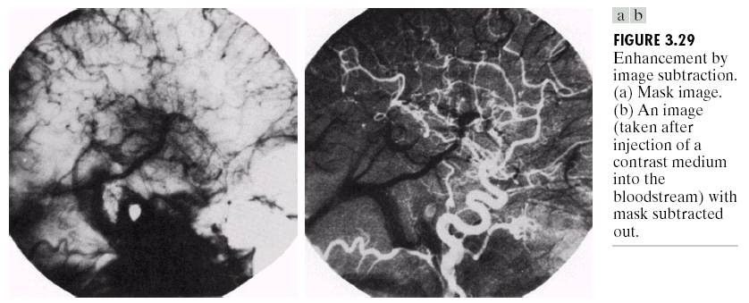
Fig. 3.29(a) shows a mask image and Fig. 3.29(b) shows an image with the mask subtracted out.

Slide 46
Image Averaging
An noisy image g(x,y) is formed by the original image f(x,y) and an additive noise (x,y), i.e.,
If (x,y) is uncorrelated and has zero mean and
then
where is the expected value of , and and
are the variances of and , all at coordinates (x,y).
(3.4-2)
,
(3.4-3)
,
(3.4-4)
,
(3.4-5)

Slide 47
The standard deviation at any point in the average image is:
Fig. 3.30 shows the original image (a), the noisy image (b), and the corresponding averaging images with K=8, 16, 64, and 128, respectively ((c) ~ (f)).
Fig. 3.31 shows the four difference images between the original image (Fig. 3.30(a)) and the four averaging images (Fig. 3.30(c) ~ (f)) and their corresponding histograms.
(3.4-6)

Slide 48
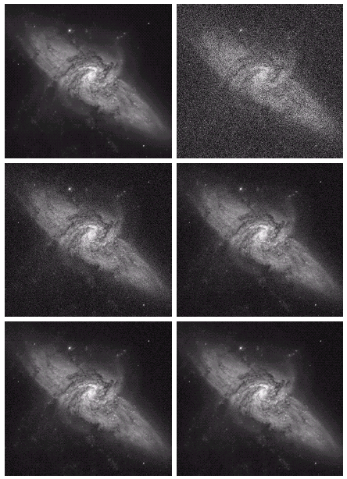
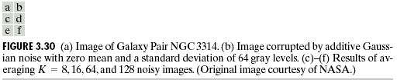

Slide 49
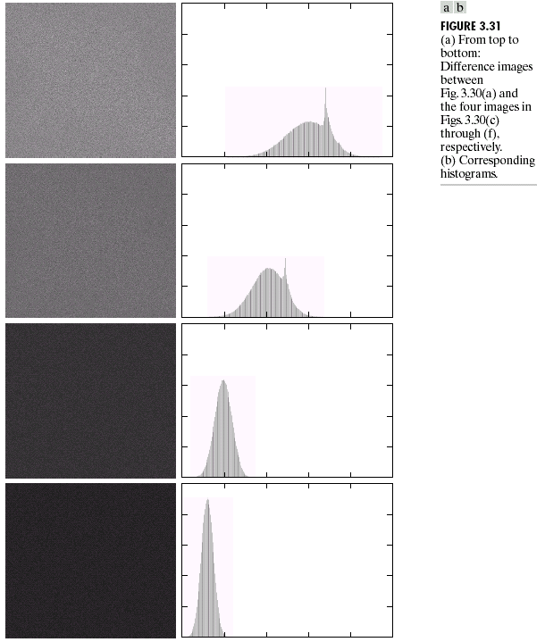

Slide 50
Basis of Spatial Filtering
Spatial filtering operations work with the values of image pixels in the neighborhood and the corresponding values of a subimage (window).
For the mask (window) in Fig. 3.32, the response R of linear filtering is:
which is the sum of products of the mask coefficients with the corresponding pixels directly under the mask.

Slide 51
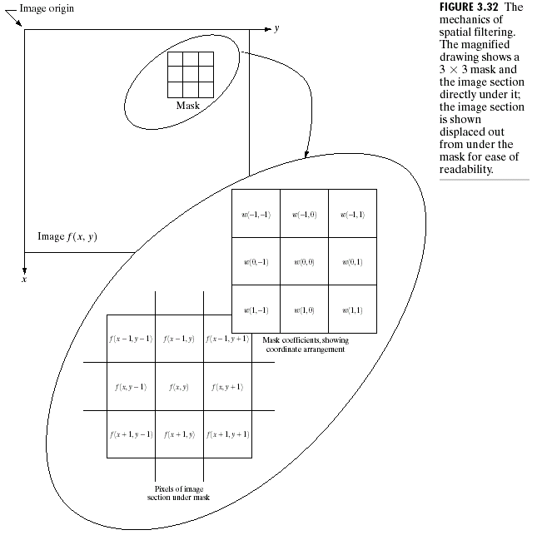
For a mask of size , m and n are usually identical odd numbers, such as …. In general, m=2a+1, n=2b+1.

Slide 52
In general, linear filtering of an image f of size with a filter mask of size is given by the expression:
where a = (m - 1)/2 and b = (n - 1)/2.
Simply the response, R, of an mask at any point (x,y) is:
where the w’s are mask coefficients, the z’s are the values of the image gray levels corresponding to those coefficients, and mn is the total number of coefficients in the mask.
For example, for the general mask shown in Fig. 3.33, the response R at any point (x,y) in the image is given by:
(3.5-1)
,
,
(3.5-2)
(3.5-3)

Slide 53
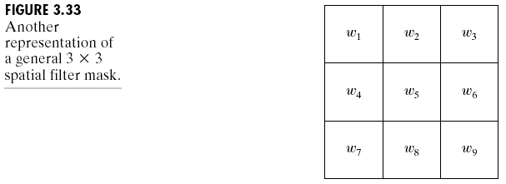

Slide 54
Smoothing Spatial Filters
Smoothing filters are used for blurring and for noise reduction.
Blurring is used in preprocessing steps.
Noise reduction can be accomplished by blurring with a linear filter or by nonlinear filtering.

Slide 55
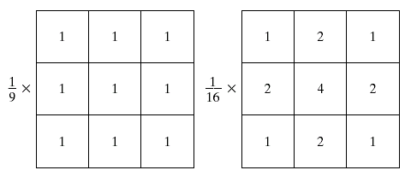
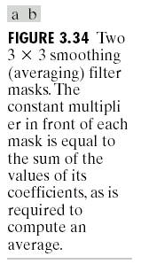
Smoothing Linear Filters
The response of a smoothing, linear spatial filter (also called an averaging filter or a low-pass filter) is simply the average of the pixels contained in the neighborhood of the filter mask (Fig. 3.34(a)).
Fig. 3.34(b) shows the weighted averaging filter, where the sum of the weighting coefficients is used to “normalize” the response.
Fig. 3.34

Slide 56
The general implementation for filtering an image with a weighted averaging filter of size (2a+1) × (2b+1) is:
Fig. 3.35 shows the smoothed results by using square averaging filters of sizes n=3, 5, 9, 15, and 35, respectively.
Fig. 3.36 show the resulted images of applying averaging (b) and then thresholding (c).
(3.6-1)

Slide 57
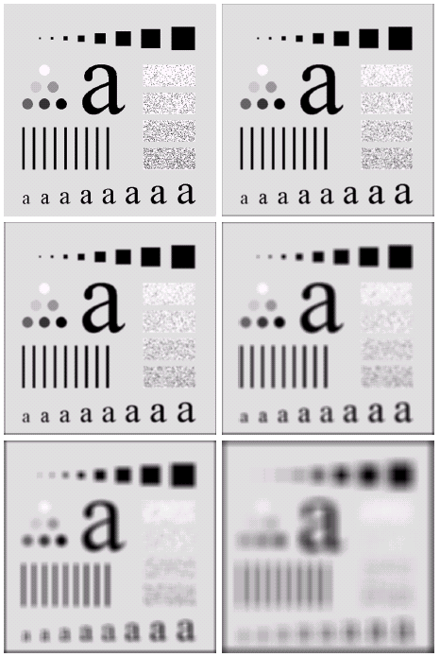
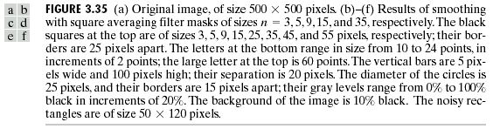

Slide 58
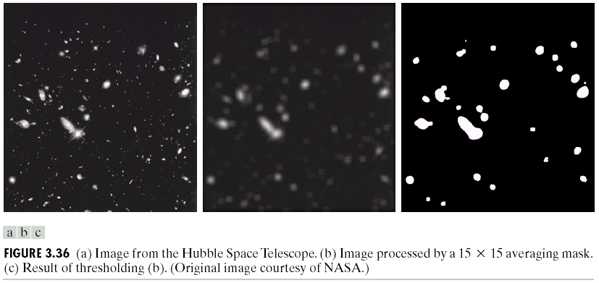

Slide 59
Order-Statistics Filters
Order-statistics filters are nonlinear filters whose response is based on ordering (ranking) the pixels contained in the subimage.
The median filter, an order-statistics filter, replaces the value of a pixel by the median of the gray levels in the neighborhood of that pixel.
Median filters are effective in the presence of impulse noise (also called pepper-and-salt noise).
The median, , of a set of values is such that half the values in the set are less than or equal to and half are greater than or equal to .
For example, the median of {1, 3, 3, 4, 5, 6, 7} is 4.
Usually the number n of values in the set is odd.

Slide 60
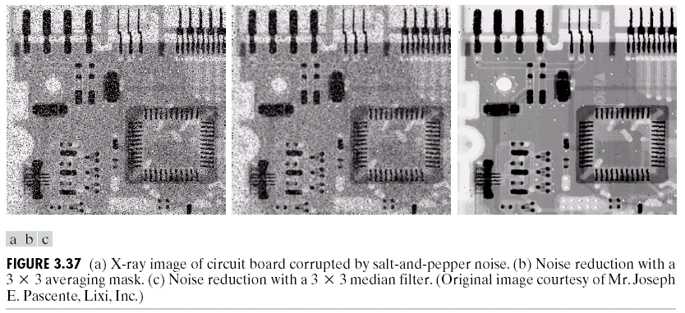
The max and min filters can be similarly defined as:
and
An illustrated noise reduction example of applying a
median filter is shown in Fig. 3.37.

Slide 61
Sharpening Spatial Filters
Sharpening is to highlight fine detail in an image or to enhance detail that has been blurred.
Sharpening can be accomplished by spatial differentiation.
Image differentiation enhances edges and other discontinuities and de-emphasizes areas with slowly varying gray-level values.

Slide 62
Foundation of Sharpening Filters
Sharpening filters can be based on first- and second-order derivatives.
A first derivative must be:
(1) zero in flat segments,
(2) nonzero at the onset of a gray-level step or ramp,
(3) nonzero along ramps.
A second derivative must be:
(1) zero in flat areas,
(2) nonzero at the onset and end of a gray-level step or
ramp,
(3) zero along ramps of constant slope.

Slide 63
The first-order derivative of a 1-D function f(x) is the difference:
The second-order derivative of a 1-D function f(x) is the difference:
A simple example is shown in Fig. 3.38.

Slide 64
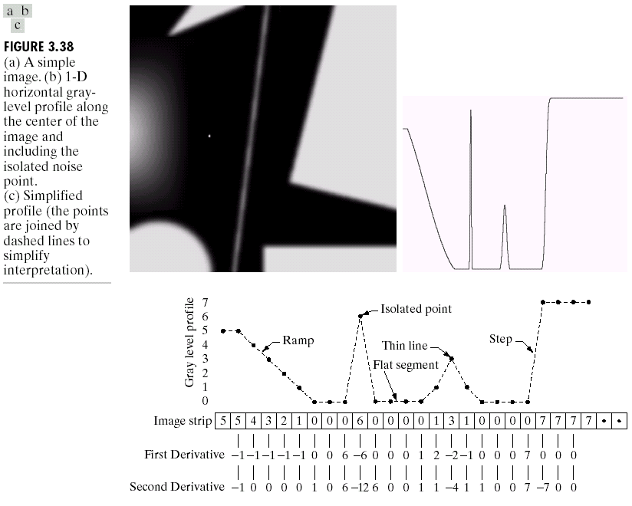

Slide 65
(1) The first-order derivative is nonzero along the entire ramp, whereas the second-order derivative is nonzero only at the onset and end of the ramp.
(2) First-order derivatives produce “thick” edges and second-order derivatives produce much finer ones.
(3) Second-order derivatives have a stronger response to fine detail, such as thin lines and isolated points, whereas first-order derivatives generally have a stronger response to a gray level step.
(4) Second-order derivatives produce a double response at step changes in gray level.

Slide 66
The Laplacian Operator
The response of a 2-D isotropic filter (or a rotation-invariant filter) is independent of the direction of the discontinuities in the image to which the filter is applied.
The simplest isotropic derivative operator is the Laplacian operator defined by:
which is a linear operator.
(3.7-1)
,
(3.7-2)
,
(3.7-3)
(3.7-4)

Slide 67
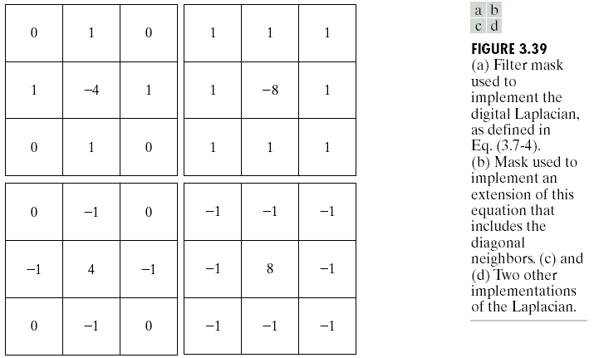
Fig. 3.39(a) shows the filter mask used to implement digital Laplacian, Fig. 3.39(b) shows the extended filter mask for digital Laplacian, and Fig. 3.39(c) and (d) shows the two other implementations of digital Laplacian.

Slide 68
The basic way of using the Laplacian for image enhancement is:
If the Laplacian image superimposed on a dark, featureless background, background features can be recovered while still preserving the sharpening effect of the Laplacian operation by Eq. (3.7-5) (adding).
if the center coefficient of the
Laplacian mask is negative,
,
(3.7-5)
,
if the center coefficient of the
Laplacian mask is positive.

Slide 69
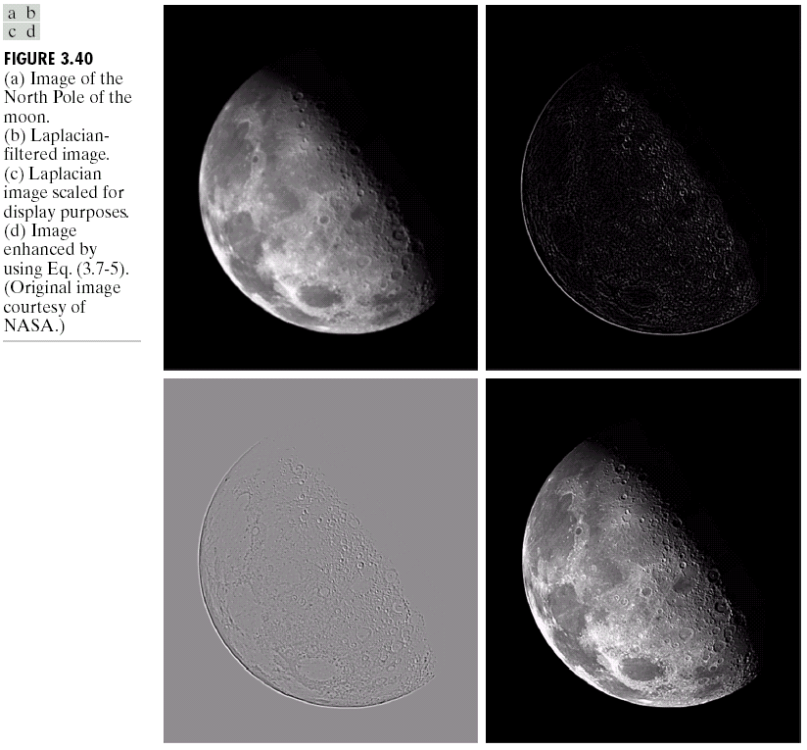
Fig. 3.40 shows the original image, the Laplacian filtered image, the Laplacian image scaled for display purposes, and the image enhanced by Eq. (3.7-5).

Slide 70
Composite Laplacian Implementation
Eq. (3.7-5) can be implemented by:
i.e., implemented by the composite Laplacian mask shown in Fig. 3.41(a).
If digital Laplacian is implemented by the extended mask in Fig. 3.39(b), then Eq. (3.7-5) can be implemented by the composite Laplacian mask shown in Fig. 3.41(b).
The processed images of the SEM image in Fig. 3.41(c) using the two composite Laplacian masks are shown in Fig. 3.41(d) and (e).
,
(3.7-6)

Slide 71
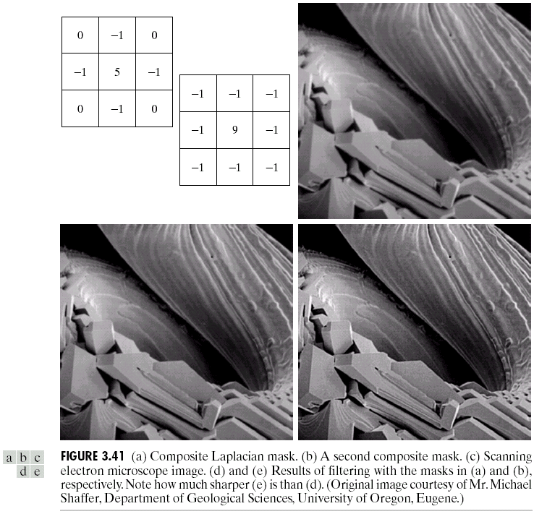

Slide 72
Unsharp Masking and High-boost Filtering
Sharpening images can be implemented by subtracting a blurred version of an image from the image itself, i.e., unsharp masking, which is:
where f_{s}(x,y) denotes the sharpened image and is a blurred version of f(x,y).
(1) Subtract the blurred version from the original (called the mask).
(2) Add the mask to the original.
,
(3.7-7)

Slide 73

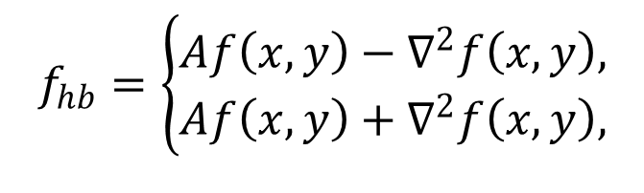
A high-boost filtered image, f_{hb}, is defined as:
where and is a blurred version of f, i.e.,
By using Eq. (3.7-7), we obtain
as the expression for computing a high-boost-filtered image.
If f_{s}(x,y) can be obtained using Eq. (3.7-5), then
$$f_{hb}\left(x,y\right)=Af\left(x,y\right)−\bar{f}\left(x,y\right),$$
(3.7-8)
$$f_{hb}\left(x,y\right)=\left(A−1\right)f\left(x,y\right)+f\left(x,y\right)−\bar{f}\left(x,y\right).$$
(3.7-9)
$$f_{hb}\left(x,y\right)=\left(A−1\right)f\left(x,y\right)+f_{s}\left(x,y\right),$$
(3.7-10)
$$f_{hb}=\left\{\begin{aligned}Af\left(x,y\right)−∇^{2}f\left(x,y\right), \\ Af\left(x,y\right)+∇^{2}f\left(x,y\right),\end{aligned}\right.$$
if the center coefficient of the
Laplacian mask is negative,
(3.7-11)
if the center coefficient of the
Laplacian mask is positive.

Slide 74
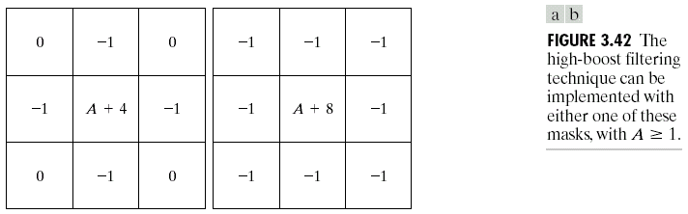
High-boost filtering can be implemented with one pass using either of the two masks shown in Fig. 3.42. Note that, when A=1, high-boost filtering becomes “standard” Laplacian sharpening.

Slide 75
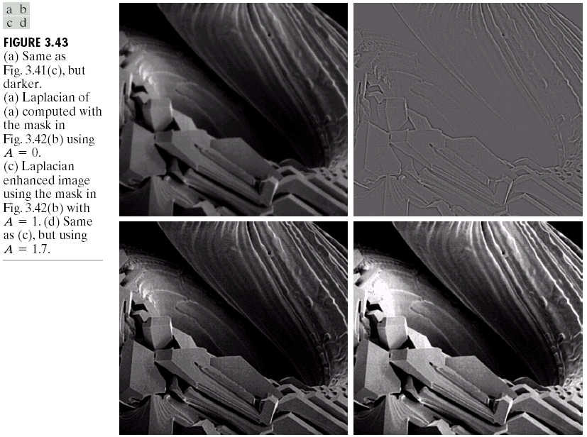
One application of boost filtering is when the input image is darker than desired. Fig. 3.43 shows an illustrated example applying the masks in Fig. 3.42.

Slide 76


First Derivatives for Enhancement-The Gradient
For a function f(x,y), the gradient of f at coordinates (x,y) is defined as:
The magnitude of this vector is given by
$$∇f=\left[\begin{aligned}G_{x} \\ G_{y}\end{aligned}\right]=\left[\begin{aligned}\frac{∂f}{∂x} \\ \frac{∂f}{∂y}\end{aligned}\right].$$
(3.7-12)
$$∇f=mag\left(∇f\right)={\left[G_{x}^{2}+G_{y}^{2}\right]}^{\frac{1}{2}} \\ ={\left[{\left(\frac{∂f}{∂x}\right)}^{2}+{\left(\frac{∂f}{∂y}\right)}^{2}\right]}^{\frac{1}{2}}.$$
(3.7-13)

Slide 77
The two components of the gradient vector are linear operators, but the magnitude of the vector is not.
The partial derivatives the gradient are not rotation invariant (isotropic), but the magnitude of the gradient vector is isotropic.
An approximate of the magnitude of the gradient is:
(3.7-14)

Slide 78
As the region shown in Fig. 3.44(a), Roberts defined:
and
<i> Using Eq. (3.7-13), we have:
<ii> Using Eq. (3.7-14), we have:
<iii> The masks shown in Fig. 3.44(b) and (c) can
implement Eq. (3.7-17), which are the Roberts cross- gradient operators.
An approximate using absolute values involving a
region is:
which can be implemented by the two masks shown in Fig. 3.44(d) and (e) (called the Sobel operators).
(3.7-15)
(3.7-16)
(3.7-17)
(3.7-18)

Slide 79
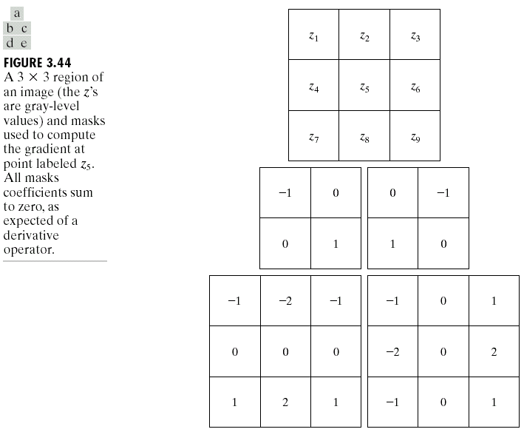

Slide 80
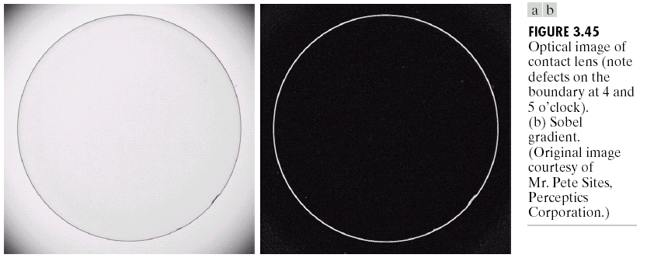
Fig. 3.45(a) shows an optical image of contact lens and Fig. 3.45(b) shows the Sobel gradient.

Slide 81
Combining Spatial Enhancement Methods
The image shown in Fig. 3.46(a) is a nuclear whole body bone scan, used to detect diseases. We want to enhance the image by sharpening it and by bringing out more of the skeletal detail.
We use digital Laplacian to highlight the fine detail, and digital gradient to enhance prominent edges. Finally, we can increase the dynamic range of the gray levels by using a gray-level transformation.

Slide 82




Fig. 3.46 shows all the intermediate and final processing results.

