Slide 1
Chapter 7 WAVELETES AND MULTIRESOLUTION PROCESSING
All this time, the guard was looking at her, first through a telescope, then through a microscope, and then through an opera glass. Lewis Carrol, through the Looking Glass
Multiresolution theory incorporates and unifies
techniques from a variety of disciplines, including
subband coding, quadrature mirror filtering (QMF),
and pyramid image processing.

Slide 2
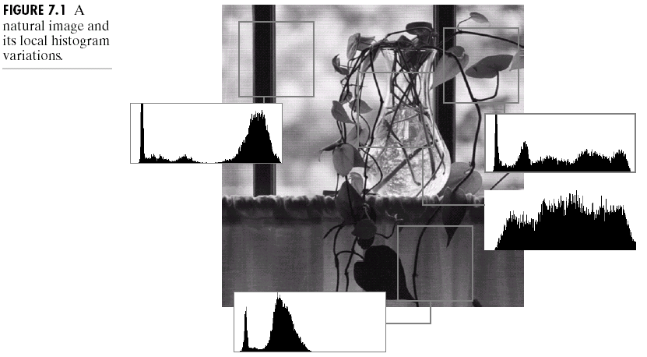
Background
As shown in Fig. 7.1, even first-order statistics vary significantly from one part of an image to another.
➔ It can be advantageous to study images at serveral resolutions, i.e., “multiresolution processing.”

Slide 3
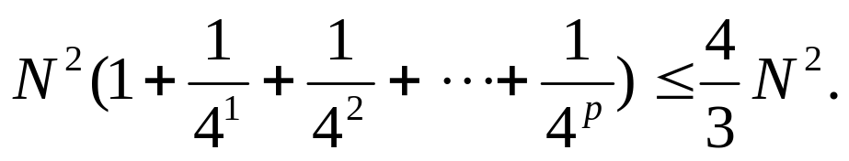
Image Pyramids
A powerful, but conceptually simple structure for representing images at more than one resolution is the image pyramid. As shown in Fig. 7.2(a), the base of the pyramid contains a high-resolution representation of the image and the apex contains a low-resolution approximation.
  (1) The base level J is size 2^{J} × 2^{J} or N × N, where J = log₂N.
  (2) Each intermediate level j is size 2^{j} × 2^{j}, where 0 ≤ j ≤ J.
  (3) Full populated pyramids are composed of J+1 resolution levels from 2^{J} × 2^{J} to 2⁰ × 2⁰.
  (4) The total number of elements a P+1 level pyramid is:

Slide 4
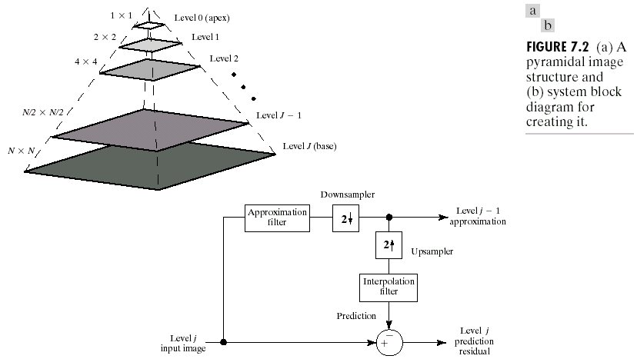
Fig.7.2(b) shows a system for constructing image pyramids.
The level j prediction residual output of Fig. 7.2(b) is used to build prediction residual pyramids, which contain a low-resolution approximation of the original image.
Note that all operations, including filtering, downsampling, and upsampling, are two-dimensional.

Slide 5
Approximation and prediction residual pyramids are computed in an iterative fashion.
  During the first iteration, j = J and the original 2^{J} × 2^{J} image is applied as the level J input image. This produces the level J-1 approximation and level J prediction residual results.
Each iteration (pass) is composed of three sequential steps:
  (1) Compute a reduced-resolution approximation of the input image (factor 2).
  (2) Upsample the output of the previous step (factor 2).
  (3) Compute the difference between the prediction of Step 2 and the input to Step 1 (the level j prediction residual).
Step 1 can be done by filtering the input and down sampling (subsampling) the filtered result by a factor 2.
  A mean pyramid by neighboring averaging, a Gaussian pyramid by lowpass Gaussian filtering, and a subsampling pyramid (without filtering).

Slide 6
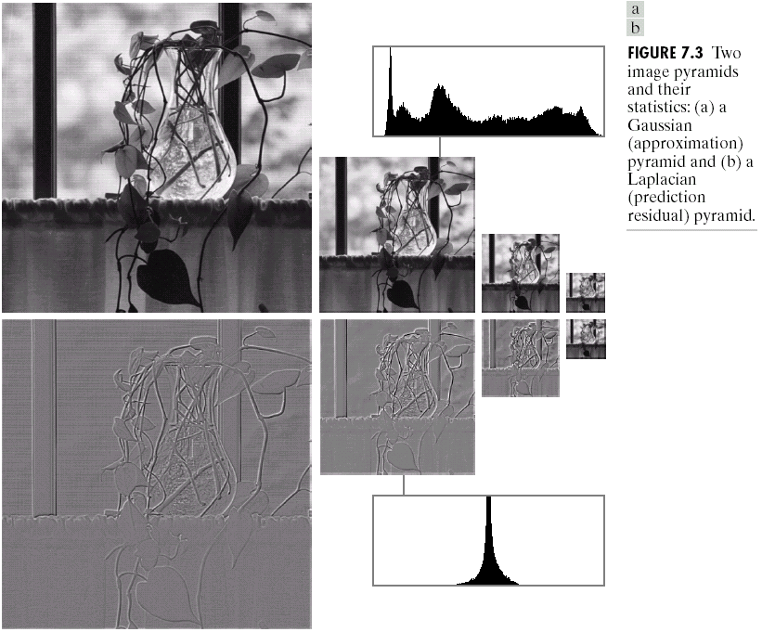
Fig. 7.3 show a Gaussian (approximation) pyramid and a Laplacian (prediction residual) pyramid.

Slide 7
The first-order statistics of the prediction residual images in the Laplacian pyramid are highly peaked around zero, which can be highly compressed.

Slide 8

Subband Coding
In subband coding, an image is decomposed into a set of band-limited components, called subbands, which can be reassembled to reconstruct the original image without error.
Fig. 7.4(a) shows the principal components of a two-band subband coding and decoding system.
  The input of the system is a one-dimensional, band-limited discrete-time signal x(n) for n = 0,1,2,…; the output sequence, , is formed through the decomposition of x(n) into y₀(n) and y₁(n) via analysis filters h₀(n) and h₁(n), and subsequent recombination via synthesis filters g₀(n) and g₁(n).
  Filters h₀(n) and h₁(n) are half-band digital filters whose idealized transfer characteristics, H₀ and H₁, are shown in Fig. 7.4(b). Filter H₀ is a lowpass filter whose output is an approximation of x(n); filter H₁ is a highpass filter whose output is the high frequency or detail part of x(n).

Slide 9

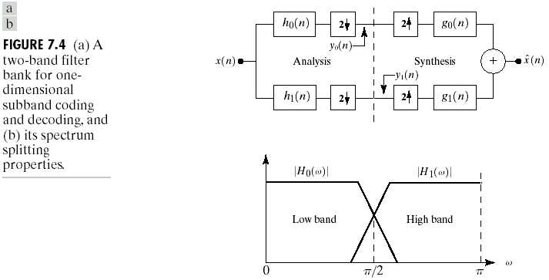
  We wish to select h₀(n), h₁(n), g₀(n), and g₁(n) (or, alternately H₀, H₁, G₀, and G₁) so that the input can be reconstructed perfectly, i.e.,

Slide 10
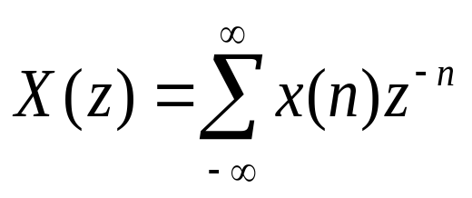
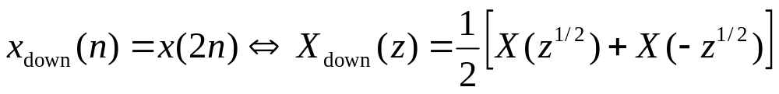
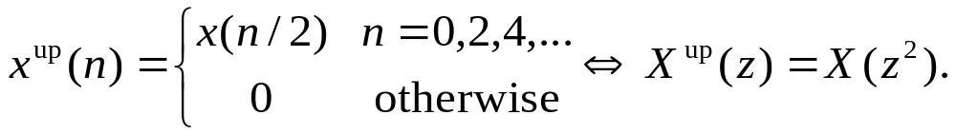
Z-transform
The Z-transform of sequence x(n) for n = 0, 1, 2, … is:
(7.1-1)
where z is a complex variable. If z=e^{jw}, Eq. (7.1-1) becomes the discrete Fourier transform of x(n).
Downsampling and upsampling by a factor of 2 in the time domain corresponds to:
(7.1-2)
(7.1-3)

Slide 11

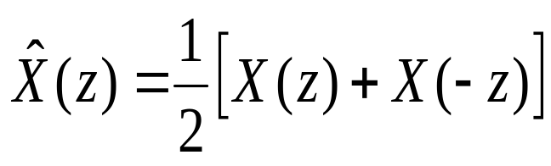
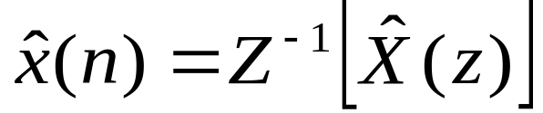
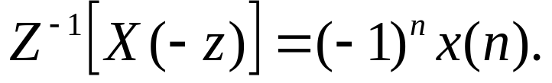
If sequence x(n) is downsampled and subsequently upsampled to yield , Eqs. (7.1-2) and (7.1-3) combine to yield:
(7.1-4)
where is the resulting downsampled-upsampled sequence. The X(-z) is the Z-transform of an aliased or modulated version of sequence x(n) with:
(7.1-5)

Slide 12
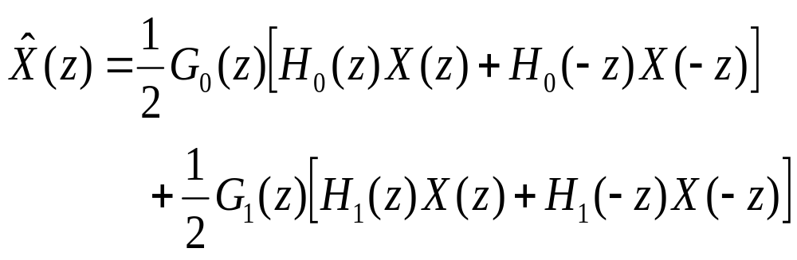
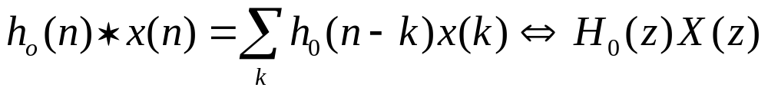
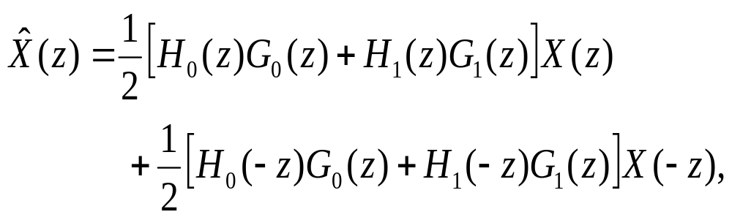
Perfect reconstruction
The system output is:
(7.1-6)
where
(7.1-7)
  ➔
  (7.1-8)
  where the second component represents the aliasing that is introduced by the downsampling-upsampling process.

Slide 13
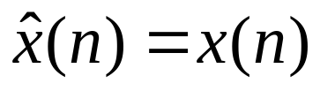
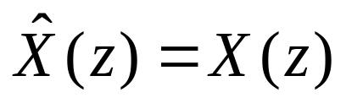
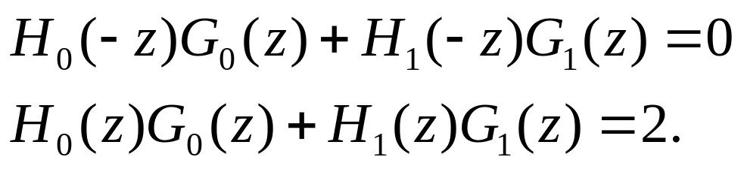
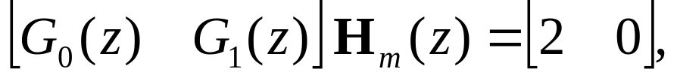
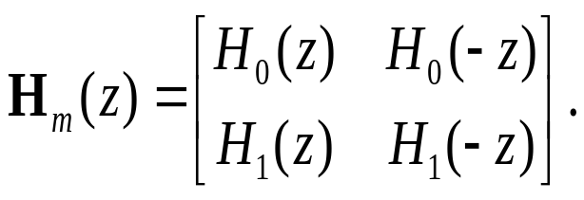
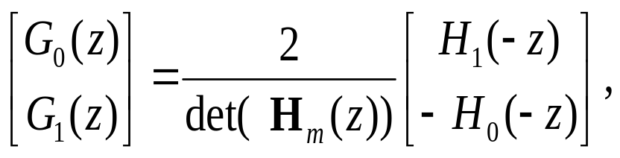
For error-free reconstruction of the input, and
, i.e., we have:
(7.1-9)
(7.1-10)
  ➔ (7.1-11)
  where analysis modulation matrix H_{m}(z) is:
  (7.1-12)
  Assuming H_{m}(z) is nonsingular, we have:
  (7.1-13)
  where det(H_{m}(z)) denotes the determinate of H_{m}(z), i.e., G₁(z) is a function of H₀(-z), where as G₀(z) is a fuction of H₁(-z).

Slide 14
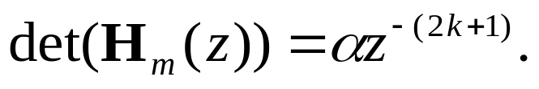

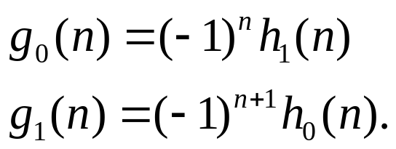
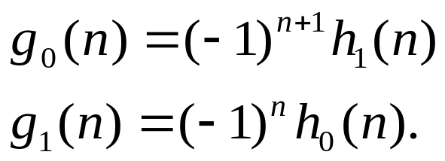
For finite impulse response (FIR) filters, the determinate of the modulation matrix is a pure delay, i.e.,
Thus, the exact form of the cross-modulation is a function of .
  Ignore the delay, letting = 2, we have:
  (7.1-14)
  If = -2, we have:
  (7.1-15)

Slide 15
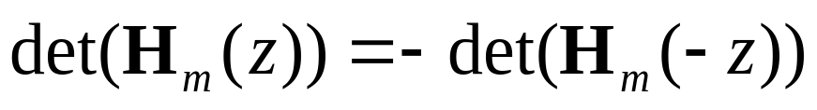
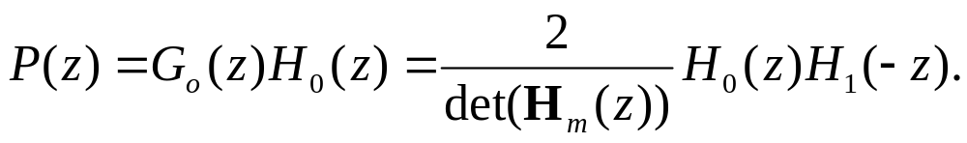
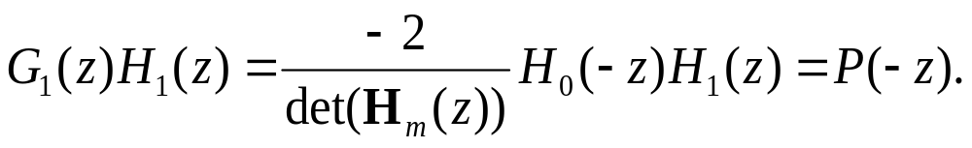

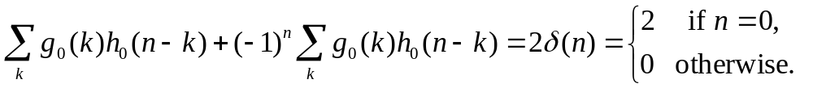
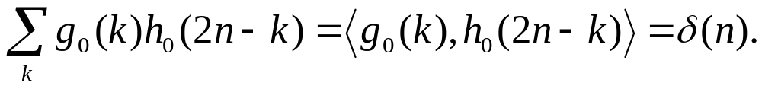
Biorthogonality of analysis and synthesis filters
From Eq. (7.1-13) and based on the fact that
, we have:
(7.1-16)
(7.1-17)
  Eq. (7.1-10) becomes:
  (7.1-18)
  Taking the inverse Z-transform, we have:
  After simplification yields:
  (7.1-19)

Slide 16
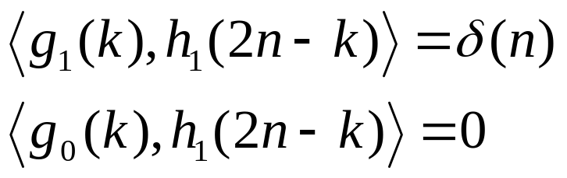
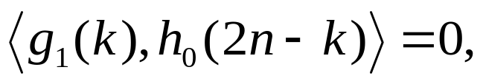
  Similarly, we can also show that:
  (7.1-20)
  In general,
  (7.1-21)
  Filter banks satisfying this condition are called biorthogonal.

Slide 17
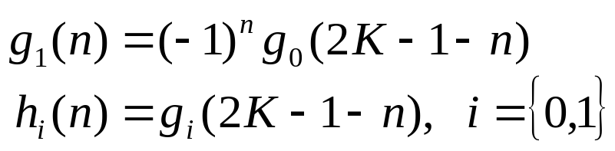
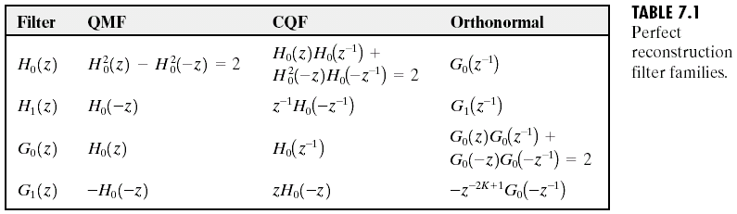
Table 7.1 gives three general solutions to Eqs. (7.1-9) and (7.1-10). Columns 1 and 2 of Table 7.1 are classic results from the filter bank literature — namely, quadrature mirror filters (QMFs) and conjugate quadrature filters (CQFs).
  Column 3 of Table 7.1 are called orthonormal. Satisfying:
  (7.1-22)
  which defines orthonormality for perfect reconstruction filter banks, and
  (7.1-23)
  where h₀, h₁, g₀, and g₁ are the impulse responses of the defined orthonormal filters.

Slide 18
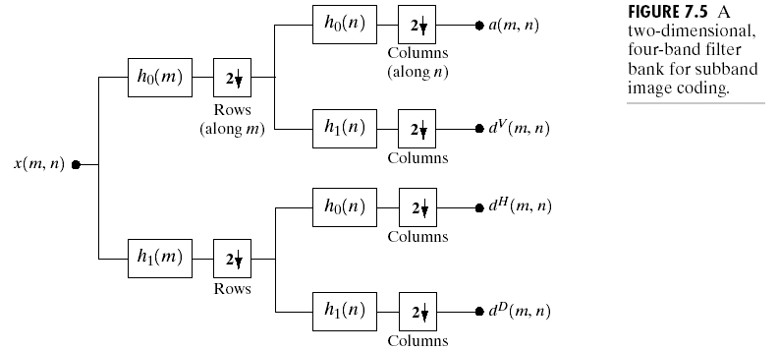
The one-dimensional filters in Table 7.1 can be used as two-dimensional separable filters for the processing of images. The resulting filtered outputs, denoted a(m, n), d^{V}(m, n), d^{H}(m, n), and d^{D}(m, n) in Fig. 7.5, are called the approximation, vertical detail, horizontal detail, and diagonal detail subbands of the image, respectively.

Slide 19
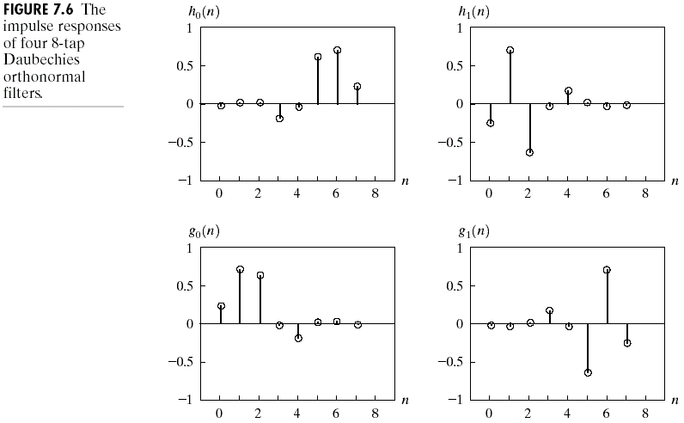
Figure 7.6 shows the impulse responses of four 8-tap orthonormal filters. The coefficients of lowpass filter h₀(n) for 0 ≤ n ≤ 7 are -0.01059740, 0.03288301, 0.03084138,
-0.18703481, -0.02798376, 0.63088076, 0.71484657, and 0.23037781 (Daubechies [1992]); the coefficients of the remaining orthonormal filters can be computed using Eq. (7.1-23).

Slide 20
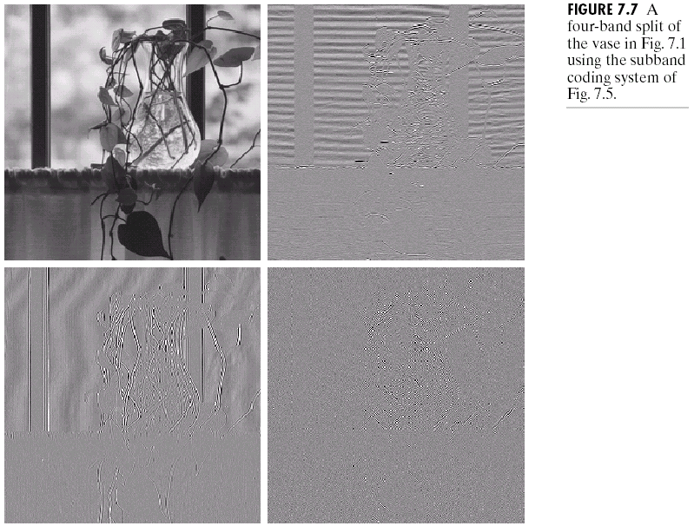
A four-band split of the 512 × 512 image of a vase in Fig. 7.1, based on the filters in Fig. 7.6, is shown in Fig. 7.7. Each quadrant of this image is a subband of size 256 × 256.

Slide 21

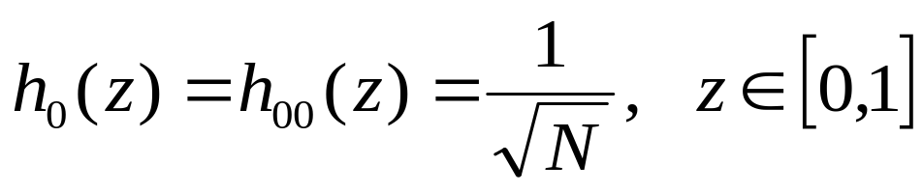
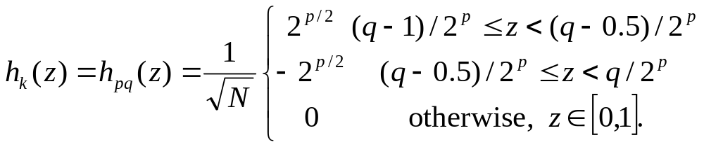
The Haar Transform
The Haar transform itself is both separable and symmetric and can be expressed in matrix form:
(7.1-24)
where F is an N×N image matrix, H is an N×N transformation matrix, and T is the resulting N×N transform.
To generate H, we define the integer k such that k = 2^{p}+q-1, where 0 ≤ p ≤ n-1, q = 0 or 1 for p = 0, and 1 ≤ q ≤ 2^{p} for p ≠ 0. Then the Haar basis functions are:
(7.1-25)
(7.1-26)

Slide 22
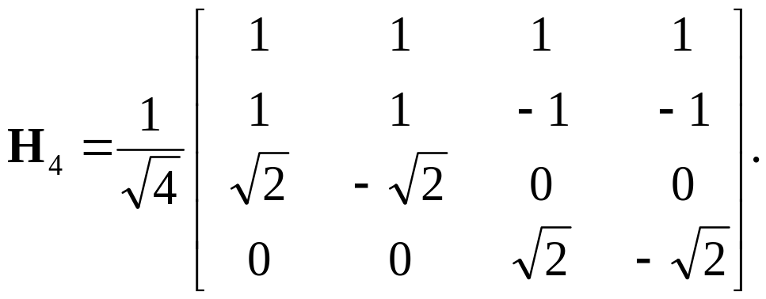
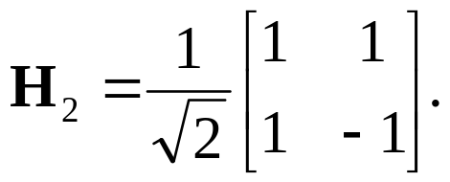
  The ith row of an N×N Haar transformation matrix contains the elements of h_{i}(z) for z = 0/N, 1/N, 2/N, …, (N-1)/N. If N=4, for example, k, q, and p assume the values:
  and the 4 × 4 transformation matrix, H₄, is:
  (7.1-27)
  Similarly, the 2 × 2 transformation matrix, H₂, is:
  (7.1-28)
k | p q
0 0 0 1 0 1 2 1 1 3 1 2

Slide 23
Figure 7.8(a) shows a multiresolution-based decomposition of Fig. 7.1 using the Haar basis functions of Eqs. (7.1-25) and (7.1-26). This representation is called the discrete wavelet transform.
  Some properties:
  1. Its local statistics are relatively constant and easily modeled. See Fig. 7.8(a).
  2. Many of its values are close to zero. This makes it an excellent candidate for image compression.
  3. Both coarse and fine resolution approximations of the original image can be extracted from it. Fig. 7.8(b)-(d) was reconstructed from the subimages of Fig. 7.8(a).

Slide 24
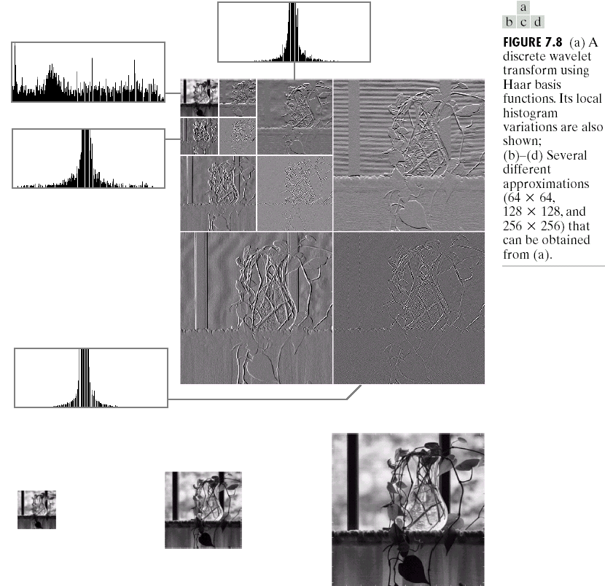

Slide 25
Multiresolution Expansions
In multiresolution analysis (MRA), a scaling function is used to create a series of approximations of a function or image, each differing by a factor of 2 from its nearest neighboring approximations.
  Additional functions, called wavelets, are then used to encode the difference in information between adjacent approximations.

Slide 26
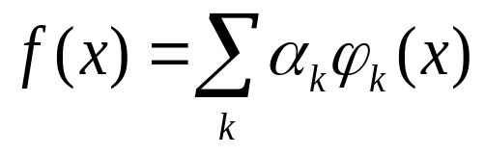

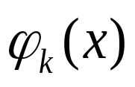
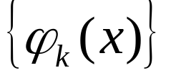
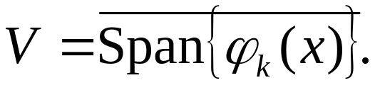

Series expansions
A signal or function f(x) can often be better analyzed as a linear combination of expansion functions:
(7.2-1)
where k is an integer index of the finite or infinite sum, the are real-value expansion coefficients, and the are real-valued expansion functions.
If the expansion is unique, the are called basis functions, and the expansion set, , is called a basis for the class of functions that can be so expressed.
The expressible functions form a function space, i.e., the closed span of the expansion set, denoted by:
(7.2-2)
Here f(x)∈V means that f(x) is in the closed span of
and can be written in the form of Eq. (7.2-1).

Slide 27
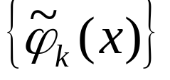

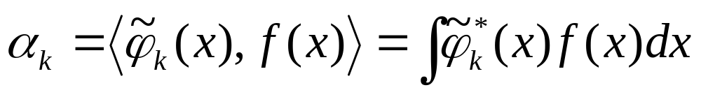
For any function space V and corresponding expansion set , there is a set of dual functions, denoted , that can be used to compute the coefficients of Eq. (7.2-1) for any f(x)∈V. That is,
(7.2-3)
where the * denotes the complex conjugate operation.

Slide 28
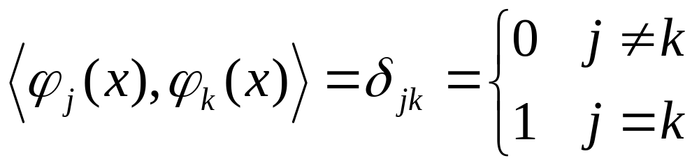
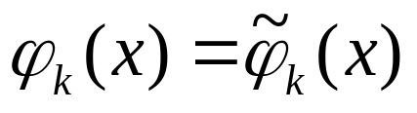
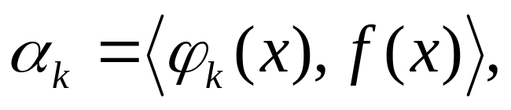
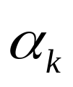
Three cases of series expansions
Case 1: If the expansion functions form an orthonormal basis for V, or equivalently:
(7.2-4)
the basis and its dual are equivalent. That is,
and Eq. (7.2-3) becomes
(7.2-5)
the are computed as the inner products of the basis functions and f(x).

Slide 29


Case 2: If the expansion functions are not orthonormal, but are an orthogonal basis for V, then
(7.2-6)
and the basis functions and their duals are called biorthogonal. The are computed using Eq. (7.2-3), and the biorthogonal basis and its dual are such that
(7.2-7)

Slide 30


Case 3: If the expansion set is not a basis for V, but supports the expansion defined in Eq. (7.2-1), it is a spanning set in which there is more than one set of for any f(x)∈V. The expansion functions and their duals are said to be overcomplete or redundant. They form a frame in which
(7.2-8)
for some A > 0, B < ∞, and all f(x)∈V.
  If A = B, the expansion set is called a tight frame and it can be shown that (Daubechies [1992])
  (7.2-9)

Slide 31






Scaling functions
Consider the set of expansion functions composed of integer translations and binary scalings of the real, square-integrable function ; that is, the set where
(7.2-10)
for all j,k∈Z and . Here, k determines the position of along the x-axis, j determines ’s
width–how broad or narrow it is along the x-axis–and 2^{j/2} controls its height or amplitude.
Because the shape of changes with j, is called a scaling function. By choosing wisely, can be made to span L²(R), the set of all measurable, square-integrable functions.

Slide 32









!
We define a subspace:
(7.2-11)
That is, is the span of over k. If , it can be written:
(7.2-12)
  Let j = j₀, the resulting expansion set, , is a subset of
  .
In general, we will denote the subspace spanned over k for any j as:
(7.2-13)

Slide 33





Consider the unit-height, unit-width scaling function (Haar [1910]):
(7.2-14)
Figure 7.9(a)-(d) shows four of the many expansion functions that can be generated by substituting this pulse-shaped scaling function into Eq. (7.2-10).
  Figure 7.9(e) shows a member of subspace V₁. This function does not belong to V₀ because the V₀ expansion functions in 7.9(a) and (b). Fig. 7.9(e) represents the function:
  Fig. 7.9(f) illustrates the decomposition of as a sum of V₁ expansion functions. Similarly, any V₀ expansion function can be decomposed using:
  Thus, if f(x) is an element of V₀, it is also an element of V₁. Equivalenly:

Slide 34


Slide 35

Four requirements of MRA
MRA Requirement 1: The scaling function is orthogonal to its integer translates.
MRA Requirement 2: The subspaces spanned by the scaling function at low scales are nested within those spanned at higher scales. That is,
(7.2-15)
  If f(x) ∈ V_{j}, then f(2x) ∈ V_{j+1}.

Slide 36





MRA Requirement 3: The only function that is common to all V_{j} is f(x)=0, i.e.,
V_{-∞}={0}. (7.2-16)
MRA Requirement 4: Any function can be represented with arbitrary precision, i.e.,
V∞={L²(R)}. (7.2-17)
Under these conditions, the expansion functions of subspace V_{j} can be expressed as a weighted sum of the expansion functions of subspace V_{j+1}. Using Eq. (7.2-12), we let
where the index of summation has been changed to n for clarity. Substituting for from Eq. (7.2-10) and changing variable to , this becomes:

Slide 37





  The simple expression with
  (7.2-18)
  The h_{φ}(n) coefficients in this recursive equation are called scaling function coefficients; h_{φ} is referred to as a scaling vector.
  Equation (7.2-18) is fundamental to multiresolution analysis and is called the refinement equation, the MRA equation, or the dilation equation.
  Eq. (7.2-18) states that the expansion functions of any subspace can be built from double-resolution copies of themselves-that is, from expansion functions of the next higher resolution space.
The scaling function coefficients for the Haar function of Eq. (7.2-14) are , the first row of matrix H₂ in Eq. (7.2-18). Thus, Eq. (7.2-18) yields:
This decomposition was illustrated graphically for in Fig. 7.9(f).

Slide 38





Wavelet functions
We can define a wavelet function that, together with its integer translates and binary scalings, spans the difference between any two adjacent scaling subspaces, V_{j} and V_{j+1}.
As shown in Fig. 7.11, we define the set of wavelets:
(7.2-19)
for all k ∈ Z, that spans the W_{j} spaces in the figure. As with scaling functions, we write
(7.2-20)
and note that if f(x) ∈ W_{j},
(7.2-21)

Slide 39

The scaling and wavelet function subspaces in Fig. 7.11 are related by:
V_{j+1} = V_{j}⊕W_{j} (7.2-22)
where ⊕ denotes the union of spaces (like the union of sets). The orthogonal complement of V_{j} in V_{j+1} is W_{j}, and all members of V_{j} are orthogonal to the members of W_{j}, i.e.,
(7.2-23)
for all appropriate j,k,l ∈ Z.
We can now express the space of all measurable, square-integrable functions as:
L²(R) = V₀⊕W₀⊕W₁⊕… (7.2-24)
L²(R) = V₁⊕W₁⊕W₂⊕… (7.2-25)
L²(R) = …⊕W₋₂⊕W₋₁⊕W₀⊕W₁⊕W₂⊕…, (7.2-26)

Slide 40

Because V₁=V₀⊕W₀, if f(x) is an element of V₁, but not V₀, Eq. (7.2-24) contains an approximation of f(x) using V₀ scaling functions; wavelets from W₀ would encode the difference between this approximation and the actual function.

Slide 41






Eqs. (7.24) through (7.2-26) can be generalized to yield:
(7.2-27)
where j₀ is an arbitrary starting scale.
Any wavelet function can be expressed as a weighted sum of shifted, double-resolution scaling functions, i.e.,
(7.2.28)
where the are called the wavelet function coefficients and is the wavelet vector.
Wavelets span the orthogonal complement spaces in Fig. 7.11, and that integer wavelet translates are orthogonal, it can be shown that is related to by:
(7.2-29)

Slide 42







The Haar scaling vector was defined as:
Using Eq. (7.2-29), the corresponding wavelet vector is
Note that these coefficients correspond to the second row of matrix H₂ in Eq. (7.1-28). Substituting these values into Eq. (7.2-28) we get , which is plotted in Fig. 7.12(a). Thus, the Haar wavelet function is:
(7.2-30)
  Using with Eq. (7.2-19), we can now generate the universe of scaled and translated Haar wavelets. Two such wavelets,
  and , are plotted in Fig. 7.12(b) and (c), respectively.
  Figure 7.12(d) shows a function of subspace V₁ that is not in subspace V₀.

Slide 43


  Using V₀ and W₀ expansion functions, the resulting expansion is:
  f(x) = f_{a}(x) + f_{d}(x)
  where
  Here, f_{a}(x) is an approximation of f(x) using V₀ scaling functions, while f_{d}(x) is the difference f (x) - f_{a}(x) as a sum of W₀ wavelets, shown in Fig. 7.12(e) and (f).

Slide 44


Slide 45






Wavelet Series Expansions
We define the wavelet series expansion of function f(x)∈ L²(R) relative to wavelet and scaling function . By Eq. (7.2-27), we can write:
(7.3-1)
where j₀ is an arbitrary starting scale and the ’s and
d_{j}(k)’s are relabeled a_{k}’s from Eqs. (7.2-12) and (7.2-21), respectively.
  The ’s are normally called the approximation or scaling coefficients; the d_{j}(k)’s are referred to as the detail or wavelet coefficients.
  In Eq. (7.3-1), the first term uses scaling function to provide an approximation of f(x) at scale j₀ and the second term, a finer resolution, is a sum of wavelets.
  Based on Eqs. (7.2-5) and (7.2-9), we have:
  (7.3-2)
  (7.3-3)

Slide 46


Consider the simple function:
shown in Fig. 7.13(a). Using Haar wavelets and a starting scale j₀=0, based on Eqs. (7.3-2) and (7.3-3), we have:

Slide 47

  Substituting these values into Eq. (7.3-1), we get the wavelet series expansion:
  (7.3-4)

Slide 48



Slide 49


Discrete wavelet transform
If the function being expanded is a sequence of numbers, like samples of a continuous function f(x), the resulting coefficients are called the discrete wavelet transform (DWT) of f(x).
Eqs.(7.3-1) through (7.3-3) becomes the DWT transform pair, for j ≥ j₀,
(7.3-5)
(7.3-6)
(7.3-7)

Slide 50




  Here, f (x), and are functions of the discrete variable x = 0, 1, 2, …, M-1. Normally, we let j₀ = 0 and select M to be a power of 2 (i.e., M = 2^{J}).
  The coefficients defined in Eqs.(7.3-5) and (7.3-6) are usually called approximation and detail coefficients, respectively.
Consider the discrete function of four points: f (0) = 1, f (1) =4, f (2)= -3, and f (3) = 0. Since M = 4, J = 2 and, with j₀ = 0, the summations are performed over x = 0, 1, 2, 3, j = 0, 1, and k = 0 for j = 0 or k = 0, 1 for j = 1. Using the Haar scaling and wavelet functions with the support = 1 and Eq.(7.3-5), we have:
because for x = 0, 1, 2, 3, i.e., the first row of H₄ in Eq.(7.1-27).

Slide 51






  By Eq. (7.3-6) using the rows 2, 3, 4 of H₄, we have:
  Thus, the discrete wavelet transform of our simple four-sample function relative to the Haar wavelet and scaling function is {1, 4, -1.5 , -1.5 }.
  By Eq. (7.3-7), we have:
  for x=0,1,2,3. If x=0, for instance,

Slide 52


Continuous wavelet transform
The continuous wavelet transform (CWT) transforms a continuous function into a highly redundant function of two continuous variables—translation and scale.
The continuous wavelet transform of a continuous, square-integrable function, f(x), relative to a real-valued wavelet, , is
(7.3-8)
(7.3-9)
and s and τ are called scale and translation parameters, respectively.

Slide 53









“”(((
Given , f(x) can be obtained using the inverse continuous wavelet transform:
(7.3-10)
where
(7.3-11)
and is the Fourier transform of .
Equations (7.3-8) through (7.3-11) define a reversible transformation as long as the so-called admissibility criterion, , is satisfied, or equivalently and and fast enough to make .

Slide 54





&&
Similarities between continuous and discrete wavelet transforms
1. The continuous translation parameter, τ, takes the place of the integer translation parameter, k.
2. The continuous scale parameter, s, is inversely related to the binary scale parameter, 2^{j}.
3. The continuous transform is similar to a series expansion [see Eq. (7.3-1)] or discrete transform [Eq. (7.3-6)] in which the starting scale j₀ = -∞.
4. Like the discrete transform, the continuous transform can be viewed as a set of transform coefficients, , that measure the similarity of f(x) with a set of basis function, . In the continuous case, however, both sets are infinite. Because
is real valued and , each coefficient from Eq. (7.3- 8) is the integral inner product, , of f(x) and .

Slide 55


The Mexican hat wavelet is:
(7.3-12)
  The continuous, one-dimensional function in Fig. 7.14(a) is the sum of two Mexican hat wavelets:
  Its Fourier spectrum is shown in Fig. 7.14(b).
  Figure 7.14(c) shows a portion (1 ≤ s ≤ 10 and τ ≤ 100) of the CWT of the function in Fig. 7.14(a) relative to the Mexican hat wavelet. The intensity plot is shown in Fig. 7.14(d).

Slide 56


Slide 57


Fast wavelet transform
The fast wavelet transform (FWT) is a computationally efficient implementation of the discrete wavelet transform (DWT), which is also called Mallat’s herringbone algorithm.
Consider the multiresolution refinement equation:
(7.4-1)
Scaling x by 2^{j}, translating it by k, and letting m=2k+n gives:
(7.4-2)

Slide 58









  A similar sequence of operations [Eq. (7.2-28)]:
  (7.4-3)
  where scaling vector in Eq. (7.4-2) is replaced by wavelet vector in Eq. (7.4-3).
  Substituting Eq. (7.2-19)—the wavelet defining equation—into Eq. (7.3-6), we get:
  (7.4-4)
  which, upon replacing with the right side of Eq.(7.4-3), becomes:
  (7.4-5)
  ➔ (7.4-6)
  Comparing Eq. (7.3-5) with j₀ = j + 1, we have:
  (7.4-7)
  that is, the DWT detail coefficients at scale j are a function of the DWT approximation coefficients at scale j+1.
  Similarly, we have:
  (7.4-8)

Slide 59






Based on Eqs. (7.4-7) and (7.4-8), we see that both and , the scale j approximation and the detail coefficients, can be computed by convolving , the scale j+1 approximation coefficients, with the time-reversed scaling and wavelet vectors, and , and subsampling the results. Figure 7.15 reduces these operations to block diagram form.

Slide 60




With , we have:
(7.4-9)
(7.4-10)
where the convolutions are evaluated at instants n = 2k for k ≥ 0.
  Note that the filter bank in Fig. 7.15 can be “iterated” to create multistage structures for computing DWT coefficients at two or more successive scales.
  Fig. 7.16(a) shows a two-stage filter bank for generating the coefficients at the two highest scales of the transform. Note that the highest scale coefficients are assumed to be samples of the function itself, i.e., , where J is the highest scale.

Slide 61



  The first filter bank in Fig. 7.16(a) splits the original function into a lowpass, approximation component [scaling coefficients W_{φ}(J-1,n)], and a highpass, detail component [coefficients ]. This is graphically illustrated in Fig. 7.16(b), where scaling space V_{J} is split into wavelet subspace W_{J-1} and scaling subspace V_{J-1}.
  The second filter bank of Fig. 7.16(a) splits the spectrum and subspace V_{J-1}, the lower half-band, into quarter-band subspaces W_{J-2} and V_{J-2}—with corresponding DWT coefficients and
  , respectively.
  The two-stage filter bank of Fig. 7.16 is easily extended to any number of scales. A third filter bank, for example, would operate on the coefficients, splitting scaling space V_{J-2} into two eighth-band subspaces W_{J-3} and V_{J-3}.

Slide 62


Slide 63






Consider the discrete function f (n) = {1, 4, -3, 0}
(7.4-11)
(7.4-12)
J = 2 and P = 2.
  Fig. 7.17 shows the sequences that result from the required FWT convolutions and downsamplings.
  For example, convolving f (n)={1, 4, -3, 0} with
  produces (with k = 2n =0).
  When downsampled by
  taking the even-indexed
  alternately use Eq. (7.4-
  9) to compute:
points, we get
for k={0, 1}. We can

Slide 64


Slide 65


The inverse fast wavelet transform (FWT⁻¹) is an equally efficient inverse transform for the reconstruction of f(x) from DWT/FWT approximation and detail coefficients,
and .
➔ Fig. 7.18 shows the FWT⁻¹ synthesis filter bank.

Slide 66







Perfect reconstruction requires g_{i}(n) = h_{i}(-n) for i={0, 1}, i.e., the synthesis and analysis filters must be time-reversed versions of one another. Since the FWT analysis filters (see Fig. 7.15) are , the required FWT⁻¹ synthesis filters are and g₁(n) =
.
The FWT⁻¹ filter bank in Fig. 7.18 implements:
(7.4-13)
Where W^{up} signifies upsampling by 2. The upsampled coefficients are filtered, by convolution with and , and added to generate a higher scale approximation.
  The inverse filter bank can be iterated, as shown in Fig. 7.19.

Slide 67

Fig. 7.20 illustrates the process for the sequence in Example 7.10.

Slide 68
The Heisenberg uncertainty principle
If you want precise information about time, you must put up with some vagueness about frequency, and vice versa. This is the Heisenberg uncertainty principle applied to information processing.
Each basis function used in the representation of a function is viewed schematically as a tile in a time-frequency plane. The tile, also called a Heisenberg cell or Heisenberg box, shows where the basis function’s energy is concentrated. Basis functions that are orthonormal are characterized by nonoverlapping tiles.

Slide 69

Figure 7.21 shows the time-frequency tiles for (a) a delta function (i.e., conventional time domain) basis, (b) a sinusoidal (FFT) basis, and (c) an FWT basis.
  In Fig. 7.21(c), at low frequencies, the tiles are shorter but are wider. At high frequencies, tile width is smaller and tile height is greater.

Slide 70












2-D Wavelet Transforms
In two dimensions, a two-dimensional scaling function,
, and three two-dimensional wavelets, , , and , are required.
Excluding products that produce one-dimensional results, like , the four remaining products produce the separable scaling function:
(7.5-1)
and separable, “directionally sensitive” wavelets:
(7.5-2)
(7.5-3)
(7.5-4)
  These wavelets measure functional variations along different directions: measures variations along columns (for example, horizontal edges), responds to variations along rows (like vertical edges), and corresponds to variations along diagonals.

Slide 71




Given separable 2-D scaling and wavelet functions, the scaled and translated basis functions are defined as:
(7.5-5)
(7.5-6)
where index i identifies the directional wavelets in Eqs. (7.5-2) to (7.5-4).
The discrete wavelet transform of function f(x,y) of size M×N is:
(7.5-7)
(7.5-8)
where j₀ is an arbitrary starting scale and the
coefficients define an approximation of f(x, y) at scale j₀. The coefficients add horizontal, vertical, and diagonal details for scales j ≥ j₀.
  We normally let j₀ = 0 and select N = M = 2^{J} so that j = 0, 1, 2, …, J-1 and m, n =0, 1, 2, …, 2^{j}-1.

Slide 72




The inverse discrete wavelet transform:
(7.5-9)
As shown in Fig. 7.22(a), with separable 2-D scaling and wavelet functions, we simply take the 1-D FWT of the rows of f(x,y), followed by the 1-D FWT of the resulting columns.
  The single-scale filter bank of Fig. 7.22(a) can be “iterated” to produce a P scale transform in which scale j=J-1, J-2,…, J-P.
  Image f(x, y) is used as the input. Convolving its rows with and and downsampling its columns, we get two subimages whose horizontal resolutions are reduced by a factor of 2.
  Two iterations of the filtering process produces the two-scale decomposition at the far right of Fig. 7.22(b). Fig. 7.22(c) shows the synthesis filter bank that reverses the process described above.

Slide 73


Slide 74

Fig.7.23 shows a three-scale FWT.

Slide 75

A well-known family of wavelets called symlets “symmetrical wavelets.” Although they are not perfectly symmetrical, they are designed to have the least asymmetry and highest number of vanishing moments for a given compact support.
  Fig. 7.24(e) and (f) shows the 4th-order 1-D symlets, while Fig. 7.24(a)−(d) shows the corresponding decomposition and reconstruction filters.
  In Fig.7.24, the coefficients of lowpass reconstruction filter g₀(n) =
  are 0.0322, -0.0126, -0.0992, 0.2979, 0.8037, 0.4976,
  -0.0296, and -0.0758 for 0 ≤ n ≤ 7.

Slide 76

!”

Slide 77

Fig. 7.24 (Con’t)
The basic approach is to:
1. Compute the two-dimensional wavelet transform of an image.
2. Alter the transform.
3. Compute the inverse transform.

Slide 78

Fig. 7.25 shows an illustrated example for applying a DFT for edge detection.

Slide 79
Fig. 7.26 shows an illustrated example for applying a DFT for noise removal.
The general wavelet-based procedure for denoising the image is as follows:
1. Choose a wavelet and number of levels or scales, P, for the decomposition. Then compute the FWT of the noisy image.
2. Threshold the detail coefficients. That is, select and apply a threshold to the detail coefficients form scales
J-1 to J-P. This can be accomplished by hard thresholding or by soft thresholding.
3. Perform a wavelet reconstruction based on the original approximation coefficients at level J-P and the modified detail coefficients for levels J-1 to J-P.
  Fig. 7.26(b) shows the result of performing these operations with 4th-order symlets, two scales (P = 2), and a global threshold of 94.9093. Fig. 7.26(b), (c), and (e) shows various reconstructions after thresholding the detail coefficients and Fig. 7.26(d) and (f) shows the information removed during the reconstructions of (c) and (e).

Slide 80


Slide 81

Wavelet Packets
The fast wavelet transform decomposes a function into a series of logarithmically related frequency bands. That is, the low frequencies are grouped into narrow bands, while the high frequencies are grouped into wider bands.
Figure 7.27(a) details the structure of the tree and links the appropriate FWT scaling and wavelet coefficients [from Fig. 7.16(a)] to its nodes. The root node is assigned the highest-scale approximation coefficients, which are samples of the function itself, while the leaves inherit the transform’s approximation and detail coefficient outputs. The lone intermediate node, , is a filter bank approximation that is ultimately filtered to become two leaf nodes.

Slide 82

  Note that the coefficients of each node are the weights of a linear expansion that produces a band-limited “piece” of root node f(n). Since any such piece is an element of a known scaling or wavelet subspace, we can replace the generating coefficients in Fig 7.27(a) by the corresponding subspace. The result is the subspace analysis tree of Fig. 7.27(b).

Slide 83


Fig. 7.28 shows a three-scale FWT filter bank.
  While the output of the upper-filter and subsampler is, to be accurate, , it has been labeled W_{J-1}─the subspace of the function that is generated by the transform coefficients. This subspace corresponds to the upper-right leaf of the associated analysis tree, as well as the rightmost or widest bandwidth segment of the corresponding frequency spectrum.
  The three-scale analysis tree of Fig. 7.28(b), for example, offers the following three expansion options:
  (7.6-1)
  (7.6-2)
  (7.6-3)

Slide 84


Slide 85

The three-scale FWT analysis tree of Fig. 7.28(b) becomes the three-scale wavelet packet tree of Fig. 7.29.
  The first subscript of a double-subscripted node identifies the scale of the FWT parent node form which it descended. The second—a variable length string of A’s and D’s—encodes the path from the parent to the node. An A designates approximation filtering, while a D indicates detail filtering.
  For example, subspace W_{J-1,DA} is obtained by “filtering” the scale
  J-1 FWT coefficients (i.e., parent W_{J-1} in Fig. 7.29) through an additional detail filter (yielding W_{J-1,D}), followed by an approximation filter (giving W_{J-1,DA}).

Slide 86

Fig. 7.30(a) and (b) is the filter bank and spectrum splitting characteristics of the analysis tree in Fig. 7.29. Note the evenly spaced frequency bands that are characteristic of full packet decompositions.

Slide 87




While the three-scale FWT analysis tree of Fig. 7.28(a) offers three possible decompositions [Eqs. (7.6-1) to (7.6-3)] the wavelet packet tree of Fig. 7.29 supports 26 different decompositions.
  For example, V_{J} [and therefore function f(n)] can be expanded as:
  (7.6-4)
  whose spectrum is shown in Fig. 7.30(b), or
  (7.6-5)
  whose spectrum is depicted in Fig. 7.31.
  In general, P-scale, one-dimensional wavelet packet transforms (and associated P+1-level analysis trees) support:
  (7.6-6)
  unique decompositions, where D(1)=1.

Slide 88














Consider the two-dimensional, four-band filter bank of Fig.
7.22(a). It splits approximation into outputs,
, , , and and it can be “iterated” to generate P scale transforms for scales j = J – 1, J – 2, …, J – P, with
  The spectrum resulting from the first iteration [i.e., using j + 1 = J in Fig. 7.22(a)] is shown in Fig. 7.32(a).
  Low-frequency quarter band in the center of the plane coincides with transform coefficients and scaling space V_{J-1}.
  The three (rather than one) wavelet subspaces, denoted by ,
  and , correspond to coefficients , , and , respectively. Figure 7.32(b) shows the resulting four-band, single-scale quaternary FWT analysis tree.

Slide 89


  Figure 7.33 shows a portion of a three-scale, two-dimensional wavelet packet analysis tree, where the first script denotes a descendent of a conventional FWT detail node is the scale of that parent detail node. The second subscript—a variable length string of A’s and D’s—encodes the path from the parent to the node under consideration.
  A P-scale, two-dimensional wavelet packet tree supports:
  (7.6-7)
  unique expansions, where D(1) = 1. Thus, the three-scale tree of Fig. 7.33 offers 83,522 possible decompositions!

Slide 90

Fig. 7.34(a) shows a scanned fingerprint and its three-scale, full wavelet packet decomposition with 64 leaves (there are 83522 possible decompositions for three-scale wavelet packet trees).

Slide 91

One reasonable criterion for selecting a decomposition for the compression of the image of Fig. 7.34(a) is the additive cost function:
(7.6-8)
This function measures the entropy or information content of two-dimensional function f.
For each node of the analysis tree, beginning with the root and proceeding level by level to the leaves:
1. Compute both the entropy of the node, denoted E_{P} (for parent entropy), and the entropy of its four offspring— denoted E_{A}, E_{H}, E_{V}, and E_{D}. For two-dimensional wavelet packet decompositions, the parent is a two-dimensional array of approximation or detail coefficients; the offspring are the filtered approximation, horizontal, vertical, and diagonal details.

Slide 92
2. If the combined entropy of the offspring is less than the entropy of the parent—that is, E_{A} + E_{H} + E_{V} + E_{D} < E_{P}— include the offspring in the analysis tree. If the combined entropy of the offspring is greater than or equal to that of the parent, prune the offspring, keeping only the parent. It is a leaf of the optimized analysis tree.
  The preceding algorithm can be used to
  (1) prune wavelet packet trees or
  (2) design procedures for computing optimal trees from scratch.
Figure 7.35 shows the optimized decomposition that results from applying the algorithm to the image of Fig. 7.34(a) with the cost function of Eq. (7.6-8). The corresponding analysis tree is given in Fig. 7.36.

Slide 93



Slide 94
Fig. 7.37(e)~(h) shows the dual scaling and wavelet functions that are characteristic of biorthogonal bases. Fig. 7.37(a)-(d) shows the corresponding decomposition and reconstruction filters.
  The coefficients of lowpass decomposition filter h₀(n) are 0, 0.0019, -0.0019, -0.017, 0.0119, 0.0497, -0.0773, -0.0941, 0.4208, 0.8259, 0.4208, -0.0941, -0.0773, 0.0497, 0.0119, -0.017, -0.0019, and 0.0010 for 0 ≤ n ≤ 17. Highpass decomposition filter h₁(n) has coefficients 0, 0, 0, 0.0144, -0.0145, -0.0787, 0.0404, 0.4178,
  -0.7589, 0.4178, 0.0404, -0.0787, -0.0145, 0.0144, 0, 0, 0, and 0 for 0 ≤ n ≤ 17.
  The corresponding coefficients of the biorthogonal synthesis filters can be computed using g₀(n) = (-1)^{n+1}h₁(n) and g₁(n) = (-1)^{n}h₀(n) of Eq. (7.1-15).

Slide 95


