Slide 1
Chapter 9 MORPHOLOGICAL IMAGE PROCESSING
In form and feature, face and limb, I grew so like my brother. That folks got taking me from him. And each for one another. The Twins
■ Mathematical morphology is a tool for extracting image
components that are useful in representation and
description of region shape, such as boundaries,
skeletons, and the convex hull.

Slide 2
Some Baic Concepts from Set Theory
Let A be a set in Z². If a = (a₁, a₂) is an element of A, then
a ∈ A. (9.1-1)
Similarly, if a is not an element of A,
a ∉ A. (9.1-2)
The set with no elements is called the null or empty set, denoted by ∅.
If every element of a set A is also an element of another set B, then A is said to be a subset of B, denoted as:
A ⊆ B. (9.1-3)

Slide 3
The union of two sets A and B, denoted by:
C = A ∪ B, (9.1-4)
is the set of all elements belonging to either A, B, or both. Similarly, the intersection of two sets A and B, denoted by
D = A ∩ B, (9.1-5)
is the set of all elements belonging to both A and B.
Two sets A and B are said to be disjoint or mutually exclusive if they have no common elements. In this case,
A ∩ B = ∅. (9.1-6)
The complement of a set A is the set of elements not contained in A:
A^{c} = {w| w ∉ A}. (9.1-7)
The difference of two sets A and B, denoted A – B, is defined as:
A – B = {w| w ∈ A, w ∉ B} = A ∩ B^{c}. (9.1-8)

Slide 4
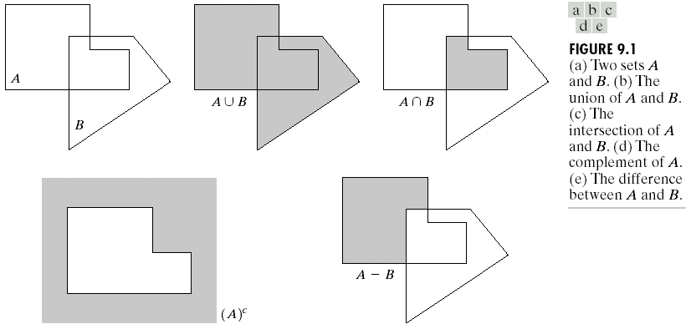
  Fig. 9.1 shows the concepts in Eqs. (9.1-4), (9.1-5), (9.1-7), and (9.1-8).

Slide 5

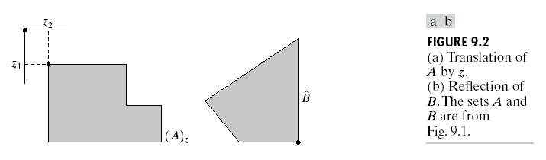
The reflection of set B, denoted , is defined as:
= {w| w = – b, for b ∈ B}. (9.1-9)
The translation of set A by point z = (z₁, z₂), denoted (A)_{z}, is defined as:
(A)_{z} = {c| c = a + z, for a ∈ A }. (9.1-10)
Figure 9.2 illustrates these two definitions using the sets from Fig. 9.1. The black dot identifies the origin of the sets shown in the figure.

Slide 6
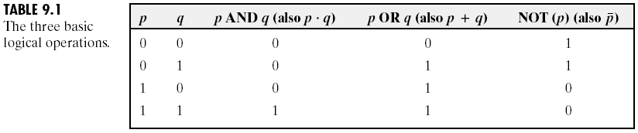
Logic operations involving binary images
The principal logic operations used in image processing are AND, OR, and NOT (COMPLEMENT). Their properties are summarized in Table 9.1. These operations are functionally complete in the sense that they can be combined to form any other logic operation.

Slide 7
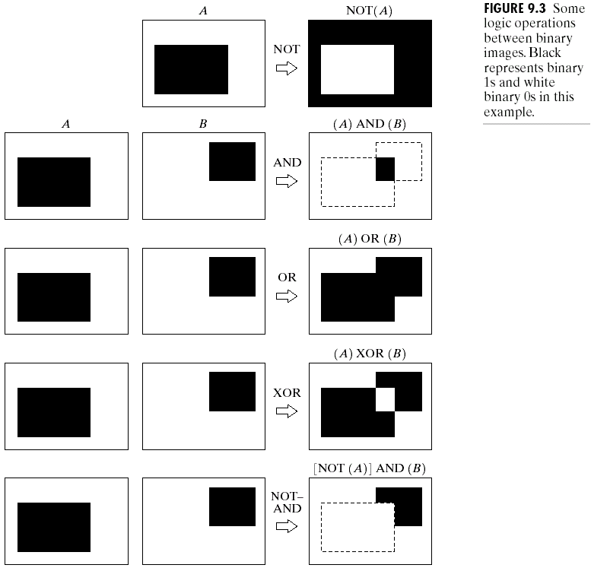
Logic operations are performed on a pixel by pixel basis between corresponding pixels of two or more images (except NOT, which operates on the pixels of a single image). Fig. 9.3 shows various examples of logic operations involving images, where black indicates a binary 1 and white indicates a 0.

Slide 8
Dilation and Erosion
With A and B as sets in Z², the dilation of A by B, denoted A ⊕ B, is defined as:
A ⊕ B = {z| ( )_{z} ∩ A ≠ ∅} (9.2-1)
  This equation is based on obtaining the reflection of B about its origin and shifting this reflection by z. The dilation of A by B then is the set of all displacements, z, such that and A overlap by at least one element.
  Eq. (9.2-1) may be rewritten as:
  A ⊕ B = {z| [( )_{z} ∩ A] ⊆ A} (9.2-2)
  Set B is commonly referred to as the structuring element in dilation, as well as in other morphological operations.

Slide 9
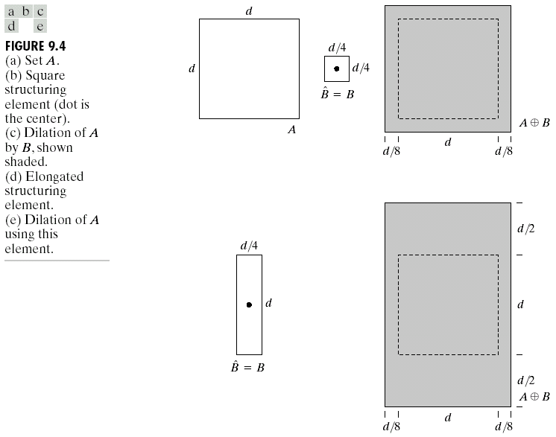
Fig. 9.4(a) shows a simple set, Fig. 9.4(b) and (d) shows two structuring elements, and Fig. 9.4(c) and (e) shows the dilation results.

Slide 10
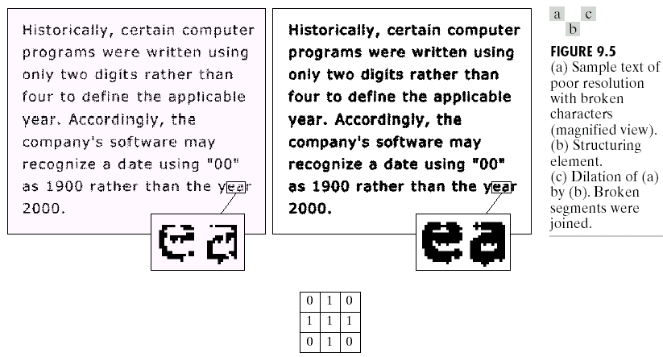
One of the simplest applications of dilation is for bridging gaps.
  Figure 9.5(a) shows the same image with broken characters that we studied in Fig. 4.19 in connection with lowpass filtering. The maximum length of the breaks is known to be two pixels.
  A simple structuring element that can be used for repairing the gaps is shown in Fig. 9.5(b).
  The result of dilating the original image with this structuring element is shown in Fig. 9.5(c).

Slide 11
○
For sets A and B in Z², the erosion of A by B, denoted A B, is defined as:
A B = {z| (B)_{z} ⊆ A}. (9.2-3)
In words, this equation indicates that the erosion of A by B is the set of all points z such that B, translated by z, is contained in A.
Fig. 9.6(a) shows a simple set, Fig. 9.6(b) and (d) shows two structuring elements, and Fig. 9.6(c) and (e) shows the erosion results.
Dilation and erosion are duals of each other with respect to set complementation and reflection, i.e.,
(A B)^{c} = A^{c} ⊕ . (9.2-4)
―
○
―
○
―

Slide 12
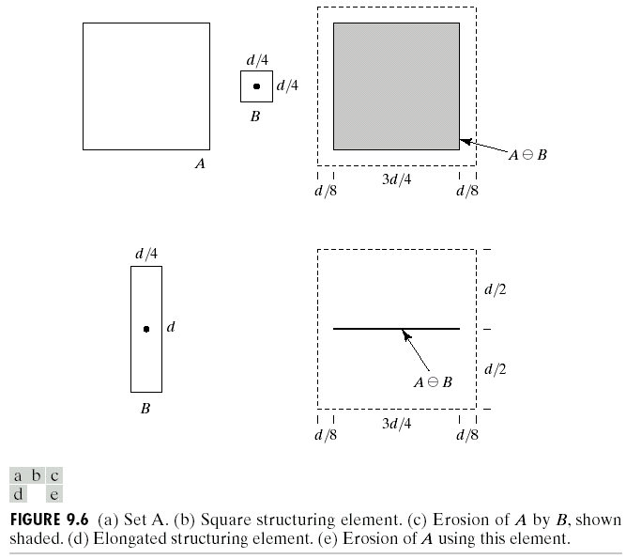

Slide 13
Starting with the definition of erosion, we have:
(A B)^{c} = {z| (B)_{z} ⊆ A}^{c}.
  If set (B)_{z} is contained in set A, then (B)_{z} ∩ A^{c} = ∅, in which case the preceding equation becomes:
  (A B)^{c} = {z| (B)_{z} ∩ A^{c} = ∅}^{c}.
  But the complement of the set of z’s that satisfy (B)_{z} ∩ A^{c} = ∅ is the set of z’s such that (B)_{z} ∩ A^{c} ≠ ∅. Thus
  (A B)^{c} = {z| (B)_{z} ∩ A^{c} ≠ ∅}
  = A^{c} ⊕
○
―
○
―
○
―

Slide 14
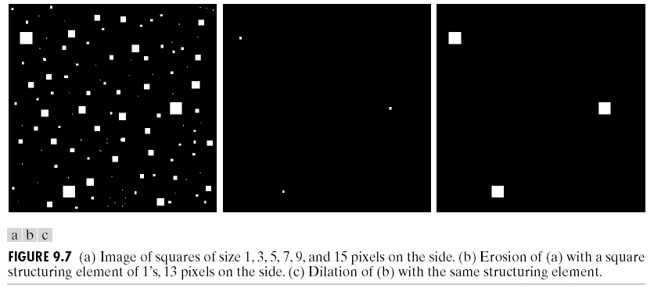
One of the simplest uses of erosion is for eliminating irrelevant detail (in terms of size) from a binary image.
  Figure 9.7(a) shows a binary image composed of squares of sizes 1, 3, 5, 7, 9, and 15 pixels on the side. Suppose that we want to eliminate all the squares except the largest ones.
  Using a structuring element of size 13×13 pixels. The result of eroding the original image with this structuring element is shown in Fig. 9.7(b).
  As shown in Fig. 9.7(c), we can restore these three squares to their original 15×15 size by dilating them with the same structuring element we used for erosion.

Slide 15
Opening and Closing
Opening generally smoothes the contour of an object, breaks narrow isthmuses, and eliminates thin protrusions. Closing also tends to smooth sections of contours but, as opposed to opening, it generally fuses narrow breaks and long thin gulfs, eliminates small holes, and fills gaps in the contour.
The opening of set A by structuring element B, denoted A。B, is defined as:
A。B = (A B) ⊕ B, (9.3-1)
i.e., the opening A by B is the erosion of A by B, followed by a dilation of the result by B.
○
―

Slide 16
The closing of set A by structuring element B, denoted A‧B, is defined as:
A‧B = (A ⊕ B) B, (9.3-2)
i.e., the closing of A by B is simply the dilation of A by B, followed by the erosion of the result by B.
As shown in Fig. 9.8, we view the structuring element B as a (flat) “rolling ball.” The boundary of A。B is then established by the points in B that reach the farthest into the boundary of A as B is rolled around the inside of this boundary.
  The opening of A by B is obtained by taking the union of all translates of B that fit into A, i.e., opening can be expressed as a fitting process:
  A。B = ∪{(B)_{z} | (B)_{z} ⊆ A } (9.3-3)
  where ∪{‧} denotes the union of all the sets inside the braces.
○
―

Slide 17
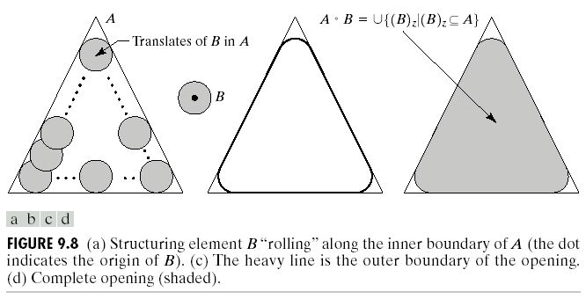

Slide 18
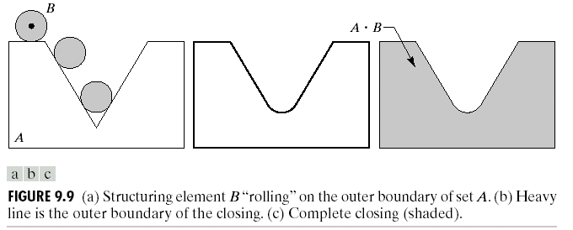
As shown in Fig. 9.9, opening and closing are duals of each other, so having to roll the ball on the outside is not unexpected. Geometrically, a point w is an element of A‧B if and only if (B)_{z} ∩ A ≠ ∅ for any translate of (B)_{z} that contains w.

Slide 19
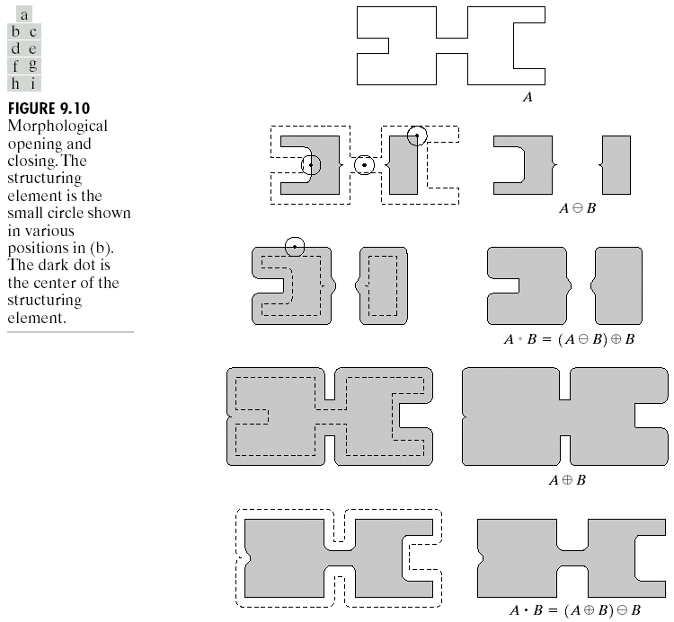
Fig. 9.10 shows an illustrated example for morphological opening and closing, where the structuring element is the small circle shown in various positions in Fig. 9.10(b).

Slide 20
As in the case of dilation and erosion, opening and closing are duals of each other with respect to set complementation and reflection,
(A‧B)^{c} = (A^{c}。 ). (9.3-4)
The opening operation satisfies the following properties:
(i) A。B is a subset (subimage) of A.
(ii) If C is a subset of D, then C。B is a subset of D。B.
(iii) (A。B)。B = A。B.
The closing operation satisfies the following properties:
(i) A is a subset (subimage) of A‧B.
(ii) If C is a subset of D, then C‧B is a subset of D‧B.
(iii) (A‧B)‧B = A‧B.

Slide 21
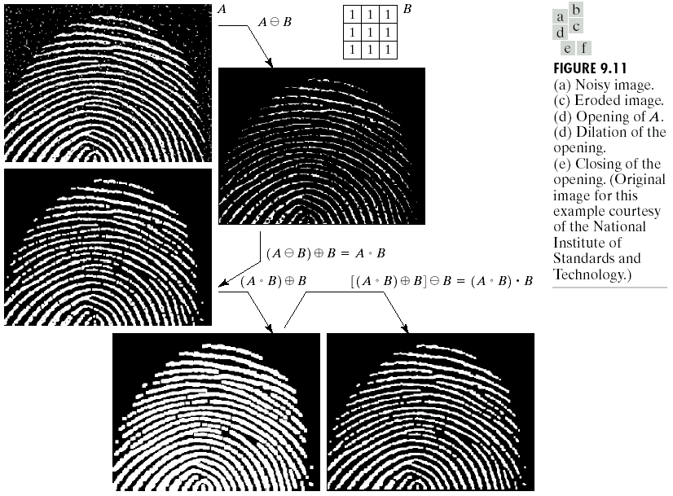


Fig. 9.11(a) shows a noisy finger-print image, Fig. 9.11(b) shows the structuring element. Fig. 9.11(c) ~ (f) shows the step-by-step sequence of the filtering operation: erosion, opening of A, dilation of the opening, and closing of the opening.

Slide 22
Hit-or-Miss Transform
The morphological hit-or-miss transform is a basic tool for shape detection. Fig. 9.12 shows a set A consisting of three shapes (subsets), denoted X, Y, and Z. The shading in Figs. 9.12(a) through (c) indicates the original sets, whereas the shading in Figs. 9.12(d) and (e) indicates the result of morphological operations, The objective is to find the location of one of the shapes, say, X.
  Let the origin of each shape be located at its center of gravity. Let X be enclosed by a small window, W. The local background of X with respect to W is defined as the set difference (W – X), as shown in Fig. 9.12(b).
  Fig. 9.12(c) shows the complement of A, which is needed later. Fig. 9.12(d) shows the erosion of A by X.

Slide 23
○
―
  A X may be viewed geometrically as the set of all locations of the origin of X at which X found a match (hit) in A.
  Fig. 9.12(e) shows the erosion of the complement of A by the local background set (W – X). The outer shaded region in Fig. 9.12(e) is part of the erosion.
  We note from Fig. 9.12(d) and (e) that the set of locations for which X exactly fits inside A is the intersection of the erosion of A by X and the erosion of A^{c} by (W – X) as shown in Fig. 9.12(f). This intersection is precisely the location sought. In other words, if B denotes the set composed of X and its background, the match (or set of matches) of B in A, denoted A B, is
  A B = (A X) ∩ [A^{c} (W – X)]. (9.4-1)
  Let B = (B₁, B₂) and B₁ = X and B₂ = W – X. Eq. (9.4-1) becomes
  A B = (A B₁) ∩ (A^{c} B₂) (9.4-2)
  Set A B contains all the (origin) points at which, simultaneously, B₁ found a match (“hit”) in A and B₂ found a match in A^{c}. Thus, Eq. (9.4-2) becomes:
  A B = (A B₁) – (A ⊕ ₂), (9.4-3)
  which is called the morphological hit-or-miss transform.
○
﹡
○
○
○
﹡
―
―
○
○
○
﹡
―
―
○
﹡
○
○
﹡
―

Slide 24
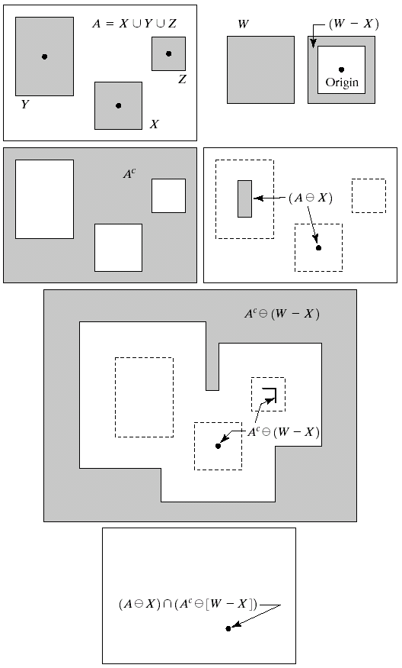
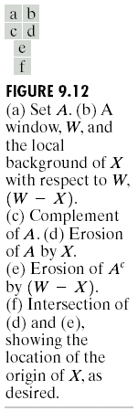

Slide 25
Basic Morphological Algorithms
When dealing with binary images, the principal application of morphology is extracting image components that are useful in the representation and description of shape.
We consider morphological algorithms for extracting boundaries, connected components, the convex hull, and the skeleton of a region.
The images are binary, with 1’s shown shaded and 0’s shown in white.

Slide 26
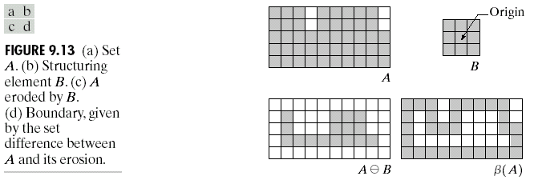
Boundary extraction
The boundary of a set A, denoted by β(A), can be obtained by first eroding A by B and then performing the set difference between A and its erosion.
β(A) = A – (A B) (9.5-1)
where B is a suitable structuring element.
  Fig. 9.13 illustrates the mechanics of boundary extraction.
○
―

Slide 27
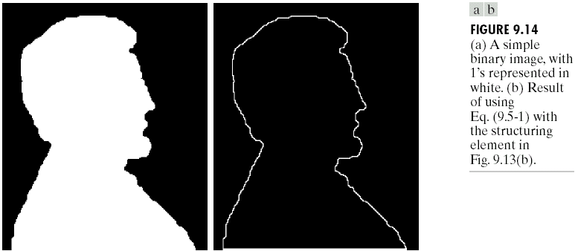
Fig. 9.14 further illustrates the use of Eq. (9.5-1) with the structuring element of Fig. 9.13(b). In this example, binary 1’s are shown in white and 0’s in black.
  Using the structuring element (3×3), the boundary shown in Fig. 9.14(b) is one pixel thick.

Slide 28
Region filling
In Fig. 9.15 A denotes a set containing a subset whose elements are 8-connected boundary points of a region. Beginning with a point p inside the boundary, the objective is to fill the entire region with 1’s.
If all nonboundary (background) points are labeled 0, then we assign a value of 1 to p to begin. The following procedure then fills the region with 1’s:
X_{k} = (X_{k-1} ⊕ B) ∩ A^{c} k = 1, 2, 3, … (9.5-2)
where X₀ = p, and B is the symmetric structuring element shown in Fig. 9.15(c). The algorithm terminates at iteration step k if X_{k} = X_{k-1}. The set union of X_{k} and A contains the filled set and its boundary.

Slide 29
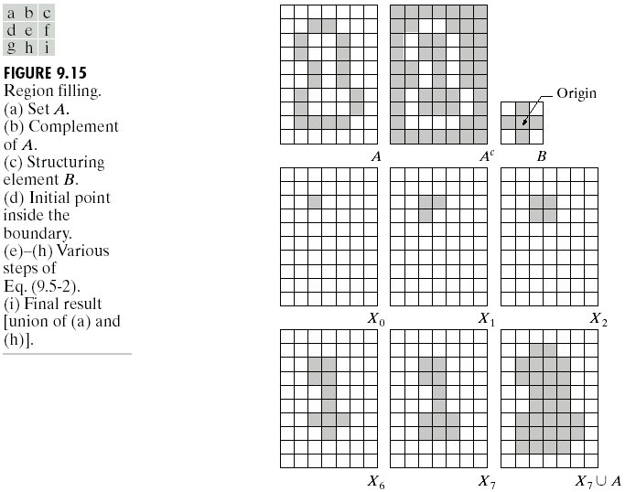
Fig. 9.15 shows the region filling results. It is assumed that a point inside each boundary is given.

Slide 30
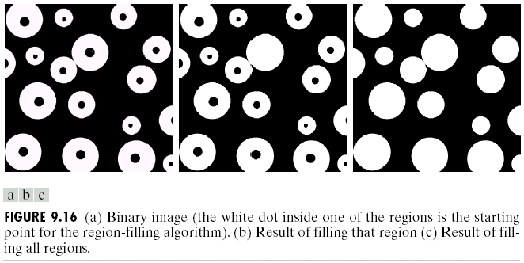
Fig. 9.16(a) shows one point selected inside one of the spheres, and Fig. 9.16(b) shows the result of filling that component. Finally, Fig. 9.16(c) shows the result of filling all the spheres.

Slide 31
Connected component extraction
Let Y represent a connected component contained in a set A and assume that a point p of Y is known. Then the following iterative expression yields all the elements of Y:
X_{k} = (X_{k-1} ⊕ B) ∩ A k = 1, 2, 3, … (9.5-3)
where X₀ = p, and B is a suitable structuring element, as shown in Fig. 9.17. If X_{k} = X_{k-1}, the algorithm has converged and we let Y = X_{k}.
  Equation (9.5-3) is similar in form to Eq. (9.5-2). The only difference is the use of A instead of its complement. This difference arises because all the elements sought (that is, the elements of the connected component) are labeled 1.

Slide 32
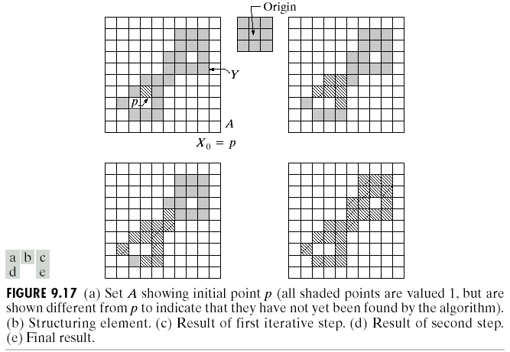
Fig. 9.17 illustrates the mechanics of Eq. (9.5-3). It is assumed that a point is known in each connected component.

Slide 33
Fig. 9.18(a) shows an X-ray image of a chicken breast that contains bone fragments. It is of considerable interest to be able to detect such foreign objects in processed food before packaging and/or shipping.
  Fig. 9.18(b) shows the binary image by a simple threshold.
  By defining significant objects that remain after erosion with a 5×5 structuring element of 1’s. The result of erosion is shown in Fig. 9.18(c).

Slide 34
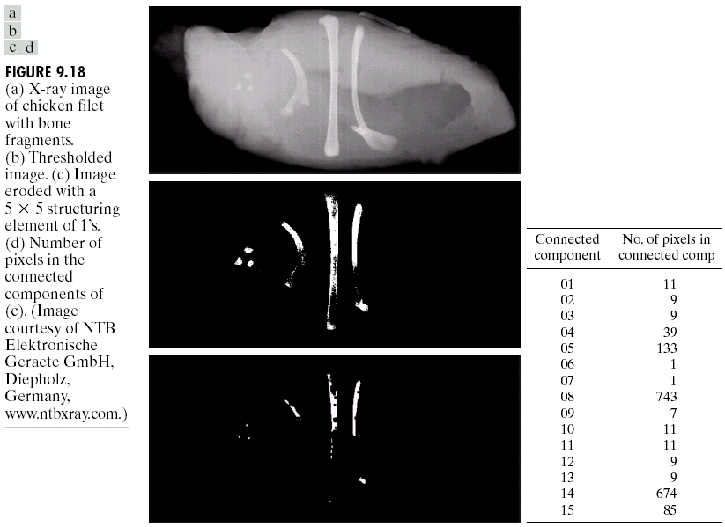

Slide 35
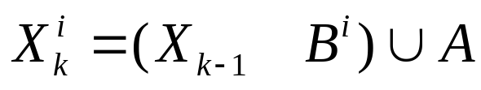

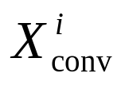
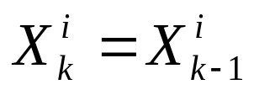
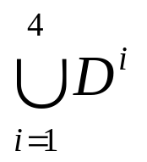
Convex hull
A set A is said to be convex if the straight line segment joining any two points in A lies entirely within A. The convex hull H of an arbitrary set S is the smallest convex set containing S. The set difference H – S is called the convex deficiency of S.
Let B^{i}, i = 1, 2, 3, 4, represent the four structuring elements in Fig. 9.19(a). The procedure consists of implementing the equation:
i = 1, 2, 3, 4 and k = 1, 2, 3, …(9.5-4)
with = A. Now let D^{i} = , where the subscript “conv” indicates convergence in the sense that . Then the convex hull of A is:
C(A) = . (9.5-5)
○
﹡

Slide 36
  In other words, the procedure consists of iteratively applying the hit-or-miss transform to A with B¹; where no further changes occur, we perform the union with A and call the result D¹. Finally C(A) is then the union of D^{i}, i = 1, 2, 3, 4.
Fig. 9.19 illustrates the procedure given in Eqs. (9.5-4) and (9.5-5). Fig. 9.19(a) shows the structuring elements used to extract the convex hull. The origin of each element is at its center. The × entries indicate “don’t care” conditions.
  Note that B^{i} is a clockwise rotation of B^{i-1} by 90°.
  The contribution of each structuring element is highlighted in the composite set shown in Fig. 9.19(h).

Slide 37
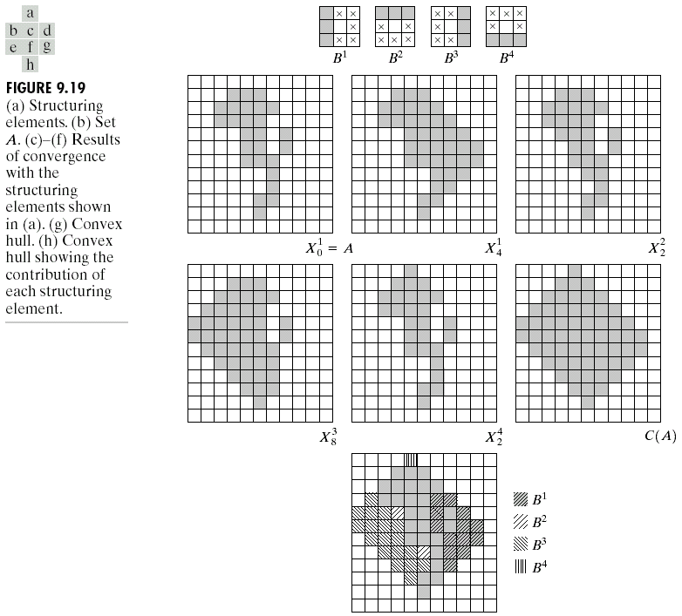

Slide 38
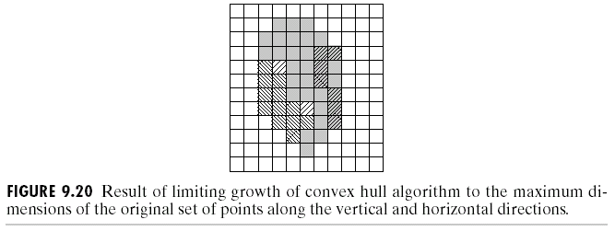
To limit growth so that the convex hull does not extend past the vertical and horizontal dimensions of the origin set of points, the example in Fig. 9.19 results in the image in Fig. 9.20.

Slide 39
Thinning
The thinning of a set A by a structuring element B, denoted A ⊗ B, can be defined in terms of the hit-or-miss transform:
A ⊗ B = A – (A B)
= A ∩ (A B)^{c}. (9.5-6)
A more useful expression for thinning A symmetrically is based on a sequence of structuring elements:
{B} = {B¹, B², B³, …, B^{n}} (9.5-7)
where B^{i} is a rotated version of B^{i-1}. Using this concept, we now define thinning by a sequence of structuring elements as:
A ⊗ {B} = (( … ((A ⊗ B¹) ⊗ B²) …) ⊗ B^{n}). (9.5-8)
○
﹡
○
﹡

Slide 40
The process is to thin A by one pass with B¹, then thin the result with one pass of B², and so on, until A is thinned with one pass of B^{n}. The entire process is repeated until no further changes occur. Each individual thinning pass is performed using Eq. (9.5-6).
Fig. 9.21 illustrates the procedure given in Eqs. (9.5-7) and (9.5-8). Note that Fig. 9.21(1) shows the thinned set converted to m-connectivity (see Section 2.5.2) to eliminate multiple paths.

Slide 41
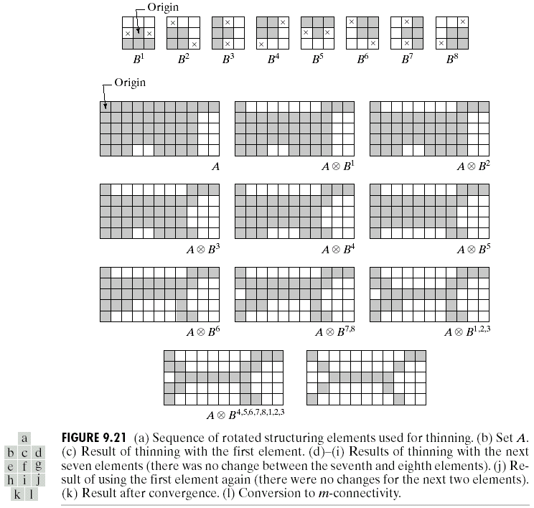

Slide 42
Thickening
Thickening is the morphological dual of thinning and is defined by:
A ⊙ B = A ∪ (A B) (9.5-9)
where B is a structuring elements suitable for thickening.
As in thinning, thickening can be defined as a sequential operation:
A ⊙ {B} = (( … ((A ⊙ B¹) ⊙ B²) …) ⊙ B^{n}). (9.5-10)
The structuring elements used for thickening have the same form as those shown in Fig. 9.21(a) in connection with thinning, but with all 1’s and 0’s interchanged.
○
﹡

Slide 43
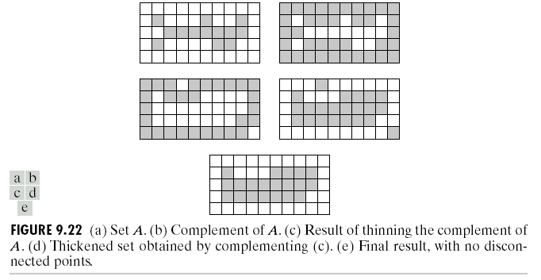
Another procedure for implementation of thickening is to thin the background of the set in question and then complement the result. In other words, to thicken a set A, we form C = A^{c}, thin C, and then form C^{c}. Fig. 9.22 illustrates this procedure.
  Depending on the nature of A, this procedure may result in some disconnected points, as Fig. 9.22(d) shows. Hence thickening by this method usually is followed by a simple postprocessing step to remove disconnected points.

Slide 44
Skeletons
As shown in Fig. 9.23, a skeleton, S(A), of a set A is intuitively simple.
(a) If z is a point of S(A) and (D)_{z} is the largest disk centered at z and contained in A, one cannot find a larger disk (not necessarily centered at z) containing (D)_{z} and included in A. The disk (D)_{z} is called a maximum disk.
(b) The disk (D)_{z} touches the boundary of A at two or more different places.

Slide 45
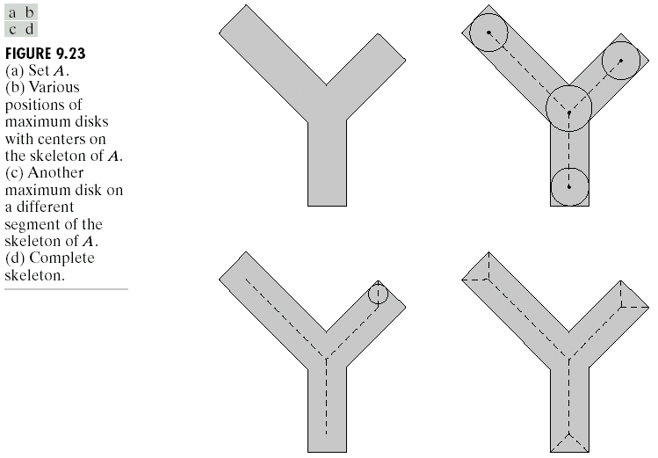

Slide 46
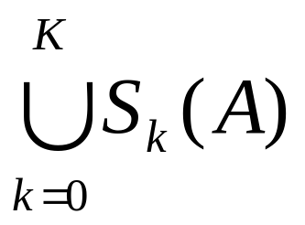
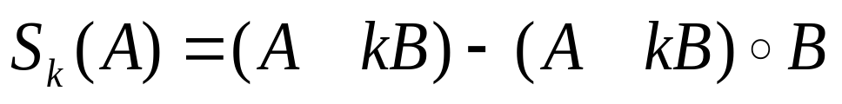
The skeleton of A can be expressed in terms of erosions and openings, i.e.,
S(A) = (9.5-11)
with
(9.5-12)
where B is a structuring element, and (A kB) indicates k successive erosions of A:
(A kB) = ( … (A B) B) …) B (9.5-13)
k times, and K is the last iterative step before A erodes to an empty set. In other words,
K = max{k| (A kB) ≠ ∅}. (9.5-14)
○
○
―
―
○
―
○
○
○
○
○
―
―
―
―
―
○
―

Slide 47
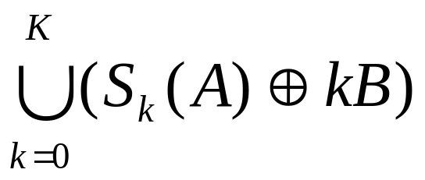
The original figure A can be reconstructed from the skeleton subsets S_{k}(A) by:
A = (9.5-15)
where (S_{k}(A) ⊕ kB) denotes k successive dilations of S_{k}(A); that is,
(S_{k}(A) ⊕ kB) = (( … (S_{k}(A) ⊕ B) ⊕ B) ⊕ …) ⊕ B. (9.5-16)
Fig. 9.24 illustrates the concept, where K = 2 in this example. The 4th column contains two partial skeletons and the final result with k = 0, 1, 2. The last column shows reconstruction of A with k = 0, 1, 2.

Slide 48
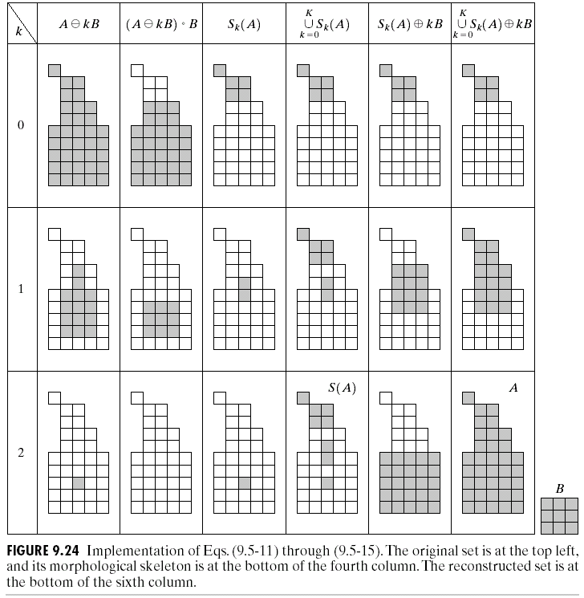
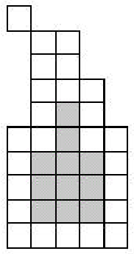

Slide 49
Pruning
Pruning methods are an essential complement to thinning and skeletonizing algorithms because these procedures tend to leave parasitic components that need to be “cleaned up” by postprocessing.
Fig. 9.25(a) shows the skeleton of a hand-printed “a.” The parasitic component on the leftmost part of the character is illustrative of what we are interested in removing.
Thinning of an input set A with a sequence of structuring elements designed to detect only end points achieves the desired result. That is, let
X₁ = A ⊗ {B} (9.5-17)
where {B} denotes the structuring element sequence shown in Figs. 9.25(b) and (c), where × signifies a “don’t care” condition.

Slide 50
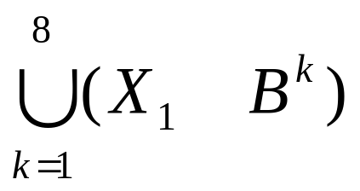
(1) Applying Eq. (9.5-17) to A three times yields the set X₁ shown in Fig. 9.25(d).
(2) The next step is to “restore” the character to its original form, but with the parasitic branches removed. To do so first requires forming a set X₂ containing all end points in X₁ [Fig. 9.25(e)]:
X₂ = (9.5-18)
where the B^{k} are the same end-point detectors shown in Fig. 9.25(b) and (c).
(3) The next step is dilation of the end points three times, using set A as a delimiter:
X₃ = (X₂ ⊕ H) ∩ A (9.5-19)
where H is a 3×3 structuring element of 1’s.
(4) Finally, the union of X₃ and X₁ yields the desired result,
X₄ = X₁ ∪ X₃ (9.5-20)
as shown in Fig. 9.25(g).
○
﹡

Slide 51
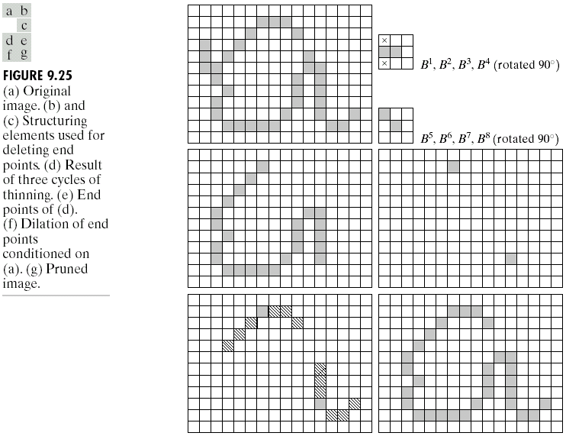

Slide 52
Summary of Morphological Operations on Binary Images
Table 9.2 summarizes the morphological results developed in the preceding sections, and Fig. 9.26 summarizes the basic types of structuring elements used in the various morphological processes.

Slide 53
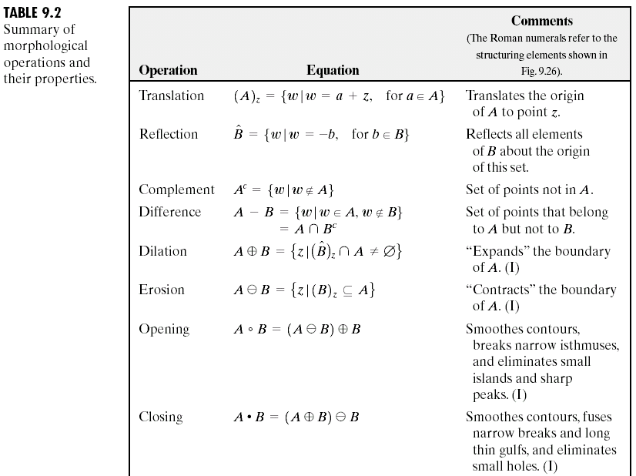

Slide 54
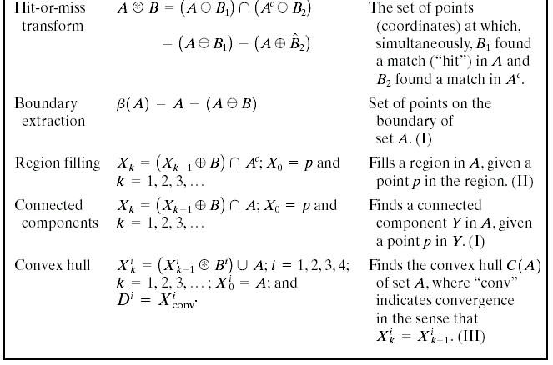
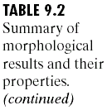

Slide 55
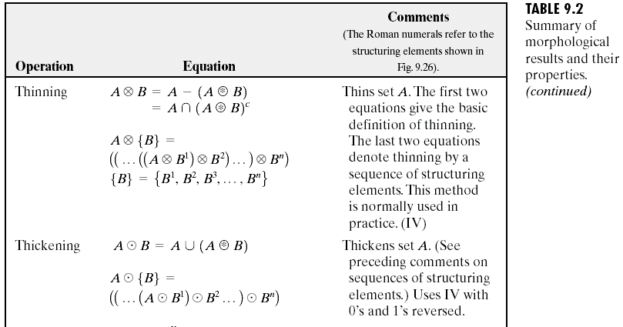

Slide 56
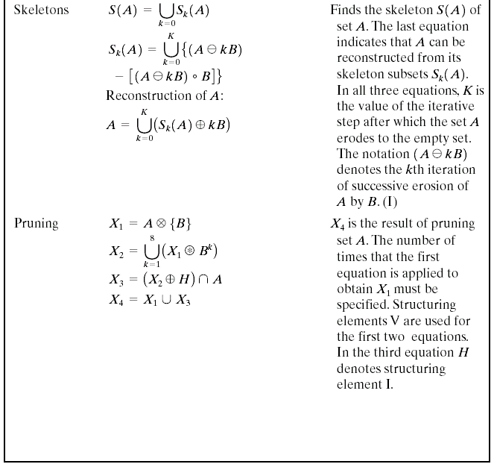

Slide 57
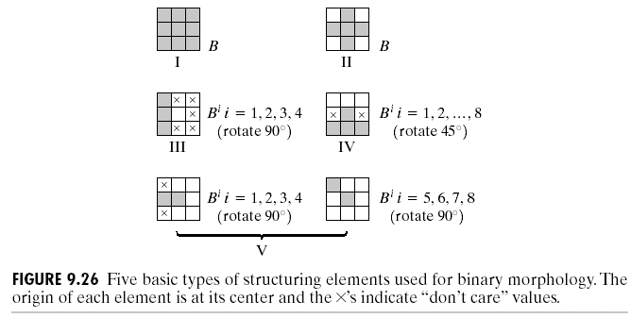

Slide 58
Extensions to Gray-Scale Images
Here f(x, y) is the input image and b(x, y) is a structuring element (a subimage function).
If Z denotes the set of real integers, (x, y) are integers from Z×Z.

Slide 59
Dilation
Gray-scale dilation of f by b, denoted f ⊕ b, is defined as:
(f ⊕ b) (s, t) =
max{f(s – x, t – y) + b(x, y) | (s – x), (t – y) ∈ D_{f}; (x, y) ∈ D_{b}} (9.6-1)
where D_{f} and D_{b} are the domains of f and b, respectively. Note that f and b are functions, rather than sets in binary mophology.
  The condition that (s – x) and (t – y) have to be in the domain of f, and x and y have to be in the domain of b, is analogous to the condition in the binary definition of dilation, where the two sets have to overlap by at least one element.

Slide 60
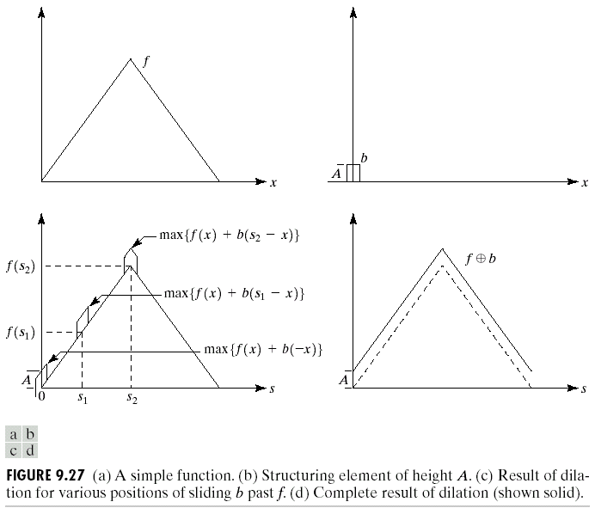
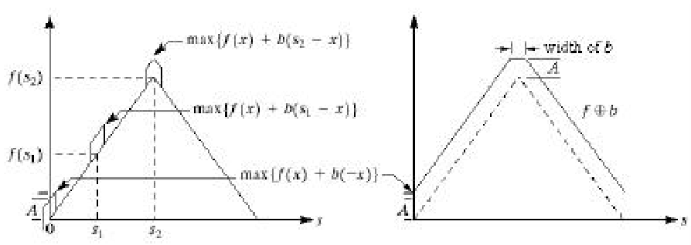
For 1-D case, Eq. (9.6-1) becomes:
(f ⊕ b) (s) = max{f(s – x) + b(x) | (s – x) ∈ D_{f} and x ∈ D_{b}}.
  The requirements that the value of (s – x) has to be in the domain of f and that the value of x has to be in the domain of b imply that f and b overlap.
  An example is shown in Fig. 9.27.

Slide 61
Erosion
○
―
Gray-scale erosion, denoted f b, is defined as:
(f b) (s, t) =
min{f (s + x, t + y) – b(x, y) | (s + x), (t + y) ∈ D_{f}; (x, y) ∈ D_{b}} (9.6-2)
where D_{f} and D_{b} are the domains of f and b, respectively.
For 1-D case, Eq. (9.6-2) becomes:
(f b) (s) = min{f (s + x) – b(x) | (s + x) ∈ D_{f} and x ∈ D_{b}}.
As in correlation, the function f (s + x) moves to the left for positive s and to the right for negative s. The requirements that (s + x) ∈ D_{f} and x ∈ D_{b} imply that the range of b is completely contained within the range of the displaced f.
  Fig. 9.28 shows the result of eroding the function of Fig. 9.27(a) by the structuring element of Fig. 9.27(b).
○
―
○
―

Slide 62
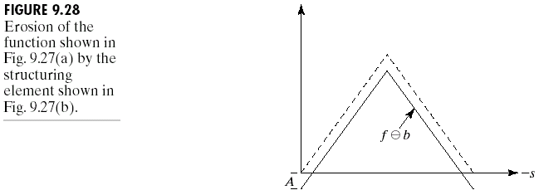

Gray-scale dilation and erosion are duals with respect to function complementation and reflection, i.e.,
(f b)^{c} (s, t) = (f ^{c} ⊕ ) (s, t) (9.6-3)
where f ^{c} = – f(x, y) and = b(–x, –y).
○
―

Slide 63
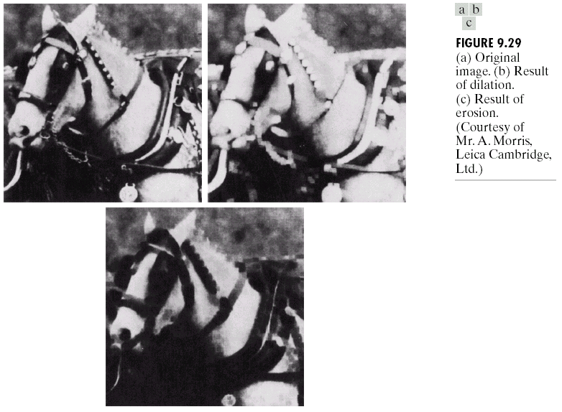
Fig. 9.29(a) shows a simple 512×512 gray-scale image, and Fig. 9.29(b) shows the result of dilating this image with a “flat-top” structuring element in the shape of a parallelepiped of unit height and size 5×5 pixels.
  Fig. 9.29(c) shows the corresponding eroding result.

Slide 64
Opening and Closing
The opening of image f by subimage (structuring element) b, denoted f。b, is :
f。b = (f b) ⊕ b, (9.6-4)
i.e., opening is simply the erosion of f by b, followed by a dilation of the result by b.
The closing of f by b, denoted f‧b, is:
f‧b = (f ⊕ b) b. (9.6-5)
The opening and closing for gray-scale images are duals with respect to complementation and reflection, i.e.,
(f‧b)^{c} = f ^{c}。 . (9.6-6)
Because f ^{c} = – f(x, y), Eq. (9.6-6) can be written also as
– (f‧b) = (–f。 ).
○
―
○
―

Slide 65
Suppose that we view an image function f(x, y) in 3-D perspective with the x- and y-axes being the usual spatial coordinates and the third axis being gray-level values.
  Suppose that we open f by a spherical structuring element, b, viewing this element as a “rolling ball.” The opening, f。b, then is the surface if the highest points reached by any part of the sphere as it slides over the entire undersurface of f.
  Fig. 9.30 illustrates this concept. Fig. 9.30(a) shows a scan line of a gray-scale image as a continuous function to simplify the illustration. Fig. 9.30(b) shows the rolling ball in various positions, and Fig. 9.30(c) shows the complete result of opening f by b along the scan line.
  Fig. 9.30(d) and (e) show the result of closing f by b. Here, the ball slides on top of the surface, and peaks essentially are left in their original form.

Slide 66
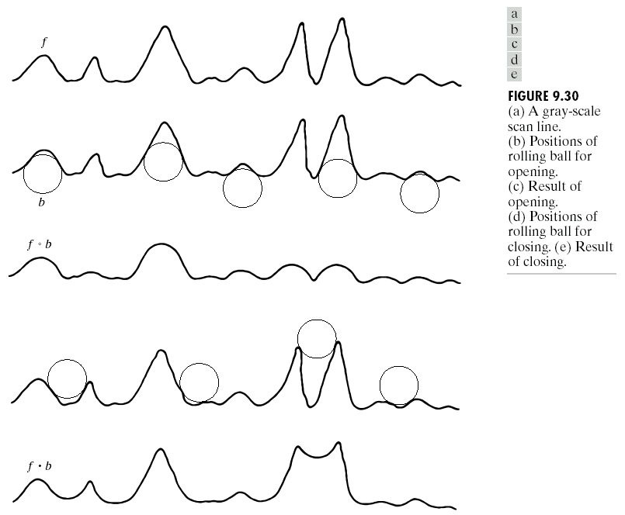

Slide 67
The properties of gray-scale opening:
(i) (f。b) ↵ f.
(ii) If f₁ ↵ f₂, then (f₁。b) ↵ (f₂。b) .
(iii) (f。b)。b = f。b.
Here e ↵ r indicates that the domain of e is a subset of the domain of r, and also that e(x, y) ≤ r(x, y) for any (x, y) in the domain of e.
The properties of gray-scale closing:
(i) f ↵ (f‧b).
(ii) If f₁ ↵ f₂, then (f₁‧b) ↵ (f₂‧b) .
(iii) (f‧b)‧b = f‧b.

Slide 68
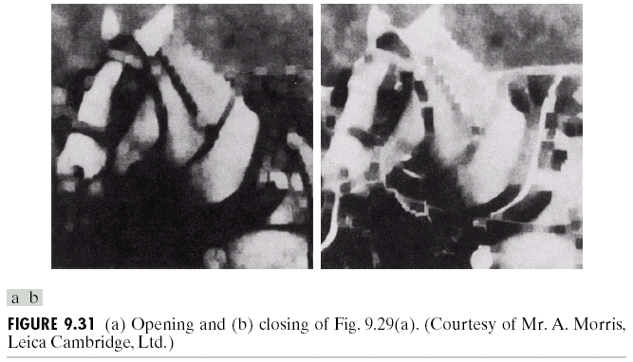
Fig. 9.31 shows the opening and closing of Fig. 9.29(a) with the same structuring element.

Slide 69
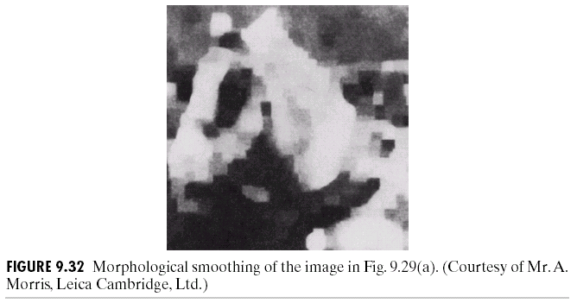
Some Applications of Gray-Scale Morphology
Unless stated otherwise, all the images shown are of size 512×512 and were processed by using the structuring element discussed in connection with Fig. 9.29.
As shown in Fig. 9.32, smoothing can be realized by performing a morphological opening followed by a closing.

Slide 70
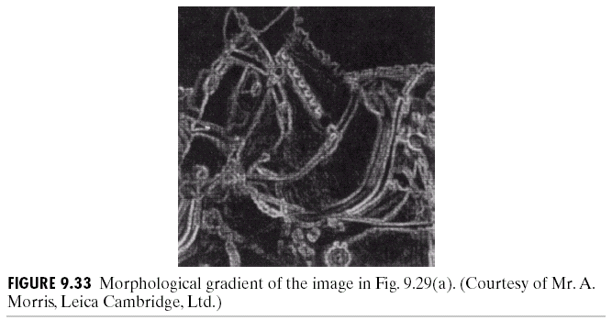
To remove small dark and bright artifacts, dilation and erosion are used to compute the morphological gradient g of an image f:
g = (f ⊕ b) – (f b). (9.6-7)
  Fig. 9.33 shows the result of computing the morphological gradient of the image shown in Fig. 9.29(a).
○
―

Slide 71

The morphological top-hat transformation h of an image f is defined as:
h = f – (f。b) (9.6-8)
  This transformation, which uses a cylindrical or parallelepiped structuring element function with a flat top, is useful for enhancing detail in the presence of shading.
  Fig. 9.34 shows the result of performing a top-hat transformation on the image of Fig. 9.29(a).

Slide 72

Fig. 9.35(a) shows a simple gray-scale image composed of two texture regions. The objective is to find the boundary between the two regions based on their textural content.
  Because closing tends to remove dark details form an image, the structuring element with its size being equal to that of the small blobs can be used to remove the small blobs.
  Next, a single opening is performed with a structuring element that is large in relation to the separation between the large blobs.
    The above process produces a light region on the left and a dark region on the right. A simple thresholding yields the boundary between the two textural regions, as shown in Fig. 9.35.

Slide 73

Granulometry is a field dealing with determining the size distribution of particles in an image.
  Fig. 9.36(a) shows an image consisting of light objects of three different sizes.
  The objects not only are overlapping, but they also are too cluttered to enable detection of individual particles.
  Opening operations with structuring elements of increasing size are performed on the original image.
  ➔ The difference between the original image and its opening is
  computed after each pass using a different structuring element.
  Fig. 9.36(b) shows the resulting size distribution in this case, where three predominant particle sizes are detected .

