Slide 1
Chapter 11 REPRESENTATION AND DESCRIPTION
Well, but reflect; have we not several times acknowledged that names rightly given are the likeness and images of the things which they name?
Socrates
A region can be represented by two methods:
(1) the region is represented by its external
characteristics (its boundary);
(2) the region is represented by its internal
characteristics (the pixels comprising the region).

Slide 2
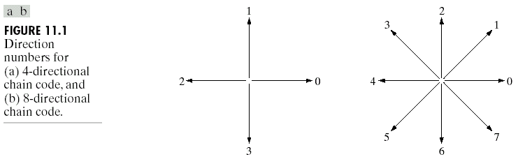
Chain Code Representation
Chain codes are used to represent a boundary by a connected sequence of straight-line segments of specified length and direction.
  Typically, this representation is based on 4- or 8-connectivity of the segments, as shown in Fig. 11.1.

Slide 3
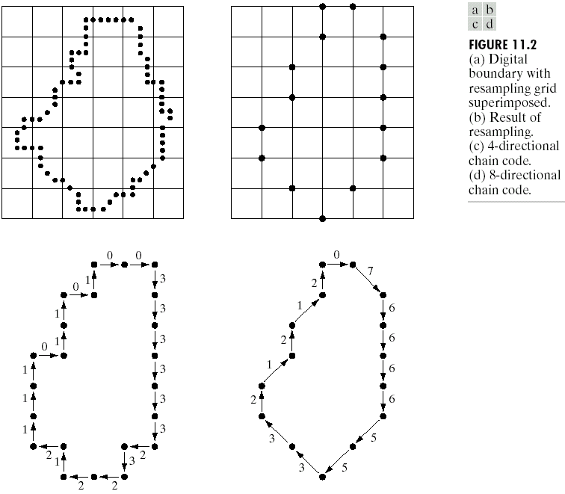
Fig. 11.2(a) shows a digital boundary with resampling grid superimposed, Fig. 11.1(b) shows the result of resampling, and Fig. 11.1(c) and (d) shows the corresponding 4- or 8-directional chain codes.

Slide 4
The chain code of a boundary depends on the starting point.
  We can treat the chain code as a circular sequence of direction numbers and redefine the starting point so that the resulting sequence of numbers forms an integer of minimum magnitude.
  10021 → the minimum integer number: 00211
  We can normalize for rotation by using the first difference of the chain code instead of the code itself. For example, the first difference of the 4-direction chain code 10103322 is 3133030.

Slide 5
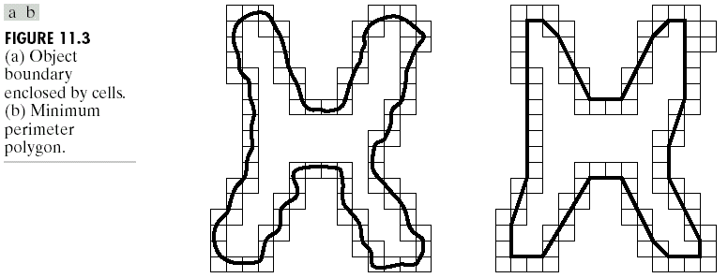
Polynomial Approximations
A digital boundary can be approximated with arbitrary accuracy by a polygon.
The goal of polygonal approximation is to capture the “essence” of the boundary shape with the fewest possible polygonal segments.
Suppose that we enclose a boundary by a set of concatenated cells, as shown in Fig. 11.3(a).
  Treating the object boundary a rubber band contained with the walls and allowing the rubber band to shrink, the minimum perimeter polygon is shown in Fig. 11.3(b).

Slide 6
Polygonal merging techniques
One merging technique is to merge points along a boundary until the least square error line fit of the points merged so far exceeds a present threshold.
  Then store the line (segment), set the error to zero, and the above procedure is repeated.
  Finally, the intersections of adjacent line segments form the vertices of the polygon.

Slide 7
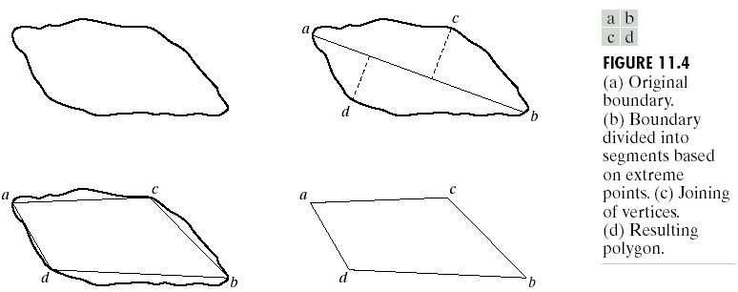
Polygonal splitting techniques
One boundary segment splitting technique to subdivide a segment successively into two parts until a specified criterion is satisfied.
  One criterion is that the maximum perpendicular distance from a boundary segment to the line joining its two end points not exceed a present threshold.
  ➔ If it does, the farthest point from the line becomes a new vertex subdividing the initial segment into two segments.
  Fig. 11.4 shows an illustrated example.

Slide 8
Signatures
A signature is a 1-D functional representation of a boundary and may be generated in various ways.
  As shown in Fig. 11.5, a simple signature is to plot the distance from the centroid to the boundary as a function of angle.
  The above signature is translation-invariant, but rotation- and scaling-variant.
  One normalization method is to select the starting point as the point farthest from the centroid (if it is unique).
  The second normalization method is to select the point on the eign axis that is farthest from the centroid.

Slide 9
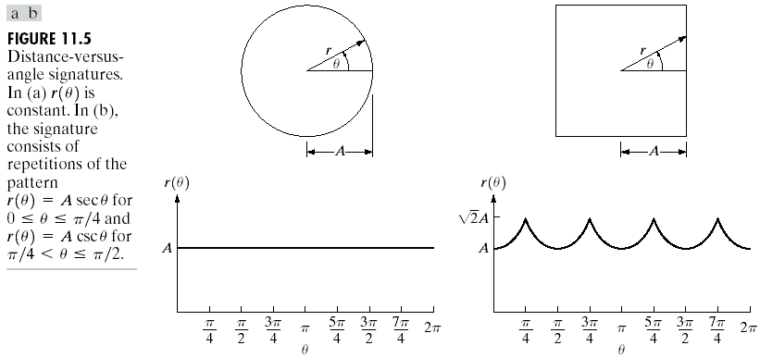
The second type of signature is to traverse the boundary and, corresponding to each point on the boundary, plot the angle between a line tangent to the boundary at that point and a reference line.
  A variation of the above approach is to use the slope density function as a signature.

Slide 10
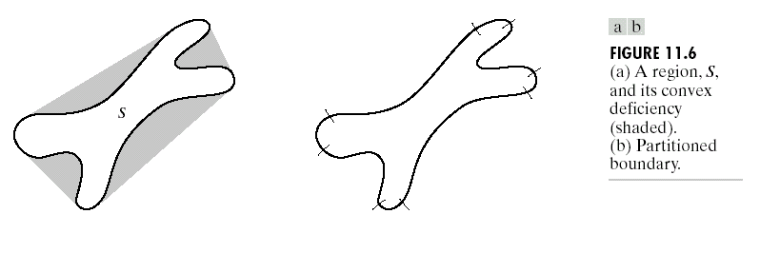
Boundary Segments
As the illustrated example shown in Fig. 11.6, the convex hull H of an arbitrary set S is the smallest convex set containing S.
  The set difference, H-S, is called the convex deficiency D of the set S.
As shown in Fig. 11.6(b), the region boundary can be partitioned by following the contour of S and marking the points at which a transition is made into or out of a component of a convex deficiency.
The convex hull and its deficiency are useful for describing an entire region as well as just its boundary.

Slide 11
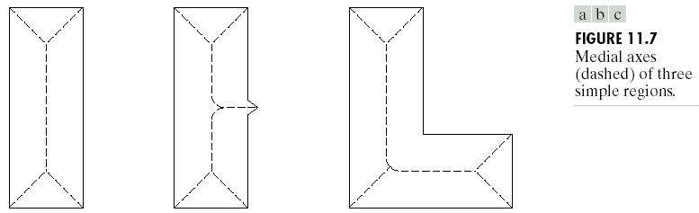
Skeletons
The skeleton of a region may be defined via the medial axis transformation (MAT) proposed by Blum.
The MAT of a region R with border B is as follows. For each point p in R, we find its closest neighbor in B. If p has more than one such neighbor, it is said to belong to the medial axis (skeleton) of R. The concept of “closest” (and the resulting MAT) depend on the definition of a distance.
  Fig. 11.7 shows some examples using the Euclidean distance.

Slide 12
Thinning algorithms iteratively delete edge points of a region subject to the constraints that deletion of these points
(1) does not remove end points,
(2) does not break connectivity, and
(3) does not cause excessive erosion of the region.
Consider a binary image, where region points have value 1 and background points have value 0. Note that a contour point is any pixel with value 1 and having at least one 8-neighbor valued 0.

Slide 13
Referring to Fig. 11.8,
Step 1: flag a contour point p₁ for deletion if the following conditions are satisfied:
(a) 2 ≤ N(p₁) ≤ 6,
(b) T(p₁) = 1,
(c) p₂ · p₄ · p₆ = 0,
(d) p₄ · p₆ · p₈ = 0, (11.1-1)
where N(p₁) is the number of nonzero neighbors of p₁; that is,
N(p₁) = p₂+p₃+…+p₈+p₉, (11.1-2)
and T(p₁) is the number of 0-1 transitions in the ordered sequence p₂, p₃, …, p₈, p₉, p₂. For example, N(p₁) = 4 and T(p₁) = 3 in Fig. 11.9.
Step 2: conditions (a) and (b) remain the same, but conditions (c) and (d) are changed to
(c’) p₂ · p₄ · p₈ = 0,
(d’) p₂ · p₆ · p₈ = 0. (11.1-3)

Slide 14
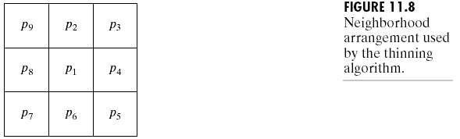
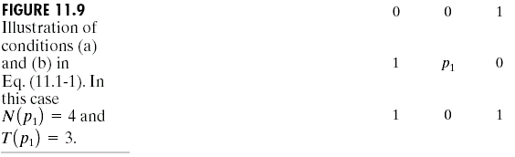
  Step 1 is applied to every border pixel in the binary region under consideration. However, the point is not deleted until all border points have been processed.

Slide 15
One iteration of the thinning algorithm consists of:
(1) applying step 1 to flag border points for deletion;
(2) deleting the flagged points;
(3) applying step 2 to flag the remaining border points for deletion; and
(4) deleting the flagged points.
  This above basic procedure is applied iteratively until no further points are deleted, at which time the algorithm terminates, yielding the skeleton of the region.
Condition (a) is violated when contour point p₁ only have one or seven 8-neighbors valued 1, i.e., p₁ is an end point of a skeleton stroke.
  Condition (b) is violated when it is applied to points on a stroke 1 pixel thick.
  Condition (c) and (d) are satisfied simultaneously by the minimum set of values: (p₄ = 0 or p₆ = 0 ) or (p₂ = 0 and p₈ = 0 ).

Slide 16
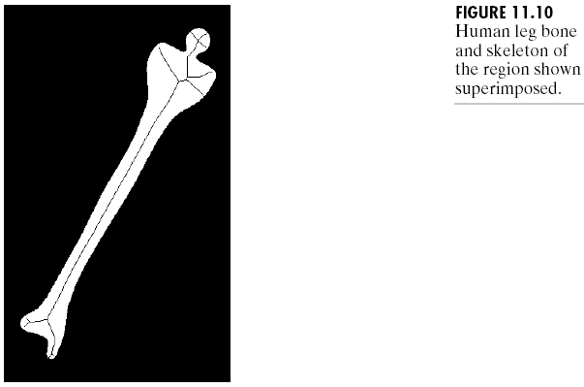
Referring to Fig. 11.8, a point satisfying conditions (a)~(d) is an east or south boundary point or a northwest corner point in the boundary.
  A point satisfying conditions (a), (b), (c’), and (d’) is a north or west boundary points or a southeast corner point.
Fig. 11.10 shows the thinning result of a human leg bone.

Slide 17


Some Boundary Descriptions
The length of a boundary is one of its simplest descriptors.
  The number of pixels along a boundary gives a rough approximation of its length.
The diameter of a boundary B is defined as:
(11.2-1)
where D is a distance measure and p_{i} and p_{j} are points on the boundary.
  The value of the diameter and the orientation of a line segment connecting the two extreme points that comprise the diameter (this line is called the major axis of the boundary) are useful descriptors of a boundary.
  The minor axis of a boundary is defined as the line perpendicular to the major axis, and of such length that a box (the basic rectangle) passing through the outer four points of intersection of the boundary with the two axes completely encloses the boundary.
  The ratio of the length of the major axis to that of the minor axis, called the eccentricity of the boundary, is a useful descriptor.

Slide 18
Curvature is defined as the rate of change of slope.
  Usually the difference between the slpoes of adjacent boundary segments (which have been represented as straight lines) is used as a descriptor of curvature at the point of intersection of the segments.
As the boundary is traversed in the clockwise direction, a vertex point p is said to be part of a convex segment if the change in slope at p is nonnegative; otherwise, p is said to belong to a segment that is concave. The description of curvature at a point can be refined further by using ranges in the change of slope.

Slide 19
Shape Numbers
The shape number of a boundary, based on the 4-directional code of Fig. 11.1(a), is defined as the first difference of smallest magnitude.
  The order n of a shape number is defined as the number of digits in its representation. Moreover, n is even for a closed boundary, and its value limits the number of possible different shapes.
  Fig. 11.11 shows all the shapes of order 4, 6, and 8, along with their chain-code representations, first differences, and corresponding shape numbers.

Slide 20
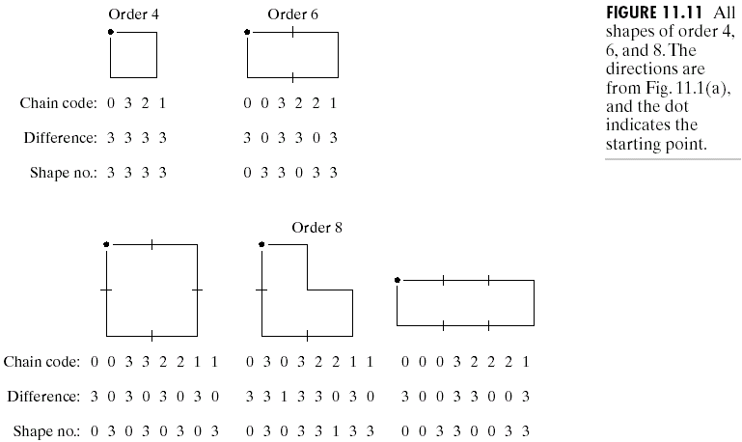

Slide 21
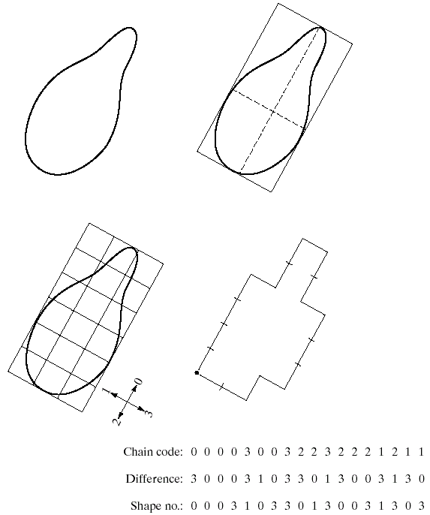
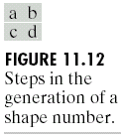
In practice, for a desired shape order, we find the rectangle of order n whose eccentricity best approximates that of the basic rectangle and use this new rectangle to establish the grid size, as an illustrated example shown in Fig. 11.12.

Slide 22
Fourier Descriptors
Fig. 11.13 shows a K-point digital boundary in the xy-plane. Starting at an arbitrary point (x₀, y₀), coordinate pairs
(x₀, y₀), (x₁, y₁), (x₂, y₂), …, (x_{K-1}, y_{K-1}) are encountered in traversing the boundary, say, in the counterclockwise direction.
  The boundary can be represented as a sequence of coordinates s(k) = [x(k), y(k)], k = 0, 1, 2, …, K-1. Each coordinate pair can be treated as a complex number:
  s(k) = x(k) + jy (k), (11.2-2)
  k = 0, 1, 2, …, K-1.
  Eq. (11.2-2) reduces a 2-D problem to a 1-D problem.

Slide 23
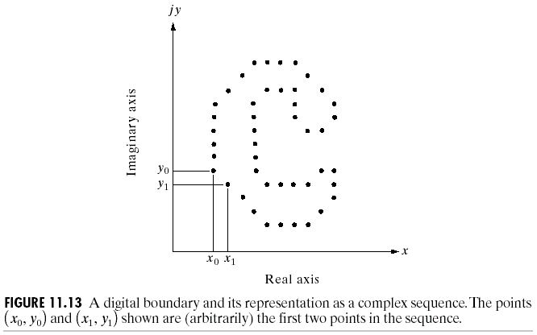
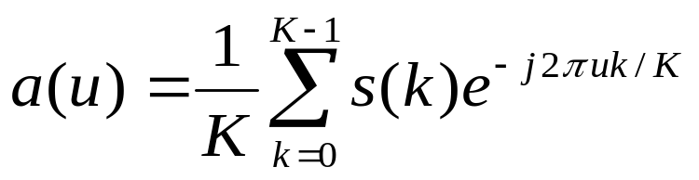
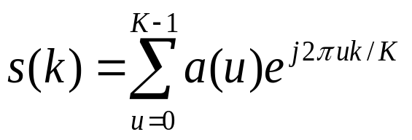
The discrete Fourier transform (DFT) of s(k) is:
(11.2-3)
for u = 0, 1, 2, …, K－1. The complex coefficients a(u) are called the Fourier descriptors of the boundary.
  The inverse Fourier transform of these coefficients restores s(k),
  (11.2-4)
  for k = 0, 1, 2, …, K－1.
,
,

Slide 24

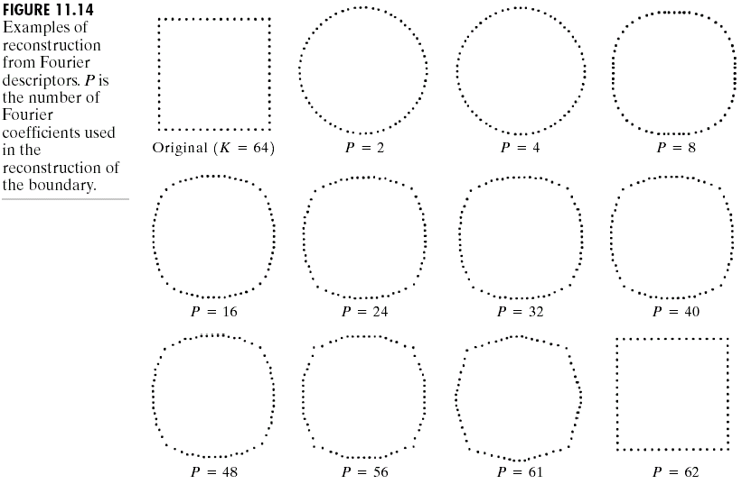
If only the first P (P < K－1) coefficients are used, the approximation to s(k) is:
(11.2-5)
for k = 0, 1, 2, …, K－1.
Fig. 11.14 shows a square boundary consisting of K = 64 points and the results of using Eq. (11.2-5) to reconstruct this boundary for various values of P.
,

Slide 25

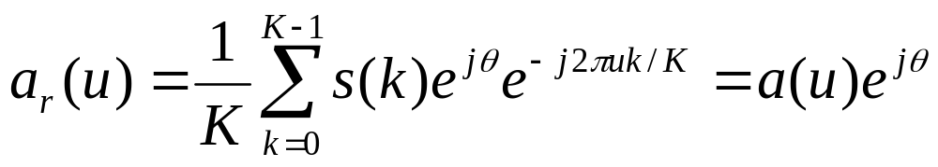
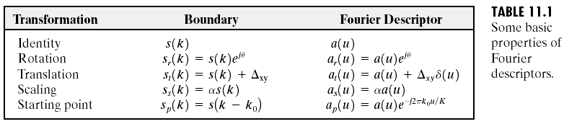
Fourier descriptors are not directly insensitive to these geometrical changes, but the changes in these parameters can be related to simple transformations on the descriptors.
  Rotation of a point by an angleθabout the origin of the complex plane is accomplished by multiplying the point by .
  The rotated sequence is s(k) , whose Fourier descriptors are:
  (11.2-6)
  for u = 0, 1, 2, …, K－1.
Table 11.1 summarizes the Fourier descriptors for a boundary sequence s(k) that undergoes rotation, translation, scaling, and changes in starting point.
  The symbol Δ_{xy} is defined as Δ_{xy} = Δx + jΔy, so
  s_{t}(k) = [x(k) + Δx] + j[y(k) + Δy]. (11.2-7)
  The expression s_{P}(k) = s(k － k₀) means redefining the sequence as:
  s_{p} = x(k － k₀) + jy(k － k₀), (11.2-8)
  which merely changes the starting point of the sequence to k = k₀ from k = 0.
,

Slide 26
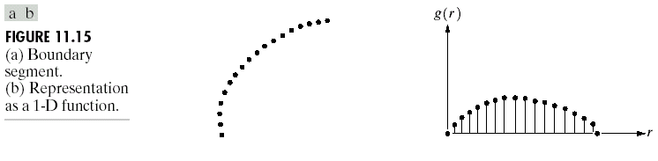
Statistical Moments
The shape of boundary segments (and of signature waveforms) can be described quantitatively by using simple statistical moments, such as the mean, variance, and higher-order moments.
Fig. 11.15(a) shows the segment of a boundary, and Fig. 11.15(b) shows the segment represented as a
1-D function g(r) of an arbitrary variable r.

Slide 27
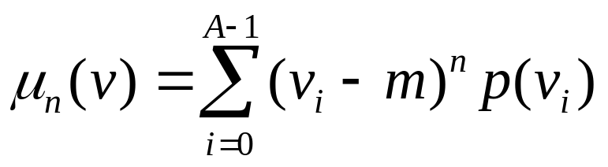
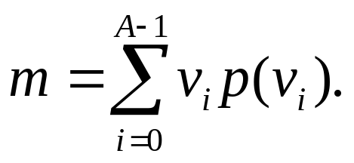

Let v be a discrete random variable representing the amplitude (g(r) in Fig. 11.15) and p(v_{i}), i = 0, 1, …, A－1 form the amplitude histogram. Then the nth moment of v about is mean m is:
(11.2-9)
where
(11.2-10)
The quantity m is recognized as the mean or average value of v and as its variance.
  Generally, only the first few moments are required to differentiate between signatures of clearly distinct shapes.
,

Slide 28
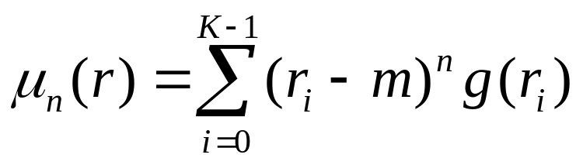
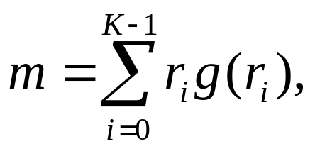


We can normalize g(r) to unit area and treat it as a histogram. Then r is treated as the random variable and the moments are:
(11.2-11)
(11.2-12)
where K is the number of points on the boundary.
  The second moment measures the spread of the curve about the mean value of r and the third moment measures its symmetry with reference to the mean.
,

Slide 29
Some Regional Descriptors
The area of a region is defined as the number of pixels in the region. The perimeter of a region is the length of its boundary.
The compactness of a region is defined as (perimeter)² / area, which is a dimensionless quantity and is minimal for a disk-shaped region.
Simple measures for regional descriptors include the mean and median of the gray levels, the minimum and maximum gray-level values, and the number of pixels with values above and below the mean.

Slide 30
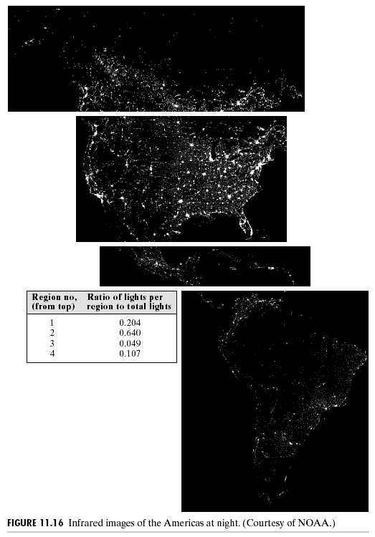
Fig. 11.16 shows a satellite infrared image of the Americas. The table alongside the images shows the ratio of the area occupied by white (the lights) to the total light area in all four regions.

Slide 31
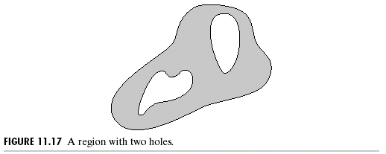
Topological Descriptors
Topology is the study of properties of a figure that are unaffected by any deformation, as long as there is no tearing or joining of the figure (sometimes these are called rubber-sheet distortions).
  Fig. 11.17 shows a region with two holes. Thus if a topological descriptor is defined by the number of holes in the region, this property obviously will not be affected by a stretching or rotation transformation.

Slide 32
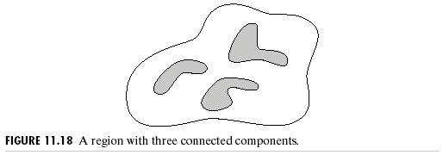
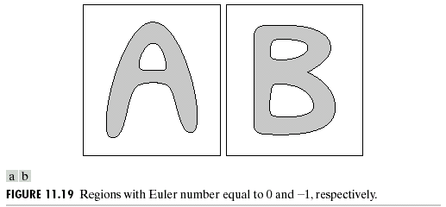
The number of connected components is a useful
The number of holes H and connected components C in a figure can be used to defined the Euler number E:
E = C － H, (11.3-1)
where the Euler number is a topological property.
  The two regions in Fig. 11.19(a) and (b) have Euler numbers equal
topological property for region descriptor.
  Fig. 11.18 shows a region with three connected components.
  to 0 and -1, respectively, where “A” has one connected component and one hole and “B” has one connected component and two holes.

Slide 33
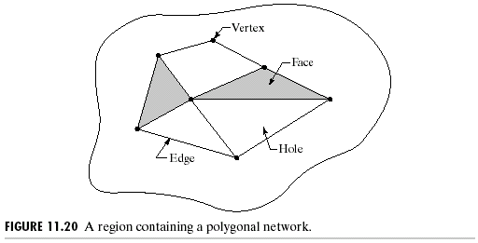
As shown in Fig. 11.20, regions represented by straight-line segments (referred to as polygonal networks) have a particularly simple interpretation in terms of the Euler number.
  Denoting the number of vertices by V, the number of edges by Q, and the number of faces by F gives the following relationship, called the Euler formula:
  V－Q＋F ＝ C－ H ＝ E.
  (11.3-2) and (11.3-3)
Fig. 11.21(a) shows an infrared image of the Washington, D.C. area and Fig. 11.21(b) shows the thresholded image. Containing 1591 connected components and 39 holes (its Euler number is 1552).
  Fig. 11.21(c) shows the connected component with the largest number of elements (8479).
  The network shown in Fig. 11.20 has 7 vertices, 11 edges, 2 faces, 1 connected region, and 3 holes; thus the Euler number is －2.

Slide 34
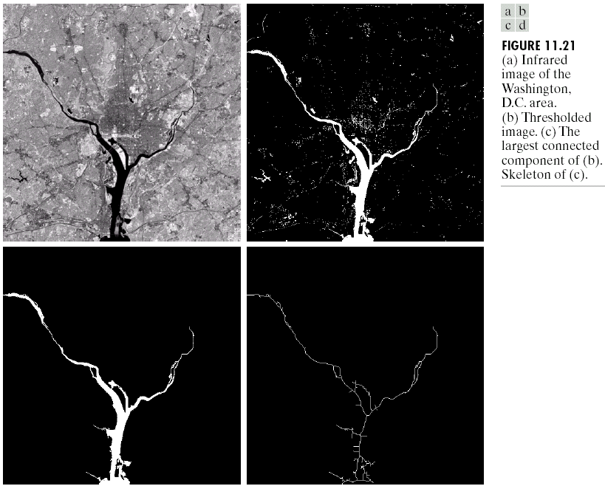
  We can use the skeleton of the connected component to perform measurements, such as the length of each branch of the river (Fig. 11.21(d)).

Slide 35
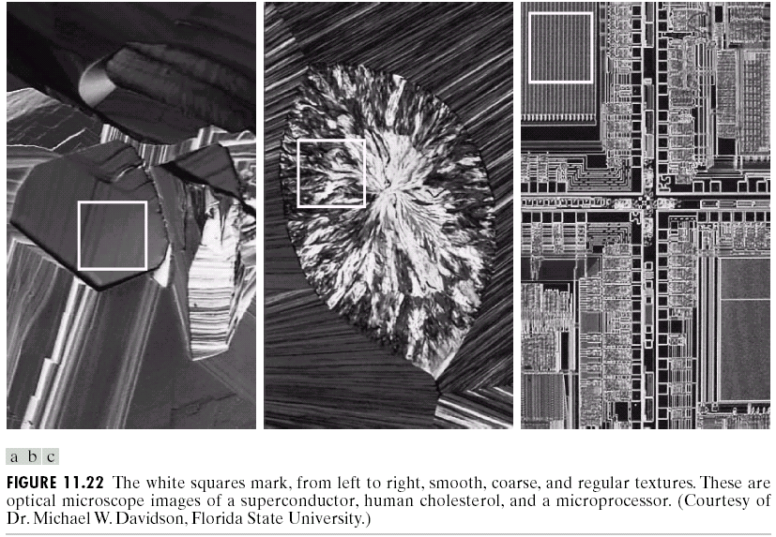
Texture
An important approach to region description is to quantify its texture content.
  As the illustrated examples shown in Fig. 11.22, the texture descriptor provides measures of properties, such as smoothness, coarseness,
  and reqularity.

Slide 36
Three principal approaches to texture description: statistical, structural, and spectral.
  Statistical approaches yield characterizations of textures as smooth, coarse, qrainy, …, etc.
  Structural techniques deal with the arrangement of image primitives.
  Spectral techniques are based on properties of the Fourier spectrum and are used primarily to detect global periodicity in an image by identifying high-energy, narrow peaks in the spectrum.

Slide 37
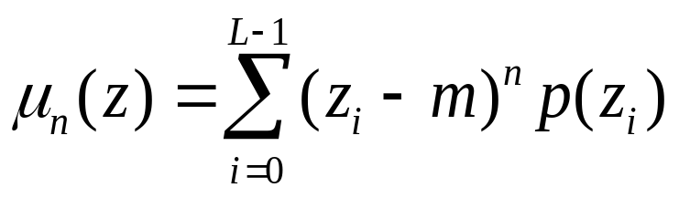
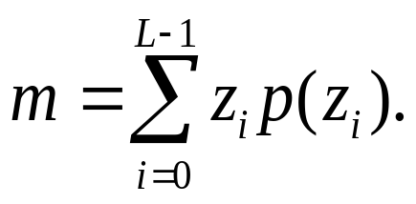
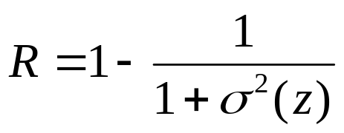
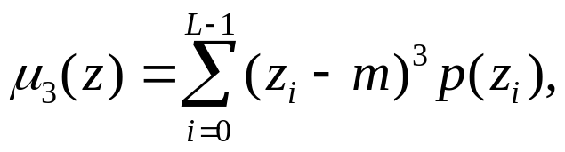
Statistical texture description
Let z be a random variable denoting gray levels and let p(z_{i}), i = 0, 1, 2, …, L – 1, be the corresponding histogram, where L is the number of distinct gray levels. The nth moment of z about the mean m is:
(11.3-4)
(11.3-5)
  u₀(z) = 1, u₁(z) = 0, and u₂(z) is a measure of gray-level contrast
  useful for relative smoothness description. For example, the measure:
  (11.3-6)
  is 0 for areas of constant intensity (the variance is zero there) and approaches 1 for large values of σ²(z).
  (11.3-7)
  is a measure of the skewness of the histogram while the fourth moment is a measure of its relative flatness.
,

Slide 38
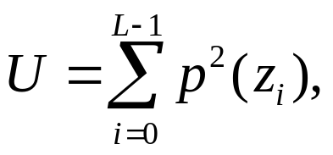
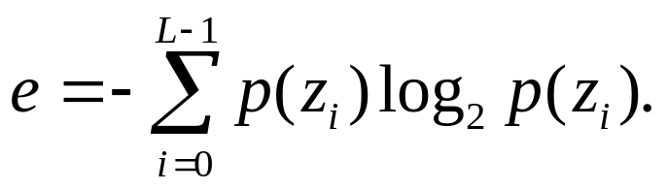
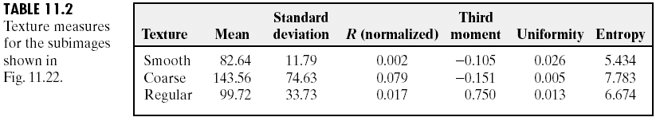
  A measure of uniformity and an average entropy measure are given by:
  (11.3-8)
  (11.3-9)
  U is maximum for an image in which all gray levels are equal (maximully uniform). Entropy is a measure of variability and is zero for a constant image.
Table 11.2 summaries the values of the preceding measures for the three types of textures in Fig. 11.22.
We can analyze textures by using not only the distribution of intensities, but also the positions of pixels with equal or nearly equal intensity values.

Slide 39
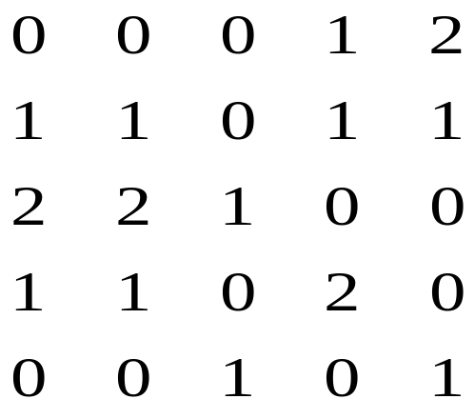
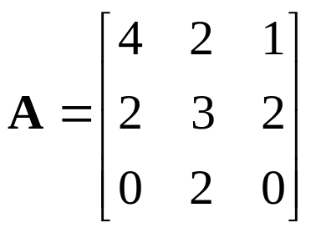
Let P be a position operator and let A be a k × k matrix whose element a_{ij} is the number of times that points with gray level z_{i} occur (in the position specified by P) relative to points with gray level z_{j}, which 1 ≤ i, j ≤ k.
  Consider the following image with z₁ = 0, z₂ = 1, and z₃ =2:
  Defining the position operator P as “one pixel to the right and one pixel below” yields the following 3 × 3 matrix A:
  where a₁₁ is the number of times that a point with level z₁ = 0 appears one pixel location below and to the right of a pixel with the same gray level (a₁₁ = 4).
  The size of A is determined by the number of distinct gray levels in the input image.
,

Slide 40
Let n be the total number of point pairs in the image that satisfy P (the sum of all values in matrix A). If a matrix C is formed by dividing every element of A by n, then c_{ij} is an estimate of the joint probability that a pair of points satisfying P will have values (z_{i}, z_{j}). The matrix C is called the gray-level co-occurrence matrix.

Slide 41
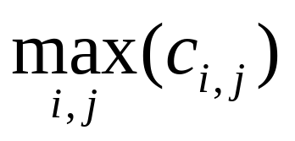
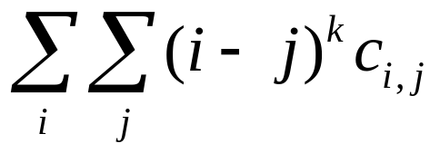

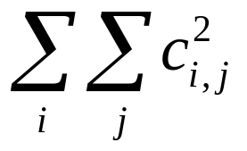
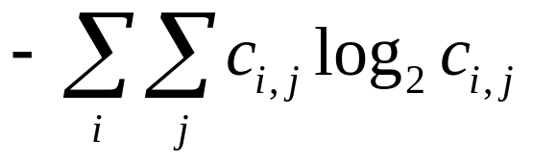
The problem is to analyze a given C matrix in order to categorize the texture of the region over which C was computed. A set of descriptors includes:
1. Maximum probability
2. Element difference moment of order k
3. Inverse element difference moment of order k
4. Uniformity
5. Entropy
  The basic idea is to characterize the “content” of C via these descriptors.
,

Slide 42
Structural approaches
If we have a rule of the form: S → aS. If a represents a circle shown in Fig. 11.23(a) and the meaning of “circles to the right” is assigned to a string of the form aaaa…., the rule
S → aS allows generation of the texture pattern in Fig. 11.23(b).
If we have the other rules: S → bA, A → cA, A → c, A → bS, S → a, where a “b” means “circle down” and a “c” means “circle to the left.”
  The form aaabccbaa corresponds to a 3x3 matrix of circles.
  Large texture patterns, as shown in Fig. 11.23(c), can be generated by the above rules.

Slide 43
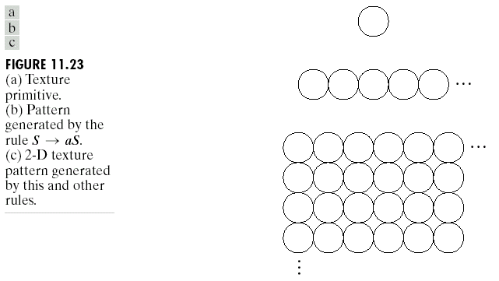

Slide 44

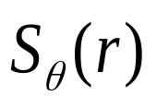
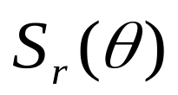
Spectral approaches
Three useful features of the Fourier transform for texture description:
(1) prominent peaks in the spectrum give the principal direction of the texture patterns,
(2) the location of the peaks in the frequency plane gives the fundamental spatial period of the patterns,
(3) eliminating any periodic component via filtering leaves nonperiodic image elements, which can then be described by statistical techniques.
Using the polar coordinate system (r, ), analyzing
for a fixed value of yields the behavior of the spectrum (such as the presence of peaks) along a radial direction from the origin, whereas analyzing for a fixed value of r yields the behavior along a circle centered on the origin.

Slide 45
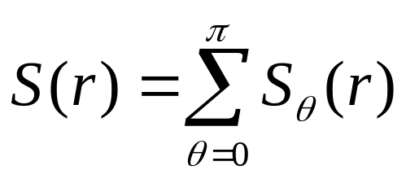
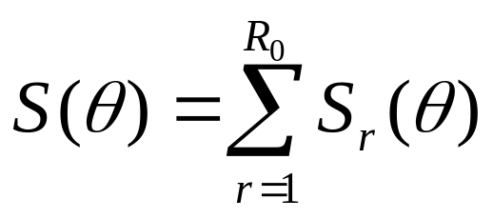
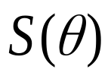

A more global description is:
(11.3-10)
(11.3-11)
where R₀ is the radius of a circle centered at the origin.
Fig. 11.24(a) shows an image with periodic texture, and Fig. 11.24(b) shows its spectrum. Fig. 11.24(c) and (d) shows plots of S(r) and , respectively.
  Fig. 11.24(e) shows another image whose texture pattern is predominantly in the horizontal and vertical directions and Fig. 11.24(f) shows the plot of for the spectrum of this image.
,
,

Slide 46



Slide 47




Moments of 2-D functions
For a 2-D continuous function f(x, y), the moment of order (p + q) is defined as:
(11.3-12)
for p, q = 0, 1, 2, … .
A uniqueness theorem (Papoulis [1991]) states that if f(x, y) is piecewise continuous and has nonzero values only in a finite part of the xy-plane, moments of all orders exist, and the moment sequence (m_{pq}) is uniquely determined by f(x, y). Conversely, (m_{pq}) uniquely determines f(x, y).
The central moments are defined as:
(11.3-13)
where
  If f(x, y) is a digital image, then
  (11.3-14)
,
,

Slide 48



The central moments of order up to 3 are:
,
,
,

Slide 49



,
,
,

Slide 50





  In summary,
,
,
,
,
,
,
,
,
,
,
,
,

Slide 51



The normalized central moments, denoted , are defined as:
(11.3-15)
where
(11.3-16)
for p + q = 2, 3, ... .
,
,

Slide 52


A set of seven invariant moments (with respect to translation, rotation and scaling):
(11.3-17)
(11.3-18)
(11.3-19)
(11.3-20)
(11.3-21)
(11.3-22)
(11.3-23)
,
,
,
,
,
,
.

Slide 53



The image in Fig. 11.25(a) is reduced to half size in Fig. 11.25(b), mirror-imaged in Fig. 11.25(c), and rotated by 2° and 45° in Fig. 11.25(d) and (e). The seven moment invariants for the images in Fig. 11.25(a)～(e) are listed in Table 11.3.

Slide 54

Principal Component Description
The principal component description is applicable to boundaries and regions.
The three elements of a color pixel is expressed in the form of a 3-D column vector x, where
  If the images are size M×N, there will be a total of K = MN three-dimensional vectors.

Slide 55


  If we have n registered images, the vectors will be n-dimensional:
  (11.4-1)
  The mean vector of the population is defined as:
  m_{x} = E{x}. (11.4-2)
  The covariance matrix of the vector population is defined as:
  C_{x} = E{(x-m_{x})(x-m_{x})^{T}}. (11.4-3)
  For K vectors samples from a random population, the mean vector and the covariance matrix can be approximated from the samples by:
  (11.4-4)
  (11.4-5)
,
,

Slide 56


Consider the four vectors x₁ = (0, 0, 0)^{T}, x₂ = (1, 0, 0)^{T}, x₃ = (1, 1, 0)^{T}, and x₄ = (1, 0, 1)^{T}. The mean vector and the covariance matrix are:
,

Slide 57


Let e_{i} and _{i}, i = 1, 2, ..., n, be the eigenvectors and corresponding eigenvalues of C_{x}, arranged (for convenience) in descending order so that _{j} ≥ _{j+1} for j = 1, 2, ..., n – 1, and A be a matrix whose rows are formed from the eigenvectors of C_{x}.
  Let the Hotelling transform is defined as:
  y = A(x-m_{x}). (11.4-6)
  It can be shown that
  m_{y} = E{y} = 0, (11.4-7)
  C_{y} = AC_{x}A^{T}, (11.4-8)
  (11.4-9)
  The off-diagonal element of this covariance matrix are 0, so the elements of the vector y are uncorrelated.
  C_{x} and C_{y} have the same eigenvalues and eigenvectors.

Slide 58



Because the rows of A are orthonormal vectors, A⁻¹ = A^{T}, and any vector x can be recovered from its corresponding y by:
x = A^{T}y + m_{x}. (11.4-10)
If we form matrix A_{k} from the k eigenvectors corresponding to the k largest eigenvalues, yielding a transformation matrix of order k × n.
  The vector reconstructed by using A_{k} is:
  (11.4-11)
  The mean square error between x and is given by:
  (11.4-12)

Slide 59

Because _{j}’s decrease monotonically, Eq. (11.4-12) shows that the error can be minimized by selecting the k eigenvectors associated with the largest eigenvalues. Thus the Hotelling transform is optimal in the sense that it minimizes the mean square error between the vector x and its approximation .
Fig. 11.26 shows six images generated by a 6-band multispectral scanner operating in the wavelengths shows in Table 11.4.

Slide 60



Slide 61

Viewing the images as shown in Fig. 11.27 allows formation of a 6-dimensional vector x = (x₁, x₂, ..., x₆)^{T} from each set of corresponding pixels in the images. Table 11.5 shows the eigenvalues of C_{x}.

Slide 62

Eq. (11.4-6) is used to generate a set of transformed y vectors corresponding to the x vectors. From them, six principal component images were assembled as shown in Fig. 11.28.

Slide 63
Consider the object shown in Fig. 11.29(a). Vectors are formed from the coordinates of the pixels in the object if we wish to describe the region.
  If we wish to describe the boundary, we only use the coordinates of the points on the boundary.
  The resulting vectors are treated as a 2-D population of random vectors.
The net effect of using the Hotelling transform is to establish a new coordinate system whose origin is at the centroid of the population and whose axes are in the direction of the eigenvectors of C_{x}, as shown in Fig. 11.29(b).
  Fig. 11.29(c) shows the object rotated by using the Hotelling transform [Eq. (11.4-6)].
  This alignment is precisely the mechanism that decorrelates the data.

Slide 64


Slide 65

Relational Descriptors
By defining the two primitive elements a and b shown, we may code Fig. 11.30(a) in the form shown in Fig. 11.30(b).
  The above description approach can be realized by the rewriting rules:
  (a) S → aA,
  (b) A → bS, and
  (c) A → b,
  where S and A are variables and elements a and b are constants corresponding to the primitives just defined.
  Rule 1 indicates that S, called the starting symbol, can be replaced by primitive a and variable A.

Slide 66


Fig. 11.31 illustrates some sample derivations of these rules, where the numbers below the structures represent the order in which rules 1, 2, and 3 were applied.
Because strings are 1-D structures, most applications of strings to image description are based on the idea of extracting connected line segments from the objects of interest, as shown in Fig. 11.32.

Slide 67


Another approach is to describe sections of an image (such as small homogeneous regions) by directed line segments, which can be joined in other ways besides head-to-tail connections.
  Fig. 11.33(a) illustrates this approach, and Fig. 11.33(b) shows some typical operations that can be defined on abstracted primitives. Fig. 11.33(c) shows a set of specific primitives consisting of line segments defined in four directions, and Fig. 11.33(d) shows a step-by-step generation of
  a specific shape, where
  (~d) indicates the primitive
  d with its direction reversed.

Slide 68

  String descriptions are best suited for applications in which connectivity of primitives can be expressed in a head-to-tail or other continuous manner.
Some descriptors may not be contiguous, which can be described by the tree descriptors.
A tree T is a finite set of one or more nodes for which
(a) there is a unique node $ designated the root, and
(b) the remaining nodes are partitioned into m disjointed sets T₁, ..., T_{m}, each of which in turn is a tree called a subtree of T.
  The tree frontier is the set of nodes at the bottom of the tree (the leaves), taken in order from left to right, as the frontier xy in Fig. 11.34.

Slide 69

Two types of information in a tree are important:
(1) information about a node stored as a set of words describing the node,
(2) information relating a node to its neighbors, stored as a set of pointers to those neighbors.
  The simple composite region in Fig. 11.35(a) can be represented by the tree representation in Fig. 11.35(b), using the relationship “inside of.”

