Slide 1
Chapter 3. Lossless Compression

Slide 2

Entropy
$$H=\sum{p_{i}∙\log_{2}{\frac{1}{p_{i}}}}$$
Entropy:
$$i=2, p_{1}=1, p_{2}=0 ⇒ H=0$$
$p_{1}=1/2, p_{2}=1/2 ⇒ H=1$ bits / symbol
$i=4, p_{1}=p_{2}=p_{3}=p_{4}=1/4 ⇒ H=2$ bits / symbol
From information theory, the average number of bits needed
to encode the symbols in a source S (using zeroth-order
entropy coding) is always bounded by the entropy of S.
zeroth-order每次coding都是一個一個來 v.s. vector quantization 綁一些人一起coding

Slide 3

The Kraft-Mcmillan Inequality (1/2)
Part 1:
Given a uniquely decodable variable-size code with K codes of size l_{i}, then
$$\sum_{i=1}^{K}{2^{{−l}_{i}}}≤1,$$
(1)
Part 2:
Given a set of K positive integers {l₁, l₂, …, l_{K}} that satisfies Eq. (1), there always exists a prefix code such that l_{i} are the sizes of its individual codes

Slide 4



The Kraft-Mcmillan Inequality (2/2)
For a source S with alphabet A = {a₁, a₂, …, a_{K}} the length l_{i} of code a_{i} can be written as
l_{i}=-log₂P(a_{i})+e_{i}
where e_{i} is the extra length of a_{i}
$$2^{−l_{i}}=2^{\left(\log_{2}{P}\left(a_{i}\right)−e_{i}\right)}=\frac{2^{\log_{2}{P}\left(a_{i}\right)}}{2^{e_{i}}}=\frac{P\left(a_{i}\right)}{2^{e_{i}}}$$
In the special case where all the extra lengths are all the same (e_{i} = e)
Then
$$\sum_{i=1}^{K}{2^{−l_{i}}}≤1$$
$$⇒\sum_{i=1}^{K}{2^{−l_{i}}}=\sum_{i=1}^{K}{\frac{P\left(a_{i}\right)}{2^{e}}=}\frac{\sum_{i=1}^{K}{P\left(a_{i}\right)}}{2^{e}}=\frac{1}{2^{e}}≤1 \\ ⇒2^{e}≥1 \\ ⇒e≥0$$
The length of a uniquely decodable code is greater or equal to the length determined by its entropy

Slide 5
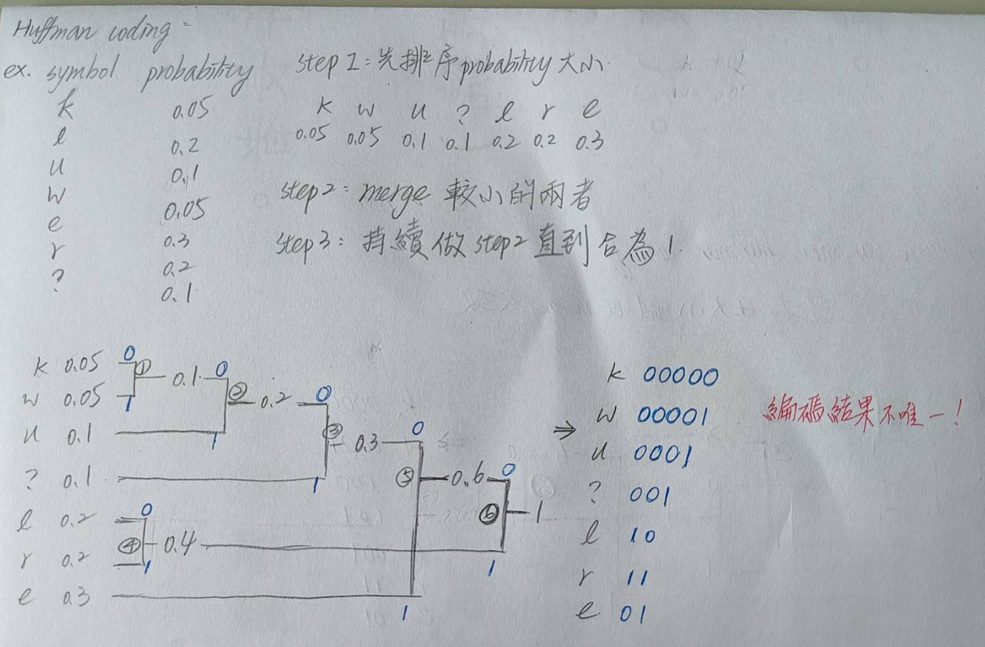

Huffman Coding (1/2)(必考)
root
1.0
0
1
0.4
0.6
1
0
0
1
0.2
0.2
0.3
0.3
l
r
0
1
e
0.1
0.2
u
1
0
0.1
0.1
?
1
0
Not unique
leaves
0.05
0.05
Entropy: 2.546439 bits/symbol
Average coding rate: 2.6 bits/symbol
k
w
$$=\sum{l_{i}}p_{i}=0.05×5+0.2×2+0.1×3+⋯$$

Slide 6
Huffman Coding (2/2)
lluure?
010110010000111011
Compression ratio: 3x7/18 = 1.16
Data expansion
Prefix code
Decoding
Transmission error propagation
Interface to fixed-length memory
Probability modeling, code-book generation

Slide 7
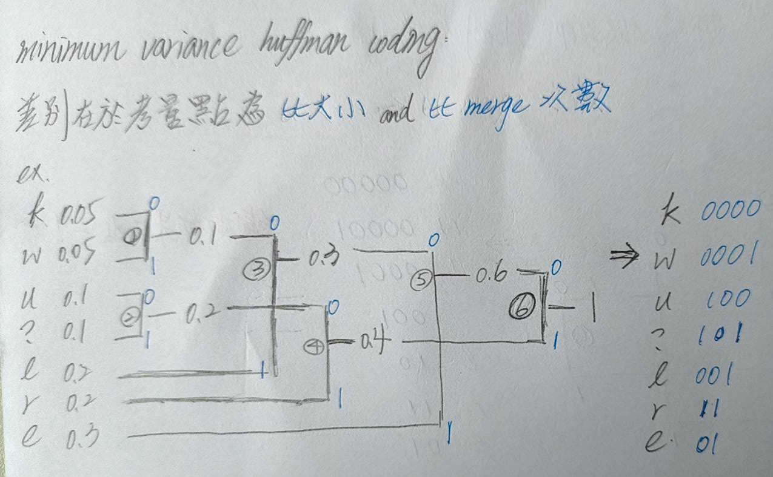
Minimum Variance Huffman Coding
Example:
H = 2.122 bits/symbol
l₁=l₂=2.2 bits/symbol
σ₁² = 0.4(1-2.2)² + 0.2(2-2.2)² + 0.2(3-2.2)² + 0.1(4-2.2)²
=1.36
σ₂² = 0.4(2 - 2 .2)² + 0.2(2 - 2.2)² + 0.1(3 - 2.2)² + 0.1(3 - 2.2)²
= 0.16
Letters | P(a_{i}) | Code 1 | Code 2
a₀ | 0.4 | 1 | 00
a₁ | 0.2 | 01 | 10
a₂ | 0.2 | 000 | 11
a₃ | 0.1 | 0010 | 010
a₄ | 0.1 | 0011 | 011
Minimum variance Huffman code

Slide 8
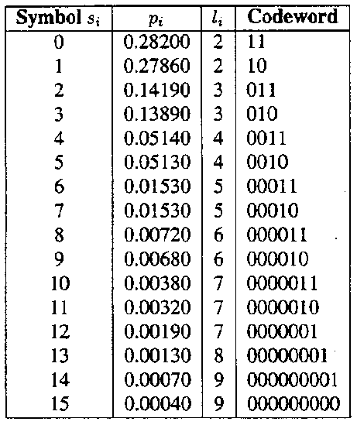
Unconstrained Length Huffman Coding

Slide 9
Constrained Length Huffman Coding
Problem: when some of the symbol possibilities are extremely small, they will require a large number of bits
Solution: shorten and hierarchy
Algorithm:
Partition symbol set S into two sets S₁ and S₂ using p_{i}=1/2^{L} as the boundary, where L is the max. codeword length expected.
Create a special symbol Q such that its frequency of occurrence is the sum of all p_{i} in S₂
Augment S₁ by Q to form a new set W. The new set has the occurrence frequencies corresponding to symbols in S₁ and the special symbol Q
Reconstruct the Huffman tree for W and S₂

Slide 10
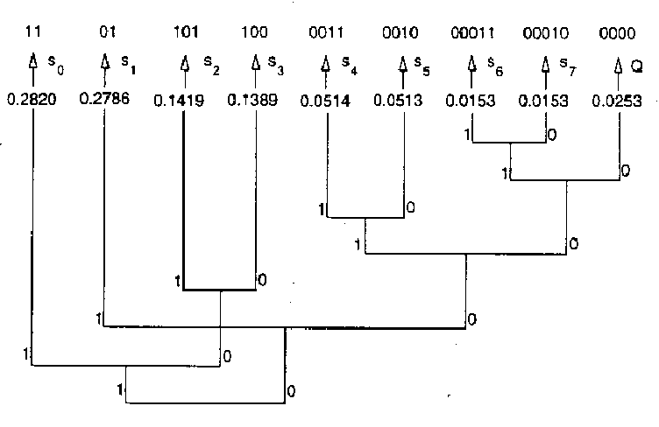
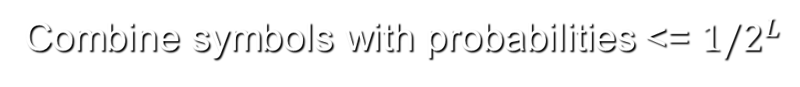
Constrained Length Huffman Coding (1/5)
Shortened Huffman code
Combine symbols with probabilities <= $1/2^{L}$
e.g., L=7

Slide 11
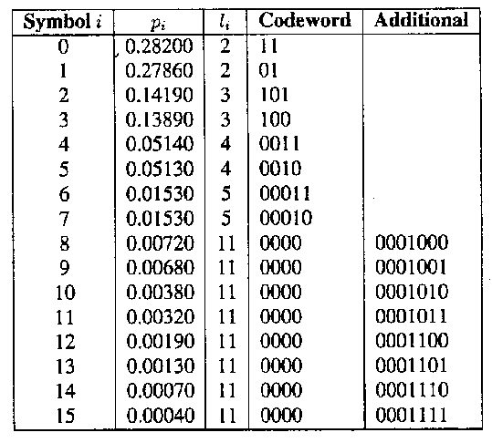
Constrained Length Huffman Coding (2/5)
Shortened Huffman code
7
7
7
7
7
7
7
7
escape-code + fixed-length code

Slide 12
Constrained Length Huffman Coding (3/5)
Ad-Hoc method
Sort symbols so that p₁ ≥ p₂ ≥ … ≥ p_{N}
For max. codeword length L, define T=2^{-L}
For p_{n}<T, set p_{n} =T
Design the codebook using the modified unconstrained Huffman coding method codewords according to the lengths

Slide 13
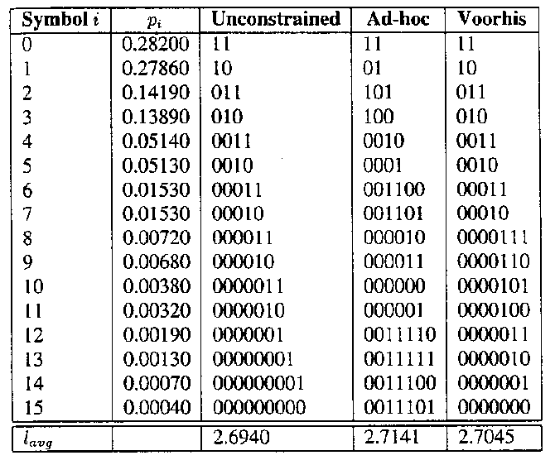
Constrained Length Huffman Coding (5/5)

Slide 14
Run-Length Coding
Input sequence:
0,0,-3,5,1,0,-2,0,0,0,0,2,-4,3,-2,0,0,0,1,0,0,-2
Run-length sequence:
(2,-3)(0,5)(0,1)(1,-2)(4,2)(0,-4)(0,3)(0,-2)(3,1)(2,-2)
Reduce the number of samples to code
Implementation is simple

Slide 15
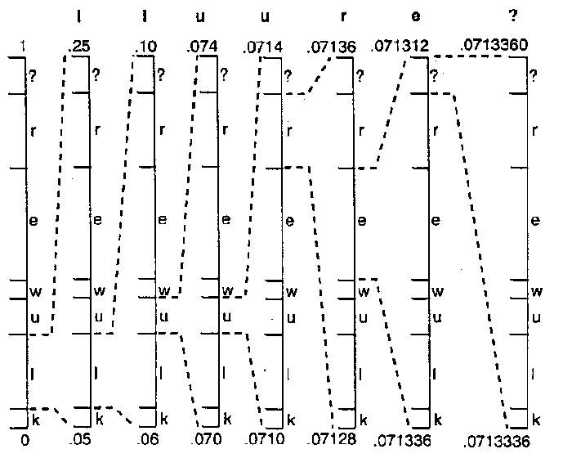
Arithmetic Coding
0.071336
1.0
0.9
0.7
0.4
0.35
0.25
0.05
S_{i} p_{i} sub-
interval
k 0.05 [0.00, 0.05)
l 0.2 [0.05, 0.25)
u 0.1 [0.25, 0.35)
w 0.05 [0.35, 0.4)
e 0.3 [0.4, 0.7)
r 0.2 [0.7, 0.9)
? 0.1 [0.9, 1.0)
0.071312
e.g., 0.0713348389 = 0.0001001001000011

Slide 16
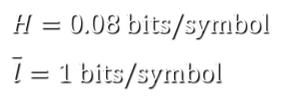
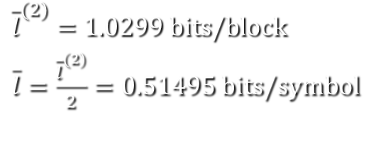
Why Arithmetic Coding? (1/2)
For a source alphabet S with highly skewed probabilities
Assign one codeword for each symbol
Symbol | P(a_{i}) | Codeword
a₁ | 0.99 | 0
a₂ | 0.01 | 1
$H=0.08 \text{bits}\text{/}\text{symbol}$
$\overline{l}=1 \text{bits}\text{/}\text{symbol}$
Assign one codeword for every two symbols
Symbols | P(a_{i}) | Codeword
a₁ a₁ | 0.9801 | 0
a₁ a₂ | 0.0099 | 11
a₂ a₁ | 0.0099 | 100
a₂ a₂ | 0.0001 | 101
${\overline{l}}^{(2)}=1.0299 \text{bits}\text{/}\text{block}$
$\overline{l}=\frac{{\overline{l}}^{(2)}}{2}=0.51495 \text{bits}\text{/}\text{symbol}$

Slide 17
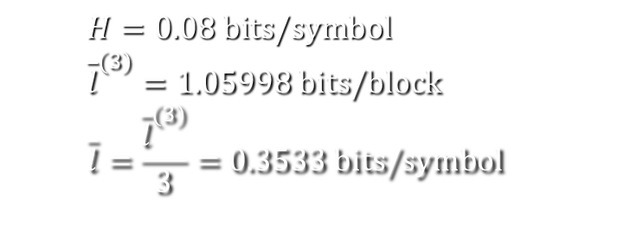
Why Arithmetic Coding? (2/2)
Assign one codeword for every three symbols
Symbols | P(a_{i}) | Codeword
a₁ a₁ a₁ | 0.970299 | 0
a₁ a₁ a₂ | 0.009801 | 100
a₁ a₂ a₁ | 0.009801 | 101
a₁ a₂ a₂ | 0.000099 | 11100
a₂ a₁ a₁ | 0.009801 | 110
a₂ a₁ a₂ | 0.000099 | 11101
a₂ a₂ a₁ | 0.000099 | 11110
a₂ a₂ a₂ | 0.0001 | 11111
$$H=0.08 \text{bits}\text{/}\text{symbol} \\ {\overline{l}}^{(3)}=1.05998 \text{bits}\text{/}\text{block} \\ \overline{l}=\frac{{\overline{l}}^{(3)}}{3}=0.3533 \text{bits}\text{/}\text{symbol}$$
To “block” several symbols together at a time
per-symbol inefficiency is now spread over the whole block
the size of the codebook increases exponentially
e.g., A = {a₁,a₂,…,a_{m}} ⇒ m^{n} codewords are needed to generate one codeword for every n symbols

Slide 18
Arithmetic Coding (1/4)
Arithmetic Code
x assign codewords to individual symbols
- assign one (normally long) code to the entire input stream
⇒ A source message is represented by an interval of real number in [0,1)
0
Example:
Symbols | P(a_{i}) | cdf F_{x}(i) | range
a₁ | 0.8 | 0.8 | [0,0.8)
a₂ | 0.02 | 0.82 | [0.8,0.82)
a₃ | 0.18 | 1 | [0.82,1)
a₁
0.8
a₂
0.82
a₃
1

Slide 19

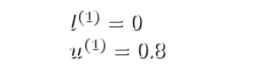



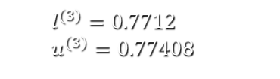
Arithmetic Coding (2/4)
Input sequence: X = (a₁a₃a₂a₁)
0
0
0.656
0.7712
0.7712
a₁
a₁
0.8
0.7712
a₂
0.773504
0.82
0.656
a₃
0.77408
1
0.8
0.8
0.77408
0.773504
$$l^{(0)}=0 \\ u^{(0)}=1$$
$$l^{(1)}=0 \\ u^{(1)}=0.8$$
$$l^{(2)}=0.656 \\ u^{(2)}=0.8$$
$$l^{(3)}=0.7712 \\ u^{(3)}=0.77408$$
$$l^{(4)}=0.7712 \\ u^{(4)}=0.773504$$
$$\left\{\begin{aligned}l^{(n)}=l^{(n−1)}+(u^{\left(n−1\right)}−l^{\left(n−1\right)})F_{x}(x_{n−1}) \\ u^{(n)}=l^{(n−1)}+\left(u^{\left(n−1\right)}−l^{\left(n−1\right)}\right)F_{x}\left(x_{n}\right) \end{aligned}\right.$$

Slide 20







Arithmetic Coding (3/4)
Code = 0.772352
Decoding steps:
Initialization
For each k
Find x_{k} s.t.
F_{x}(x_{k-1})≤code*<F_{x}(x_{k})
(4) Update l^{(k)} & u^{(k)}
(5) Continue until the entire sequence has been decoded
$$\left\{\begin{matrix}l^{(0)}=0 \\ u^{(0)}=1\end{matrix}\right.$$
$$x_{1}=a_{1}$$
$$\left\{\begin{matrix}l^{(1)}=0 \\ u^{(1)}=0.8\end{matrix}\right.$$
$$\left\{\begin{matrix}l^{(0)}=0 \\ u^{(0)}=1\end{matrix}\right.$$
0
$$code^{∗}=\frac{0.772352−0.0}{0.8−0.0}=0.96544 \\ x_{2}=a_{3} \\ \left\{\begin{matrix}l^{(2)}=0.656 \\ u^{(2)}=0.8\end{matrix}\right.$$
$$code^{∗}=\frac{code−l^{(k−1)}}{u^{(k−1)}−l^{(k−1)}} \\ =\frac{code−lower_{l}imit}{range}$$
a₁
$$code^{∗}=\frac{0.772352−0.656}{0.8−0.656}=0.808 \\ x_{3}=a_{2} \\ \left\{\begin{matrix}l^{(3)}=0.7712 \\ u^{(3)}=0.77408\end{matrix}\right.$$
0.8
a₂
0.82
a₃
1
$$code^{∗}=\frac{0.772352−0.7712}{0.77408−0.7712}=0.4 \\ x_{4}=a_{1}$$

Slide 21
Arithmetic Coding (4/4)
How to know when the entire sequence has been decoded?
The length of the sequence is known in advance
the encoder can start by writing the unencoded size on the output stream
- An additional symbol EOF is added
with a small probability
A high-probability symbol narrows the interval less than a low-probability one does
- high-probability symbols contribute fewer bits to the coded sequence
0
Symbols | P(a_{i}) | cdf F_{x}(i) | range
a₁ | 0.8 | 0.8 | [0,0.8)
a₂ | 0.02 | 0.82 | [0.8,0.82)
a₃ | 0.18 | 1 | [0.82,1)
a₁
0.8
a₂
0.82
a₃
1

Slide 22
Adaptive Arithmetic Coding
Example
for a source alphabet {a,b,c}
input sequence = b c c b
0
0.3333
0.5834
0.6334
0.6390
P(a)=1/5
P(a)=1/6
P(a)=1/3
P(a)=1/4
0.6001
0.6390
0.4167
0.3333
P(b)=2/6
b
P(b)=2/5
P(b)=1/3
b
P(b)=2/4
0.6501
0.6334
0.6667
0.5384
c
P(c)=3/6
P(c)=2/5
P(c)=1/3
P(c)=1/4
c
1
0.6667
0.6667
0.6667
0.6501

Slide 23
Arithmetic Coding
QM Coder - binary arithmetic coding
Implementation issues
- Incremental input/output
- High-precision arithmetic
- Re-normalization
- Decoding termination
- Probability modeling
Why it works and why it works better than Huffman coding
Probability model 需預先知道資料性質（例如說誰誰誰出現機率高低），但是online（轉播）不行，因此可以拿之前類似的video 統計的結果先當作ref.，再依現在的資料進行fine-tune
最接近最優entropy

Slide 24
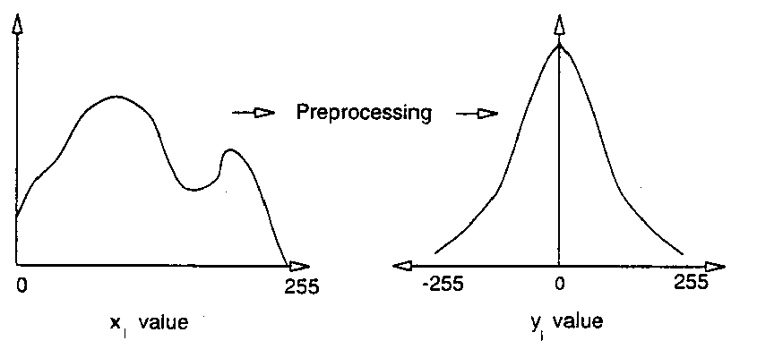



Predictive Coding
進行鄰近（已知點）差值計算，得到preprocessing 後的樣子（相對均勻分布->相對集中分布，entropy 大->小，平均coding長度降低）
Histogram
Histogram
$$x_{i} value$$
$$y_{i} value$$

Slide 25
Lossless Predictive Coding
DPCM (differential pulse code modulation) System:
x
e
e
x
+
E.C.
E.D.
+
-
+
x’
x’
Predictor
r = x
Predictor
r = x
E.C.: Entropy Coder
E.D.: Entropy Decoder
Encoder
Decoder
Dynamic range increased by 1-bit
Synchronization between encoder
and decoder
x
Decoder inside the encoder
Transmission error
Region of causal predictor

Slide 26
An Example of 2-D DPCM Coding
A
B
X
X = (A+B)/2
Histogram (x 1,000)
Histogram (x 1,000)
40
30
20
10
0
2.5
2.0
1.5
1.0
0.5
0
0
50
100
150
200
250
-200
-100
0
100
200
Intensity level
Intensity level
Histogram of the
original “Lena” image
Histogram of the DPCM
residual signal of “Lena”

Slide 27
Source-Model Mismatch
Prob.
a: source, b: model with
large degradation
b
a
signal

Slide 28
Some Research Activities
Re-synchronization after transmission errors
Reversible Huffman code
High-speed implementation
Multiplication-free arithmetic coding
Adaptive entropy coding
Higher-order entropy coding

