Slide 1
Chapter 2. Video Basics & Video Coding Fundamentals

Slide 2
Video Basics

Slide 3
Images And Video
…
time
Pixel or Pel
Line
Sequence
Frame or Picture

Slide 4
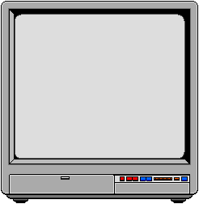
Video Basics
a single scan line
Video
Camera
Video Cable
Video Monitor
Voltage
(proportional
to brightness)
wall
wall
forehead
waveform of scan line shown
hair
hair
Time
sync and blanking
active video

Slide 5
Video Representation
Progressive Scan
Interlaced Scan
1
Frame
1
Frame
Field 2
Frame 2
Field 1
Field 2
Frame 1
Field 1

Slide 6
The Progressive Raster
y
Scan lines viewed edge-on
Active
Video
Note: All scan lines
are sampled at
each time instant.
Vertical Blanking
time
x
Frame Period

Slide 7
The Interlaced Raster
y
Scan lines viewed edge-on
Active
Video
Note: Alternate scan
lines are sampled
at each time instant.
Vertical Blanking
time
x
Frame Period
Field Period
nominal frame rates: 30 Hz (NTSC), 25 Hz (PAL-Europe)

Slide 8
Why Interlacing
Background
  In 1930’s, interlaced scanning was developed as a bandwidth saving technique
  Persistence of vision causes two fields to fuse into a single image, without flicker
  All broadcasting today uses interlaced scanning
Advantages:
  High vertical detail retained for still portions of the scene
Drawbacks:
  Reduced vertical detail for moving areas
  Flicker at edges of objects (e.g., text), which is why computer industry uses progressive scanning for monitors
  More complicated signal processing for resizing, frame rate conversion, etc.
靜止時有細節
動作時模糊

Slide 9
Interlaced Video Artifact
Progressive Scan
Interlaced Scan

Slide 10
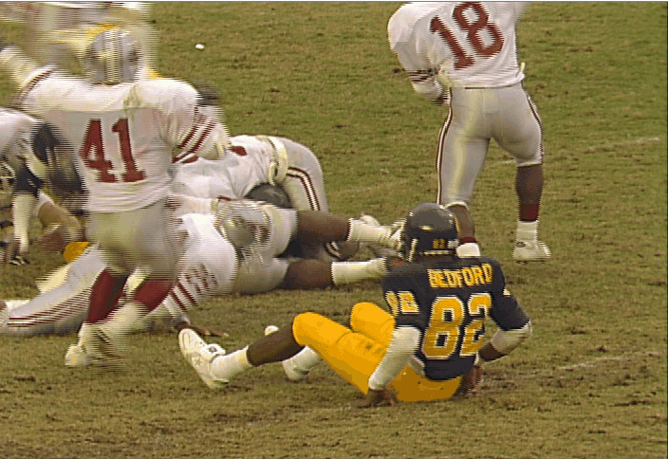
Example of Interlacing

Slide 11
Human Visual System (HVS) Basics
Human visual system (HVS) has limitations that can be exploited for video system design:
  Limited response to black-and-white detail
  Even more limited response to color detail
  Image motion appears fluid at rates above 24 Hz
  Flicker not annoying at picture rates above 24 Hz
  limited ability to track rapidly moving objects
  Insensitivity to “noise”
    at object edges
    in highly detailed areas of a scene
    in bright areas of a scene
    immediately after scene changes

Slide 12
Color Video is an
Additive Mixing of RGB Light
Color Video
G
Green
Yellow
Cyan
White
Black
R
Red
Blue
Magenta
B

Slide 13
Component Video
R’G’B’ (Gamma corrected) - YC_{b}C_{r} -YUV - YIQ
Y
U
V
0.299 0.587 0.114
- 0.147 - 0.289 0.436
0.615 - 0.515 - 0.100
R’
G’
B’
=
Y: black-and-white component
U, V: color differences
Y-C_{b}-C_{r}: a scaled and offset version of Y-U-V
Y: 16-235; C_{b},C_{r}: 16-240
Y
C_{b}
C_{r}
0.299 0.587 0.114
- 0.169 - 0.331 0.500
0.500 - 0.419 - 0.081
R’
G’
B’
=

Slide 14
Component Video (Cont.)
R’G’B’ (Gamma corrected) -YC_{b}C_{r}-YUV - YIQ
Y
B-Y
R-Y
0.299 0.587 0.114
- 0.299 - 0.587 0.886
0.701 - 0.587 - 0.114
R’
G’
B’
=
C_{b},C_{r}: renormalized blue and red color differences of B-Y and R-Y, respectively

Slide 15
Component Video (Cont.)
Y-I-Q: an optional format used in NTSC composite TV
I: in phase
Q: quadrature phase
(R-Y)cos33 (B-Y)sin33
I
=
+
1.14
2.03
(R-Y)sin33 (B-Y)cos33
Q
=
+
1.14
2.03

Slide 16
Composite NTSC
Video bandwidth:
Raster format:
Field rate:
Scan lines:
Subcarrier:
4.3 MHz
2:1 Interlaced
59.94 Hz
525 lines/frame, total
486 lines/frame, active
3.579545MHz
S = Y + I cos(2p¦_{s}t) + Q sin(2p¦_{s}t)

Slide 17
NTSC Composite Video
Y
4.2 MHz
LPF
NTSC
R
+
I
1.5 MHz
LPF
G
Matrix
X
+
3.58 MHz
Osc.
Q
90 shift
B
0.5 MHz
LPF
X
NTSC signal and spectrum
Artifact of NTSC composite video

Slide 18
CCIR 601 4:2:2 Format
Luma sampling frequency
Chroma sampling frequency
Frames/sec
Luma #active samples/line
Chroma #active samples/line
Active #lines/frame
Sample resolution
Data rate
NTSC
13.5 MHz
6.75 MHz
30
720
360
480
8 bits
166 Mb/s
PAL
13.5 MHz
6.75 MHz
25
720
360
576
8 bits
166 Mb/s
30x720x480x8x2 = 25x720x576x8x2 = 166 Mb/s

Slide 19
Common Digital Video Formats
4:2:2 YC_{b}C_{r}
4:1:1 YC_{b}C_{r}
4:2:0 YC_{b}C_{r}
Luma (Y)
sample
H.26x, MPEG-1
MPEG-2
Chroma
(YC_{b}C_{r})
sample
Image format
Resolution
Frame rate
YC_{b}C_{r}
Scan type
ITUR-601 (NTSC)
720 x 480
30
4:2:2
interlaced
ITUR-601 (PAL)
720 x 576
25
4:2:2
interlaced
SIF (NTSC)
352 x 240
30
4:2:0
progressive
SIF (PAL)
352 x 288
25
4:2:0
progressive
CIF
352 x 288
30
4:2:0
progressive
QCIF
176 x 144
30
4:2:0
progressive

Slide 20
Video Coding Fundamentals

Slide 21
Needs for Video Compression
Without compression
- Visual telephony (e.g., CIF @ 15 frames/s):
352 (pels) x 288 (lines) x 15 (frames/s) x 1.5 bytes = 18.25 Mbit/s
- Digital TV (ITUR601 4:2:0 @ 30 frames/s):
720 (pels) x 480 (lines) x 30 (frames/s) x 1.5 bytes = 124.4 Mbit/s
- HDTV (e.g. 1280x720 pels 4:2:0 @ 60 frames/s):
1280 (pels) x 720 (lines) x 60 (frames/s) x 1.5 bytes = 663.6 Mbit/s
Compression results in lower bitrates which enables new
applications and results in lower transmission and storage cost

Slide 22
Video Coding History
1960: AT&T analog videophone (wide bandwidth, small black-and=white pictures)
1980s: CCITT (now ITU) proposed the H.120 standard (DPCM based, E1/T1 rate)
Late 1980: JPEG chose DCT -based compression scheme due to the possibility of progressive image transmission (VQ thus lost the chance of being adopting in the standards)
1989: ITU defined the H.261 standard for coding at px64Kbits/s channels (DPCM+DCT)
Early 1990s: MPEG-1 was defined for storage of video (e.g., CD-ROMs ) with a target bit-rate of 1.5Mbits/s based on the H.261-like framework.
1992-1994: MPEG-2 was defined for the broadcast video applications.
1996: The H.263 standard as an extension of H.261 was defined for very low bit-rate applications (< 64kbits/s, e.g., PSTN and mobile networks). H.263 also works good for high bit-rate applications.
MPEG-4 and MPEG-7 aim to fulfill the goal of providing new functionality: object-based processing, robust video transmission, multimedia database retrieval, etc.

Slide 23
Compression
Remove Redundancy: statistical, spatial, temporal, human perception
Model-Based: Fractal, Object-based, …
Waveform-based:
Lossless (entropy, reversible): Huffman, Run-length,
Arithmetic, Lempel-Ziv, …
Lossy:
Spatial domain: DPCM (Differential Pulse Code Modulation),
VQ (Vector Quantization), …
Frequency domain:
Transform-based: DCT (Discrete Cosine Transform) ...
Filter-based: Subband/Wavelet, ...
將數個pixel裹成vector一起弄
Intra-frame coding: same as still image coding
Inter-frame coding: reduce temporal correlation
Motion-compensated predictive coding, object-based, ...

Slide 24
Rate-Distortion Function of Lossy Compression
Distortion
同rate下，distortion越小越好，psnr越大越好
D
Rate
R
Distortion Measure:
PSNR (Peak Signal-to-Noise Ratio)
PSNR = 10 log ( N x 255² / Σ (err²) )
Subjective evaluation

Slide 25
Video vs. Image Compression
Temporal redundancy
Interlaced artifact
Temporal artifact after compression/decompression
Transmission buffer and rate-control
Often need real-time encoding/decoding
Latency is a concern for 2-way applications

Slide 26
Standard Video Encoder
Video
in
+
DCT
Q
VLC
_
Compressed
video out
IQ
IDCT
+
Frame memory
Motion
estimation
(ME)
DCT: Discrete Cosine Transform
IDCT: Inverse DCT
Q: Quantization
IQ: Inverse Quantization
VLC: Variable Length Coding
Motion
vector

Slide 27
Block Based Coding
大部分都是使用raster scan，但有可能中間有error，因此會用error-concealment達到修正error
time

Slide 28
Block Based Coding (Cont.)
Sequence
…
Block
Picture
GOB
C_{b}
C_{r}
Y
Y
Y
Y
…
Macroblock (MB)
GOB：group of block，每個block則切分成四個(Y、Cb、Cr)，此block也可稱為MB

Slide 29
Intra Coding: Transform Coding
Encoder
Transform
Coefficients
Image Block
Entropy
Coding
Bitstream
T
Q
101001...
Transform
Quantization
為lossy coding為何一定有誤差的原因（因為為多對一mapping）
Decoder
Reconstructed
Image Block
Bitstream
Entropy
Decoding
–1
T
101001...
Inverse
Transform

Slide 30

Lossless Coding
also known as: entropy coding, reversible coding, or bit-preserving coding
$$H=\sum{p_{i}∙\log_{2}{\frac{1}{p_{i}}}}$$
entropy（不確定性）最小時為某個人機率為1，其餘為0。最大時為每個人機率相等。此coding 即為送出必要的bits數來消除不確定性
Entropy:
$i=2, p_{1}=1, p_{2}=0 ⇒ H=0$ bits / symbol
$p_{1}=1/2, p_{2}=1/2 ⇒ H=1$ bits / symbol
$i=4, p_{1}=p_{2}=p_{3}=p_{4}=1/4 ⇒ H=2$ bits / symbol
From information theory, the average number of bits needed
to encode the symbols in a source S (using zeroth-order
entropy coding) is always bounded by the entropy of S.

Slide 31
Lossless Coding (Cont.)
Run-Length Coding (RLC):
Input sequence:
0,0,-3,5,1,0,-2,0,0,0,0,2,-4,3,-2,0,0,0,1,0,0,-2
Run-length sequence:
(2,-3)(0,5)(0,1)(1,-2)(4,2)(0,-4)(0,3)(0,-2)(3,1)(2,-2)
Many variations
Reduce the number of samples to code
Implementation is simple

Slide 32
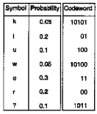
Lossless Coding (Cont.)
Huffman Coding: VLC (variable length coding)
1.0
0
1
0.4
0.6
1
0
0
1
0.2
0.2
0.3
0.3
l
r
0
1
e
0.1
0.2
u
1
0
0.1
0.1
?
1
0
Not unique
0.05
0.05
k
w

Slide 33
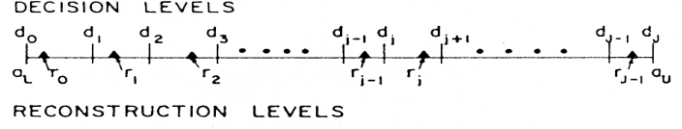
Lossy Coding: Quantization
Output
codewords
Many to one mapping
Many different ways of implementation
(table lookup, divide by the
quantization step-size and
round/truncate)
The only functional block that
introduces errors in standard video
encoders
Input level

Slide 34



Discrete Cosine Transform (DCT)
DC coefficient
AC coefficients
Horizontal freq.
DCT
Vertical freq.
8x8 image block
DCT coefficients
$$F\left(u,v\right)=\frac{1}{4}C\left(u\right)C(v)\sum_{m=0}^{7}{\sum_{n=0}^{7}{f(m,n)\cos{[\frac{\left(2m+1\right)uπ}{16}]}\cos{[\frac{\left(2n+1\right)vπ}{16}]}}}$$
$$f\left(m,n\right)=\frac{1}{4}\sum_{u=0}^{7}{\sum_{v=0}^{7}{C\left(u\right)C\left(v\right)F(u,v)\cos{[\frac{\left(2m+1\right)uπ}{16}]}\cos{[\frac{\left(2n+1\right)vπ}{16}]}}}$$
$$C\left(u\right),C\left(v\right)=\left\{\begin{aligned}1/\sqrt{2}, u,v=0, \\ 1, otherwise. \end{aligned}\right.$$

Slide 35
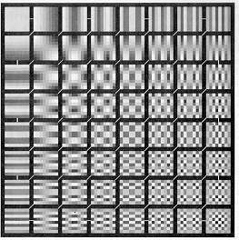
8x8 DCT Basis Functions

Slide 36
8x8 DCT
52 55 61 66 70 61 64 73
63 59 66 90 109 85 69 72
62 59 68 113 144 104 66 73
63 58 71 122 154 106 70 69
Pixel domain
67 61 68 104 126 88 68 70
79 65 60 70 77 68 58 75
85 71 64 59 55 61 65 83
87 79 69 68 65 76 78 94
DCT
IDCT
DC
609 - 29 - 62 25 55 - 20 - 1 3
7 - 21 - 62 9 11 - 7 - 6 6
- 46 8 77 - 25 - 30 10 7 - 5
Frequency
domain
- 50 13 35 - 15 - 9 6 0 3
AC
11 - 8 - 13 - 2 - 1 1 - 4 1
- 10 1 3 - 3 - 1 0 2 - 1
- 4 - 1 2 - 1 2 - 3 1 - 2
- 1 - 1 - 1 - 2 - 1 - 1 0 - 1
DC: F(0,0)= (1/8) ΣΣ f(m,n)
related to the average value of the block

Slide 37
2-D DCT Coefficients
dc
dc
Low
frequencies
Vertical edges
Medium
frequencies
Horizontal edges
High
frequencies
High
frequencies

Slide 38


Effect of DCT+Quantization
②
Motion compensated
difference block
①
994
-
34
20
38
22
0
5
-
1
DCT
-
49
17
8
-
17
-
4
-
1
4
-
2
149
35
-
37
-
15
1
3
-
1
-
4
58
8
-
32
-
3
-
9
-
11
2
-
4
-
27
5
26
6
9
7
8
0
9
41
53
8
0
1
-
1
2
③
0
2
-
1
-
6
-
2
-
3
0
1
DCT
Q
Z
3
-
14
-
12
2
-
1
-
7
-
5
-
1
①
②
QUANTIZATION (Step size = 30)
③
IQ
④
33
-
1
1
1
1
0
0
0
-
2
1
0
-
1
0
0
0
0
IQ, IDCT
5
1
-
1
0
0
0
0
0
2
0
-
1
0
0
0
0
0
IDCT
-
1
0
1
0
0
0
0
0
0
1
2
0
0
0
0
0
0
0
0
0
0
0
0
0
④
0
0
0
0
0
0
0
0
Mean Square Error = 38.75

Slide 39
Temporal Redundancy Removal: Inter Coding
Conditional replenishment
  Transmit only the changing blocks
Previous Frame
Current Frame

Slide 40
Inter Coding: Motion Compensation
Motion
  Pixel-based motion
  Block-based motion
  Object-based motion
Previous Frame
Current Frame

Slide 41
Block Based Motion Compensation
Block matching to estimate motion
Motion vectors and residue are transmitted
Search Range Ω
Motion Vector
X_{t}(p,q)
the block at location (p,q) in t-th frame
Motion Vector
V_{t}(p.q) =(Vec_{i},Vec_{j})
Reference Frame
the location in the search range Ω
that has the maximum correlation value
between blocks in temporally adjacent frames
Current Frame

Slide 42
Block Based Motion Compensation
previous frame
current frame
M+2p
M
mv
N+2p
N
best matched block
search area
one motion vector (mv) per block
matching criteria: mean-absolute-differences (MAD),
mean-squared-differences (MSD), cross-correlation-function (CCF)
in CCITT H.261 px64 kb/s video codec standard: block size 16x16,
motion vector values not to exceed +/- 15 pixels

Slide 43
Motion Compensation Prediction (MCP)
Encoder
Decoder
current
frame
previous
frame
residuals
mv

Slide 44
CODEC (Intra)
x(n)
DCT
Q
IQ
IDCT
x’(n)
CODEC = COder+DECoder

Slide 45
CODEC (Inter)
x(n)
r(n)
Entropy Codec
+
+
DCT
Q
–
IQ
IQ
IDCT
IDCT
r’(n)
r’(n)
+
+
MC
D
x’(n)
x’(n)
D
MC
x’_{MC}(n-1)
x’(n-1)
x’(n-1)
x’_{MC}(n-1)
MV
MV
ME
x(n)
x’(n-1) or x(n-1)

Slide 46
Why Standards?
Important for communication
Customers prefer standards to proprietary schemes: freedom to choose
Adoption of standards increases volume and brings down cost of service and SW/HW
Reduce the risk of deploying new technology
Major players often participate
Facilitate development on a common ground
Provide research opportunities

Slide 47
Types of Standards
Industrial/Commercial standards
  Mutual agreement among companies
  May become de facto standards
Voluntary standards
  By volunteers in open committees
  Based on consensus
  Market driven
  Need to stay ahead of technology
The second type is more beneficial to all

Slide 48
Global Standards Arena
International
  ITU: International Telecommunication Union
    ITU-T: ITU Telecommunication Standardization Sector (CCITT)
    ITU-R: ITU Radio Communication Sector (CCIR)
  ISO: International Standards Organization
  IEC: International Electrotechnical Commission
  JTC1: Joint Technical Committee on Information Technology
Regional
  CEN/CENELEC: Committee for European Normalization
  PASC: Pacific Area Standards Congress
  ETSI: European Telecom Standard Institute
National
  ANSI: American National Standards Institute

Slide 49
Some Video Coding Standards
Specify only the decoder
Standardize the minimum

Slide 50
Video Quality Assessment

Slide 51
Rate-Distortion Tradeoff
Distortion
D
R
Rate

Slide 52
Video Quality Assessment
Subjective Assessment – DSCQS
(double atimulus continuous quality scale)
Traditional Objective Assessment – PSNR and SSIM
(peak signal to noise ratio and structure similarity)
Perceptual Objective Assessment -
  Human visual perception based
  Capturing image imperfections

Slide 53
DSCQS (double stimulus continuous quality scale)
Observers are shown multiple scene pairs with the reference and the to-be-compared scenes randomly.
A_{i}
B_{i}
B_{j}
A_{j}

Slide 54
DSCQS (Cont.)
Scoring is on a continuous quality scale from excellent to bad.
Analysis is based on the difference in rating for each pair rather than the absolute values.
A
B
Excellent
Good
Fair
Poor
Unacceptable

Slide 55
DSCQS (Cont.)
By far the most reliable quality measurement method
Requires special viewing room and equipment
Needs a large group of people
Large amount of post-processing on data

Slide 56
Objective Assessments: Goals
Establish a good quality assessment model
The model takes as inputs the source and the processed video clips.
Compare the model output to DSCQS test score
If the result is consistent with DSCQS measurement, the model can substitute DSCQS

Slide 57
Objective Assessments: Requirements
Ability to predict subjective quality with low error
Predictions agree monotonically with the relative magnitudes of subjective quality ratings
Prediction is robust with respect to a variety of video impairments

Slide 58
Standard Groups Involved in Video Quality Evaluation
ITU-T SG9 and SG12
  Q21/9 and Q4/9
  G.1000, G.1010 in SG12
ITU-R WP 6Q
T1A1 (Committee T1)
IEEE Broadcasting Technology

Slide 59
Video Quality Recommendations
BT.500 Methodology for the subjective assessment of the quality of television pictures
P.910 Subjective video quality assessment methods for multimedia applications
P.911 Subjective audiovisual quality assessment methods for multimedia applications
P.920 Interactive test methods for audiovisual communications
P.930 Principles of a reference impairment system for video
P.931 Multimedia communications delay, synchronization and frame rate measurement
J.143 User requirements for objective perceptual video quality measurements in digital cable television
J.144 Objective perceptual video quality measurement techniques for digital cable television in the presence of a full reference

Slide 60
Standardization of Objective Video Quality Evaluation Methods
Standards and Reports
ITU-T &
ITU-R
T1A1 &
IEEE
VQEG
Validation
Testing
Industry & Academia
Results

Slide 61
Models: Two Approaches
1. Establish a model that simulates the human visual stimulation
2. Establish a model that find the relationship between measurable parameters and perceptual distortion (blurring, tiling, noise, …)

Slide 62
Objective Quality Assessment Models
Tested by Video Quality Experts Group (VQEG)
  Tested video bit-rate from 768 kb/s to 50 Mb/s
  (4:2:0 - 4:2:2 MPEG-2 )
  All have strengths and weaknesses
  PSNR (peak signal to noise ratio) and the model developed by ITS (Institute for Telecommunications Studies) have displayed results close to DSCQS
No model can substitute DSCQS in every aspect

Slide 63


PSNR (Peak Signal to Noise Ratio)
For a video sequence of K frames of NxM dimension with 8 bit depth:
$$RMSE=\sqrt{\frac{1}{N⋅M⋅K}\sum_{k=1}^{K}{\sum_{i=1}^{N}{\sum_{j=1}^{M}{{\left[x(i,j,k)−\hat{x}(i,j,k)\right]}^{2}}}}}$$
$$PSNR=20⋅\log_{10}{\frac{255}{RMSE}}$$
Very easy to compute
Well understood by most researchers

Slide 64
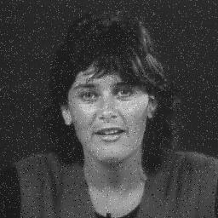
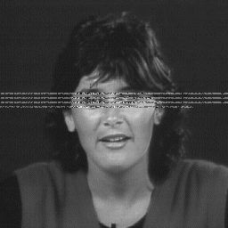
Problems of PSNR
Some reconstructed images with different errors
have the same PSNR value

Slide 65
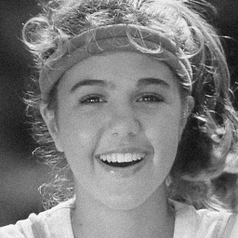

Digital Video Creates “Patterned” Noise
Random “Analog” Noise
Blocky “Digital” Noise
MSE = 27.10
MSE = 21.26
Measures like MSE suitable for analog noise no longer work for digital noise

Slide 66
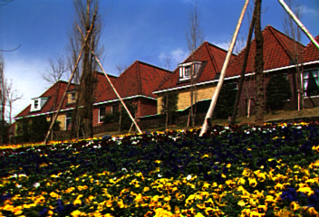
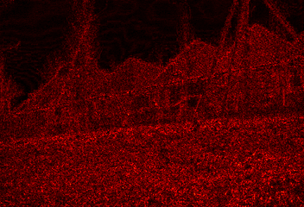
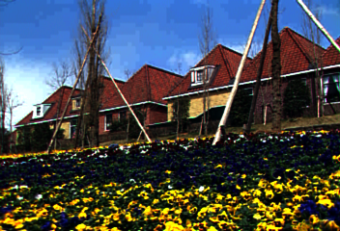
Patterned noise in the
sky much more perceptible
even though much smaller
in terms of pixel differences
Source Frame
Difference Map
Coded Frame

Slide 67
ITS Model
Map image imperfections onto measurable parameters.
Works well for a wide range of bit-rates
Produces results consistent with DSCQS
Computationally efficient

Slide 68
  Perceptual Impairment Factor vs.
  A Measurable Parameter
Image Blur | Step response rise-time
Edge Busyness | Step response jitter width
False Contouring | S_{p-p} to minimum quantizing p-p
Granular Noise | Equivalent analog signal SNR expressed as S_{p-p}/N_{rms}
Dirty Window | Maximum noise amplitude
Movement Blur | Rise-time of a moving edge
Jerkiness | Field or frame difference in terms of moving edge position

Slide 69
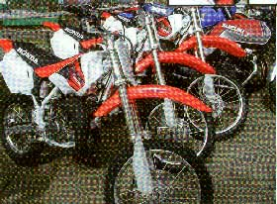
  Some Digital Noises with Predictive Coding
Granular noise: random noise in flat areas of the picture
Edge busyness: jittery appearance of edges (for video)
Slope overload: blur of high-contrast edges, Moiré patterns in periodic structures.
Moiré pattern

