Slide 1
Chapter 6.
Other Compression Techniques
Vector quantization (VQ)
Fractal coding
Subband and wavelet coding
Model-based coding

Slide 2
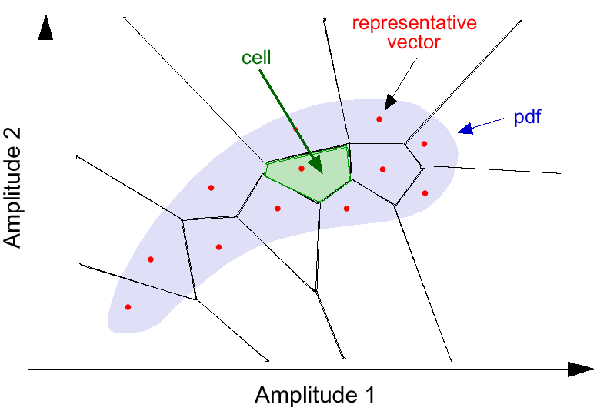
Vector Quantization

Slide 3
Vector Quantization (Cont.)
Best Match
Search
Table
Lookup
index
Codebook
...
...
...
...

Slide 4
LBG Algorithm
Linde, Buzo, Gray (1980): Lloyd algorithm generalized for VQ
Best representative
vectors
for given subdivision
of training set
Best subdivision
of training set
for given
representative vectors
Assumption: fixed codeword length
Code book unstructured: full search

Slide 5
VLC VQ
Chou, Lookabaugh, Gray (1989): extended LBG algorithm for entropy-coded VQ
Lagrangian cost function to solve an unconstrained problem:
min{D+λR}
Unstructured codebook: full search for min{D+λR}
The most general coder structure:
any source coder can be interpreted as VQ with VLC

Slide 6
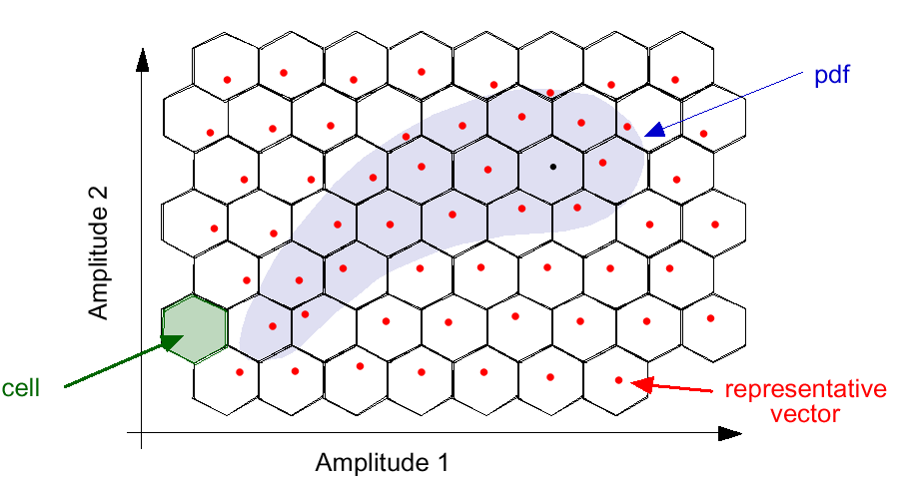
Lattice Vector Quantization

Slide 7
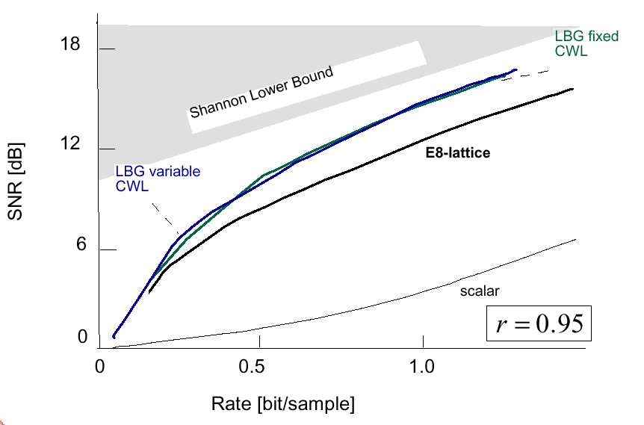
8D VQ of Gauss-Markov Source
Shannon lower bound

Slide 8
Vector Quantization
Highly asymmetrical encoding and decoding complexity
Encoding complexity depends on the codebook size
Decoding is done simply by table lookup
Codebook design usually is an iterative process, which
involves off-line training
Different codebook designs result in different quality

Slide 9
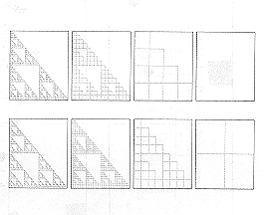
Fractals

Slide 10
Affine Transformation
Maps points into new points according to affine transform:
x’
y’
a b
c d
]
[
x
y
]
[
e
f
]
[
]
[
=
+
Can model translation, rotation, and scaling.

Slide 11
Fractal Image Coding
Partition the image
into DOMAIN regions
Find the affine transform
and the best matched RANGE
Choose a set of allowable
RANGE regions
Store the affine coefficients
Last
DOMAIN ?
N
Choose the class of
affine transforms
Point to next
DOMAIN
Y
Point to the first DOMAIN
Output header and the
packed affine coefficients

Slide 12
Fractal Image Decoding
Read domain partition info
and unpack affine coef.
Replace DOMAIN with transformed
data using the affine coefficients
Store the affine coefficients
Create memory buffers for the
DOMAIN and RANGE screens
Last
DOMAIN ?
N
Point to next
DOMAIN
Initialize the RANGE
screen buffer to an
arbitrary initial state
Y
More
iterations?
N
Output the
final DOMAIN
screen
Y
Point to the first DOMAIN
Copy contents of DOMAIN
screen to RANGE screen

Slide 13
Fractal Coding
- Real-time encoding is a problem
- Currently quality may not be better than JPEG and MPEG
(especially for high quality applications)
- Real-time decoding can be implemented using regular PC
- Resolution independent

Slide 14
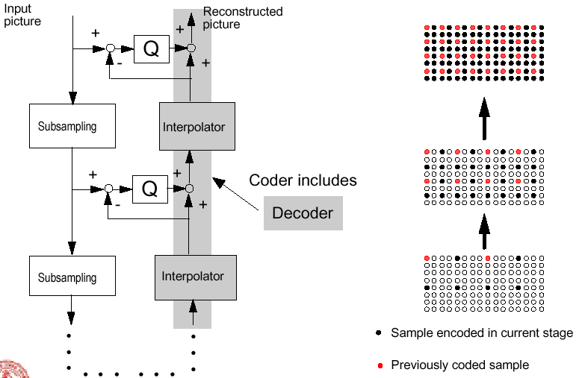
Interpolation Error Coding

Slide 15
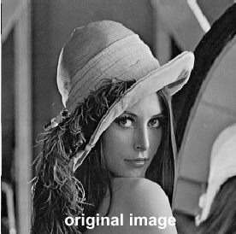
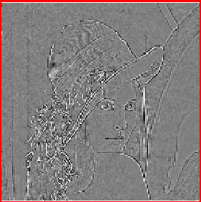
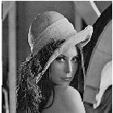
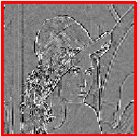

Interpolation Error Coding (Cont.)
Signals to be encoded

Slide 16
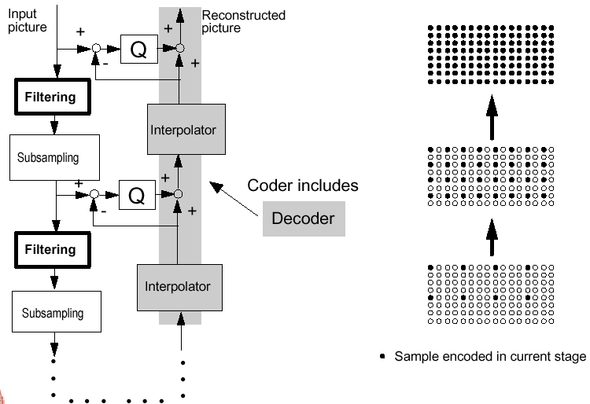
Predictive Pyramid Coding

Slide 17

Predictive Pyramid Coding (Cont.)
$$\text{Number} \text{of} \text{samples} \text{to} \text{be} \text{encoded}\text{ =} \\ \left(1+\frac{1}{N}+\frac{1}{N^{2}}+⋯\right)=\frac{N}{N−1}×\text{number} \text{of} \text{original} \text{image} \text{samples}$$
subsampling factor

Slide 18
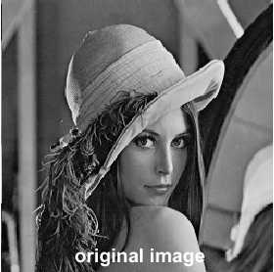
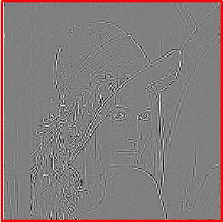

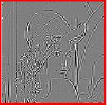

Predictive Pyramid Coding (Cont.)
Signals to be encoded

Slide 19
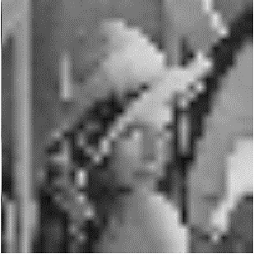

Interpolation Error Coding vs. Pyramid
Resolution layer #0, interpolated to original size for display
Interpolation error coding
Pyramid

Slide 20
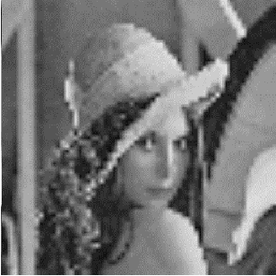
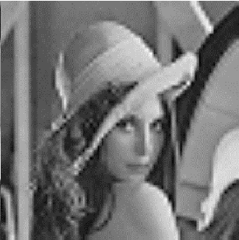
Interpolation Error Coding vs. Pyramid (Cont.)
Resolution layer #1, interpolated to original size for display
Interpolation error coding
Pyramid

Slide 21
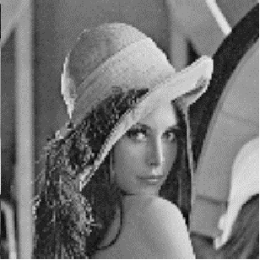

Interpolation Error Coding vs. Pyramid (Cont.)
Resolution layer #2, interpolated to original size for display
Interpolation error coding
Pyramid

Slide 22

Interpolation Error Coding vs. Pyramid (Cont.)
Resolution layer #3
=
(original)
Interpolation error coding
Pyramid

Slide 23
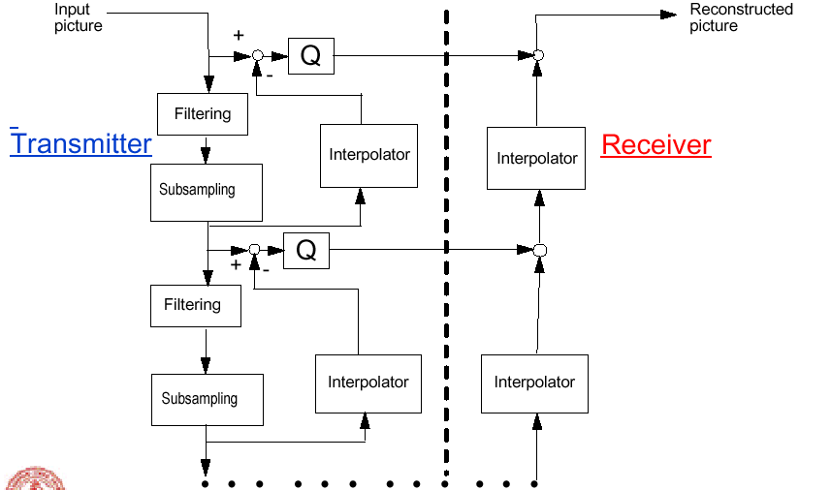
Open-loop Pyramid (Laplacian Pyramid)

Slide 24
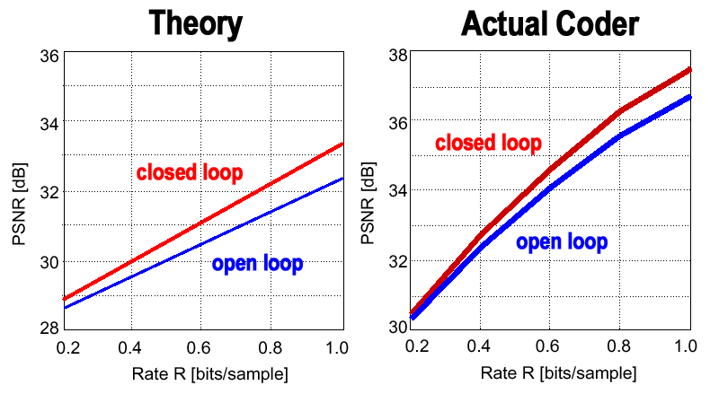
Two-layer Open- vs. Closed-loop Pyramids

Slide 25
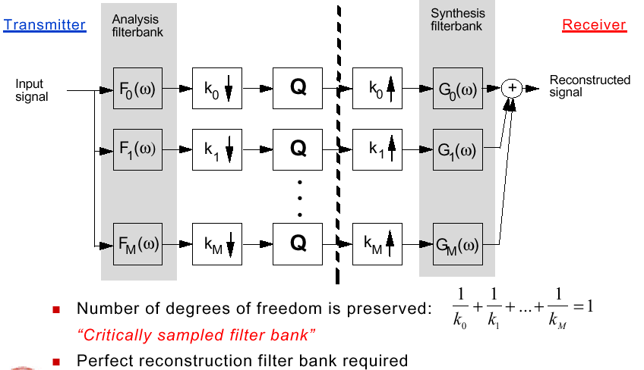
Subband Coding

Slide 26
Two-Band Analysis Filter Band
amplitude
low band
high band
frequency
0
W/2
W
To eliminate aliasing distortion, the synthesis and analysis filters must have certain relationships

Slide 27

Two-Band Subband Codec
H
0
(
z
)
2
2
G
0
(
z
)
X(z)
coding and
Σ
Y(z)
transmission
upsample
H
1
(
z
)
2
2
G
1
(
z
)
downsample by a factor of 2
$H_{0}\left(z\right):$ the z-transform of the low-pass analysis filter
$H_{1}\left(z\right):$ the z-transform of high-pass analysis filter
$G_{0}\left(z\right)$ and $G_{1}\left(z\right)$ are the corresponding synthesis filters
The downsampling factor is 2, so as the upsampling

Slide 28




Perfect Reconstruction in Subband Coding
The reconstructed output in z-transform notation:
$$Y(z)=G_{0}(z)⋅Y_{0}(z)+G_{1}(z)⋅Y_{1}(z)$$
where
$$Y_{0}(z)=\frac{1}{2}[H_{0}(z)⋅X(z)+H_{0}(−z)⋅X(−z)]$$
$$Y_{1}(z)=\frac{1}{2}[H_{1}(z)⋅X(z)+H_{1}(−z)⋅X(−z)]$$
The aliasing components from the downsampling of the lower and higher bands are given by H₀(-z)X(-z) and H₁(-z)X(-z), respectively. Then
$$Y(z)=\frac{1}{2}[H_{0}(z)⋅G_{0}(z)+H_{1}(z)⋅G_{1}(z)]X(z) \\ +\frac{1}{2}[H_{0}(−z)⋅G_{0}(z)+H_{1}(−z)⋅G_{1}(z)]X(−z)$$

Slide 29

Perfect Reconstruction in Subband Coding
The first term is the desired reconstructed signal, while the second term is aliased components. That is
$$G_{0}(z)=H_{1}(−z) \text{and} G_{1}(z)=−H_{0}(−z)$$
With such a relation between the synthesis and analysis filters, the reconstructed signal now becomes:
$$Y(z)=\frac{1}{2}[H_{0}(z)⋅H_{1}(−z)−H_{0}(−z)⋅H_{1}(z)]X(z)$$

Slide 30
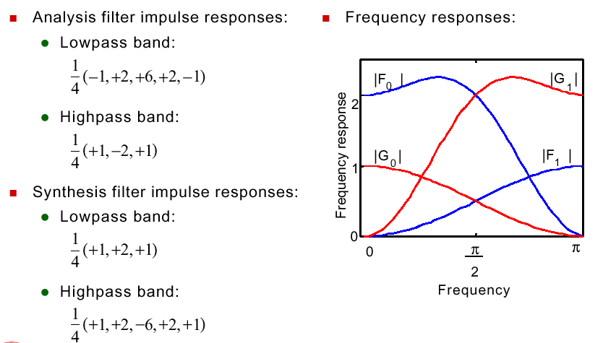
Example: Two-channel Filter Bank with Perfect Reconstruction

Slide 31
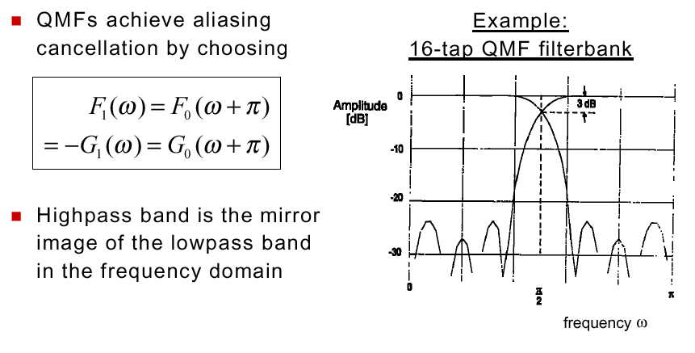

Quadrature Mirror Filter

Slide 32
Subband and Wavelet Coding
amplitude
frequency
0
f₀
2f₀
3f₀
4f₀
5f₀
6f₀
7f₀
8f₀
9f₀
10f₀
Subband Decomposition
amplitude
frequency
0
f₀
2f₀
4f₀
8f₀
16f₀
Wavelet Decomposition

Slide 33
Subband and Wavelet Coding (Cont.)
h(n)
2
2
h’(n)
+
g(n)
2
2
g’(n)
h(n)
2
h(n)
2
g(n)
2
h(n)
2
g(n)
2
g(n)
2

Slide 34
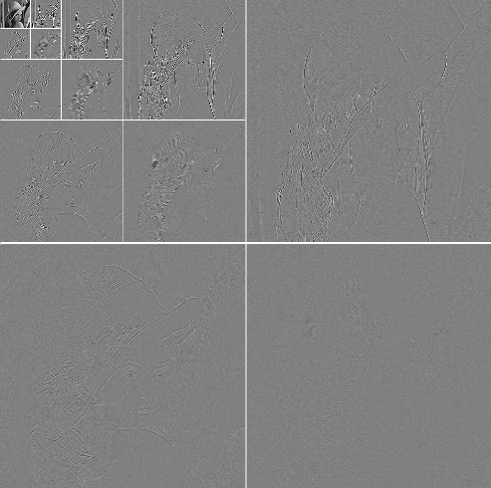
2-D Discrete Wavelet Transform (Cont.)

Slide 35
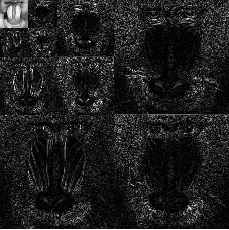
Similarities among Image Subbands

Slide 36
Zerotree Coding of Higher Bands
The higher order wavelet coefficients are coded with the embedded zero-tree wavelet (EZW)
based on the concept of quantization by successive approximation,
exploits the similarities of the bands of the same orientation.

Slide 37

Principle of Successive Approximation
l/4
l/8
l/16
l/32
l
L
l/2
The quantized length can be expressed as
$$\hat{L}=0×l+1×\frac{l}{2}+0×\frac{l}{4}+0×\frac{l}{8}+1×\frac{l}{16}⋅+1×\frac{l}{32}⋅⋅⋅⋅⋅=\frac{l}{2}+\frac{l}{16}+\frac{l}{32}$$

Slide 38
Zerotree Coding: Quadtree Representation of Higher Bands
Subimages of lower bands have quarter dimensions of their higher bands
A quad-tree representation of the bands of the same orientation for a 10-band splitting is shown below
If a coefficient in LH₃ is zero, it’s more likely that its children in higher bands of LH₂ and LH₁ will also be zero => “zero tree”
HL₃
HL₂
LL
LH₃
HH₃
HL₁
HH₂
LH₂
LH₁
HH₁

Slide 39
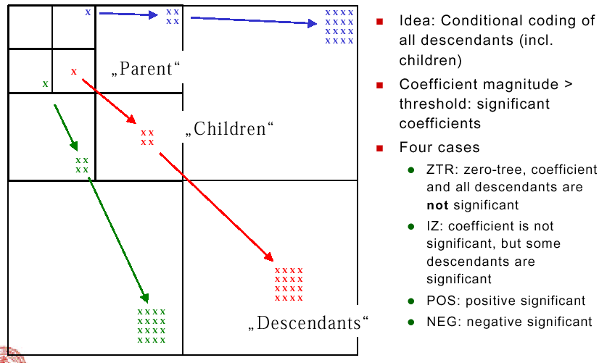
Embedded Zerotree Wavelet Algorithm
Ideal:

Slide 40
Embedded Zerotree Wavelet Algorithm (Cont.)
For the highest bands, ZTR and IZ symbols are merged into one symbol Z
Successive approximation quantization and encoding
Initial “dominant” pass
Set initial threshold T, determine significant coefficients
Arithmetic coding of symbols ZTR, IZ, POS, NEG
Subordinate pass
Refine magnitude of coefficients found significant so far by one bit (subdivide magnitude bin by two)
Arithmetic coding of sequence of zeros and ones.
Repeat dominant pass
Set previously found significant coefficients to zero
Decrease threshold by factor of 2, determine new significant coefficients
Arithmetic coding of symbols ZTR, IZ, POS, NEG
Repeat subordinate and dominate passes, until bit budget is exhausted.

Slide 41
A Coding Example of EZW
63 | -34 | 49 | 10 | 7 | 13 | -12 | 7
-31 | 23 | 14 | -13 | 3 | 4 | 6 | -1
15 | 14 | 3 | -12 | 5 | -7 | 3 | 9
-9 | -7 | -14 | 8 | 4 | -2 | 3 | 2
-5 | 9 | -1 | 47 | 4 | 6 | -2 | 2
3 | 0 | -3 | 2 | 3 | -2 | 0 | 4
2 | -3 | 6 | -4 | 3 | 6 | 3 | 6
5 | 11 | 5 | -6 | 0 | 3 | -4 | 4

Slide 42
A Coding Example of EZW (Cont.)
Subband | Coef Value | Symbol | Rec Value
LL3 | 63 | POS | 48
HL3 | -34 | NEG | -48
LH3 | -31 | IZ | 0
HH3 | 23 | ZTR | 0
HL2 | 49 | POS | 48
HL2 | 10 | ZTR | 0
HL2 | 14 | ZTR | 0
HL2 | -13 | ZTR | 0
LH2 | 15 | ZTR | 0
LH2 | 14 | IZ | 0
LH2 | -9 | ZTR | 0
LH2 | -7 | ZTR | 0
HL1 | 7 | Z | 0
HL1 | 13 | Z | 0
HL1 | 3 | Z | 0
HL1 | 4 | Z | 0
LH1 | -1 | Z | 0
LH1 | 47 | POS | 48
LH1 | -3 | Z | 0
LH1 | -2 | Z | 0

Slide 43
Features of The EZW Algorithm
The use of zero trees reduces the number of symbols to be encoded
The use of a very small alphabet to represent an image makes adaptive arithmetic coding very efficient
The maximum distortion of each pass is bounded by the threshold used in the pass
At any given pass, only the coefficients with magnitudes larger than the current threshold are encoded nonzero => prioritize the coefficients of different importance
With the successive approximation process, the encoding and decoding process can stop at any point
Embedded spatial/SNR scalability

Slide 44
Embedded Zerotree Wavelet Algorithm (Cont.)
Decoding: bitstream can be truncated to yield a coarser approximation: “embedded” representation
JPEG-2000 standard similar to SPIHT

Slide 45
Model-based Coding
Has potential to achieve very low bitrates by using
source models at both the encoder and decoder
- Object oriented coding
- Wired frame model

Slide 46
Parameters of Object Based Coding
Shape
.
Motion
Texture
Information

Slide 47
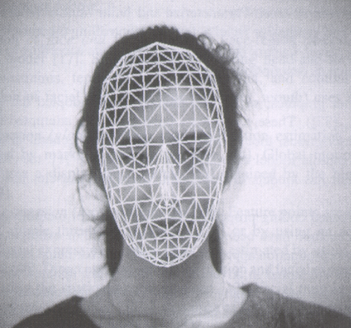
Wire-Frame Model

