Slide 1
Chapter 10 3-D Video Representation Using Depth Maps
Karsten Mu¨ller, Philipp Merkle, and Thomas Wiegand

Slide 2
Outline
Introduction
Three-Dimensional Video (3DV) Solutions Based on Stereo Signals
3DV Display Comparison
Multiview Video Coding
Color-Only View Extraction
3DV Using Depth Maps
Scene Depth Representation
Depth Provision
Depth-Image-Based Rendering
Depth Signal Coding
Depth-Image-Based Rendering

Slide 3
Introduction
Three-dimensional video (3DV) allows the representation of 3-D visual information through a display that provides the illusion of depth perception.
Two-dimensional video signals offer a number of monocular cues for depth perception including linear perspective and occlusion, whereas 3DV offers the sensation of depth from two slightly different projections of the scene onto the two eyes of the viewer.
The local differences between the images on the retinas of the two eyes are called disparities.

Slide 4
Introduction
Stereo display
Current display technology for 3DV consists of flat screens, only offering the illusion of depth by representing the images that are seen by the two eyes with a parallax angle [24]. The technology by which the parallax is created is the deciding factor for the 3DV format.
Most 3-D displays are stereo displays that require exactly two views at each instant. A stereo display for multiple viewers requires special 3-D glasses that filter the corresponding view for the left and right eyes of each viewer.
A simple approach towards effectively representing a stereo video signal is given by treating two views as two video signals with statistical dependency, which can be exploited by compression techniques known from classical video coding .

Slide 5
Introduction
The two acquired views provide a good basis for computing another view in between them, using additional scene geometry information like depth or disparity data.
Views that are not in-between the acquired views are more critical as background content is revealed, where no information from either view is available.
The problem is more severe when the view generation needs to be done using compressed views containing quantization noise.

Slide 6
Introduction
Multiview displays
Multiview displays typically do not require 3-D glasses, but require the availability of many views (e,g., eight or nine views).
For multiview synthesis based on a stereo video signal, a user perceives many viewing pairs, which consist of two synthesized views for a number of viewing positions, while the viewing pair for repurposed stereo consists of one original and one synthesized view.

Slide 7
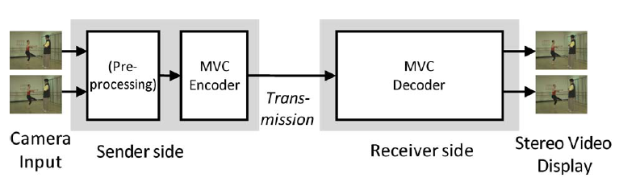
3DV Solutions Based on Stereo Signals
In Fig. 1, 3DV systems are based on stereo technology from capturing via coding and transmission to 3-D displays.
Fig. 1. First generation 3DV system based on stereoscopic color-only video.

Slide 8
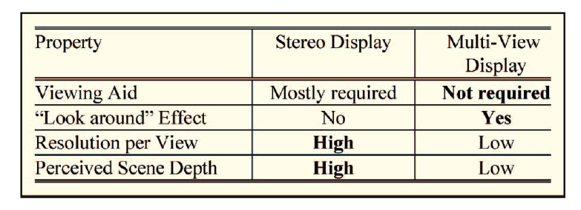
3DV Solutions Based on Stereo Signals
A stereo video signal captured by two input cameras is first preprocessed. This includes possible image rectification for row-wise left and right view alignment [12], as well as color and contrast correction due to possible differences between the input cameras.
A. 3DV Display Comparison
Table 1. Comparison of stereo and multiview display properties.

Slide 9
3DV Solutions Based on Stereo Signals
Multiview displays mostly suffer from a limited overall display resolution.
An optimization problem: the chosen number of views, only few views give a higher resolution per view and more views are required for better 3-D viewing.
One solution: the manufacturing of 3-D ultrahigh definition multiview displays (e.g., 50 high resolution views). This also improves the viewing angle problem of current multiview displays, as the viewing range becomes wider.

Slide 10
3DV Solutions Based on Stereo Signals
In current displays, two contradicting requirements have to be fulfilled: a strong depth impression and a seamless viewing change between neighboring stereo pairs.
If a 3-D ultrahigh resolution display with a large number of views will be used, the disparity range between neighboring views can be made very small to provide seamless viewpoint change.

Slide 11
3DV Solutions Based on Stereo Signals
B. Multiview Video Coding (MVC)
In multiple view scenarios, the camera views share common scene content such that a coding gain is achievable by exploiting statistical dependencies in spatially neighboring views.
An MVC coder basically consists of N parallelized single-view coders. Each of them uses temporal prediction structures, where a sequence of successive pictures is coded as intra (I), predictive (P), or bi-predictive (B) pictures.

Slide 12
3DV Solutions Based on Stereo Signals
To improve coding efficiency, we may use hierarchical B pictures [42], where a B picture hierarchy is created by a dyadic cascade of B pictures that are references for other B pictures.
For MVC, the single-view concepts are extended that a current picture in the coding process can have temporal as well as interview reference pictures for prediction [29].

Slide 13
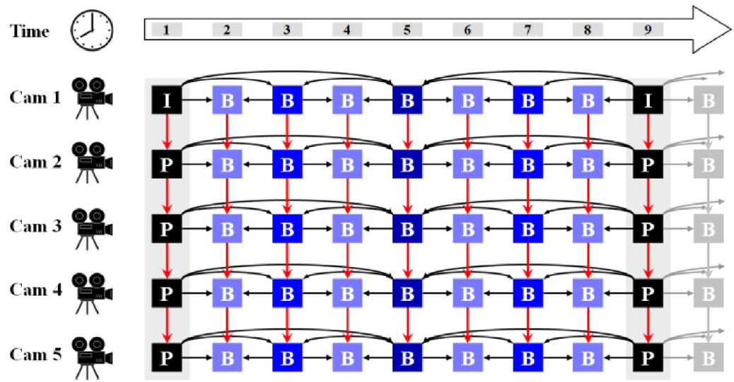
3DV Solutions Based on Stereo Signals
Fig. 2. Example coding structure in MVC for linear five camera setup and GOP size of eight pictures. The red arrows indicate interview prediction.

Slide 14
3DV Solutions Based on Stereo Signals
The bit rate resulting from MVC is linearly proportional to the number of display views N, as shown in Fig. 3.
An array of 16 linearly arranged camera views from the Rena sequence was used, a subset of nine adjacent cameras was selected, and the experiments were carried out and averaged for all possible nine out of 16 camera subsets.
Here, no temporal prediction was used in order to avoid the superposition of temporal and interview coding effect.

Slide 15
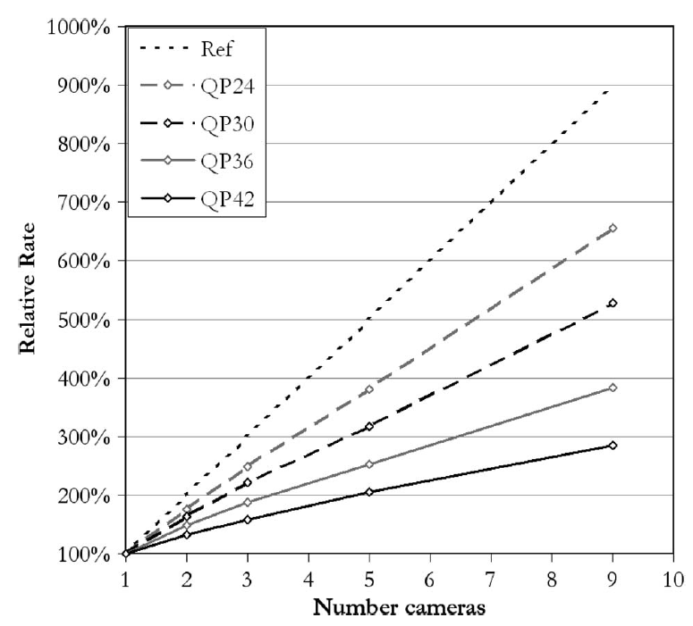
3DV Solutions Based on Stereo Signals
Fig. 3. Results of coding experiments on camera density in linear camera array in terms of average rate relative to one camera rate.

Slide 16
3DV Solutions Based on Stereo Signals
C. Color-Only View Extraction
In practical systems, the number of used input views is limited to only a few, e.g., two or three.
How many cameras are required to allow error-free synthesis of views at arbitrary positions and how dense these cameras have to be spaced?
The original 3-D scene can be considered as a continuous signal, which is recorded by a limited number of cameras at discrete positions.

Slide 17
3DV Solutions Based on Stereo Signals
The original continuous 3-D signal is sampled in two domains.
The scene is sampled by the discrete sample array of horizontal and vertical sensor elements in each camera.
The scene is also sampled by the discrete camera positions (investigated by Chai et al. [4] and called “plenoptic sampling”).
Here, the sampling by the camera sensor and camera positions is described by discrete coordinates in the image plane (u,v), as well as discrete coordinates in the camera plane (s, t), respectively, as shown in Fig. 4.

Slide 18
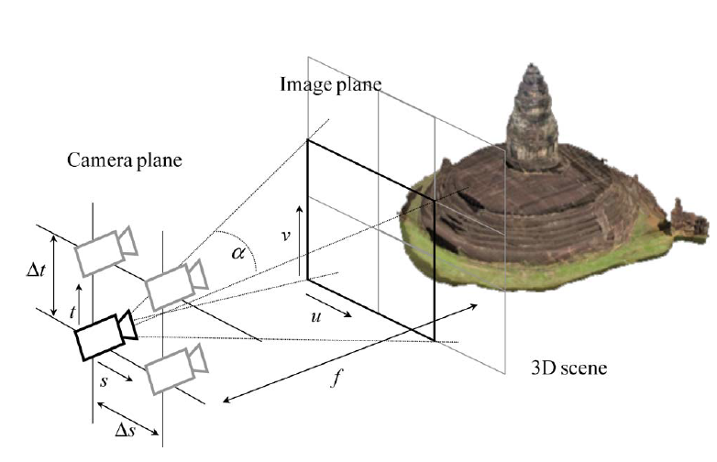
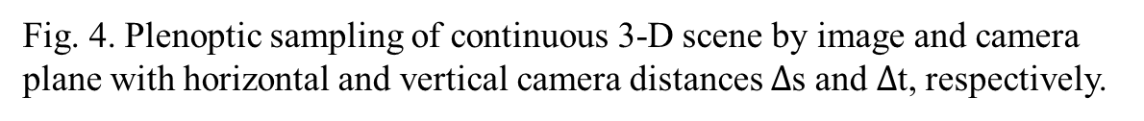
3DV Solutions Based on Stereo Signals
Fig. 4. Plenoptic sampling of continuous 3-D scene by image and camera plane with horizontal and vertical camera distances $∆$s and $∆$t, respectively.

Slide 19
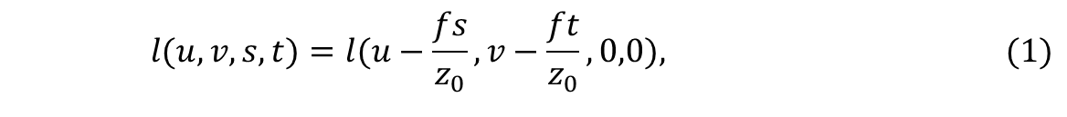
3DV Solutions Based on Stereo Signals
For multicamera sampling, a continuous light field $l(u,v,s,t)$ is defined.
Using parallel camera setting, the light field can be transformed to the base camera at (s, t) = (0,0) as
where $f$ represents the camera focal length and $z_{0}$ is a constant scene depth value.
$$l(u,v,s,t)=l(u−\frac{fs}{z_{0}},v−\frac{ft}{z_{0}},0,0),\begin{matrix} & & \end{matrix} \begin{matrix} & & \end{matrix}(1)$$

Slide 20
3DV Solutions Based on Stereo Signals
By classical sampling theory, sampling of a signal at discrete positions leads to repetitions of the frequency spectrum, e.g., if the spatial distance between two samples is $∆$s , its associated distance between two spectrum repetitions in frequency domain is 2$π/∆$s.
Assuming a highest frequency${ Ω}_{max}=2πF_{max}$ for that signal, nonzero frequency components exist in the interval [$−{ Ω}_{max}$, ${ Ω}_{max}$] and adjacent spectrum repetitions have to be separated at least by $2F_{max}$ times in order not to overlap.
For perfect and alias-free signal reconstruction, the classical sampling condition gives 2$π/∆$s $≥2{ Ω}_{max}$.

Slide 21
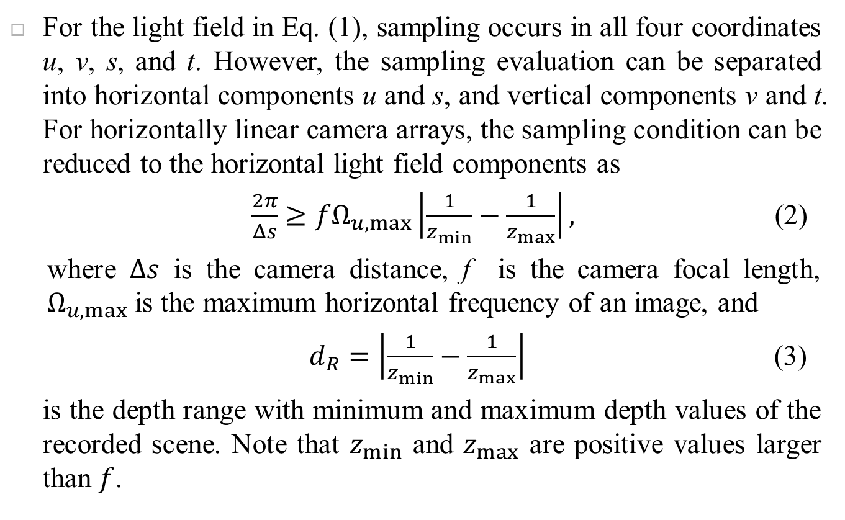
3DV Solutions Based on Stereo Signals
For the light field in Eq. (1), sampling occurs in all four coordinates u, v, s, and t. However, the sampling evaluation can be separated into horizontal components u and s, and vertical components v and t. For horizontally linear camera arrays, the sampling condition can be reduced to the horizontal light field components as
$\frac{2π}{Δs}≥fΩ_{u,max}\left|\frac{1}{z_{min}}−\frac{1}{z_{max}}\right|,$ (2)
where $Δs$ is the camera distance, f is the camera focal length, $Ω_{u,max}$ is the maximum horizontal frequency of an image, and
$d_{R}=\left|\frac{1}{z_{min}}−\frac{1}{z_{max}}\right|$ (3)
is the depth range with minimum and maximum depth values of the recorded scene. Note that $z_{min}$ and $z_{max}$ are positive values larger than $f$.

Slide 22
3DV Solutions Based on Stereo Signals
Eq. (2) gives the sampling condition for linear camera settings for alias-free continuous light field reconstruction from sparse color data. The required distance between neighboring cameras, $Δs$, is inversely proportional to the full depth range of the recorded 3-D scene using ideal sensors.
Real cameras, however, only record a portion of a 3-D scene, limited by their aperture angle, as shown in Figs. 4 and 8. Thus, the overlapping area of commonly recorded scene content in neighboring parallel cameras becomes smaller with increasing camera distance $Δs$ and decreasing $z_{min}$.

Slide 23
3DV Solutions Based on Stereo Signals
Based on the aperture angle $α$ , the maximum value of $Δs$ is limited by the minimum scene overlap: $Δs<$ $2z_{min}∙tan⁡(α/2)$.
If a scene has a large depth range $d_{R}$, a small camera distance is necessary for alias-free continuous light field reconstruction, i.e., view synthesis at any intermediate position.
In Eq. (2), the highest horizontal frequency $Ω_{u,max}$ as well as the focal length $f$are usually fixed by the number of samples of a given camera sensor. If the camera distance is too large, alias in the form of double images occurs, as shown in Fig. 5 on the left-hand side.
Therefore, a good quality view synthesis from two or three camera views is not possible, if only color information is available.

Slide 24
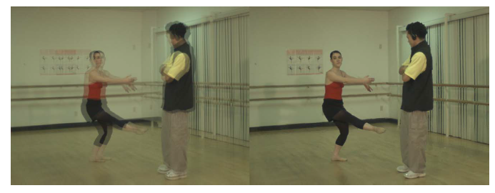
3DV Solutions Based on Stereo Signals
Fig. 5. Intermediate view synthesis from color-only camera data with alias (left) and from color with 8-b depth values without alias (right) for the Ballet set.

Slide 25
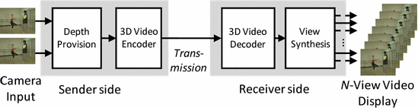
3DV Using Depth Maps
The provision of a large number of views for multiview displays is not efficient with video data only.
The efficiency can be drastically increased using scene geometry information like a depth map. A 3DV transmission system using depth maps is shown in Fig. 6.
Fig. 6. 3DV system based on depth-enhanced multiview video.

Slide 26
3DV Using Depth Maps
Assume that a few cameras, e.g., two or three, are used. The 3DV encoder generates the bit stream containing color and depth data, which can be decoded at the receiver.
One challenging property of this 3DV system is the interdependency between depth provision, coding, and view synthesis. These three parts influence each other.
Producers of 3DV content will have control over the resulting multiview display output, which therefore appears similar across different display types and a certain transmission quality can be guaranteed for comparable 3-D viewing quality.

Slide 27
3DV Using Depth Maps
A. Scene Depth Representation
If additional scene geometry data are available, e.g., in form of a depth value for each color sample in the camera plane, the sampling condition in Eq. (2) changes [4].
These depth values are quantized into a number of different values. Then, the depth range d_{R} in Eq. (2) is split into a number of S quantization intervals d_{R,i}, i=1…S , with d_{R,i}= d_{R} /S.

Slide 28
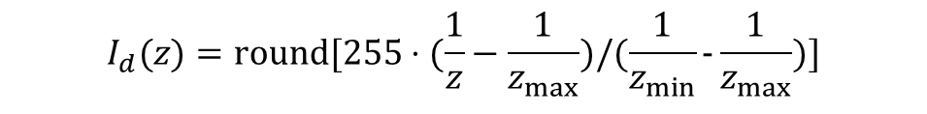
3DV Using Depth Maps
Such a depth-enhanced format for two different views is shown in Fig. 7 with color and per-sample depth information. Note that the maximum value for $Δs$ is again limited for real-world cameras by their aperture angle.
The depth data are usually stored as inverted real-world depth data I_{d} (z), according to
Here, a representation with 8 b/sample and values between 0 and 255 is assumed.
$$I_{d}(z)=\text{round}[255⋅(\frac{1}{z}−\frac{1}{z_{max}})/(\frac{1}{z_{min}}-\frac{1}{z_{max}})]$$
(4)

Slide 29
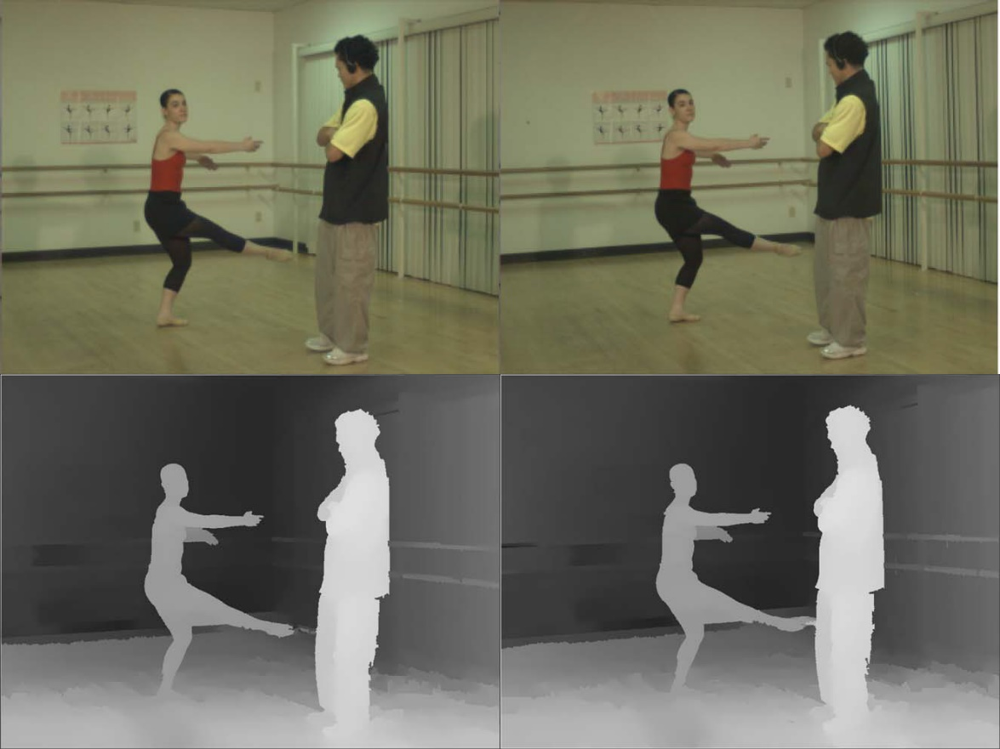
3DV Using Depth Maps
Fig. 7. Example for depth enhanced format: two view plus depth format for the Ballet set.

Slide 30
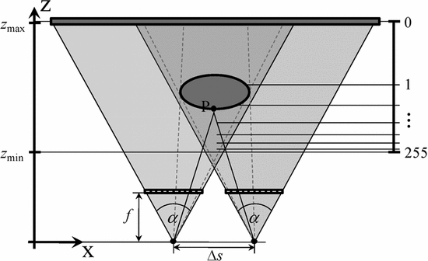
3DV Using Depth Maps
Some advantages: since depth values are inverted, a high depth resolution of nearby objects is achieved, while farther objects only receive coarse depth resolution, as shown in Fig. 8.
Fig. 8. Inverse depth sampling with 8-b resolution between z_{min} and z_{max}.

Slide 31
3DV Using Depth Maps
The stored depth values are quantized similarly to these shift or disparity values. However, the inverse quantized depth values are not identical to disparity values, since disparity values depend on the camera distance or baseline in contrast to depth values.
Consequently, the stored depth representation in Eq. (4) combines the advantages of inverse quantization for more natural depth representation with the independency from camera baselines and image resolutions.

Slide 32
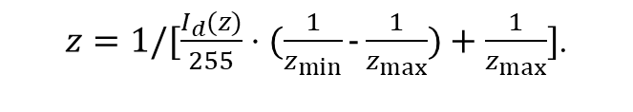
3DV Using Depth Maps
For retrieving the depth values z from the depth maps, in synthesis scenarios, we have
The original minimum and maximum depth values z_{min} and z_{max} are required and signaled with the 3DV format for a correct geometric displacement in synthesized intermediate views.
$z=1/[\frac{I_{d}(z)}{255}⋅(\frac{1}{z_{min}}-\frac{1}{z_{max}})+\frac{1}{z_{max}}]$.
(5)

Slide 33
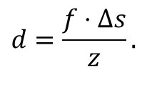
3DV Using Depth Maps
B. Depth Provision
The depth data can be estimated based on the acquired pictures, as intensively investigated in the research community [41]. Depth estimation algorithms attempt to match corresponding signal components in two or more original cameras using a matching function [44] with different area support and size [3].
Recently, depth estimation has been studied for multiview video content and temporal consistency in order to provide depth data for 3DV applications [26, 31, 45].
Depth estimation algorithms generate disparity values d in the matching process, which relate to real-world depth values z as
$$d=\frac{f⋅Δs}{z}.$$
(6)

Slide 34
3DV Using Depth Maps
Depth provision can be provided by time-of-flight cameras, which record low-resolution depth maps [25]. Here, postprocessing is required for interpolating depth for each video sample [6].
Such sensors currently lack accuracy for larger distances and have to be placed at slightly different positions than the video camera.
For synthetic sequences, scene geometry information is available, e.g., in the form of wireframe models [15] or 3-D point coordinates [49].
Thus, depth data can be extracted as the distance between a selected camera position and the given scene geometry information.

Slide 35
3DV Using Depth Maps
With depth data, a coding format can be specified, using per-sample depth values for each input video view, as shown in Fig. 7 for a depth-enhanced two-view format.
The video signal from two different perspectives is required for partially occluded data behind foreground objects in one original view, which becomes visible in an intermediate view and can be filled with the visible data from the other view (hole-filling).

Slide 36
3DV Using Depth Maps
For stereo displays with correct baseline, the two video views can be used directly without generating additional views.
The data format should contain at least two videos and two associated depth signals from different viewpoints in order to generate the required range of views with good quality for a multiview display.

Slide 37
3DV Using Depth Maps
C. Depth-Image-Based Rendering
Intermediate views are generated via 3-D projection or 2-D warping from original camera views, referenced as DIBR.
Assume that camera views are rectified in a preprocessing step. The complex process of general DIBR is simply horizontal sample shifting from original into newly rendered views.

Slide 38
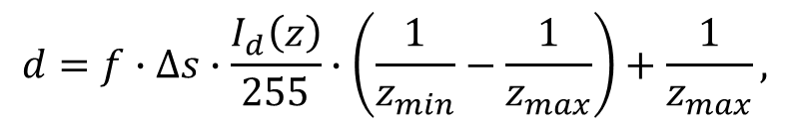
3DV Using Depth Maps
The sample shifts are obtained by calculating disparity values d from the stored inversely quantized depth values $I_{d}(z)$ as
where f is the focal length and $∆s$ is camera baseline. If $∆s$ is given as the spatial distance between two original cameras, d represents the disparity between these cameras and has to be scaled for any intermediate view.
$$d=f∙∆s∙\frac{I_{d}\left(z\right)}{255}∙\left(\frac{1}{z_{min}}−\frac{1}{z_{max}}\right)+\frac{1}{z_{max}},$$
(7)

Slide 39
3DV Using Depth Maps
Consider two original cameras, camera 0 and camera 1, with corresponding color samples $c_{0}$ and $c_{1}$ at positions $(u_{0},v_{0})$ and $(u_{1},v_{1})$, respectively.
An intermediate view between both cameras is to be synthesized with corresponding sample $c_{κ}$ at position $(u_{κ},v_{κ})$.
Here, k represents the intermediate position parameter, which specifies the intermediate position between camera 0 and camera 1 (e.g., $κ=0.5$ specifies the middle view between both original cameras).

Slide 40
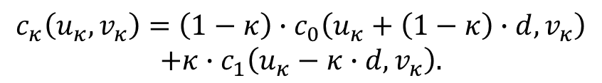
3DV Using Depth Maps
View synthesis of $c_{κ}(u_{κ},v_{κ})$ can be described by
Via horizontal $κ$-scaled disparity values from Eq. (6) or Eq. (7), sample positions in the original views and the intermediate position $(u_{κ},v_{κ})$ are related by
$$c_{κ}\left(u_{κ},v_{κ}\right)=\left(1−κ\right)∙c_{0}\left(u_{0},v_{0}\right)+κ∙c_{1}\left(u_{1},v_{1}\right).$$
(8)
$$c_{κ}\left(u_{κ},v_{κ}\right)=\left(1−κ\right)∙c_{0}\left(u_{κ}+\left(1−κ\right)∙d,v_{κ}\right)$$
$$+κ∙c_{1}\left(u_{κ}−κ∙d,v_{κ}\right).$$
(9)

Slide 41
3DV Using Depth Maps
D. Depth Signal Coding
Typically MVC is used in 3DV format, as it is optimized for this type of data, in which depth data showing different characteristics are employed.
Depth maps have large homogeneous regions within scene objects and abrupt signal changes at object boundaries with different depth values

Slide 42
3DV Using Depth Maps
To preserve important edge information, depth signal coding approaches:
Down-sample & up-sample: down-sampling before classical MVC encoding and special up-sampling after decoding to recover some of the original depth edge information.
Coding depth data with MVC: based on rate-distortion optimization for an intermediate view.
Wavelet coding: obtain better edge preservation in depth compression.
Computer graphics-based: depth maps were converted into meshes and coded with mesh-based compression methods.
Platelet coding

Slide 43
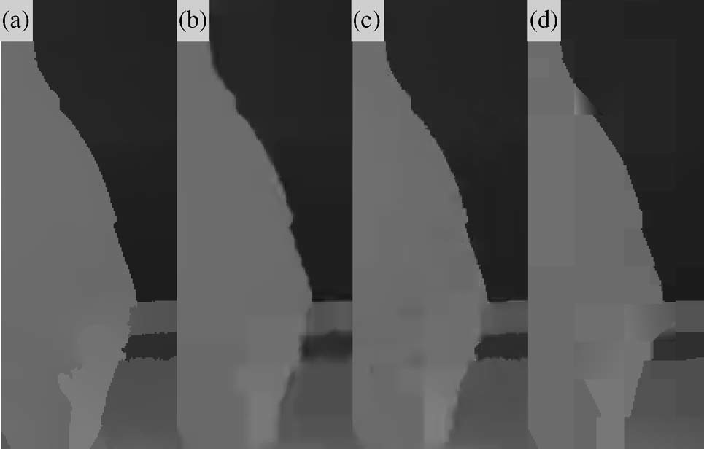
3DV Using Depth Maps
Using coding techniques, coding artifacts occur for high compression ratios with platelets as well, as shown in Fig. 9.
Fig. 9. Impact of coding artifacts on depth maps for Ballet sequence:
(a) original uncoded depth,
(b) H.264/AVC (intra-only) coded depth,
(c) MVC (fully optimized) coded depth, and
(d) platelet coded depth at the same bit rate.

Slide 44
3DV Using Depth Maps
With H.264/AVC (Fig. 9(b)), compression artifacts appear as edge smoothing, where intra-only coding was used.
In Fig. 9(c), fully optimized MVC with temporal and interview prediction was used. Here, edge smoothing artifacts are also present.
A better reconstruction quality is achieved for MVC, as compared with in H.264/AVC simulcasting (especially visible at sharp edges).
The artifacts for platelet coding in Fig. 9(d) are coarser edge approximation. This is visible for the foreground/background edge towards the bottom of Fig. 9. Here, edge preservation of platelet coding is much closer to the original depth edge than for the other two coding methods. The height and sharpness of the depth edge is much better preserved in platelet coding.

Slide 45
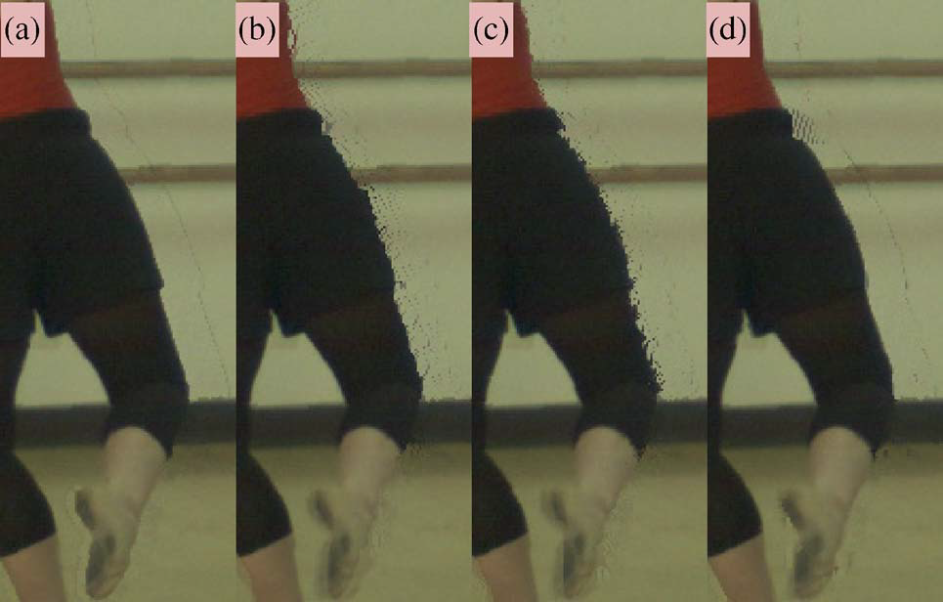
3DV Using Depth Maps
Fig. 10. Impact of depth coding artifacts on view synthesis rendering
for Ballet sequence with uncoded color data: (a) original uncoded
depth, (b) H.264/AVC (intra) coded depth, (c) MVC (fully optimized)
coded depth, and (d) platelet coded depth for the associated depth map from Fig. 9.

Slide 46
3DV Using Depth Maps
The synthesized result from uncoded depth and video data is shown in Fig. 10(a).
H.264/AVC and MVC in Fig. 10(b) and (c) show color displacement artifacts around foreground objects due to depth edge smoothing.
For platelet coding, the foreground boundaries are much better preserved as shown in Fig. 10(d).

Slide 47
3DV Using Depth Maps
E. Advanced View Synthesis Methods
For high-quality view synthesis, advanced processing is usually used. For hole filling, inpainting methods are used. Here, surrounding texture information and statistics are used to fill missing information in synthesized views.
Postfiltering is applied in order to remove wrongly projected outliers and to provide a better overall impression.
In advanced synthesis, a reliability-based approach is taken with one or two boundary layers.

Slide 48
3DV Using Depth Maps
Depth edges are classified as “unreliable areas,” while the remaining areas are labeled as “reliable areas.”
The reliable areas are directly projected or shifted into the intermediate view.
The unreliable boundary areas are split into foreground and background data. Foreground areas are projected next and merged with the reliable data. Afterwards, the background data are projected and also merged.

Slide 49
3DV Using Depth Maps
The foreground data are merged with the reliable data in a frontmost sample approach, where the color sample with the smallest depth value is taken and with that most of the important information of the foreground boundary layer is preserved.
In contrast, background information is only used to fill remaining uncovered areas.
Finally, different view enhancement algorithms, including outlier removal, hole filling, and natural edge smoothing, are applied.

Slide 50
3DV Using Depth Maps
For view synthesis, foreground/background object boundary determination is important. A simple projection from original views cause corona artifacts, as shown in Fig. 11(a) and (c).
Corona artifacts are induced by certain effects (incorrect depth values and edge samples), which contain a combination of foreground and background color samples. Object edges may be fuzzy and may contain semitransparent content.
The results of advanced view synthesis are shown in Fig. 11. Intermediate views are synthesized from uncompressed [Fig. 11(a) and (b)] and compressed data [Fig. 11(c) and (d)].
Reliability-based layer projection was switched off for the results in Fig. 11(a) and (c), where corona artifacts are visible.

Slide 51
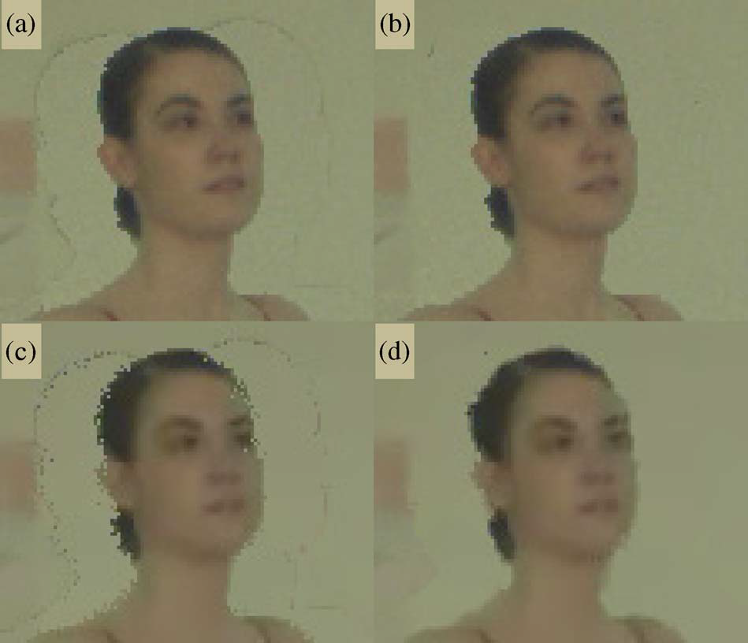
3DV Using Depth Maps
Fig. 11. Comparison of intermediate view quality: (a) and (c) with simple view synthesis and (b) and (d) with reliability-based view synthesis. (a) and (b) using uncompressed data and (c) and (d) using compressed data from the Ballet sequence.

