Slide 1
Chapter 11.
Video Encoder Optimization

Slide 2
Introduction
Variable-bitrate nature of video
Channel: constant bit rate (CBR) (e.g., PSTN, ISDN, ...) or variable bit rate (VBR) (e.g., IP, ...)
Bit-rate and delay constraints
PSNR
PSNR
bitrate
bitrate
CBR
time
VBR
time

Slide 3
Rate Control Schemes
Rate control adapts quantizer to meet bitrate and delay constraints based on
Current frame complexity
Buffer fullness
Mathematical modeling
Examples of rate control schemes in video standards:
H.261: RM8
MPEG2: TM5
H.263+: TMN8

Slide 4
H.261: RM8
Buffer size = q * 6.4 kb (100ms)
Quantization step size varies from 4 to 64 with step 2
When the buffer fullness exceeds q*6.4 kb, the coefficients
and the motion vectors are set to zero in the next macro block
Buffer Fullness
Quantizer Step Size
< 400*q
4
< 600*q
6
< 800*q
8
...
...
< 6200*q
62
>= 6200*q
64

Slide 5
MPEG-2: TM5
1. Target bit allocation: estimates the number of bits for coding the next picture.
2. Rate control: sets the reference value of the quantization parameter for each macroblock.
3. Adaptive quantization: modifies the reference value of the quantization parameter according to the spatial activity in the macroblock

Slide 6
MPEG-2: TM5
Step 1 - Bit Allocation (Complexity estimation)
After a picture of a certain type (I, P, or B) is encoded, the respective “global complexity measure” (X_{i}, X_{p}, or X_{b}) is updated as:
X_{i} = S_{i} × Q_{i}, X_{p} = S_{p} × Q_{p}, X_{b} = S_{b} × Q_{b},
where S_{i}, S_{p}, S_{b} are the number of bits generated by encoding this picture and Q_{i}, Q_{p} and Q_{b} are the average quantization parameter computed by averaging the actual quantization values used during the encoding of all the macroblocks
Initial values: X_{i} = (160 * bit_rate) / 115, X_{p} = (60 * bit_rate) / 115, X_{b} = (42 * bit_rate) / 115
bit_rate is measured in bits/s.

Slide 7



MPEG-2: TM5
Step 1 - Bit Allocation (Picture target setting)
The target number of bits for the next picture in the Group of pictures (T_{i}, T_{p}, or T_{b}) is computed as:
$$T_{i} = max \{\frac{R}{1+\frac{N_{p}X_{p}}{X_{i}K_{p}}+\frac{N_{b}X_{b}}{X_{i}K_{b}}},bit_rate/(8×picture_rate)\}$$
$$T_{p} = max \{\frac{R}{N_{p}+\frac{N_{b}K_{p}X_{b}}{K_{b}X_{p}}},bit_rate/(8×picture_rate)\}$$
$$T_{b} = max \{\frac{R}{N_{b}+\frac{N_{p}K_{b}X_{p}}{K_{p}X_{b}}},bit_rate/(8×picture_rate)\}$$

Slide 8
MPEG-2: TM5
where: K_{p} and K_{b} are “universal” constants dependent on the quantization matrices. K_{p} = 1.0 and K_{b} = 1.4
R is the remaining number of bits assigned to the GOP. R is updated as follows:
After encoding a picture , R = R - S_{i,p,b}
where is S_{i,p,b} is the number of bits generated in the picture just encoded (picture type is I, P or B).
Before encoding the first picture in a GOP (an I-picture):
R = G + R
G = bit_rate × N / picture_rate
N is the number of pictures in the GOP

Slide 9
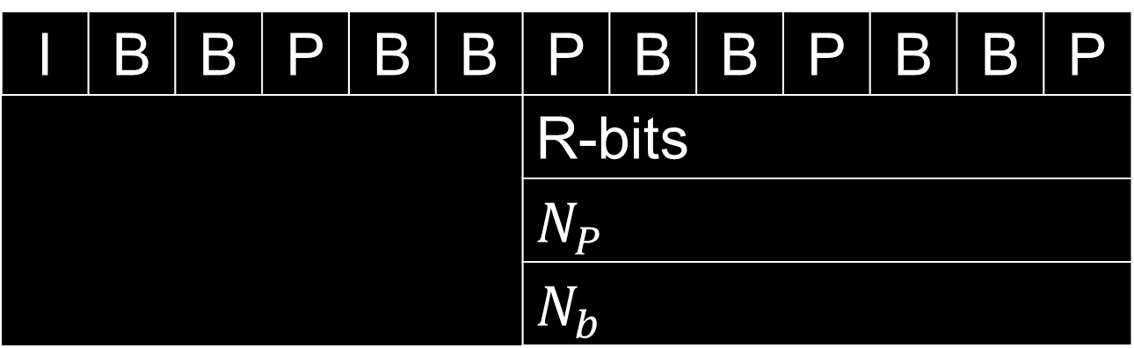
MPEG-2: TM5
At the start of the sequence R = 0.
N_{p} and N_{b} are the number of P-pictures and B-pictures remaining in the current GOP in the encoding order.
Remaining pictures in GOP
I | B | B | P | B | B | P | B | B | P | B | B | P
 |  |  |  |  |  | R-bits
 |  |  |  |  |  | $$N_{P}$$
 |  |  |  |  |  | $$N_{b}$$

Slide 10





MPEG-2: TM5
Step 2 - Rate Control
Before encoding macroblock j (j ≥ 1), compute the fullness of the appropriate virtual buffer:
depending on the picture type.
where are initial fullness of virtual buffers - one for each picture type.
B_{j} is the number of bits generated by encoding all macroblocks in the picture up to and including j.
MB_cnt is the number of macroblocks in the picture.
are the fullness of virtual buffers at macroblock j, one for each picture type.
$$d_{j}^{i}=d_{0}^{i}+B_{j−1}−\frac{T_{i} (j−1)}{MB_cnt}$$
$$d_{j}^{p}=d_{0}^{p}+B_{j−1}−\frac{T_{p} (j−1)}{MB_cnt}$$
$$d_{j}^{b}=d_{0}^{b}+B_{j−1}−\frac{T_{b} (j−1)}{MB_cnt}$$
or
or
$$d_{0}^{i}, d_{0}^{p}, d_{0}^{b}$$
$$d_{j}^{i}, d_{j}^{p}, d_{j}^{b}$$

Slide 11



MPEG-2: TM5
Next compute the reference quantization parameter Q_{j} for macroblock j as follows:
Q_{j} = (d_{j} × 31) / r
where the “reaction parameter” r is given by
r = 2 × bit_rate / picture_rate
and d_{j} is the fullness of the appropriate virtual buffer.
The initial value for the virtual buffer fullness is:
$$d_{0}^{i}=10×r / 31$$
$$d_{0}^{p}=K_{p}d_{0}^{i}$$
$$d_{0}^{b}=K_{b}d_{0}^{i}$$

Slide 12




MPEG-2: TM5
Step 3 - Adaptive Quantization
Compute a spatial activity measure for the macroblock j from the four luminance frame-organized sub-blocks (n=1..4) and the four luminance field-organized sub-blocks (n=5..8) using the intra (i.e. original) pixel values:
where
and are the sample values in the n-th original 8*8 block.
Normalize act_{j}:
avg_act is the average value of actj the last picture encoded. On the first picture, avg_act = 400.
$$act_{j}=1+min(vblk_{1},vblk_{2},...,vblk_{8})$$
$$vblk_{n}=\frac{1}{64}\sum_{k=1}^{64}{(P_{k}^{n}−P_mean_{n})^{2}}$$
$$P_mean_{n}=\frac{1}{64}\sum_{k=1}^{64}{P_{k}^{n}}$$
$$P_{k}^{n}$$
$$N_act_{j}=\frac{(2×act_{j})+avg_act}{act_{j}+(2×avg_act)}$$

Slide 13

MPEG-2: TM5
Obtain mquant_{j} as:
where where Qj is the reference quantization parameter obtained in step 2. The final value of mquant_{j} is clipped to the range [1..31] and is used and coded in either the slice or macroblock layer.
Known Limitations
Step 1 does not handle scene changes efficiently.
A wrong value of avg_act is used in step 3 after a scene change.
VBV compliance is not guaranteed.
$$mquant_{j}=Q_{j}×N_act_{j}$$

Slide 14
Rate-Distortion Optimized Rate Control
Resource allocation
Bits
Computing Power
Constraint:
Channel Bandwidth
Distortion Measure
Sum of Squared Error: SSE or MSE
Sum of Absolute Difference: SAD or MAD
General Formulation;
Optimize the quality by appropriately allocating the resources under the physical constraints

Slide 15
MINAVE vs. MINMAX
MINAVE
Minimize the “average” distortion (rate) subject to the rate (distortion) constraint
Maximize the average quality but may cause larger quality fluctuation
MINMAX
Minimize the “maximum” distortion (rate) subject to the rate (distortion) constraint
Smoother quality
Lexicographic Optimization
Constant Q approach
MINMAX is a special case of this approach

Slide 16





Formulation of MINAVE (MDR Example)
$$\min_{qi∈V}\sum_{i=1}^{N}{D(qi)}$$
subject to
$$\sum_{i=1}^{N}{Ri(qi)}≤R\text{target}$$
is equivalent to minimize
$$C(λ)=\sum_{i=1}^{N}{Ci}=D(λ)+λR(λ)$$
$$=\sum_{i=1}^{N}{D[qi(λ)]}+λ\sum_{i=1}^{N}{R[qi(λ)]}$$
$$R_{target}=\sum_{i=1}^{N}{R[q_{i}^{∗}(λ)]}$$
if

Slide 17





Formulation of MINAVE (MDR Example)
$$\min_{qi∈Q}\sum_{i=1}^{N}{R(qi)}$$
subject to
$$\sum_{i=1}^{N}{Di(qi)}≤D\text{target}$$
is equivalent to minimize
$$C(λ)=\sum_{i=1}^{N}{Ci}=R(λ)+λD(λ)$$
$$=\sum_{i=1}^{N}{R[qi(λ)]}+λ\sum_{i=1}^{N}{D[qi(λ)]}$$
$$D_{target}=\sum_{i=1}^{N}{D[q_{i}^{∗}(λ)]}$$
if

Slide 18
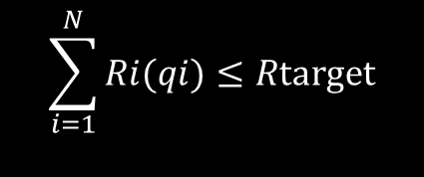
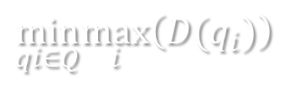
MINMAX Rate Control
$$\min_{qi∈Q}\max_{i}\left(D(q_{i})\right)$$
subject to
$$\sum_{i=1}^{N}{Ri(qi)}≤R\text{target}$$
How to solve this kind of optimization problem?
A bisection-like iterative method to first solve MINMAX MRD then solve MINMAX MDR is proposed to solve the problem
G.M. Schuster et al., “Review of the Minimum Maximum Criterion for Optimal Bit Allocation Among Dependent Quantizers” IEEE Tran. Multimedia Mar. 1999.

Slide 19
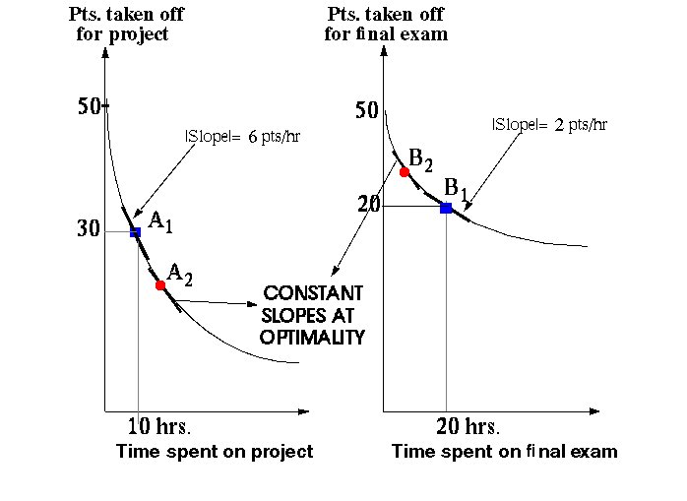
Example of Lagrangian Multiplier Optimization

Slide 20
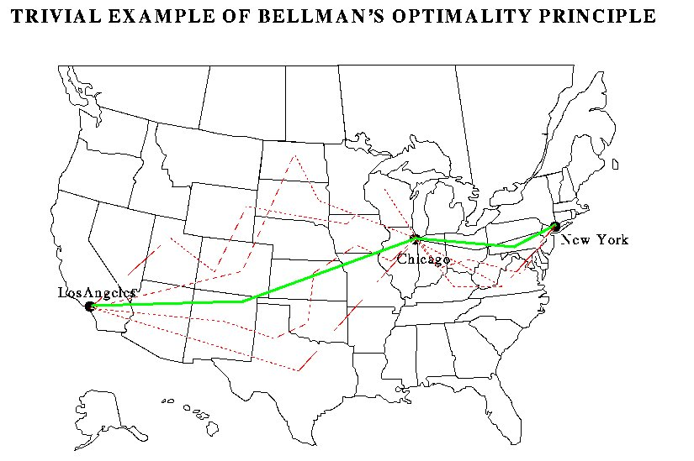
Example of Dynamic Programming

Slide 21
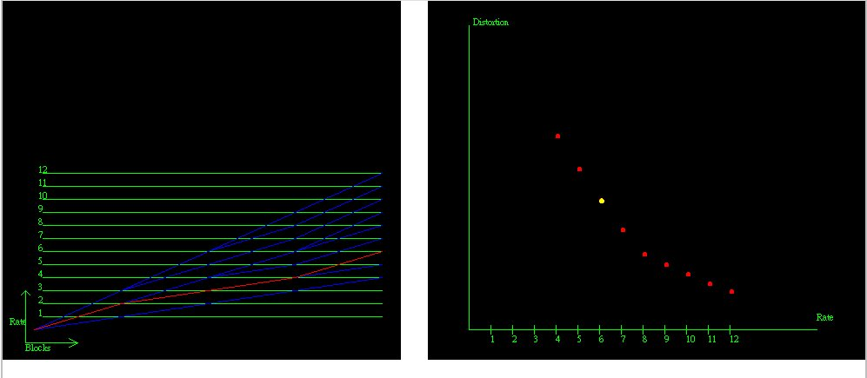
Example of Dynamic Programming

Slide 22
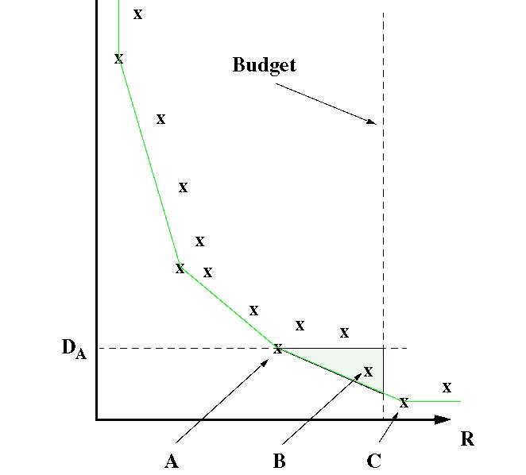
Lagrangian Multiplier vs. Dynamic Programming

Slide 23
Lagrangian Multiplier vs. Dynamic Programming (Cont.)
Lagrangian Multiplier
is limited to select only the operating points on the convex hull of the overall R-D characteristic
fast algorithm is available due the convex hull property (Bisection search)
Dynamic Programming
relatively large computation and memory cost
the complexity gets close to exhaustive search if the depth of dependency is deep

Slide 24
H.263+: TMN8
In the frame-layer, a target number of bits per frame is selected. In the macroblock-layer, the quantization parameter (QP) is adapted to achieve that target.
Frame-Layer Rate Control
Let H - Number of bits produced by the previous encoded frame.
R - Target bit rate in bits per second (e.g., 10000 bps, 24000 bps, etc.).
G - Frame rate of the original video sequence in frames per second (e.g. 30 fps)
F - Target frame rate in frames per second (e.g., 7.5 fps, 10 fps, etc.). G/F must be an integer
M - Threshold for frame skipping. By default, set M= R/F. (M/R is the maximum buffer delay.)
A - Target buffer delay is AM sec. By default, set A= 0.1.

Slide 25



H.263+: TMN8
The number of bits in the encoder buffer is W = max (W + H - R/F, 0) .
Set skip = 1.
While W > M
{
W= max (W - R/F, 0)
skip++
}
Skip encoding the next “$skip⋅G/F−1$
” frames of the original video
Sequence.
The target number of bits per frame is:
$$Δ=\left\{\begin{matrix}\frac{w}{F}, W> A⋅M \\ w−A⋅M, Otherwise.\end{matrix}\right.$$
$$B=\frac{R}{F}−Δ$$
where

Slide 26
Rate-Distortion Optimization
Constrained Optimization Problem:
Choose q={q_{i}}, to minimize D(q), given constraint R(q)=B. (i=1,2,…,N).
D(q) is the “object function”, R(q) is the “constraint”, q is the set of quantization step-sizes to be determined, N is the dimension of the q.
Note: In rate control case, D(q) is the distortion, q represents the quantization parameters, R(q) is the rate (number of bits), B is the number of bits for the frame.

Slide 27
Solution by Lagrangian Multiplier
Introduce Lagrangian Multiplier λ and convert it to an unconstrained problem:
Min_{q} [J=D(q)+ λ(R(q)-B)]
Partial derivatives on q_{i}, λ should be zero:
∂ D/ ∂ q_{i}+ λ(∂ R/ ∂ q_{i})=0
R(q)= B
Now we have N+1 equations and N+1 unknowns (q_{i}, i=1, 2,…,N, λ) – solvable!

Slide 28

TMN8 MB-Layer Rate Control
Rate model for an MB (assuming DCT coefficients are Laplacian distributed with variance σ² )
$$B_{i}=A(K\frac{σ^{2}}{Q_{i}^{2}}+C)$$
A – number of pixels in one macroblock
K – model parameter
σ² – variance
Q_{i} – quantization step size
C – overhead for the frame (bits/pixel)
* - K and C are model parameters, will be updated dynamically

Slide 29


TMN8 MB-Layer Rate Control (Cont.)
Distortion Model – Mean Square Error (MSE)
$$D_{MSE}=\frac{1}{N}\sum_{i=1}^{N}{α_{i}^{2}\frac{Q_{i}^{2}}{12}}$$
N – number of macro-blocks in the frame
α – model parameter
Q_{i} – quantization step size
$$α_{k}=\left\{\begin{matrix}2\frac{B}{16^{2}N}\left(1−σ_{k}\right)+σ_{k}, & \frac{B}{16^{2}N}<0.5, \\ 1, \begin{matrix}\begin{matrix} & & \end{matrix} & & \end{matrix} & \text{otherwise}. \end{matrix}\right.$$

Slide 30



TMN8 MB-Layer Rate Control (Cont.)
Construct the cost function
$$J=\frac{1}{N}\sum_{i=1}^{N}{α_{i}^{2}\frac{Q_{i}^{2}}{12}}+λ[\sum_{i=1}^{N}{A(K\frac{σ_{i}^{2}}{Q_{i}^{2}}+C)−B]}$$
To minimize J, we set its partial derivatives on Q_{i} and λ to zero, and get
$$Q_{i}^{∗}=\sqrt{\frac{AK}{(B−ANC)}\frac{σ^{i}}{α^{i}}\sum_{k=1}^{N}{α^{k}σ^{k}}}$$
$$i=1,...,N$$

