Slide 1

Homework 2
Deadline: 2022/10/16(一) 23:59

Slide 2
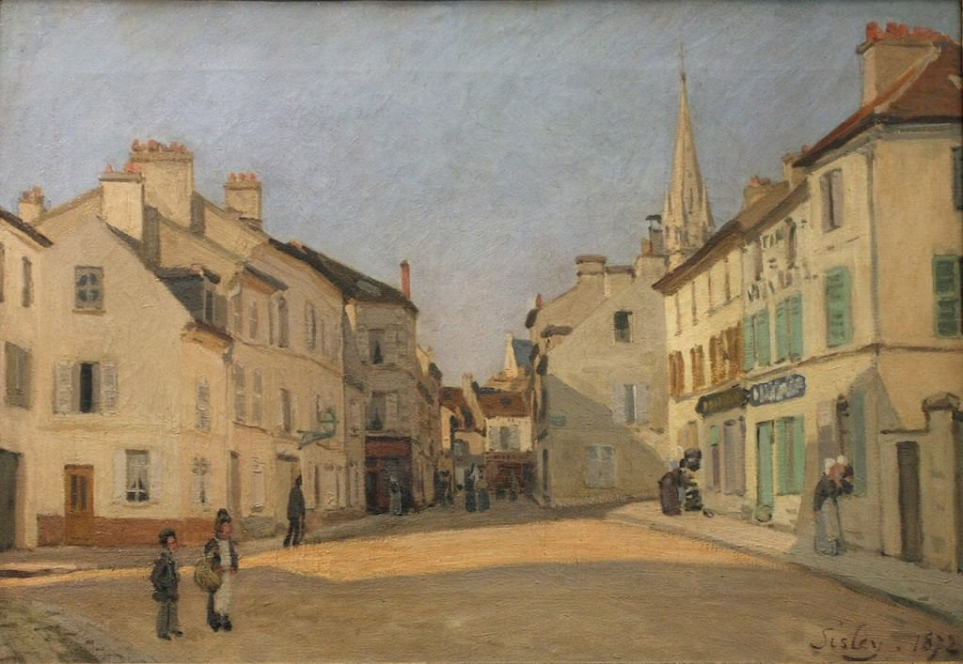
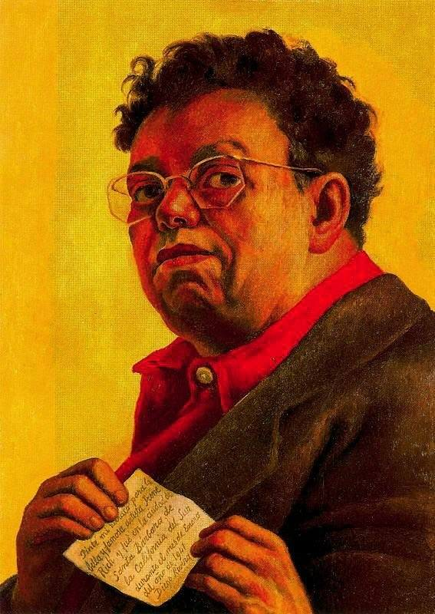
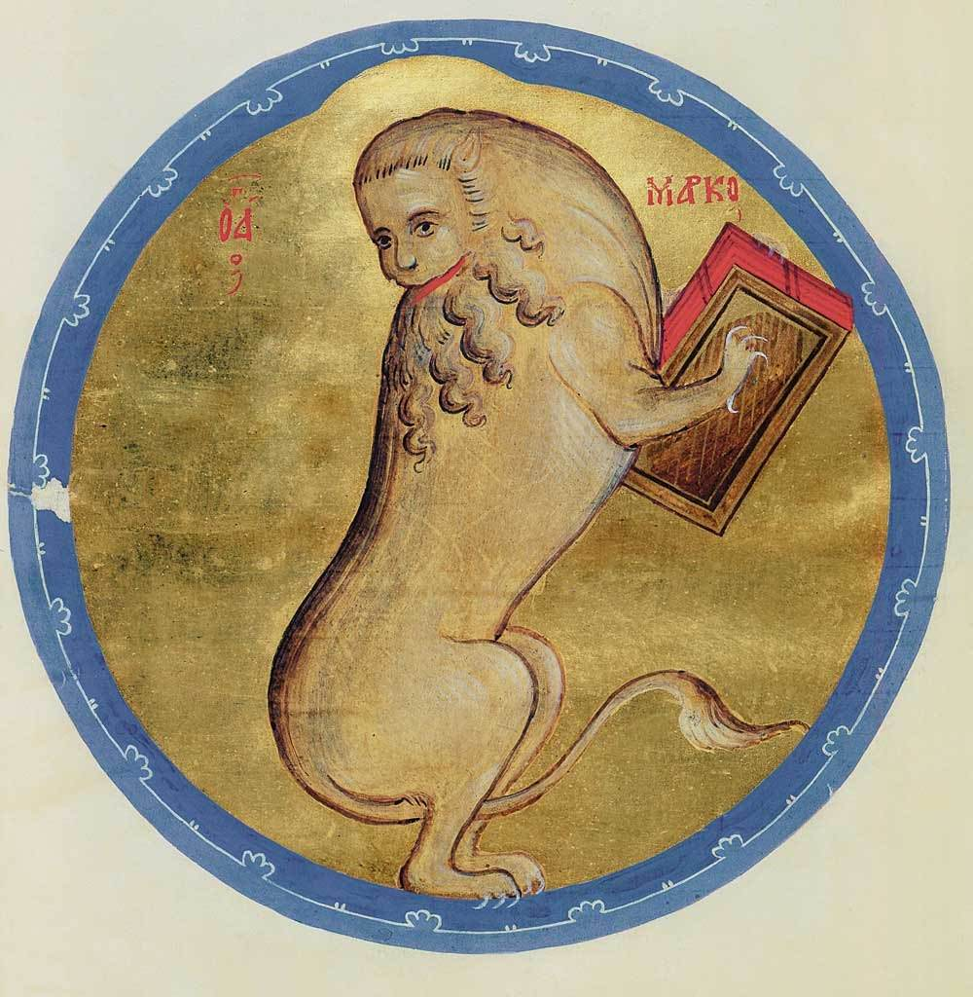
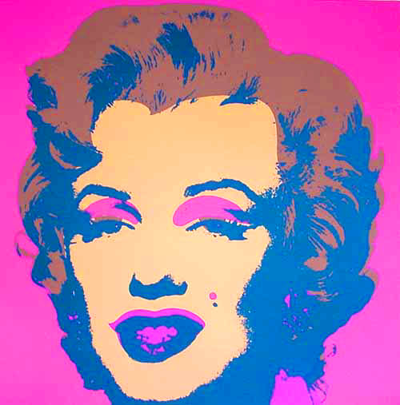
Artists’ Paintings Classification
Alfred Sisley
Andrei Rublev
Andy Warhol
Diego Rivera

Slide 3
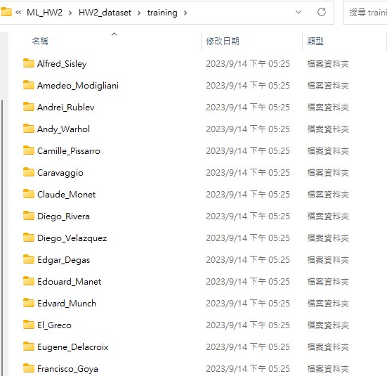
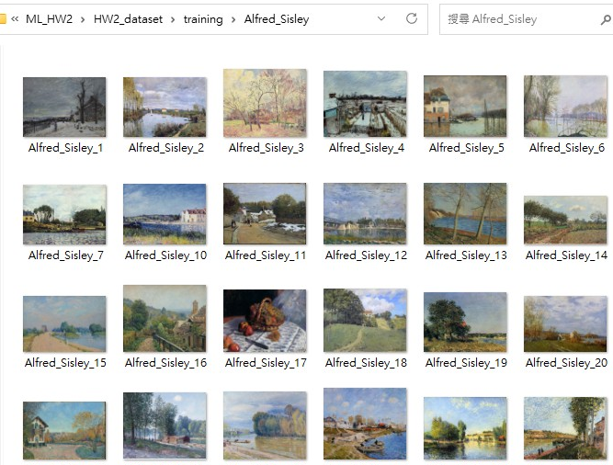
Dataset
7284 Training images
834 Testing images (Grading set)
Different resolution images in jpg format

Slide 4
How To Do?
Framework: No limited
Recommand: PyTorch、Tensorflow
Free platform: Colab、Kaggle
Preprocess : Matching Images and Labels
Train : Build Your Model and Validate it.
Test : Use Grading set to test.
Save Testing results to CSV file

Slide 5
Model Example
Multilayer Perceptron
AlexNet
VGG
ResNet
…

Slide 6
Grading Guide
Evaluation Metrics
Accuracy
Precision & Recall
Report
Model Architecture
Validation Results
Problems and Solutions
Methods to improve accuracy
Evaluation metrics intro

Slide 7
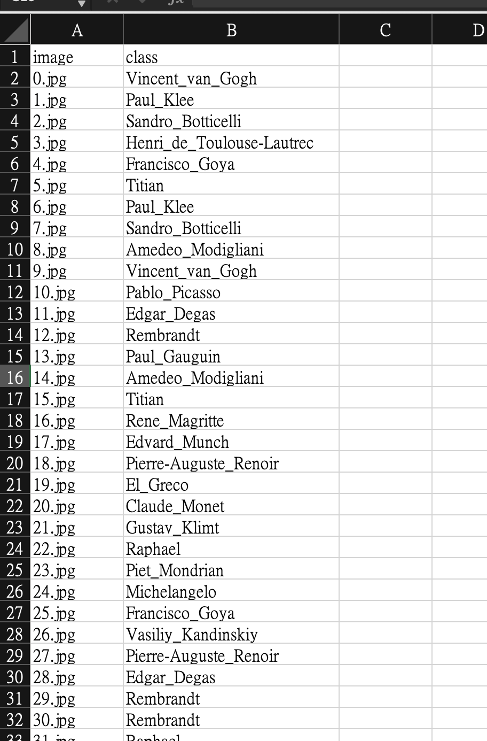
Uploading Rules
學號_grading_data.csv(30%)
Code (需要適當註解)
學號_ report.pdf (70%)
請將上述檔案壓縮成一個(學號_姓名.zip)檔

Slide 8
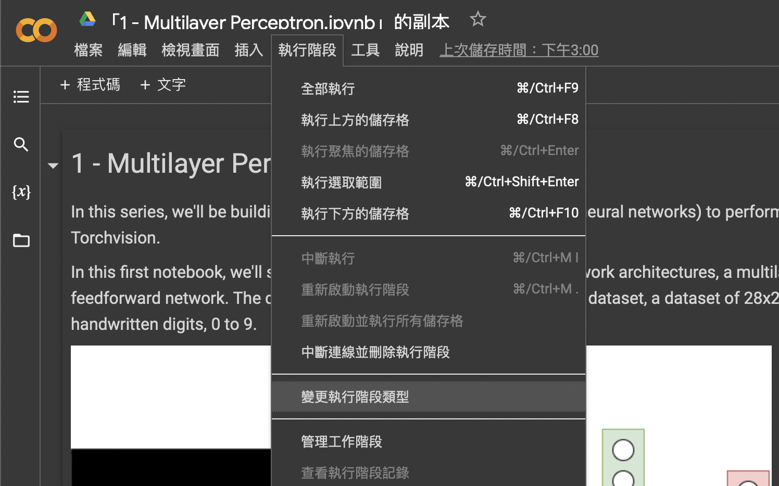
Google Colab

Slide 9
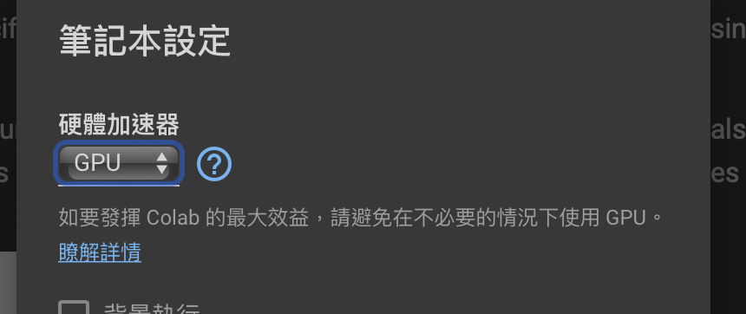
Google Colab

