Slide 1

Final ProjectCryptDB
Eric Marriott
csci e63 Big Data Analytics, 2014
Harvard Extension School
Professor: Zoran B. Djordjević
@Eric Marriott
*
Notes:
*

Slide 2
Background
- Most online and otherwise networked applications use a SQL-based database-management system (DBMS), such as MySQL or PostgreSQL.
- These systems are tried and tested, well supported and consistently updated FOSS (free and open-source software)
- However, these systems are vulnerable to different attacks and have several inherent security flaws and concerns
*

Slide 3
Background (DBMS security)
- An application server sends SQL queries to the DBMS server and receives results. An attack on the network, application server, or DBMS server can leak information about the queries being transmitted. An attacker may also acquire the ability to make queries themselves, allowing them to make off with and/or modify the database.
- Anyone with direct access to the DBMS server can read the plaintext database. Even if the database is encrypted server-side, it must be unencrypted to be used with the DBMS, so a hacker that has gained access to the server, or even a nosy administrator, can passively read the data and even view queries being made by the application server live.

Slide 4
Background (DBMS security)
- Ideally, data should only be accessible by certain people. This is especially true for personal data, such as social security numbers, bank info, credit card information, etc. This is (arguably) becoming more important in the post-Snowden world, as people are becoming more security-conscious with the personal data. Why should an online merchant have permanent access to your credit card information, even when you are not logged in? What if their servers are compromised? The news is always reporting on major data thefts. For example, the Target credit breach in December 2013 in which information on tens of millions of credit cards were stolen.

Slide 5
Background (Solutions)
There are several possible solutions to these problems
- Columns can be fully encrypted, and decrypted by the client, who possesses the decryption key for certain entries. This has several major disadvantages:
- The client has to perform any of the computation required, and send data back to the application server. If the clients are end-users, there can be massive hardware variation, slowing down their systems. However, the main problem here is security (and general feasibility). For security reasons, clients cannot perform the computation for many types of operations, such as initiating bank transactions.
- SQL queries can be done on encrypted data by using fully homomorphic encryption. Homomorphic encryption is a type of encryption that allows operations to be carried out on encrypted data, resulting in an encrypted result, without every un-encrypting the data. A fully homomorphic encryption system allows for any operation to be performed on the encrypted data without ever decrypting it. Until 2009, this was only theoretically possible, but a working implementation was created by an IBM researcher. However, this technique is computationally VERY expensive, making it useless in most applications for DBMSes, where any performance at all is desired.
http://www-03.ibm.com/press/us/en/pressrelease/27840.wss

Slide 6
Background (CryptDB)
CryptDB is a piece of software developed by researchers at MIT’s Computer Science and Artificial Intelligence Laboratory (CSAIL), to solve some of these issues.
- CryptDB is actually a misnomer, as it is not a DBMS, it is a sort of proxy layer between the user/application server and an unmodified DBMS.
- CryptDB sits between an application and the DBMS server. The application connects to CryptDB and authenticates with a password-protected keychain stored on the proxy server (in theory it doesn’t matter too much where the keychain is stored, as long as the password is sufficiently strong).
- CryptDB processes the SQL queries sent by the application server on encrypted data stored on the DBMS server - the DBMS server never sees unencrypted data, so anyone that has compromised the server cannot understand any of the data in the database.
- If the proxy server is compromised, the only query information that that attacker can possibly get is from users that are logged in, as those keychains are unencrypted.

Slide 7
How it Works
- CryptDB uses an ‘onion’ style encryption scheme, where entries in the database are stored under layers of different encryption schemes. CryptDB has 6 layer types - 1 ‘random’ layer with strong encryption, and 5 layers of different encryption schemes which support various operations on encrypted data. These layers make up different ‘onions’, which each get their own column.
- The ‘random’ layer RND, which is the outer layer of encryption. This layer is very secure, using industry-standard AES and Blowfish (depending on data type). This layer is not homomorphic, and thus is ‘peeled’ off when any operation is done on the column. Leaks no information about the data.
- The homomorphic layer HOM which uses the homomorphic Paillier algorithm, which is used to add INT values. This layer is also very secure.
- The SEARCH layer, which is used for searching for a text value using the SQL LIKE operation. It is secure, but can only work on text values.

Slide 8
How it Works
- The deterministic layer DET, which is used solely for equality determination (for instance the SQL query “SELECT * FROM table WHERE number=’one’;” (however SEARCH may be better for this particualar operation). Secure but weaker than HOM or SEARCH, starts off with a layer of RND on top until needed.
- The ordering layer OPE (Order-Preserving-Encryption), which reveals the order of column entries (does not give away values). This is kept under a layer of RND, as it leaks order (as is its purpose).
- The equality and range-join layer OPE-JOIN, is a new encryption scheme developed by the developers of CryptDB. This layer allows for equality JOIN operations, as well as range join. This leaks both order and equality, and is kept under a layer of OPE (if range is all that is needed, there is no reason to remove OPE) and a layer of RND. Note: JOIN is the same as OPE-JOIN, just not under the OPE layer, so does not reveal order (only used for equality join).

Slide 9
How it Works
- Each column is actually secured with 3 onion columns in the database. These columns are the onion equality column (layers RND,DET,JOIN) the onion order column (RND,OPE,OPE-JOIN), and (if a text column) onion search column (SEARCH), or (if an INT column) onion add column (HOM).
- Currently, once an onion layer is peeled off, it is not put back on again. This is to save computation time. As you will see, the initially decryption is what takes up most of the query time.

Slide 10
Installation and Requirements
- Install dependencies for building CryptDB using ‘official’ install script on an updated Ubuntu 12.04 or 13.04 system
$ sudo apt-get install ruby git
- Get CryptDB source, compile using official install script
$ git clone -b public git://g.csail.mit.edu/cryptdb
$ echo "export EDBDIR=$HOME/cryptdb" >> ~/.bashrc && source ~/.bashrc
$ cd cryptdb && ./scripts/install.rb
That’s it! Ready to start using CryptDB...

Slide 11
Using CryptDB
- Start CryptDB proxy
$ $EDBDIR/bins/proxy-bin/bin/mysql-proxy --plugins=proxy --event-threads=4 \ --max-open-files=1024 \ --proxy-lua-script=$EDBDIR/mysqlproxy/wrapper.lua
--proxy-address=127.0.0.1:3307 \ --proxy-backend-addresses=localhost:3306
- Connect to the DBMS through CryptDB proxy
$ mysql -u root -pletmein -h 127.0.0.1 -P 3307
- That’s it, you can now perform queries.

Slide 12
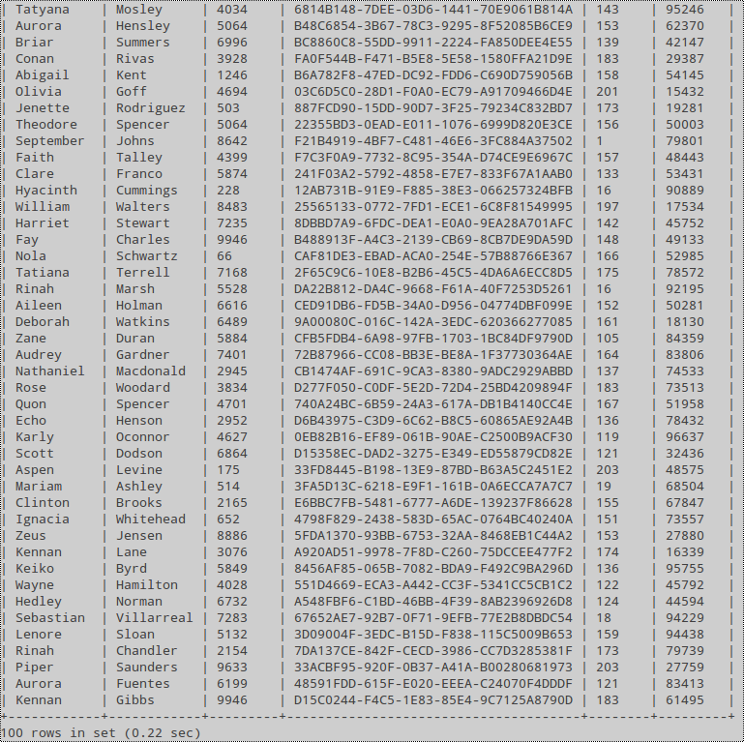
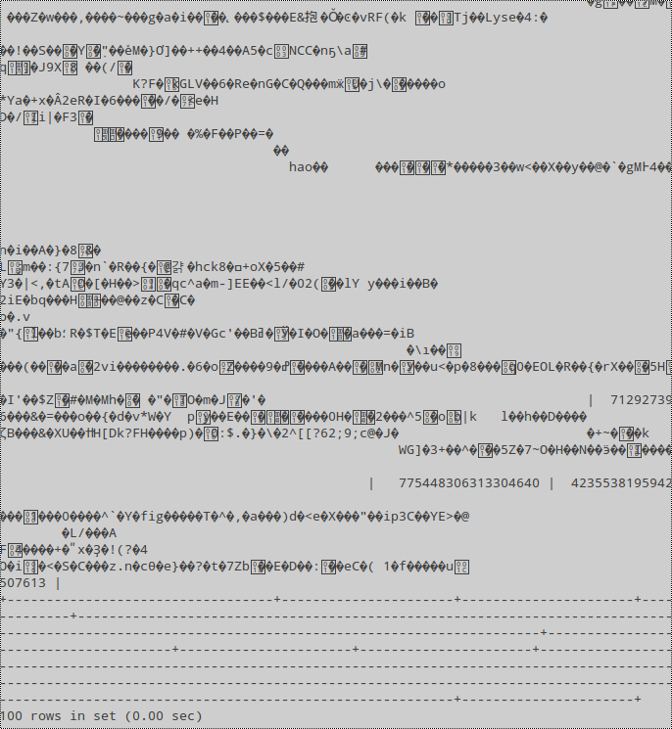
Demonstration
The same table viewed through the DBMS server
Table viewed through CryptDB proxy

Slide 13
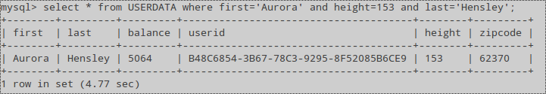
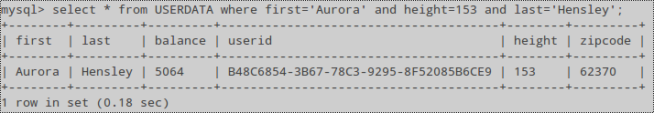
Demonstration
Initial search query on sent to CryptDB proxy...takes a while
Same query sent again...Takes no time at all! The onions have been peeled...

Slide 14
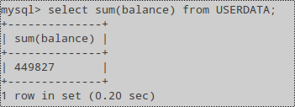
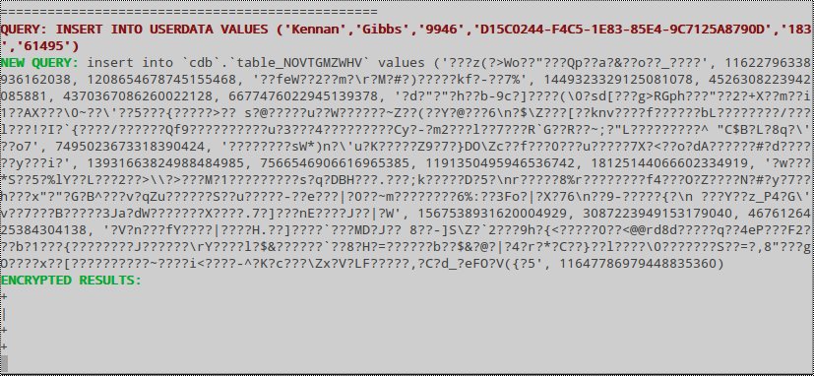
Demonstration
CryptDB also supports homomorphic addition through the Pallier algorithm!
This is how the query looks on the proxy server...CryptDB transforms the user generated query into a query on encrypted data using the user’s keychain!

Slide 15

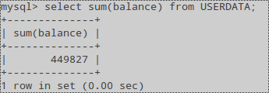
Demonstration
Of course, the same queries are substantially faster on an unencrypted DB...

Slide 16
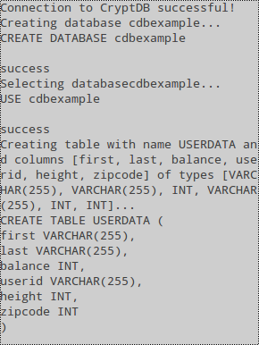
Demonstration
Here is the output of a quick Java program I wrote to connect to CryptDB, and read the CSV file into the database. It is easy to connect to the proxy using the MySQL Connector/J JDBC driver, which is FOSS created by MySQL.
Using this method it would be very easy to connect
CryptDB to Hadoop. Whether it would be a good idea
is another question...
To connect using the driver, on the normal JDBC connection creation string consists of the IP and port of the CryptDB proxy server, as well as the password. Easy!

Slide 17
Conclusion
- CryptDB is an excellent proof of concept, and is the first piece of software that efficiently solves most of the security issues of DBMSes.
- CryptDB does not (yet) support mathematical operations beyond addition.
- Complex math would be hard to add, and would require at least one more ‘onion’.
- Queries seem quite fast. The developers report CryptDB to be an average of 26% slower than vanilla MySQL for most cases. I have not noticed it being that fast, but it certainly is quite fast, and I have not done any sort of optimization.
- It is easy to implement CryptDB with Java. Hadoop anyone? Would it be worth it?
CryptDB is a wonderful piece of FOSS that brings a level of security and performance previously unmatched to the DBMS world. Much more development is needed to perfect it, however companies like Google have already forked it and are contributing to development. Onions are the future!

Slide 18
References and Links
- MIT CryptDB website http://css.csail.mit.edu/cryptdb/
- - CryptDB whitepaper http://people.csail.mit.edu/nickolai/papers/raluca-cryptdb.pdf
- - Developer’s JOIN encryption scheme whitepaper
http://people.csail.mit.edu/nickolai/papers/popa-join-tr.pdf
- - Developer’s OPE encryption scheme whitepaper
http://web.mit.edu/ralucap/www/mope.pdf
- - CryptDB SigOPS SOSP talk
https://www.youtube.com/watch?v=YNmuYh7FbQY
- IBM researcher develops fully homomorphic encryption scheme
http://researcher.watson.ibm.com/researcher/view_group_subpage.php?id=2661
- Links to my presentation on YouTube:
Part 1: https://www.youtube.com/watch?v=l40xRtBe87g
Part 2: https://www.youtube.com/watch?v=K4AauL8xx0A

