Slide 1
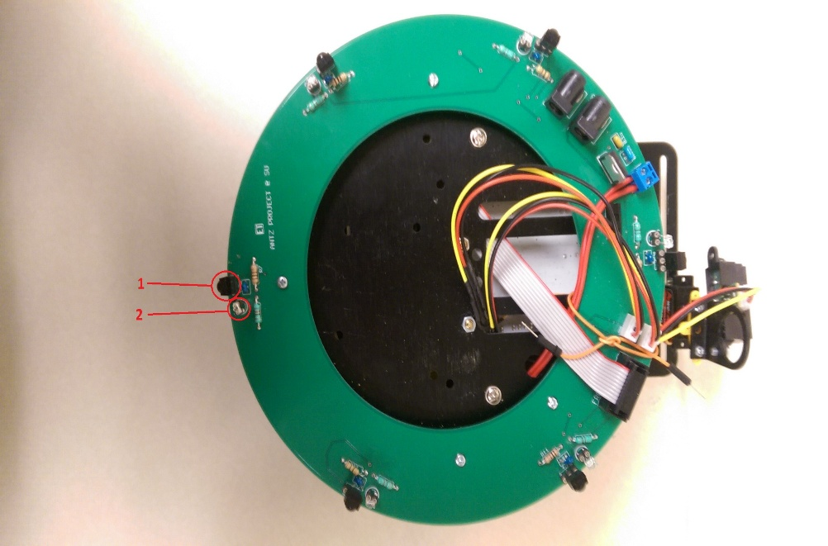
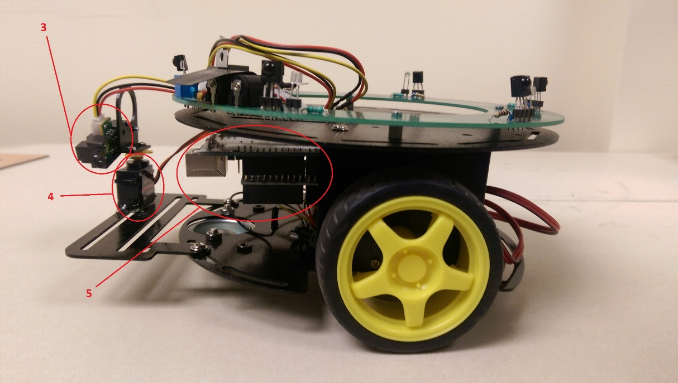
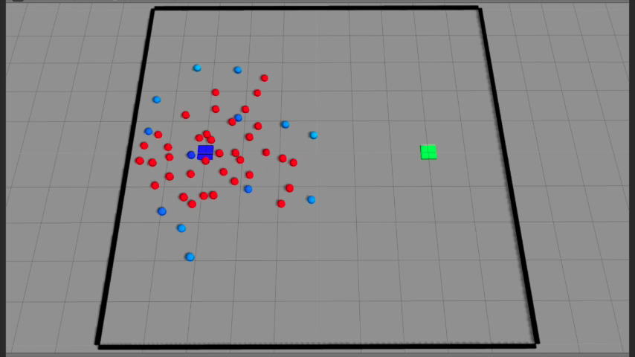
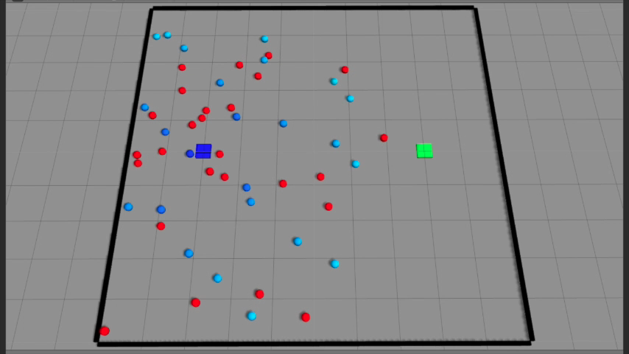
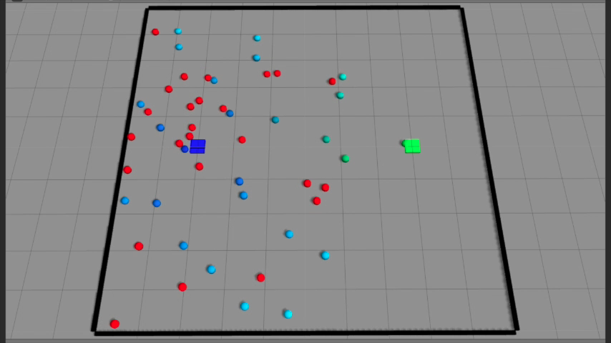
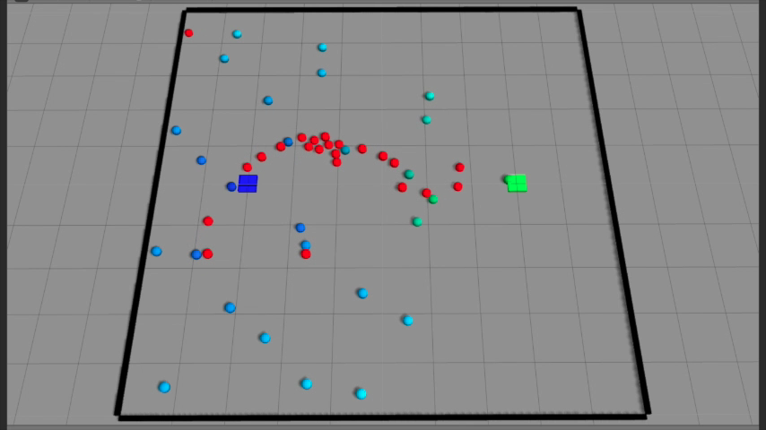
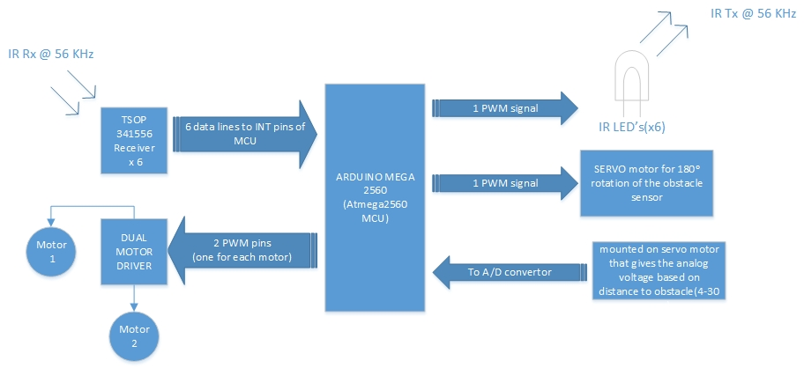
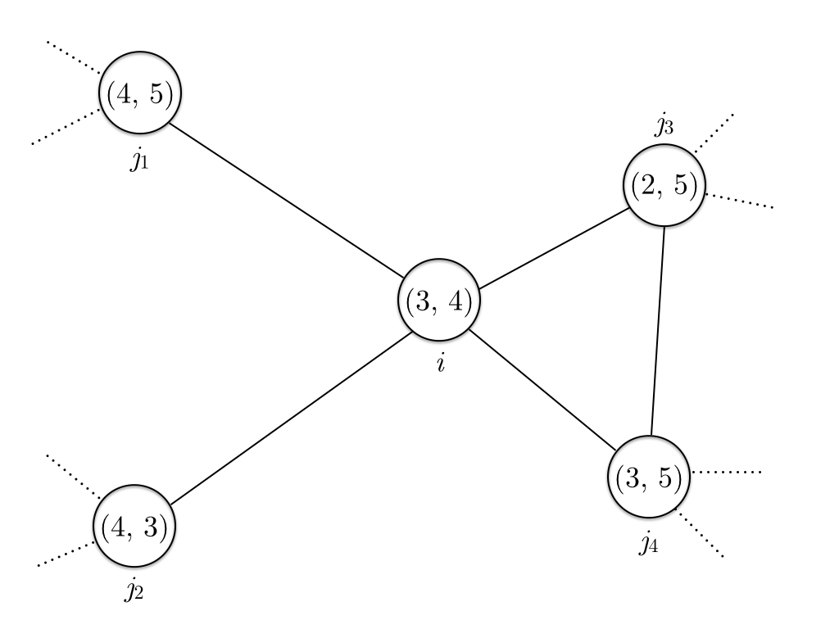
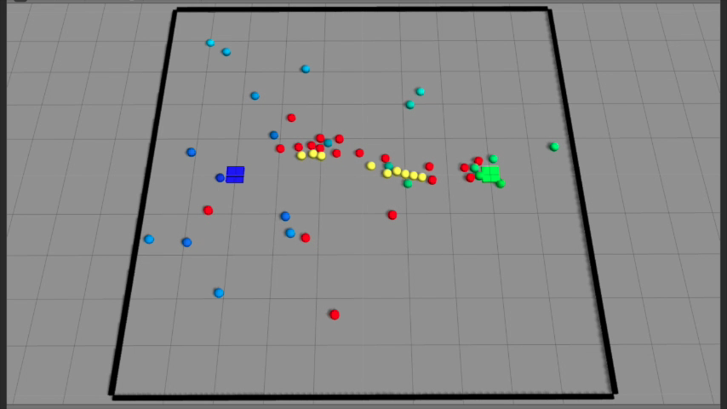
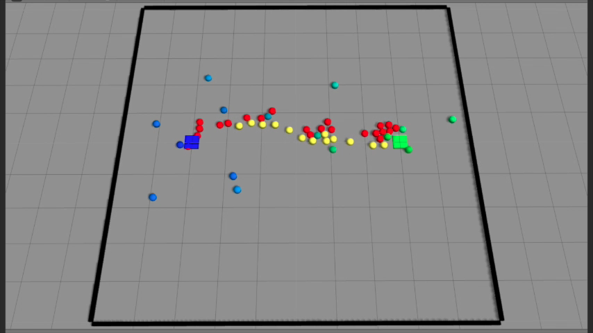

Swarm Robotics
Zhi Xing, Gajendranath Gaurav Roy Puli, Jae C. Oh
Syracuse University
Abstract
Foraging Algorithm
Hardware
We’re working on robot swarm foraging, where a swarm of robots find and transport “food” using local communication and coordination without any kind of centralized control. The algorithm we’re using dynamically assigns one of two roles to a robot: an explorer or a guider. The guiders, called beacons, broadcasts signals and the explorers, or walkers, explore and world and follow the signals. We have successfully simulated the algorithm in Gazebo robotics simulator, designed and manufactured a robot prototype, named Antz, for swarm robotics applications such as foraging, and developed software packages for Antz.
The goal of foraging is for the robots to find the food source(s) in the world and bring foods back to the nest. In the algorithm we’re implementing, each robots can take up one of two roles: walker or beacon.
Beacons store and broadcast two values as indicators of distances, one for nest and one for food. These values are propagated from one beacon to another. Figure 1 shows part of a network formed by beacon with the nodes labeled by the two values. Figure 2 shows our simulation of the algorithm in Gazebo robotics simulator.
The hardware for the robot is kept as simple as possible so as to make it robust and for the most cost effective solution. Figure 3 shows the specification of the Antz robot we designed. Figure 4 is a high-level overview of how the hardware components work together.
Introduction
In swarm robotics, a large number--perhaps thousands--of robots must cooperate to achieve common goals. The key challenges are scalability and robustness in the absence of centralized controls. Our foraging algorithm uses completely distributed and autonomous robots that can dynamically assume useful roles, either being explorers or guiders, by utilizing their local information only. Because our solution is completely distributed and localized, it is expected to scale out very well even with an extremely large number of robots.
We also developed a robot hardware prototype that can be used for general swarm robot research. Many robotics research efforts stop at simulation work; however, we believe that robotics algorithms must be developed to work in the physical world. The challenge is to design algorithms that work in the physical world not only in a simulated world. The lessons learned in this research will help us to design cyber-physical systems that require the seamless integration of computational algorithms and physical components.
Figure 3. Top and side view of Antz robot
Legend :
1. Infrared Receiver : This TSOP 34156 Receiver, receives infrared waves at 56 KHz and outputs a active
low digital signal.
2. Infrared Transmitter(IR LED) : With the help of the PWM output the IR LED outputs IR waves at 56 KHz.
3. IR obstacle sensor : This sensor allows the robot to avoid objects in front of it and also obstacles on the side with
the help of rotation provided by the servo motor. This can read ranges in between 4-30 cms.
4. Servo motor : It allows for the rotation of the obstacle sensor and rotates to a range of 180ᵒ
5. Arduino + motor driver : The program is burnt onto the Arduino and a motor driver shield for the Arduino provides
The required voltage and current for the two motors connected to it. The Arduino used is Mega which houses the
ATMega 2560 microcontroller by AVR. This was chosen because of its multiple timers and large number of pins.
(A) Swarm starts out from nest.
(B) The swarm gradually explores the world.
(C) A walker has located the food source and became
a beacon.
(D) Other walkers are going towards the food source.
Figure 4. High-level overview of hardware
(E) Walkers transport food back and to the nest. Remote
beacons turn back to walkers.
(F) A stable transportation line is formed.
Application Areas
Swarm foraging algorithms such as ours can be applied in many scenarios include:
Search and rescue
Surveillance
Discovery of minerals in scientific missions
Figure 1. A beacon network. The two values on each node are (distance to nest, distance to nest).
Beacon i has value (3, 4) because j₃ has (2, x) and j₂ has (y, 3).
Figure 2. Gazebo simulation of foraging algorithm. Color codes:
Blue square – nest Green square – food source
Blue circle – beacon close to nest Green circle – beacon close to food source
Red circle – walker without food Yellow circle – walker with food
Contacts
Zhi Xing
zxing01@syr.edu
Gajendranath Gaurav Roy Puli
gpuli@syr.edu
Jae C. Oh
jcoh@syr.edu

