Slide 1

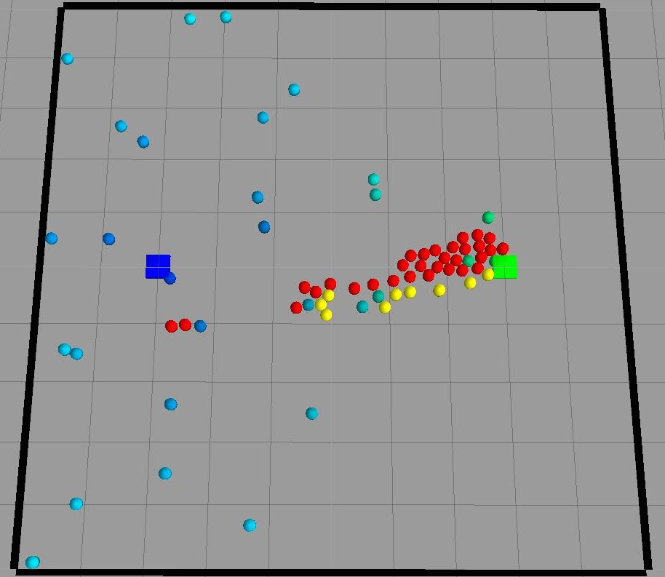
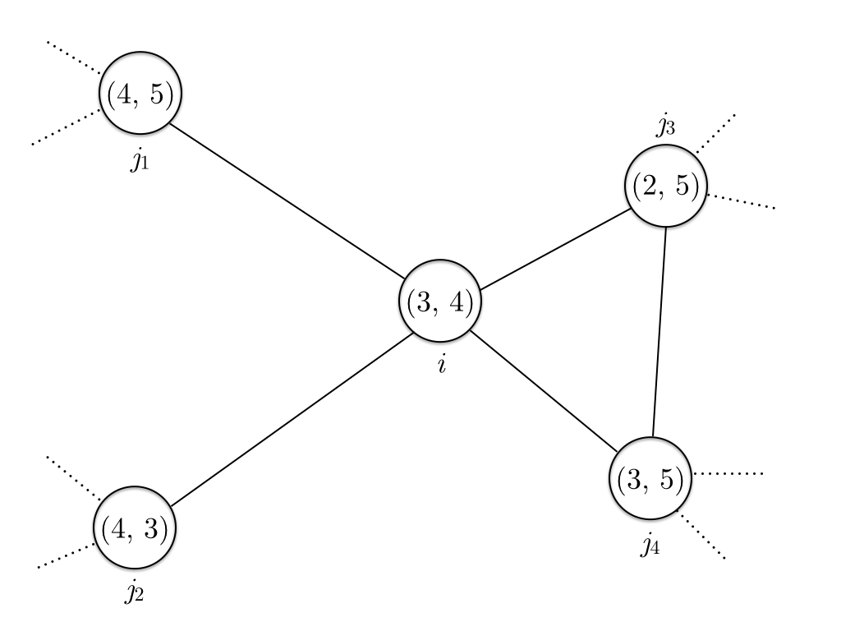
Swarm Robotics
REPLACE THIS BOX WITH YOUR ORGANIZATION’S
HIGH RESOLUTION LOGO
REPLACE THIS BOX WITH YOUR ORGANIZATION’S
HIGH RESOLUTION LOGO
Zhi Xing, Gajendranath Gaurav Roy Puli
Syracuse University
Abstract
Foraging Algorithm
Simulation
We’re working on robot swarm foraging, where a swarm of robots find and transport “food” using local communication and coordination without any kind of centralized control. The algorithm we’re using dynamically assigns one of two roles to a robot: an explorer or a guider. The guiders, called beacons, broadcasts signals and the explorers, or walkers, explore and world and follow the signals. We have successfully simulated the algorithm in Gazebo robotics simulator, designed and manufactured a robot prototype, named Antz, for swarm robotics applications such as foraging, and developed software packages for Antz.
The goal of foraging is for the robots to find the food source(s) in the world and bring foods back to the nest. In the algorithm we’re implementing, each robots can take up one of two roles: walker or beacon.
A beacon is stationary. It stores a nest cardinality and a food cardinality, and broadcasts these two values. It also receives broadcastings from neighboring beacons, and sets its own cardinalities to the received minimum cardinality value plus one. The beacon next to the nest has nest cardinality 0 and the beacon next to the food source has food cardinality 0. Effectively, beacons and targets (nest and food source) form a network, and the cardinalities of a beacon are gradient values indicating the distance of the beacon to the targets.
An example of such a beacon network is shown in Figure 1. In this network,
nodes are beacons and an edge between two beacons indicates they’re within communication radius of each other. The values in a node are (nest cardinality, food cardinality) of the beacon. The cardinalities of beacon i are (3,4) because the minimum nest cardinality it receives is 2, which is from beacon j₃, and the minimum food cardinality it receives is 3, which is from beacon j₂.
A walker is mobile. It doesn’t send out any data, but receives the broadcastings from beacons and follows the minimum values to reach a target. For example, if a walker is going towards the food, it will compare all the food cardinalities it receives from the beacons in its vicinity and go towards the one sending the minimum value.
We implemented the algorithm in Gazebo, a open-source robotic simulator with Open Dynamic Engine (ODE). We chose Gazebo because it can better reflect problems such as collision and congestion. Figure 2 is a picture the simulation after the food source has been located. The blue square is the nest, the green square is the food source, red circles are walkers going towards food, yellow circles are walkers going towards nest, and blue/green circles are beacons. The blueness and greenness indicate a beacon’s distance to nest and food source.
Introduction
Hardware
In swarm robotics, a large number--perhaps thousands--of robots must cooperate to achieve common goals. The key challenges are scalability and robustness in the absence of centralized controls.
Many swarm robotics researchers use the foraging problem as a test bed for new algorithms. Foraging problems can represent a variety of problems including search and rescue. In this problem, robots must find locations of “food” without any previous knowledge or a centralized control.
Our approach uses completely distributed and autonomous robots that can dynamically assume useful roles, either being explorers or guiders, by utilizing their local information only. Because our solution is completely distributed and localized, it is expected to scale out very well even with an extremely large number of robots.
We also developed a robot hardware prototype that can be used for general swarm robot research. The hardware utilizes the Arduino Mega 2560 board and infrared emitters and receivers for communication and obstacle detection. The key difficulty of designing the robot is the communication protocol, which currently is implemented as a state machine running as Interrupt Service Routines.
Click here to insert your Results text. Type it in or copy and paste from your Word document or other source.
This text box will automatically re-size to your text. To turn off that feature, right click inside this box and go to Format Shape, Text Box, Autofit, and select the “Do Not Autofit” radio button.
To change the font style of this text box: Click on the border once to highlight the entire text box, then select a different font or font size that suits you. This text is Calibri 20pt and is easily read up to 3 feet away on a 24x36 poster, and up to 6 feet away on a 48x72 poster.
Zoom out to 100% (for 24x36) or 200% (for 48x72) to preview what this will look like on your printed poster.
Speaking of Results, yours will look better if you remember to run a spell-check on your poster! After you’ve added your content click on Review, Spelling, or press F7.
Figure 1. A beacon network
Figure 2. Gazebo simulation
Contacts
Zhi Xing
zxing01@syr.edu
Gajendranath Gaurav Roy Puli
gpuli@syr.edu

