Slide 1


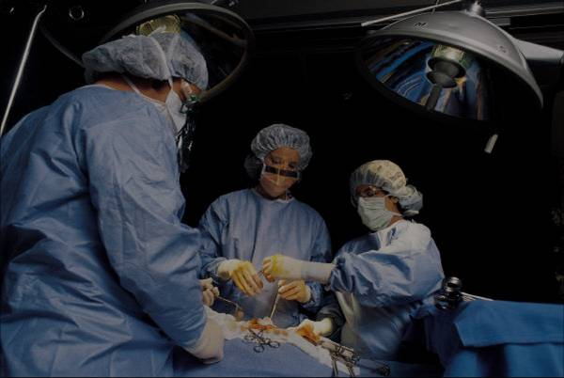
REPLACE THIS BOX WITH YOUR ORGANIZATION’S
HIGH RESOLUTION LOGO
Swarm Robotics
REPLACE THIS BOX WITH YOUR ORGANIZATION’S
HIGH RESOLUTION LOGO
Zhi Xing, Gajendranath Gaurav Roy Puli
Syracuse University
Abstract
Foraging Algorithm
Click here to insert your Abstract text. Type it in or copy and paste from your Word document or other source.
This text box will automatically re-size to your text. To turn off that feature, right click inside this box and go to Format Shape, Text Box, Autofit, and select the “Do Not Autofit” radio button.
To change the font style of this text box: Click on the border once to highlight the entire text box, then select a different font or font size that suits you. This text is Calibri 20pt and is easily read up to 3 feet away on a 24x36 poster, and up to 6 feet away on a 48x72 poster.
Zoom out to 100% (for 24x36) or 200% (for 48x72) to preview what this will look like on your printed poster.
Click here to insert your Methods and Materials text. Type it in or copy and paste from your Word document or other source.
This text box will automatically re-size to your text. To turn off that feature, right click inside this box and go to Format Shape, Text Box, Autofit, and select the “Do Not Autofit” radio button.
To change the font style of this text box: Click on the border once to highlight the entire text box, then select a different font or font size that suits you. This text is Calibri 20pt and is easily read up to 3 feet away on a 24x36 poster, and up to 6 feet away on a 48x72 poster.
Zoom out to 100% (for 24x36) or 200% (for 48x72) to preview what this will look like on your printed poster.
Chart 1. Label in 16pt Calibri.
Introduction
Hardware
Software
In swarm robotics, a large number--perhaps thousands--of robots must cooperate to achieve common goals. The key challenges are scalability and robustness in the absence of centralized controls.
Many swarm robotics researchers use the foraging problem as a test bed for new algorithms. Foraging problems can represent a variety of problems including search and rescue. In this problem, robots must find locations of "food" without any previous knowledge or a centralized control.
Our approach uses completely distributed and autonomous robots that can dynamically assume useful roles, either being explorers or guiders, by utilizing their local information only. Because our solution is completely distributed and localized, it is expected to scale out very well even with an extremely large number of robots.
We also developed a robot hardware prototype that can be used for general swarm robot research. The hardware utilizes the Arduino Mega 2560 board and infrared emitters and receivers for communication and obstacle detection. The key difficulty of designing the robot is the communication protocol, which currently is implemented as a state machine running as Interrupt Service Routines.
Click here to insert your Results text. Type it in or copy and paste from your Word document or other source.
This text box will automatically re-size to your text. To turn off that feature, right click inside this box and go to Format Shape, Text Box, Autofit, and select the “Do Not Autofit” radio button.
To change the font style of this text box: Click on the border once to highlight the entire text box, then select a different font or font size that suits you. This text is Calibri 20pt and is easily read up to 3 feet away on a 24x36 poster, and up to 6 feet away on a 48x72 poster.
Zoom out to 100% (for 24x36) or 200% (for 48x72) to preview what this will look like on your printed poster.
Speaking of Results, yours will look better if you remember to run a spell-check on your poster! After you’ve added your content click on Review, Spelling, or press F7.
Click here to insert your Discussion text. Type it in or copy and paste from your Word document or other source.
This text box will automatically re-size to your text. To turn off that feature, right click inside this box and go to Format Shape, Text Box, Autofit, and select the “Do Not Autofit” radio button.
To change the font style of this text box: Click on the border once to highlight the entire text box, then select a different font or font size that suits you. This text is Calibri 20pt and is easily read up to 3 feet away on a 24x36 poster, and up to 6 feet away on a 48x72 poster.
Zoom out to 100% (for 24x36) or 200% (for 48x72) to preview what this will look like on your printed poster.
Conclusions
Click here to insert your Conclusions text. Type it in or copy and paste from your Word document or other source.
This text box will automatically re-size to your text. To turn off that feature, right click inside this box and go to Format Shape, Text Box, Autofit, and select the “Do Not Autofit” radio button.
To change the font style of this text box: Click on the border once to highlight the entire text box, then select a different font or font size that suits you. This text is Calibri 20pt and is easily read up to 3 feet away on a 24x36 poster, and up to 6 feet away on a 48x72 poster.
Zoom out to 100% (for 24x36) or 200% (for 48x72) to preview what this will look like on your printed poster.
Table 1. Label in 16pt Calibri.
 | Heading | Heading | Heading
Item | 800 | 790 | 4001
Item | 356 | 856 | 290
Item | 228 | 134 | 238
Item | 954 | 875 | 976
Item | 324 | 325 | 301
Item | 199 | 137 | 186
Figure 1. Label in 16pt Calibri.
Figure 2. Label in 16pt Calibri.
Contacts
References
Zhi Xing
zxing01@syr.edu
Gajendranath Gaurav Roy Puli
gpuli@syr.edu

