Slide 1
Model Driven Approach to Risk Aware Recommender System
Vishnu Srivastava

Slide 2
Contents:
Introduction
Research Problem
Solution and Contribution
Approach & Research Progress

Slide 3

Introduction
Big-Data (Volume, Velocity, Variety…)
To support Effective Decision Making
Recommender Systems
Collaborative filtering
(grouping users based on similarity)
Content-based filtering
Hybrid Recommender Systems

Slide 4
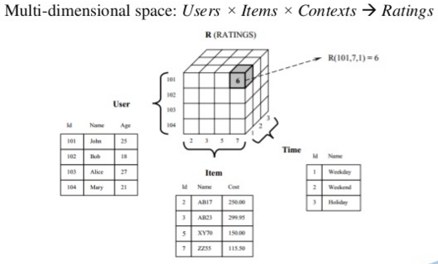
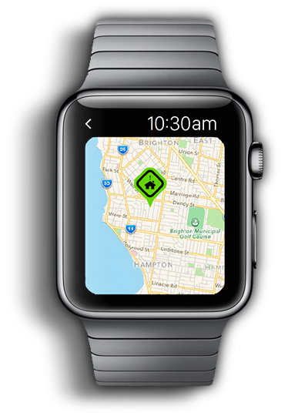
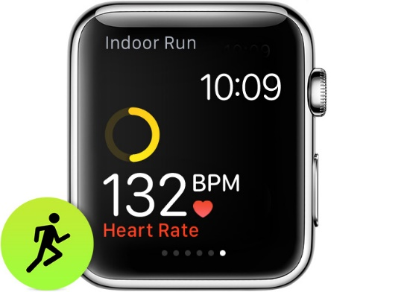
Context Aware Recommender System
Context-aware recommender systems
(CARS) generate more relevant recommendations
by adapting them to the specific contextual
situation of the user(Location, time etc).

Slide 5
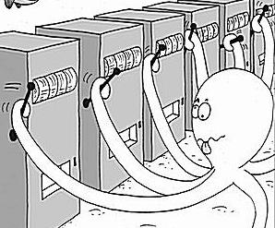
Multi-armed bandit Problem (MBP)
The name "multi-armed bandits" comes from a scenario in which a gambler faces several slot machines, a.k.a. "one-armed bandits", that look identical at first but produce different expected winnings. The crucial issue here is the trade-off between acquiring new information (exploration) and capitalizing on the information available so far (exploitation).

Slide 6
Research Problem
Traditional algorithms used for context aware recommender system are not efficient enough to accommodate the increase in the number of sources(sensors and usage data) available (Re-calculation and re-programing to accommodate a new data source).
We have algorithms that generate good recommendations but no criteria to decide when to deliver those recommendations to the user. In many applications, such as recommending personalized content, it is also important to consider the risk of upsetting the user so as not to push recommendations in certain circumstances, for instance, during a professional meeting, early morning, late-night. Therefore, the performance of the recommender system depends in part on the degree to which it has incorporated the risk into the recommendation process.

Slide 7
Possible Solution
Model-driven Approach: The model-driven approach separates the analytics logic from the technical big data platform. This allows you to change platform components later, without rewriting your analytics.
A dynamic risk sensitive recommendation system called DRARS (Dynamic Risk-Aware Recommender System), which models the context-aware recommendation as a bandit problem.
Djallel Bouneffouf. DRARS, A Dynamic Risk-Aware Recommender System. Computation and Language [cs.CL], 2014

Slide 8
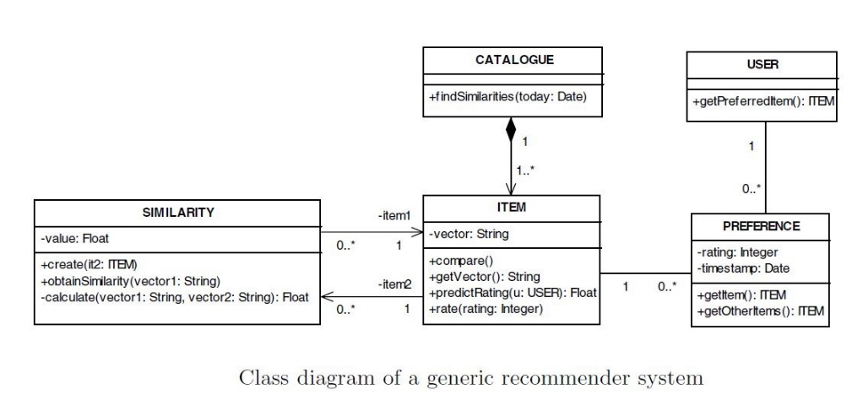
Approach & Research Progress
1. Models and Abstraction(Almost Complete)
To model the recommender system using user data such as location, browsing history, dwell time and click through rate(CTR). This will be followed by integrating risk factor into model by using Bayesian optimization for MBP.
2. Verification and Validation (In-progress)
In order to test the validity of the system, the model will be studied in terms of its scope of implementation in Equity Portfolio management.
3. Domain Specific Language (DSL) (In-progress)
The purpose of the domain specific language for our system is to allow its users to implement a risk aware recommendation system with reduced complexity of achieving. Domain specific languages aim at raising the abstraction level, thereby lowering the complexity of achieving a specific task.

Slide 9
References
Abowd, G. D., Dey, A. K., Brown, P. J., “Towards a better understanding of context and context-awareness,” in Proceedings of the 1st international symposium on Handheld and Ubiquitous Computing, HUC ’99, (London, UK), pp. 304–307, Springer-Verlag,1999.
Adomavicius, G. and Tuzhilin, A., “Toward the next generation of recommender systems: A survey of the state-of-the-art and possible extensions,”IEEE Transactions on Knowledge and Data Engineering, vol. 17, pp. 734–749,June 2005.
Anderson, C. R., A machine learning approach to web personalization. PhD thesis, 2002.
Atefeh Jajvand, Mir Ali Seyyedi, A. S., “A Hybrid Recommender System for Service Discovery,” International Journal of Innovative Research in Computer and Communication Engineering, vol. 4, no. 2, pp. 1344–1347, 2013.
Auer, P., Cesa-Bianchi, N., Freund, Y., and Schapire, R. E., “Gambling in a rigged casino: The adversarial multi-armed bandit problem,” in Proceedings of the 36th Annual Symposium on Foundations of Computer Science, FOCS ’95, (Washington, DC, USA), pp. 322–, IEEE Computer Society, 1995.
Auer, P., Cesa-Bianchi, N., and Fischer, P., “Finite-time analysis of the multi-armed bandit problem,” Machine Learning, vol. 47, pp. 235–256, May 2002.
Baeza-Yates, R. A. and Ribeiro-Neto, B., Modern Information Retrieval. Boston, MA, USA: Addison-Wesley Longman Publishing, 1999.
Balabanovic, M. and Shoham, Y., “Content-based, collaborative recommendation,” Communications of the ACM, vol. 40, pp. 66–72, 1997.
Bettini, C., Brdiczka, O., Henricksen, K., Indulska, J., Nicklas,D., Ranganathan, A., and Riboni, D., “A survey of context modelling and reasoning techniques,” Pervasive and Mobile Computing, vol. 6, no. 2, pp. 161 –180, 2010. Context Modelling, Reasoning and Management

Slide 10
Questions ?

