Slide 1
Multi-Agent Modeling of Risk-Aware and Privacy-Preserving Recommender Systems
Presented by: Vishnu Srivastava
David R. Cheriton School of Computer Science

Slide 2
Contents
Introduction
Privacy in Recommender Systems
Risk Factor
Multi-Agent Modeling
Problem Statement
Contributions
Proposed Approach
Case Study: A Job Recommender System
Conclusions and Future Work

Slide 3
Introduction
Recommender Systems Overview
Recommender systems are software systems that produce a list of items which depends on a user’s preferences, interests or observed behavior related to the items.
Examples:
Movie recommendations;
Financial service recommendations;
Commercial product recommendations;
Social network recommendations.

Slide 4
Introduction
Existing Approaches
Collaborative Filtering
Collaborative filtering methods are based on collecting and analyzing a large amount of information on users’ preferences, activities and behaviours and predicting what users will like based on their similarity to other users.
Content Based Filtering
Recommendations are based on the information on the content of the items rather than on other users’ opinion.
Hybrid Recommender Systems
It combines collaborative filtering and content-based filtering. Hybridization techniques can be:
Weighted: The score of different recommendation approaches are combined numerically.
Switching: The system chooses amongst recommendation approaches and applies the selected one.

Slide 5
Introduction
Recent Approaches
Context-Aware Recommender Systems
Context-aware recommender systems (CARSs) generate more relevant recommendations by adapting them to the specific contextual situation of the user (e.g., location, time, social connections).
Risk-Aware Recommender Systems
In many applications, such as recommending personalized content, it is also important to consider the risk of upsetting the users by providing inaccurate recommendations. A risk factor is calculated for the items and the ones with a lower risk factor value are recommended to the user. Bouneffouf has introduced the concept of risk factor in the RSs [2].

Slide 6
Privacy in Recommender Systems
Overview
Information privacy in a Recommender System focuses on the disclosure of information of an individual, the effects that disclosure have on this person, and his or her control and consent.
Privacy Concerns
Data Collection: Many users are not aware of the amount and extent of information that a service provider is able to collect and what can be derived from this information.
Data Retention: Online information is often difficult to remove, and the service provider may even intentionally prevent or hinder removal of data. This is because there is commercial value in user information for competitive advantage through analysis.
Data Sales: The wealth of information that is stored in online systems is likely to be of value to third parties and may be sold in some cases.
Other Concerns: Data leaks and recommendations revealing private information.

Slide 7
Privacy in Recommender Systems
Privacy Protection Mechanisms
Anonymization: Service providers often deal with privacy issues by obscuring the link between the users and their data. This can be done through anonymization, which involves removing any identifiable information from the data while preserving data structure.
Randomization: It involves injecting random noise in the data to maintain user privacy while preserving the structure in the data.
User Control: It mitigates concerns over privacy risk breaches in the RSs by giving the users the option to manage the release of their information to the RSs.

Slide 8
Risk Factor
After getting the contextual data from a user, the data is passed to a semantic analyzer in order to generate meaning from that data.
Based on the results from the semantic analyzer, a list of items are prepared to be recommended to the user.
A risk factor is calculated for each of the items and only those items with lower values of risk are recommended to the user.
According to Bouneffouf more than 30 algorithmic variations exist to calculate the risk factor (e.g., variance of the cost analysis, Bayesian optimization).
Contextual Data
Semantic Analysis
Risk Calculation

Slide 9
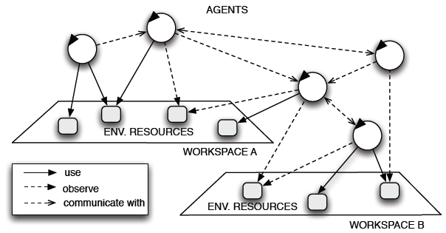
Multi-Agent Modeling
A multi-agent system (MAS) model is a model composed of multiple interacting intelligent agents within an environment. Multi-agent system models can be used to represent solutions to problems that are difficult or impossible for an individual agent or a monolithic system to solve.
The model represents multiple individual agents and their activities and interactions.

Slide 10
Multi-Agent Modeling
MADEM
MADEM (Multi-Agent Domain Engineering Methodology) is an approach for designing multi-agent systems based on reusable software artefacts (e.g., activity models, goal models).
The approach involves breaking down a complex system into subsystem containing independent agents and designing the subsystem around the behaviour of those agents.
Girardi and Marinho provide a description of a multi-agent model for web usage mining in the context of agent-based Recommender Systems by utilizing MADEM (Multi-Agent Domain Engineering Methodology). However, the authors did not take into consideration recommendation risks and privacy.

Slide 11
Problem Statement
There is a lack of a modelling approach for the RSs that takes into account both sufficient knowledge of the user’s context and the privacy of the users.
To the best of my knowledge, there is no research that focuses on modeling recommender systems based on agent based approaches in software engineering, and which takes into account both a user’s context and privacy.

Slide 12
Contributions
The aim of this research is to provide a multi-agent based system model of RSs by introducing both privacy and risk-related abstractions into traditional recommender systems.
Such a recommender system can be referred as Risk-Aware and Privacy Preserving recommender system (RPRS).
Using this approach a recommender system is divided into subsystems. This breakdown into subsystems enables the designers of the RS to focus on each of the sub-objectives that must be accomplished by the individual units in order to fulfil the overall objective of the entire system.
The applicability of the approach is illustrated by a case study involving a job recommender system in which the general design model is applied to represent the required domain-specific abstractions.

Slide 13
Proposed Approach
Description of the Relationship Model
Steps of the Proposed Approach
The system is conceptually broken down into three subsystems (i.e. the Data Subsystem, the Contextual Risk Subsystem and the Privacy Subsystem)
Input
Input
Input
Breakdown of the System into Subsystems
Description of the goal model for the Subsystems
Design Behavior: Activity Model
Design Behavior: Sequence Diagram
Combined Model of the System

Slide 14
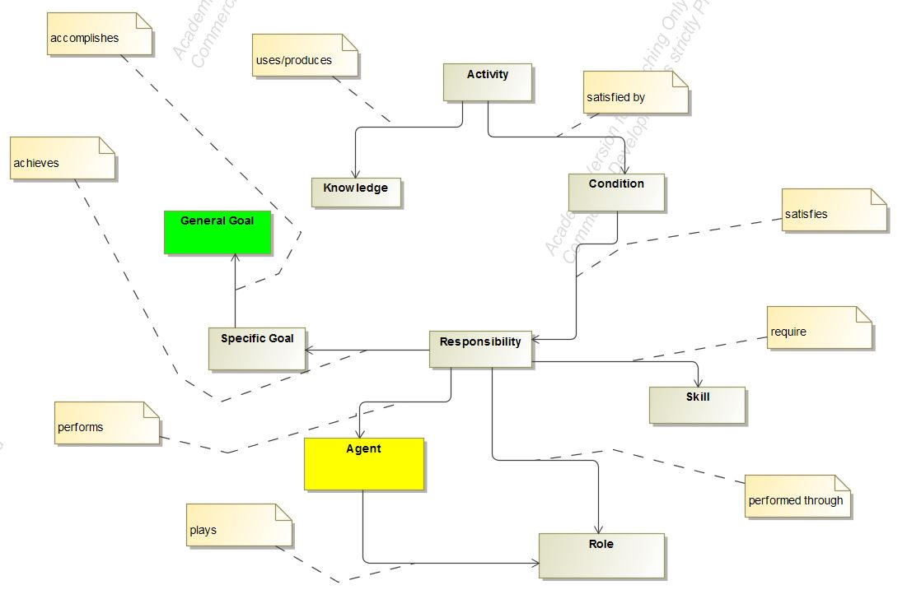
Proposed Approach
Relationship Model
Define the general goals to be achieved.
Define the specific goals of the subsystems.
Introduce independent agent(s) in each subsystem.
Describe the roles of the agents within each subsystem.
Define the responsibilities that are fulfilled by the individual agents based on the activities they perform within each subsystem. These responsibilities help in achieving the specific subsystem goals.

Slide 15
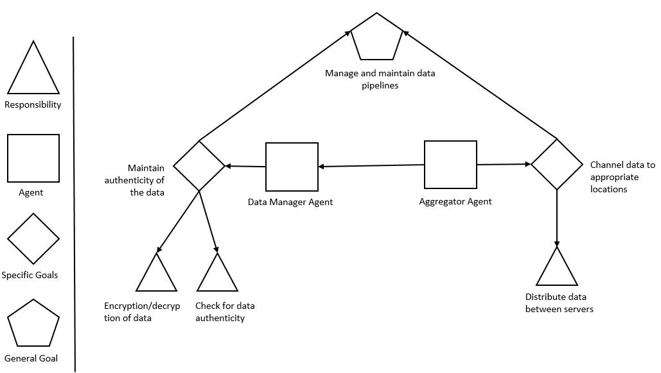
Proposed Approach
Goal Model: Data Subsystem
Data Manager Agent:
Specific Goal: Maintain the authenticity of the data.
Responsibilities: Encrypt or decrypt data and check data authenticity.
Aggregator Agent:
Specific Goal: Channel data to appropriate locations.
Responsibilities: Distribute data within the subsystems or between servers.
Subsystem Objective : Maintain and manage data pipelines within the RPRS.

Slide 16
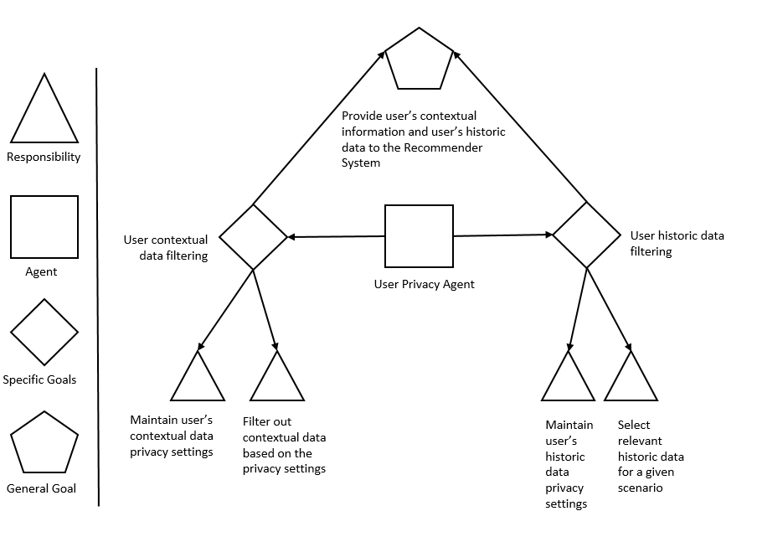
Proposed Approach
Goal Model: Privacy Subsystem
User Privacy Agent:
Specific Goal: Filter out the user’s contextual and historic data.
Responsibilities: Maintain the user’s privacy settings for the contextual and the historic data and filter out non-relevant data based on the privacy settings or system requirements.
Subsystem Objective : The overall objective of the privacy subsystem is to provide filtered user’s contextual and historic data to the RPRS.

Slide 17
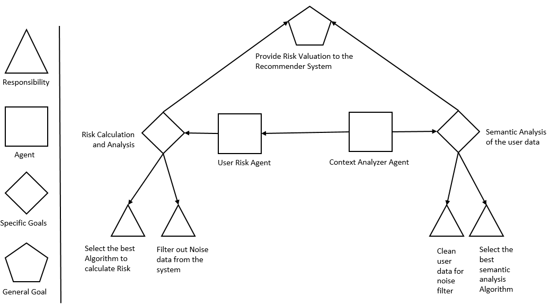
Proposed Approach
Goal Model: Risk Subsystem
User Risk Agent:
Specific Goal: Calculate the risk factor for the contextual data.
Responsibilities: Select the best algorithm for calculating the risk and filtering out unwanted high risky or noisy recommendations from the system.
Context Analyzer Agent:
Specific Goal: Perform semantic analysis of the user data.
Responsibilities: Clean the contextual data and selecting the best possible algorithm for the semantic analysis.
Subsystem Objective : The overall objective of the risk subsystem is to provide a risk evaluation to the RPRS.

Slide 18
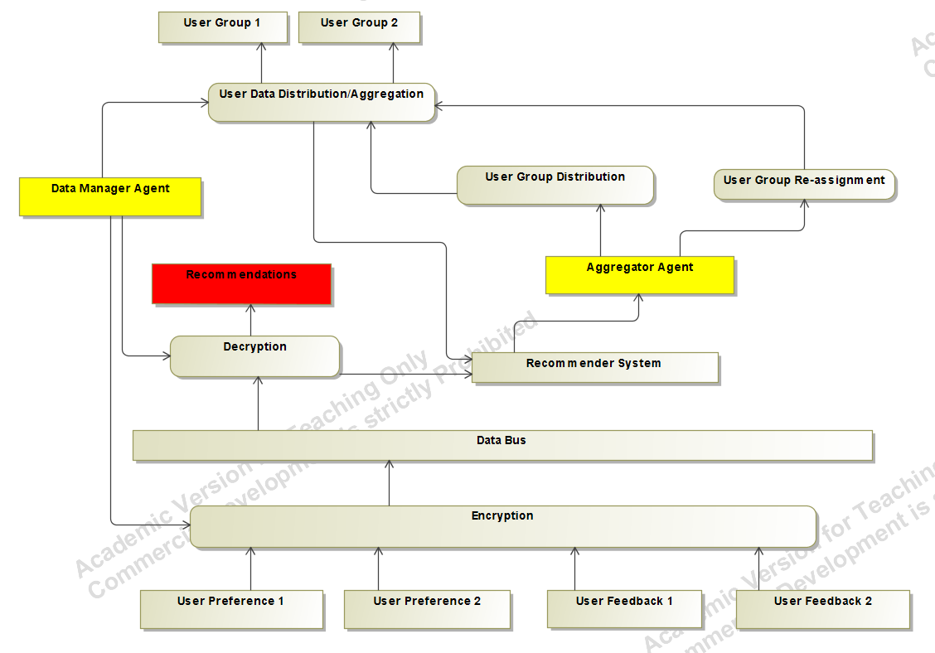
Proposed Approach
Activity Model: Data Subsystem
The Data Manager Agent ensures data authenticity (e.g., MD5 hashing, encryption, decryption).
The Aggregator Agent can assume the role of a message broker such as Apache Kafa and RabbitMQ.

Slide 19
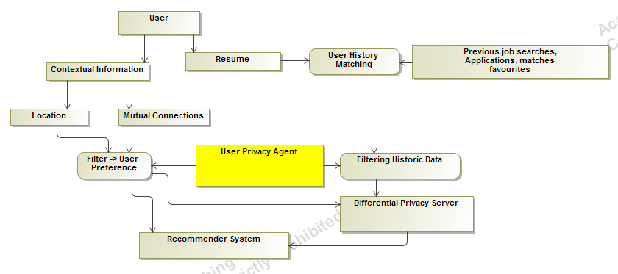
Proposed Approach
Activity Model: Privacy Subsystem
Within this subsystem the contextual and personal information is extracted from the user and fed into the RPRS.
An additional privacy server is used to support the privacy protecting mechanisms, i.e. randomization and anonymization.

Slide 20
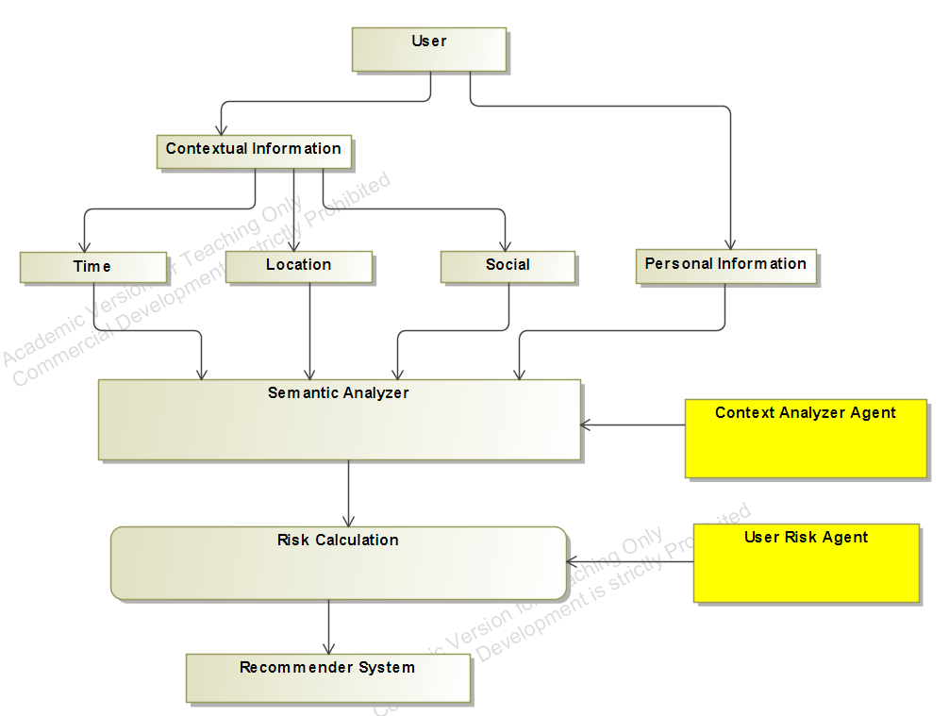
Proposed Approach
Activity Model: Risk Subsystem
The information processed in this subsystem is used by the RPRS to generate a more context-aware recommendations by not only providing more relevant information to its users but also keeping itself aware of the risks associated with disturbing or negatively affecting the user with inaccurate recommendations.
This tradeoff between providing relevant recommendations and the associated risks is captured by the risk factor.

Slide 21
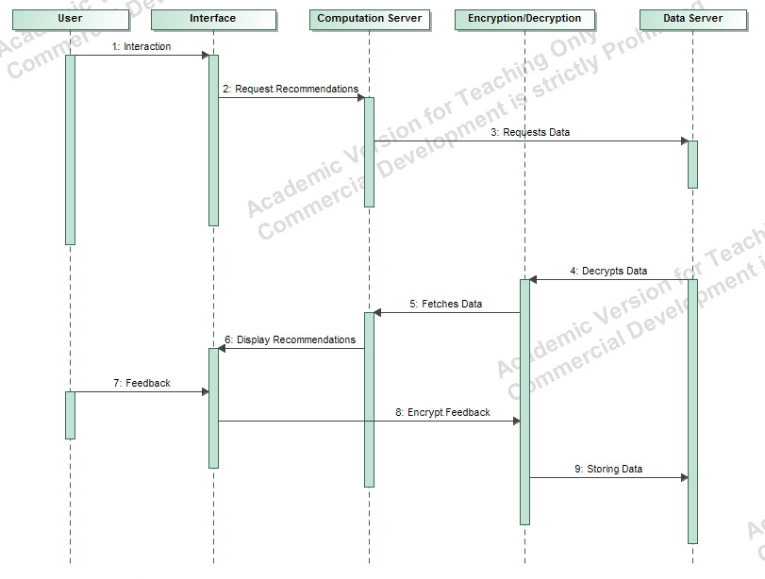
Proposed Approach
Sequence Diagram: Data Subsystem
First, a request for generating recommendations is placed by the user which results in pulling data from the database.
The data is decrypted and fetched to the computation server where the data is checked for authenticity.
The data received by the data server or the database is encrypted before storing.

Slide 22
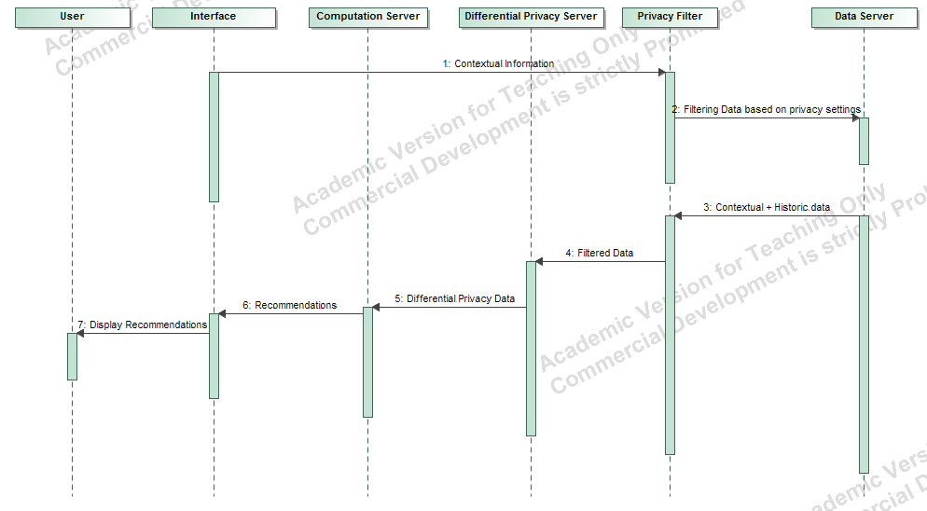
Proposed Approach
Sequence Diagram: Privacy Subsystem
The contextual data from the user interface (e.g., a website or a mobile device) is sent to the privacy filter and stored in the data server or the database.
This data is then pulled from the database along with the user’s historic data and sent to the privacy server for randomization and anonymization.
This processed data is then forwarded to the computation server for generating recommendations.
The recommendations are sent to the user interface.

Slide 23
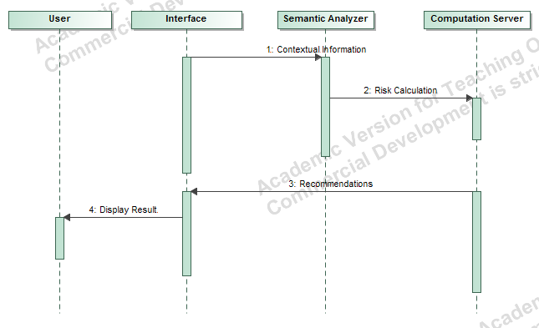
Proposed Approach
Sequence Diagram: Risk Subsystem
First, a connection is established with a sensing device at the user’s end through a specific interface.
A low-level abstraction of the user’s data is sent to the servers running the semantic analysis.
The data from the semantic analyzer is processed and forwarded to the computation server for risk factor calculation. The recommendations are forwarded to the user through the same interface.

Slide 24
Case Study: A Job Recommender System
The objective of this case study is to show how the proposed approach can be used to model an enhanced job recommender system.
In order to provide a specific RPRS model to support job recommendations, information about how job recommendations work conceptually and from a processing viewpoint are needed so that goal diagrams, activity diagrams and sequence diagrams are produced as part of the specific RPRS design model.
After reviewing the literature on job recommendation systems, two studies were found that provide to some extent the required information [9, 10].
The first paper provides the information needed for the generation of the RPRS goal models, and the second paper, provides the information required to produce the RPRS activity and sequence diagrams.

Slide 25
Case Study: A Job Recommender System
Data Sources
The two papers discuss the following data sources within a job recommender system:
Contextual information:
Candidate: LIKE, APPLY , VISIT and Social Interactions
Employer: POSTS and VIEWS
Item metadata:
Candidate: Resume
Employer: Job Description
Historic Data:
Candidate: Job Applications
Employers: Previous Job Offers, Current Employee’s Skills
Recommendation feedback: Not Interested

Slide 26
Case Study: A Job Recommender System
Goal Model: Responsibilities
Data Subsystem:
Encrypt the data obtained from the employers and the candidates and store this data in a database and making it available for use by fetching and decrypting it.
Maintain the pipelines of candidate’s data and the employer’s data within the system.
Privacy Subsystem:
Anonymize and randomize the data.
Maintain the privacy settings of the employer’s and the candidate’s data in the system.
Filter out contextual data and historic data based on the privacy settings of the candidate and the employer.

Slide 27
Case Study: A Job Recommender System
Responsibilities
Risk Subsystem:
Perform semantic analysis on the candidate’s data and the employer’s data.
Calculate the risk using a candidate’s information and an employer’s information.

Slide 28
Case Study: A Job Recommender System
Goal Model: Specific Goals
Goal Model: General Goals
Data Subsystem:
Maintain the authenticity of the data
Channel the data through the system while protecting.
Privacy Subsystem:
Perform contextual and historic data filtering and selection
Risk Subsystem:
Perform semantic analysis of the user data.
Calculate the risk factor for contextual data.
Data Subsystem:
Manage and maintain data pipelines within RPRS.
Privacy Subsystem:
Provide user contextual and historic data filtering to the RPRS.
Risk Subsystem:
Provide risk evaluation to the RPRS.

Slide 29
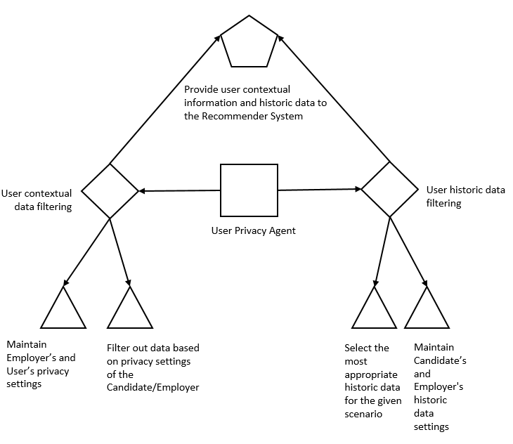
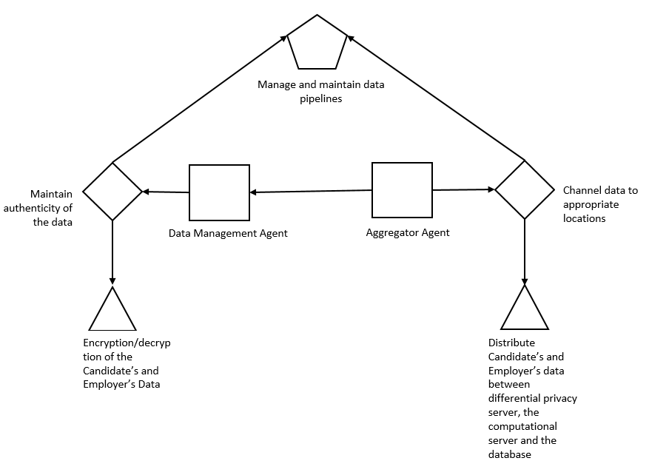
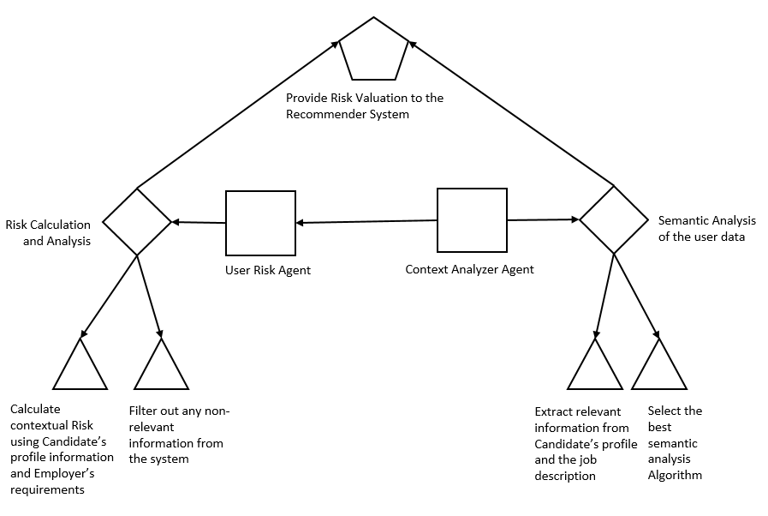
Case Study: A Job Recommender System
Generate Recommendations
Recommendations
Goal Model
System Objective
Responsibility
Agent
Specific Goals
General Goal

Slide 30
Case Study: A Job Recommender System
Activity Diagram
Data Subsystem
Different processes and software tools manage the encryption/decryption of the candidate’s and employer’s data and the transfer of data within a server or between different servers.
Privacy Subsystem
A candidate’s and an employer’s privacy settings are maintained by using privacy protection mechanisms (e.g., anonymization and randomization) to preserve the privacy of the users of the system.
Risk Subsystem
A risk factor is calculated for each of the jobs to be recommended to a candidate and for each candidate profile to be recommended to an employer.

Slide 31
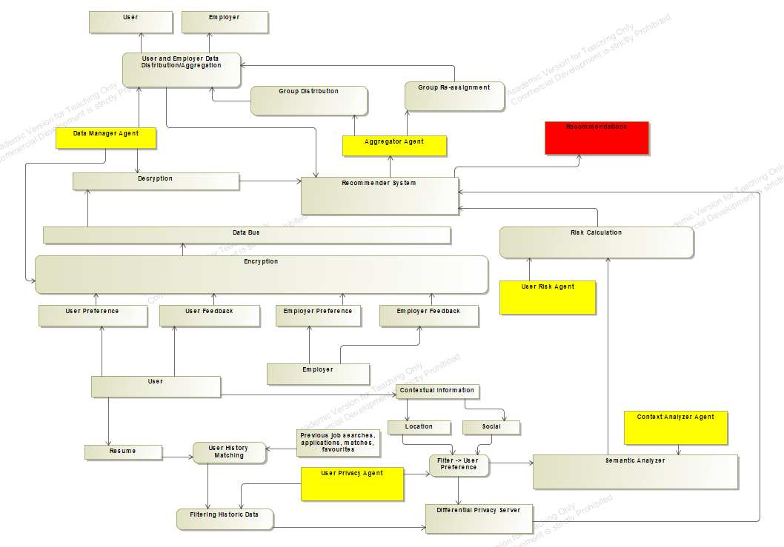
Case Study: A Job Recommender System
Activity
Diagram

Slide 32
Case Study: A Job Recommender System
Sequence Diagram
Data Subsystem:
The process within the data subsystem is initiated when a candidate or an employer interacts with the system interface.
The data from the interface is sent to the computation server from where the recommendations are generated.
The recommendations are forwarded to the interface and the feedback is obtained in order to enhance the recommendations. This data is encrypted and then again stored in the database.

Slide 33
Case Study: A Job Recommender System
Sequence Diagram
Privacy Subsystem:
The candidate’s contextual data is first sent to a privacy filter before it is forwarded to the database or data server. The filtered data is recovered from the database for the purpose of generating the recommendations.
The candidate’s data and the employer’s job description data are sent to a differential privacy server to enforce anonymization and randomization. Then, the data is processed by the recommendation server to generate recommendations for the candidates and the employers through a system interface.
Risk Subsystem:
The candidate’s contextual information is fed into the computation server after being processed by the semantic analyzer. Based on the algorithms for risk factor calculations on the computation server, the recommendations are generated.

Slide 34
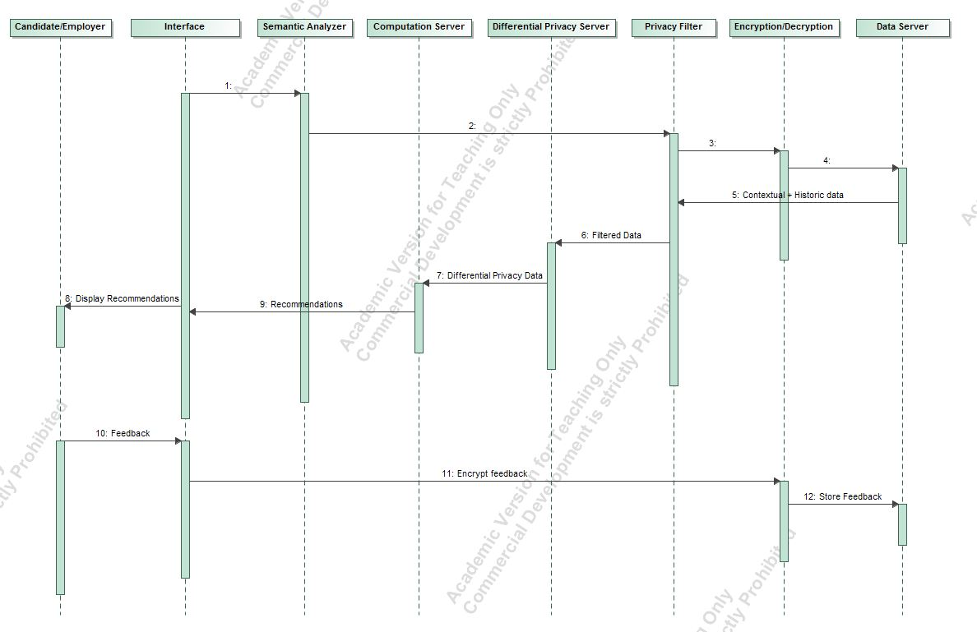
Case Study: A Job Recommender System
Sequence
Diagram

Slide 35
Conclusions and Future Work
Conclusions
A multi-agent based system model of RSs is proposed that introduces both privacy and risk-related abstractions into traditional recommender systems.
The approach also enables the RS designers to be aware of the each of the small objectives that must be accomplished by the each individual system unit in order to fulfil the objective of the entire system.
This high level approach to model a RPRS system is helpful for domain experts by supporting them to produce design models at a more abstract level, to focus on the concepts and processing aspects of the system, and to apply the general RPRS design models in order to produce solutions for specific applications domains.

Slide 36
Conclusions and Future Work
Limitations
The proposed approach is limited to an agent-based design methodology. However, there are other design approaches described in the literature.
It also relies on a limited set of design diagrams.
The approach can be applied to a specific application domain such as job recommender system based on the conceptual and processing-related information about the application domain. However, in many cases this information is not readily available.

Slide 37
Conclusions and Future Work
Future Work
The RPRS multi-agent approach proposed in this thesis can be extended or improved in the future in many ways.
The approach can be applied in other application domains, e.g., the news or restaurant domains.
The approach can take advantage of other UML models, such as use case diagrams or state diagrams.
Frameworks can be implemented using domain-specific languages to generate automatically the code of the system.
Finally, model verification methods and experimental case studies can also be used to enhance the approach.

Slide 38
Thank You !

Slide 39
References
[1] Girardi R, Marinho LB. A domain model of Web recommender systems based on usage mining and collaborative filtering. Requirements Engineering. 2007 Jan 1;12(1):23-40.
[2] Bouneffouf D. DRARS, A Dynamic Risk-Aware Recommender System (Doctoral dissertation, Institut National des Telecommunications).
[3] Sankar CP, Vidyaraj R, Kumar KS. Trust Based Stock Recommendation System–A Social Network Analysis Approach. Procedia Computer Science. 2015 Jan 1;46:299-305.
[4] Zhao VN, Moh M, Moh TS. Contextual-Aware Hybrid Recommender System for Mixed Cold-Start Problems in Privacy Protection. In Big Data Security on Cloud (Big Data Security), IEEE International Conference on High Performance and Smart Computing (HPSC), and IEEE International Conference on Intelligent Data and Security (IDS), 2016 IEEE 2nd International Conference on 2016 Apr 9 (pp. 400-405). IEEE.
[5] Elmisery AM, Rho S, Botvich D. Collaborative privacy framework for minimizing privacy risks in an IPTV social recommender service. Multimedia Tools and Applications. 2016 Nov 1;75(22):14927-57.
[6] Ma X, Li H, Ma J, Jiang Q, Gao S, Xi N, Lu D. APPLET: a privacy-preserving framework for location-aware recommender system. Science China Information Sciences. 2017 Sep 1;60(9):092101.1.
[7] Rasmussen C, Dara R. Recommender Systems for Privacy Management: A Framework. In High-Assurance Systems Engineering (HASE), 2014 IEEE 15th International Symposium on 2014 Jan 9 (pp. 243-244). IEEE.

Slide 40
References
[8] Wang Z, Liao J, Cao Q, Qi H, Wang Z. Friendbook: a semantic-based friend recommendation system for social networks. IEEE Transactions on Mobile Computing. 2015 Mar 1;14(3):538-51.
[9] Guo S, Alamudun F, Hammond T. RésuMatcher: A personalized résumé-job matching system. Expert Systems with Applications. 2016 Oct 30;60:169-82.
[10] Lu Y, El Helou S, Gillet D. A recommender system for job seeking and recruiting website. In Proceedings of the 22nd International Conference on World Wide Web 2013 May 13 (pp. 963-966). ACM.
[11] McSherry F, Mironov I. Differentially private recommender systems: building privacy into the net. In Proceedings of the 15th ACM SIGKDD international conference on Knowledge discovery and data mining 2009 Jun 28 (pp. 627-636). ACM.
[12] Shokri R, Pedarsani P, Theodorakopoulos G, Hubaux JP. Preserving privacy in collaborative filtering through distributed aggregation of offline profiles. In Proceedings of the third ACM conference on Recommender systems 2009 Oct 23 (pp. 157-164). ACM.

