Slide 1
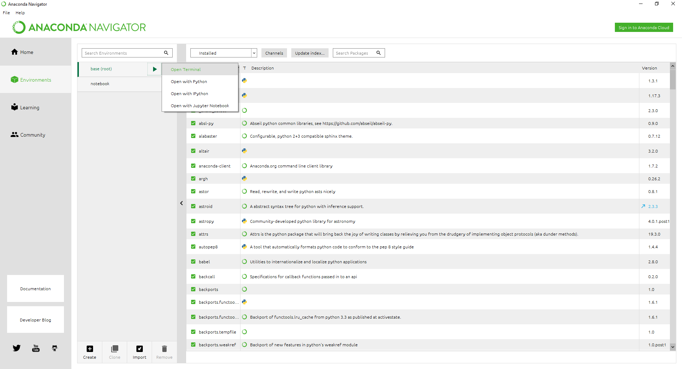
Example - 1
1. Initiate the tool
As a host:
First, make sure streamlit, fbprophet, sktime, tensorflow, and any required packages have been installed in your environment. The open the terminal or cmd for the environment. Personally, I used anaconda.
As a user:
Nothing yet.
*There might be some unexpected issues when there are many users using the app at the same time, so strongly recommend host the app by yourself.
pip install sktime
pip install fbprophet
conda install -c conda-forge tensorflow
pip install streamlit

Slide 2
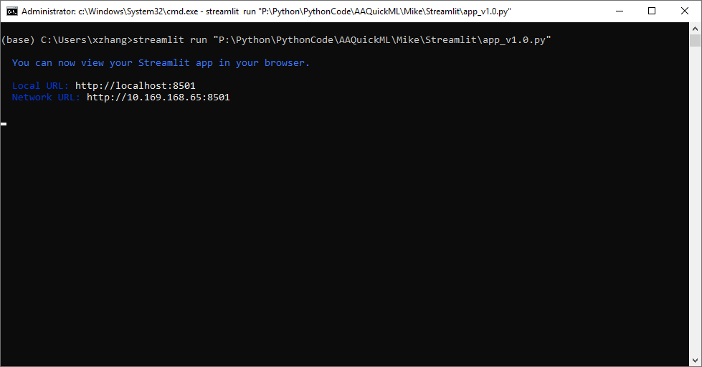
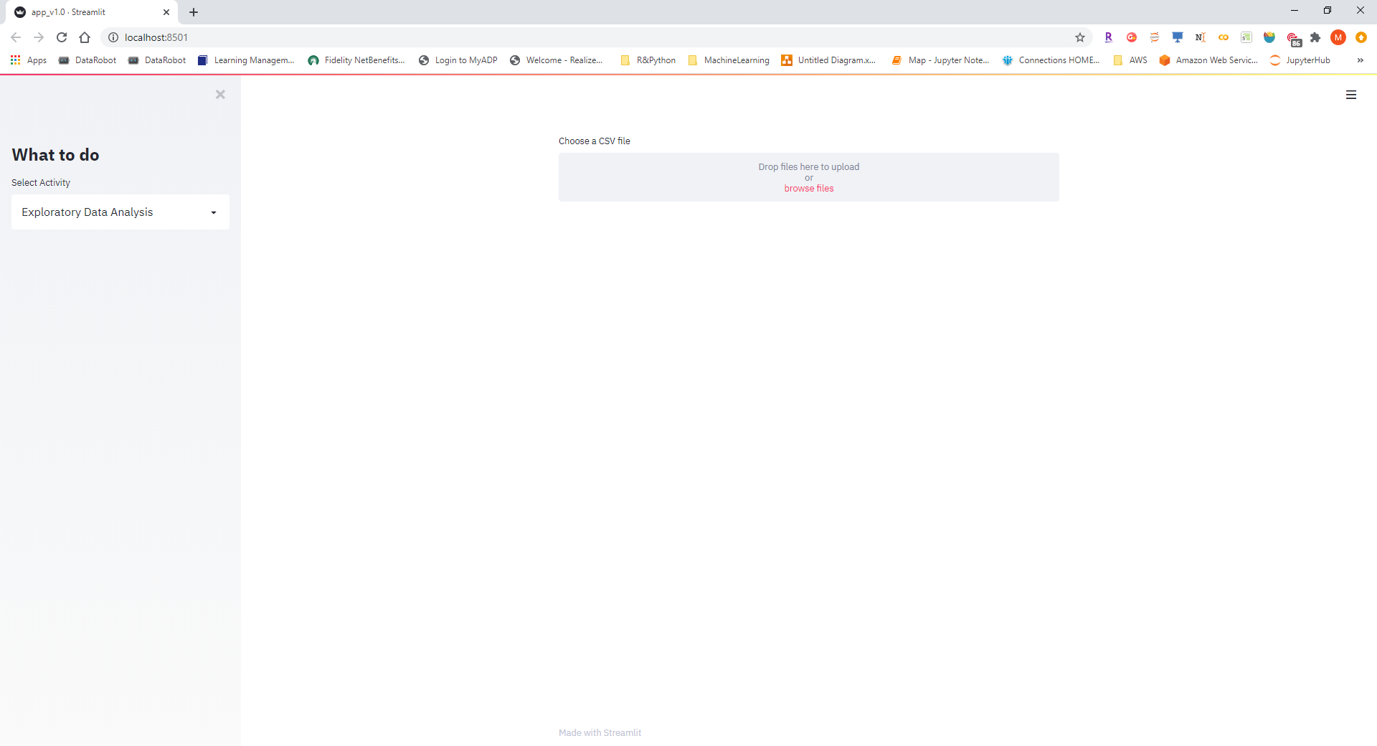
Type in the following command
streamlit run “P:\Python\PythonCode\AAQuickML\Mike\Streamlit\app_v1.0.py”
You should see the below and a browser should automatically open up

Slide 3
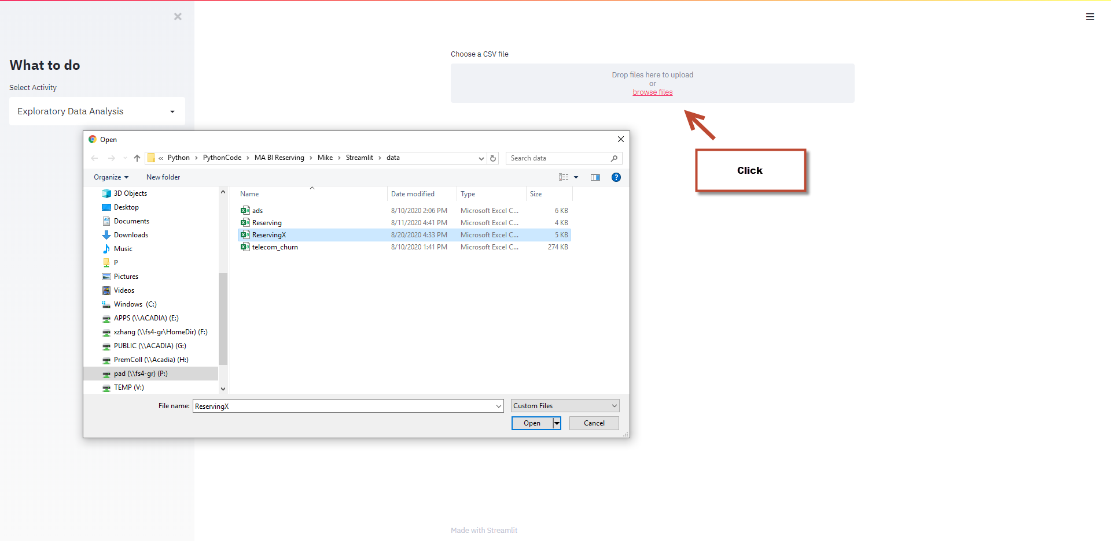
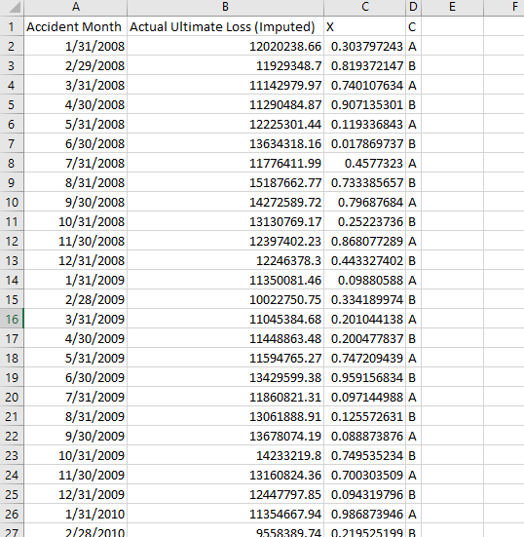
Import any dataset you wish to do your analysis with. As of v1, the app can only scale your data automatically, but data preprocessing will be the focus for the next version. Here, I will just use ReservingX as an example. There are two important columns, time stamps and time series Y.

Slide 4
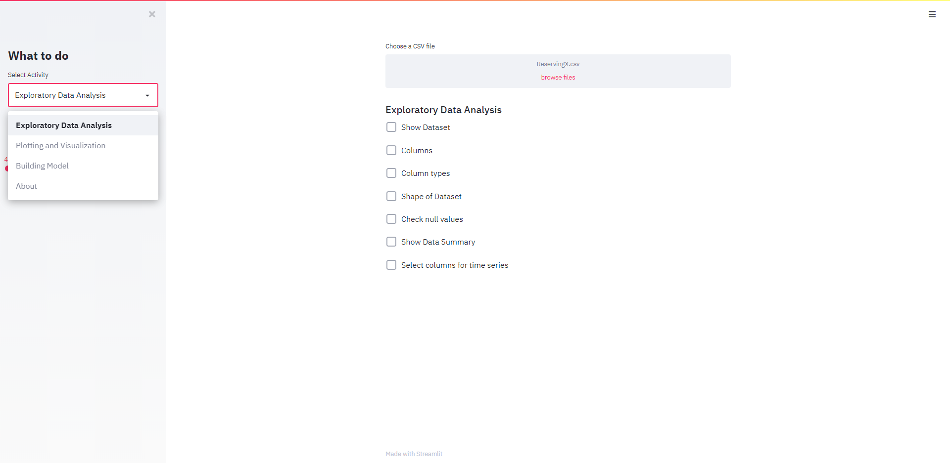
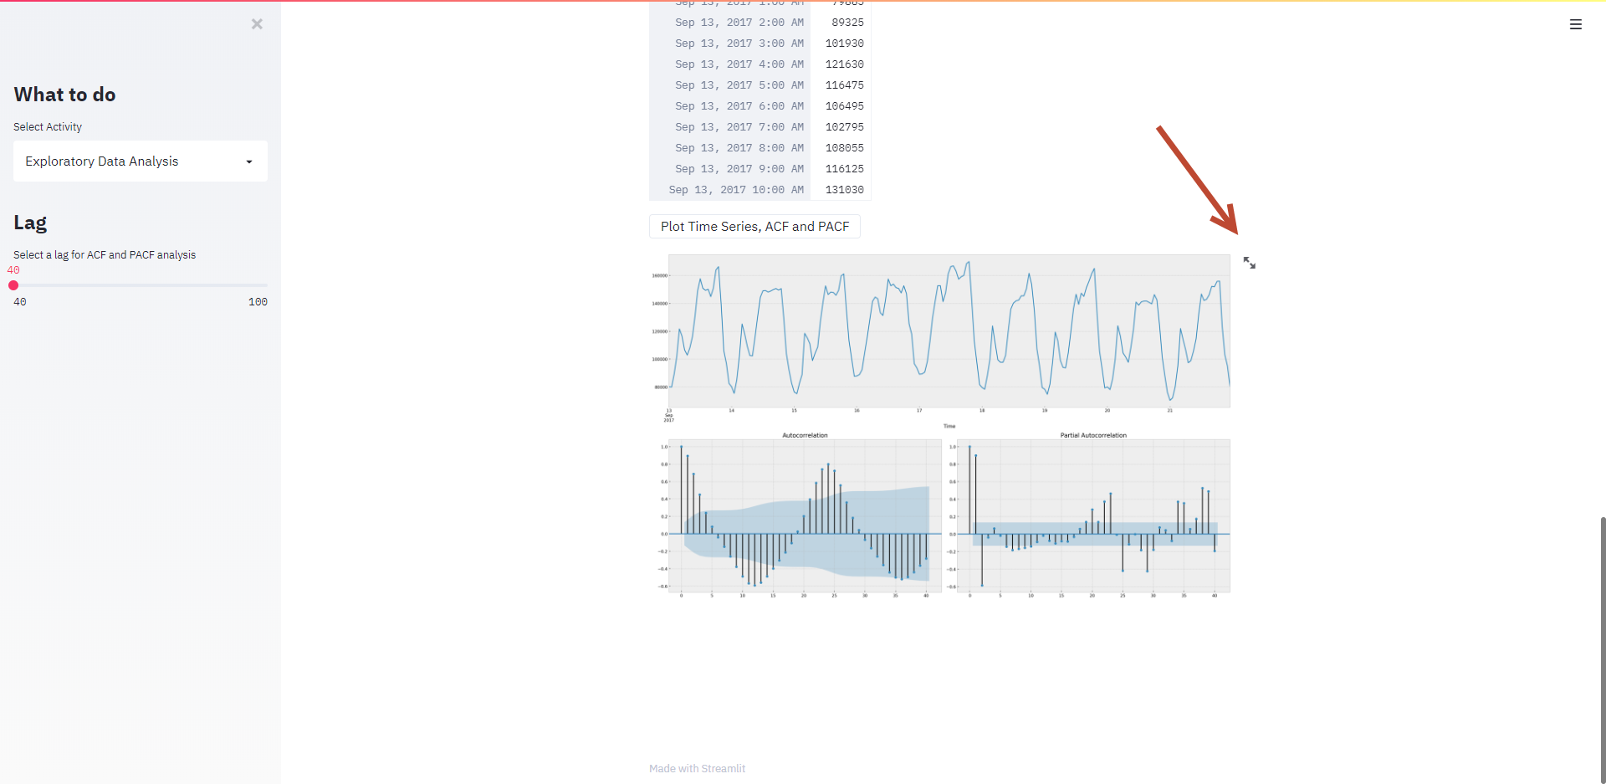
You can start explore your dataset with the app. For the first two options, most of things are quite straight forward. ACF sometimes doesn’t work and is deprecated. ACF helps you determine some parameters in your time series model, but it’s completely automated in the modeling stage.

Slide 5
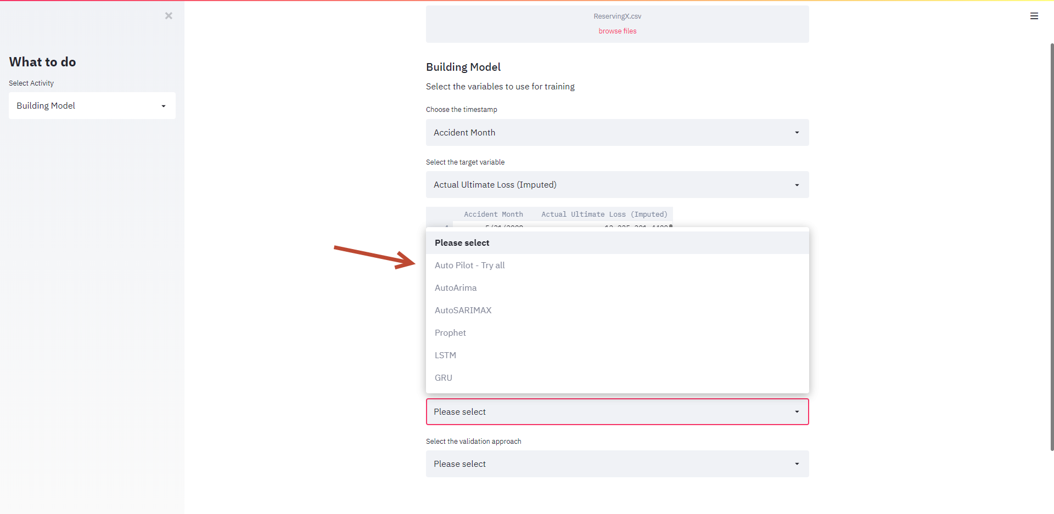
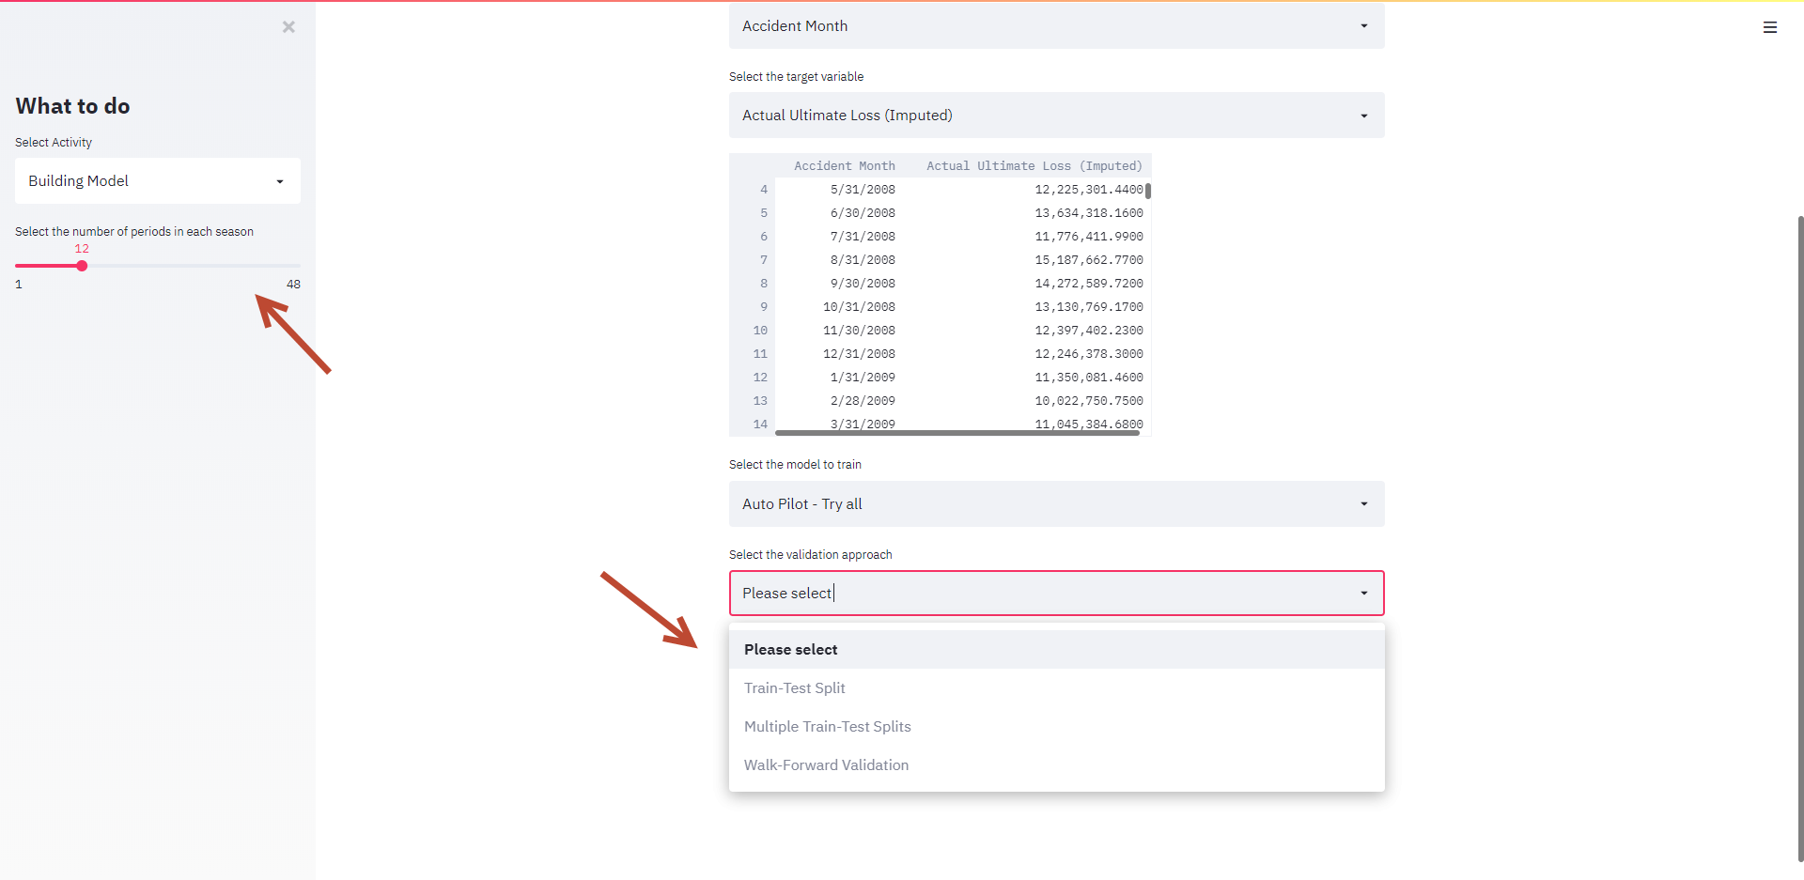
For modeling, please see details in documentation. Here, I will just exhibit Auto Pilot function. Select Auto Pilot, then select number of periods in one season and validation method.

Slide 6
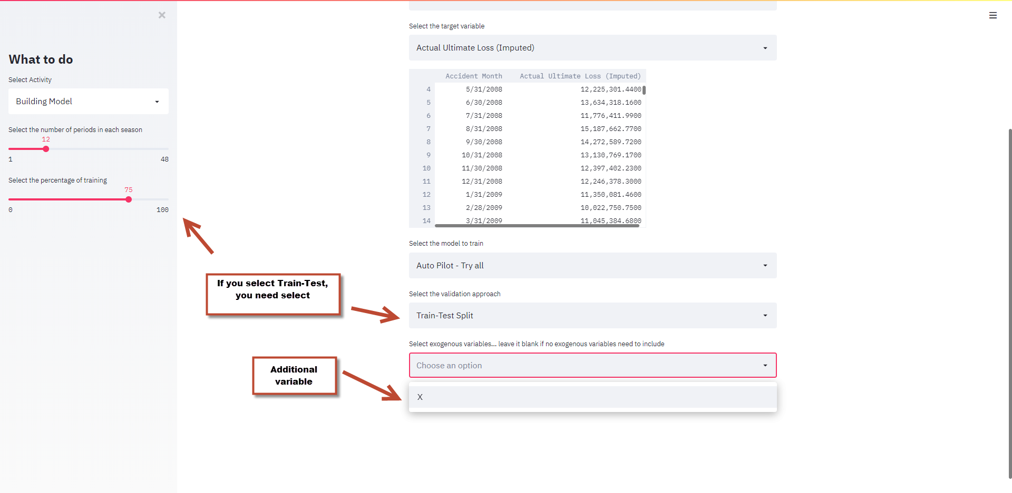
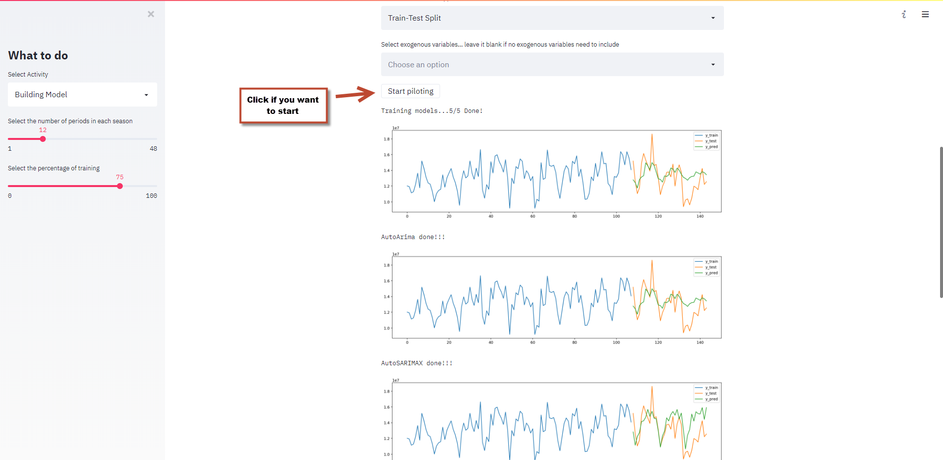
Continue. Different validation methods will need different additional parameters. Just make sure pay attention to the left side. You can also choose any exogenous variables to include or leave it blank if you don’t wish to include any. Hit start button if you are ready to start.

Slide 7
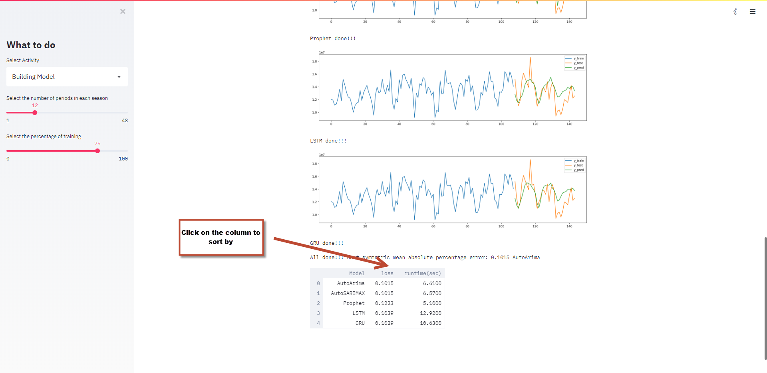
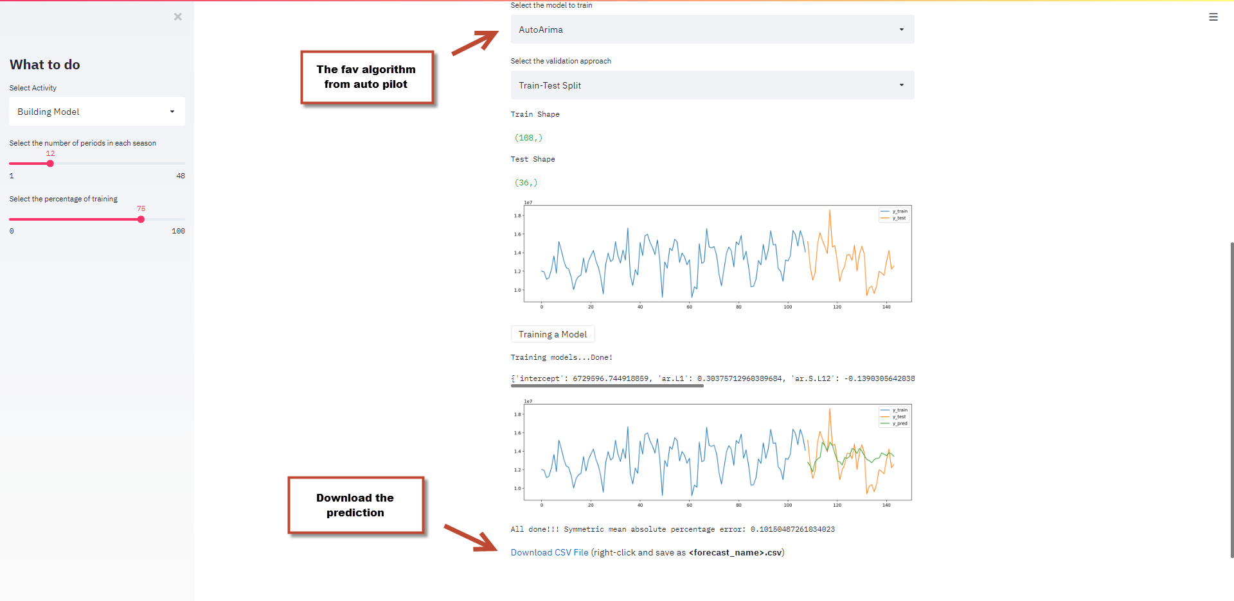
After auto pilot is done, results for each modeling algorithms will show at bottom. Choose the one you like and set it as modeling approach if you wish to do more with it. Other than Auto Pilot, prediction results will be available to download once the models are done.

