Slide 1
HVI: A New Color Space for Low-light Image Enhancement
NYCU Group 2

Slide 2
Motivation

Slide 3
Related work

Slide 4
Methodology

Slide 5
Outline
  - HVI Color Space Construction (Core Ideas)
  - Dual-branch Enhancement Network
  - Perceptual-inverse HVI Transformation

Slide 6
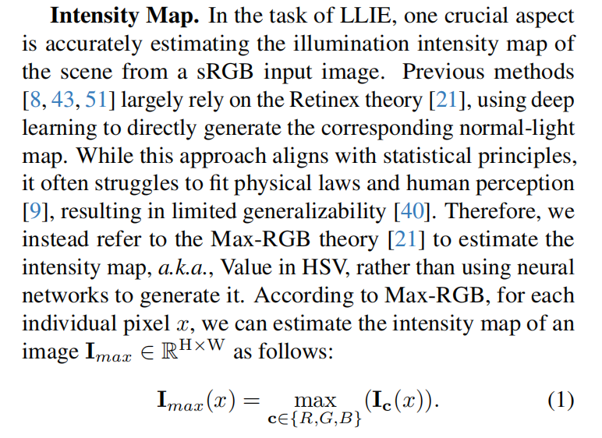
Step 1: Estimate intensity map
HVI Color Space Construction

Slide 7
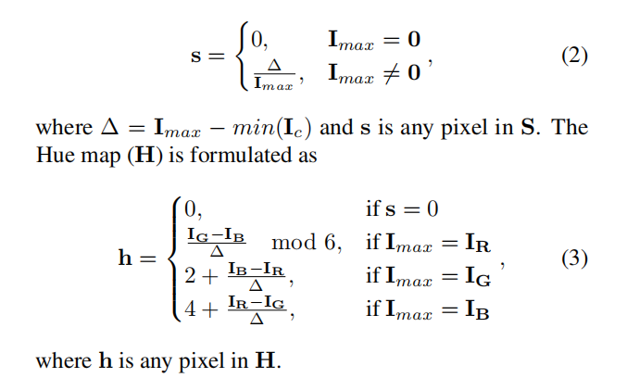
Step 2: Convert to HSV components
Compute H and S as in standard HSV

Slide 8
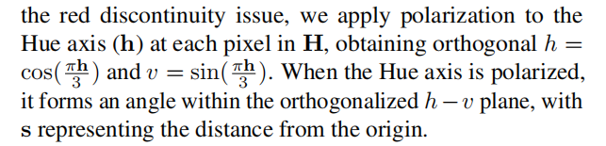

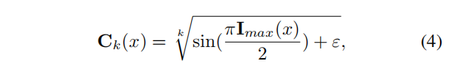
Step 3: Polarize the Hue axis
Step 4: Learnable intensity collapse

Slide 9
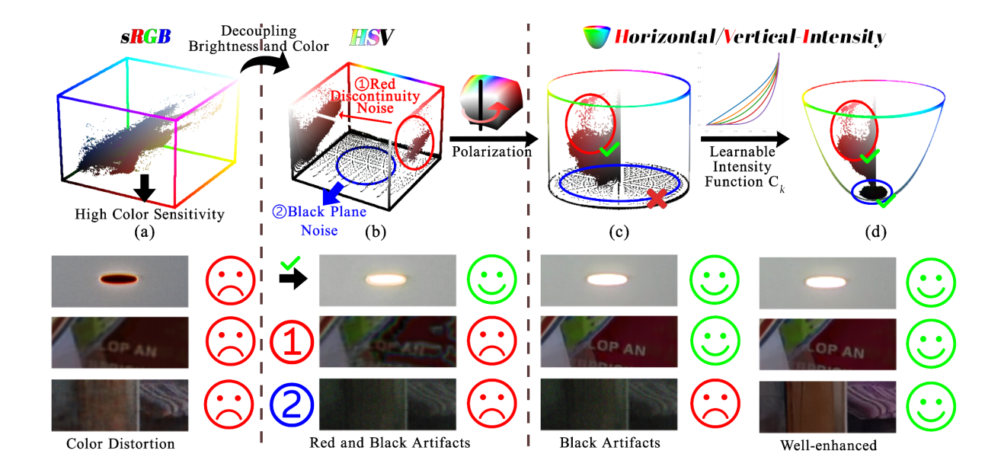

Slide 10

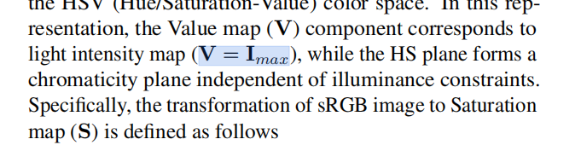
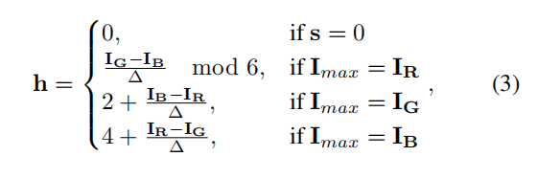
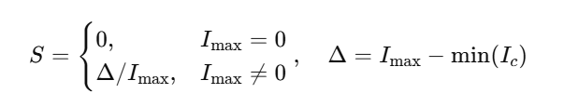


HSV
HVI

Slide 11
Final HVI Representation
HVI image can be represent as

Slide 12
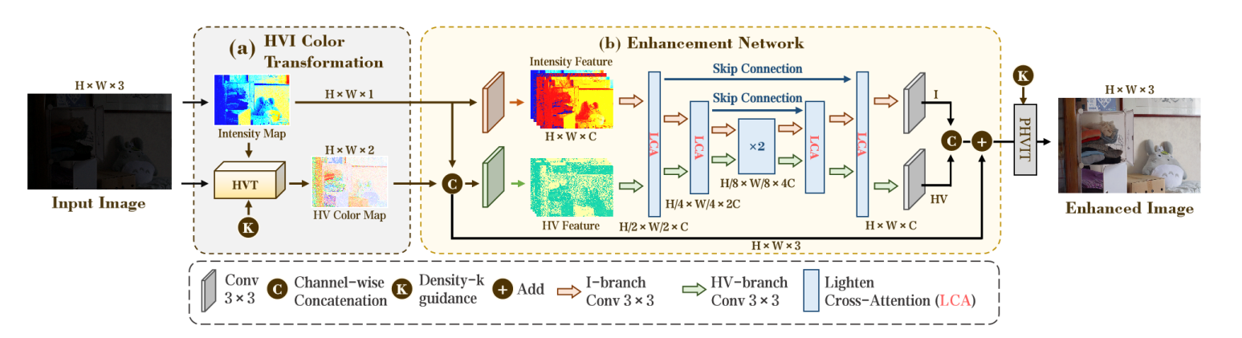
Dual-branch Enhancement Network
HV-branch & I-branch
LCA（Lighten Cross-Attention）

Slide 13
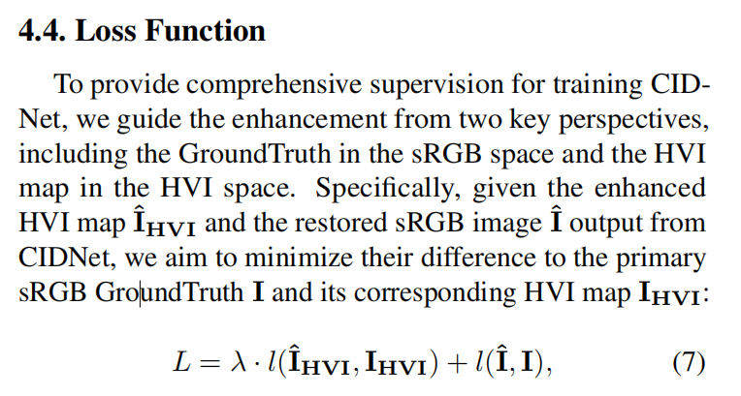
Loss Function

Slide 14

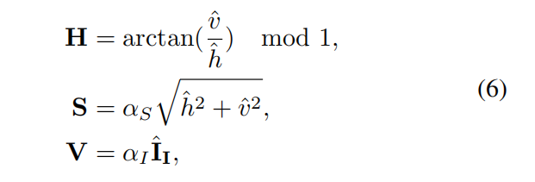
Perceptual-inverse HVI Transformation

Slide 15
Experimental Results

Slide 16
No adaptive k (Base)
Epochs / metric | PSNR(↑) | SSIM(↑) | LPIPS(↓)
10 | 19.287 | 0.723 | 0.257
100 | 21.355 | 0.819 | 0.148
200 | 22.598 | 0.843 | 0.117
300 | 22.64 | 0.846 | 0.1155

Slide 17
Adaptive-k (Proposed)
Epochs / metric | PSNR(↑) | SSIM(↑) | LPIPS(↓)
10 | 19.924 | 0.749 | 0.243
100 | 21.208 | 0.812 | 0.160
200 | 22.134 | 0.834 | 0.122
300 | 22.843 | 0.839 | 0.117

Slide 18
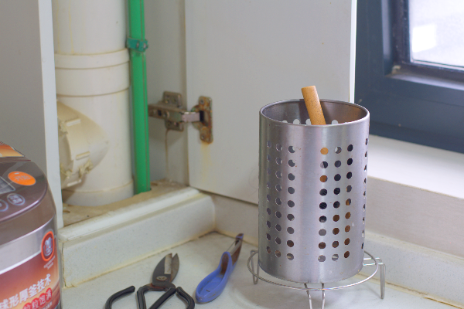
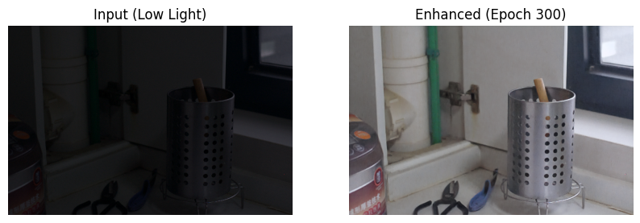
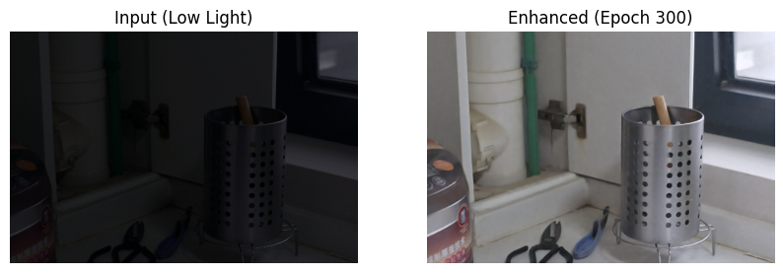
Visualization
No adaptive-k
adaptive-k

Slide 19
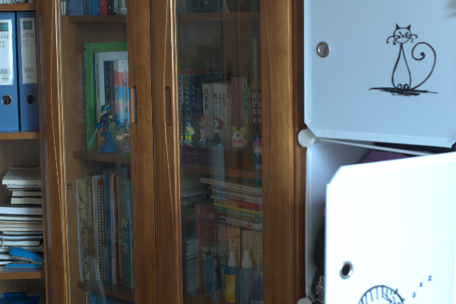
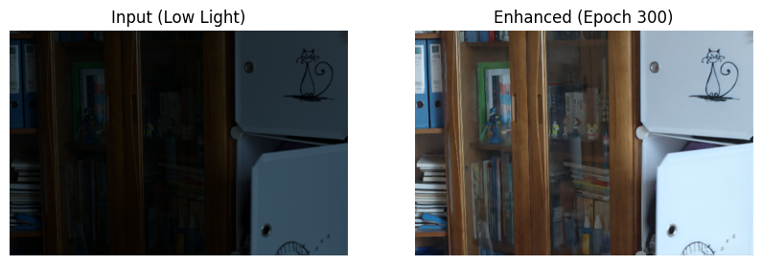
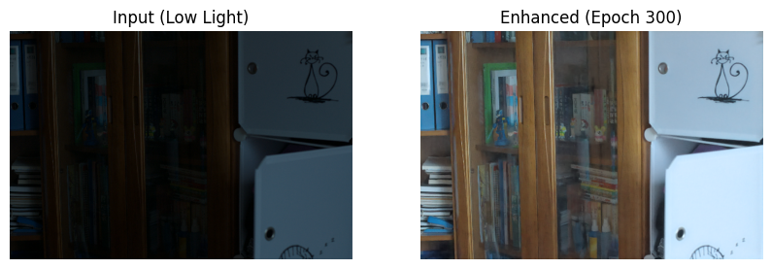
Visualization
No adaptive-k
adaptive-k

