Slide 1
REVISION
What is the advantage of using code-behind pages when adding functionality to a Web Form?
How is a code-behind page associated with an .aspx page?
List the three ways you can add code to an ASP.NET page.
When does a form post back to itself?
How can you determine through code if the Page_Load event is being run as a result of a postback?

Slide 2
Creating a Component by using Visual Studio 2010

Slide 3
When you use an object-oriented language to develop an application, you can use existing classes and components.
You can use Visual Studio 2010 to create a component and use it in other applications.

Slide 4
What are Classes and Component?

Slide 5
Class Definition
Classes are groups of code statements that have no UI.
Classes provide functionality in an application.
You can use classes to organize functions and give them a single name by which they are referenced.
Classes also have properties and methods.
Properties are the way that you set the characteristics of a class and methods are the way that you invoke the actions of a class.
When you want to use a class and its methods, you instantiate an instance of the class.

Slide 6
Component Definition
Components are classes that are compiled into a DLL file.
Because the component is its own file, you can REUSE it in different parts of an application.
You can reference a component from an application by using the component's namespaces and class names.

Slide 7
SIMPLE REVISION ON OOP CONCEPTS
An object has a unique identity, state, and behaviors.
The state of an object consists of a set of data fields (also known as properties) with their current values.
The behavior of an object is defined by a set of methods.

Slide 8
Objects of the same type are defined using a common class
A class is a template or blueprint that defines what an object’s data and method will be
An object is an instance of a class
You can create many instances/objects of a class
Creating an instance is referred to as INSTANTIATION

Slide 9
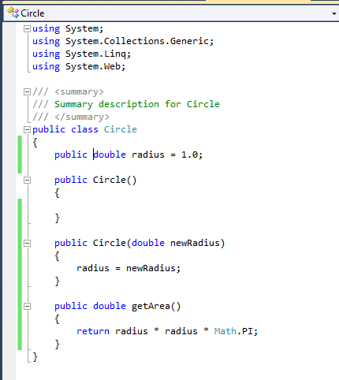
CLASSES
Data Field
Constructors
Method

Slide 10
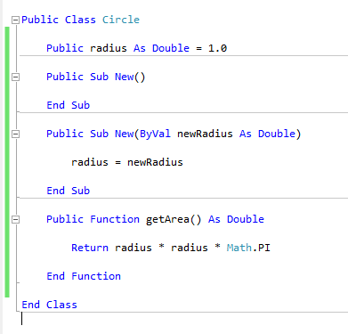

Slide 11
C# class uses
variables to define DATA FIELDS
methods to define BEHAVIOURS
A class provides methods of special type, known as CONSTRUCTORS which are invoked when a new object is created

Slide 12
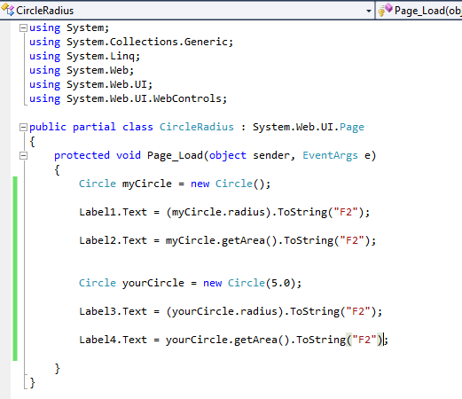

Slide 13
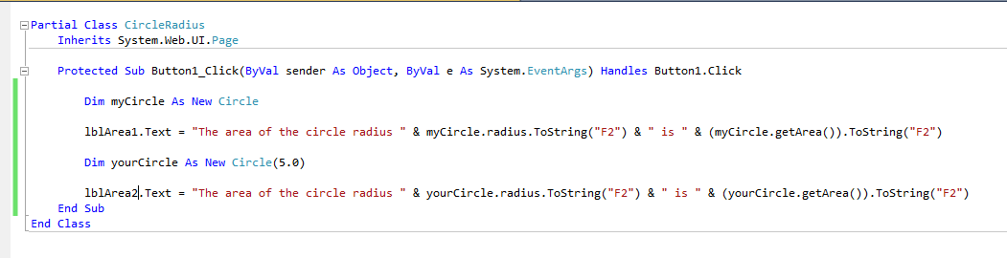

Slide 14
Creating a Class

Slide 15
Definition
A class is a template for an object.
This template defines attributes for storing data and defines operations for manipulating that data.
A class also defines a set of restrictions that you can use to allow or deny access to its attributes and operations.

Slide 16
Creating a New Class
You can create a class in any Visual Studio 2010 project.
You can also create a new class library, which contains only the class and its methods but no UI (windows or forms).
If you create a class in an existing project, the class exists in the project namespace.
If you create a new class library, Visual Studio 2010 creates a default namespace and places that new class in that namespace.

Slide 17
