Slide 1
Introduction to HTML
Outline
Introduction
Editing HTML
First HTML Example
W3C HTML Validation Service
Headers
Linking
Images
Special Characters and More Line Breaks
Unordered Lists
Nested and Ordered Lists
Web Resources

Slide 2
Objectives
In this chapter, you will learn:
To understand important components of HTML documents.
To use HTML to create Web pages.
To be able to add images to Web pages.
To understand how to create and use hyperlinks to navigate Web pages.
To be able to mark up lists of information.

Slide 3
1 Introduction
  HTML = HyperText Markup Language
  A markup language
  Separation of the presentation of a document from the structure of the document’s information
  Technology of the World Wide Web Consortium (W3C)

Slide 4
2 Editing HTML
  HTML documents are in source-code form
  It can be edited by using a text editor (e.g. Notepad, Wordpad, emacs, etc. EditPlus text editor is included in IPositif CD)
  .html or .htm file-name extension
  Web server: Stores HTML documents
  Web browser: Requests HTML documents

Slide 5
3 First HTML Example
  HTML Comments: start with <!-- and end with -->
  html element: <html>
    head element: <head>
      Head section of HTML document
      Title of the document
      Style sheets and scripts
    body element: <body>
      Body section of HTML document
      Page’s content the browser displays
  Start tag
  End tag

Slide 6
<!-- Fig. 4.1: main.html -->
<!-- Our first Web page -->
<html>
<head>
</head>
<body>
</body>
</html>
Comments
Head section
Start tag
Body section
end tag

Slide 7
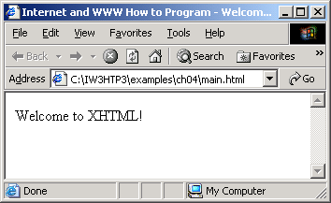
Example1: First HTML example: main.html
<!-- Fig. 4.1: main.html -->
<!-- Our first Web page -->
<html>
<head>
<title>Internet and WWW How to Program - Welcome</title>
</head>
<body>
<p>Welcome to XHTML!</p>
</body>
</html>

Slide 8
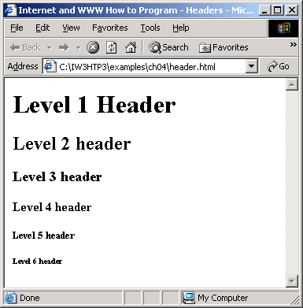
5 HTML Header Elements
<body>
<h1>Level 1 Header</h1>
<h2>Level 2 header</h2>
<h3>Level 3 header</h3>
<h4>Level 4 header</h4>
<h5>Level 5 header</h5>
<h6>Level 6 header</h6>
</body>
Six headers ( header elements): h1 through h6
Example2: Headers elements h1 trough h6: header.html

Slide 9
6 Linking
Linking is done through Hyperlink
  References other sources such as HTML documents and images
  Both text and images can act as hyperlinks
Created using the a (anchor) element
  Attribute href: specifies the location of a linked resource
  Link to e-mail addresses using mailto: URL
<strong> tag is use to create a bold text

Slide 10
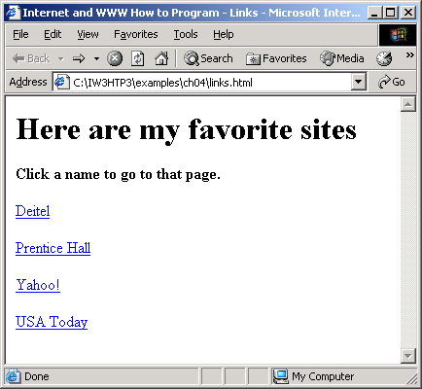
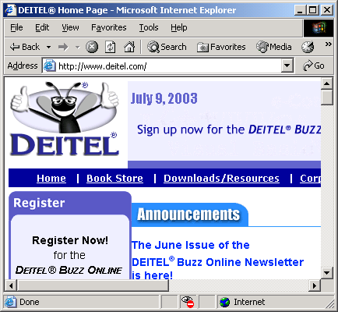
Example3: Linking to other Web pages: links.html
<body>
<p><a href = "http://www.deitel.com">Deitel</a></p>
<p><a href = "http://www.prenhall.com">Prentice Hall</a></p>
<p><a href = "http://www.yahoo.com">Yahoo!</a></p>
<p><a href = "http://www.usatoday.com">USA Today</a></p>
</body>
User click

Slide 11
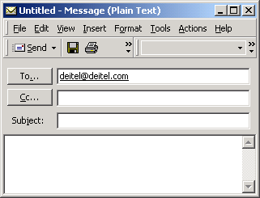
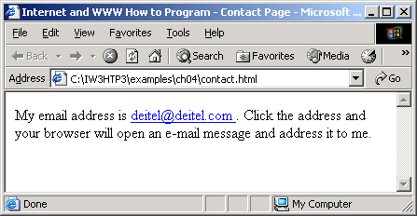
Example 4: Linking to an e-mail address: contact.html
<p>
My e-mail address is
<a href = "mailto:deitel@deitel.com"> deitel@deitel.com</a>
. Click the address and your browser will
open an e-mail message and address it to me.
</p>
Email Client Application

Slide 12
7 Images
Three most popular formats
  Graphics Interchange Format (GIF)
  Joint Photographic Experts Group (JPEG)
  Portable Network Graphics (PNG)
Image element: <img />
  src attribute: specifies the location of the image file
  width and height attribute: measure in pixels (picture elements)
Empty elements
  Terminated by character / inside the closing right angle bracket (>), or by explicitly including the end tag

Slide 13
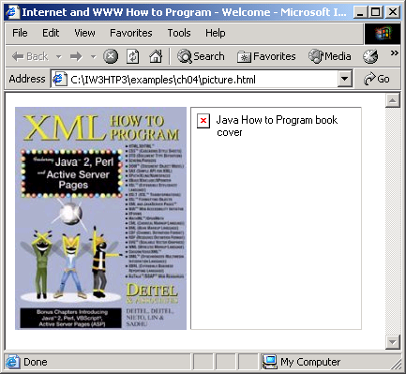
Example 5: Images in XHTML files: picture.html
<p>
<img src = "xmlhtp.jpg" height = "238" width = "183"
alt = "XML How to Program book cover" />
<img src = "jhtp.jpg" height = "238" width = "183"
alt = "Java How to Program book cover" />
</p>
Image jhtp.jpg not available

Slide 14
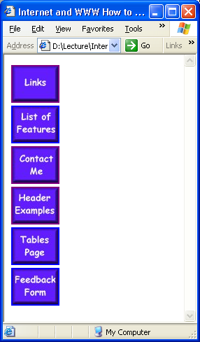
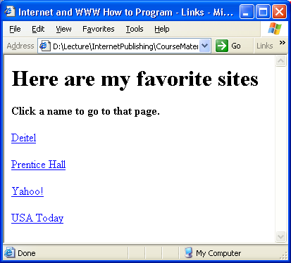
Example 6: Images as link in anchors: nav.html
<a href = "links.html">
<img src = "buttons/links.jpg" width = "65"
height = "50" alt = "Links Page" />
</a><br />
<a href = "list.html">
<img src = "buttons/list.jpg" width = "65"
height = "50" alt = "List Example Page" />
</a><br />
.
.
.
.
links.html

Slide 15
8 Special Characters and More Line Breaks
Character entity references (in the form &code;)
Numeric character references (e.g. &#38;)
del: Strike-out text
sup: superscript text
sub: subscript text
<hr />: Horizontal rule (horizontal line)

Slide 16
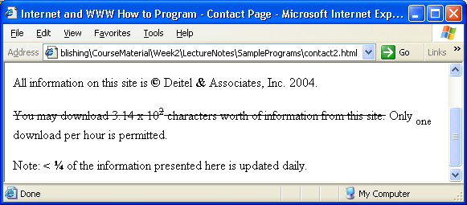
Example 7: Special characters in HTML: contact2.html
<hr /> <!-- inserts a horizontal rule -->
<p>All information on this site is <strong>&copy;</strong>
Deitel <strong>&amp;</strong> Associates, Inc. 2004.</p>
<p><del>You may download 3.14 x 10<sup>2</sup> characters worth of
information from this site.</del> Only <sub>one</sub> download per hour is
permitted.</p>
<p>Note: <strong>&lt; &frac14;</strong> of the information presented here is
updated daily.</p>.

Slide 17
9 Unordered Lists
Unordered list element: ul
Creates a list in which each item begins with a bullet symbol (called a disc)
li (list item)
  Entry in an unordered list

Slide 18
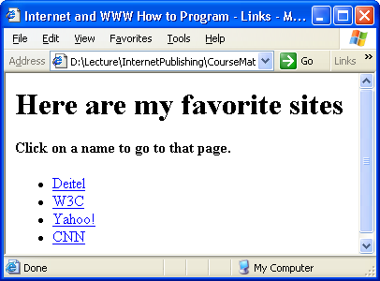
Example 8: Unordered lists in HTML: links2.html
<ul>
<li><a href = "http://www.deitel.com">Deitel</a></li>
<li><a href = "http://www.w3.org">W3C</a></li>
<li><a href = "http://www.yahoo.com">Yahoo!</a></li>
<li><a href = "http://www.cnn.com">CNN</a></li>
</ul>
add four list items

Slide 19
10 Nested and Ordered Lists
Represent hierarchical relationships
Ordered lists: ol
  Creates a list in which each item begins with a number

Slide 20
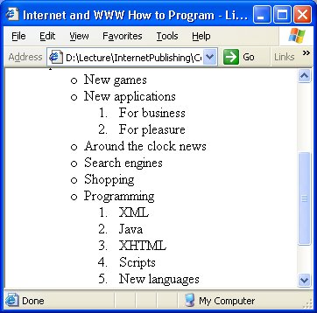
<ul>
<li>New games</li>
<li>New applications
<ol>
<li>For business</li>
<li>For pleasure</li>
</ol>
</li>
<li>Around the clock news</li>
<li>Search engines</li>
<li>Shopping</li>
<li>Programming
<ol>
<li>XML</li>
<li>Java</li>
<li>XHTML</li>
<li>Scripts</li>
<li>New languages</li>
</ol>
</li>
</ul>
Example 9: Nested and ordered lists in HTML: list.html
nested ordered list
Another nested ordered list

Slide 21
11 Web Resources
www.w3.org/TR/xhtml11
www.xhtml.org
www.w3schools.com/xhtml/default.asp
validator.w3.org
hotwired.lycos.com/webmonkey/00/50/index2a.html
wdvl.com/Authoring/Languages/XML/XHTML
www.w3.org/TR/2001/REC-xhtml11-20010531

