Slide 1
Module 6:
Tracing in Microsoft ASP.NET Web Applications

Slide 2
Tracing
It is difficult, its not impossible, to catch every possible error in code when you first develop the Web application
Errors can either be
  compile-time errors
    found by compiler
  run-time errors
    can use debugger, the Trace object or the Debug object

Slide 3
Objectives
Use the Trace object to view runtime information about a Web application

Slide 4
Understanding Tracing
Runtime Information
Enabling Tracing
Using the Trace Object
Viewing Trace Results
Using Application-Level Trace

Slide 5
Introduction
Tracing means receiving informative messages about the execution of a Web application at runtime
These informative messages from the running Web application can help diagnose problems or analyze performance
MS VS .NET offers 2 objects that can be used for gathering such information during runtime
  DEBUG object
  TRACE object

Slide 6
Runtime Information
During runtime, you can:
  Output values of variables
  Assert whether a condition is met – logic errors
  Trace through the execution path of the application
You can collect runtime information using:
  The Trace object
  The Debug object

Slide 7
Runtime
You can collect information while your Web application is running by using the Debug and Trace objects
Types of information
  During runtime
    Output values of variables
    Determine whether certain conditions have been met (e.g. there is Trace.WriteIf method that only outputs a message of the condition is met)
    Follow the execution path of the application (to ensure that processing is occurring properly)

Slide 8
Runtime objects
TRACE
  Enables you to display information on a Web page or save it in memory
  Tracing can be enabled and disabled by changing a single setting in the Web.config file
  You just remove the trace statements on a production server

Slide 9
Runtime objects
DEBUG
  To output debugging information
  Will only run when they are compiled in debug mode and when the Web application is run in the debugger
  If you create a release build, the statements will not run
  Messages are displayed in the Output window of the debugger
  To print debugging information and check logic → you can make your code more stable without impacting the final product’s performance or code size

Slide 10
Enabling Tracing
Page-level tracing displays trace statements only on the configured page
Enabling page-level tracing
Application-level tracing displays trace information for all pages in a Web application
Enabling application-level tracing in the Web.config file
<%@ Page Language="vb" Trace="true" %>
<%@ Page Language="c#" Trace="true" %>
<trace enabled="true" pageOutput="true"
localOnly="true"/>

Slide 11
Page-level Tracing
All trace message are appended to the end of the Web page
Allows you to quickly view trace messages at the same time that you are viewing the Web page
After tracing is enabled, all Trace.Write statements in your code will appear on the page
When you are finished using trace, you can disable trace rather than removing all Trace.Write statements from your code

Slide 12
Application-level Tracing
When you enable application-level tracing, you enable tracing for all of the pages in the Web application
Allows you more flexibility in writing trace statements
You can write trace messages to the page or to memory
Saved to memory are accessible by the application-level trace viewer, trace.axd

Slide 13
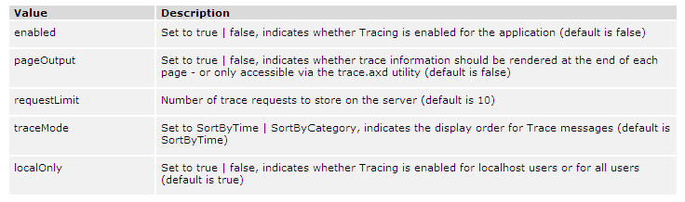
Enabling Tracing

Slide 14
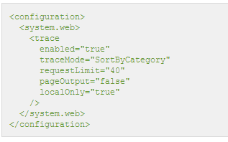
Enabling Tracing

Slide 15
TRACE object
To write trace messages on a page (or in memory), you use the Trace.Write and Trace.Warn methods
You can use the IsEnabled property of the Trace object to dynamically change the state of tracing in a page

Slide 16
Using the Trace Object
Inserting trace messages
Conditional execution with Trace.IsEnabled
Trace.Write ("category", "message")
Trace.Warn ("category", "message")
If Trace.IsEnabled Then
strMsg = "Tracing is enabled!"
Trace.Write("myTrace", strMsg)
End If
if (Trace.IsEnabled)
{
strMsg = "Tracing is enabled!";
Trace.Write("myTrace", strMsg);
}

Slide 17
Using the Trace Object
Dynamically change state of trace
Trace.IsEnabled = False
Dynamically change state of trace

Slide 18
Trace.Write & Trace.Warn
You use the Write and Warn methods of the Trace object to output trace messages
Trace.Write and Trace.Warn work exactly the same way, except that Warn writes trace messages in the color red
When using the Write and Warn methods, you provide a message to be written, along with a corresponding category for the message, as shown in the following code:
Trace.Write (“Custom Trace”, “Beginning User Code ...”)
Trace.Warn (“Custom Trace”, “Array count is null!”)

Slide 19
Trace.IsEnabled
There are situations when you may want to generate trace messages only when tracing is enabled for Web page or Web application
For these situations, the Trace object has a Boolean property named IsEnabled that allows you to call the Write and Warn methods only when tracing is enabled

Slide 20
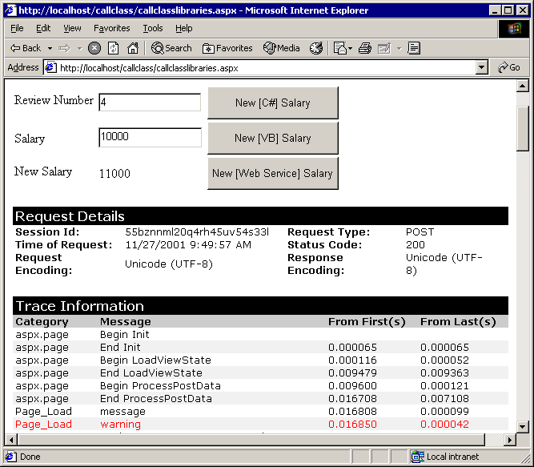
Viewing Trace Results

Slide 21
Using Application-Level Trace
Page
Application
Result
Application-level trace statements are displayed on individual pages
Set pageOutput=false in the Web.config file and trace results are viewable by trace viewer
Trace=True
Trace=True or Trace=False
Trace results are displayed on page
Trace=False
Trace=True or Trace=False
Trace results are not displayed
Trace not set
Trace=True
Trace results are displayed on page
http://server/project/trace.axd

Slide 22
Review
Understanding Tracing

Slide 23
Exercise
What is the difference between using the Trace object and using the Debug object?
What is the difference between page level tracing and application level tracing?
How do you enable application level tracing?
How do you configure trace so that trace information is visible only to local users of your web site?

Slide 24
Exercise
Read the following scenarios and determine whether trace messages will be displayed or not?
a. Trace turned on in Default.aspx but off in Web.config. View Default.aspx.
b. Trace turned off in Default.aspx but on in Web.config.
View Default.aspx.
c. Trace turned on in Default.aspx but off in Web.config. View Default2.aspx.
d. Trace turned on in Default.aspx but on in Web.config. View Default2.aspx.

Slide 25
~ End of Slides ~

