Slide 1
Module 7:
Validating User Input

Slide 2
Overview
Overview of User Input Validation
Using Validation Controls
Page Validation

Slide 3
Lesson:
Overview of User Input Validation
What Is Input Validation?
Client-Side and Server-Side Validation
ASP.NET Validation Controls

Slide 4
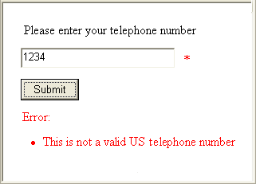
What Is Input Validation?
Def : A process of verifying that a user’s input on a web form matches the expected data value, range or format.
Works by comparing user input against a predetermined input format.
Verifies that a control value is correctly entered by the user
Blocks the processing of a page until all controls are valid
Avoids spoofing
or the addition of
malicious code

Slide 5
Client-Side and Server-Side Validation
ASP.NET can create both client-side and server-side validation
Client-side validation
  Dependent on browser version
  Instant feedback
  Reduces postback cycles
  Uses JavaScript and DHTML
Server-side validation
  Repeats all client-side validation
  Can validate against stored data
  Server side validation control
User Enters
Data
Error
Message
Valid?
No
Client
Yes
Server
Valid?
No
Yes
Web Application
Processed

Slide 6
ASP.NET Validation Controls
ASP.NET provides validation controls to:
Compare values
Compare to a custom formula
Compare to a range
Compare to a regular expression pattern
Require user input
Summarize the validation controls on a page

Slide 7
ASP.NET Validation Controls
ASP.NET provides validation controls to:
Compare values – Compares an input control to another input control. Eg: Password verification fields.(CompareValidator)
Compare to a custom formula – Allows you to write your own code to create the validation expression. (CustomValidator)
Compare to a range – Verifies that the user input is between two values or the values of other input controls. (RangeValidator)
Compare to a regular expression pattern – Verifies that the entry matches a pattern that has been defined by a regular expression. (RegularExpressionValidator)

Slide 8
ASP.NET Validation Controls
Require user input – checks whether a value has been entered on the control.
( RequiredFieldValidator )
Summarize the validation controls on a page – Display a summary of all of the validation errors on the page. Typically placed naer the Submit button to provide immediate feedback on the page input status. ( ValidationSummary )

Slide 9
Lesson:
Using Validation Controls
Adding Validation Controls to a Web Form
Positioning Validation Controls on a Web Form
Combining Validation Controls
Input Validation Controls
Using the RegularExpressionValidator Control
Using the CustomValidator Control

Slide 10
Adding Validation Controls to a Web Form
Add a validation control
Select the input control to validate
Set validation properties
<asp:TextBox id="txtName" runat="server" />
<asp:Type_of_Validator
id="Validator_id"
runat="server"
ControlToValidate="txtName"
ErrorMessage="Message_for_error_summary"
Display="static|dynamic|none"
Text="Text_to_display_by_input_control">
</asp:Type_of_Validator>

Slide 11
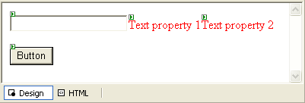
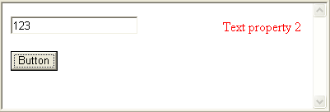
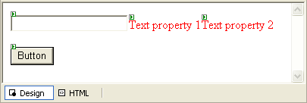
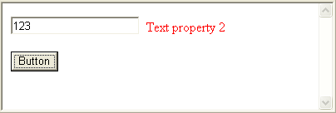
Positioning Validation Controls on a Web Form
Create error messages
Select display mode
  Static:
  fixed layout for the error page
  Dynamic
  Enables validation controls to render in the page as part of the text flow

Slide 12
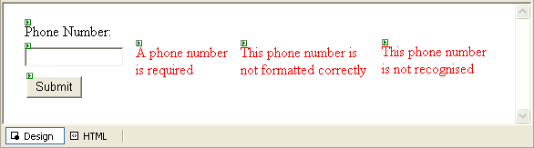
Combining Validation Controls
Can have multiple validation controls on a single input control
Only the RequiredFieldValidator checks empty controls

Slide 13
Input Validation Controls
RequiredFieldValidator
  InitialValue
CompareValidator
  ValueToCompare or ControlToCompare
  Type
  Operator
RangeValidator
  MinimumValue
  MaximumValue
  Type
Code Examples

Slide 14
Using the RegularExpressionValidator Control
Used when input must conform to a pre-defined pattern
Visual Studio .NET includes patterns for:
  Telephone numbers
  Postal codes
  E-mail addresses
<asp:RegularExpressionValidator …
ControlToValidate="US_PhoneNumber"…
ValidationExpression="((\(\d{3}\) ?)|(\d{3}-))?\d{3}-\d{4} "
…>*</asp:RegularExpressionValidator >

Slide 15
Demonstration: Using Validation Controls
Create an ASP.NET Web Form with TextBox and Button controls
Add a RequiredFieldValidator control
Add a RangeValidator control
Add a RegularExpressionValidator control

Slide 16
Using the CustomValidator Control
Can validate on client-side, server-side, or both
  ClientValidationFunction
  OnServerValidate
Validate with:
  Formula
  Data
  COM objects
  Web Service

Slide 17
Demonstration: Using the CustomValidator Control
Add a CustomValidator control
Write the server-side code
Write the client-side script
Test the result

Slide 18
Lesson: Page Validation
Using the Page.IsValid Property ( Server-side verification )
Using the ValidationSummary Control ( Client-side verification )
Demonstration: Using the Page.IsValid Property and the ValidationSummary Control
.NET enables you to verify that all of the controls on a page are valid before the controls perform some action.
The verification of validity can be conducted on either client or server, depending on the browser being used.

Slide 19
Using the Page.IsValid Property
Polls all validation controls
Sub cmdSubmit_Click(s As Object, e As EventArgs)
If Page.IsValid Then
Message.Text = "Page is valid!"
' Perform database updates or other logic here
End If
End Sub
private void cmdSubmit_Click(object s, System.EventArgs e)
{ if (Page.IsValid)
{ Message.Text = "Page is Valid!";
// Perform database updates or other logic here
}
}

Slide 20
Using the ValidationSummary Control
Collects error messages from all validation controls on the page
Can display text and error messages
Use Text="*" to indicate the location of the error
<asp:ValidationSummary id="valSummary"
runat="server"
HeaderText="These errors were found:"
ShowSummary="True"
DisplayMode="List"/>

Slide 21
Review
Overview of User Input Validation
Using Validation Controls
Page Validation

Slide 22
~ End of Slides ~

