Slide 1
MNIST Handwritten Digit Recognition
Comparing MLP · CNN · Transformer
Assignment 4.1 | Ziru Xu

Slide 2
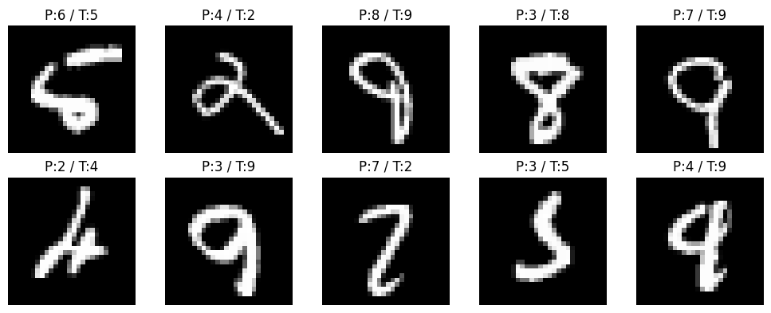
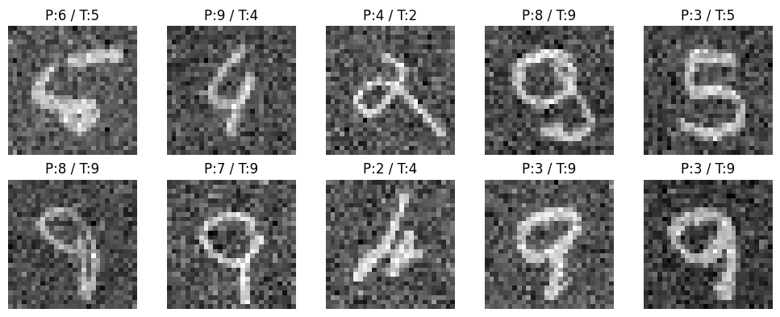
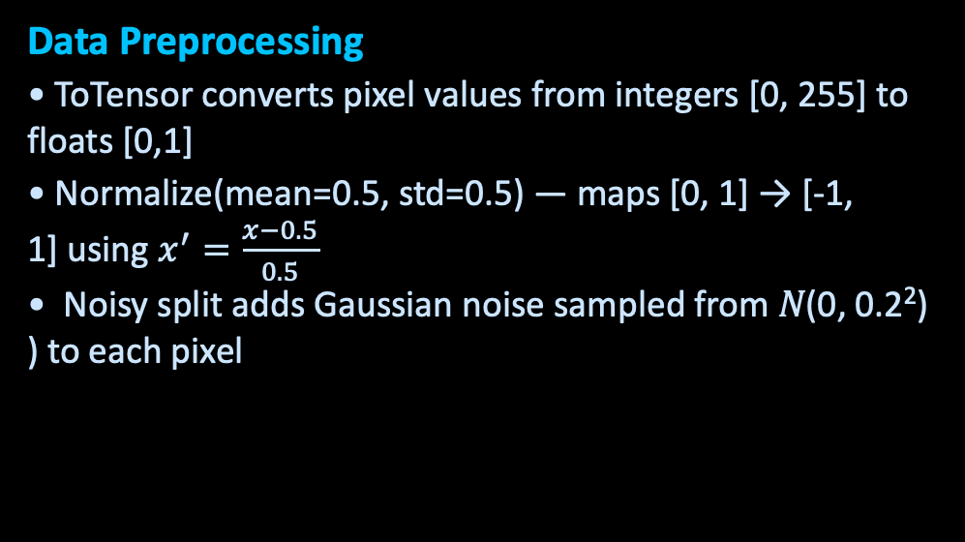
Problem & Dataset
The Problem & Dataset
• Classify handwritten digits 0-9
• MNIST: 60,000 train / 10,000 test images
• Image size: 28 × 28 grayscale pixels
• 10 classes (digits 0 through 9)
Sample Digits
Data Preprocessing
• ToTensor converts pixel values from integers [0, 255] to floats [0,1]
• Normalize(mean=0.5, std=0.5) — maps [0, 1] → [-1, 1] using $x^{′}=\frac{x−0.5}{0.5}$ • Noisy split adds Gaussian noise sampled from 𝑁(0, 0.2²) ) to each pixel
Clean vs Noisy

Slide 3
Model 1 — Multi-Layer Perceptron (MLP)
Overview - No spatial awareness — pixels treated independently
• The Multi-Layer Perceptron (MLP) is a fully connected neural network that processes input data as a one-dimensional vector.Since an MLP cannot directly handle 2D spatial structure, the image is first flattened into a vector of length 784 (28 × 28).
• Simple, fast baseline
Hyperparameters
Hyperparameter | Value
Optimizer | Adam
Learning rate | 1e-3
Loss function | CrossEntropyLoss
Epochs | 5
Layer | Calculation | Params
Linear(784 → 256) | 784×256 + 256 | 200,960
Linear(256 → 128) | 256×128 + 128 | 32,896
Linear(128 → 10) | 128×10 + 10 | 1,290
235,146 parameters
Flatten step: 28×28 → 784-dim vector
Input 784
Hidden 1 256 ReLU
Hidden 2 128 ReLU
Output 10 classes
→
→
→
Notes:
The Multi-Layer Perceptron (MLP) is a fully connected neural network that processes input data as a one-dimensional vector.
For the MNIST dataset, each image has a size of 28 × 28 pixels. Since an MLP cannot directly handle 2D spatial structure, the image is first flattened into a vector of length 784 (28 × 28).
The architecture used in this model is:
- Input layer: 784 neurons (flattened image)
- Hidden layer 1: 256 neurons with ReLU activation
- Hidden layer 2: 128 neurons with ReLU activation
- Output layer: 10 neurons (one for each digit class 0–9)

Slide 4
Model 2 — Convolutional Neural Network (CNN)
Overview
• The Convolutional Neural Network (CNN) is designed to process image data by preserving spatial structure and learning local patterns such as edges and shapes.
• Unlike the MLP, the CNN takes the input image in its original 28 × 28 grayscale format and applies convolutional filters to extract features.
• Spatial hierarchy via two conv layers + pooling
• Far fewer parameters than equivalent MLP
Hyperparameters
Optimizer | Adam
Learning rate | 1e-3
Loss function | CrossEntropyLoss
Epochs | 5
Layer | Calculation | Params
Conv2d(1→32, 3×3) | 1×32×3×3 + 32 | 320
Conv2d(32→64, 3×3) | 32×64×3×3 + 64 | 18,496
Linear(12544 → 128) | 12544×128 + 128 | 1,605,760
Linear(128 → 10) | 128×10 + 10 | 1,290
1,625,866 parameters
Conv1 32 filters 3×3 ReLU
Conv2 64 filters 3×3 ReLU
MaxPool 2×2
FC 128 ReLU
Output 10 classes
→
→
→
→

Slide 5
Model 3 — Transformer Encoder
Architecture
• The Transformer model is based on a self-attention mechanism, which allows it to model relationships between different parts of the input. Instead of using convolutions, it processes the image as a sequence of patches.
• The 28 × 28 image is divided into smaller patches (e.g., 4 × 4), and each patch is treated as a token in a sequence.
• Learnable positional encoding preserves order
28×28 image
Component | Params
Patch projection Linear(16→64) | 1,088
Positional embedding (49×64) | 3,136
2× TransformerEncoderLayer (attn + FFN) | 562,304
Classifier Linear(64→10) | 650
↓
Patch Embed 4×4 patches
↓
+ Pos. Encoding
↓
Transformer Encoder ×2
567,178 parameters
Hyperparameters
↓
Global Avg Pool
Optimizer | Adam
Learning rate | 1e-3
Loss function | CrossEntropyLoss
Epochs | 5
↓
Classifier 10 classes

Slide 6
Model Comparison
Model
Clean Acc.
Noisy Acc.
Δ (drop)
MLP
96.94%
96.08%
−0.86%
Solid baseline
Transformer
97.65%
96.62%
−1.03%
Strong, no convs
CNN ★
99.01%
98.26%
−0.75%
Best overall
99.01%
98.26%
97.65%
96.94%
96.62%
96.08%
MLP Clean
MLP Noisy
CNN Clean
CNN Noisy
Trans Clean
Trans Noisy

Slide 7
Key Takeaways
CNN is best for image tasks
Because it understands the 2D structure of images, CNN scored the highest — 99.01% on clean images and only dropped by 0.75% under noise.
Transformers work — even without convolutions
By splitting the image into patches and using attention to connect them, the Transformer achieved 97.65% accuracy without any convolutional layers.
MLP is a strong baseline
Even though MLP throws away all spatial information by flattening the image into a 1D vector, it still reached 96.94% — showing MNIST is simple enough for a plain fully-connected network.
Gaussian noise affects all models, but minimally
Adding random noise to test images dropped accuracy by less than 1.1% across all three models. CNN was the most resilient, losing only 0.75%.

