Slide 1

JMMM: A Mobility Model for WBANs based on Human Joint Movements
Speaker : Xiaoyu Zhang
Chengjie Guan, Bin Liu,
Zhiqiang Liu, Yufei Zhang and Xiaoyu Zhang
University of Science and Technology of China

Slide 2
Content
Introduction & Background
Mobility Modeling
Suggested Configurations
Simulations and results
Conclusion

Slide 3
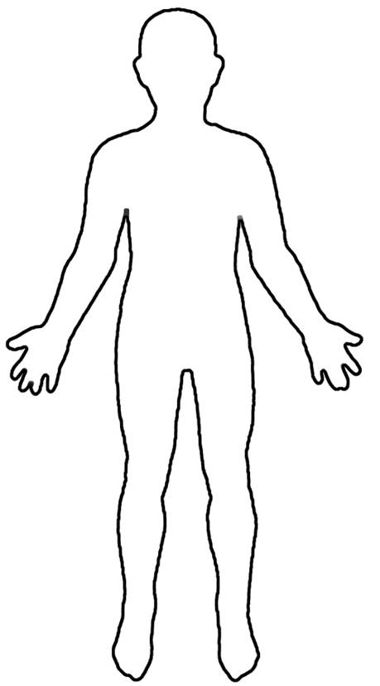
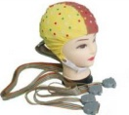
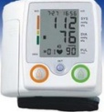
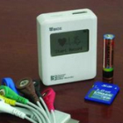

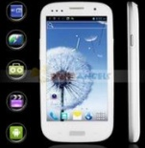
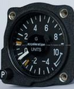
Introduction & Background
Overview of WBANs
EEG
Architecture
Sensor Nodes
(ECG, EEG, Blood Pressure…)
Sink Node
ECG
Blood Pressure
Application
E-health
Aid for Disabled
Entertainment
…
Accelerometer
Characteristics
Limited resource
Tightly fixed on body
Mobility
Wireless Body Area Network(WBAN)

Slide 4
Introduction & Background
Mobility Models
Application
An essential prerequisite for performance evaluation of protocols for wireless networks with node mobility …
For networks with node mobility:
Simulations without an proper mobility model are not reliable at all !

Slide 5
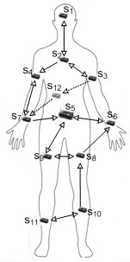
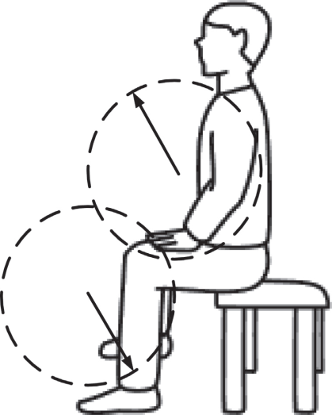
Introduction & Background
Models for WBANs
MoBAN [1]
MMoW [2]
Based on RPGM model
Markov-based posture selection strategy
Different parameters for different postures
A less flexible model
The distance between normal node and the sink node are constrained
The actions determining the move of the sensor nodes
Shortage: no enough consideration on the regularity of the body movements,
both mobile models are not well fitted to the movement of the human body
[1] M. Nabi, M. Geilen, and T. Basten. Moban: A configurable mobility model for wireless body area networks. In Proceedings of the 4th International ICST Conference on Simulation Tools and Techniques, pages 168–177. ICST (Institute for Computer Sciences, Social-Informatics and Telecommunications Engineering), 2011.
[2] M. M. Sandhu, M. Akbar, M. Behzad, N. Javaid, Z. A. Khan, and U. Qasim. Mobility model for wbans. In Broadband and Wireless Computing, Communication and Applications (BWCCA), 2014 Ninth International Conference on, pages 155–160. IEEE, 2014.

Slide 6
Mobility Modeling
Features of Mobility in WBANs:
WBAN moves as a whole as the body moves
Each node in the WBAN has its own mobility pattern
Structure of JMMM
Global movements + Individual Movements
Positions of sensor nodes are calculated according to the positions of the main joints
Individual movement patterns are established with different postures adopted

Slide 7
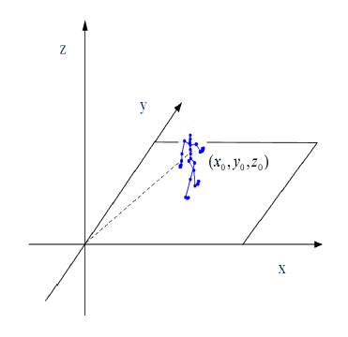
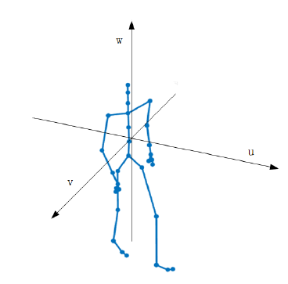
Mobility Modeling
Coordinate Systems in this Research
The global coordinate system, GCS
The relative coordinate system, RCS
Coordinates of the origin in the GCS：
Angle between axis x in the GCS and u in the RCS：
Coordinate conversion between the GCS and the RCS
(1)

Slide 8
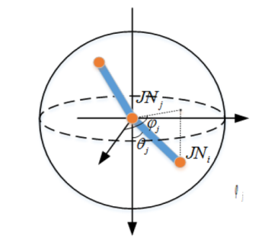
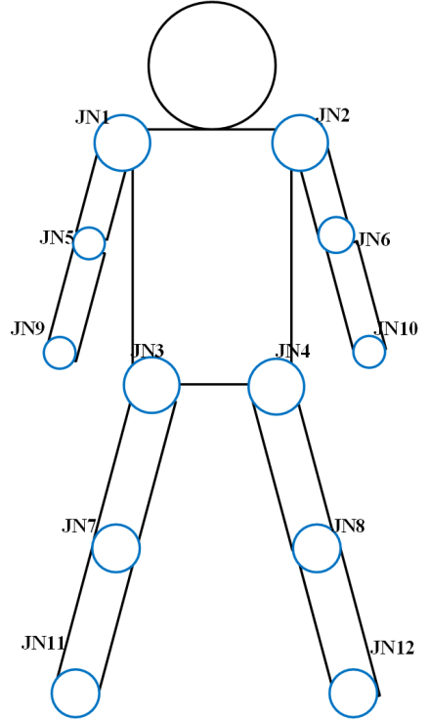
Mobility Modeling
Position Determination of Human joints
The number of main joints on human body
The model of the joint movement in three dimensions
The spherical coordinates
System, SCS
Coordinates of can be calculate by its rotation center:
(2)

Slide 9
Mobility Modeling
GCS: The specific position of the human body relative to the horizontal plane
RCS: The position relative to the middle chest, which is used to calculate the
coordinates in the GCS
SCS: Limb movement is rotating, which involves change of the angle, so we
need SCS to calculate the position of the limb joint relative to the
rotation center, then according to eq(2) figure out the position in the RCS,
finally according to eq(1) we can get the position in the GCS
We can calculate the position of any human joint through these three
coordinates systems

Slide 10
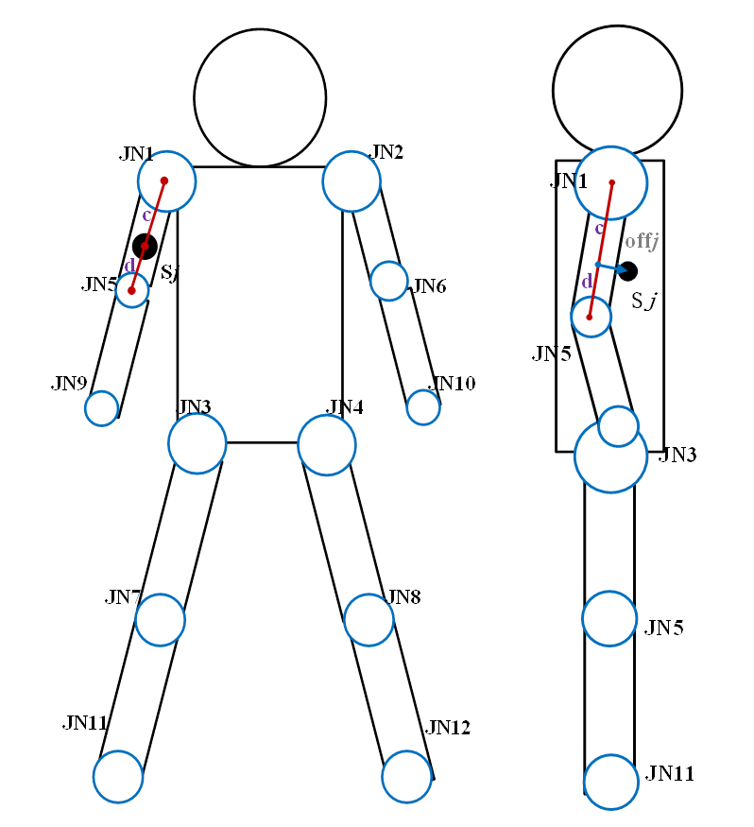
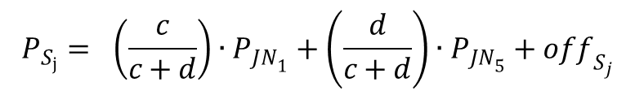
Mobility Modeling
Position Determination of Normal nodes
In the RCS, the coordinates of sensor Si can be denoted as:
The linear combination of the joints’ coordinates
The thickness of the body and the size of the sensors
Example:
$$P_{S_{j}}= \left(\frac{c}{c+d}\right)∙P_{{JN}_{1}}+\left(\frac{d}{c+d}\right)∙P_{{JN}_{5}}+{off}_{S_{j}}$$

Slide 11
Mobility Modeling
Global Movements
Global mobility determines the move of the human body in the GCS
RWPM model
Position of the origin of the RCS:
determines the angle and its value are determined by the current posture
Position of the joints on the trunk:
Calculated by Eq (1)

Slide 12
Mobility Modeling
Individual Movements
Individual mobility determines the move of the joints and nodes on the limbs
Different movement patterns in different postures
Static postures:
sitting, standing and lying-down
Dynamic postures:
walking, running
Various parameters are adopted to define different postures and the parameters can be configured by users freely

Slide 13
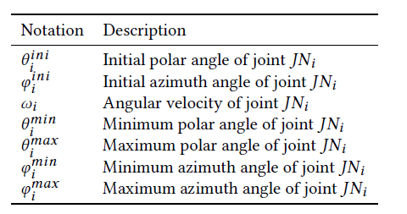
Mobility Modeling
Static postures
Movement pattern
Characteristics
the limbs tremble occasionally while the trunk keeps still
Initial pose:
Configurable parameters
Angle Ranges:
Rotation state update:
Joint position update:

Slide 14
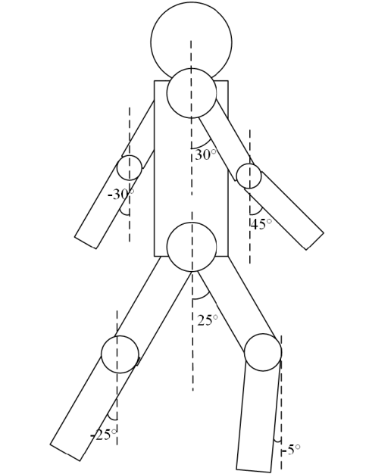
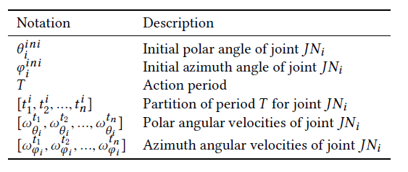
Mobility Modeling
Dynamic posture: walking
Initial pose
Characteristics
In which the arms stretch to the limit
The limbs show repetitive movement: when the left arm moves forward, the right leg moves forward as the right arm moves backward
Configurable parameters

Slide 15
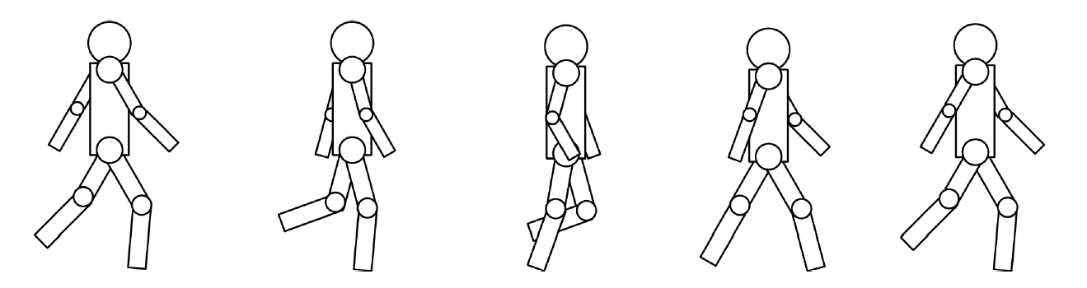
Mobility Modeling
Dynamic posture: walking
Human postures in walking process
Movement Analysis
For upper limbs:
Within one action period, the velocity of the rotation is nearly constant
Action Period
For lower limbs:
Four stages are used to characterize the mobility pattern

Slide 16
Mobility Modeling
Dynamic posture: walking
Joint position update:
Constraints:
For polar angle:
For azimuth angle:
for symmetry

Slide 17
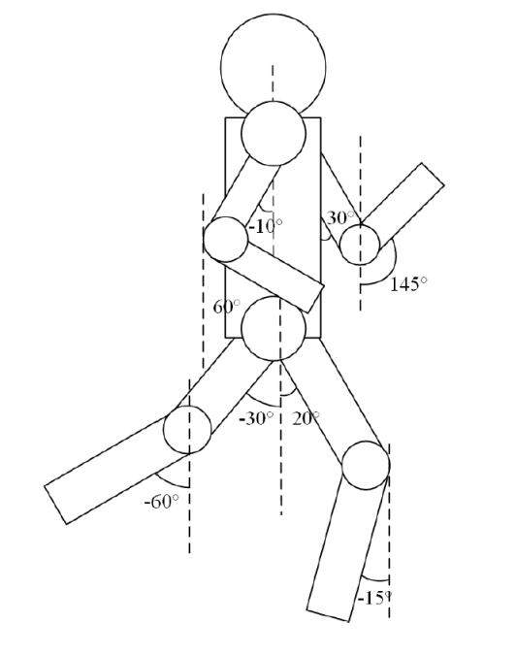
Mobility Modeling
Dynamic posture: running
Initial pose
Characteristics
In which the arms stretch to the limit
Similar to walking posture, but with a higher frequency
Configurable parameters

Slide 18
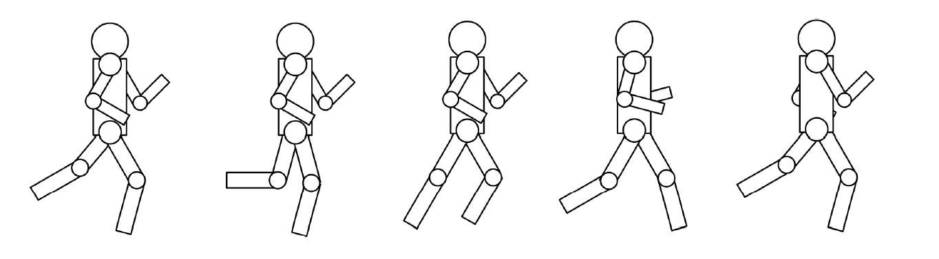
Mobility Modeling
Dynamic posture: running
Human postures in running process
Movement Analysis
For upper limbs:
The arms firstly keep still, then begin to swing at a uniform speed
Action Period
For lower limbs:
Compared to walking, four stages are also used but the values are different
The way to update joint positions and the constraints are the same to walking

Slide 19
Suggest Configurations
For static postures
All parameters can be adjusted by users to characterize the poses of static postures in which they want to simulate.
For dynamic postures
Values of the parameters determine the performance of the model in dynamic motions. Improper configurations may lead to an unreliable result.

Slide 20
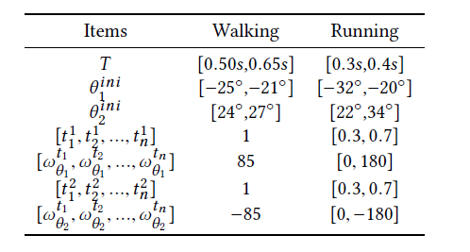
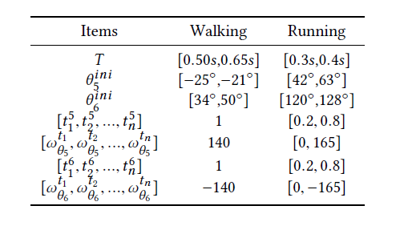
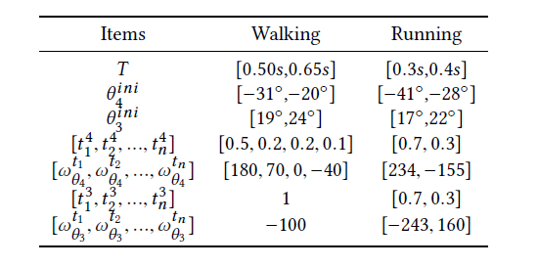
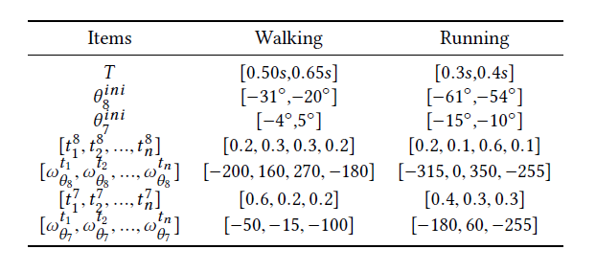
Suggest Configurations
Data in CMU motion capture[1] database are analyzed to give the empirical values of the parameters in JMMM
Table I: Suggested configuration for shoulder joints
Table II: Suggested configuration for elbow joints
Table III: Suggested configuration for hip joints
Table IV: Suggested configuration for knee joints
[1] Cmu motion capture database. http://mocap.cs.cmu.edu.

Slide 21
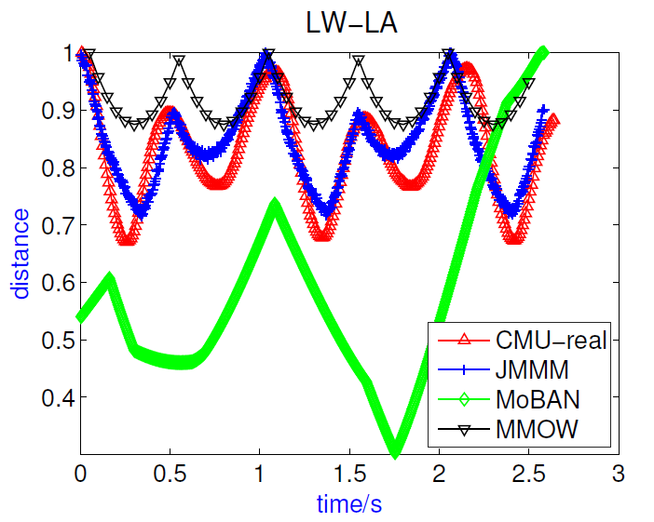
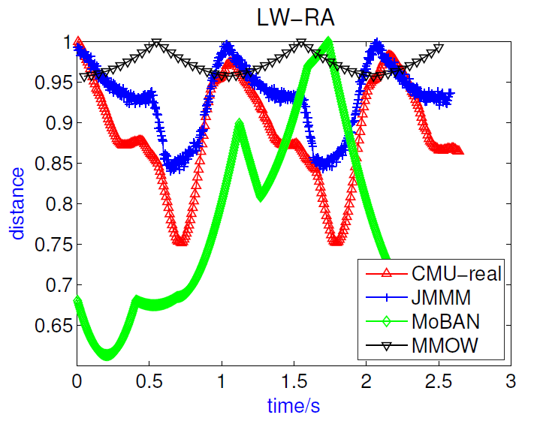
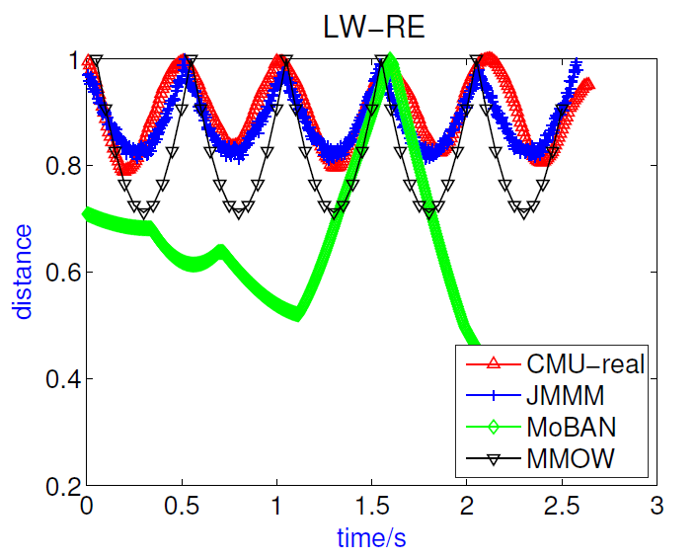
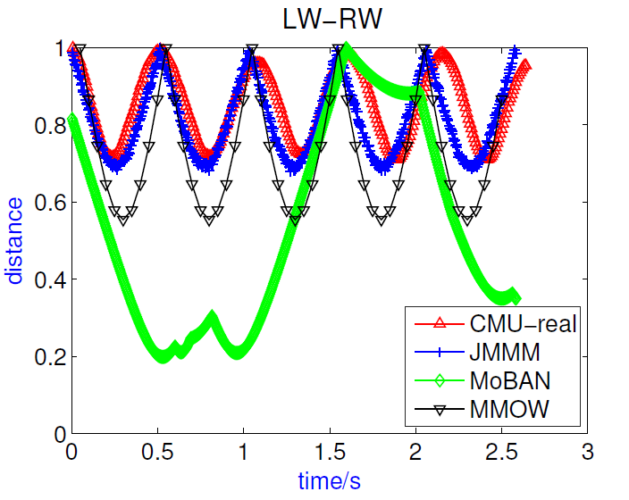
Simulations and Results
Walking posture
With the periodicity and regularity of human motion taken into consideration, JMMM performs best in the three models and matches the real data well in all four cases in walking posture.

Slide 22
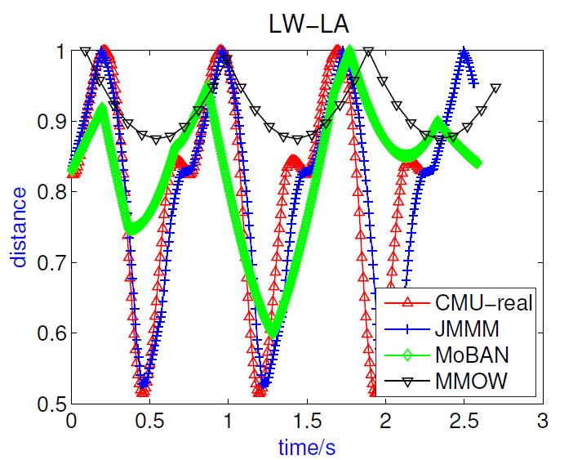
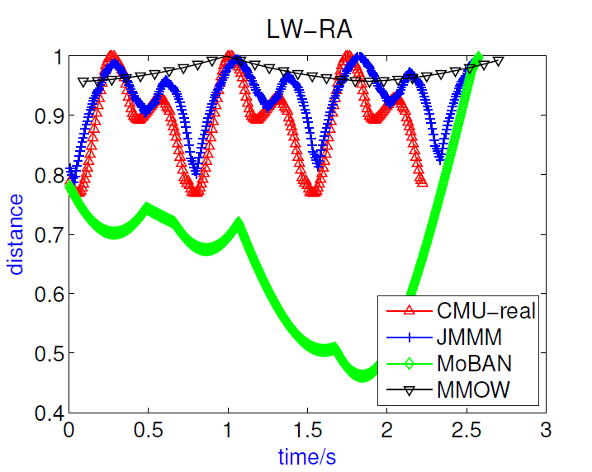
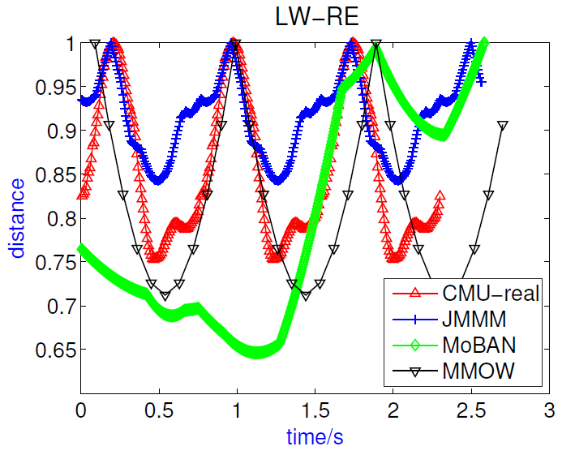
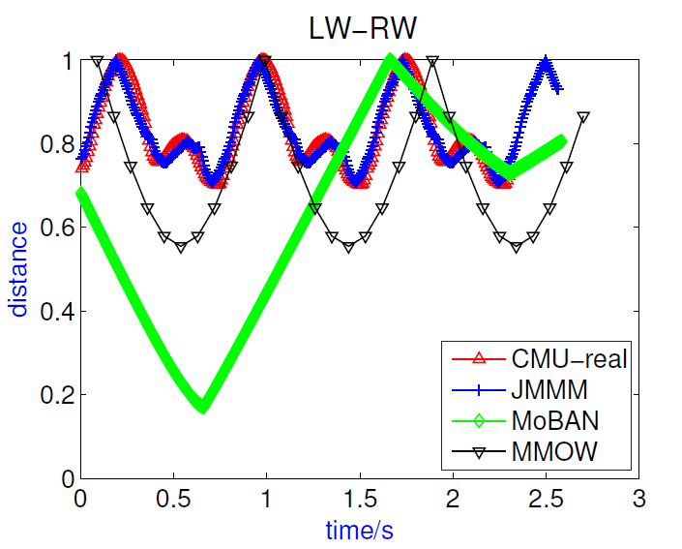
Simulations and Results
Running posture
JMMM achieves good performance in case LA-LW, LW-RA and LW-RW, and matches the trend in case LW-RE while the results of other two models are far from the real data.

Slide 23
Conclusion
JMMM can characterize the patterns of node movement in WBANs more precisely and truly compared to the existed models
JMMM provides configurable parameters for users to adjust to adopted the model in their unique application scenarios

Slide 24
Thank you for your attention
Any questions?

