Slide 1




Demographic Characteristics of Students Who Do or Do Not Post in an Undergraduate Engineering Online Discussion Forum
Presenter: Yuqin Duan
Mentor: Nick Stites
Advisor: Prof. Dr. Jennifer DeBoer
School of Electrical and Computer Engineering, Purdue University
School of Engineering Education, Purdue University
purdue.edu/freeform | freeform@purdue.edu

Slide 2
Background/Story
Online discussion forums have become widely used in undergraduate classrooms
ME274 blog provides a platform for students to discuss anything related to the course
From Gephi statistics, we are able to quantify a student’s involvement in the online blog

Slide 3
This Study:
compares gender, ethnicity, and international status of students who did and did not participate in an online discussion forum
Future Study
Case Study
Applied to general module

Slide 4
Method:
Gephi(Outdegree) -> Filter(Consented) ->
R-Code(Bar, density graph)
Data Summary:
Spring 2015, Spring 2016, Fall 2016
Participants: 360(After consented)
Total: 739(After consented)

Slide 5
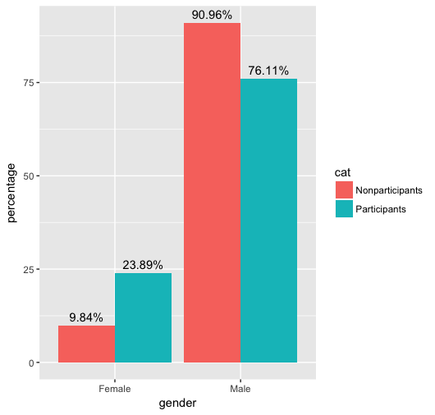
Descriptive Statistics: Gender
Future study: Should we look at the ratio of students by grades?

Slide 6
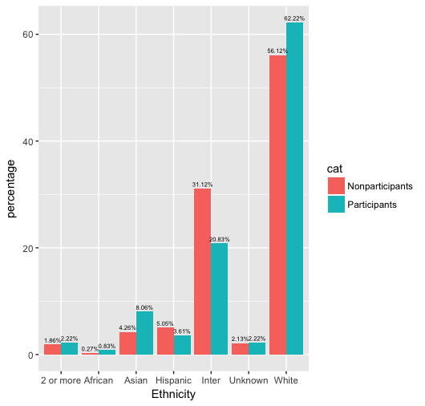
Descriptive Statistics: Ethnicity

Slide 7
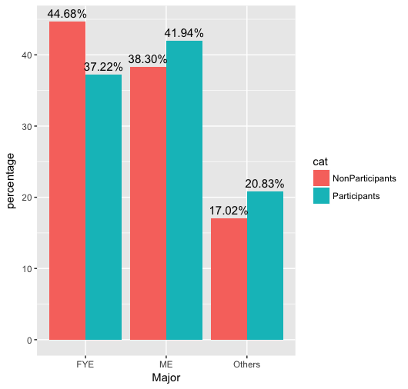
Descriptive Statistics: Students’ Major

Slide 8
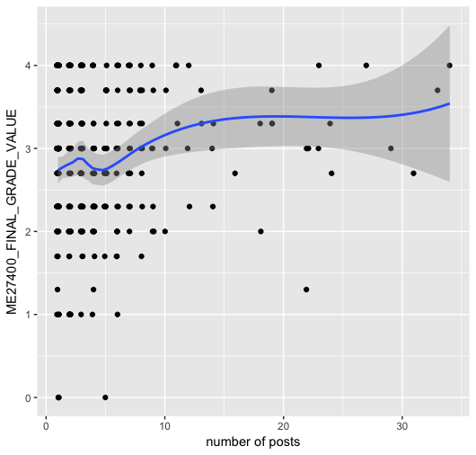
Descriptive Statistics: ME274 & # of posts

Slide 9
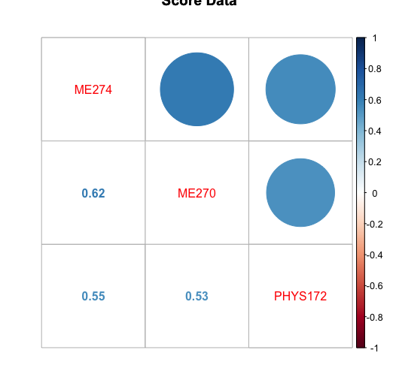
Descriptive Statistics: ME270 & PHYS172

Slide 10
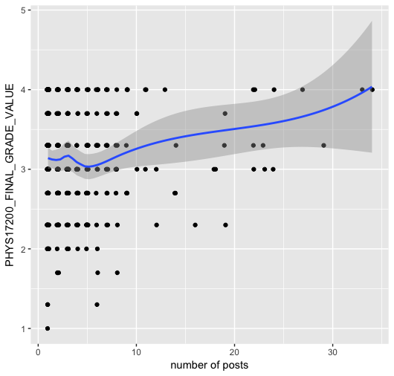
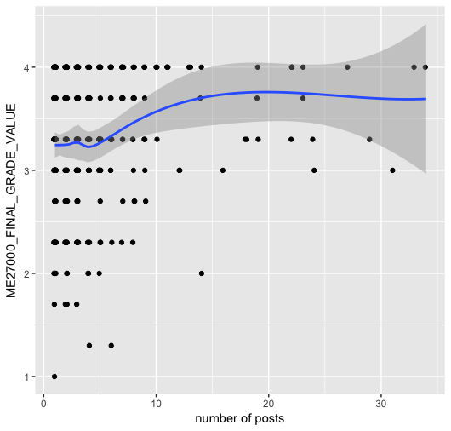
Descriptive Statistics: ME270 & PHYS172

Slide 11
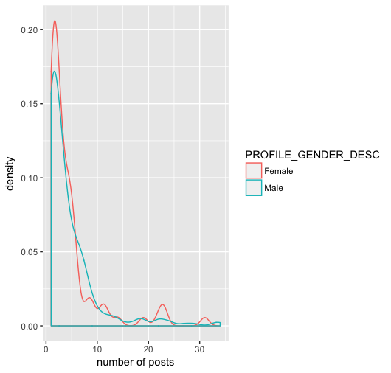
Descriptive Statistics: Gender

Slide 12
Summary
Result:
female students are more likely to be involved in online discussions than their male counterparts
White and American Asians are overrepresented but international students are underrepresented in the engaged group
Students who know the related knowledge well are more engaged in forum
According to density plots, future statistic tests will be applied.

