Slide 1
ME274 2015 Report
Yuqin sophia Duan
DR. DEBOER LAB

Slide 2
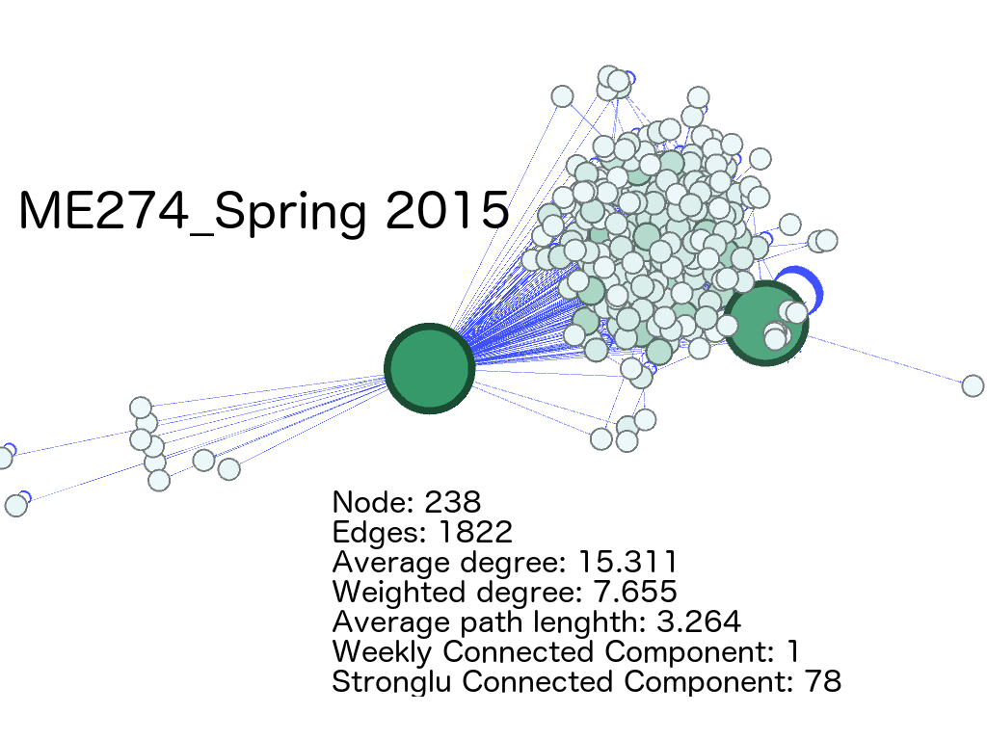
SPRING 2015

Slide 3
SPRING 2015
Layout: ForceAtlas 2
Nodes color: Depending on degree
Nodes size: Depending on degree
Edges color: Depending on weight

Slide 4
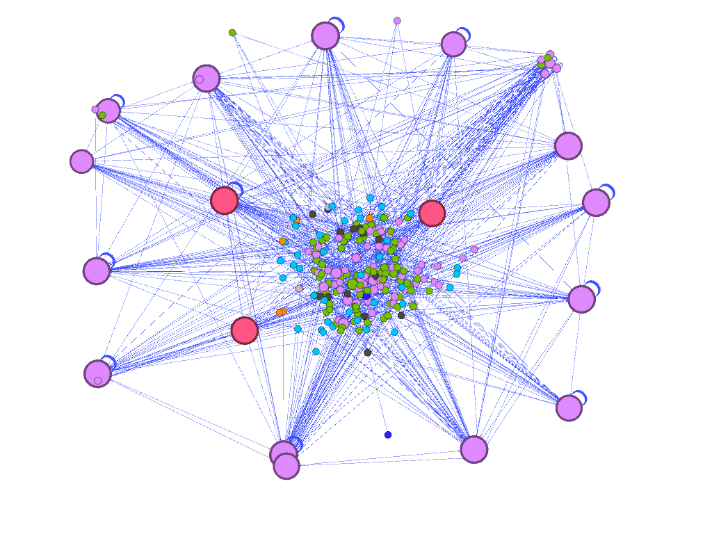
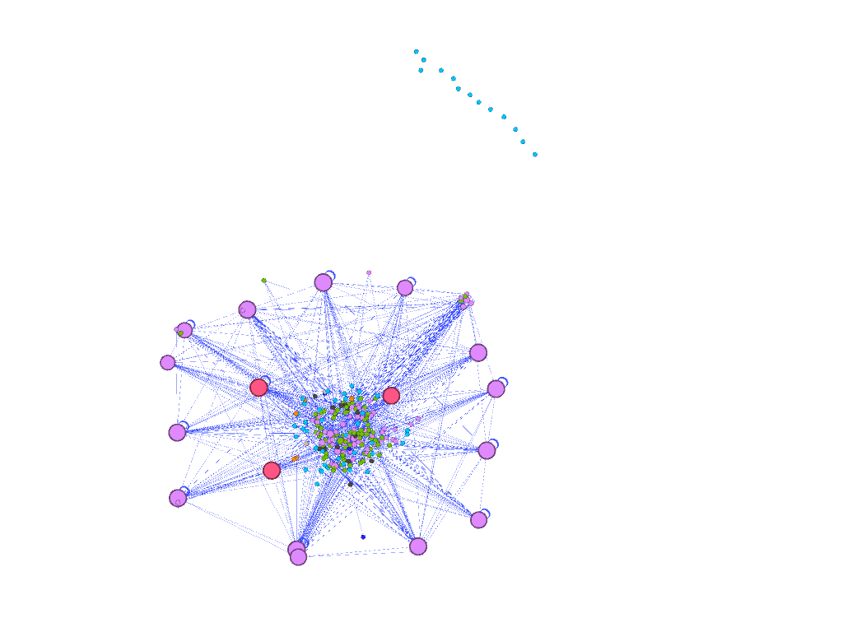
Eccentricity:
Pink: 5.0 (33.05%)
Green: 6.0 (32.63%)
Blue: 0.0 (22.88%)
Grey: 9.0 (0.42%)

Slide 5
Statistics
 | Not Including Instructors | Including instructors
Average Degree | 9.39 | 15.311
Weighted Degree | 4.695 | 7.655
Diameter | 9 | 9
Average Paths | 3.433 | 3.264
Connected Components | Weakly: 14 Strongly: 89 | 1 78

Slide 6
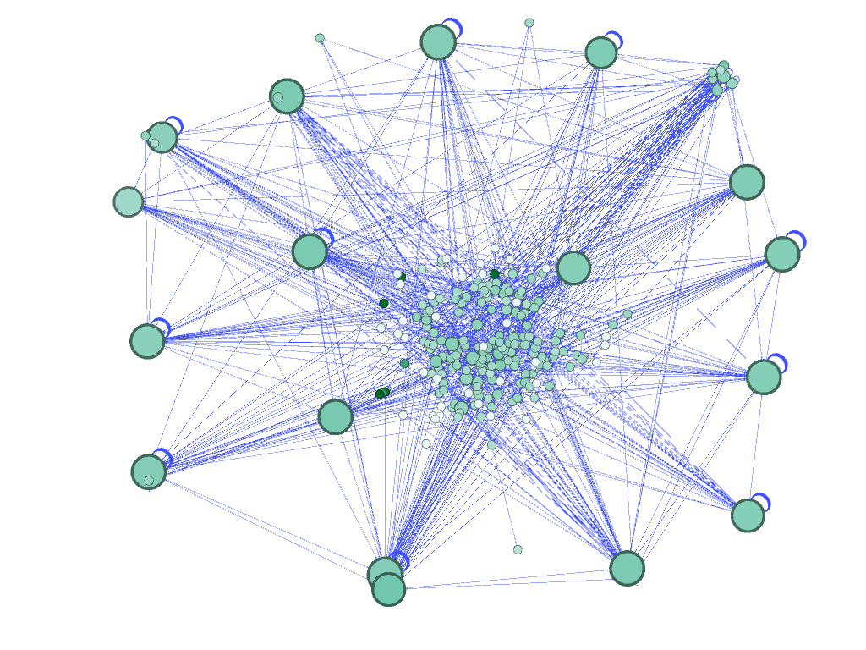
Closeness Centrality

Slide 7
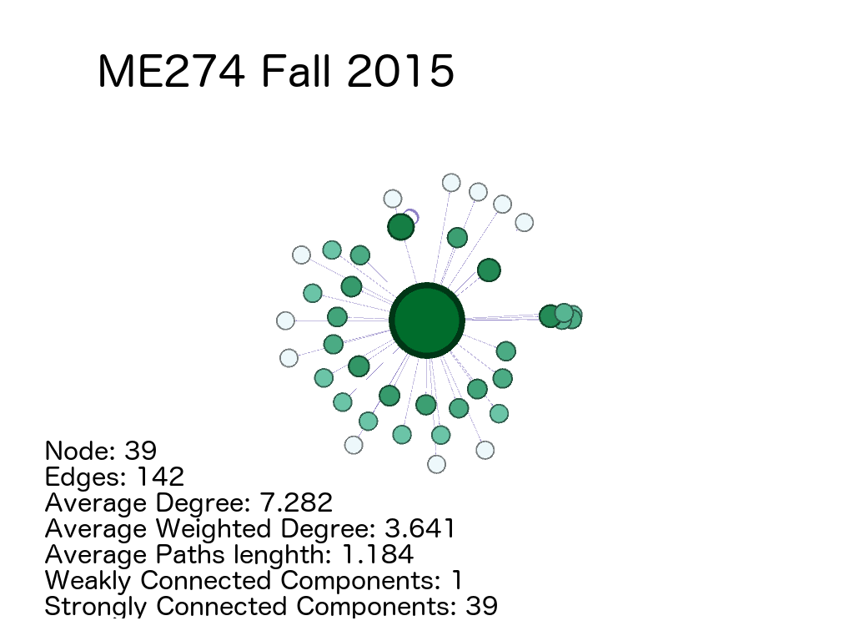
Fall 2015

Slide 8
FALL 2015
Layout: ForceAtlas 2
Nodes color: Depending on degree
Nodes size: Depending on degree
Edges color: Depending on weight

