Slide 1
ME274 2016 Fall
Yuqin Sophia Duan
Class of 19’

Slide 2
BLOG DATA
In what DATA am I interested?
The data that shows how a student is involved in blog conversation
The data that shows the influence or importance of a student’s answer
How to analyze?
Extract useful data from blog (Poster/commenter ID, poster/commenter time)
Draw network visualization
Calculate statistics
Compare across semesters -> Normalization

Slide 3
BLOG DATA
Why is it important?
Help us to see in general how people participated in 274 blog
Helps examine the social media influence
What is the goal?
To see if participation in blog activities(social media) makes a difference in students’ performance
To see how different blog statistics related to students’ performance

Slide 4
Background: Nodes = students, edges = posts Statistics:
 | Mathematical Meaning | Physical Meaning
Degrees | The number of edges connected to a node | How much a person participated in blog
Out-degrees | The number of edges pointing from a node | How much a person replied others
In-degrees | The number of edges pointing to a node | How many replies a person got
Eccentricity | The distance between a node and the node that is furthest from it | The size of personal network
Closeness Centrality | The sum of geodesic distances from node i to all n – 1 nodes in the network | Shows how a student connects with other students
Betweenness Centrality | How often a node appears on the shortest paths between nodes in the network | Shows how often a student was connected directly with others
Page Rank | How important a point is | How important a student is

Slide 5
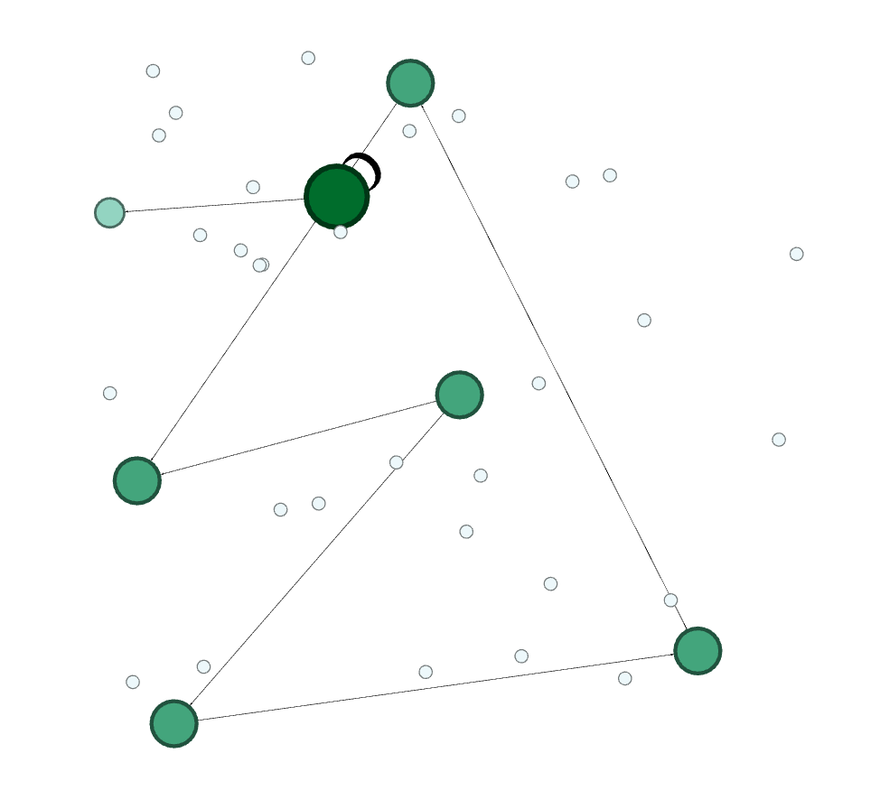
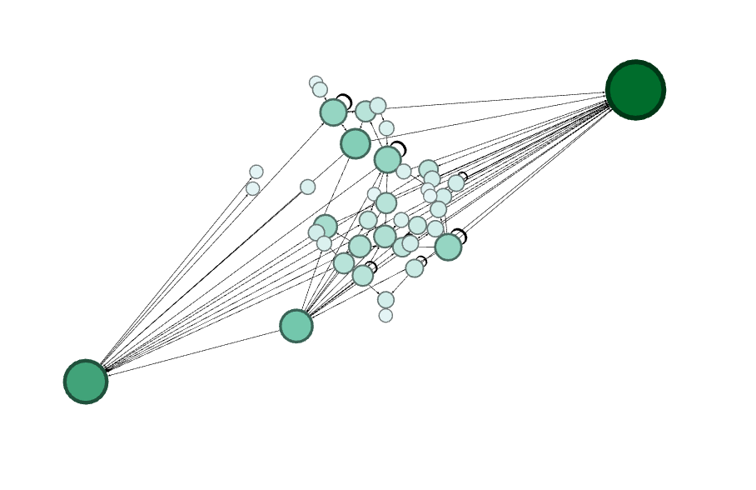
ME274 Fall Gephi visualization
2015 2016

Slide 6
Fall Semesters
 | Fall 2015 | Fall 2016
Node | 37 | 64
Edges | 142 | 301
Average Degrees | 0.368 | 3.683
Weighted Degrees | 0.184 | 1.841
Diameter | 3 | 9
Average Path | 1.63 | 3.205

Slide 7
4 semesters
 | Spring 2015 | Fall 2015 | Spring 2016 | Fall 2016
Node | 235 | 37 | 200 | 64
Total Students | 403 | 110 | 414 | 118
Participate Ratio | 0.583 | 0.336 | 0.483 | 0.542
Average Degrees | 9.39 | 0.368 | 4.55 | 3.683
Weighted Degrees | 4.695 | 0.164 | 2.275 | 1.841
Average Paths | 3.433 | 1.63 | 4.795 | 3.205

Slide 8
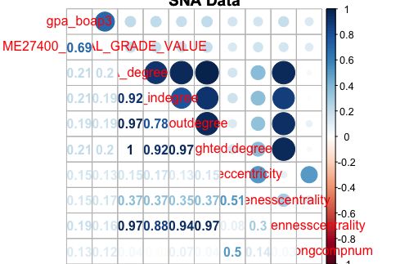
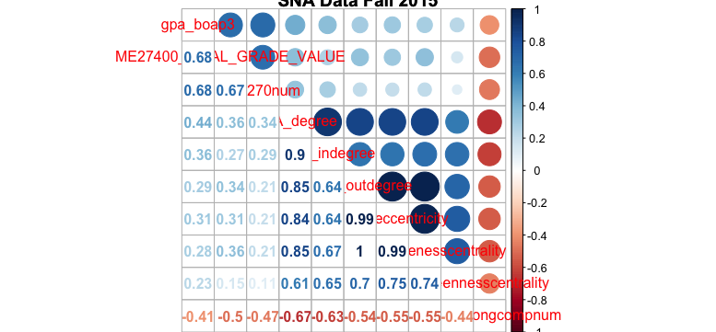
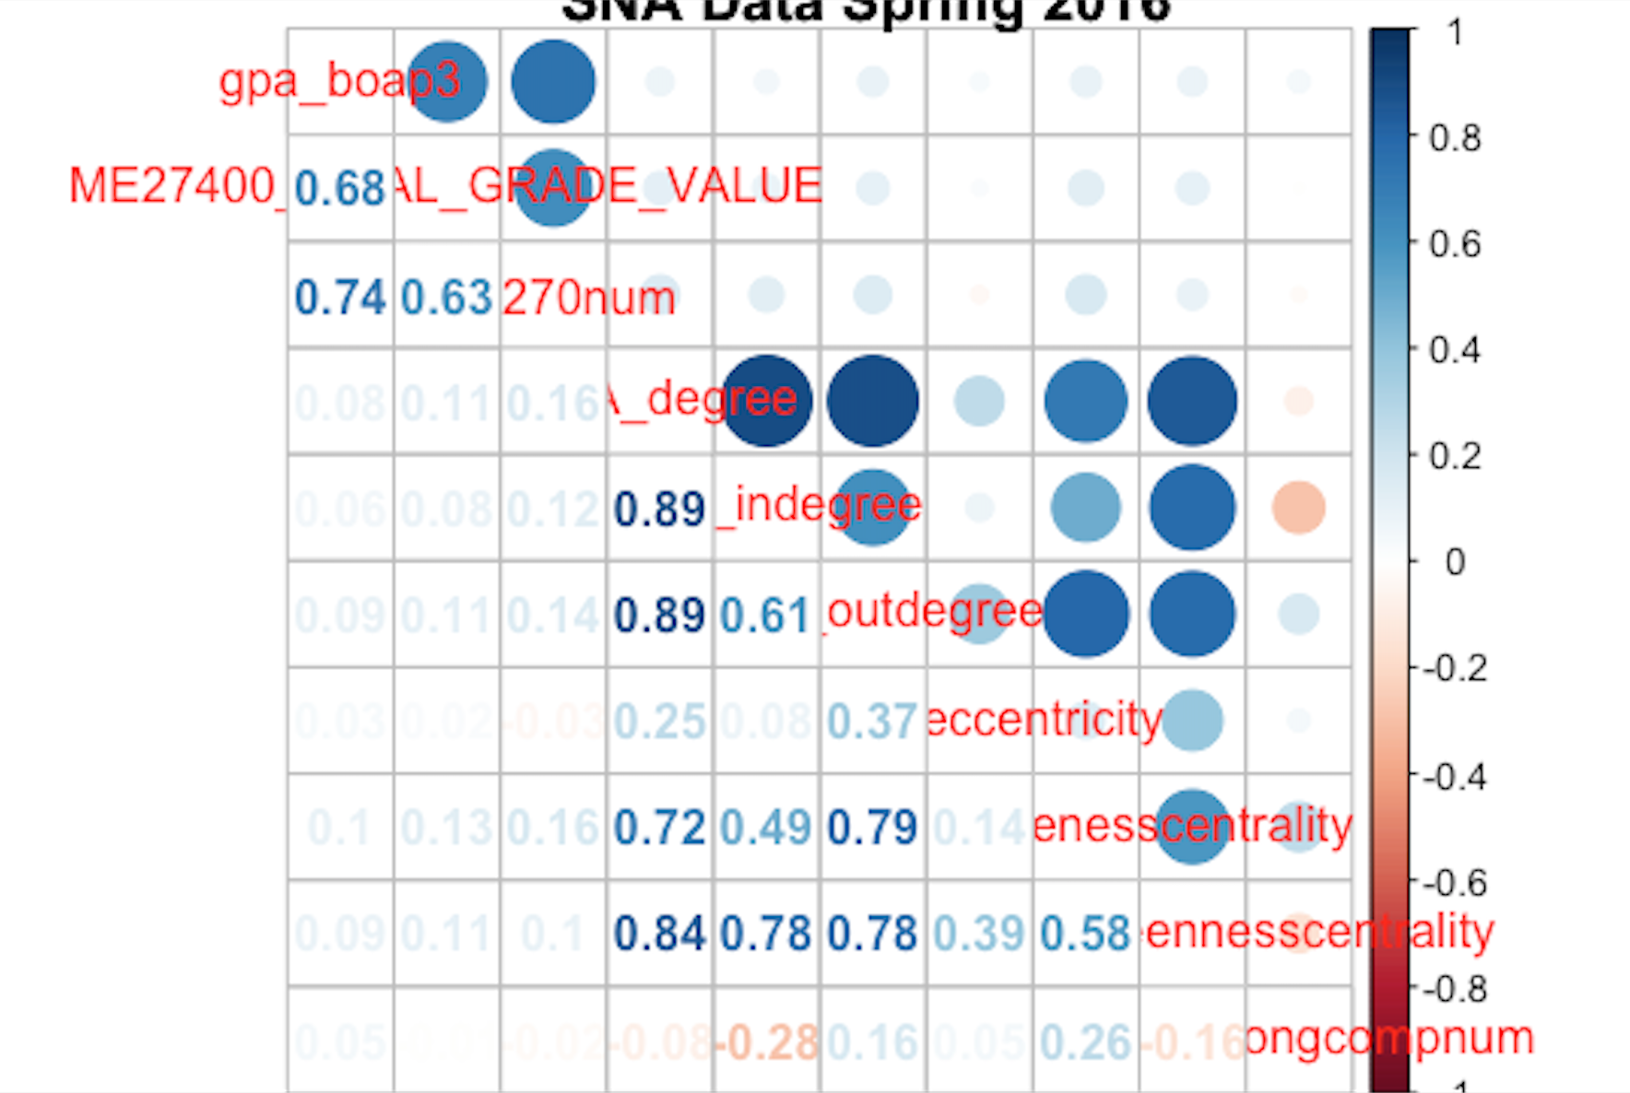
Spring 2015
Spring 2016
Fall
2015

Slide 9
Conclusion
General:
More students are getting involved in blog activities
The connection between each student is stronger

Slide 10
Future plans
Individual:
Find out the correlation coefficient between students’ performance and statistics that describe individual
Compare
If (strong related -> active && good performance) {
Find a pattern
}
Else {
Try to see if participation helps improve performance
}

