Slide 1
ME274 Spring 2016
Yuqin Sophia Duan
Dr. Deboer Lab

Slide 2
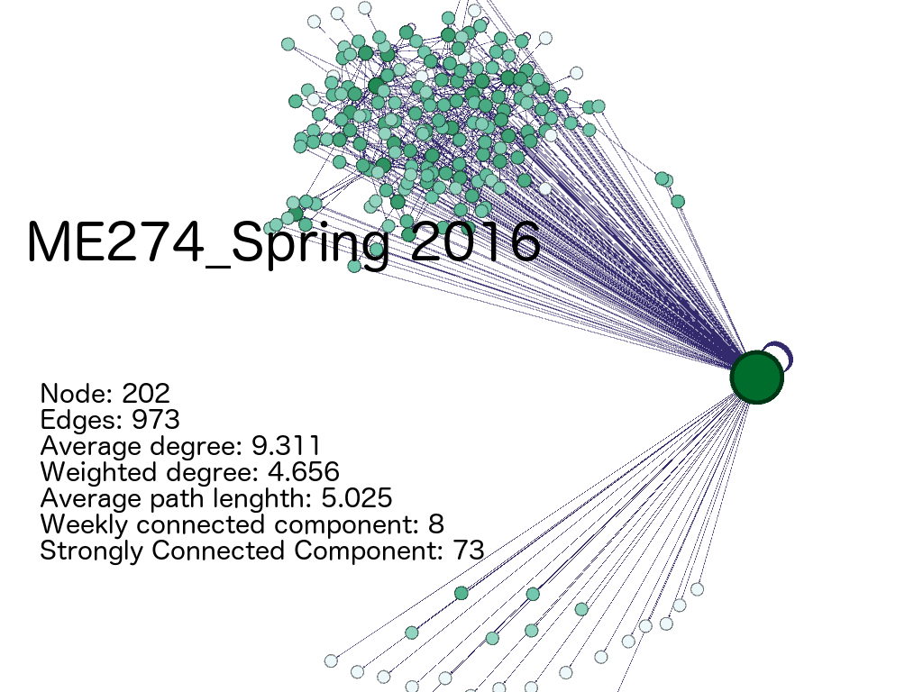
Spring 2016

Slide 3
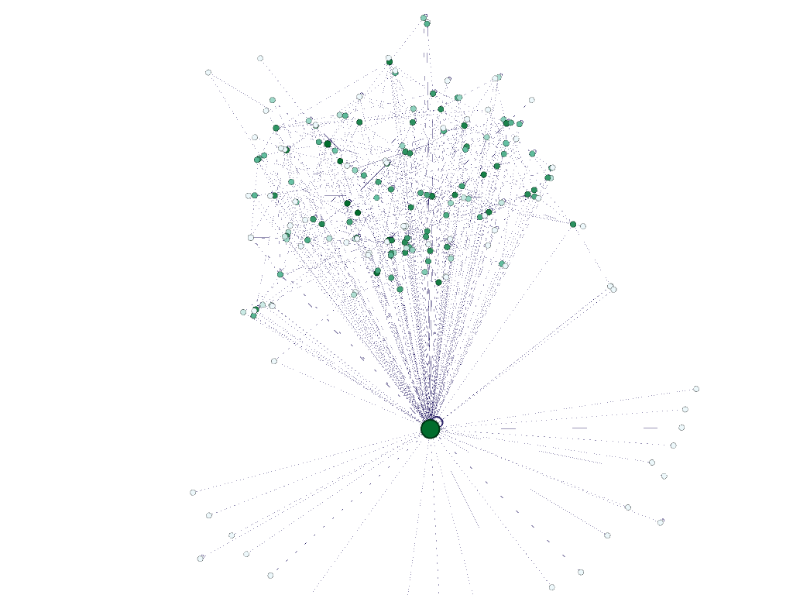
Spring 2016
Layout: ForceAtlas 2
Nodes color: Depending on degree
Nodes size: Depending on degree
Edges color: Depending on weight

Slide 4
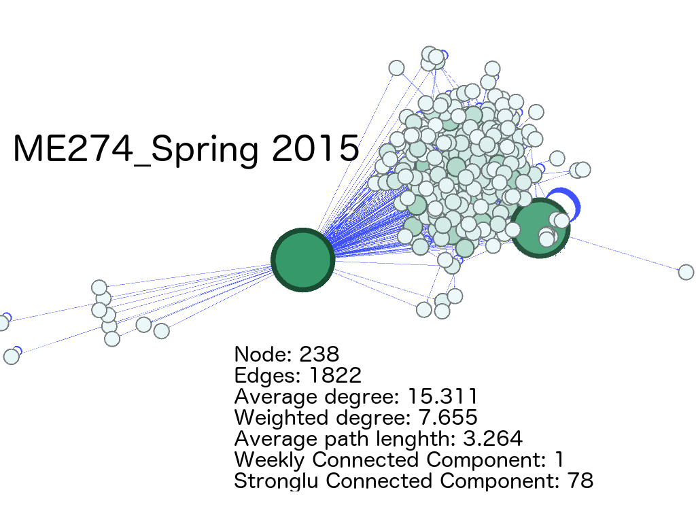
Spring Terms

Slide 5
Spring Terms
Only Students
 | 2015 | 2016
Average Degree | 9.39 | 4.55
Weighted Degree | 4.695 | 2.275
Diameter | 9 | 13
Average Paths | 3.433 | 4.795
Connected Components | Weakly: 14 Strongly: 89 | Weakly: 21 Strongly: 102

Slide 6
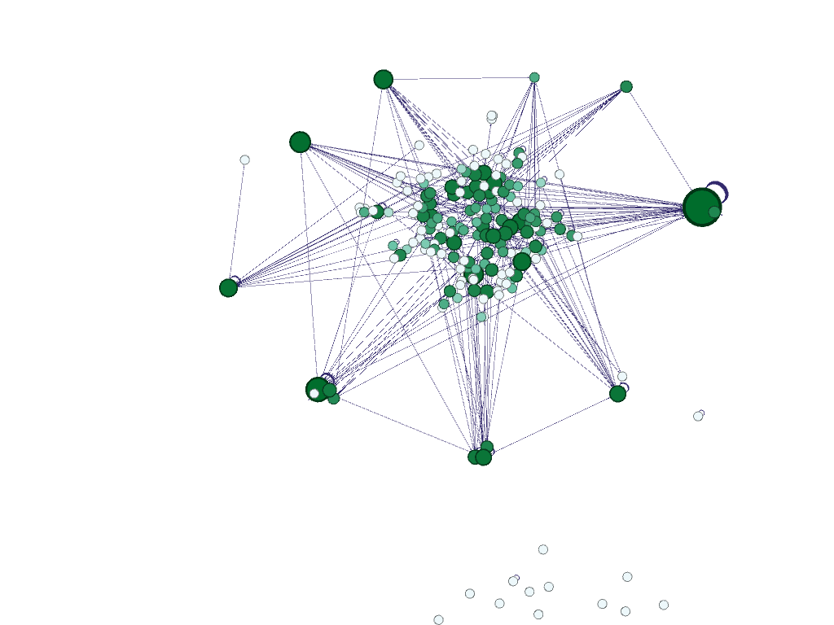
Spring 2016
Only students
Betweenness Centrality
It measures how often a node appears on the shortest paths between nodes in the network
Cohesiveness

Slide 7
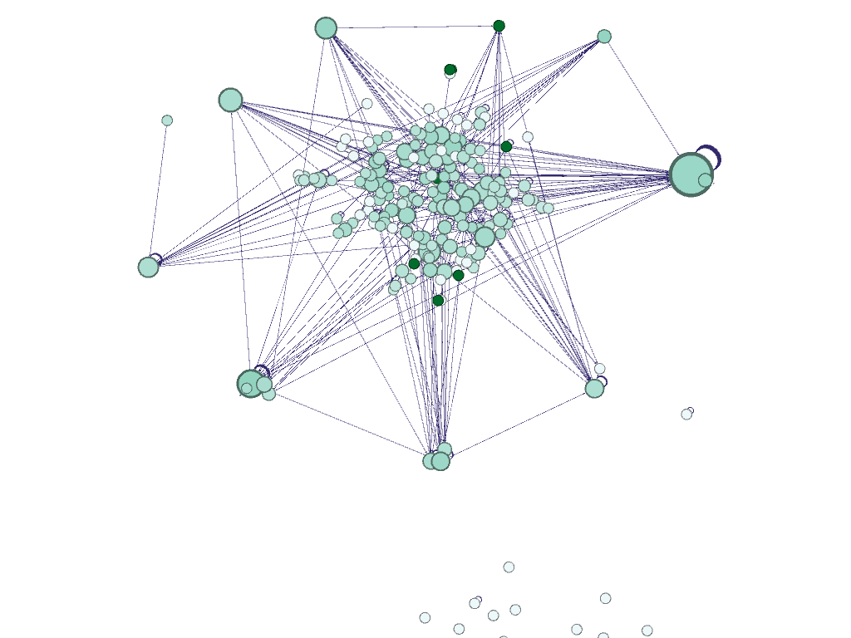
Betweenness & Closeness
Distance
Ratio

Slide 8
Connected Components TT
Tarjan Algorithm
5 const int LEN = 100000 + 10;
6 vector<int> Map[LEN];
7 int dfn[LEN], low[LEN], dclock, scc_cnt, sccn[LEN], n, m;
8 stack<int> s;
9
10 void sccinit(){
11 for(int i=0; i<LEN; i++) Map[i].clear();
12 while(!s.empty())s.pop();
13 dclock = scc_cnt = 0;
14 memset(sccn, 0, sizeof sccn);
15 memset(dfn, 0, sizeof dfn);
16 }
17
18 void dfs(int u){
19 dfn[u] = low[u] = ++dclock;
20 s.push(u);
21 for(int i=0; i<Map[u].size(); i++){
22 int v = Map[u][i];
23 if(!dfn[v]){
24 dfs(v);
25 low[u] = min(low[u], low[v]);
26 }else if(!sccn[v]) low[u] = min(low[u], dfn[v]);
27 }
28 if(low[u] == dfn[u]){
29 scc_cnt++;
30 while(1){
31 int x = s.top();s.pop();
32 sccn[x] = scc_cnt;
33 if(x == u) break;
34 }
35 }
36 }

Slide 9
Reference
Lineage [Web log review]. (2015, May 30).
Tarjan, R. (1971). Depth-first search and linear graph algorithms. 12th Annual Symposium on Switching and Automata Theory (swat 1971). doi:10.1109/swat.1971.10
http://epubs.siam.org/doi/pdf/10.1137/0201010

Slide 10
Thanks for listening

