Slide 1

Religion and morality
A0201251A
Notes:
Evolution-of-Religion-and-Morality
This project was designed to explore the relationship between certain elements of religions, like supernatural beliefs and rituals, and prosocial behavior. Data were collected over 8 countries around the world with different elements of religion involved.

Slide 2
Explain or Predict
Explain behavior—accurately describe its causal underpinnings—and to
Predict behavior—accurately forecast behaviors that have not yet been observed
In practice, however, these two goals are rarely distinguished (Yarkoni et.al, 2017)
Problems with explanatory model: “p-hacking” (Simmons, Nelson, & Simonsohn, 2011) ; replication crisis (Open Science Collaboration, 2015)
Building predictive models on the test data can ultimately improve our ability to explain the causes of behavior in the long term.
Notes:
Researchers argued that Historically understanding human behavior this has meant being able both to explain behavior—that is, to accurately describe its causal underpinnings—and to predict behavior—that is, to accurately forecast behaviors that have not yet been observed. He also identified that in practice, however, these two goals are rarely distinguished.
After reviewing the typical explanatory approach as practiced by most of psychology, he pointed out problems such as “p-hacking” (Simmons, Nelson, & Simonsohn, 2011) and the inability of researchers to consistently replicate the results of prior experiments (Open Science Collaboration, 2015). Re-analysing the same data with predictive models on the test data can ultimately improve our ability to explain the causes of behavior in the long term. Thus, an emphasis on prediction can be viewed not as an opponent of explanation, but rather as a complementary goal that can ultimately increase theoretical understanding. In this case, it is to better understand the possible religious causes for prosocial behavior.

Slide 3
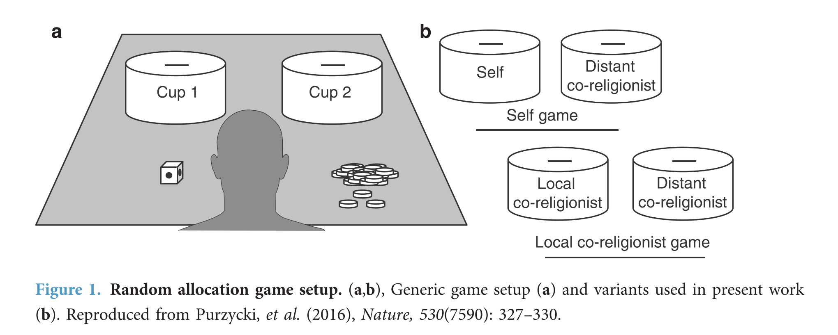
Dataset
Random allocation game (Treatment conditions: presence of religious prime)
2 games; 2 cups; fair 2-colored dice; a stack of 30 coins per game
Notes:
Participants IN the dataset played two games: the Local Co-Religionist Game and the SelfGame. My report focuses on predicting the outcome for the self-game. For the SelfGame, participants were told that the 2 cups were reserved for themselves and a different individual from a distant co-religionist community. Co-religionists are defined as people who share similar beliefs and practices revolving around the god that most closely approximated to that of the most morally concerned, punitive, and omniscient deity (see below).
Participants must think of which cup they would like to put a coin into, then roll the die. If the die comes up one color, participants are supposed to put the coin into the cup they thought of. If it comes up another color, then they are supposed to put the coin into the opposite cup to the one they thought of. Participants knew that they cankeep for themselves the money allocated to their cup, and that the money left in the other cups are given to the distant co-religionist. Participants play alone, which allows cheating. Total combined valuation for games were set at roughly a single day’s wage in the local community, is another incentive for participants to cheat.

Slide 4
Survey questions
Asked participants what they thought the game was about AFTER experiment. If they mentioned ‘honesty’, ‘fairness’,or ‘cheating’ in their responses, they were given a score of ‘1’ for the HONEST variable, and a ‘0’ for all other responses.
Sex, age, number of children, years of education
Subjective sense of material security & confidence
Religious beliefs about God
Evaluations about Police
Evaluations of group relations and similarities (between local and distant co-religionist community)
Notes:
The dataset also includes many interesting survey questions. After the game, participants were asked what they thought the game was about. “Honest” variable encodes 1 If they mentioned ‘honesty’, ‘fairness’,or ‘cheating’ in their responses, and a ‘0’ were given for all other responses.
Sex, age, number of children, years of education, Subjective sense of material security & confidence,Religious beliefs about God, Evaluations about Police,Evaluations of group relations and similarities were also measured.

Slide 5
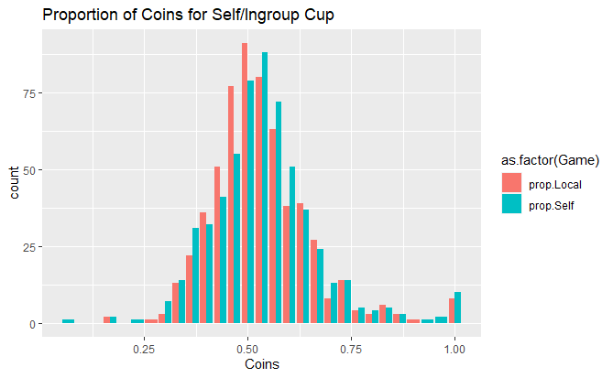
Data exploration
Proportion of coins = Number of coins/30
Normal distribution, observations = 592
Count: Mean = 16.13, Min = 2, Max = 30, sd = 3.86
Notes:
TREATMENT
Binomially distributed
Similar pattern for local and self game

Slide 6
Variables: Bivariate Correlation
Term | SELF Cup
MBG | 0.05831
TREATMENT | 0.04008
CHILDREN | 0.026694
CORELEMO | 0.002544
BGR1 | -0.01977
MMAT | -0.03652
SEX | -0.04595
AGE | -0.05098
HONEST | -0.06454
OMNI.BG | -0.06635
INGFIRST | -0.08682
POLEVAL | -0.09383
MMATc | -0.09585
FORMALED | -0.1129
LGDIEPUN | -0.11897
MLG | -0.13724
INGREMO | -0.139
LGR1 | -0.14831
OUTGREMO | -0.16127
OMNI.LG | -0.1887
CORELSIM | -0.21754
DIEPUN | -0.23649
22 predictors
"AGE","SEX","FORMALED","CHILDREN","HONEST","TREATMENT","MMAT","MMATc","DIEPUN","LGDIEPUN","OMNI.BG","OMNI.LG","MBG","MLG","BGR1","LGR1","CORELEMO","INGREMO","OUTGREMO","CORELSIM","POLEVAL","INGFIRST“ “INGROUP”
Participants with NA for these predictors omitted from analysis (observations = 316)
Notes:
22 PREDICtors included as the full model, participants with missing data from these predictorsare removed

Slide 7
Methods
-Linear regression vs elastic net vs decision tree vs random forest vs boosting
-10 Fold Repeated CV, Centered predictors with Caret
- Full model with all 22 predictors included
Simpler model (Feature selection)
Compare Full vs simpler model for each method (choosing predictors)
Choose best model out of 4 methods
Notes:
I trained the final dataset with 4 methods – linear regression, elastic net, decision tree and random forest using caret and centered all the predictors for comparison across methods.. First I applied 10 Fold Repeated Cross validation to each method with all 22 predictor previously identified. These methods with all predictors included are termed full model.
Next, I will construct a simpler model for each method by feature selection. Redundant predictors that are unimportant are removed for each method. The criteria for removing will be examined later.
Next I will choose the best model for each method by comparing the CV error of each model when different predictors are included. Finally I will choose the best model among 4 methods with lowest CV error.

Slide 8
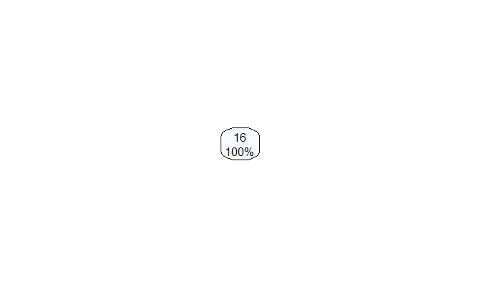
Best model ( 22 predictors)
 | RMSE | Rsquared
Linear Model | 4.0195 | 0.0921
Elastic Net (alpha =0, lambda = 5.0505 ) | 3.8862 | 0.1006
Decision Tree | 3.9831 | NA
Random Forest | 3.8845 | 1070
Performance can be improved after feature selection

Slide 9
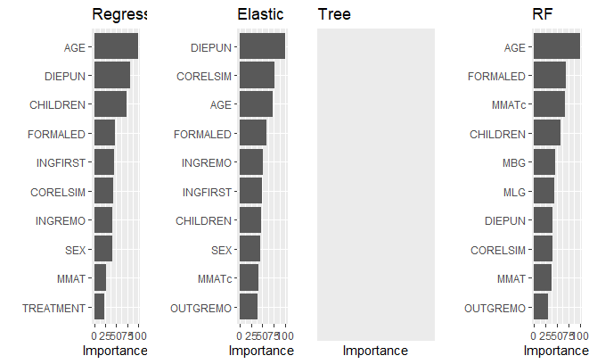
VIP for full model

Slide 10
Variable | Important for (>50) | Operationalization
AGE | Linear; Elastic; Random Forest
DIEPUN | Linear; Elastic | ● Does ______________ ever punish people for their behavior? ● Can _________ influence what happens to people after they die?
CHILDREN | Linear, Random Forest
FORMALED | Elastic Net, Random Forest
CORELSIM | Elastic Net | How similar are DISTANT’s traditions/religious beliefs and practices with the LOCAL?
INGREMO | Elastic Net | How emotionally close do you feel toward an LOCAL? (INGREMO)
MMATc | Random Forest | How certain are you that you will be able to buy or produce enough food to eat t in the next _________?
Notes:
Important variables with importance level more than 50 in the vip package are listed this table. Overall, 7 unique predictors are identified. Children refers to the number of children the participant has, while formaled referes to the years of formal education received.
DIEPUN measures participant’s belief about punishment from god and influence of god after death)
Corelsim measures the participant’s judegment of similarity of religious practices between the co-religionist community and his own community.
INGREMO measures emotional proximity the participant feels towards local in his community
MMATc measures material confidence, asks explicitly how certain pp are that they are able to secure enough food to eat within a certain timeframe

Slide 11
Important variables
 | Variables
Linear (3 variables) | AGE,DIEPUN, CHILDREN
Elastic Net (6 variables) | AGE,DIEPUN, CORELSIM, FORMALED,INGREMO
Random Forest ( 5 variables) | AGE, FORMALED,MMATc,CHILDREN
Lm_elastic (shared) | AGE,DIEPUN
Lm_elastic_rf (shared) | AGE
Importance > 50
5 combinations of predictors
Notes:
How similar are DISTANT’s traditions/religious beliefs and practices with the LOCAL? (CORELSIM)
Moralistic local god

Slide 12
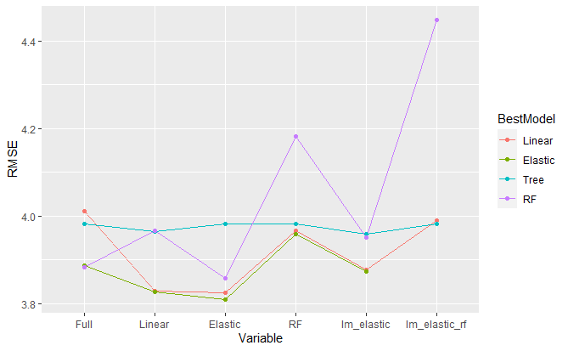
Full vs variable elimination: CV error
Importance > 50
Lm_elastic = shared important predictors (importance > 50) between linear model and elastic net. [AGE,DIEPUN]
Lm_elastic_rf = shared important predictors (importance > 50) between linear model elastic net and random forest. [AGE]
Notes:
CV error are plotted for each method conditioned on the predictors used for the model.,. Sticking to the criteria of selecting variables with importance level more than 50. Full refers to the case when all 22 predictors used, different labels On the x-axis refers to the combinations of predictors used for each model
linear refers to the case when only important variables for linear regression are used. Elastic refers to the case when only important variavles for elastic net used, and rf refers to when only important variables for rf are used. Lm_elastic refers to the case when only shared important predictors between lm and elastic net are used. Lm_ elastic include AGE, DIEPUN
Lm_elastic_rf = shared important predictors (importance > 50) between linear model elastic net and random forest. [AGE

Slide 13
Best Model for each method: CV error
Linear regression with elastic predictors (rmse =3.824432)
Elastic net with elastic predictors(rmse = 3.810089)
DT with lm_elastic predictors (rmse = 3.958665)
RF with elastic predictors (rmse = 3.858191)
AGE,DIEPUN, CORELSIM, FORMALED,INGREMO
AGE, DIEPUN
Notes:
CV error for each method and combination of predictors are pltted to identify the best models. Out of the four methods, linear regression, elastic net and random forest attained the lowest rsme when only variables important to elastic net are included. These include 6 variables:
Lastly, the best decision tree model is attained when only important variables shared between lm and elastic net are included, consist of only 2 variables: age and diepun. Was expected as a simpler decision tree model with fewer decision nodes to go through will not overfit the training data.
Interesting to note that rmse for decision tree has a much smaller variance across different predictors. I wasn’t expecting this small range of variation compared to the other models as I conceived decision tree model to be very sensitive to input variables.

Slide 14
Conclusion 1
Elastic net is efficient as feature selection model
Notes:
Thus I conclude that elastic net is efficient as a feature selection model as the models constructued with predictors that are important for elastic net all attain the lowest rmse across the training methods.

Slide 15
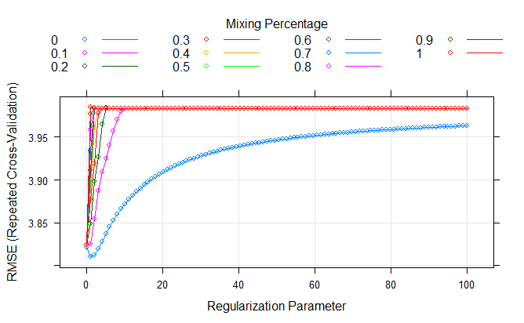
Fine-tuning Elastic net
Before finetuning:
Alpha = 0,
Lambda = 0.101
RMSE = 3.810089
After finetuning:
Alpha = 0,
Lambda = 0.121
RMSE = 3.809817
= Ridge regression

Slide 16
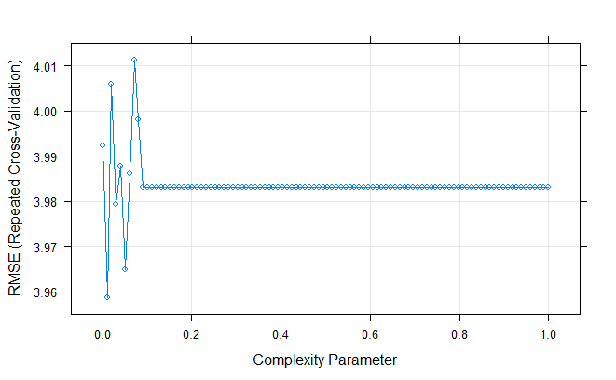
Fine-tuning
Best model for decision tree (shared variables with importance > 50 for lm,elastic and rf)
Cp = 0.01011, RMSE = 3.9587
After fine-tuning:
Cp = 0.05437, RMSE = 3.9422

Slide 17
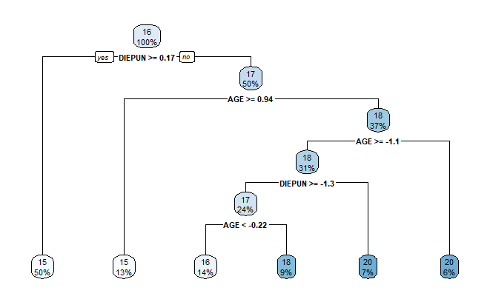
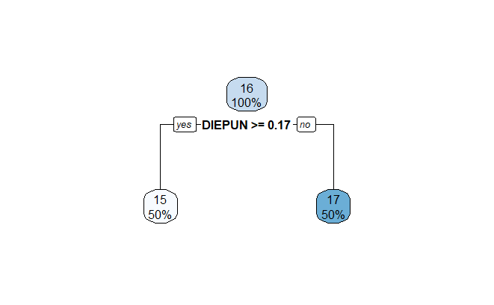
Decision Tree: Best model
Fine-tuning
Shared important variables for LM and elastic
Notes:
Fine-tuning allows us to choose a smaller complexity parameter and subsequently only includes one predictor

Slide 18
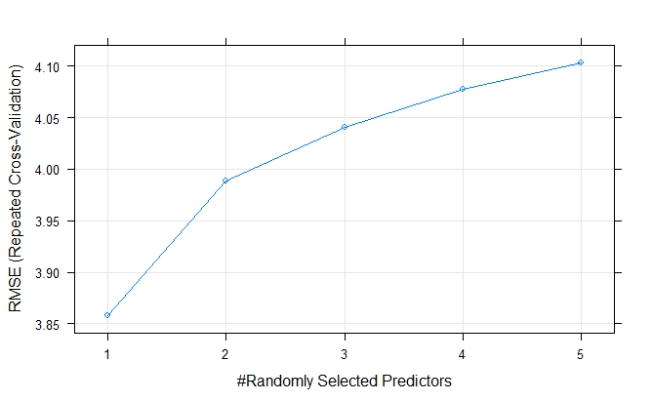
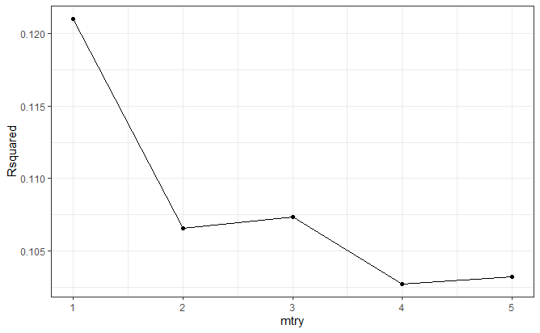
RF
Mtry = 1, rmse = 3.858191
Notes:
Best model of random forest has randomly sample one predictor as candidates at each split. This results is consistent with the final model of decision tree, consisting of only one predictor

Slide 19
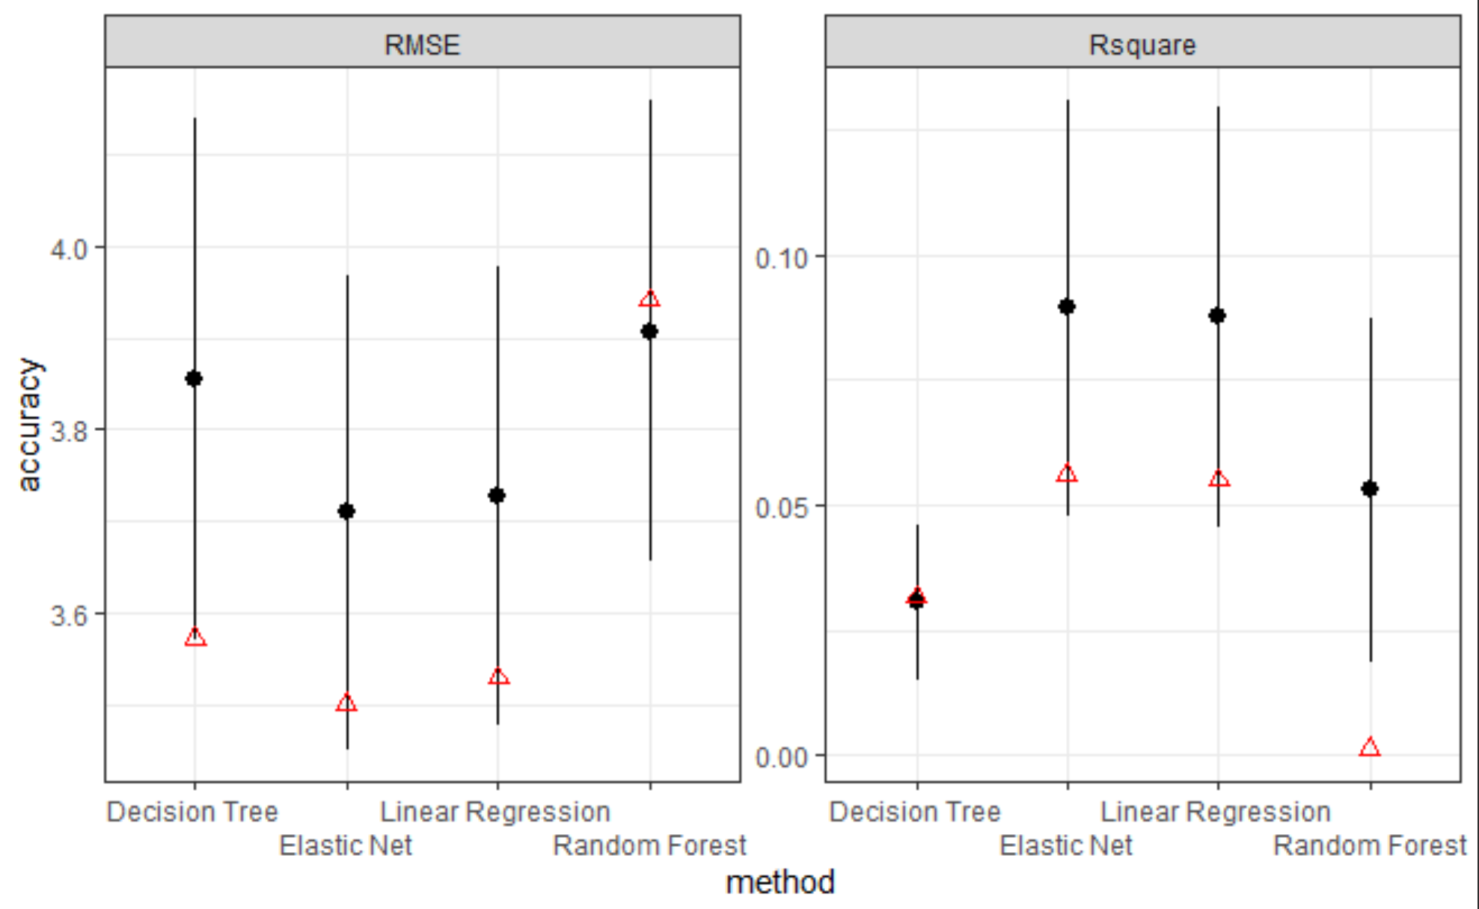
Compare best model across methods
Bootstrapped resampling for train and test data
Notes:
original test performance estimates in the resample plot: Elasticnet has the lowest mean RMSE, highest mean R2
Elastic net is the best perfoming model, followed by linear regression
Random forest performs better than decision tree; but decision tree is more interpretable.

Slide 20
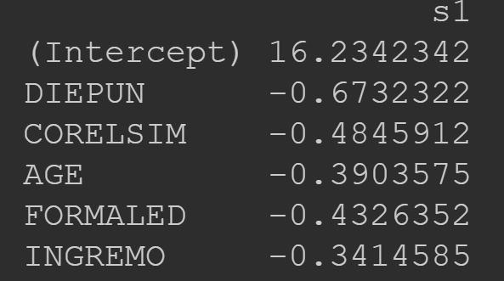
Interpreting the best model
Linear regression (elastic predictors)
Elastic = Ridge
Notes:
The best performing model of all methods is the elastic net model, however it has a smaller coefficient for the predictors compared with linear regression when both models are regressed on the exact same predictors. With alpha 0, elastic net is essentially Ridge Regression, it then tunes multiple regression data that suffer from multicollinearity, leading to better predictions
All the 3 best models agree that DIEPUN is the most important predictor and that it exerts a negative effect. At the beginning of the report bivariate of all predictors with the dv are reported, and DIEPUN is most strongly negatively correlated with the dv. Thus the linear effect of DIEPUN is well-captured by all the models. The second most important predictor for lm and elastic net is corelsim, which also exerts a negative effect on the dv
Since all the predictors are centered with preprocess in caret. Interpretation of the coefficients considers the average of each predictor.
The higher the score of DIEPUN (suggest belief in punishment from god and influence of god after death), less number of coins are kept in the self cup –which is reasonable and as expected. Similarly, the higher the score of corelsim (suggest belief in similarity of religious practices between two communities), the lesser the coins kept in the self cup.In conclusion, the predictors listed for lm and elastic best model encourage prosocial and moral behavior as less coins are kept for oneself.
Decision tree yields similar results for the effect of DIEPUN. The baseline prediction is 16 coins kept for oneself. The model predicts that when the participant score for DIEPUN is 0.17 above average, he keeps less coin for himself.

Slide 21
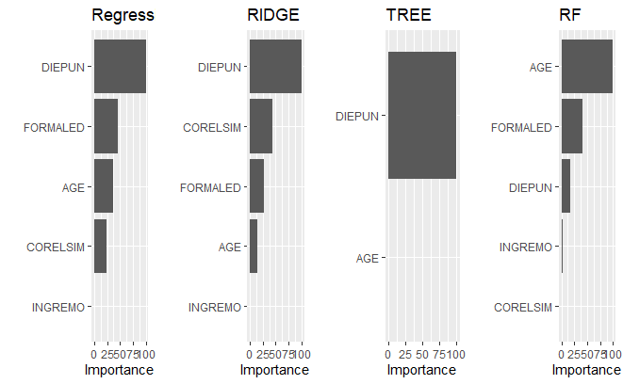
Conclusion 2
Redundant;collinearity
Tree: Less is more
Blackbox: information
Notes:
I conclude that feature selection is an important process when many predictors are involved and comparison of models across training methods are needed. Redudant predictors and multicollinearity are factors that influence the performance of linear regression.
It was a surprise to me that when all the 22 predictors are feeded to decision tree, the tree model could not identify any important variable to utilize for prediction. It was counterintuitive at first that there wasn’t any information gain when many predictors are provided but then I realize that the decision tree considers all the predictors at once on the basis of Gini Impurity Index or Information Gain, thus any small change could lead to a significant diff in the optimal tree. Lastly as expected, blackbox method random forest did perform better than tree . Vip reveals information about the important variables for rf , suggesting that age has a non-linear effect that are not captured by the other models.

Slide 22
Limitations
Interactive effects not considered
Binomial distribution of response variable not fully utilized: X~B(30,p)
Prediction on test data is poor (R2 < 20% )
Random effects of game type (Local vs Self)?
Notes:
There are several limitations of the previous analysis, first is that only main effects are considered. Second is that the binomial dist of the count of coins are not considered. Binomial regression that uses maximum likelihood estimation to estimate p for each observation could yield better results. Third is that prediction on test data even for the best model is poor, less than .02. Lastly, I only considered one of the two games as I use the number of coins in the self game as the dependent variable. Random effects of game type can also be explored to identify possible interaction effects. I will now move on to resolving the first two limitations.

Slide 23
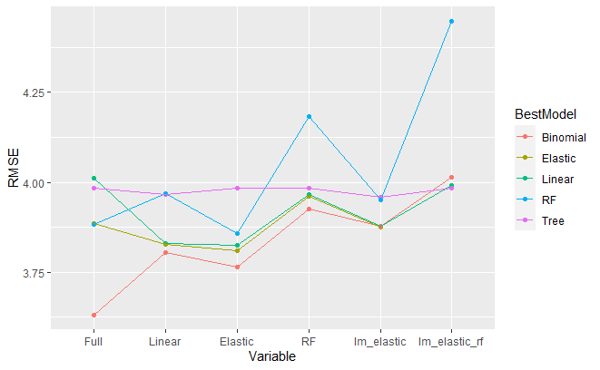
Binomial regression
Notes:
The same procedure is applied to binomial regression conditional on different combinations of predictors used. Plots of cv error across methods show that binomial regression including all 22 predictors outperforms previously best performing model. However, this raises concern for overfitting

Slide 24
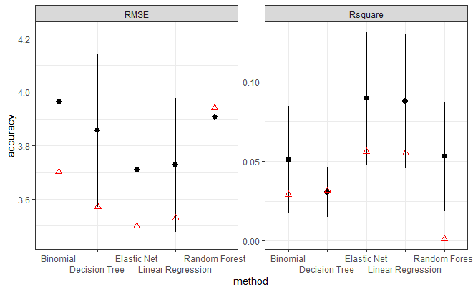
Compare best model across methods
- Overfitting (binomial regression)
Bootstrapped resampling for train and test data
Notes:
Bootstrapped resampling for train and test data are once again plotted with
original test performance estimates added. Resampling performance shows that elastic net is still the best performing model, followed by elastic net. Poor performance of binomial regression for test data suggests overfitting

Slide 25
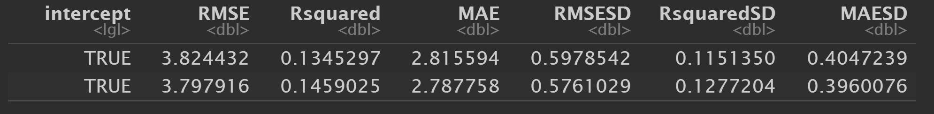
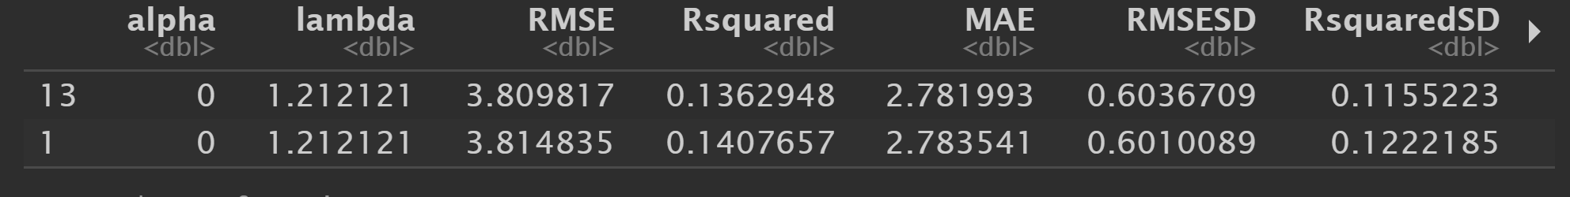

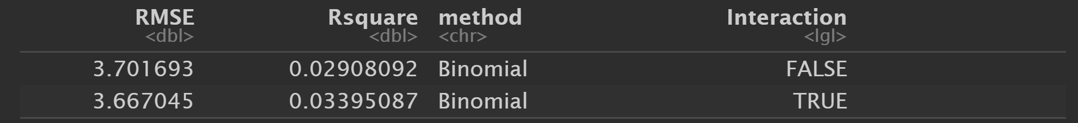
Adding Interactions: Predictive accuracy
DIEPUN*CORELSIM added
Improvement in LM
Elastic Net is already adequate, captures non-linear effects
Train
Improvement for binomial regression
Test
Notes:
Next I added interaction term between top two important predictors for the best models, that is DIEPUN and corelsim
When this term is added in, there is an improvement for the best model of linear regression
However, interaction term reduces performance of elastic net, this is not surprising as elastic net is already adequare in capturing non-linear effects.
Lastly, adding interactive term increases performance of binomial regression.
Due to the time constraint I could’nt explore all possible two-way interactions between important variables individually but the results for including interactions of top two predictors suggest to me that there are other higher order non-linear effects unidenfied in the current analysis.

Slide 26
Explain or predict
“The higher participants rated their moralistic gods as punitive and knowledgeable about human thoughts and actions, the more coins they allocated to geographically distant co-religionist strangers relative to both themselves and local co-religionists. “ (Purzycki, et al, 2016) [Binomial Regression]
Training data [Binomial regression: R2 ~ 20%]
Predictive models: limited predictive accuracy [Binomial R2 < 10% ]
“goodness of fit” between the statistical model and the sample data: overfit?
Notes:
Lastly, I will end my report discussing whether the predictive models constructed in this report complements the traditional explanatory models. The researchers used binomial regression to model the data and concluded that participants belief about punishment from god leads to more coins given to to geographically distant co-religionist strangers in the self game. This finding is replicated in my report. Binomial regression yields R2 of close 20% However, the highest resampling R square for binomial regression is no greater than 10%. Previous analysis with binomial regression being the best model for training data suggests that binomial regression is overfitting to the sample data and has limited predictive accuracy for unobserved data.
Therefore,
While researchers using traditional explanatory models could find significant amount of variance explained by the predictors. This does not mean that the same predictors can be used to predict another round of random allocation game with different group of participants accurately, as testified by this report.

Slide 27
References
Open Science Collaboration. (2015). Estimating the reproducibility of psychological science. Science, 349(6251). 10.1126/science.aac4716
Purzycki, B., Apicella, C., Atkinson, Q. et al. Moralistic gods, supernatural punishment and the expansion of human sociality. Nature 530, 327–330 (2016). https://doi-org.libproxy1.nus.edu.sg/10.1038/nature16980
Purzycki, B., Norenzayan, A., Apicella, C., Atkinson, Q., Cohen, E., McNamara, R., … Henrich, J. (2016b). Cross-cultural dataset for the evolution of religion and morality project. Scientific Data, 3, 16099. doi: 10.1038/sdata.2016.99
Simmons JP, Nelson LD, & Simonsohn U (2011). False-Positive Psychology Undisclosed Flexibility in Data Collection and Analysis Allows Presenting Anything as Significant. Psychological Science, 0956797611417632. 10.1177/0956797611417632
Yarkoni, T., & Westfall, J. (2017). Choosing Prediction Over Explanation in Psychology: Lessons From Machine Learning. Perspectives on psychological science : a journal of the Association for Psychological Science, 12(6), 1100–1122. https://doi.org/10.1177/1745691617693393

