Slide 1
IO

Slide 2
Java NIO
Channels and Buffers
标准IO，byte/character stream打交道
NIO，Channel <=> Buffer
Non-blocking IO
Java NIO让我们可以实现非阻塞IO，即对Channel进行IO请求后，立刻返回做其他逻辑，Data is read into the buffer 。
Selector
一个线程监控多个channels上的事件，

Slide 3
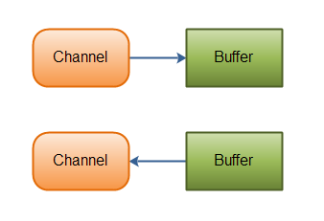
Channels & Buffers
Below cover the basic data types that you can send via IO: byte, short, int, long, float, double and characters.
ByteBuffer
CharBuffer
DoubleBuffer
FloatBuffer
IntBuffer
LongBuffer
ShortBuffer
Below covers UDP + TCP network IO, and file IO.
FileChannel
DatagramChannel
SocketChannel
ServerSocketChannel

Slide 4
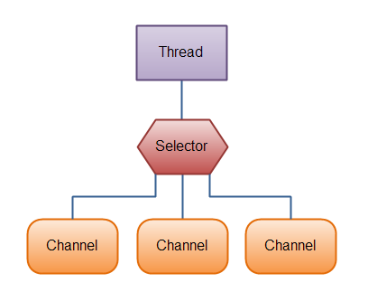
Selectors
To use a Selector you register the Channel's with it. Then you call it's select() method. This method will block until there is an event ready for one of the registered channels. Once the method returns, the thread can then process these events. Examples of events are incoming connection, data received etc.

Slide 5
Java NIO Channel
You can both read and write to a Channels. Streams are typically one-way (read or write).
Channels can be read and written asynchronously.
Channels always read to, or write from, a Buffer.

Slide 6
Java NIO Buffer
A buffer is essentially a block of memory.
Write data into the Buffer
Call buffer.flip()
Read data out of the Buffer
Call buffer.clear() or buffer.compact()

Slide 7
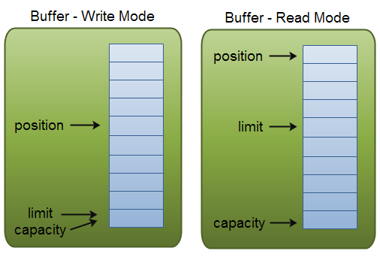
Java NIO Buffer

Slide 8
Java NIO Buffer
ByteBuffer
MappedByteBuffer
CharBuffer
DoubleBuffer
FloatBuffer
IntBuffer
LongBuffer
ShortBuffer
ByteBuffer buf = ByteBuffer.allocate(48);
int bytesRead = inChannel.read(buf);
buf.put(127);
int bytesWritten = inChannel.write(buf);
byte aByte = buf.get();

Slide 9
Java NIO Buffer
rewind()
clear() and compact()
buffer.mark();
//call buffer.get() a couple of times, e.g. during parsing.
buffer.reset(); //set position back to mark.

Slide 10
Java NIO Buffer equals()
Two buffers are equal if:
They are of the same type (byte, char, int etc.)
They have the same amount of remaining bytes, chars etc. in the buffer.
All remaining bytes, chars etc. are equal.

Slide 11
Java NIO Buffer compareTo()
A buffer is considered "smaller" than another buffer if:
The first element which is equal to the corresponding element in the other buffer, is smaller than that in the other buffer.
All elements are equal, but the first buffer runs out of elements before the second buffer does (it has fewer elements).

