Slide 1
The Netflix API processes 10+ billion HystrixCommand executions per day using thread isolation.
Each API instance has 40+ thread-pools with 5-20 threads in each (most are set to 10).
Hystrix是Netflix开源的一款容错框架.
包含常用的容错方法：
线程隔离
信号量隔离
降级策略
熔断技术。

Slide 2
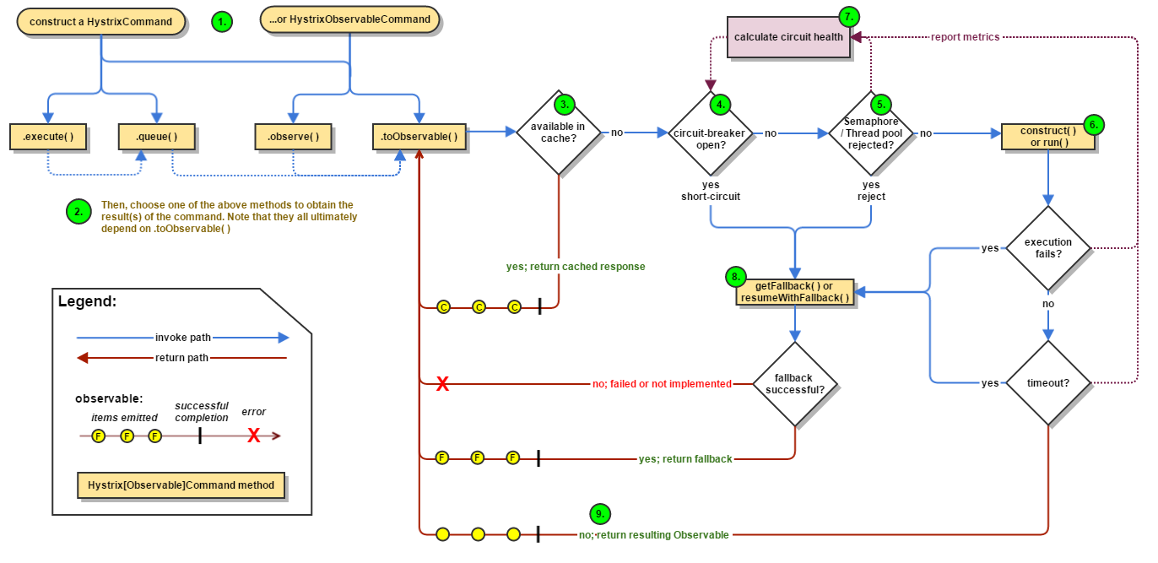
Work Flow
https://github.com/Netflix/Hystrix/wiki/How-it-Works

Slide 3
HystrixCommand HystrixObservableCommand
表示请求，它需要调用下游的依赖。
https://design.codelytics.io/hystrix/how-it-works

Slide 4
Execute the command
execute() — blocks, then returns the single response received from the dependency (or throws an exception in case of an error)
queue() — returns a Future with which you can obtain the single response from the dependency
observe() — subscribes to the Observable that represents the response(s) from the dependency and returns an Observable that replicates that source Observable
toObservable() — returns an Observable that, when you subscribe to it, will execute the Hystrix command and emit its responses
The synchronous call execute() invokes queue().get(). queue() in turn invokes toObservable().toBlocking().toFuture(). Which is to say that ultimately every HystrixCommand is backed by an Observable implementation, even those commands that are intended to return single, simple values.
Notes:
K value = command.execute();
Future<K> fValue = command.queue();
Observable<K> ohValue = command.observe(); //hot observable
Observable<K> ocValue = command.toObservable(); //cold observable

Slide 5
Is the Response Cached? Is the Circuit Open? Is the Thread Pool/Queue/Semaphore Full?

Slide 6
HystrixObservableCommand.construct() HystrixCommand.run()
HystrixCommand.run() — returns a single response or throws an exception
HystrixObservableCommand.construct() — returns an Observable that emits the response(s) or sends an onError notification
调用下游的逻辑都写在上述方法中。相当于是wrap所有的调用到一个command中。
todo：getFallback之后的话，原本执行这一堆调用的线程资源能否回收，对应的http client的处理？等。

Slide 7
HystrixObservableCommand.construct() HystrixCommand.run()
InterruptedException
If the work wrapped by Hystrix does not respect InterruptedExceptions, the thread in the Hystrix thread pool will continue its work, though the client already received a TimeoutException.
So make sure to correctly configure connection and read/write timeouts on the HTTP clients.

Slide 8
Get the Fallback
Write your fallback to provide a generic response, without any network dependency, from an in-memory cache or by means of other static logic. If you must use a network call in the fallback, you should do so by means of another HystrixCommand or HystrixObservableCommand.

Slide 9
Threads & Thread Pools
Clients (libraries, network calls, etc) execute on separate threads.
Hystrix uses separate, per-dependency thread pools as a way of constraining any given dependency so latency on the underlying executions will saturate the available threads only in that pool.
一个依赖对应一个线程池。该依赖挂了的话，最多就是爆了一个线程池而不是所有的。
It is possible for you to protect against failure without the use of thread pools, but this requires the client being trusted to fail very quickly (network connect/read timeouts and retry configuration) and to always behave well.

Slide 10
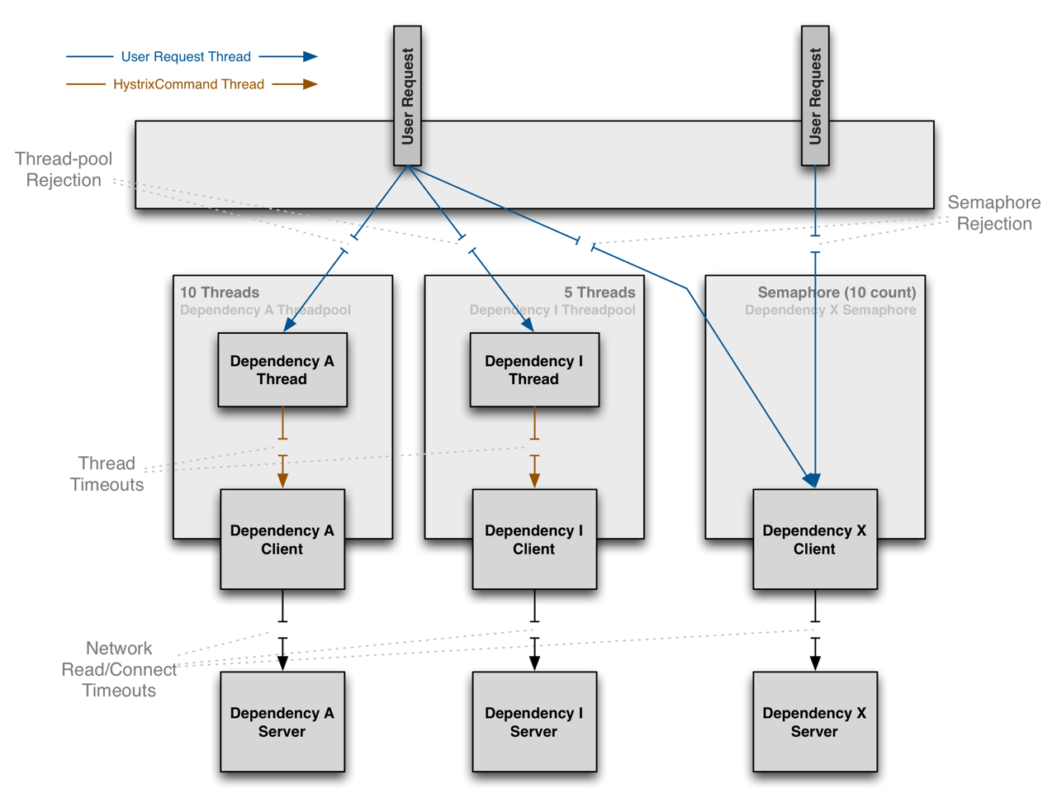

Slide 11
Benefits of Thread Pools
The application is fully protected from runaway client libraries. The pool for a given dependency library can fill up without impacting the rest of the application.
The application can accept new client libraries with far lower risk. If an issue occurs, it is isolated to the library and doesn’t affect everything else.
When a failed client becomes healthy again, the thread pool will clear up and the application immediately resumes healthy performance, as opposed to a long recovery when the entire Tomcat container is overwhelmed.
If a client library is misconfigured, the health of a thread pool will quickly demonstrate this (via increased errors, latency, timeouts, rejections, etc.) and you can handle it (typically in real-time via dynamic properties) without affecting application functionality.
If a client service changes performance characteristics (which happens often enough to be an issue) which in turn cause a need to tune properties (increasing/decreasing timeouts, changing retries, etc.) this again becomes visible through thread pool metrics (errors, latency, timeouts, rejections) and can be handled without impacting other clients, requests, or users.
Beyond the isolation benefits, having dedicated thread pools provides built-in concurrency which can be leveraged to build asynchronous facades on top of synchronous client libraries (similar to how the Netflix API built a reactive, fully-asynchronous Java API on top of Hystrix commands).
In short, the isolation provided by thread pools allows for the always-changing and dynamic combination of client libraries and subsystem performance characteristics to be handled gracefully without causing outages.

Slide 12
Drawbacks of Thread Pools
The primary drawback of thread pools is that they add computational overhead.
Each command execution involves the queueing, scheduling, and context switching involved in running a command on a separate thread.

Slide 13
Semaphores
This allows Hystrix to shed load without using thread pools but it does not allow for timing out and walking away.
If you trust the client and you only want load shedding, you could use this approach.
HystrixCommand and HystrixObservableCommand support semaphores in 2 places:
Fallback: When Hystrix retrieves fallbacks it always does so on the calling Tomcat thread.
Execution: If you set the property execution.isolation.strategy to SEMAPHORE then Hystrix will use semaphores instead of threads to limit the number of concurrent parent threads that invoke the command.

Slide 14
Semaphores
if a dependency is isolated with a semaphore and then becomes latent, the parent threads will remain blocked until the underlying network calls timeout.
Semaphore rejection will start once the limit is hit but the threads filling the semaphore can not walk away.

Slide 15
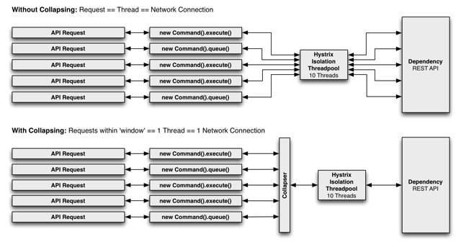
Request Collapsing
https://design.codelytics.io/hystrix/request-collapsing
first without and then with request collapsing (assuming all connections are “concurrent” within a short time window, in this case 10ms).

Slide 16
Why Use Request Collapsing?
Use request collapsing to reduce the number of threads and network connections needed to perform concurrent HystrixCommand executions. Request collapsing does this in an automated manner that does not force all developers of a codebase to coordinate the manual batching of requests.

Slide 17
Global Context (Across All Tomcat Threads)
User Request Context (Single Tomcat Thread)
Object Modeling and Code Complexity

Slide 18
maven 依赖
<hystrix.version>1.3.16</hystrix.version>
<hystrix-metrics-event-stream.version>1.1.2</hystrix-metrics-event-stream.version>
<dependency>
<groupId>com.netflix.hystrix</groupId>
<artifactId>hystrix-core</artifactId>
<version>${hystrix.version}</version>
</dependency>
<dependency>
<groupId>com.netflix.hystrix</groupId>
<artifactId>hystrix-metrics-event-stream</artifactId>
<version>${hystrix-metrics-event-stream.version}</version>
</dependency>

Slide 19
依赖命名:CommandKey
每个CommandKey代表一个依赖抽象,相同的依赖要使用相同的CommandKey名称。依赖隔离的根本就是对相同CommandKey的依赖做隔离.

Slide 20
依赖分组:CommandGroup
//使用HystrixCommandGroupKey工厂定义
public HelloWorldCommand(String name) {
Setter.withGroupKey(
HystrixCommandGroupKey.Factory.asKey("HelloWorldGroup"))
}
CommandGroup是每个命令最少配置的必选参数，在不指定ThreadPoolKey的情况下，字面值用于对不同依赖的线程池/信号区分.

Slide 21
线程池/信号:ThreadPoolKey
public HelloWorldCommand(String name) {
super(Setter.withGroupKey(HystrixCommandGroupKey.Factory.asKey("ExampleGroup"))
.andCommandKey(HystrixCommandKey.Factory.asKey("HelloWorld"))
/* 使用HystrixThreadPoolKey工厂定义线程池名称*/
.andThreadPoolKey(HystrixThreadPoolKey.Factory.asKey("HelloWorldPool")));
this.name = name;
}
当对同一业务依赖做隔离时使用CommandGroup做区分,但是对同一依赖的不同远程调用如(一个是redis 一个是http),可以使用HystrixThreadPoolKey做隔离区分.

Slide 22
请求缓存 Request-Cache
请求缓存可以让(CommandKey/CommandGroup)相同的情况下,直接共享结果，降低依赖调用次数，在高并发和CacheKey碰撞率高场景下可以提升性能.

Slide 23
信号量隔离:SEMAPHORE
隔离本地代码或可快速返回远程调用(如memcached,redis)可以直接使用信号量隔离,降低线程隔离开销.

Slide 24
命令调用合并:HystrixCollapser
使用场景:
HystrixCollapser用于对多个相同业务的请求合并到一个线程甚至可以合并到一个连接中执行，降低线程交互次和IO数,但必须保证他们属于同一依赖.

