Slide 1
The Netflix API processes 10+ billion HystrixCommand executions per day using thread isolation.
Each API instance has 40+ thread-pools with 5-20 threads in each (most are set to 10).
Hystrix是Netflix开源的一款容错框架.
包含常用的容错方法：
线程隔离
信号量隔离
降级策略
熔断技术

Slide 2
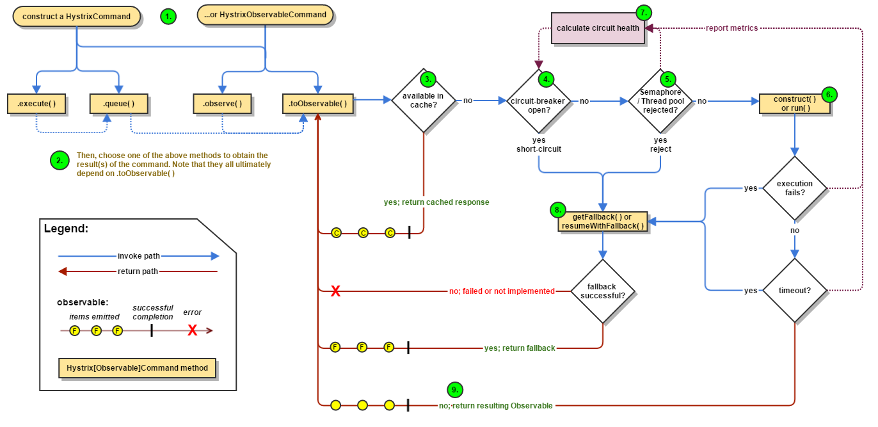
Work Flow
https://github.com/Netflix/Hystrix/wiki/How-it-Works

Slide 3
HystrixCommand HystrixObservableCommand
表示请求，指向下游依赖的请求。
前者返回a single response
后者返回一个Observable，它会发射response。
https://design.codelytics.io/hystrix/how-it-works

Slide 4
Execute the command
execute() — blocks, then returns the single response received from the dependency (or throws an exception in case of an error)
queue() — returns a Future with which you can obtain the single response from the dependency
observe() — subscribes to the Observable that represents the response(s) from the dependency and returns an Observable that replicates that source Observable
toObservable() — returns an Observable that, when you subscribe to it, will execute the Hystrix command and emit its responses
The synchronous call execute() invokes queue().get(). queue() in turn invokes toObservable().toBlocking().toFuture().
Which is to say that ultimately every HystrixCommand is backed by an Observable implementation, even those commands that are intended to return single, simple values.
Notes:
K value = command.execute();
Future<K> fValue = command.queue();
Observable<K> ohValue = command.observe(); //hot observable
Observable<K> ocValue = command.toObservable(); //cold observable

Slide 5
Is the Response Cached? Is the Circuit Open? Is the Thread Pool/Queue/Semaphore Full?

Slide 6
HystrixObservableCommand.construct() HystrixCommand.run()
HystrixCommand.run() — returns a single response or throws an exception
HystrixObservableCommand.construct() — returns an Observable that emits the response(s) or sends an onError notification
调用下游的逻辑都写在上述方法中。相当于是wrap所有的调用到一个command中。
todo：getFallback之后的话，原本执行这一堆调用的线程资源能否回收，对应的http client的处理？等。

Slide 7
HystrixObservableCommand.construct() HystrixCommand.run()
需要注意的是，潜在的线程（超时了的）是没有办法暂停的，最多就是向它丢一个InterruptedException
InterruptedException
If the work wrapped by Hystrix does not respect InterruptedExceptions, the thread in the Hystrix thread pool will continue its work, though the client already received a TimeoutException.
这个做法会浪费hystrix的线程池资源，尽管负载已经被“较好的削峰了”。大多数的httpclient 库都不会interpret InterruptedException。
So make sure to correctly configure connection and read/write timeouts on the HTTP clients.

Slide 8
HystrixObservableCommand.construct() HystrixCommand.run()
在response都正常 无exception的情况下，Hystrix在做了一个logging和metrics reporting之后就会返回logging。
run()
返回一个observable（emit single response）
make a onCompleted notification
construct()
返回一个observable（emit single response）

Slide 9
Calculate Circuit Health
Hystrix reports successes, failures, rejections, and timeouts to the circuit breaker, which maintains a rolling set of counters that calculate statistics.

Slide 10
Get the Fallback
Write your fallback to provide a generic response, without any network dependency, from an in-memory cache or by means of other static logic.
If you must use a network call in the fallback, you should do so by means of another HystrixCommand or HystrixObservableCommand.
It is a poor practice to implement a fallback implementation that can fail. You should implement your fallback such that it is not performing any logic that could fail.

Slide 11
Get the Fallback
The result of a failed or nonexistent fallback will differ depending on how you invoked the Hystrix command:
execute() — throws an exception
queue() — successfully returns a Future, but this Future will throw an exception if its get() method is called
observe() — returns an Observable that, when you subscribe to it, will immediately terminate by calling the subscriber’s onError method
toObservable() — returns an Observable that, when you subscribe to it, will terminate by calling the subscriber’s onError method

Slide 12
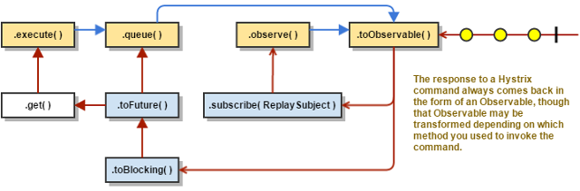
Return the Successful Response
If the Hystrix command succeeds, it will return the response or responses to the caller in the form of an Observable.

Slide 13
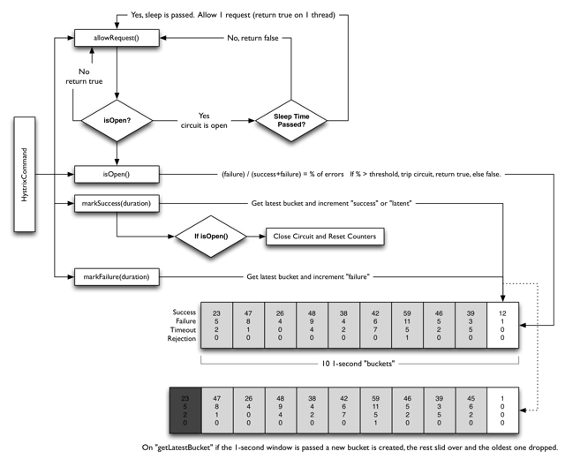
Circuit Breaker

Slide 14
Circuit Breaker
Assuming the volume across a circuit meets a certain threshold (HystrixCommandProperties.circuitBreakerRequestVolumeThreshold())...
And assuming that the error percentage exceeds the threshold error percentage (HystrixCommandProperties.circuitBreakerErrorThresholdPercentage())...
Then the circuit-breaker transitions from CLOSED to OPEN.
While it is open, it short-circuits all requests made against that circuit-breaker.
After some amount of time (HystrixCommandProperties.circuitBreakerSleepWindowInMilliseconds()), the next single request is let through (this is the HALF-OPEN state). If the request fails, the circuit-breaker returns to the OPEN state for the duration of the sleep window. If the request succeeds, the circuit-breaker transitions to CLOSED and the logic in 1. takes over again.

Slide 15
Isolation
Hystrix employs the bulkhead pattern to isolate dependencies from each other and to limit concurrent access to any one of them.

Slide 16
Threads & Thread Pools
Clients (libraries, network calls, etc) execute on separate threads.
This isolates them from the calling thread (Tomcat thread pool) so that the caller may “walk away” from a dependency call that is taking too long.
Hystrix uses separate, per-dependency thread pools as a way of constraining any given dependency so latency on the underlying executions will saturate the available threads only in that pool.
一个依赖对应一个线程池。该依赖挂了的话，最多就是爆了一个线程池而不是所有的。
It is possible for you to protect against failure without the use of thread pools, but this requires the client being trusted to fail very quickly (network connect/read timeouts and retry configuration) and to always behave well.

Slide 17
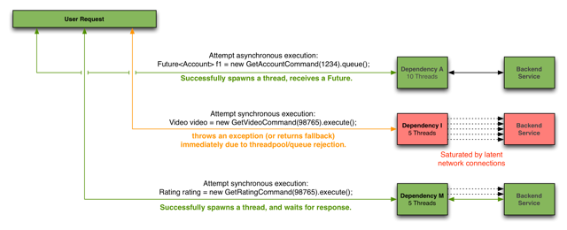
Threads & Thread Pools

Slide 18
Netflix选用线程池作为Hystrix隔离机制的原因
Many applications execute dozens (and sometimes well over 100) different back-end service calls against dozens of different services developed by as many different teams.
Each service provides its own client library.
Client libraries are changing all the time.
Client library logic can change to add new network calls.
Client libraries can contain logic such as retries, data parsing, caching (in-memory or across network), and other such behavior.
Client libraries tend to be “black boxes” — opaque to their users about implementation details, network access patterns, configuration defaults, etc.
In several real-world production outages the determination was “oh, something changed and properties should be adjusted” or “the client library changed its behavior.”
Even if a client itself doesn’t change, the service itself can change, which can then impact performance characteristics which can then cause the client configuration to be invalid.
Transitive dependencies can pull in other client libraries that are not expected and perhaps not correctly configured.
Most network access is performed synchronously.
Failure and latency can occur in the client-side code as well, not just in the network call.

Slide 19
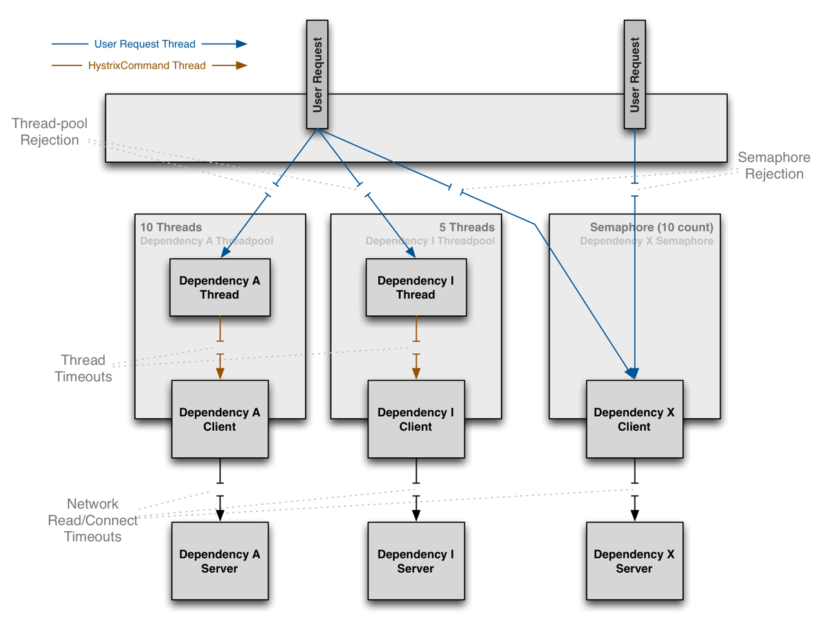

Slide 20
Benefits of Thread Pools
The application is fully protected from runaway client libraries. The pool for a given dependency library can fill up without impacting the rest of the application.
The application can accept new client libraries with far lower risk. If an issue occurs, it is isolated to the library and doesn’t affect everything else.
When a failed client becomes healthy again, the thread pool will clear up and the application immediately resumes healthy performance, as opposed to a long recovery when the entire Tomcat container is overwhelmed.
If a client library is misconfigured, the health of a thread pool will quickly demonstrate this (via increased errors, latency, timeouts, rejections, etc.) and you can handle it (typically in real-time via dynamic properties) without affecting application functionality.
If a client service changes performance characteristics (which happens often enough to be an issue) which in turn cause a need to tune properties (increasing/decreasing timeouts, changing retries, etc.) this again becomes visible through thread pool metrics (errors, latency, timeouts, rejections) and can be handled without impacting other clients, requests, or users.
Beyond the isolation benefits, having dedicated thread pools provides built-in concurrency which can be leveraged to build asynchronous facades on top of synchronous client libraries (similar to how the Netflix API built a reactive, fully-asynchronous Java API on top of Hystrix commands).
In short, the isolation provided by thread pools allows for the always-changing and dynamic combination of client libraries and subsystem performance characteristics to be handled gracefully without causing outages.

Slide 21
Benefits of Thread Pools
应用完全不会受到跑飞了的客户端库的影响。该依赖对应线程池即使满了也不会影响应用的其它部分。
应用可以以极低的风险试用新的客户端库。理由同一
跑飞了的客户端库恢复之后，线程池会clearup然后应用立刻恢复健康。
如何客户端配置错了，线程池的健康程度可以立刻反应得到实时处理。
如果客户端服务改变了性能，会需要修改properties，修改时长、重试等。这些都是可以从线程池的metrics中看出来，并且得到实时处理。
除了隔离功能，使用线程池提供了内建的并发，可以在同步客户端库之上，构建一个异步的外观。

Slide 22
Benefits of Thread Pools
综上，线程池隔离让 不断变化并且动态组合 客户端库成为一种能力，并且可以优雅地处理一些性能问题，而不至于引起服务暂停。
当然，尽管线程提供了隔离能力，但是客户端代码本身还是需要有timeout、或者有能力响应线程interrupt，不然会永久阻塞线程，占用资源。

Slide 23
Drawbacks of Thread Pools
The primary drawback of thread pools is that they add computational overhead.
Each command execution involves the queueing, scheduling, and context switching involved in running a command on a separate thread.

Slide 24
Semaphores
This allows Hystrix to shed load without using thread pools but it does not allow for timing out and walking away.
If you trust the client and you only want load shedding, you could use this approach.
HystrixCommand and HystrixObservableCommand support semaphores in 2 places:
Fallback: When Hystrix retrieves fallbacks it always does so on the calling Tomcat thread.
Execution: If you set the property execution.isolation.strategy to SEMAPHORE then Hystrix will use semaphores instead of threads to limit the number of concurrent parent threads that invoke the command.

Slide 25
Semaphores
if a dependency is isolated with a semaphore and then becomes latent, the parent threads will remain blocked until the underlying network calls timeout.
Semaphore rejection will start once the limit is hit but the threads filling the semaphore can not walk away.

Slide 26
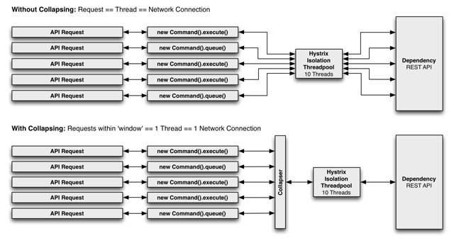
Request Collapsing
https://design.codelytics.io/hystrix/request-collapsing
first without and then with request collapsing (assuming all connections are “concurrent” within a short time window, in this case 10ms).

Slide 27
Why Use Request Collapsing?
Use request collapsing to reduce the number of threads and network connections needed to perform concurrent HystrixCommand executions. Request collapsing does this in an automated manner that does not force all developers of a codebase to coordinate the manual batching of requests.

Slide 28
Global Context (Across All Tomcat Threads)
User Request Context (Single Tomcat Thread)
Object Modeling and Code Complexity

Slide 29
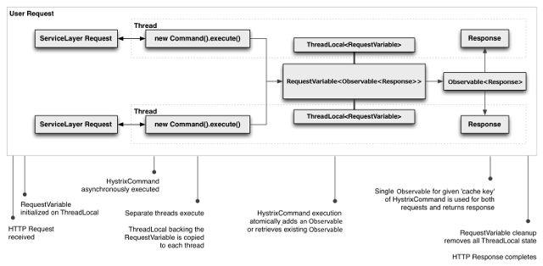
Request Caching

Slide 30
Request Caching
The benefits of request caching are:
Different code paths can execute Hystrix Commands without concern of duplicate work.
Data retrieval is consistent throughout a request.
Eliminates duplicate thread executions.

Slide 31
maven 依赖
<hystrix.version>1.3.16</hystrix.version>
<hystrix-metrics-event-stream.version>1.1.2</hystrix-metrics-event-stream.version>
<dependency>
<groupId>com.netflix.hystrix</groupId>
<artifactId>hystrix-core</artifactId>
<version>${hystrix.version}</version>
</dependency>
<dependency>
<groupId>com.netflix.hystrix</groupId>
<artifactId>hystrix-metrics-event-stream</artifactId>
<version>${hystrix-metrics-event-stream.version}</version>
</dependency>

Slide 32
Hystrix给了我们三种key来用于隔离：
CommandKey，针对相同的接口一般CommandKey值相同，目的是把HystrixCommand，HystrixCircuitBreaker，HytrixCommandMerics以及其他相关对象关联在一起，形成一个原子组。采用原生接口的话，默认值为类名；采用注解形式的话，默认值为方法名。
CommandGroupKey，对CommandKey分组，用于真正的隔离。相同CommandGroupKey会使用同一个线程池或者信号量。一般情况相同业务功能会使用相同的CommandGroupKey。
ThreadPoolKey，如果说CommandGroupKey只是逻辑隔离，那么ThreadPoolKey就是物理隔离，当没有设置ThreadPoolKey的时候，线程池或者信号量的划分按照CommandGroupKey，当设置了ThreadPoolKey，那么线程池和信号量的划分就按照ThreadPoolKey来处理，相同ThreadPoolKey采用同一个线程池或者信号量。

Slide 33
依赖命名:CommandKey
每个CommandKey代表一个依赖抽象,相同的依赖要使用相同的CommandKey名称。依赖隔离的根本就是对相同CommandKey的依赖做隔离.

Slide 34
依赖分组:CommandGroup
//使用HystrixCommandGroupKey工厂定义
public HelloWorldCommand(String name) {
Setter.withGroupKey(
HystrixCommandGroupKey.Factory.asKey("HelloWorldGroup"))
}
CommandGroup是每个命令最少配置的必选参数，在不指定ThreadPoolKey的情况下，字面值用于对不同依赖的线程池/信号区分.

Slide 35
线程池/信号:ThreadPoolKey
public HelloWorldCommand(String name) {
super(Setter.withGroupKey(HystrixCommandGroupKey.Factory.asKey("ExampleGroup"))
.andCommandKey(HystrixCommandKey.Factory.asKey("HelloWorld"))
/* 使用HystrixThreadPoolKey工厂定义线程池名称*/
.andThreadPoolKey(HystrixThreadPoolKey.Factory.asKey("HelloWorldPool")));
this.name = name;
}
当对同一业务依赖做隔离时使用CommandGroup做区分,但是对同一依赖的不同远程调用如(一个是redis 一个是http),可以使用HystrixThreadPoolKey做隔离区分.

Slide 36
请求缓存 Request-Cache
请求缓存可以让(CommandKey/CommandGroup)相同的情况下,直接共享结果，降低依赖调用次数，在高并发和CacheKey碰撞率高场景下可以提升性能.

Slide 37
信号量隔离:SEMAPHORE
隔离本地代码或可快速返回远程调用(如memcached,redis)可以直接使用信号量隔离,降低线程隔离开销.

Slide 38
命令调用合并:HystrixCollapser
使用场景:
HystrixCollapser用于对多个相同业务的请求合并到一个线程甚至可以合并到一个连接中执行，降低线程交互次和IO数,但必须保证他们属于同一依赖.

