Slide 1
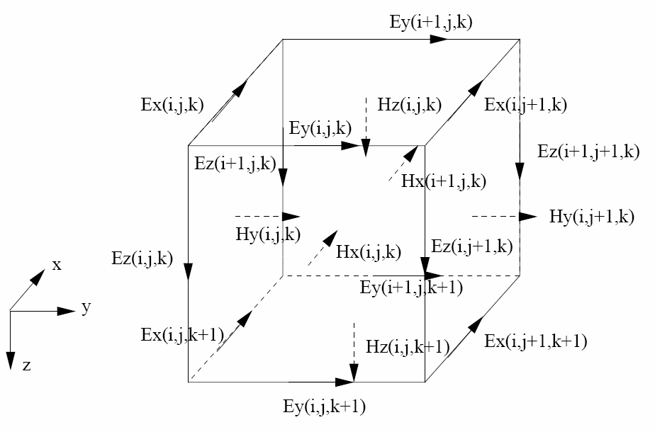
Figure 1: Staggered finite difference grid for the 3D MT forward problem. Electric field components defined on cell edges are the primary EM field component, which the PDE is formulated in terms of. The magnetic field components can be defined naturally on the cell faces; these are the secondary EM field in this numerical formulation.

Slide 2


B_{x}
B_{x}
B_{x}
B_{x}
B_{x}
B_{x}
B_{x}
B_{x}
B_{x}
Figure 2: Finite difference grid for the 2D MT TM mode forward problem. The scalar B_{x} magnetic field, defined on 2D cell corners is the primary field. The secondary field components are E_{y} and E_{z}, defined on vertical and horizontal cell edges, respectively.

Slide 3
Level I
NLCG
(etc)
DataSpace
d
MeasComb
L
SensMatrix
J
Level II
SolnRHS
e,b
DataFunc
EMsolver
S⁻¹
Pmult
P
Forward Solver
Model Parameter
m
EMeval
Numerical Discretization
Grid
EMfield
Figure 3: Overview of modular inversion system, including module usage dependency (arrows). Dashed lines delineate three major groups: (a) Level I, generic inversion routines; (b) Level 2, application specific interface to (c) numerical discretization module, which are applicable to multiple EM problems with similar numerical treatment.

