Slide 1
Computational recipes for EM Inverse Problems: Mathematical Framework
Gary D. Egbert
College of Oceanic and Atmospheric Sciences
Oregon State University
Corvallis OR

Slide 2
Outline
Brief overview of EM inversion: several approaches, similar computations: solve forward problem, computations involving Jacobian (derivative) of model→ data mapping
General expression for Jacobian → more specific expressions given a few general assumptions
Derive structure of Jacobian calculations → guide development of a general modular system
2D and 3D MT examples → enough differences to illustrate power of abstract treatment

Slide 3
Goal: more efficient minimization of the quadratic penalty functional
Data misfit (N_{d} data)
Model roughness (M parameters)
Note: the introduction follows the original motivation for the modular system: testing more efficient minimization algorithms … want to come back to this!

Slide 4
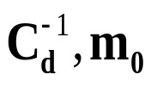
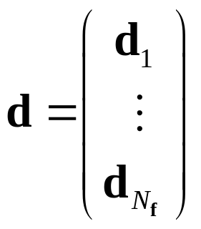
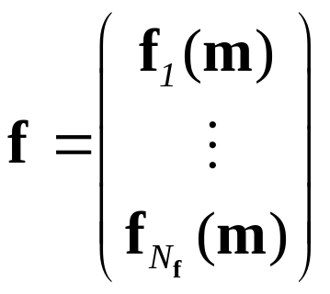
Goal: more efficient minimization of the quadratic penalty functional
Data misfit (N_{d} data)
Model roughness (M parameters)
Rescale data, shift model to eliminate
Focus on the case where there are data for N_{f} frequencies:
each of which requires solution of a separate forward problem
Similar situation arises with multiple sources; both sorts of problems are extremely common in EM geophysics

Slide 5
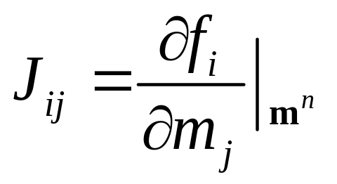
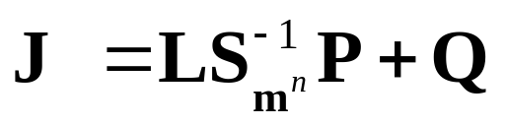
Gradient-based minimization of J : Requires Jacobian of non-linear model parameter/data mapping
Formal expression for Jacobian:
measurement functionals
Sparse matrices related to model parameterization
forward solver
Computation of each column of J requires solving the forward problem once

Slide 6

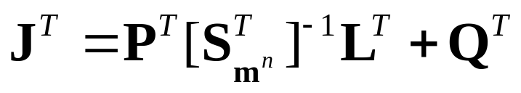
Gradient-based minimization of J : Requires Jacobian of non-linear model parameter/data mapping
Formal expression for Jacobian, at :
adjoint solver
measurement functionals
Sparse matrices related to model parameterization
Computation of each row of J requires solving the adjoint problem once
→ Very expensive computationally for 3D

Slide 7



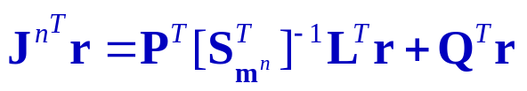
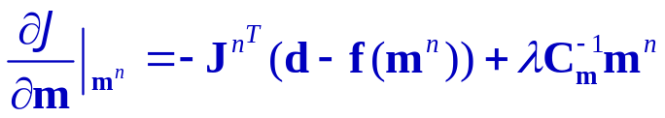

Gradient Based Solution Approaches
Gauss-Newton (GN): compute full Jacobian, then solve
set
and iterate
GN: local approximation of second derivative of penalty functional (Hessian)
Conjugate Gradients (CG): solve G-N system using CG; requires matrix-vector product i.e., compute, at each search step:
two solver calls per search step
Non-linear Conjugate Gradients (NLCG): directly minimize J using CG--requires derivatives
No direct use of Hessian … line search in conjugate descent directions
Essentially the same computations as required for CG

Slide 8
Gradient Based Solution Approaches
Gauss-Newton (GN): compute full Jacobian, then solve
Explicit, full Jacobian calculation
set
and iterate
Conjugate Gradients (CG): solve G-N system using CG; requires matrix-vector product i.e., compute, at each search step:
two solver calls per search step
Implicit, partial Jacobian calculation
Non-linear Conjugate Gradients (NLCG): directly minimize J using CG--requires derivatives
Essentialy the same computations as required for CG

Slide 9
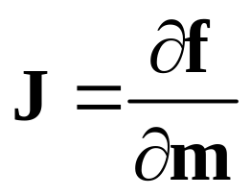
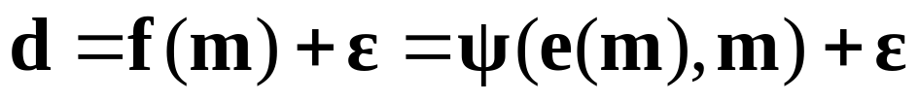
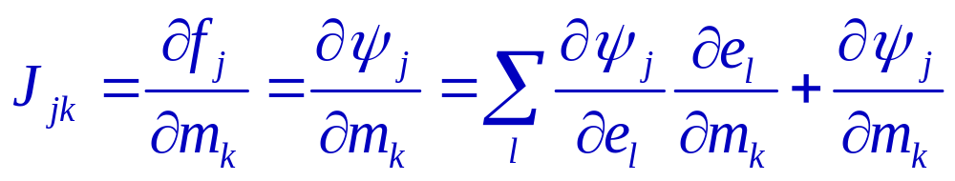
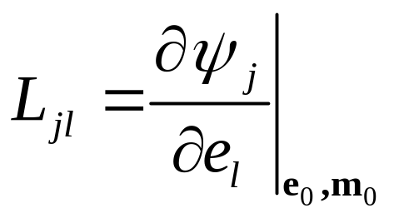
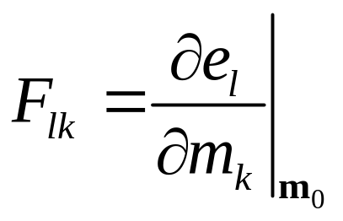
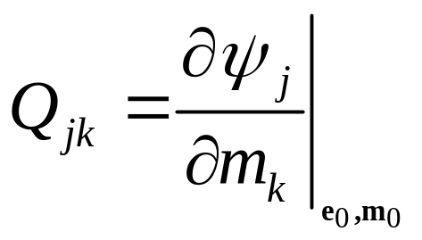
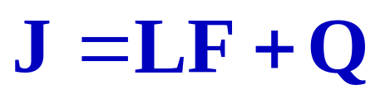
Further details on Jacobian calculation
Data (d_{j}) are related to model parameter (m) via:
Jacobian:
Jacobian components:
Define:

Slide 10
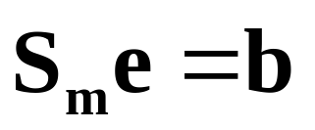
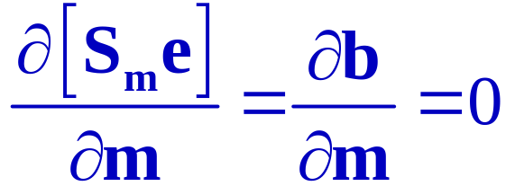
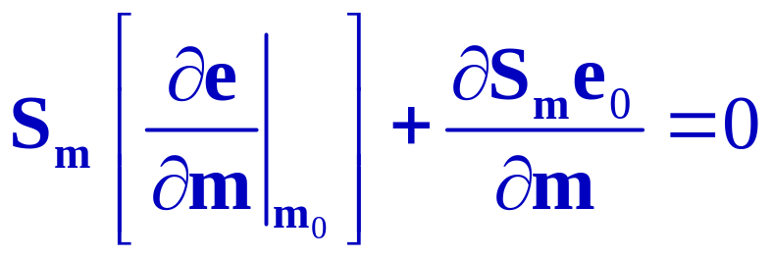
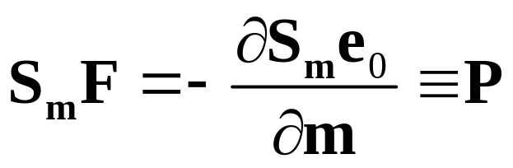
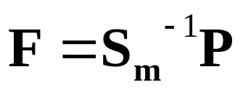
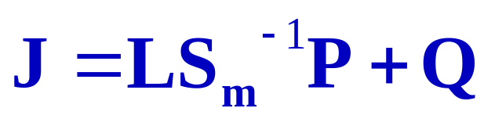
Write discretized partial differential equation as:
Sources, BC
Differential operator
EM solution
Take derivative with respect to model parameter vector m (and assume b is fixed)
Thus:

Slide 11
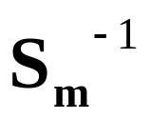
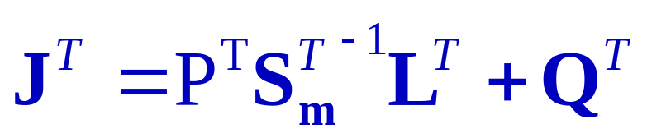
Need to be able to multiply by
Thus need to implement operators L, P, Q plus solver for the EM equations
Also need to be able to multiply by
Thus need to implement “adjoints” or transposes for all operators, including the EM equation solver

Slide 12

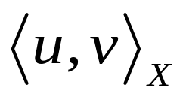
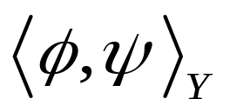
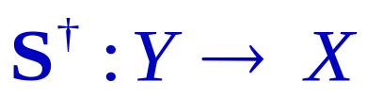
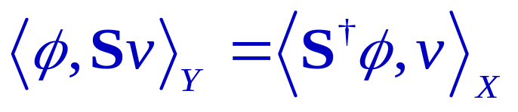
Adjoints for EM equations:
Definition of adjoint (Hilbert space … with inner products)
Where X and Y are vector spaces endowed with inner products
is the operator satisfying
Depends on inner product definitions
For discrete (finite dimensional vector space) case: S is a matrix, adjoint is transpose S^{T}

Slide 13
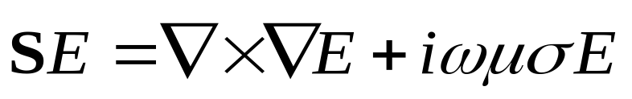
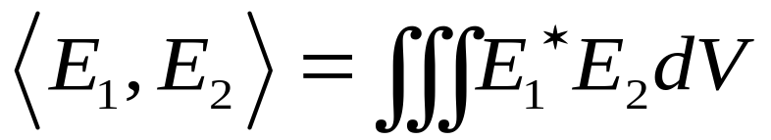
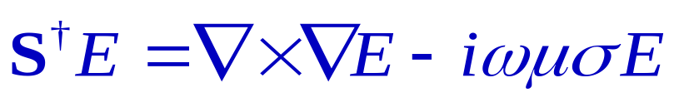
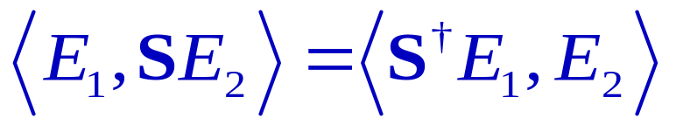

EM operators (derived from Maxwell’s equations) such as
are self adjoint (except for time reversal) with respect to usual (L₂) inner product:
I.e., if
then
And similarly for operators like:

Slide 14
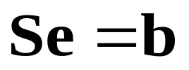
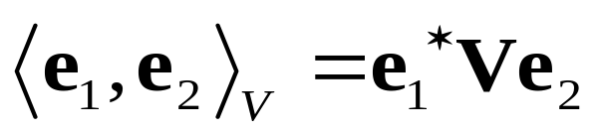
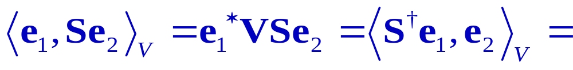
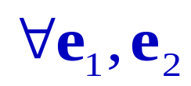
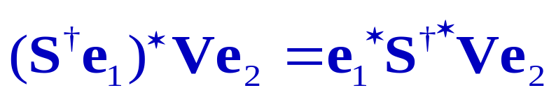
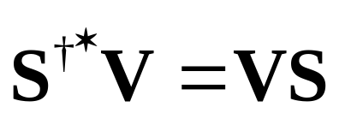
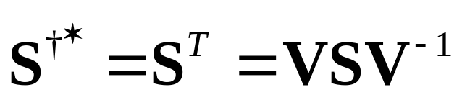
approximate the EM equations on a discrete numerical grid
and approximate the L₂ inner product as
where V is a diagonal matrix of cell volume weights for the discrete grid
The adjoint with respect to this inner product should be the conjugate S*, or

Slide 15
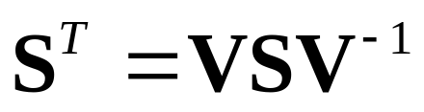

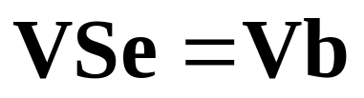
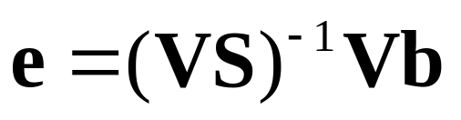
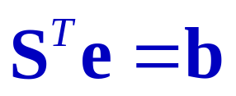
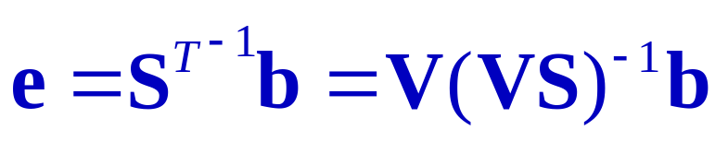
So VS is a symmetric (but not Hermitian) matrix
Easier to solve this system iteratively … usually we solve forward problem as
or
Solution to
can be computed as
Apply same solver (VS)⁻¹ and multiply by V, but in different order (some more complications in practice!)

Slide 16
Note: if we can afford to actually form the matrix S for the discrete approximation to the operator solving the transposed problem is easy. The approach just describe works when an iterative scheme is implemented for the symetrized problem

Slide 17
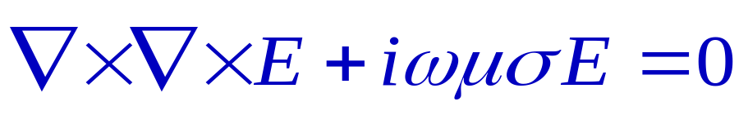
Specific Example:
x
z
y
E_{x}
E_{y}
E_{z}
3D MT Staggered grid: Electric field components defined on edges

Slide 18
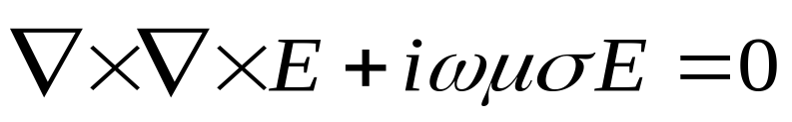
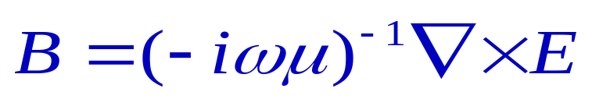
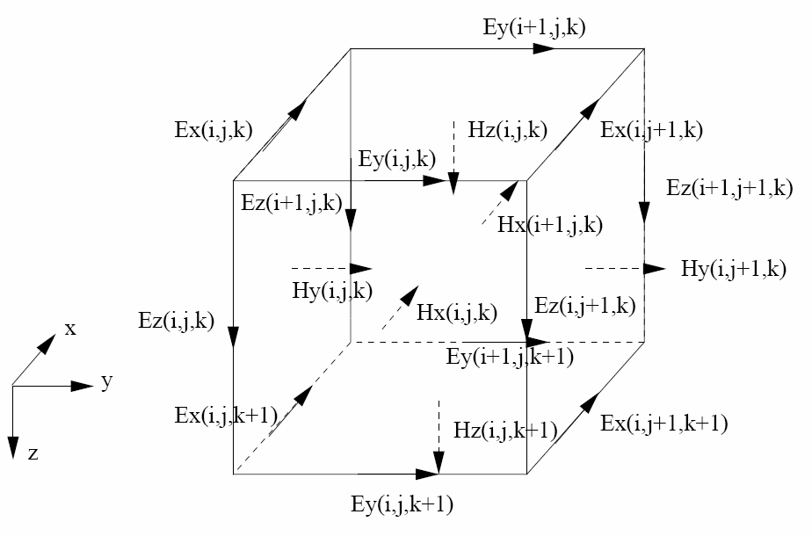
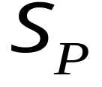

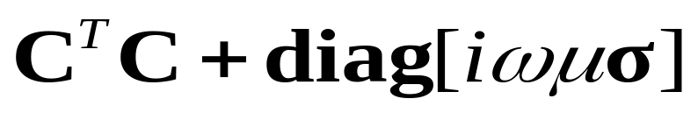
“Conjugate Grids”
Electric field components defined on edges (primary fields)
Magnetic field components defined on faces (secondary fields)
Discrete operator equation can be written:
Adjoint of discrete curl: maps cell faces to cell edges
Discrete curl: maps cell edges to cell faces

Slide 19
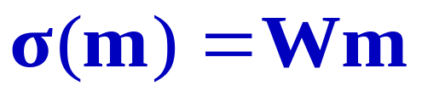

Conductivity parameterization:
Each cell is an independent parameter (conductivity or log conductivity)
Primary model parameter mapping: average from cells onto edges, where electric field components are defined
x
z
y
E_{y}
Linear conductivity
Log conductivity
W = operator that averages from cells to edges

Slide 20
Conductivity parameterization:
Each cell is an independent parameter (conductivity or log conductivity)
Primary model parameter mapping: average from cells onto edges, where electric field components are defined
x
z
y
E_{x}
Linear conductivity
Log conductivity
W = operator that averages from cells to edges

Slide 21




Another Example:
3D MT Staggered grid (Mackie):
Magnetic field components defined on edges (primary fields)
Electric field components defined on faces (secondary fields)
Discrete operator equation can be written:

Slide 22



Example:
2D MT: TM mode equation
y
z
B_{x}
B_{x}
B_{x}
Centered difference approximation at B_{x} node
B_{x}
B_{x}
B_{x}
“Stencil”
B_{x}
B_{x}
B_{x}

Slide 23


Example:
2D MT: TM mode equation
y
z
Conjugate Grids:
Nodes = B_{x}
(primary fields)
B_{x}
B_{x}
B_{x}
B_{x}
B_{x}
B_{x}
Edges = E_{y,} E_{z}
(secondary fields)
B_{x}
B_{x}
B_{x}

Slide 24


TM mode equation
y
B_{x}
B_{x}
B_{x}
z
Centered difference approximation at B_{x} node:
Need  defined on cell edges
B_{x}
B_{x}
B_{x}
B_{x}
B_{x}
B_{x}

Slide 25





TM mode equation
y
B_{x}
B_{x}
B_{x}
z
Model Parameteriztion:
Conductivity in each cell …
B_{x}
B_{x}
B_{x}
B_{x}
B_{x}
B_{x}

Slide 26





TM mode equation
y
B_{x}
B_{x}
B_{x}
z
Model Parameteriztion:
Log conductivity in each cell …
B_{x}
B_{x}
B_{x}
B_{x}
B_{x}
B_{x}

Slide 27






TM mode equation
Primary model parameter mapping
Convert to resistivity in each cell …
B_{x}
B_{x}
B_{x}
B_{x}
B_{x}
B_{x}
B_{x}
B_{x}
B_{x}

Slide 28

TM mode equation
Primary model parameter mapping
Convert to resistivity in each cell …
average onto cell edges
B_{x}
B_{x}
B_{x}
B_{x}
B_{x}
B_{x}
B_{x}
B_{x}
B_{x}

Slide 29
TM mode equation
Primary model parameter mapping
Convert to resistivity in each cell …
average onto cell edges
B_{x}
B_{x}
B_{x}
B_{x}
B_{x}
B_{x}
B_{x}
B_{x}
B_{x}

Slide 30




TM mode
Discrete Operator Equation
Electric fields are computed on the conjugate grid from the magnetics through multiplication by the operator

Slide 31






Computing P:
General case (for Finite difference at least)
Discrete (FD) approximation to PDE operator takes the form:
Example: 3D MT on staggered FD grid
defined on edges

Slide 32





Computing P:
General case (for Finite difference at least)
Discrete (FD) approximation to PDE operator takes the form:
Example: 2D MT, TM mode
defined on edges

Slide 33






Computing P:
Write out in components ….
Thus:
Dependence on model parameterization
Independent of model parameterization

Slide 34





Computing P:
3D MT, electric field staggered grid:
linear conductivity:
log conductivity:

Slide 35



Computing P:
2D MT, TM mode
linear conductivity:
log conductivity:

Slide 36




Computing L, Q:
General case (Finite difference)
Data functional j
Evaluation functionals for “primary” field components (e.g., electric for 3D MT; B_{x} for 2D TM)
Evaluation functionals for “secondary” field components (e.g., magnetic for 3D MT; E_{y,} E_{z} for 2D TM)

Slide 37



Rows of L, Q:
Linear combination of evaluation functionals
Same coefficients

Slide 38




Example: 2D MT Impedance
Linear combination of evaluation functionals for E, B at one location … real (imaginary) parts correspond to one row of the matrix L, for real (imaginary) parts of impedance at one location (and period)

Slide 39





Example: 3D MT Impedance Tensor
2x2 matrices … two components each of E, B for two different sources
Perturbation to EM solutions causes perturbation to Z
in components …
Row of L corresponding to ij element of impedance tensor for one location (real/imaginary parts …)

Slide 40

Some Key points (data functionals):
Need data functionals, and linearized data functionals for inversion using sensitivities
Linearized data functionals can be expressed in terms of fundamental EM field component evaluation functionals. Thus
Columns of Λ are basic EM field component evaluation functionals
Columns of A are coefficients of linear combinations
Evaluations functionals will depend on grid numerical discretization details, but the form of the linear combinations, and the value of the coefficients do not

Slide 41



Key points (data functionals):
For 3D MT, the data functionals act on a pair of EM solutions e = (e₁, e₂), computed for different boundary conditions. The data functional can be written as
same EM field component evaluation functionals are used for both modes
Coefficients are different for the two modes
Thus:

Slide 42


To compute sensitivity (using reciprocity)
For 3D MT this really looks like (omitting Q)

Slide 43


Back to 3D MT
in components …
Consider the two (complex!) rows of the matrix A associated with the elements the impedance with fixed index I … These take the form

Slide 44


Thus the sensitivity for these two rows looks like
Only one adjoint solution required to compute sensitivities for real and imaginary parts of two impedance elements

Slide 45






Example: 2D TM MT: Evaluation functionals
Interpolate “primary” (modeled) EM component
Interpolate B_{x} from nodes to observation point
B_{x}
B_{x}
B_{x}
B_{x}
B_{x}
B_{x}
B_{x}
B_{x}
B_{x}
y
z

Slide 46

Example: 2D TM MT: Evaluation functionals
unmodeled EM component
Interpolate E_{y} from faces to observation point …
y
z

Slide 47


Example: 2D TM MT: Evaluation functionals
unmodeled EM component
first need to compute E_{y} from B_{x} (gradient, multiplied by ) on each edge
Then interpolate to observation point
y
z

Slide 48


Example: 2D TM MT: Evaluation functionals
unmodeled EM component
Combine the two steps … express functional in terms of modeled field
y
z
The resulting functional depends on model parameters

Slide 49
Example: 2D TM MT: Evaluation functionals
unmodeled EM component
Need E_{y} on surface for MT … need to extrapolate
y
z

Slide 50


Example: 2D TM MT: Evaluation functionals
unmodeled EM component
Need E_{y} on surface for MT … need to extrapolate
Interpolate:
Ez to two sides of box
Ey to bottom
Bx to center
Use
to solve for Ey on top of box

Slide 51
Example: 2D TM MT: Evaluation functionals
unmodeled EM component
Combine to get stencil for Ey at node on surface; interpolate between nodes
Interpolate:
Ez to two sides of box
Ey to bottom
Bx to center
Use
to solve for Ey on top of box

Slide 52




“Stencil” for 3D MT impedance on air-Earth interface—all components of tensor
x
z
y

Slide 53
Key points (evaluation functionals)
Evaluation functionals can be represented as local interpolation operators of the primary (modeled) and secondary EM fields, represented by sparse vectors on the spaces of such fields
Conversion from primary to secondary fields can be expressed as a local difference operator … thus can express evaluation operators for secondary fields as sparse vectors on the space of primary field components
In some cases the coefficients of the evaluation functionals will depend on model parameters … corresponding row of Q is non-zero

Slide 54



Evaluation functionals depend on model parameters:
To be more explicit formalize the discussion of evaluation functionals for 2D TM mode
Secondary fields were related to primary fields through a finite difference transformation operator
We then apply an interpolation operator to the secondary field, so that the evaluation functional takes the form
where the dependence on model parameters is made explicit

Slide 55




Computations (as previously for P) show:
Thus, the row of Q takes the form
Only dependence on model parameter … same for all rows!

Slide 56


Thus we have (for this and similar cases):
Depends only on numerical grid, specific data functionals … for row j:
Depends on details of model parameterization, mapping to numerical grid
Multiplication by Q (and Q^{T}) can be factored into sequential parts: one independent of the details of the model parameterization, and the other independent of details of the data functionals

Slide 57



Evaluation/ Interpolation of electric fields in 3D staggered grid EM (e.g., MT) revisited
x
Evaluate E_{y} at a location on the surface near a discontinuity in conductivity
z
y
Normal component of currents are continuous:
1) interpolate J_{y} = E_{y} in y direction (along y-edges)
2) Convert back to E_{y} = J_{y}
3) Interpolate in x (and z) directions to observation point
Evaluation data functionals again depend on model parameterization

Slide 58

Kind of ugly/hard to explain precisely … but can show that Q for this case can be decomposed similarly …
Where Q₀ is independent of the model parameterization (but does depend on ₀, the background edge conductivity)

Slide 59



Summary

