Slide 1
Computational recipes for EM Inverse Problems: Modular Implementation
Gary D. Egbert
College of Oceanic and Atmospheric Sciences
Oregon State University
Corvallis OR

Slide 2
Current paradigm: NLCG (or related non-linear optimization approach such as quasi-Newton) are the only practical alternative for large data sets, 3D problems
To compare different approaches (including some new ones) we are developing and using a “modular” EM inversion system

Slide 3
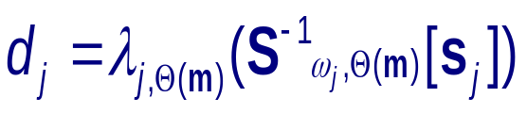




Non-linear forward mapping: component vector spaces and mappings
Model space
m
DiffEq coeff map
Depend. of  on 
EM solution e
Sources BCs: s
Forward Solver
Data functionals
Data
d

Slide 4
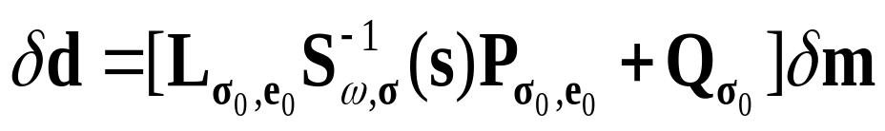




Linearized Forward Mapping: Data Sensitivities
Sources, BCs: s
Forward Solver
EM solution e
Linearized Data func.
Linearized coeff map
Model space
m
Depend. of  on 
Data
d
Similar/same mapping components and data objects are used for forward calculation, gradients, sensitivities … modular system facilitates code reuse

Slide 5
Modular Inversion System
  Test bed for rapid development/prototyping of new inversion algorithms
  Allow inversion methods developed for one problem (e.g., 3D MT) to be rapidly transitioned to other EM problems (e.g., Marine CSEM)
  Simplify extension/maintenance of code (e.g., modify model parameterization, add new transmitter or receiver configurations)
  Take advantage of advances in forward modeling (e.g., faster, more flexible non-structured grids) without having to start over on the inversion

Slide 6
Take advantage of “object oriented” features of Fortran 90/95 to develop building blocks
→ Well defined interfaces to all modules
Limited “public access” : routines can only modify specific inputs and control parameters
Extensive use of derived data types : e.g., grid, electric field solution vectors are represented as single self contained objects
Operators (e.g., finite difference) look externally like matrices, but internally are written in a more natural way … code is easier to understand and modify
Dynamic allocation of memory

Slide 7
DataSpace
d
MeasComb
L
SensMatrix
J
NLCG
(etc)
SolnRHS
e,b
DataFunc
EMsolver
S⁻¹
Pmult
P
InterpEB
Forward Solver
Model Parameter
m
Grid
EMfield

Slide 8
Level I
NLCG
(etc)
DataSpace
d
MeasComb
L
SensMatrix
J
Level II
SolnRHS
e,b
DataFunc
EMsolver
S⁻¹
Pmult
P
InterpEB
Forward Solver
Model Parameter
m
Numerical Discretization
Grid
EMfield

Slide 9
Level I
NLCG
(etc)
DataSpace
d
MeasComb
L
SensMatrix
J
Level II
SolnRHS
e,b
DataFunc
EMsolver
S⁻¹
Pmult
P
InterpEB
Forward Solver
Model Parameter
m
Numerical Discretization
Grid
EMfield

Slide 10
Level I
NLCG
(etc)
DataSpace
d
MeasComb
L
SensMatrix
J
“Level I” routines
Independent of specific inverse problem—in particular exactly the same code is used for 2D and 3D MT
Data vectors have specific (though fairly general) structure and public attributes. Details of the data vector structure are referred to by other level I routines
Intent is to have multiple inversion algorithm modules, supported by MeasComb, SensMatrix

Slide 11
Level I
NLCG
(etc)
DataSpace
d
MeasComb
L
SensMatrix
J
“Level I” routines (cont)
Some other algorithms will require extension/modifciation of supporting modules
Try to do parallelization all at this level???

Slide 12
Level I
NLCG
(etc)
DataSpace
d
MeasComb
L
SensMatrix
J
Level II
SolnRHS
e,b
DataFunc
EMsolver
S⁻¹
Pmult
P
Forward Solver
Model Parameter
m
InterpEB
Numerical Discretization
Grid
EMfield

Slide 13
“Level II” routines
Interface layer which “hides” implementation details for a specific application from the generic level I
Level II
SolnRHS
e,b
DataFunc
EMsolver
S⁻¹
Pmult
P
Key data types (e.g., EMsoln=e, EMrhs=b) and methods which manipulate them are defined in level II. The names of these data types are fixed (because they are used in generic Level I routines). Internal structure is problem specific … internal attributes are not referred to in Level I routines

Slide 14
“Level II” routines (cont.)
Routines defined at this level (to implement data functionals, EM solver, multiplication by P/Q) also must
Level II
SolnRHS
e,b
DataFunc
EMsolver
S⁻¹
Pmult
P
have “generic” names, and interfaces, as these again are called by Level I routines.
Implementation of the required functionality is very problem specific.
Adding new observation functionals, or developing inversion for a different EM technique can be accomplished through changes at this level only

Slide 15
Level I
NLCG
(etc)
DataSpace
d
MeasComb
L
SensMatrix
J
Level II
SolnRHS
e,b
DataFunc
EMsolver
S⁻¹
Pmult
P
Forward Solver
Model Parameter
m
InterpEB
Numerical Discretization
Grid
EMfield

Slide 16
Numerical discretization
These routines define the discretization used to solve the EM problem numerically
Defines the basic spaces and operations used to represent and manipulate primary and secondary field objects
Specific to the numerical modeling approach/assumptions—e.g., 2D vs 3D
InterpEB
Numerical Discretization
Grid
EMfield

Slide 17
Numerical discretization(cont.)
Not specific to EM technique—same code could be used with different data types or sources, and with different forward problem formulations or solvers
Building blocks for abstract (higher level) EMsoln objects
InterpEB
Numerical Discretization
Grid
EMfield

Slide 18
Numerical discretization: module Grid
type gridDef(2D,3D) :
  derived data type which contains all information needed to characterize grid: e.g., x , y , z , x₀ , y₀ , z₀ + derived quantities
  pointer to modeling grid is attached to and gives context to many higher level objects (m, e, b); the structure of the code depends on this grid information being readily available to routines which manipulate these objects
  name of type can be anything

Slide 19
Numerical discretization: module grid
Key routines
  create_grid(2D,3D) ➔ create
  deall_grid(2D,3D) ➔ deall
  gridCalcs (computes derived quantities from basic inputs)
Common for all derived data types

Slide 20
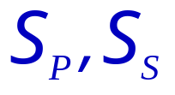
Numerical discretization: module EMfield
3D case: multiple modules
type cvector :
  derived data type used to represent complex vector fields defined on edges or faces (i.e., primary or secondary EM solution fields )
type rvector :
  derived data type used to represent real vector fields defined on edges or faces (e.g., conductivity on edges)

Slide 21
Numerical discretization: module EMfield
3D case
type cscalar :
  derived data type used to represent complex scalar fields defined on cell centers or corners (e.g., potential field needed for computing divergence correction)
type rscalar :
  derived data type used to represent real scalar fields defined on cell centers or corners (e.g., cell conductivity)

Slide 22
Numerical discretizations: module EMfield
3D case:
type sparseVecC :
  derived data type used to represent sparse complex vector fields defined on edges or faces (i.e., primary or secondary EM solution fields , used to represent evaluation functionals

Slide 23
Numerical discretization: module EMfield
3D case: multiple modules
Key routines: create_* , deall_* , plus:
copy_* , zero_*
add_* , subtract_* , scMult_* , linComb_*
diagMult_* , diagDiv_*
dotProd_*
getReal_* , getImag_* (only for complex)
Linear algebra
Some routines (linear algebra, dot products) implemented for mixed types (e.g., cvector/rvector or cvector/sparseVecC)

Slide 24
Numerical discretization: module EMfield
2D case: single module
  type cvector :
  type sparseVecC :
2D versions
Similar creation, linear algebra, dotproduct, etc. routines are defined
Note: because the basic EM solution objects in the 2D case are scalar fields (E_{x} for TE, B_{x} for TM) there is no need to distinguish between “vectors” and “scalars” … 2D cvector just has a single component! Also, we use complex data types for everything in this case.
“Rules” are more relaxed for lower level modules!

Slide 25
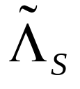
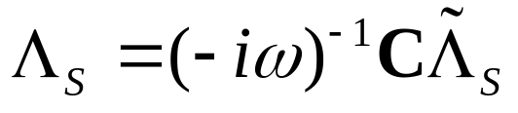
Numerical discretization: module InterpEB
Evaluation functionals for primary and secondary fields (columns of ☹_{P} ☹_{S}) : 3D case→ tri-linear spline interpolation
Key routines: return interpolation coefficients LC (sparseVecC) for location x, component xyz
  EinterpSetup(grid,x,xyz,LC) → primary field (E)
  BinterpSetup(grid,x,xyz,LC) → secondary field (B) using faces (i.e., columns of )
  BfromESetup(grid,omega,x,xyz,LC) → secondary field (B) from E (i.e., columns of )

Slide 26


Numerical discretization: module InterpEB
Idea: BfromESetup first calls BinterpSetup to find sparse vector of interpolation coefficients from faces then sums appropriate columns of C to form
2D MT Case: same, but idea, but separate routines are needed for TE/TM modes

Slide 27
Level I
NLCG
(etc)
DataSpace
d
MeasComb
L
SensMatrix
J
Level II
SolnRHS
e,b
DataFunc
EMsolver
S⁻¹
Pmult
P
Forward Solver
Model Parameter
m
InterpEB
Numerical Discretization
Grid
EMfield

Slide 28
Model Parameter Module
defines the modelParam data type (m)
all attributes of the data type are private--no routine outside of the module can reference specific model parameter attributes. This will simplify maintenance of interchangeable model parameter modules.
Depends on and uses grid and EMfield modules only. At least some of the module is used by most other routines, including interpolation, solver, and the Level I inversion routines.
Model Parameter
m
All model parameter functionality must be inside this module, including basic creation, deallocation, I/O, linear algebra, model covariance, parameter mappings ((m))

Slide 29
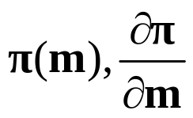
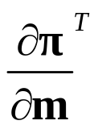

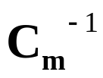
Module ModelParameter: Key groups of routines:
Utility, linear algebra, vector space: create_*, deall_*, copy_* , zero_*, add_* , scMult_* , linComb_*, dotProd_*, I/O
Mapping routines: non-linear and linear mappings from model parameter to grid: + adjoint
Note: names of these three routines need to be same to allow interchangeable model parameterizations, but specific names are not referred to by Level I routines
Model covariance operator: initialize, multiply by
(ideally might want also )
Note: Covariance routines are referenced by Level I inversion routines—names/interfaces of these need to be fixed)

Slide 30
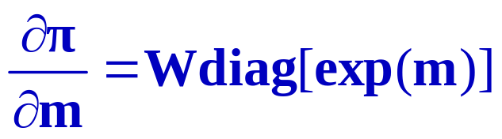
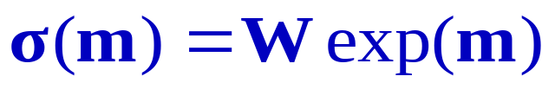
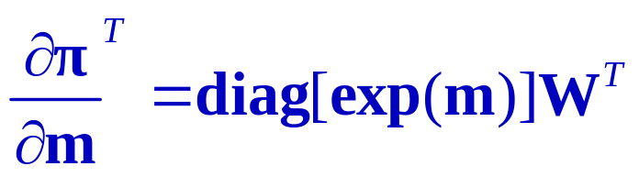
Conductivity parameterization:
Each cell is an independent parameter (log conductivity)
Primary model parameter mapping: average from cells onto edges, where electric field components are defined
x
z
y
E_{y}
W = operator that averages from cells to edges

Slide 31
Level I
NLCG
(etc)
DataSpace
d
MeasComb
L
SensMatrix
J
Level II
SolnRHS
e,b
DataFunc
EMsolver
S⁻¹
Pmult
P
Forward Solver
Model Parameter
m
InterpEB
Numerical Discretization
Grid
EMfield

Slide 32
Forward Solver Modules
Core of the inversion
Forward solver needs to be fairly general:
  Solve for arbitrary forcing, boundary conditions
  solve adjoint as well as “forward” problem
  clean interface
Forward Solver
derived from existing code (2D MT) or developed as part of the modular system (3D MT)

Slide 33
2D MT Forward Modeling
“Wrapped” version of an existing solver: REBOCC 2D MT inversion of Siripunvaraporn and Egbert (2000)
F90 subroutines: setup, solve, set boundary conditions, update conductivity, frequency
FwdTEmod
FwdTMmod
WSfwd2D
F77 subroutines, taken from REBOCC …

Slide 34
3D MT Forward Modeling
Interface: setup model operators, solve 3D system, set solver control parameters, retrieve diagnostics
Uses 2D forward solver modules to set boundary conditions for forward problem
EMsolve3D
Generic iterative solvers: QMR, PCG
Boundary conditions
solver
Model operators for 3D EM, including divergence correction
Model operator and solver modules make extensive use of EMfield module
Model
Operators

Slide 35
Level I routines: Data Space
Data space objects (d) : Need to support
multivariate data … impedance tensor elements, real and imaginary parts, amplitude and phase
multiple data types (TE vs. TM, impedances, phases only, vertical field TFs, interstation TFs) … other geophysical data … which all might be combined in a single inversion
multiple transmitters (different frequencies for MT; different source locations for active source techniques)
multiple receivers (sites or?) all for same data type, transmitter

Slide 36
Data Space
Dictionaries: record meta-data associated with dataType, transmitter, receiver
(e.g., the site coordinates for a receiver, the frequency and/or location of the transmitter)
Individual observations are identified by three indicies, to denote dataType, transmitter, receiver
Different data types might need different sorts of meta-data … separate dictionaries can be provided for each data type if necessary
(e.g., inter-station TFs require 2 site locations in receiver dictionary; impedances one)
Dictionaries are application specific: not in Level I!

Slide 37
Data Space
Data space objects:
type dvec : contains multicomponent (real) data from all receivers for a fixed data type, transmitter (e.g., all TM mode impedances for a fixed frequency)
    + dataType index
    + transmitter index
    + array of receiver indices
    + error bars
type dvecMTX : array of all dvec objects—the full data vector or “d”

Slide 38
Data Space
Data space routines: The usual for a vector space!
create_* , deall_* copy_* , zero_*, I/O, add_* , subtract_* , scMult_* , linComb_*, dotProd_*
+ routines for dealling with error bars
All basic routines for both dvec and dvecMTX objects—MTX versions constructed from the single transmitter versions

Slide 39
Level II (“interface”) routines: SolnRHS
Module defines specific instance of EM solution objects (e), EM “right hand side” objects (b) + sparse vector objects used to represent linearized data functionals ()
Data types are implemented differently for each application (e.g., 2D vs. 3D) but have fixed names:
  type EMsoln
  type EMrhs
  type EMsparse

Slide 40
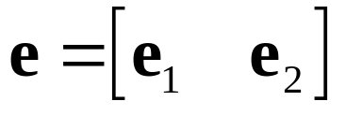
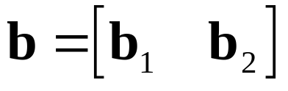
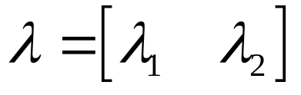
Level II (“interface”) routines: SolnRHS
For 3D MT all of the basic data types contain components for two polarizations:
EMsoln objects contain a pointer to the model parameter object used for the solution, as well as
dataType and transmitter indices.
  Thus have the module dependency:
  EMfield → ModelParameter → SolnRHS

Slide 41
Level II (“interface”) routines: SolnRHS
Routines: The usual basics:
  create_*, deall_*, copy_*, dotProd_*, linComb_*, add_*
  + mixed (sparse+full vector) for add_*, linComb_*
  (not all routines needed for all types…so far)
Names, interfaces of routines must be same, as these are called by Level I routines

Slide 42
Level II (“interface”) routines: DataFunc
Names, interfaces of key routines must be fixed, as these are called by Level I routines:
  nonLinDataFunc(e,iDt,iRx,Z, (+optional))
  LinDataFunc(e0,iDT,iRX,L,Q)
also have dictionary initialization routines

Slide 43

Level II (“interface”) routines: DataFunc
Defines the data functionals needed for the specific applications—this module is the only one that must be modified to add a new data type
(e.g., vertical field TFs, interstation TFs, apparent resistivity and phase)
In the lineraized data functional decompositon
  this implements A (interpEB implements ☹)
dataType, transmitter, receiver dictionaries are in this module (or should be!)

Slide 44
Level II (“interface”) routines: EMsolver
Provides a uniform interface to the application specific FWD module
Key public routines:
  initSolver(iDt,iTx,m,e0,e,rhs) → initialize for data type iDt, transmitter iTx, model parameter m
  exitSolver(e0,e,rhs) → deallocates, cleans up
  fwdSolve(iTx,iDt,e) → solves forward problem for data type iDt, transmitter iTx (determines forcing)
  sensSolve(iTx,iDt,ForA,rhs,e) → solves forward or adjoint problem (ForA) for given rhs
e0,e are EMsoln objects, rhs is EMrhs

Slide 45
Level II (“interface”) routines: EMsolver
Routines use iDt, iTx to determine which solver to call (e.g., TE vs. TM) and other needed information (e.g., frequency, source term for forward problem)
Internal structure of these routines can be very different for different applications

Slide 46
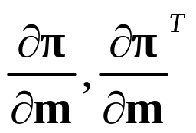
Level II (“interface”) routines: Pmult
Implements multiplication by P and P^{T}
Key public routines:
  Pmult(e0,m,e) → multiplies model parameter m by matrix P (depends on background solution e0)
  PmultT(e0,e,m,mImag) → multiplies EM solution e by matrix P^{T} (depends on e0); result is model parameter m (and optionally Imag(P^{T}e) )
Internal structure is again application dependent
Uses from modelParameter module

Slide 47
Level II (“interface”) routines: Pmult
Should also include multiplicaiton by Q, Q^{T}
Need to work on this … how to interact with dataFunc part of Q ? Current implementation is not quite optimal!

Slide 48
Level I routines: MeasComb
This module combines individual data functionals (generated as sparse vectors in DataFunc) into the complete forward operator (f) and operations with the matrix L, L^{T}
Key public routines:
  dataMeas(e,d) → computes d = f(e)
  linDataMeas(e0,e,d,dm) → computes d = Le+Qm (L, Q depend on e0 … and possibly on m0, which e0 contains a pointer to! dm is optional input)
  linDataComb(e0,d,b,q) → computes b = L^{T}d (and optionally Q^{T}d

