Slide 1
Product Review Analysis of Ski Goggles
Zheyi Li
zheyil@andrew.cmu.edu

Slide 2
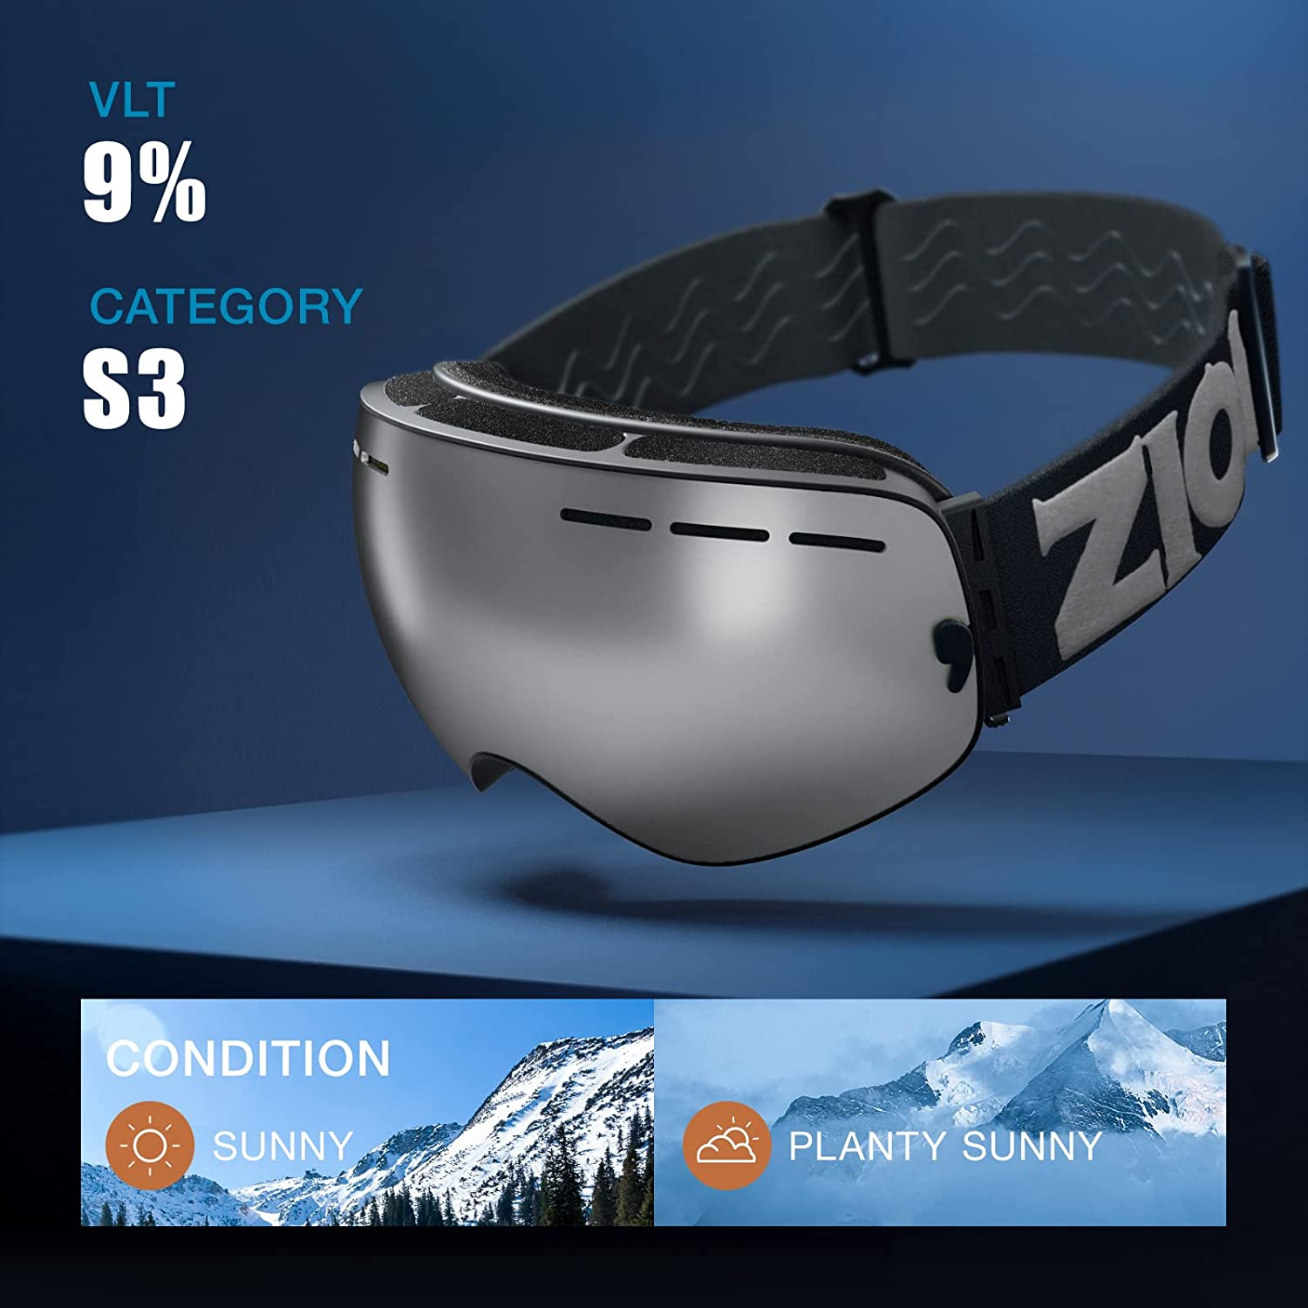
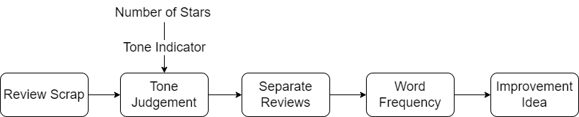
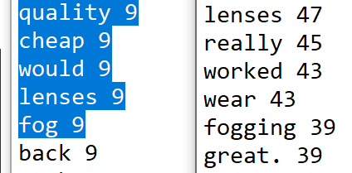
Brief Process
Redesign Recommendation
Fig. Product of Interest
Anti-fog lenses
Fig. Frequency Result

Slide 3
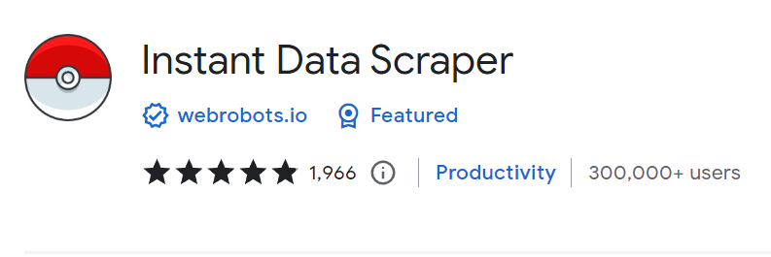
Primary Challenge
Data Scrapping:
Didn’t know how
Keep getting rejected by Amazon
Solution:
Library: pyautogui
Chrome extension: Instant Data Scraper

Slide 4
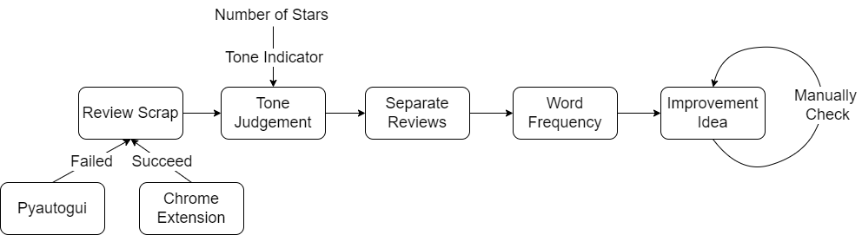
Backup Slides
Description of the technical choices:
I chose two libraries: Pandas and NLTK. The reason for choosing Pandas is that the data set comes in as a .csv file and pandas is a good tool for operating it. NLTK was chosen for filtering the stopwords. I did try to manually select them but soon I realize there were too many and using a library is a much easier way.
Description all of the primary challenges:
As mentioned, scrapping for the original dataset is my biggest challenge. The idea of using the number of stars as a tone indicator is pretty straightforward. So is getting the word frequency

